Slide 1
The Impact of The Great Richmond Reroute on the city’s distressed neighborhoods
NNIP Showcase Presentation
Sarin Adhikari, CURA@VCU
Oct 19, 2018

Slide 2
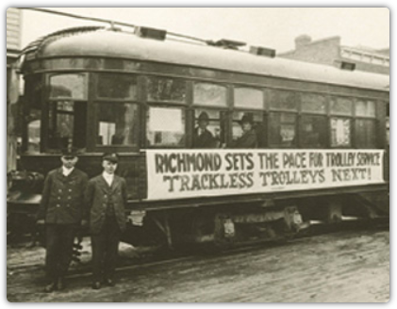
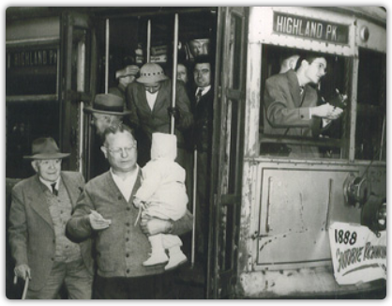
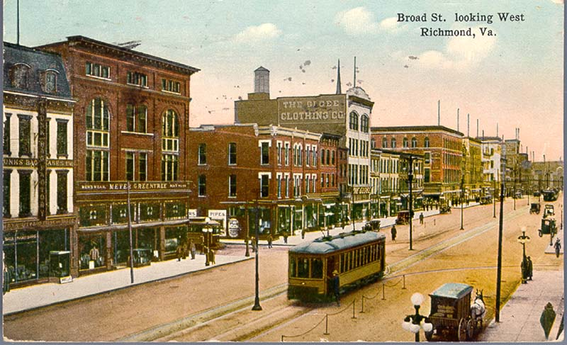
THE IMPACT OF THE GREAT RICHMOND REROUTE ON THE CITY’S DISTRESSED NEIGHBORHOODS
Until 2017, GRTC routes followed almost the same pattern as that of the Streetcars in the 1800s and earlier bus routes in the 1940s.

Slide 3
An Effort to Improve Efficiency
THE IMPACT OF THE GREAT RICHMOND REROUTE ON THE CITY’S DISTRESSED NEIGHBORHOODS
B
 |  |  |  |  |  |  |  |  | A
B
 |  |  |  |  |  |  |  |  | A

Slide 4
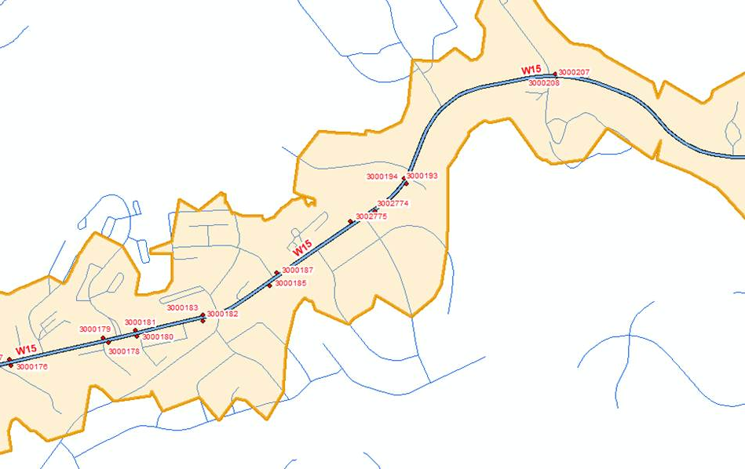
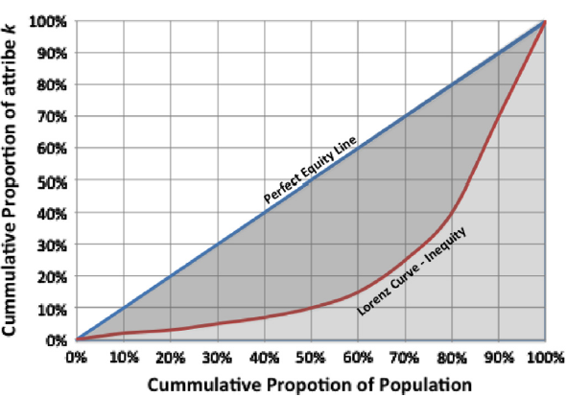
Methodology
THE IMPACT OF THE GREAT RICHMOND REROUTE ON THE CITY’S DISTRESSED NEIGHBORHOODS
Connecting Power Accessibility Equity
Capacity and Frequency 1/2 Mile Network Distance Gini
Average Speed
Distance to Destination
Development Density
Transfer Index
Adopted from Mishra et al. (2012)

Slide 5
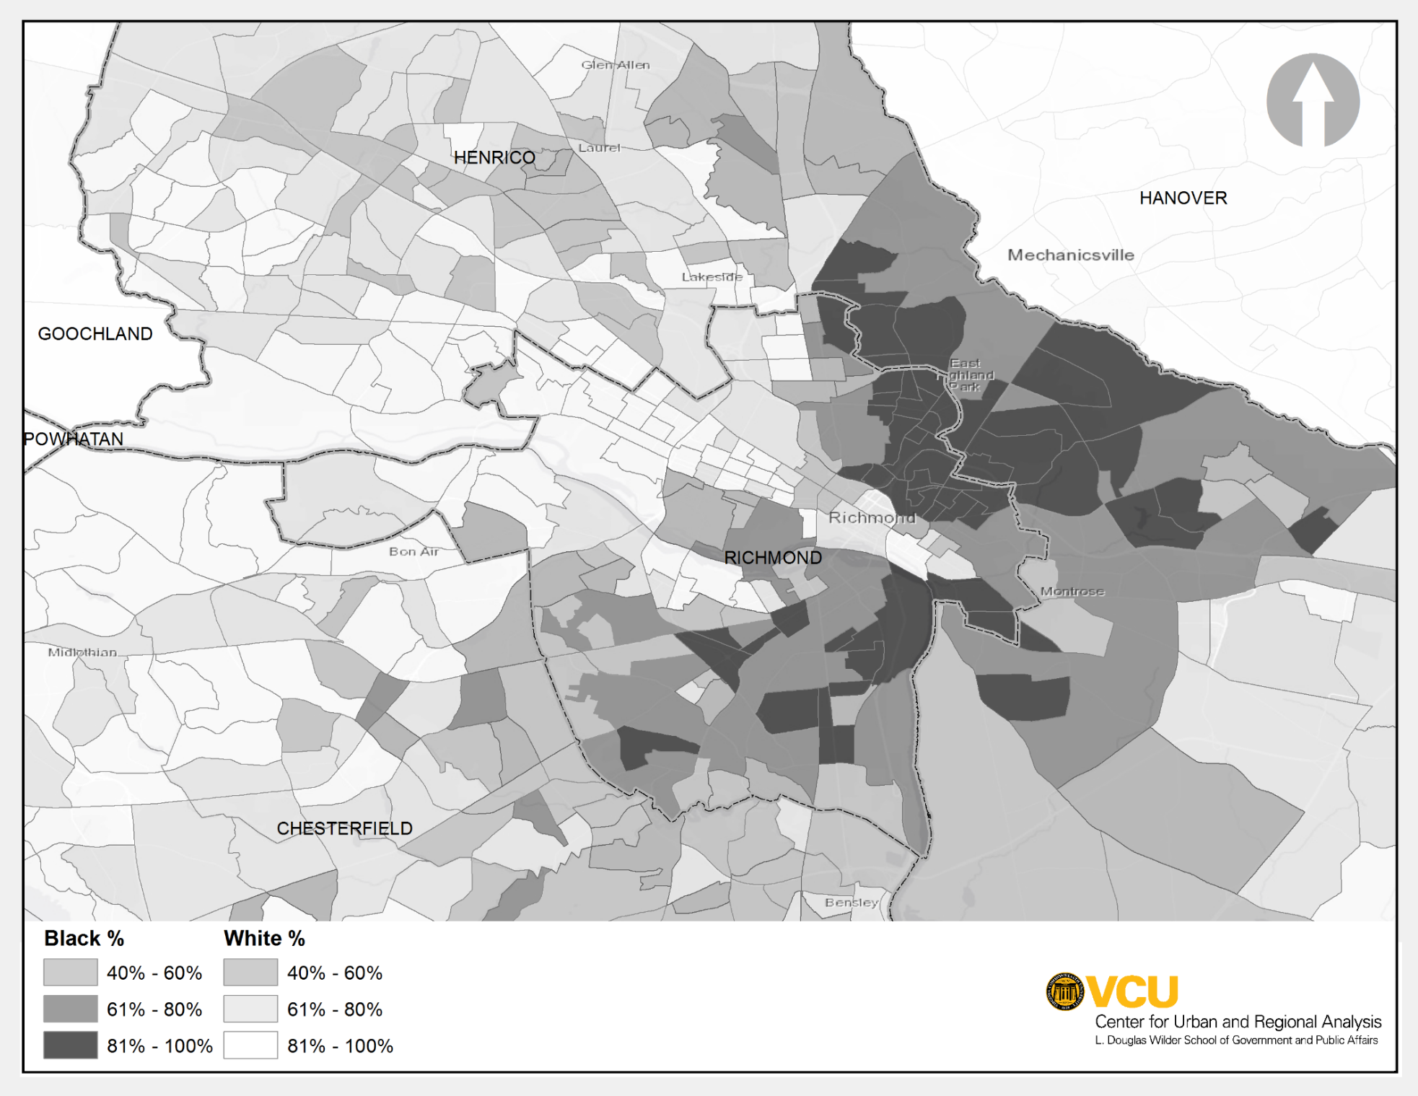
Geographic Distribution of Race
THE IMPACT OF THE GREAT RICHMOND REROUTE ON THE CITY’S DISTRESSED NEIGHBORHOODS

Slide 6
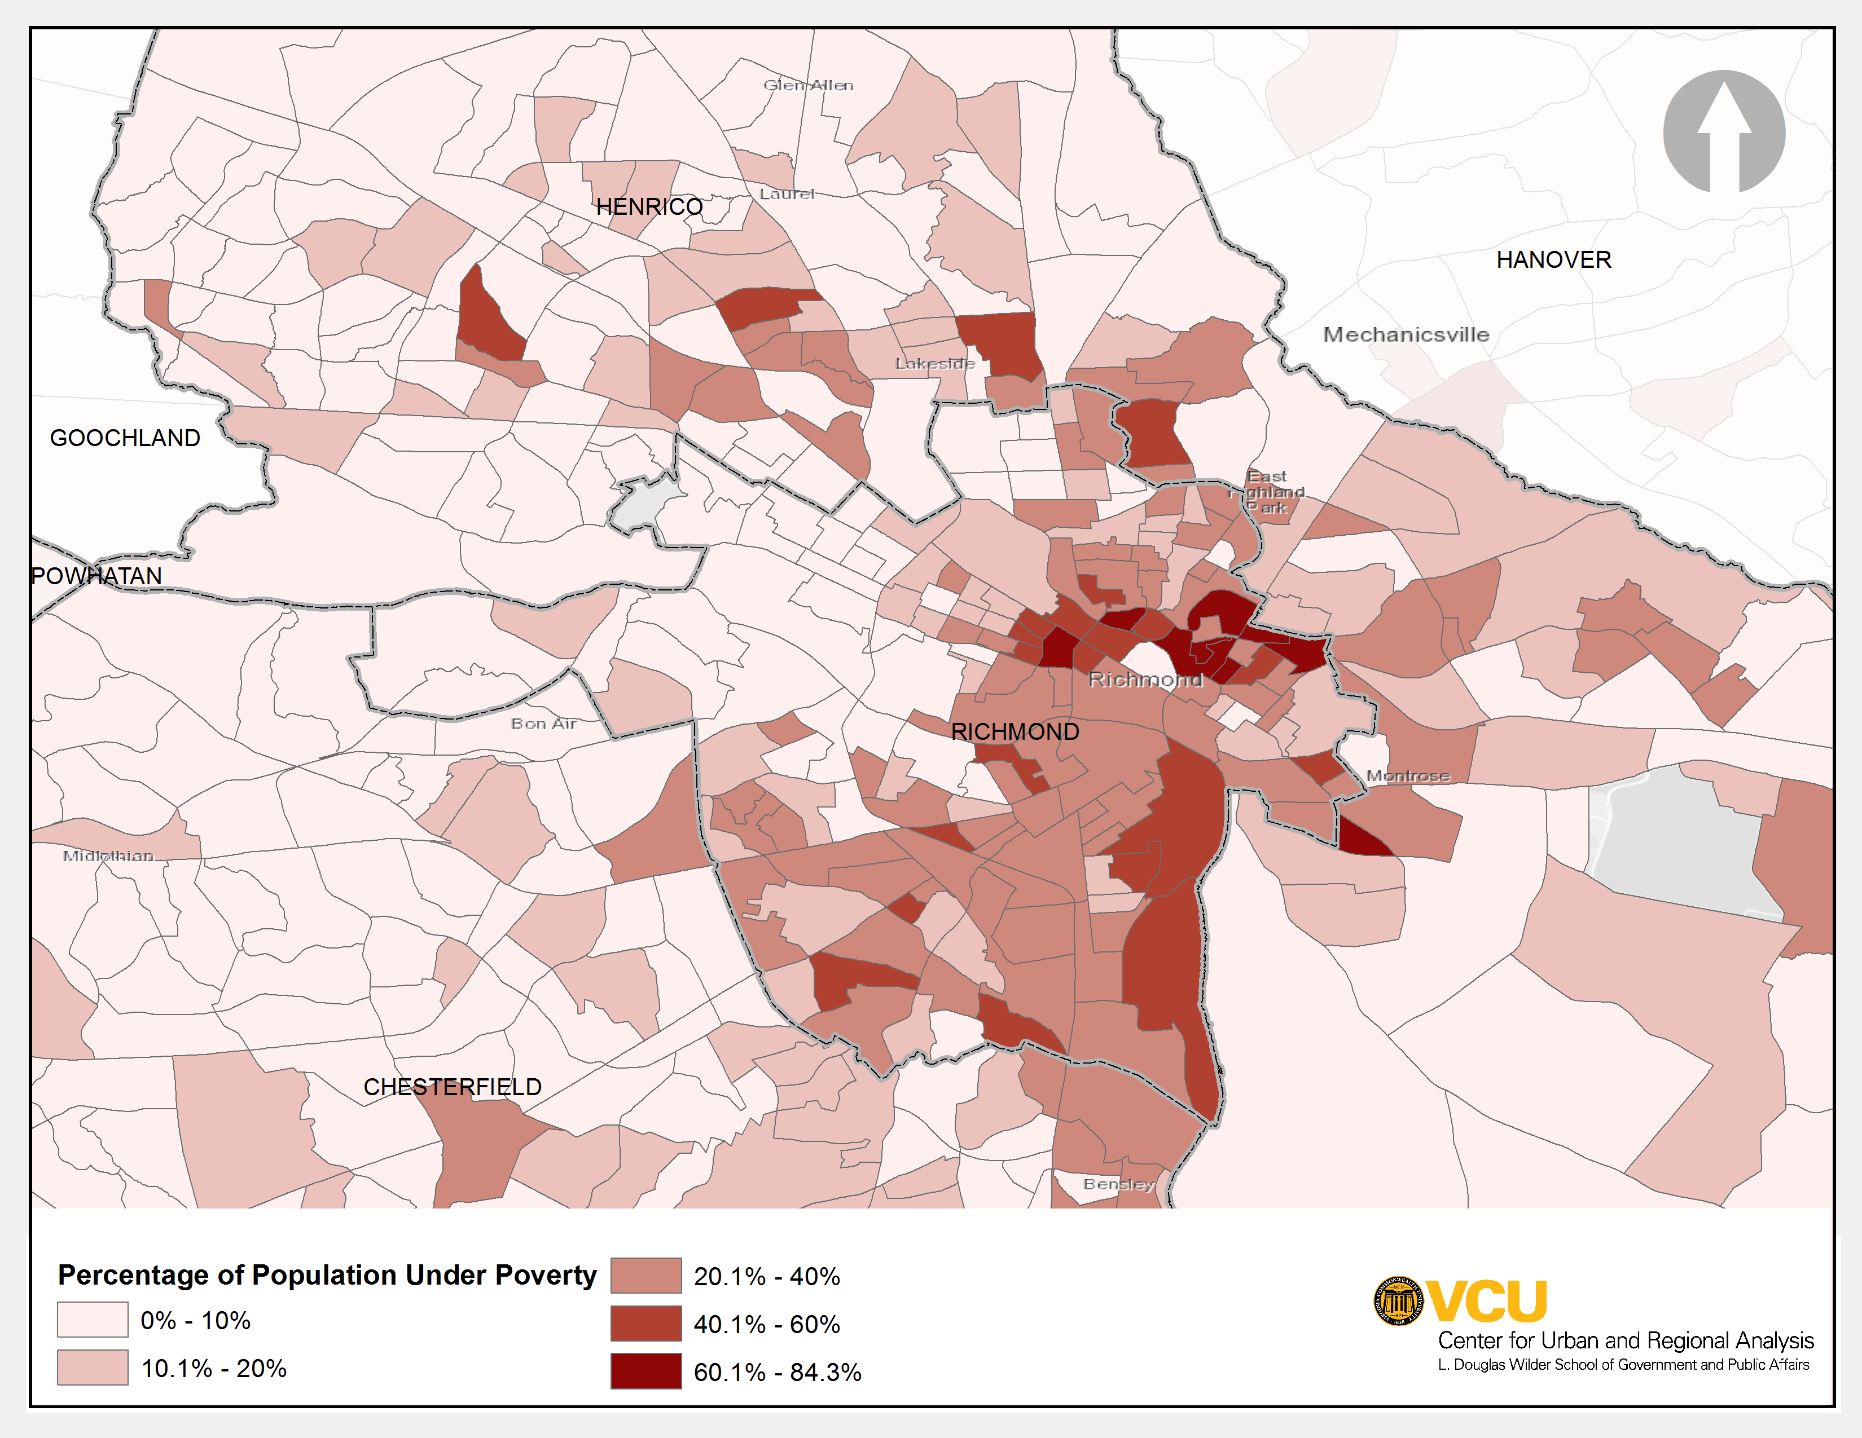
Geographic Distribution of Poverty
THE IMPACT OF THE GREAT RICHMOND REROUTE ON THE CITY’S DISTRESSED NEIGHBORHOODS

Slide 7
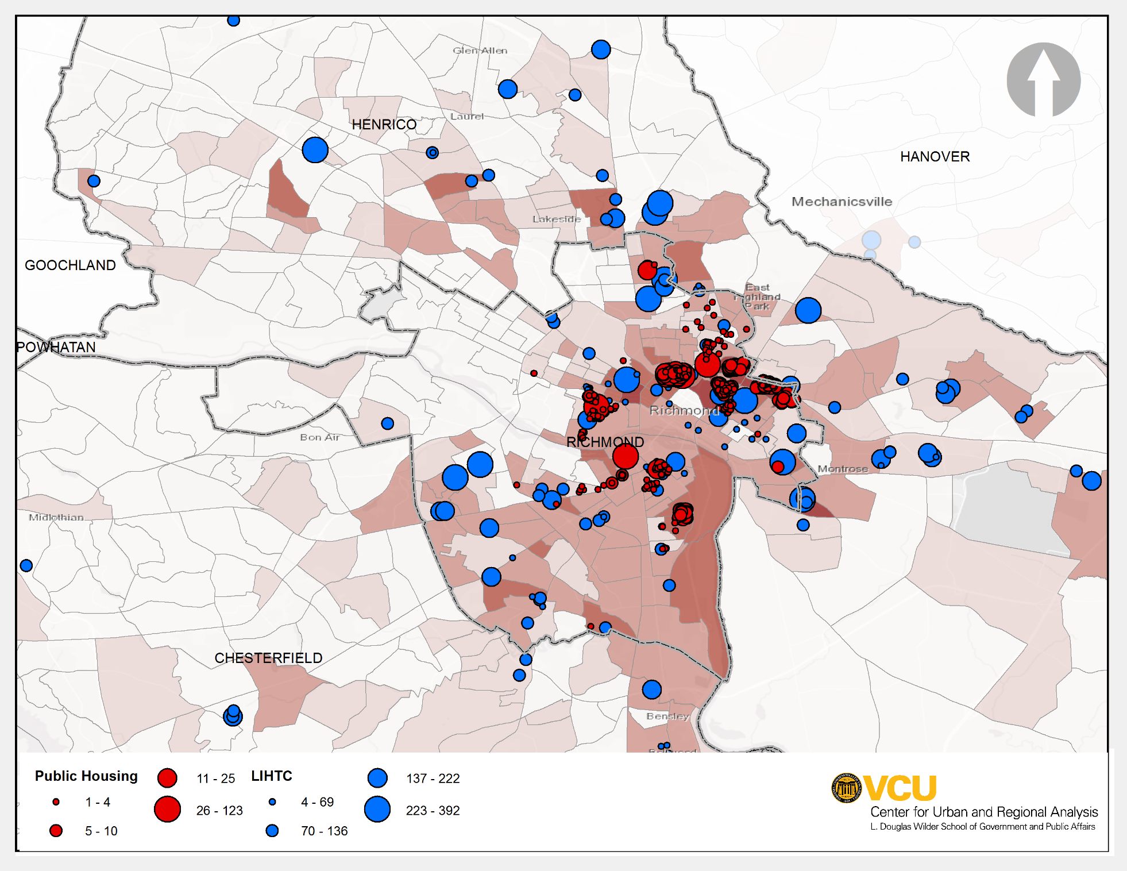
Geographic Distribution of Poverty (Contd.)
THE IMPACT OF THE GREAT RICHMOND REROUTE ON THE CITY’S DISTRESSED NEIGHBORHOODS

Slide 8
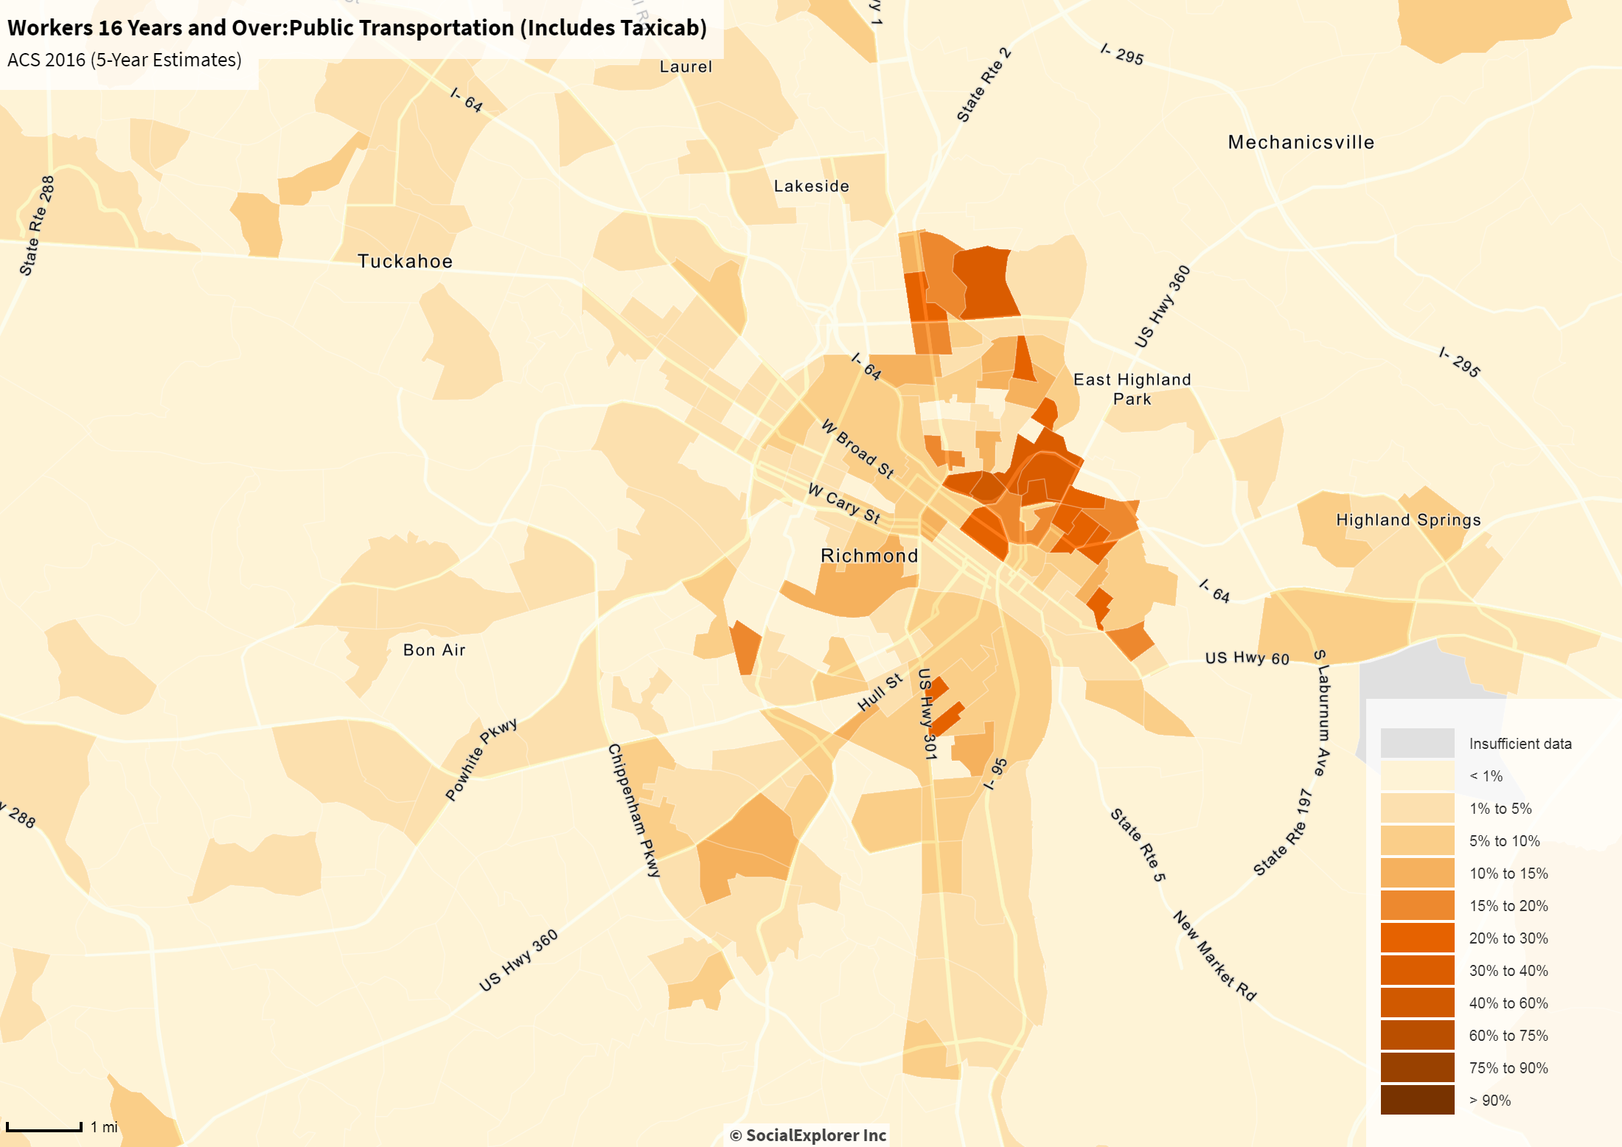
Geographic Distribution of Transit Users
THE IMPACT OF THE GREAT RICHMOND REROUTE ON THE CITY’S DISTRESSED NEIGHBORHOODS

Slide 9
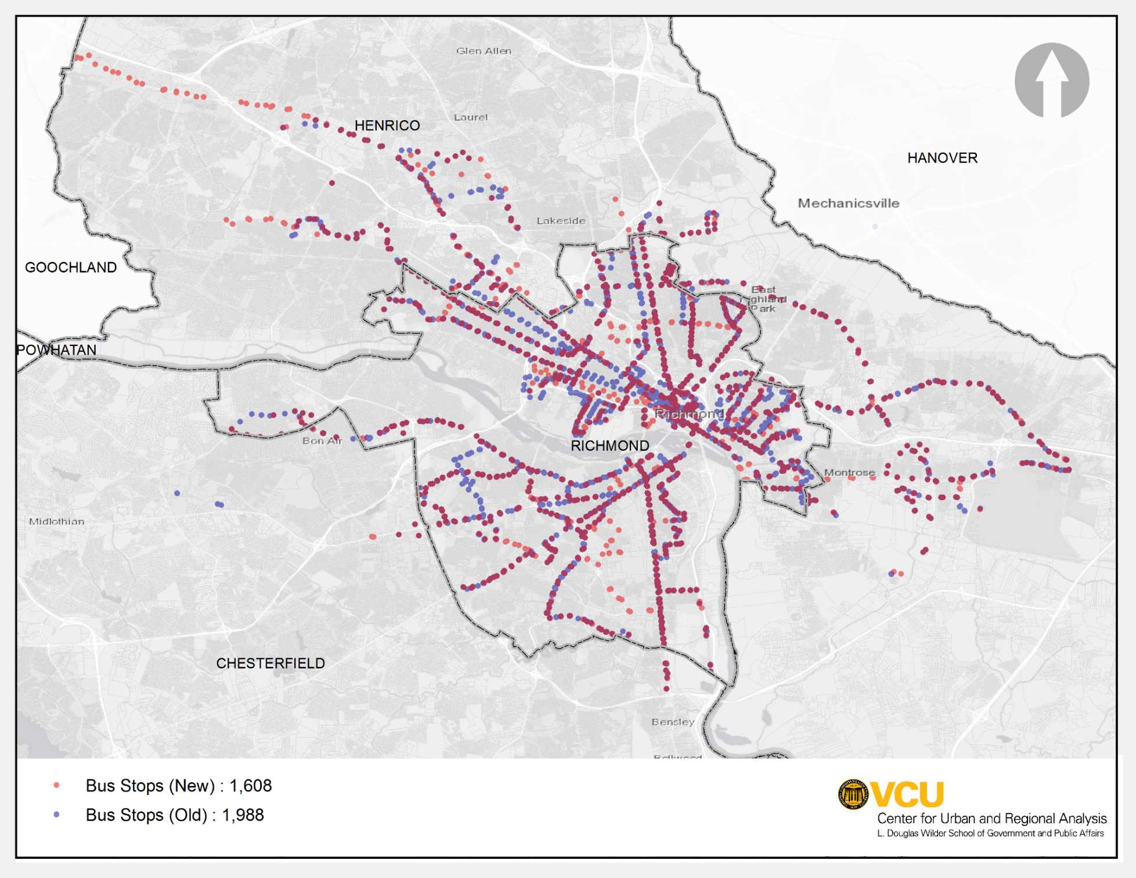
GRTC Stops Old and New Stops before = 1,988 Stops after = 1,608
THE IMPACT OF THE GREAT RICHMOND REROUTE ON THE CITY’S DISTRESSED NEIGHBORHOODS

Slide 10
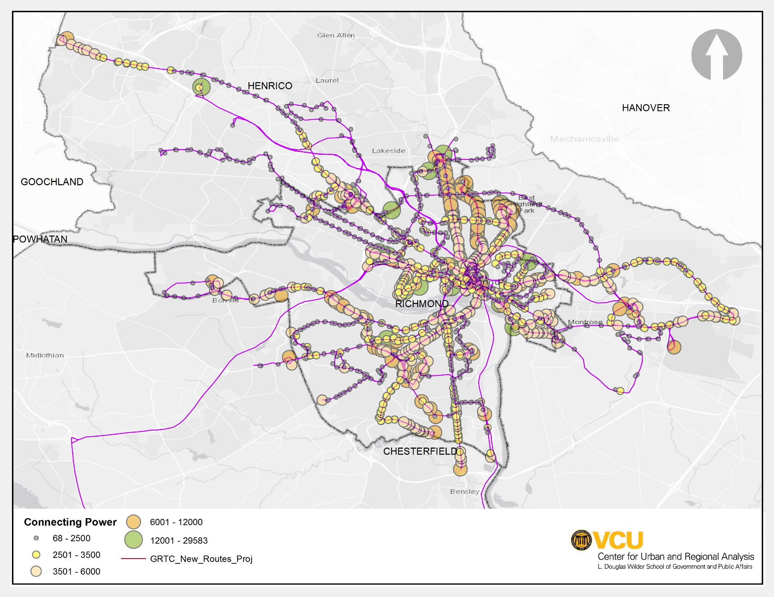
Connecting Power For each stop on each line after reroute
THE IMPACT OF THE GREAT RICHMOND REROUTE ON THE CITY’S DISTRESSED NEIGHBORHOODS

Slide 11
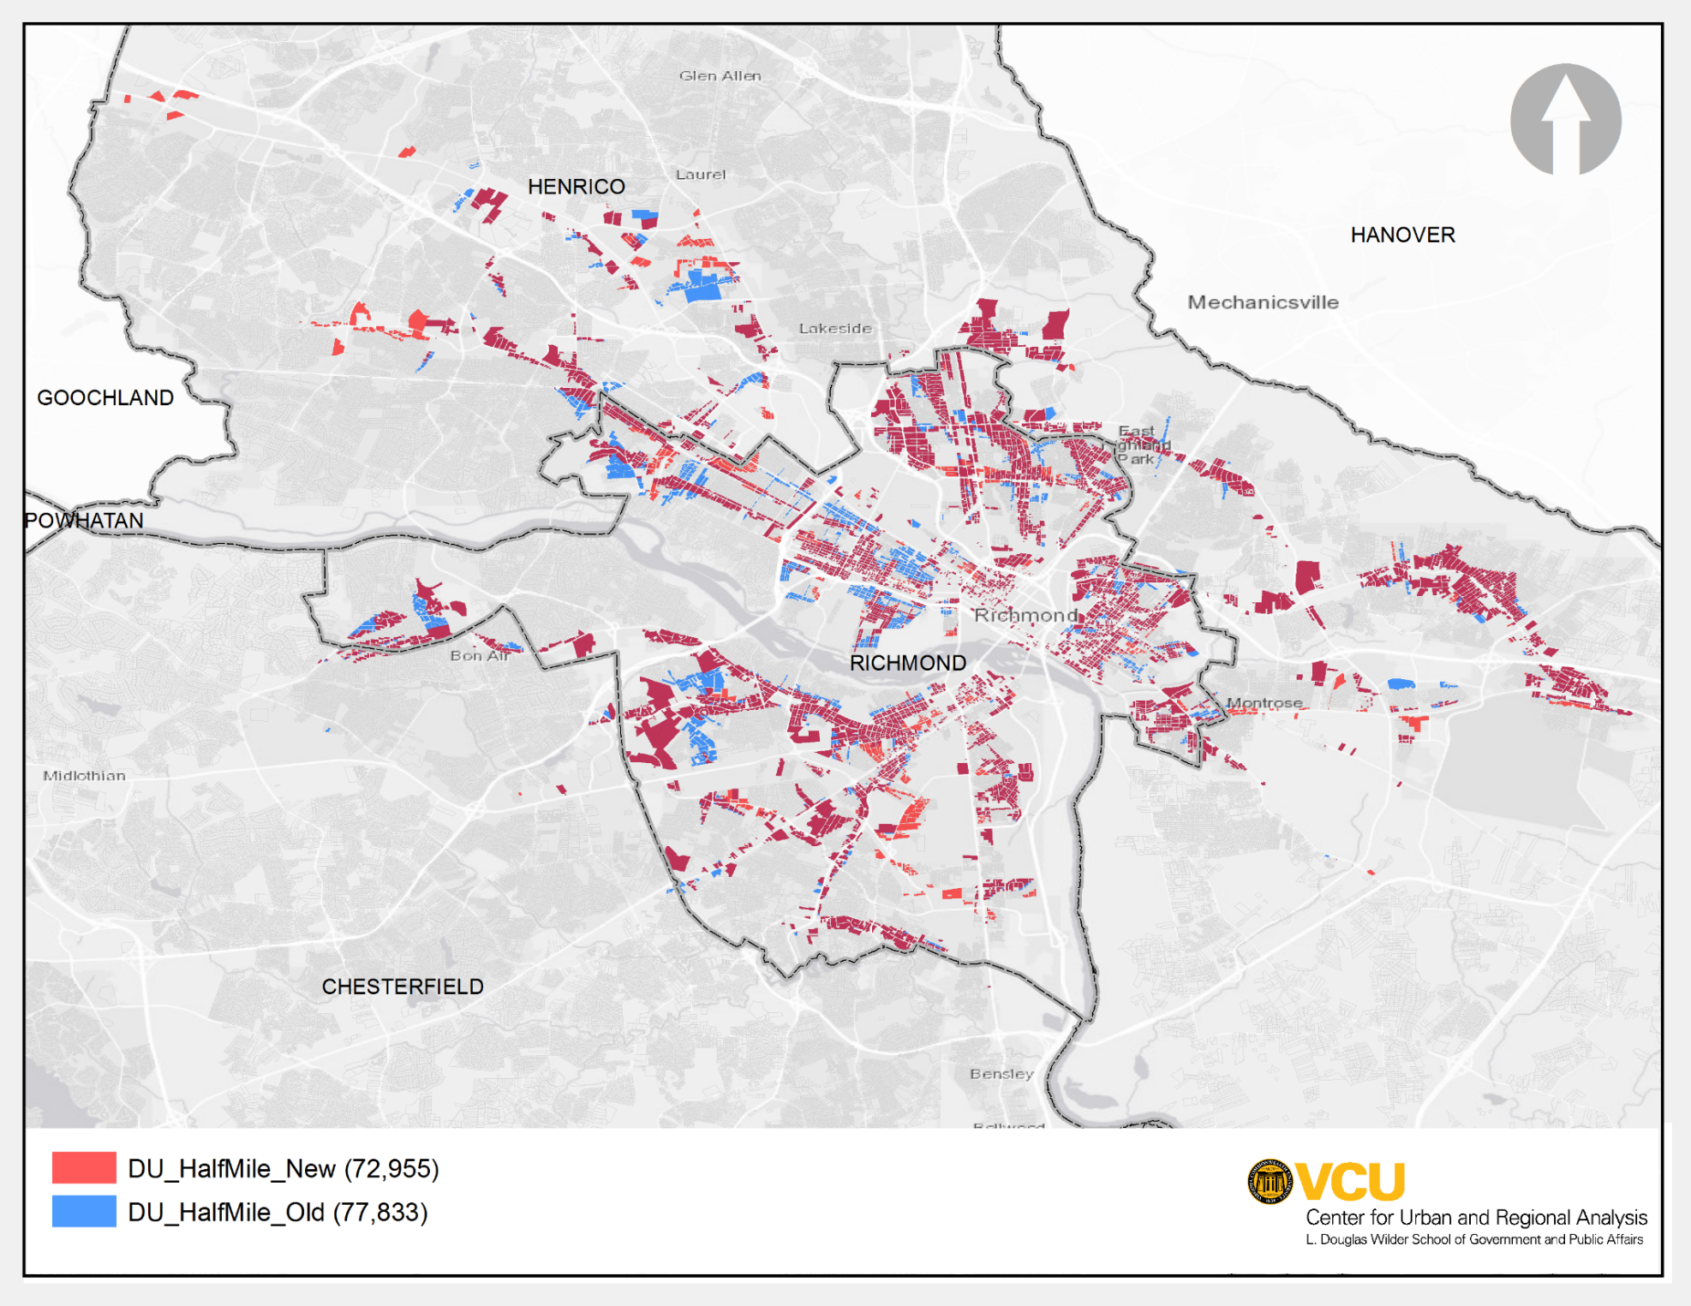
Dwelling Units Served
THE IMPACT OF THE GREAT RICHMOND REROUTE ON THE CITY’S DISTRESSED NEIGHBORHOODS

Slide 12
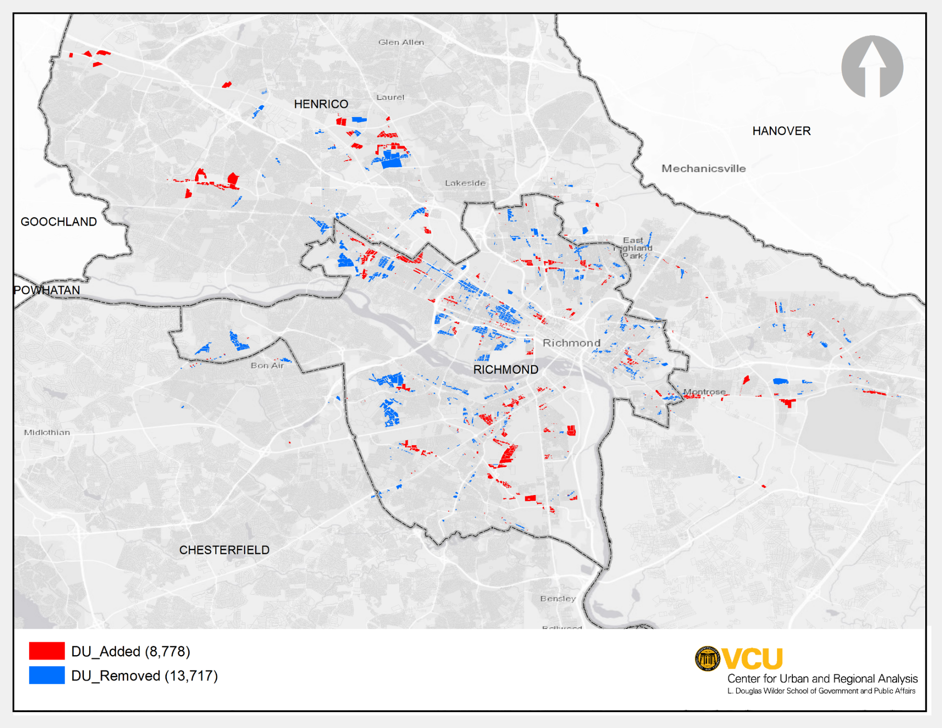
Dwelling Units Added / Removed Net DUs disenfranchised 4,939 (36% reduction)
THE IMPACT OF THE GREAT RICHMOND REROUTE ON THE CITY’S DISTRESSED NEIGHBORHOODS

Slide 13
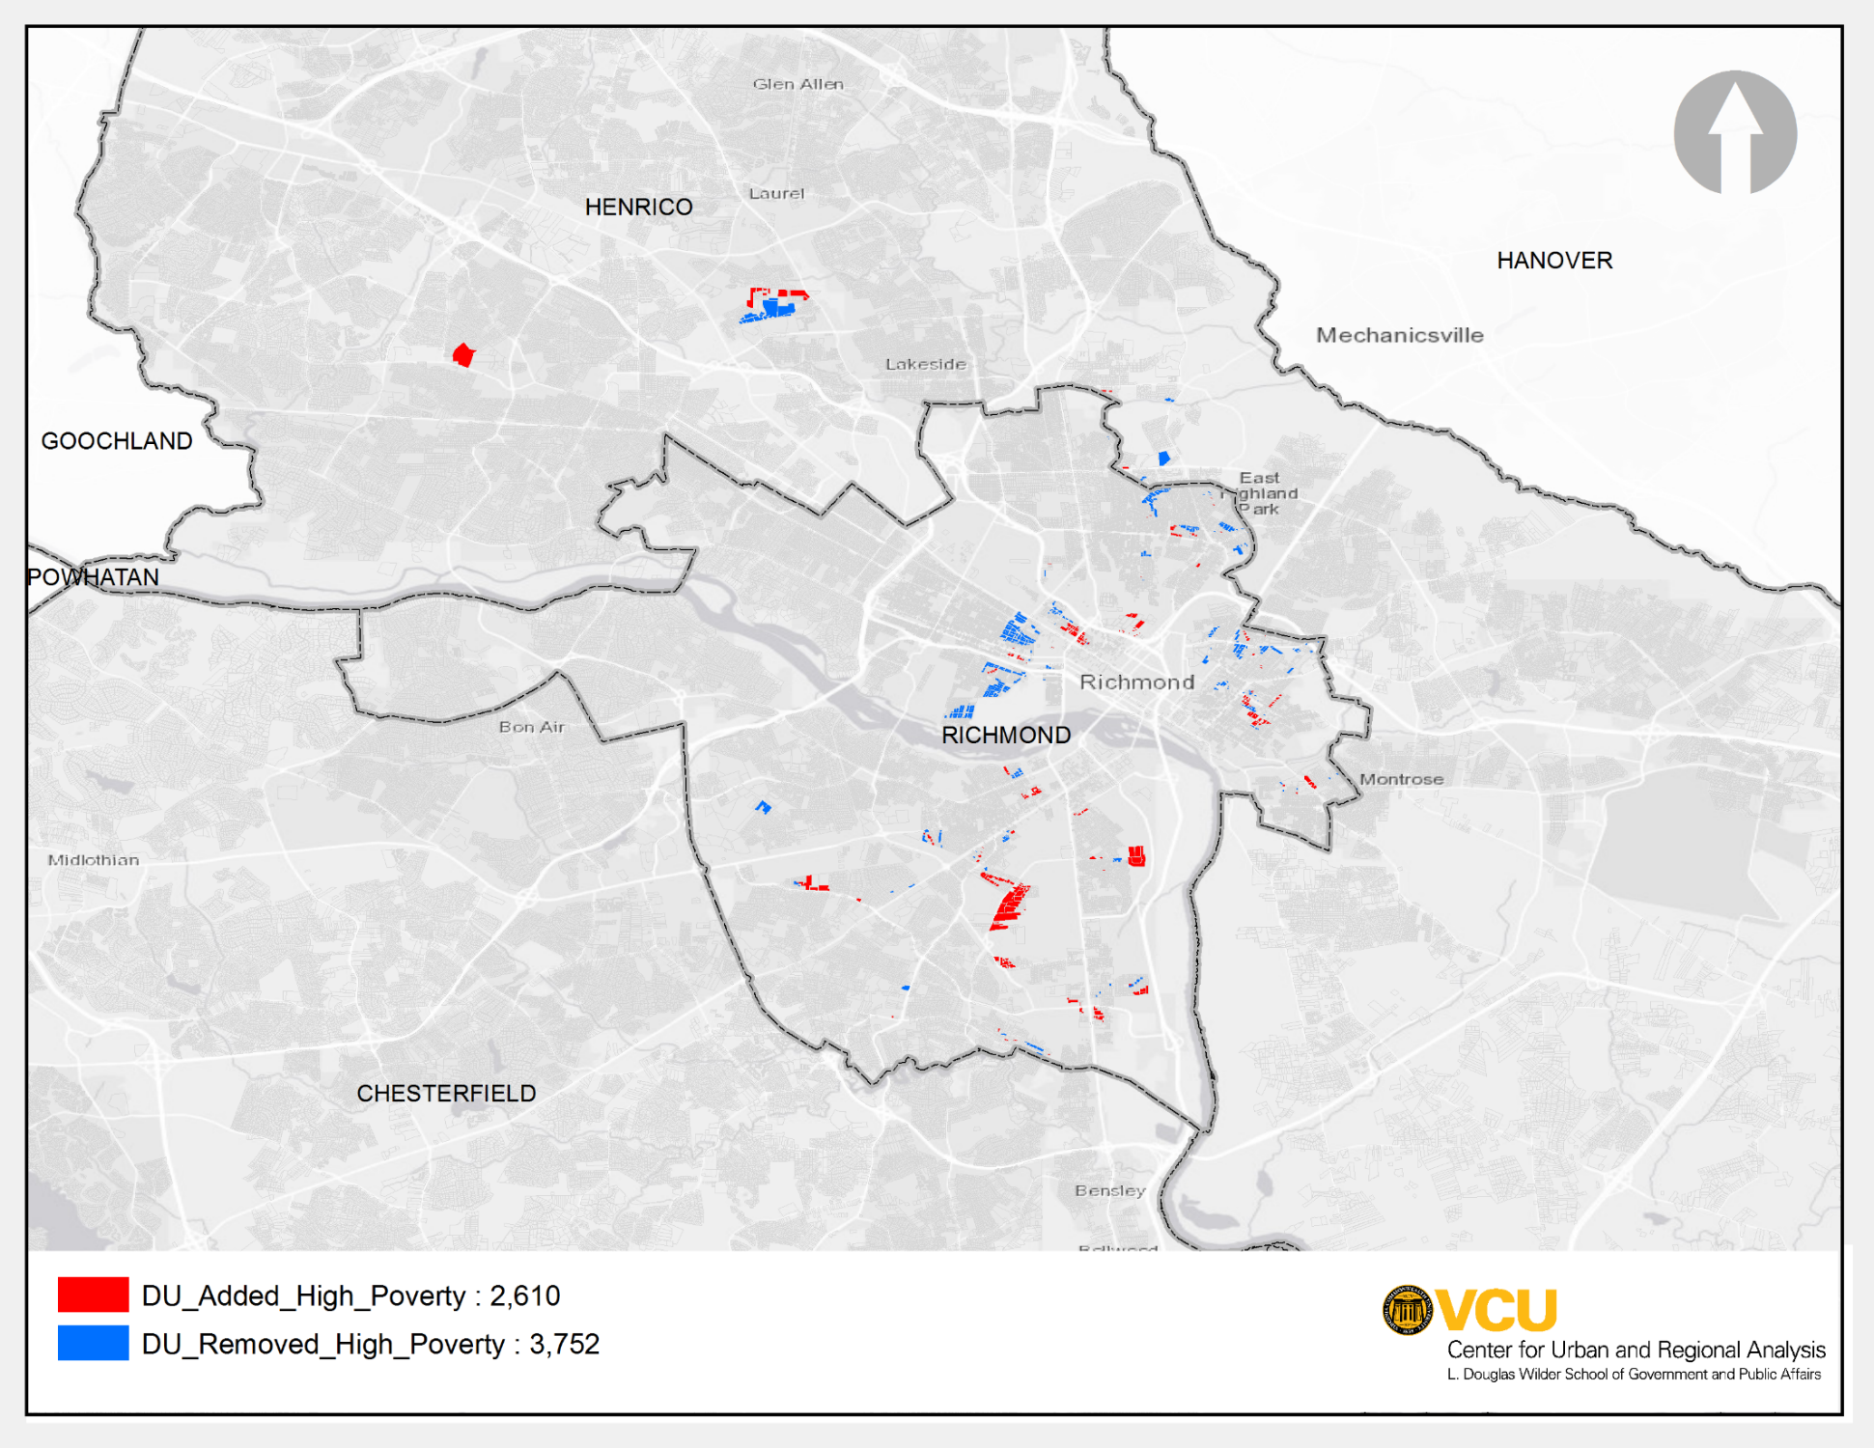
Dwelling Units Added/Removed in High Poverty Areas Net DUs disenfranchised 1,142 (30% reduction)
THE IMPACT OF THE GREAT RICHMOND REROUTE ON THE CITY’S DISTRESSED NEIGHBORHOODS

Slide 14
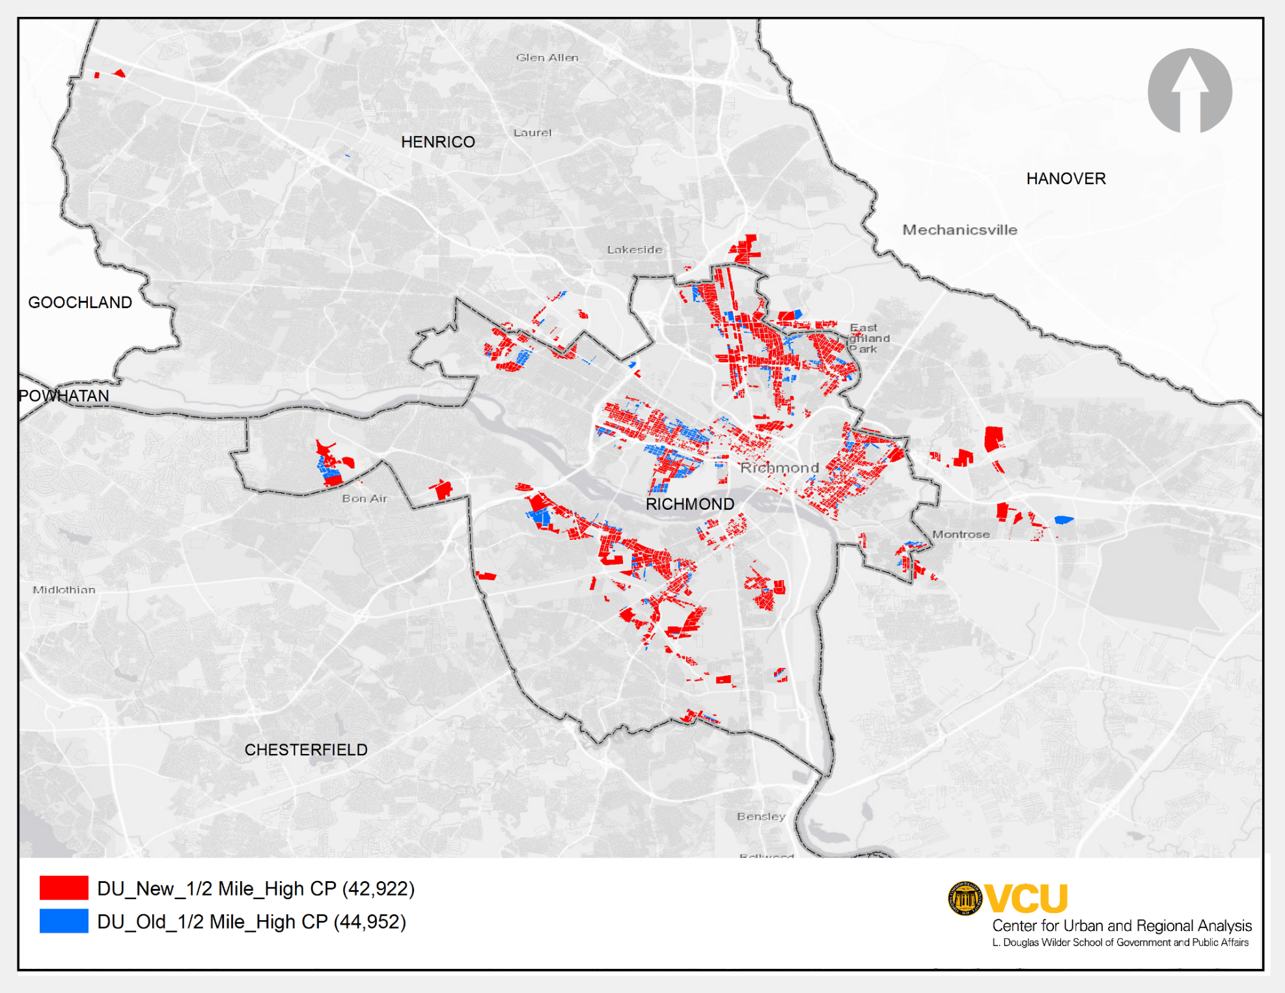
Dwelling Units Added/Removed Near Nodes with High Connecting Power Net DUs disenfranchised 2,030 (4.5% reduction)
THE IMPACT OF THE GREAT RICHMOND REROUTE ON THE CITY’S DISTRESSED NEIGHBORHOODS

Slide 15
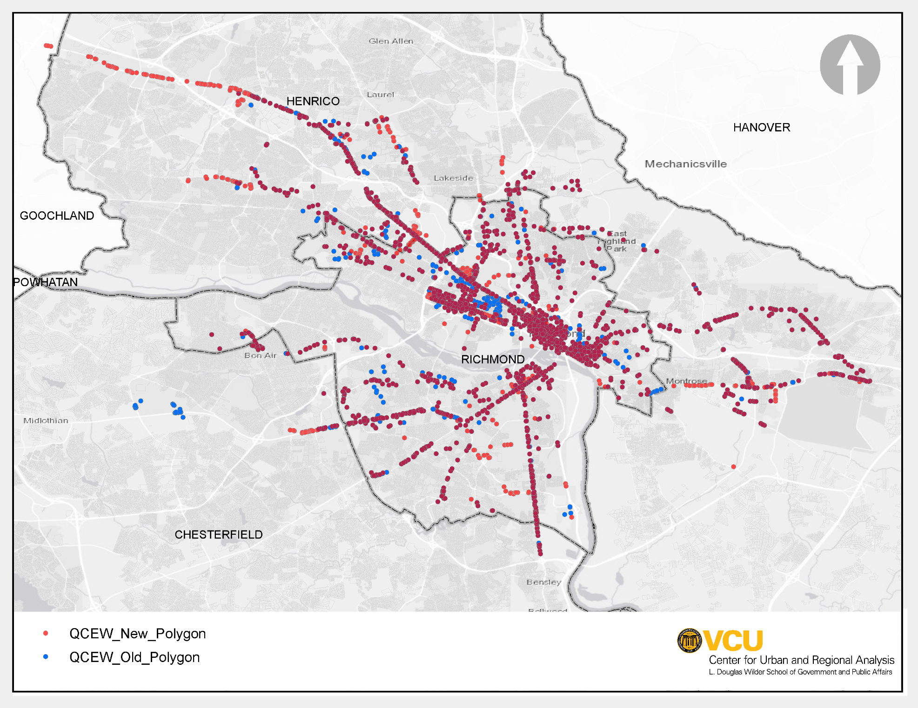
Access to Jobs: Old and New Routes
THE IMPACT OF THE GREAT RICHMOND REROUTE ON THE CITY’S DISTRESSED NEIGHBORHOODS
+5.2%

Slide 16
Summary
THE IMPACT OF THE GREAT RICHMOND REROUTE ON THE CITY’S DISTRESSED NEIGHBORHOODS
The Great Richmond Reroute has disenfranchised about 36% of the city’s population from access to public transit.
1,142 dwelling units in low-poverty areas are disconnected after the reroute.
Most of the dwelling units added to the walkshed (due to reroute) are near the nodes with low connecting power.
People in low-poverty areas have greater need for the transit service, hence reduction in accessibility impacts them more.
The reroute has added about 8,000 new jobs into the transit walkshed.

Slide 17
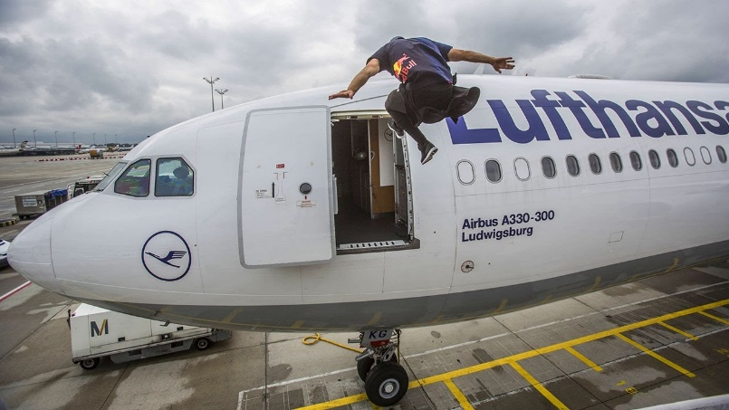
THE IMPACT OF THE GREAT RICHMOND REROUTE ON THE CITY’S DISTRESSED NEIGHBORHOODS
Need to run now to catch an early flight, please feel free to send you questions or comments via email.
sadhikari@vcu.edu
Thank You!

