Slide 1
Westside Atlanta: Westside Community Investment Map
Bernita Smith, Director
Ryan Barrett, Principal Geospatial Coordinator
Layla Bellows, Data Analyst

Slide 2
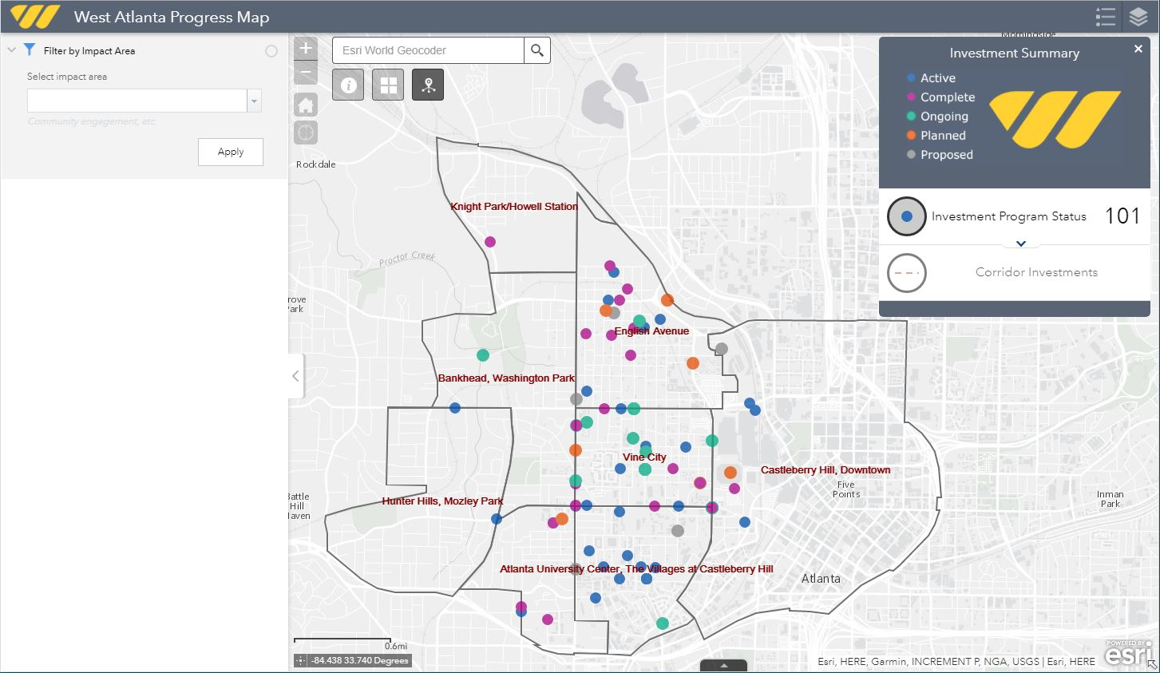

Slide 3
About the project
West Atlanta has a wealth of history and educational institutions yet continues to suffer from decades of systematic disenfranchisement.
Today, numerous local and national organizations have funneled cash resources into the area in an effort to stimulate revitalization.
Westside Future Fund, one such organization, sought to create a map that would help the community understand more about the projects underway in the neighborhood and their anticipated timelines for completion.

Slide 4
The data model
Indicates phase of project completion
x, y coordinates enabled faster execution
Impact areas are based on WFF’s focus areas

Slide 5
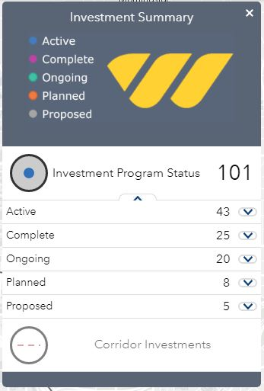
Project Goal #1: Project Status
Frequently, members of the community feel that promised projects are never achieved and/or do not benefit them.
The primary goal of the map is to show residents which projects currently are benefiting the community and which ones are in the pipeline.

Slide 6
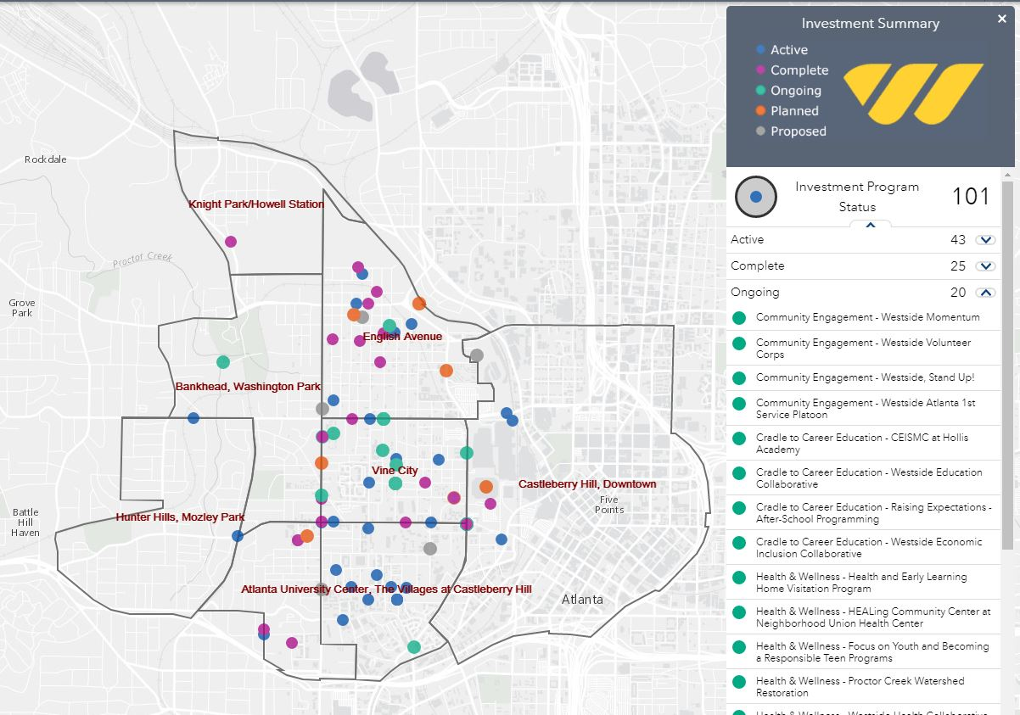

Slide 7
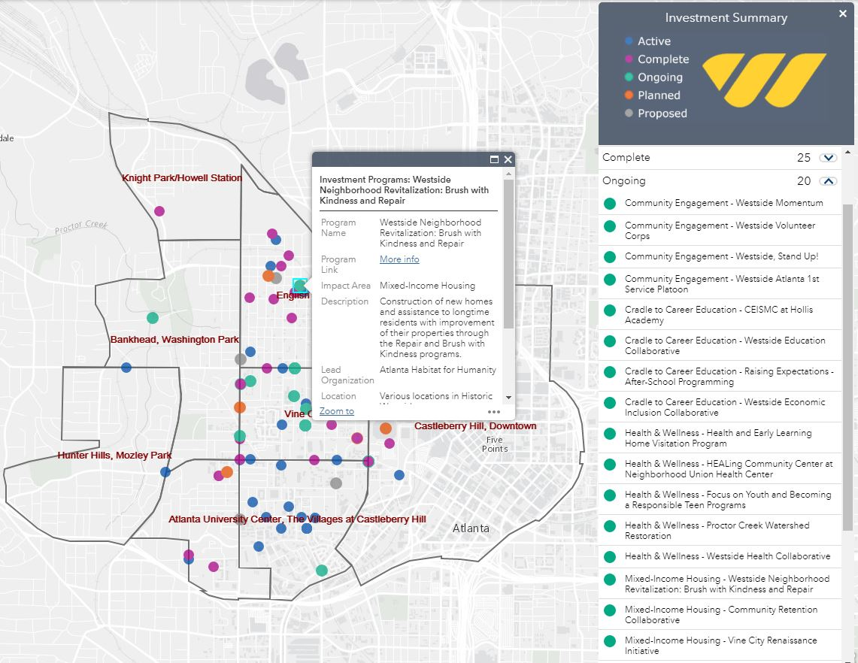
Clicking on any item of interest opens a pop-up window with all the details that were included in the data table.

Slide 8
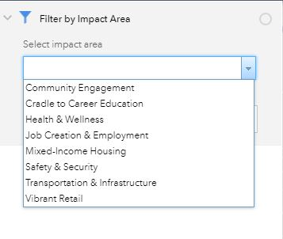
Project Goal #2: Impact areas
A secondary focus was to allow the residents to explore by the projects’ impact area:
Community engagement
Cradle to career education
Health and wellness
Job creation and employment
Mixed-income housing
Safety and security
Transportation and infrastructure
Vibrant retail

Slide 9
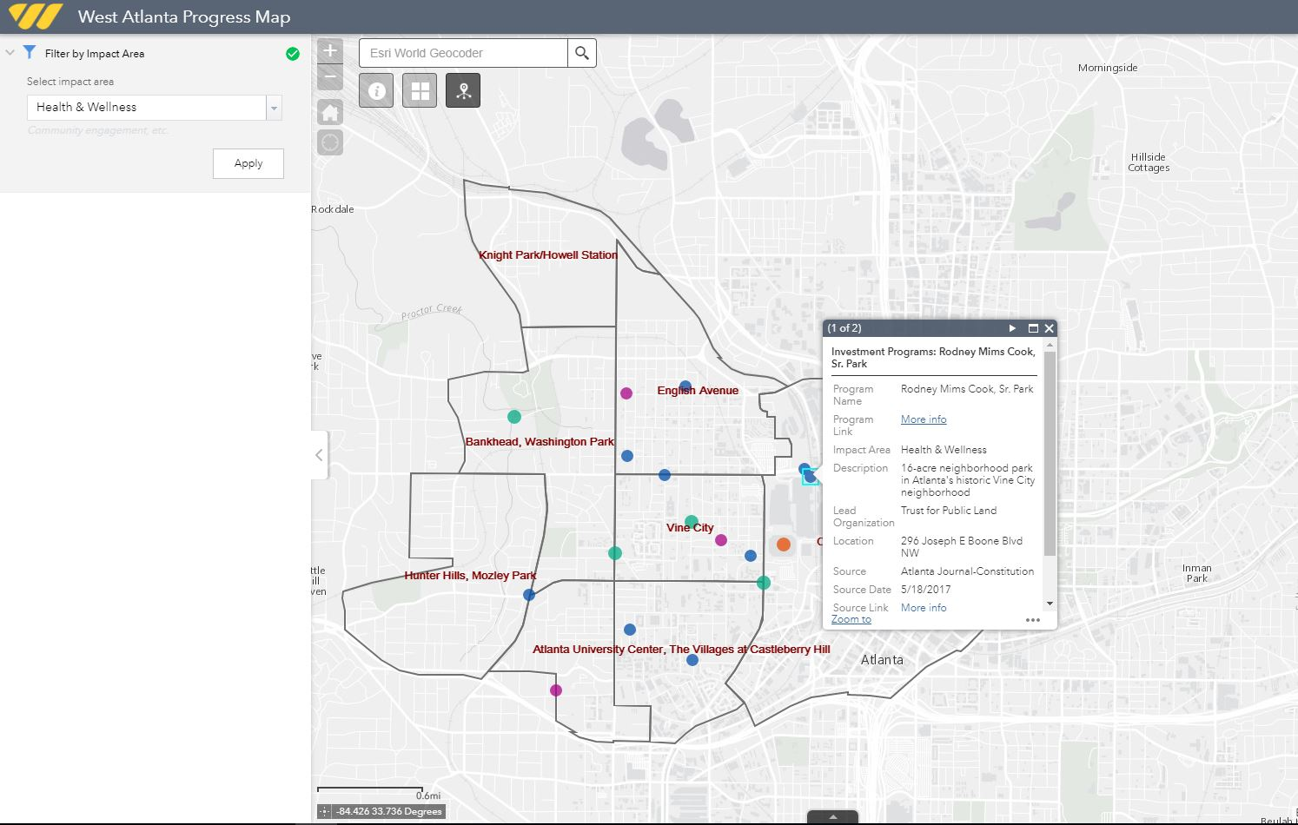
Clicking on the arrow reveals additional ways to interact with the data.

Slide 11
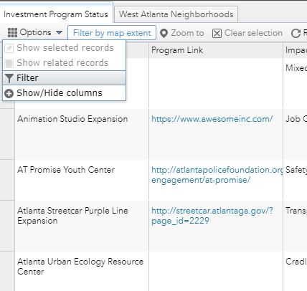
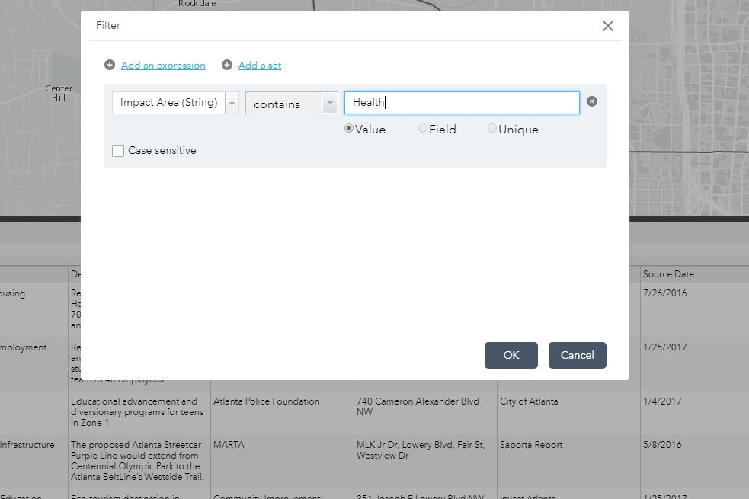
The table has additional methods for filtering information.

Slide 12
Take a test drive on your tablet or laptop at: http://bit.ly/WestsideATL Questions?

