Slide 1
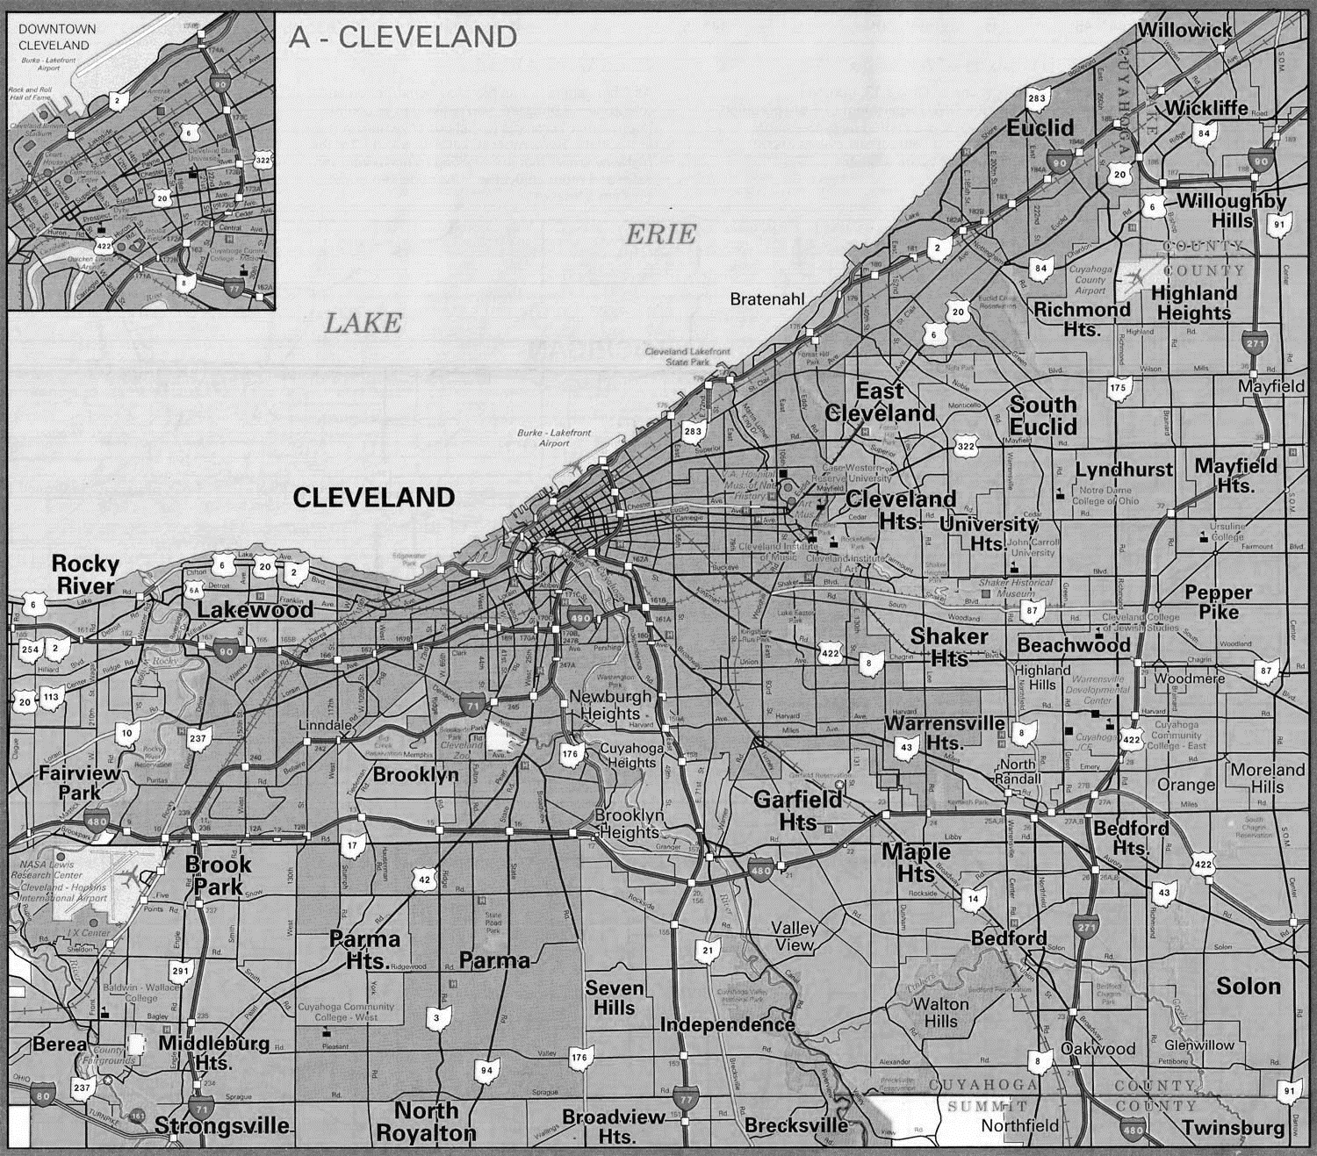
First Suburbs Code Enforcement Data and Technology Project
Nina Holzer, Case Western Reserve University

Slide 2
First Suburbs Context
Mission to initiate and support policies and practices that protect, maintain, and redevelop mature communities and foster regional cooperation.
Government-led advocacy organization working to revitalize Cleveland’s mature, developed community
Seeks to raise awareness of the challenges and inequities associated with urban sprawl and disinvestment

Slide 3
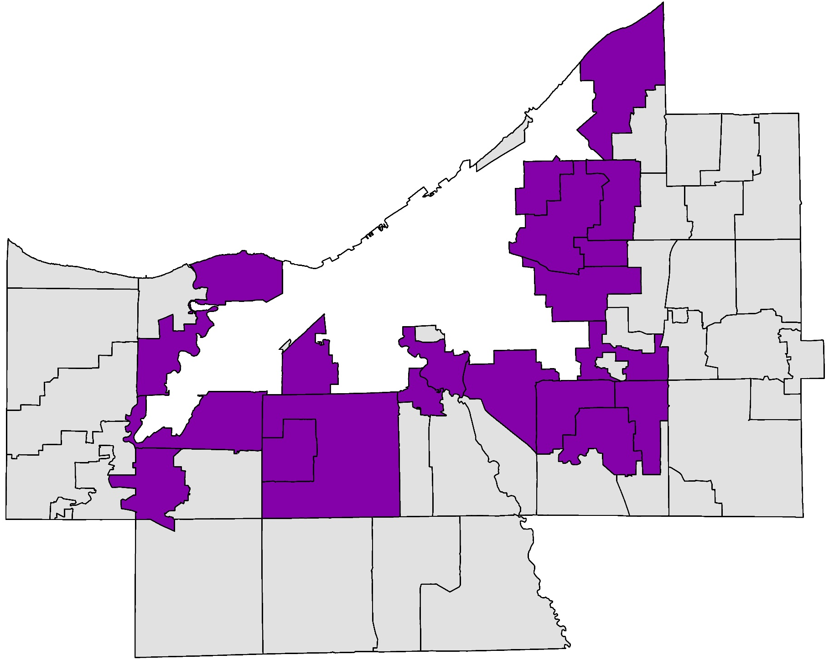
The First Suburbs Consortium
City of Cleveland
First Suburbs Consortium Member
Cleveland!
Outer-ring/Non-Member Suburbs

Slide 4
First Suburbs Context
To battle housing issues, City of Cleveland has the code enforcement partnership that allies housing specialists from neighborhoods across the city
Use NST to house their data and complete reports
Can compare their data to other data shared through the system
Provides a city-wide snapshot of housing issues

Slide 5
First Suburbs Context
First Suburbs municipalities do not have one centralized software system that holds their data
May have different ordinances
May have different processes
May have different data collection and data management
No way of getting a full snapshot of the needs county-wide

Slide 6
Project Context
2013 – First Suburbs Housing Policy White Paper
Need for a county-wide housing policy
Need for accurate, parcel-based property condition information
Urges County to explore feasibility of expanding NST too include data from suburbs
2014 – Consortium reaches out to Poverty Center
Seek aid in improving data and data management tools for suburban code enforcement at a county level
2015 – First Suburbs Regional Code Enforcement Data and Technology Project is launched

Slide 7
First Suburbs Regional Code Enforcement Data and Technology Project
Goals –
Understanding current code enforcement data management practices of First Suburb communities
Increasing capacity to use existing resources for the purposes of code enforcement and other neighborhood stabilization activities
Evaluating potential code enforcement data management systems for shared use of First Suburb communities

Slide 8
First Suburbs Regional Code Enforcement Data and Technology Project
What We Did –
Two Phases:
Understanding current code enforcement data management and education on existing resources
Survey
Site Visits
Examining potential data systems and software solutions

Slide 9
First Suburbs Regional Code Enforcement Data and Technology Project
Survey Structure –
What tools they currently use
Property Intake: What information do they capture and in what form
Property Inspection: What information do they capture and in what form
Property Enforcement: What information do they capture and in what form
Pros and cons of current system
Exporting
Other tools at their disposal

Slide 10
First Suburbs Regional Code Enforcement Data and Technology Project
Survey Findings–
17 suburbs participated
Majority keep electronic records
Split between satisfied and dissatisfied with current system
A variety of software systems were represented – some web-based, some locally hosted, some outsourced

Slide 11
First Suburbs Regional Code Enforcement Data and Technology Project
Site Visits –
Deep dive into the code enforcement process
Had suburbs show us their software system and run us through scenarios
Viewed any “shadow systems”
Learned of any external influences impacting their process
Learned of any needs that weren’t disclosed of in the survey

Slide 12
First Suburbs Regional Code Enforcement Data and Technology Project
Site Visits Findings –
Many suburbs are doing a lot with a little
The code is different but the processes are similar
Uncovered the challenges in the following areas:
Technology
Human Resources
External Forces

Slide 13
First Suburbs Regional Code Enforcement Data and Technology Project
Reporting –
Provided a survey write-up and final findings report
Presented findings to the group asked them to affirm or challenge our findings
Discussed findings and shared important considerations (eg. data ownerships)
Had cities that were content with their systems share present their code enforcement software to the group

Slide 14
First Suburbs Regional Code Enforcement Data and Technology Project
Next Steps –
Pilot group
Explore data-sharing
Ongoing training and exploration of software systems

Slide 15
First Suburbs Regional Code Enforcement Data and Technology Project
Considerations –
When conducting a project like this, need to remind partners that:
Software is not a silver bullet
People drive a process
Is it a software issue or a training issue?
Ask partners: is it cheaper to invest in a new software or take a couple days to train your department?

