Slide 1
25 Years of Data for Community Action
Mark Abraham
Executive Director, DataHaven
Fellow, W.K. Kellogg Foundation
Twitter: @ctdata / @urbandata
Neighborhood Indicators: Tips from the Field

Slide 2
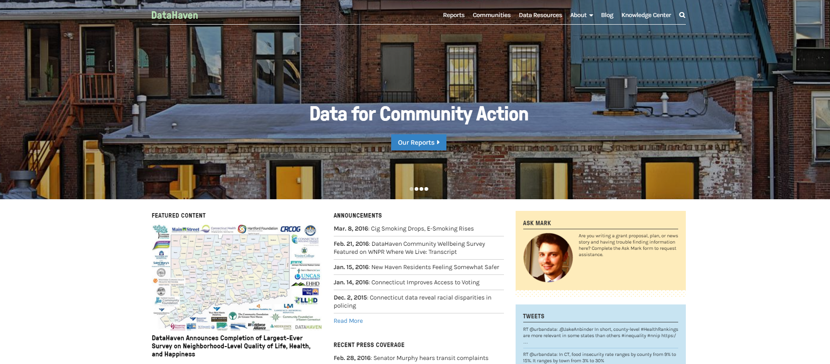
About
DataHaven is a non-profit organization with a 25-year history of public service to Greater New Haven and Connecticut.
ctdatahaven.org

Slide 3
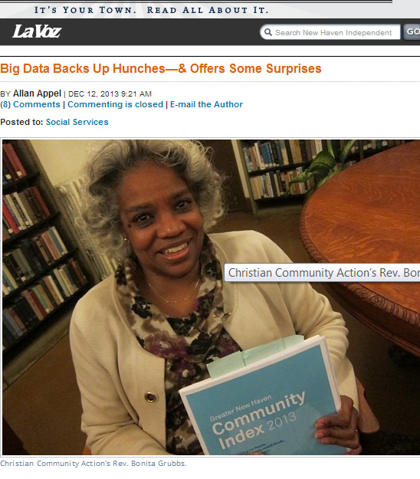
Typical Reactions to Neighborhood Indicator Programs
Desired | Avoidable
“We now have data we can believe in.” “We can see ourselves in this data” | “We don’t believe the data… that people don’t think our parks are in good condition. My park is beautiful”

Slide 4
Typical Reactions to Neighborhood Indicator Programs
Desired | Avoidable
“We now have data we can believe in.” “We can see ourselves in this data” | “We don’t believe the data… that people don’t think our parks are in good condition. My park is beautiful”
“The data has been an extraordinary way to bring people together” “We helped design the questions and choose the data used” | “How was this report used?” “How was data collected?” “This is our report, don’t speak for us”

Slide 5
Typical Reactions to Neighborhood Indicator Programs
Desired | Avoidable
“We now have data we can believe in.” “We can see ourselves in this data” | “We don’t believe the data… that people don’t think our parks are in good condition. My park is beautiful”
“The data has been an extraordinary way to bring people together” “We helped design the questions and choose the data used” | “How was this report used?” “How was data collected?” “This is our report, don’t speak for us”
“We carry this everywhere we go!” “We refer to these data all the time” | “This is hard to read.” “Data for the whole city/county isn’t useful to my area”

Slide 6
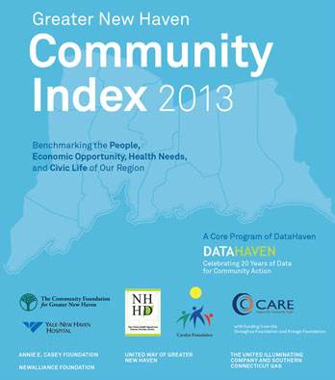
Timeline
Community Index (2013) and Community Wellbeing Survey/Neighborhood Survey (2012) of 2,600 randomly-selected adults
One report/tool, but inputs include
Hospitals
City health departments
Funders/United Ways
Public school systems
Economic development
Health and human services providers
Residents (through primary data collection and partnerships)

Slide 7
Timeline
Community Index (2013) and Community Wellbeing Survey/Neighborhood Survey (2012) of 2,600 randomly-selected adults
One report/tool, but inputs include
Hospitals
City health departments
Funders/United Ways
Public school systems
Economic development
Health and human services providers
Residents (through primary data collection and partnerships)

Slide 8
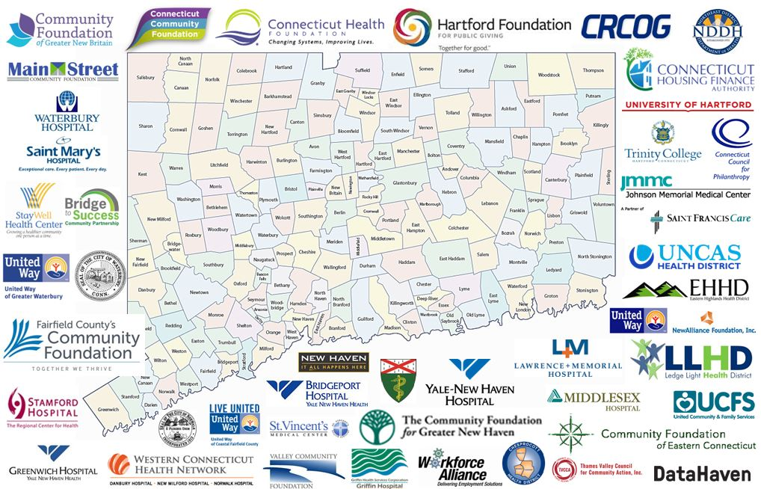
Timeline
Community Index (2013) and Community Wellbeing Survey (2012)
Statewide expansion of Community Wellbeing Survey to 20,000 interviews (2015)
2016 Community Wellbeing Index
Greater New Haven
Fairfield County
Lower Naugatuck Valley partnership
Town-level reports

Slide 9
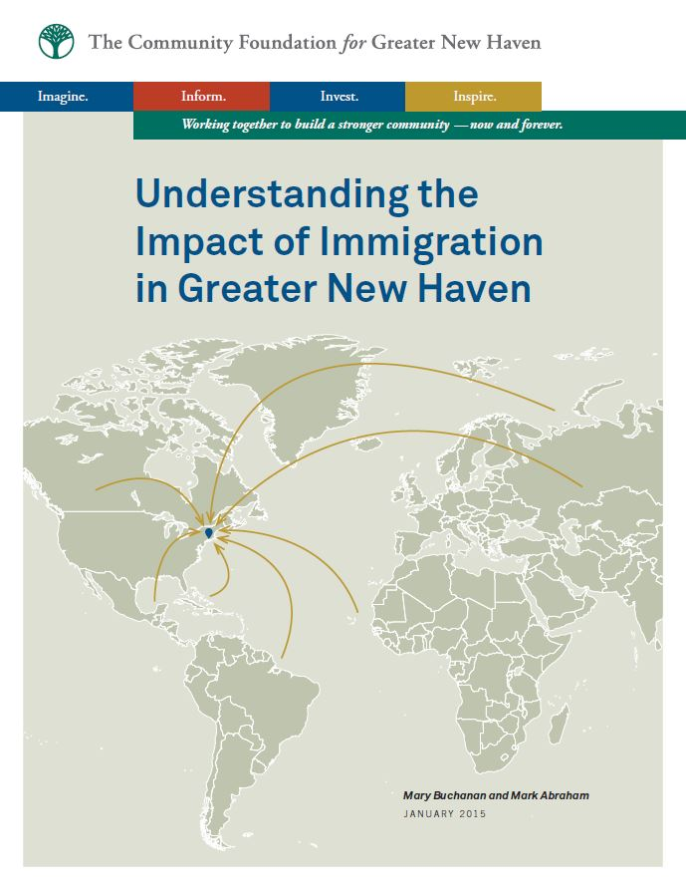
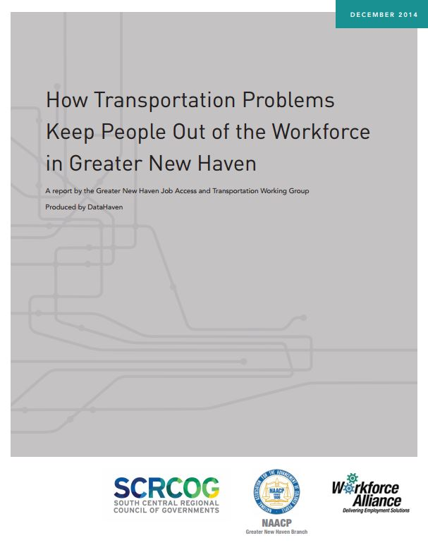
Timeline
Greater New Haven Community Index (2013) and Community Wellbeing Survey (2012)

Slide 10
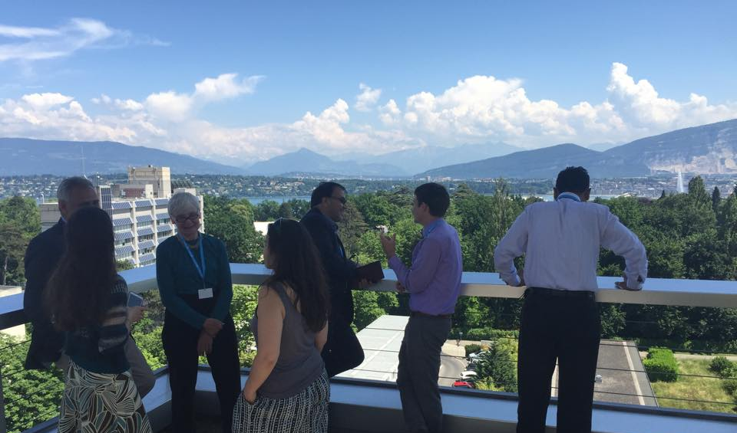
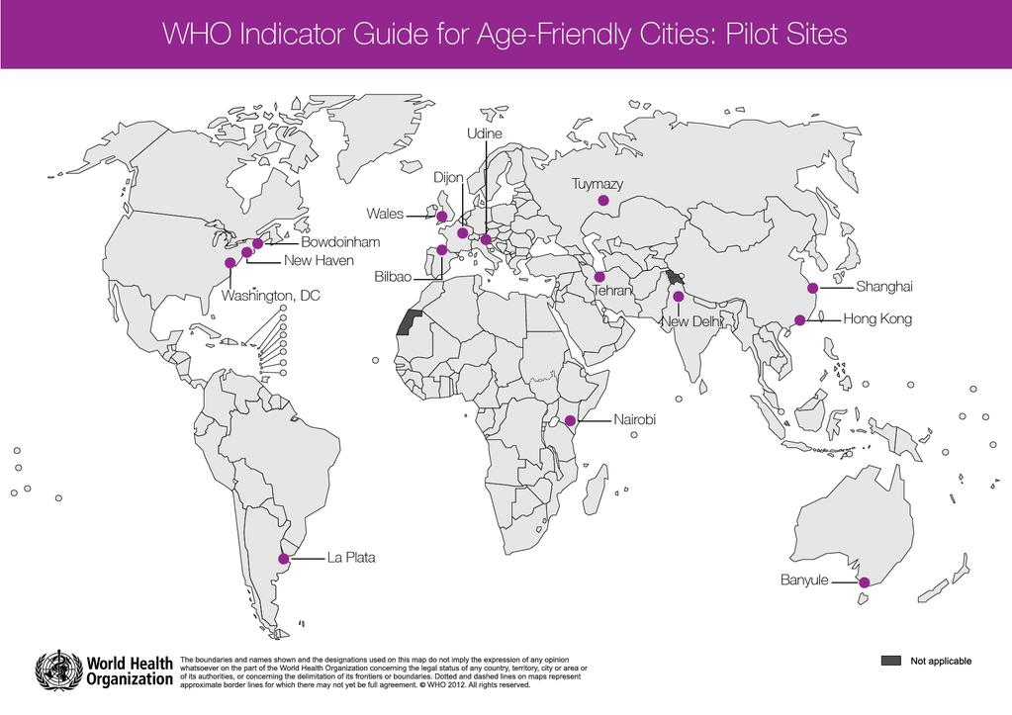
Timeline

Slide 11
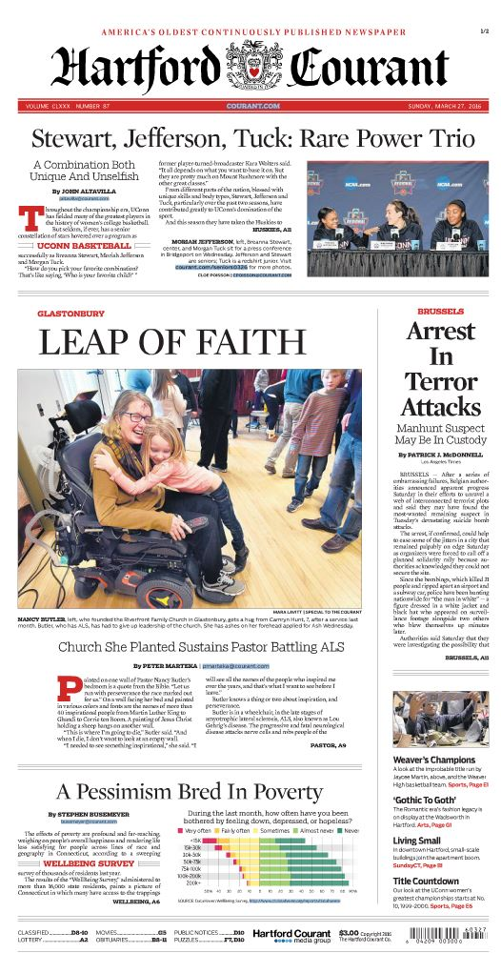
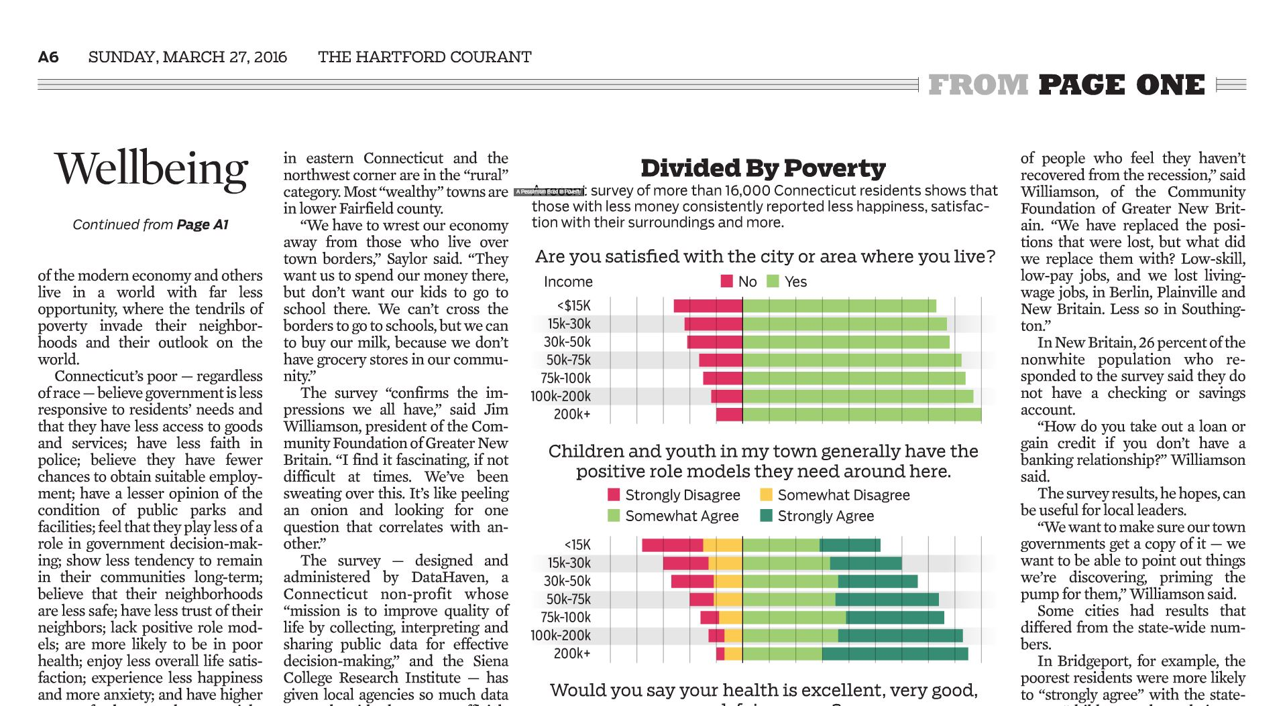
DataHaven Community Wellbeing Survey

Slide 12
Percent who feel their area is a good place to raise children
By Income
Sources: 2015 DataHaven Community Wellbeing Survey; ZIP code distress levels based on 2016 Distressed Communities Index (This slide is preliminary, please do not cite)

Slide 13
Percent who feel their area is a good place to raise children
By Income
By Income and ZIP code
Sources: 2015 DataHaven Community Wellbeing Survey; ZIP code distress levels based on 2016 Distressed Communities Index (This slide is preliminary, please do not cite)

Slide 14
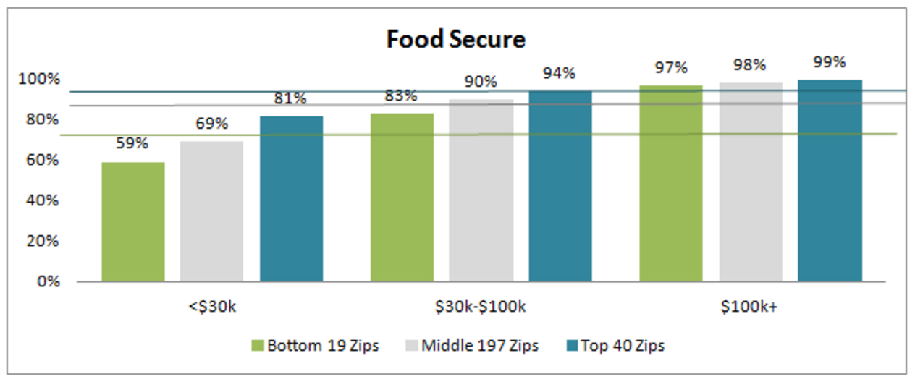
Percent of adults who are food secure
Sources: 2015 DataHaven Community Wellbeing Survey; ZIP code distress levels based on 2016 Distressed Communities Index (This slide is preliminary, please do not cite)

Slide 15
Age Adjustments
Sources: 2015 DataHaven Community Wellbeing Survey; (This slide is preliminary, please do not cite)

Slide 16
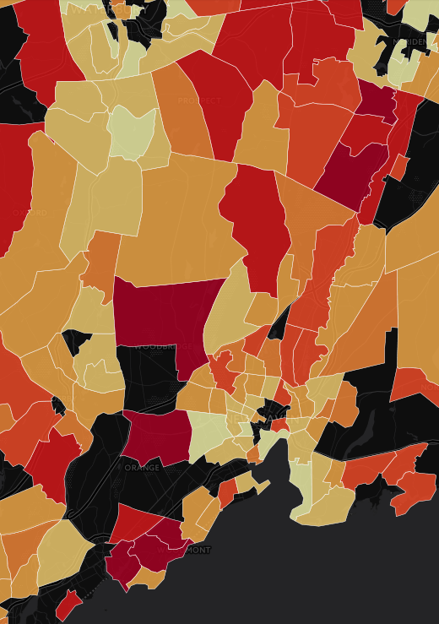
Other Considerations
When data are created at a fine-grained level, a larger investment in resources is needed:
time and expertise to analyze the data;
collect relevant measures at that same level;
protect confidentiality and share with users;
Communications:
Investing in excellent graphic design
Working more closely with journalists
Creating multiple products (e.g., one-page briefs) to translate information into digestible summaries
Sources: 2015 DataHaven Community Wellbeing Survey; (This slide is preliminary, please do not cite)

Slide 17
Optimal Child Development
Graduation rate
Educated Kids
Healthy Families
Secure Families
Early reading, Healthy infants
Poverty, economic stress, housing
Civic Engagement
Effective Decision-making
Racial Equity
Notes:
We often think of data as a way to measure progress toward goals and support community action. We can choose any societal goal for the top of the pyramid – let’s pick optimal child development, which is a universally shared one, perhaps measured by “graduation rate” among other things.
Looking at just about any goal, “predictive” community indicators include education, health, and family security -- of which safe, healthy, and affordable housing connected to other community resources is a key part.
But lower part of pyramid is equally important to measure and take action on. Without racial equity, without neighborhood equity, as previous slides show, overall progress is impossible.

Slide 18
Indicator Programs: Data Sharing vs. Power Sharing
Data Sharing | Power Sharing
Single report, product, or website produced All control over product and schedule rests in one organization State how the data might be used, but leave the actual use in others’ hands | Collective production, evaluation, and ownership of multiple products over time Planning for future projects together Multiple users of product(s), using it in different ways with different voices Shared funding/multiple funders Others actively use the data, meaning that partners must build in more time and resources to ensure correct use. Fund 2-3 years of dissemination.

Slide 19
Indicator Programs: Data Sharing vs. Power Sharing
Data Sharing | Power Sharing
Single report, product, or website produced All control over product and schedule rests in one organization State how data might be used, but leave the actual use in others’ hands | Collective production, evaluation, and ownership of multiple products over time Planning for future projects together Multiple users of product(s), using it in different ways with different voices Shared funding/multiple funders Others actively use the data, meaning that partners must build in more time and resources to ensure correct use. Fund 2-3 years of dissemination.

Slide 20
Indicator Programs: Data Sharing vs. Power Sharing
Data Sharing | Power Sharing
Single report, product, or website produced All control over product and schedule rests in one organization State how data might be used, but leave the actual use in others’ hands | Collective production, evaluation, and ownership of multiple products over time Planning for future projects together Multiple users of product(s), using it in different ways with different voices Shared funding/multiple funders Others actively use the data, meaning that partners must build in more time and resources to ensure correct use. Fund 2-3 years of dissemination.

