Slide 1
NOT Your Father’s Inventory:
Traditional MethodS
NEW Uses
Katie Pritchard
Milwaukee
NNIP San Antonio
April 5-8, 2016
Notes:
Good afternoon. I’m Katie Pritchard, representing Milwaukee as the newest site of NNIP and partnership of funders and usesers that are determined to secure a sustainable data intermediary in our community. I will talk this afternoon about two inventories of services that are used by both traditional and new audiences and some lessons that may be of interest to you. The first is an inventory of free and community clinics and the second is an inventory of programs that are working well at the intersection of community development, criminal justice and health.

Slide 2
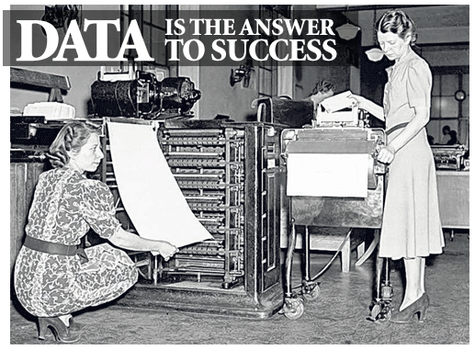
Notes:
Refresher from the last ignite – where we left off
We have always believed that data is the answer to success, but we have some hard felt principles that temper that belief.
Data has to be useful and used. We measure our success by seeing data used---
More than the data warehouse
Using data to make decisions as the highest form
Useful and understood-
Data visualization and storytelling with data
Why inventories?
Old-fashioned but necessary
How we get the data and what we do with it
Making the information useful to the intended user
Modernizing the inventories

Slide 3
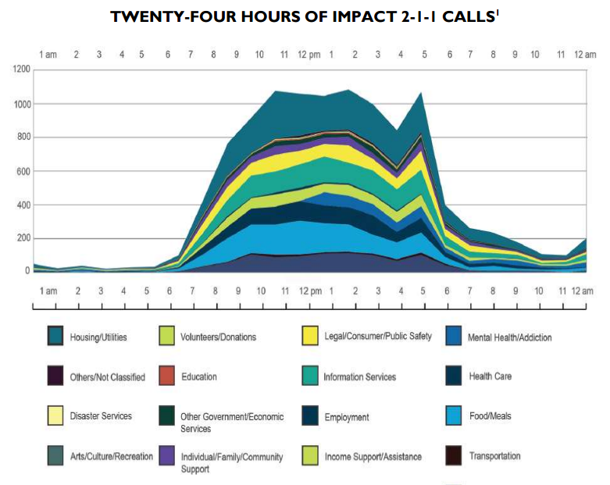
Notes:
Why, might you ask, is this day of readily available information is any inventory needed? As you’ll recall, 2-1-1 is a “real time” place to access information about services that are available in our community. This data visualization shows not only what kind of services people are calling about (e.g. Housing, education, employment, health care etc., but the peak hours when calls come in to locate services in the various categories. But for a deeper dive, inventories are sometimes needed.
From Leading Indicators, Leading Change: IMPACT 2-1-1’s First Ten Years and Future Prospects report
http://www.impactinc.org/fileadmin/user_upload/planning-council/PDF/10-Year-Report-FINAL.pdf

Slide 4
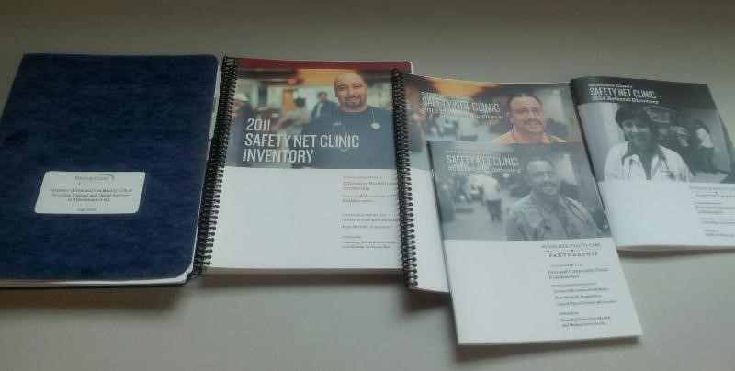
Notes:
A coalition of the five hospital systems in Milwaukee, for example, knew a lot about people being served in Hospitals and emergency rooms, but very little about the Safety Net Clinics that were serving under and uninsured residents. The first task was to identify the clinics and the hospital systems collectively identified 18. With lots of leg work and some labor intensive efforts, we uncovered over 65 clinics providing over 750,000 clinic visits annually! Imagine a health system that left out that kind of data.
Progression of our “Safety Net reports.
Initially a planning guide.
Now a more practical referral guide because of feedback from the community.

Slide 5
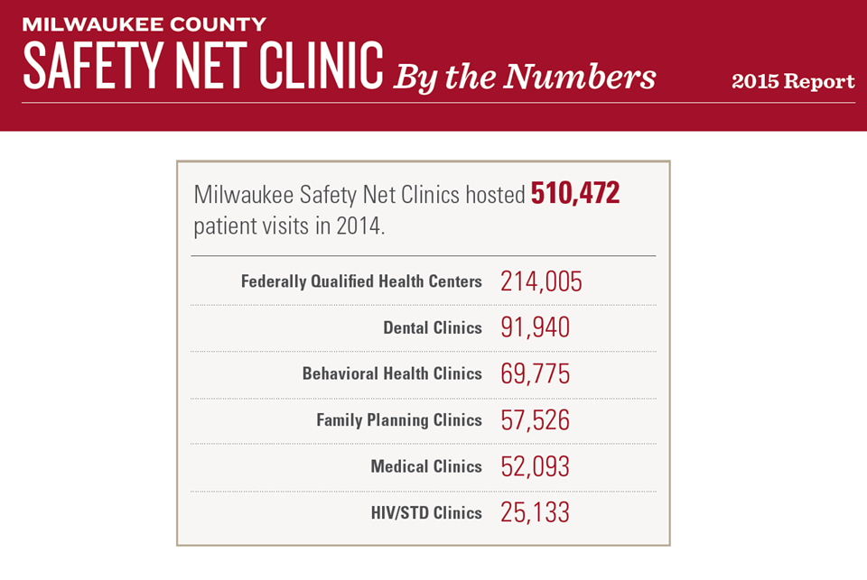
Notes:
The original purpose was to provide the data about the number of clinic visits, the number of under and uninsured patients without a medical home, and types of services provided by the clinics. Here’s a high level look at the number of clinic visits during the first year of the Affordable Care Act.
This is the current high level analysis piece, which is a companion to the referral guide.

Slide 6
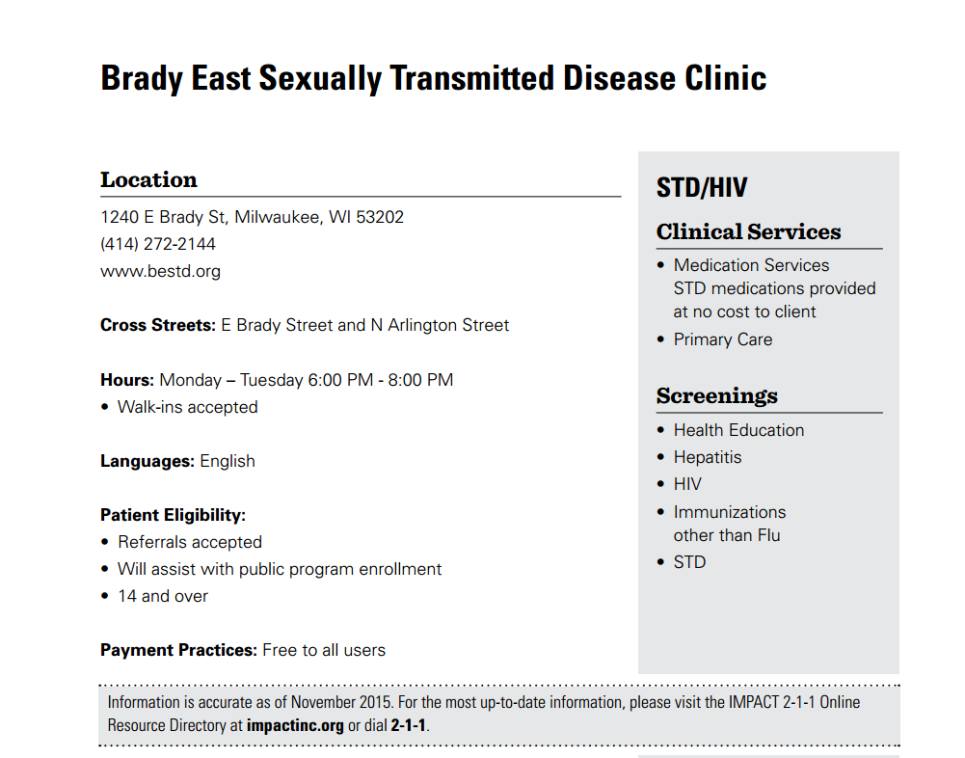
Notes:
Getting the data was a first practical step as it led to the demand for a referral guide that provided key information about each clinic --- where are they, what public transportation is available to them, what hours are they open, what language do they speak and importantly, what health services and screenings do they provide.
Example of a clinic page, with data for referrals.

Slide 7
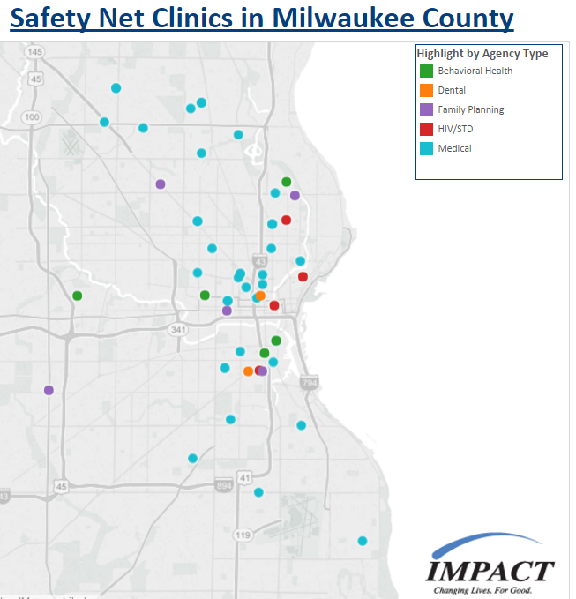
Notes:
Distribution of clinics in Milwaukee by “type,” including Medical, Dental, Family Planning, HIV/STD and Behavioral Health. Mapping the clinic location was critical High end users were emergency rooms and social workers at the hospitals. Demand has grown and its now requested by the Public School System, and most recently insurance companies! One inventory– many uses.

Slide 8
Public Health & Health Care
Safety & Criminal Justice
Community Development & Economic Development
Notes:
A second inventory being produced is the product of a conference sponsored by the Federal Reserve bank where the push is to look at the intersection of community development and health. In Milwaukee, we’ve added Safety to the mix and are attempting to identify those programs that are working beyond their silos, often at the neighborhood level, to integrate improvements in these areas.
Healthy, More Prosperous Milwaukee group
Public health and health care professionals
DA’s office and Public Defender’s office
Support from Federal Reserve Bank and leaders in community/economic development

Slide 9
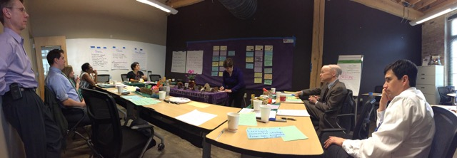
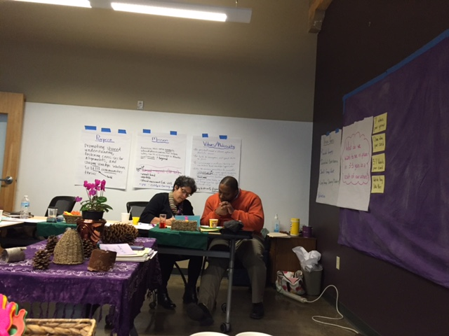
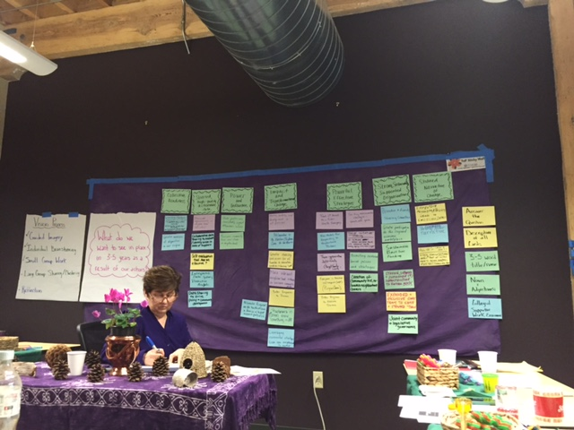
Notes:
Picture of the group from strategic planning session hosted at Planning Council
How it was made?
Through intersectoral work – HSP-MKE
Build relationships and trust among ourselves if we want our data to represent the same

Slide 10
Notes:
Describe the inventory here:
A resources that describes the work of agencies and programs such as local nonprofits, MPD, and the Zilber School of Public Health, working well at the intersection of public health/health care, safety/criminal justice, and community development/economic development in Milwaukee
Identify potential partners and resources, learn with and from each other, and discover opportunities to secure a safer, healthier, and more prosperous Milwaukee

Slide 11
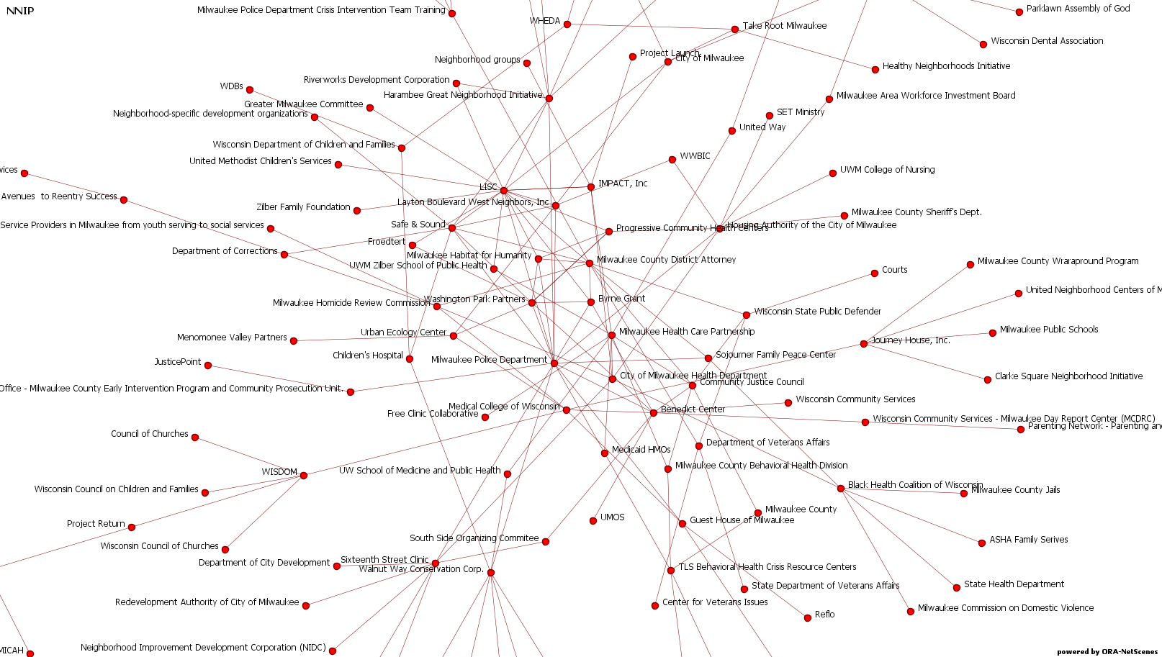
Notes:
Screenshot of a 2D network
Opportunity to use innovative technology to interpret and present data.
Use of network analysis
Can visually show who’s bridging the sectors, answering more directly where the intersection of these sectors is occurring

Slide 12
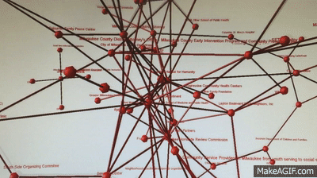
Notes:
GIF showing 3D network
Continue with use of network analysis
Display interactions happening in Milwaukee, not just with this inventory but in some of our neighborhood work

Slide 13
Notes:
Other examples
For example, the Northwestern Mutual Foundation has identified three neighborhoods in which they are investing. Their theory of change is that if the neighborhood organizations that they support are working well together, conditions in the neighborhood will improve. This baseline network analysis provides a snapshot of initial conditions that will be used to assess progress over time.

Slide 14
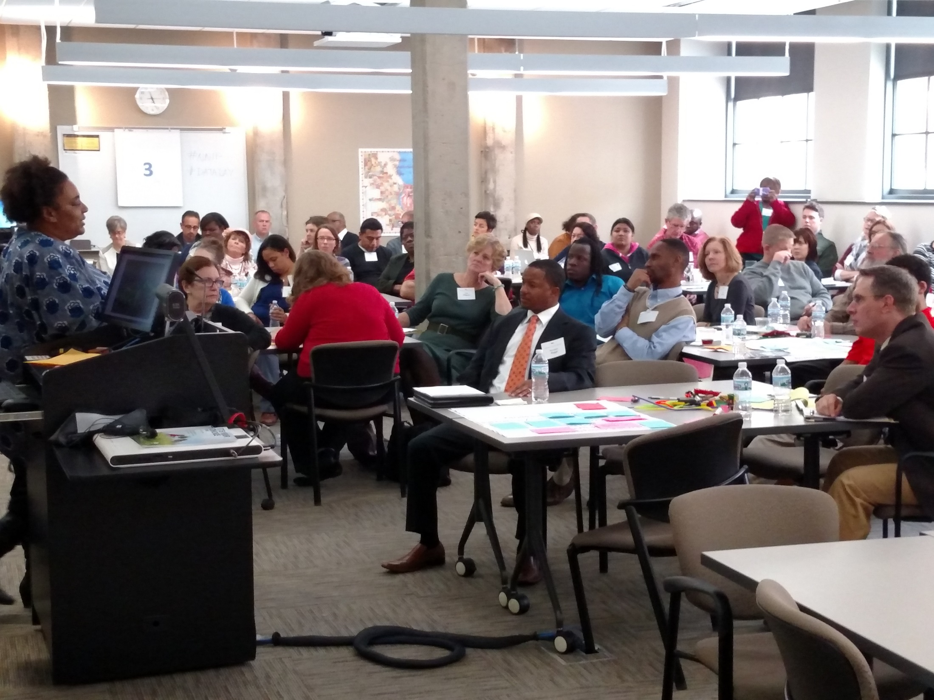
Notes:
Data day pic.
Importance of involving the community
New audiences and new approaches – tying our work back to NNIP and making our data useful and used.

Slide 15
These Inventories are not sitting on the Shelf!
Need to build trust among partners
Consideration of the end users
Recognition that it’s developmental and we have to start somewhere and
A push to go beyond the usual users and uses.
Notes:
And So, while our methods of collecting the information require
The need to build trust among partners,
Consideration of our end users,
Recognition that its developmental but that we have to start somewhere and
a push to
Going beyond the usual user and uses.
The data derived from these inventories are not sitting on the shelf!

