Slide 1
2-1-1 as a Source of Health and Human Services DAta
October 21-23, 2015

Slide 2
Community Research Partners
Who we are:
501(c)(3) founded in 2000
Our Mission: Strengthen communities through data, information, and knowledge
Our Partners:

Slide 3
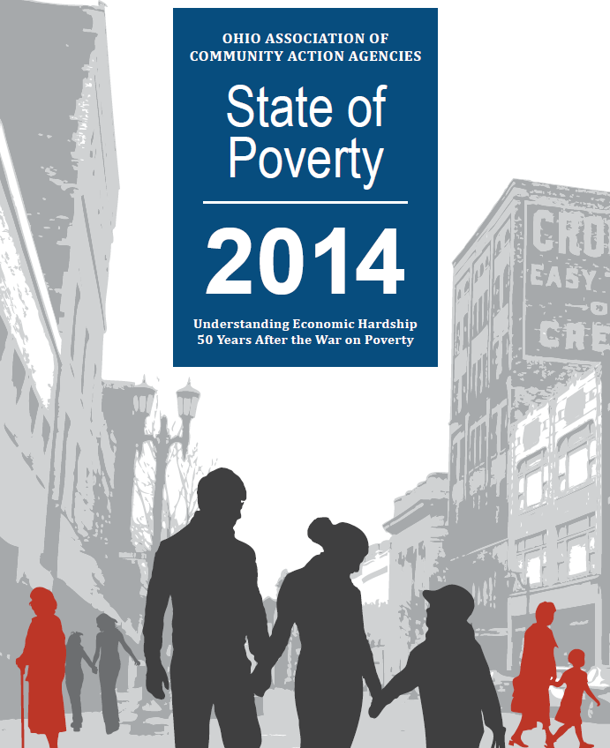
What We Do

Slide 4
What We Do
Evaluate data or programs
Literature reviews
Case studies
Conduct focus groups and surveys
Mapping
Conduct field work/field surveys
Create data dashboards and visualization

Slide 5
American Community Survey
https://www.census.gov/programs-surveys/acs/methodology/mandatory-voluntary-methods.html

Slide 6
2-1-1 Call Line

Slide 7
Hands On Central Ohio
Client details
Zip code
Age
Income
Language spoken
Household size
Race
Minor child in household

Slide 8
What are the needs?
Food
Assistance paying bills
Medical needs
Shelter
Shelter for Men
Community Shelter for Women
Emergency Housing Services
Transitional Housing Program

Slide 9
Are resources available where there are needs?

Slide 10
Pros:
Hands On has useful data
CRP has data experts
Data currently unused
Rapid data updates

Slide 11
Cons:
lose 3rd party evaluator perspective?
Not representative sample of population
2-1-1 not in every city
No consistent cycle for funding

Slide 12
Questions we could answer
Are there patterns in needs (e.g., housing first, food first?)
Who are the callers not following up on referrals?
Does the percent of successful referrals differ by category?
And more

Slide 13
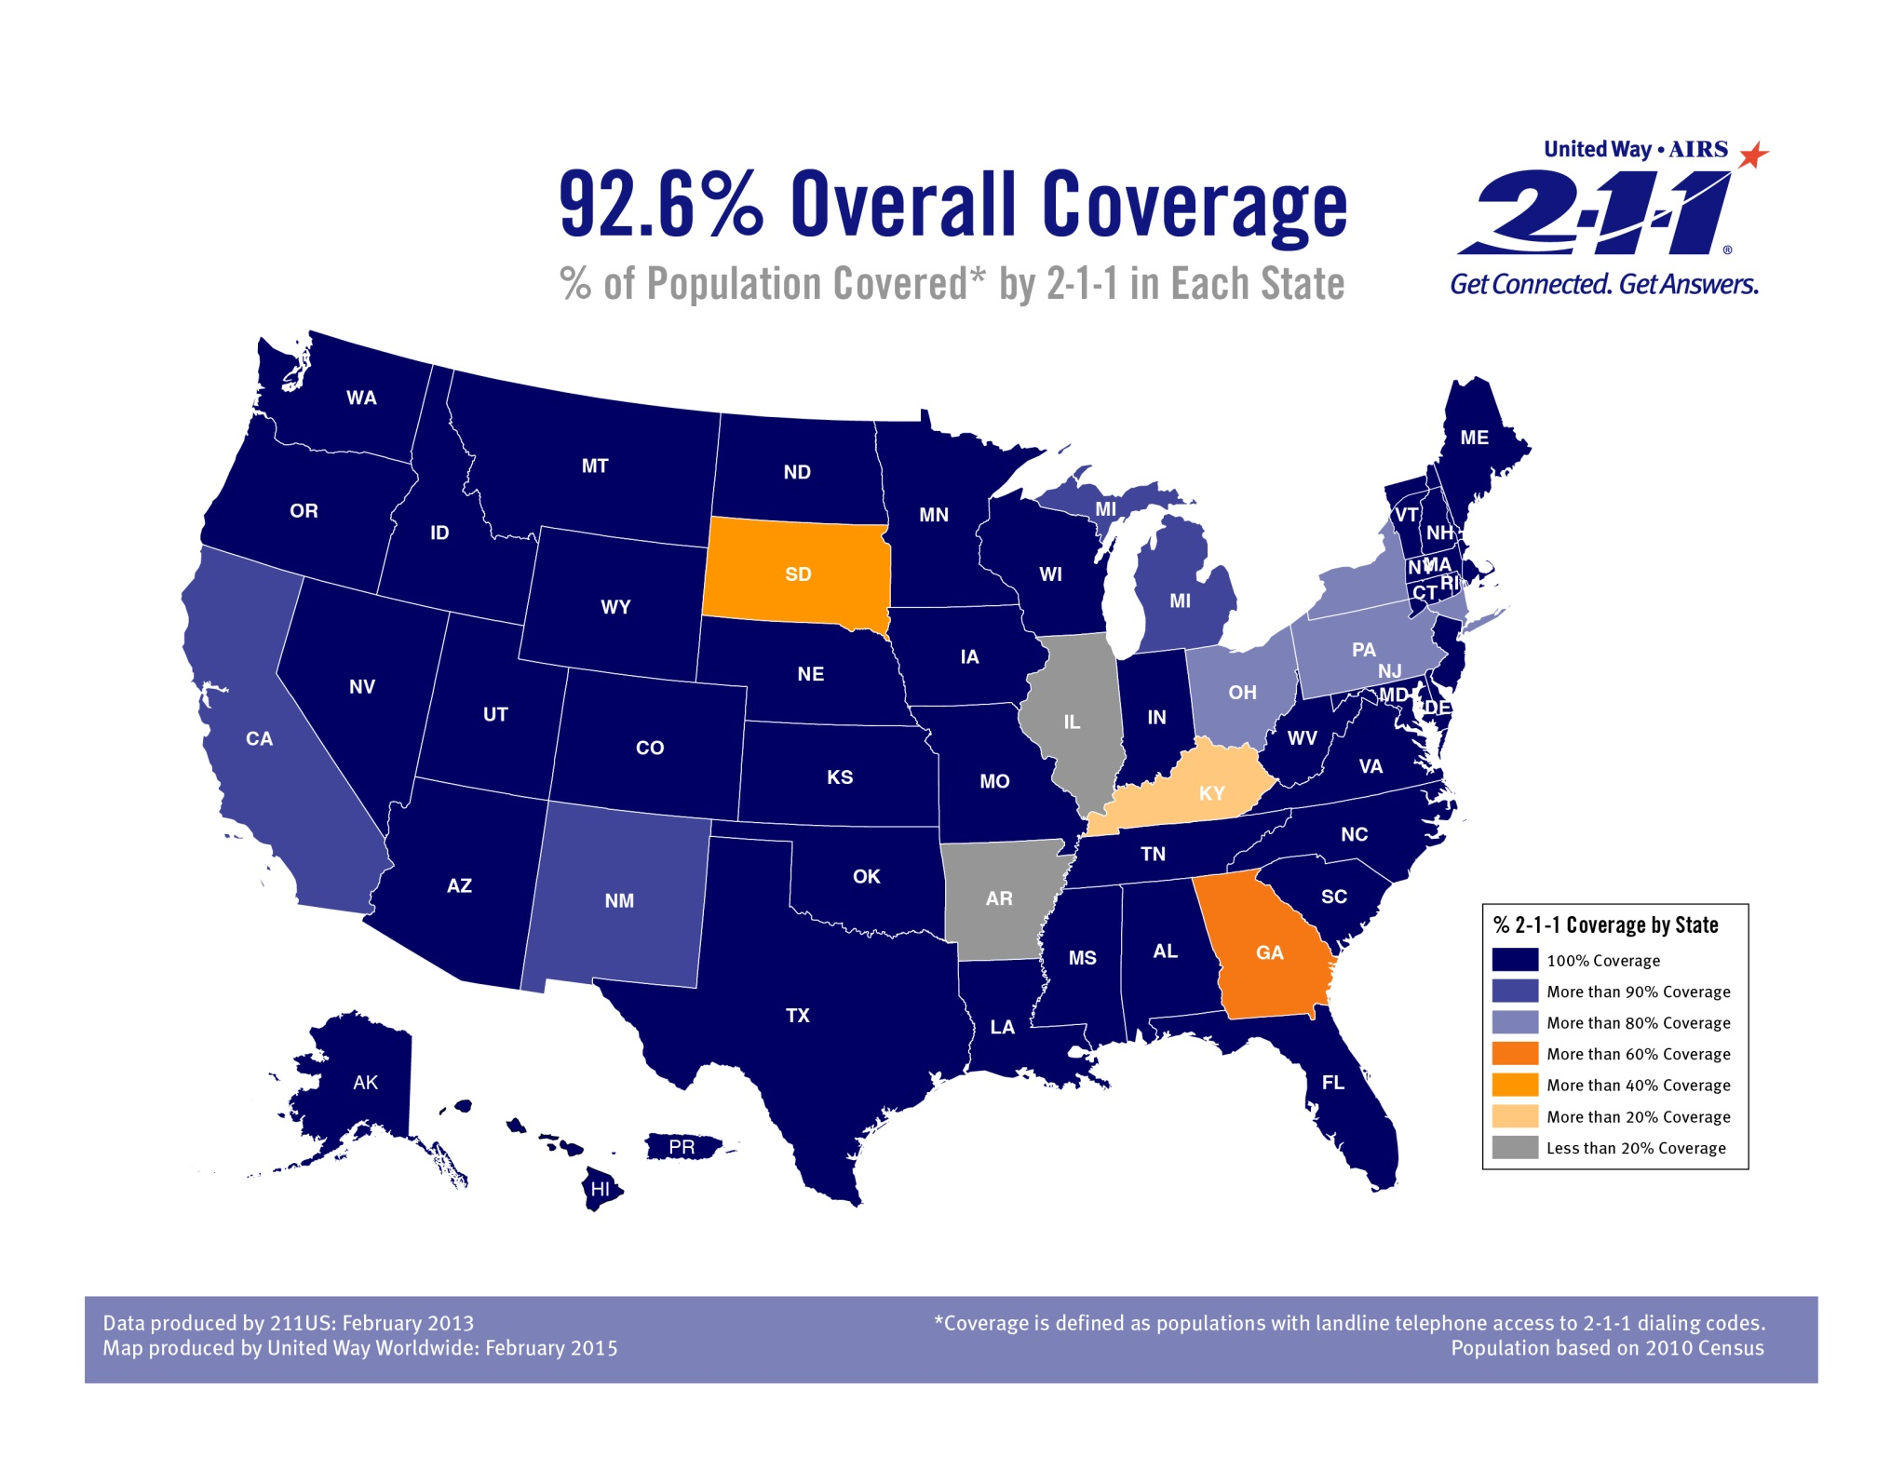

Slide 14
Contact information
Megan Johanson, PhD
Director of Research and Data Services
P: 614-737-2965
mjohanson@researchpartners.org
Community Research Partners
399 East Main Street, Suite 100
Columbus, Ohio 43215
www.researchpartners.org
@CRPColumbus

