Slide 1
Motor City Mapping 2016 Update
From Data System to Data Collaborative
Noah Urban, Data Driven Detroit
September, 2016

Slide 2
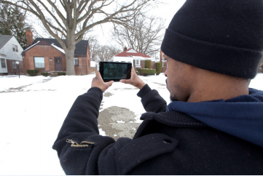
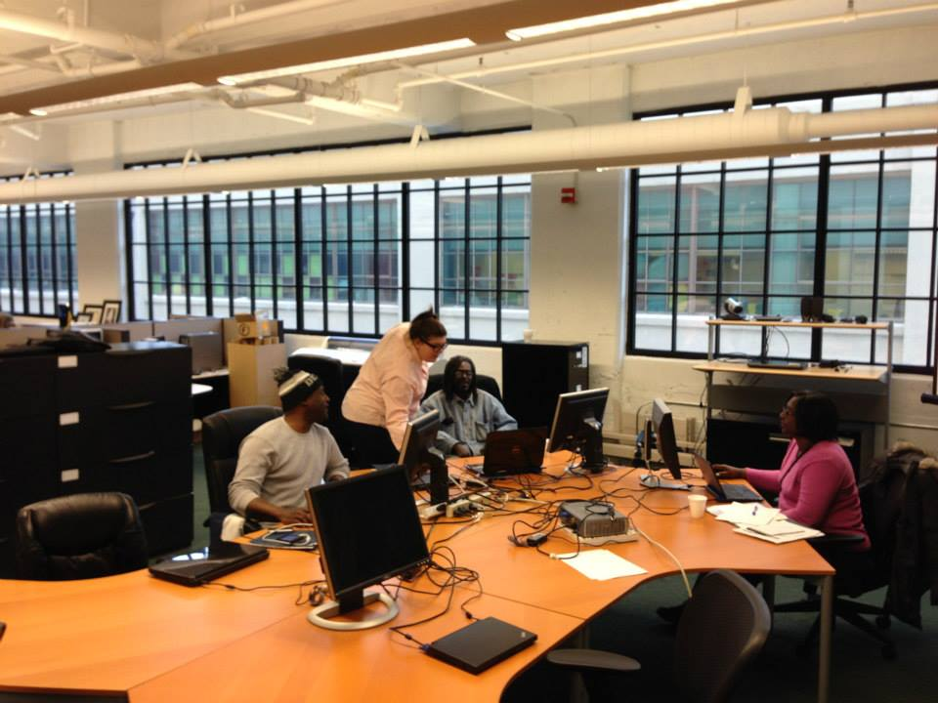
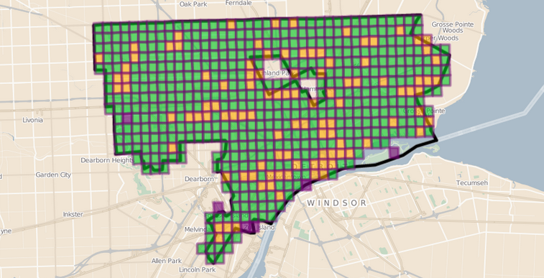
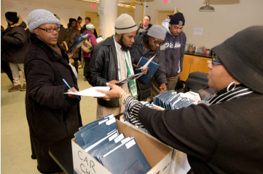
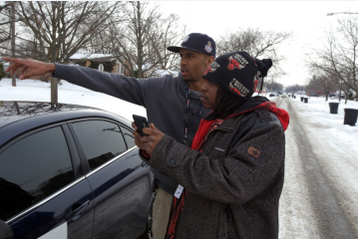
Background

Slide 3
A Comprehensive Property-Level Data System
Properties with No Gas or Electric Service
Historic Designations
Fire Incidents
Water Shutoffs
Current Land Use
Fannie Mae/Freddie Mac Inventories
Historic Resource Survey
Detroit Land Bank Authority Inventory
Crime
Valassis Direct Mailing, Inc., Vacancy Data
Tax Foreclosures
Tax Distress
Property Transactions
Building Permits
Business Licenses
“Improve Detroit” Calls
Assessment Data
Land Bank Sales
Blight Violations

Slide 4
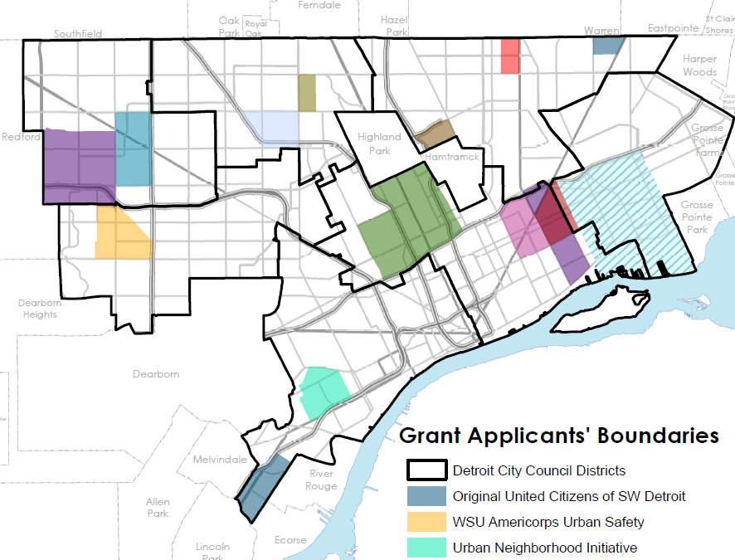
Laying the Groundwork for Community Engagement

Slide 5
2016 To Date
Data Automation
New Collaborations with the City
How can we make Motor City Mapping sustainable?

Slide 6
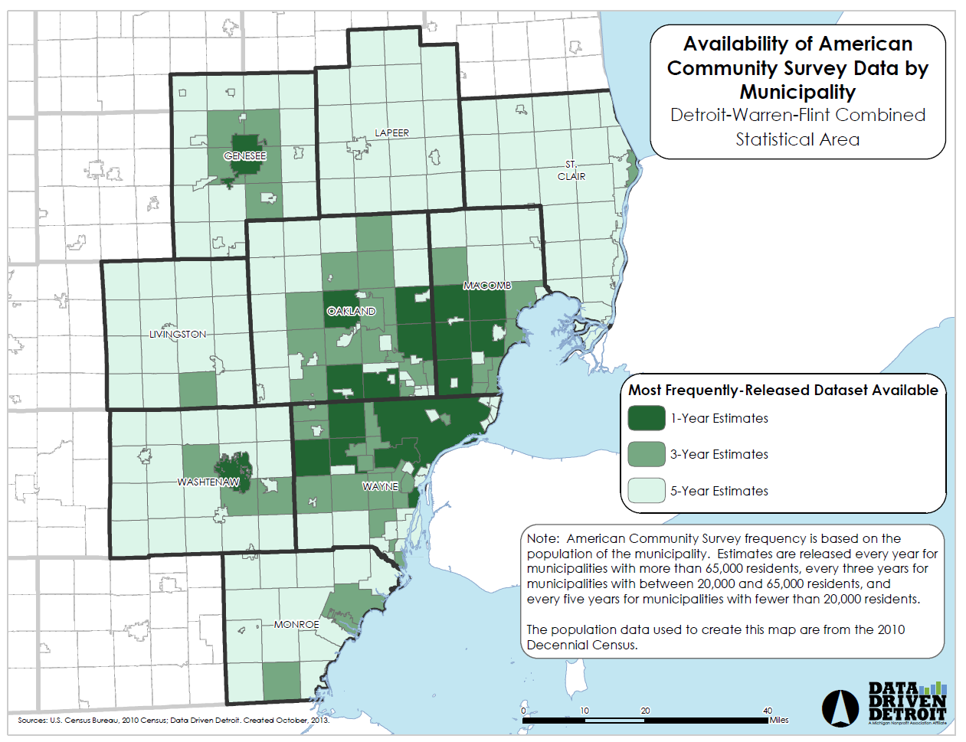




Evolving Challenges

Slide 7
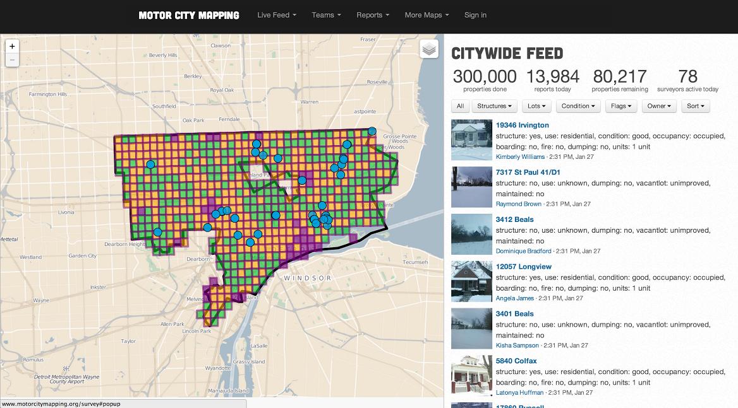
The Question of Sustainability

Slide 8


Previous Strategies to Address Challenges
Site Control
Dashboard
Other City Departments (Future)
DLBA
Other City Departments (Future)
Data Manager
3rd Party Data Providers
Official Database
Public Blexting
Motor City Mapping

Slide 9



Exploring a Different Approach

Slide 10
Metro Detroit Data Alliance
MDDA
D3
LOVELAND Technologies
Core Regional Partners
Detroit Department of Innovation and Technology

Slide 11
Plan for Phase 1 of Implementation
  Visioning, Philosophy, and Principles
  Build out Legal and Collaborative Frameworks
  Design Central Data System and Processes for Updating
  Construct Front-End Interface

Slide 12
Thoughts on Sustainability
Paid member access to ETL Capacity
  Improve partners’ data processes
  Feed data into the collaborative
Build dashboards and interfaces for higher-level analytics
  Leverage academic relationships
Explore corporate sponsorships

Slide 13
Lessons Learned So Far
Due diligence is important
  A lot of other people are thinking about this
  Every region will be different, but we’ve learned a lot from other partners (thanks, Pittsburgh!)
Notes:
12

Slide 14
Lessons Learned, Cont.
Don’t underestimate the scale of the undertaking – start thinking about it as soon as possible!
  Planning for Politics
  Financial Sustainability
Notes:
12

Slide 15
www.DataDrivenDetroit.org
@D3Detroit
AskD3@DataDrivenDetroit.org
TechTown
440 Burroughs #330
Detroit, Michigan 48202

