Slide 1
United, We Get Stuff Done
How Data You Can Use is building NNIP capacity in Milwaukee with students and volunteers.

Slide 2
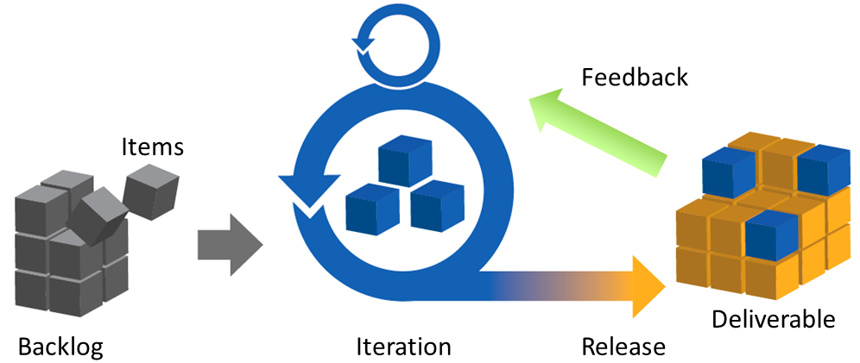
We want to...
Serve as agents of change, helping Milwaukee make more informed decisions to achieve better outcomes.
This is a long effort, so let’s iterate fast, work with people, and go around when we need to!

Slide 3
But we face challenges.
Funding...
...and capacity!
...roadblocks...

Slide 4
Who is in our ecosystem?
Professional, Learning and Amateur Technologists
Software Developers
Graphic Designers
Mapping (GIS) Specialists
Data & Social Scientists
Big Data & Statistical Experts
Technology Educators
Government Officials and Employees
Community Activists and Storytellers
Human Service Experts
Journalists
Nonprofit Professionals
Active Residents

Slide 5
Tech Industry.
Entrepreneurs.
Community @ Large.
City, County & State Government.
Nonprofit Organizations.
Private and Public Foundations.
Universities.
News Organizations.

Slide 6
What are the best methods to use?
+
Code for America focuses on engaging the community to create tools.
NNIP’s focus on data quality brings more integrity to the work.
Leverage talent in the community to build capacity for our organization, our partners and the community at large.

Slide 7
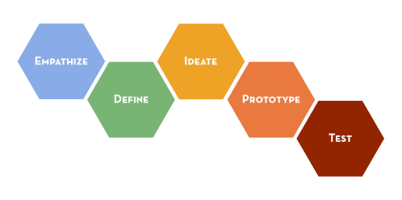
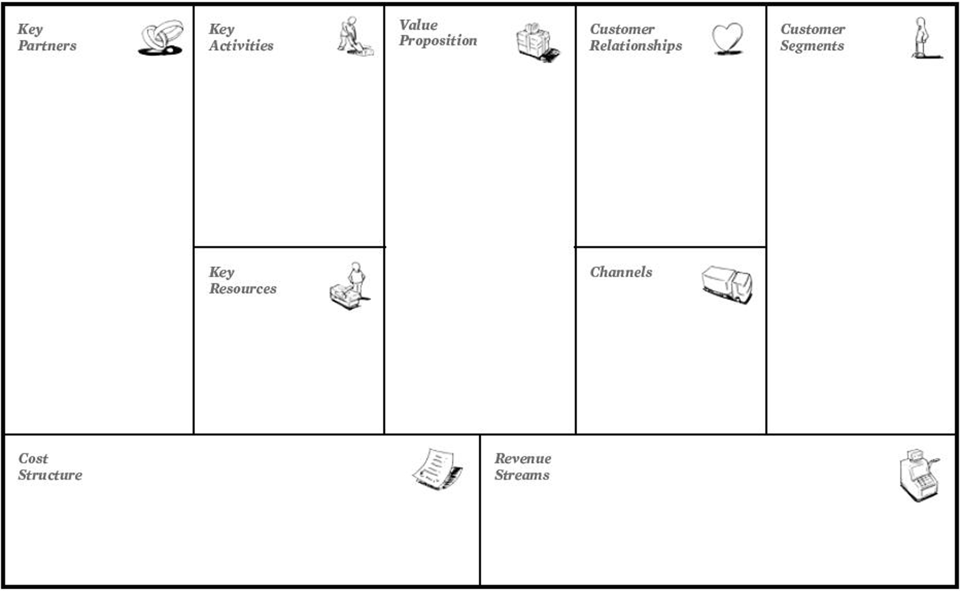
Lean/Agile Consultation
Product Discovery
Needs Analysis
Team Coaching
Market Analysis
User Personas
Execution is the hard part, make it easy!

Slide 8
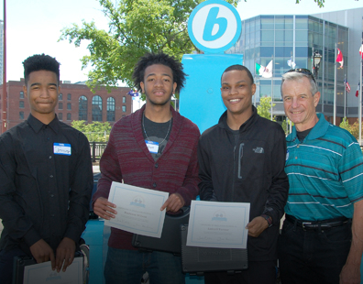
Servant Leadership
The most important things to modern employers and relevant universities are 21st century skills, experience, diversity and leadership development. All of things are accomplished with Servant Leadership.
Program Development
Operating Partner
Evaluation
Opportunity Pipeline

Slide 9
Examples of what we are doing.
Informing, engaging and supporting technologists and activists to execute on community-informed projects and market needs.
The MKE Digital Playbook: Our guide for digital efforts and best practices.
http://github.com/milwaukeedata/playbook

Slide 10
Digital Solutions Hub
If we can’t go through, let’s go around!

Slide 11
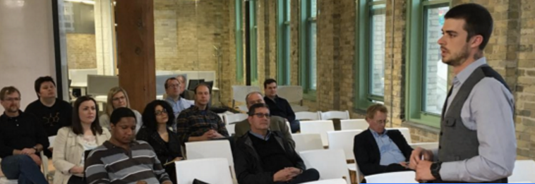
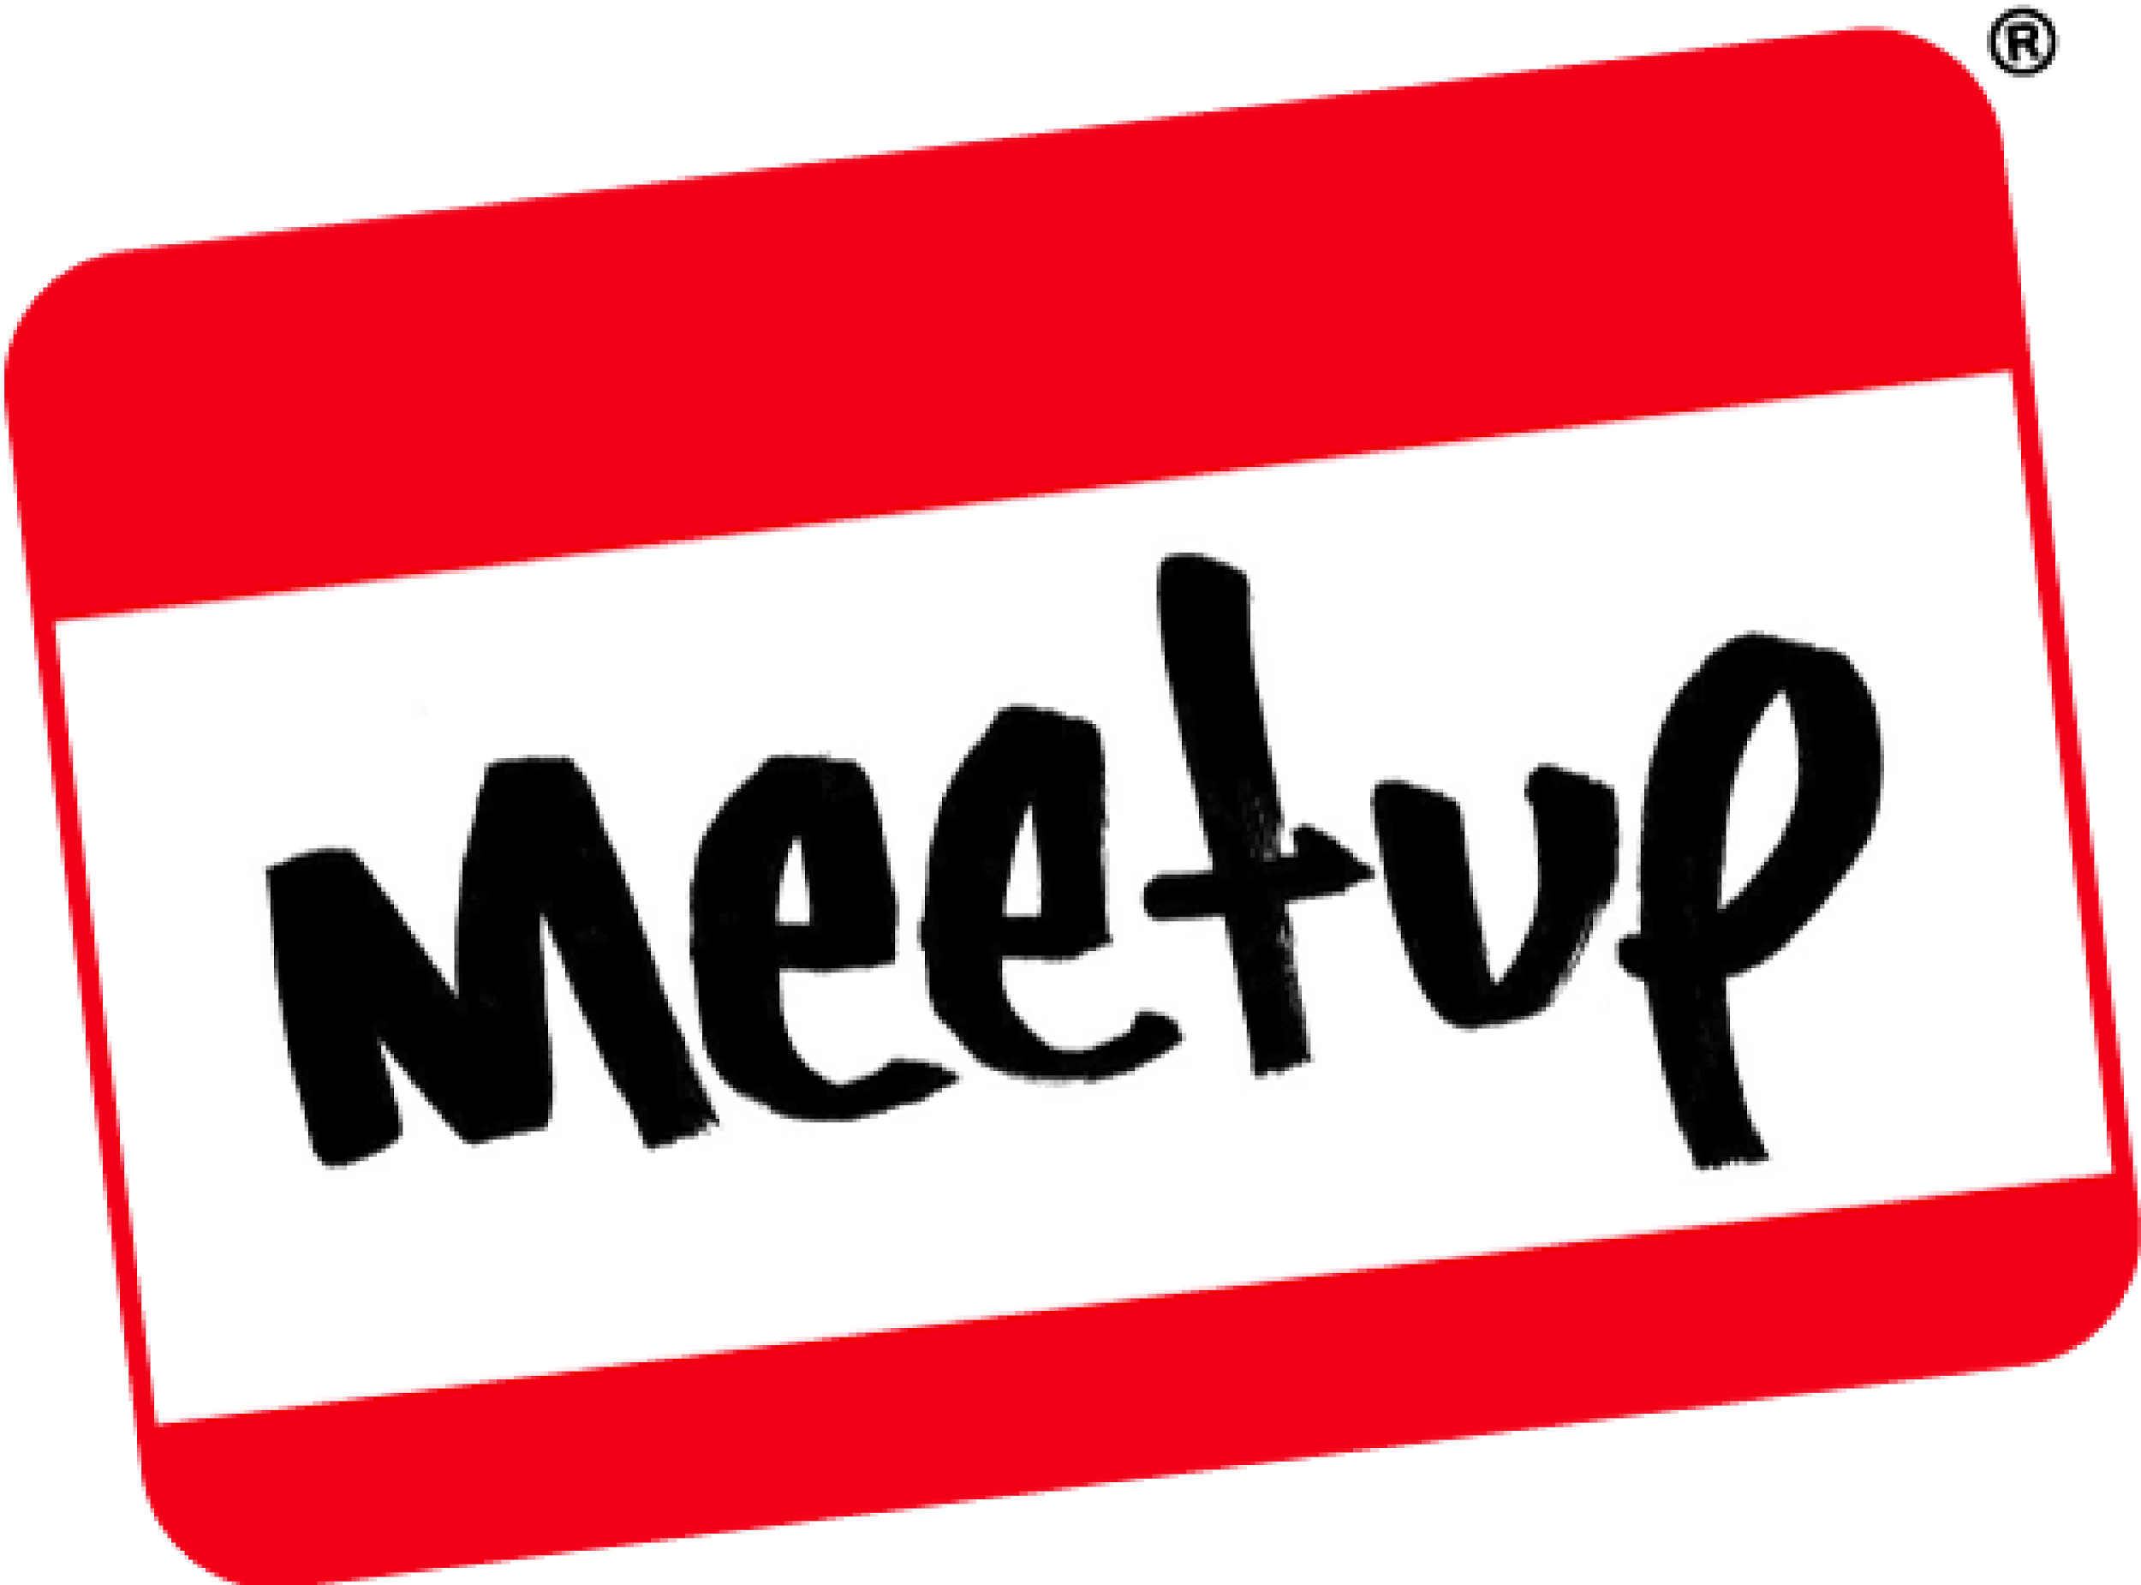
Community Engagement
Providing ample opportunity for people to get engaged, from weekly workshops, ongoing education, social media shares and email updates!

Slide 12
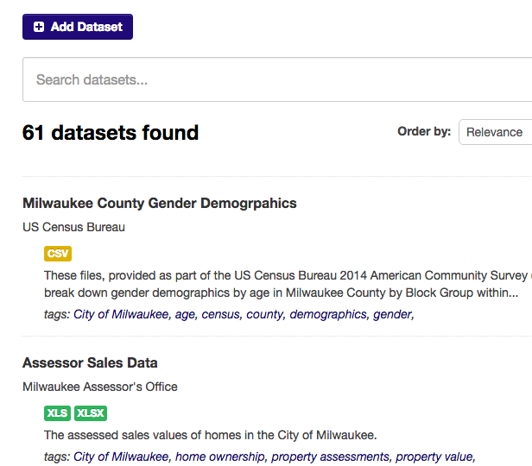
Community Data Portal
Help aggregate data and applications, improving communal data knowledge and data literacy over time.
http://mkecommunitydata.com
City of Milwaukee Open Data Policy
City of Madison Open Data Ordinance

Slide 13
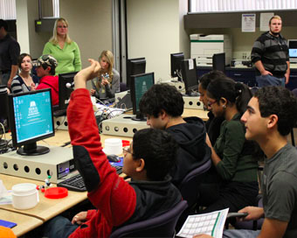
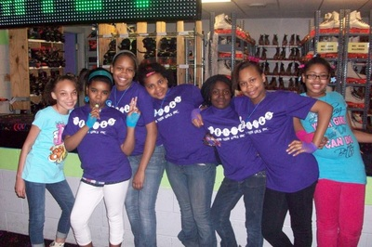
Technology Servant Leadership
Design programs that reduce the challenges for organizations, educators and students to engage with and effectively help community organizations.
+

Slide 14
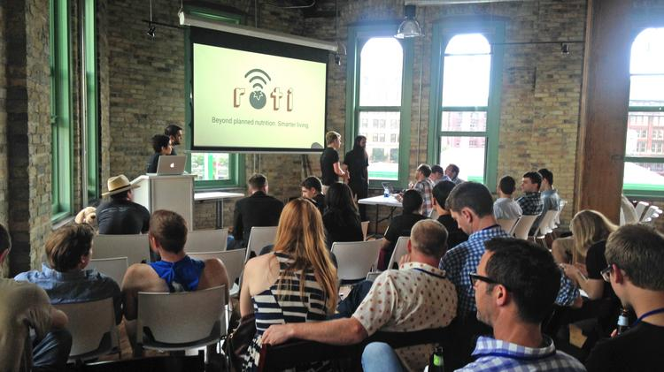
Intentional Hackathons
Organize hackathons with corporate sponsors that align with their values and marketing goals, but focus on solving “market needs”, not just building a product.

Slide 15
And, the results are…?
3 completed projects for NGOs with 2nd & 3rd year college students.
30+ ideas generated at hackathons, 5 of which are now active projects.
A community of more than 600 and growing.
Partnered w/ 2 foundations, 3 universities, 2 counties, 2 cities, NGOs & industry.
62 datasets and 36 showcase apps from more than 27 organizations, containing hundreds of individual data files (for now!)
Like what you see? Let us know, because we want to share and replicate!
http://datayoucanuse.com OR http://milwaukeedata.org

