Slide 1

NATIONAL NEIGHBORHOOD
INDICATORS PARTNERSHIP
Notes:
Pleased to be here as a member
We are always happy to preserve a blue dot on the map
We are the newest member of NNIP
Milwaukee– Swallow the l
we are on the fresh coast
Sometimes people on the other coasts confuse us with other places that start with an M- not Minneapolis, Minnesota, Michigan
GRATEFUL for the pioneering work of Todd Clausen and Michael Barndt
And the work they did as the Data Center

Slide 2
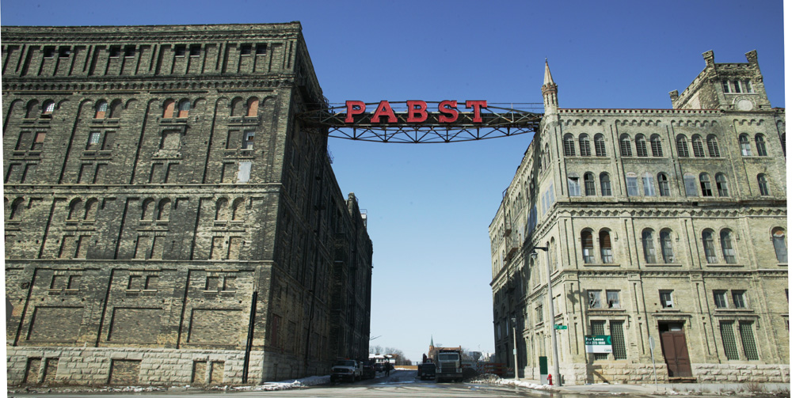
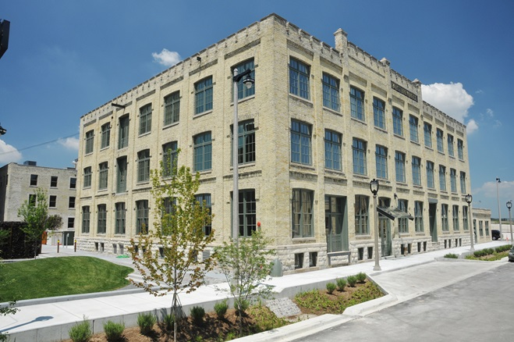
Notes:
Besides the Fons, Laverne and Shirley, the brewers and bratwurst
It was beer that made Milwaukee famous.
Our offices are in the redevelopment of the Pabst brewery– the Boilerhouse which once provided the power for what was once the largest operating brewery in the world

Slide 3

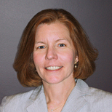

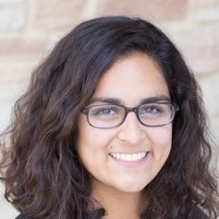

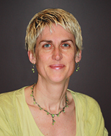
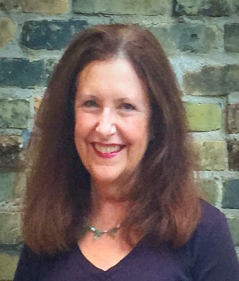



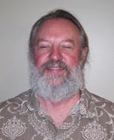
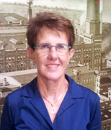

Notes:
Today we are powered by a Small 7.5 FTE but mighty staff and honored to be the home of hardworking interns, fellows, and consultants
We are anthropoligists, pyschologists, sociologists, public health, Political scientist and educators

Slide 4











JOSEPH J. ZILBER
School of Public Health
Notes:
Small but mighty staff – lifted by our affiliation with multiple partners
United Way, local foundations, school of public health, medical college of wisconsin–
Add milwaukee succeeds

Slide 5
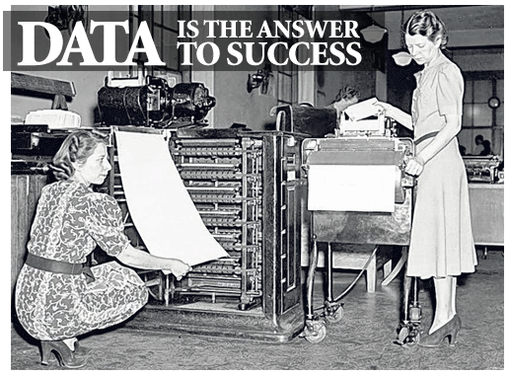
Notes:
50 year old organization with roots in the Planning Council movement. We have always believed that data is the answer to success, but we have some hard felt principles that temper that belief.

Slide 6
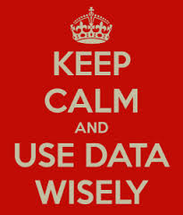
Notes:
Data has to be useful and used. We measure our success by seeing data used---
More than the data warehouse
Using data to make decisions as the highest form
Useful and understood-
Data visualization and storytelling with data

Slide 7
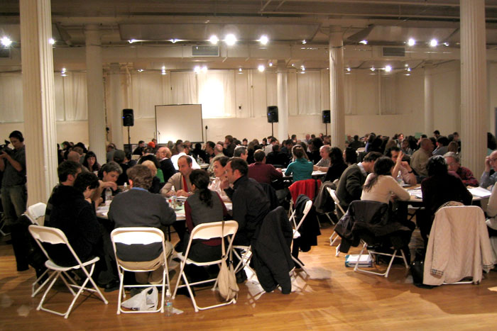
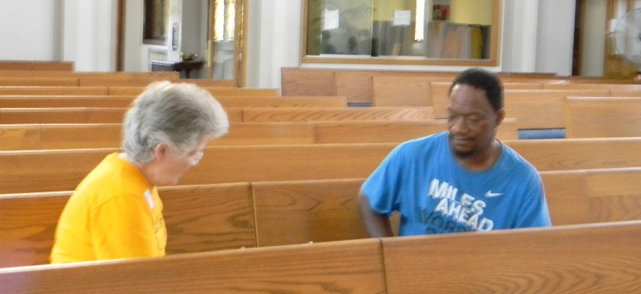
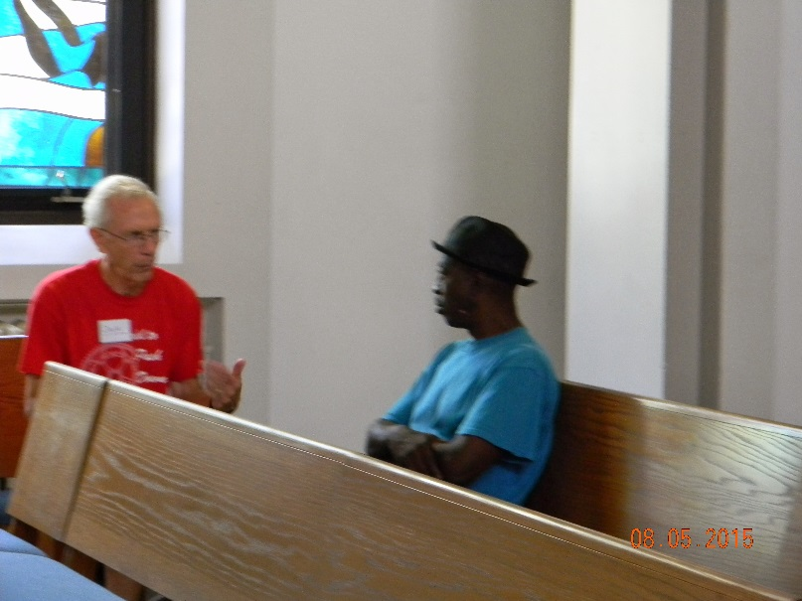
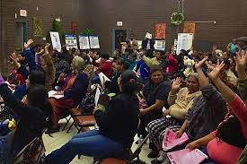
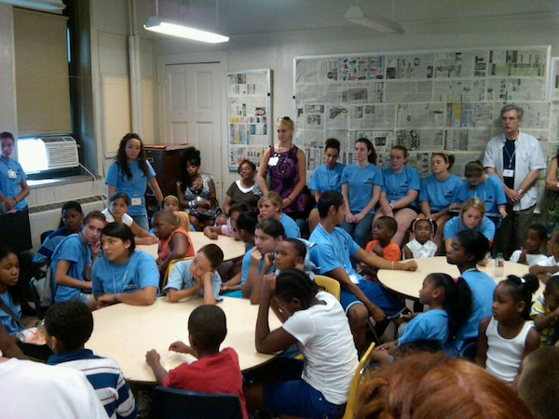
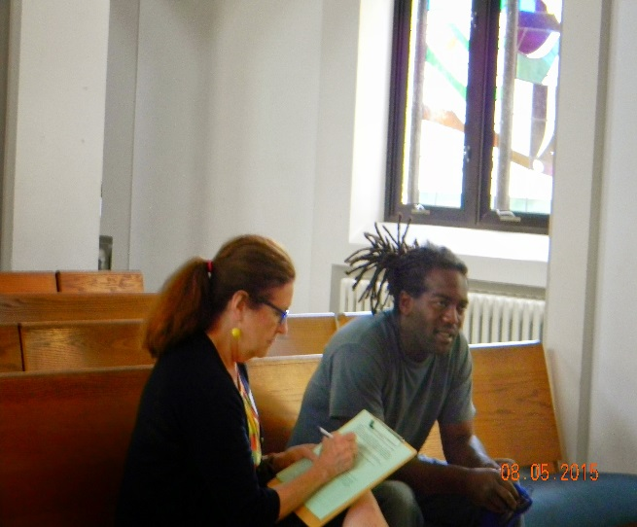
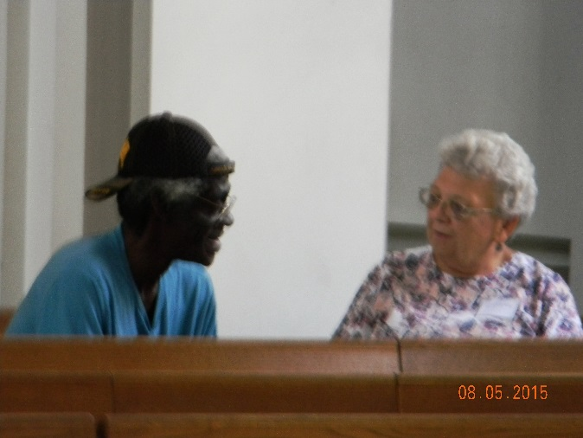
Notes:
2. We believe the highest use is to inform decisions and, with our Planning Council roots, we subscribe to the PLAN WITH AND NOT FOR belief. As a result community engagement is a part of our process and community ownership of the data is a goal
We work to assure that residents are owners and interpreters of data not just subjects.

Slide 8

Notes:
3. We have a rule– No data without stories, no stories without data
Recognizing the weight of evidence is heightened when quantitative and qualitative analysis are combined
after all, what is story but data with a soul.

Slide 9
From infant mortality to Alzheimer’s
Notes:
Traditionally our focus has been on health and human services and our project span the spectrum from Infant mortality to Alzheimer's’ disease. These are three reports that have provided data that has lead to system change and that’s our measure of success. More recently, our scope has become more broadly defined

Slide 10
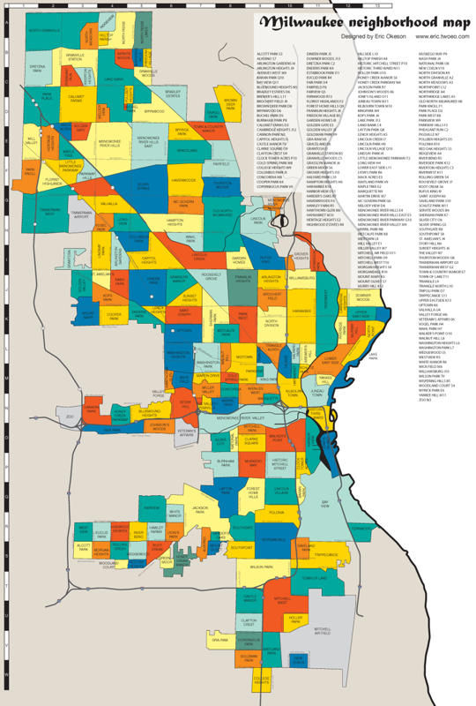
Notes:
Milwaukee has always been a city of neighborhoods
But the relatively recentl focus of the federal governemtn on Place Based Intiatives has heightened that focus. Choice, Promise and Byrne grants
The push of LISC and the Federal reserve bank to combine economic development with community development and
Local funders taking a place based approach to funding

Slide 11
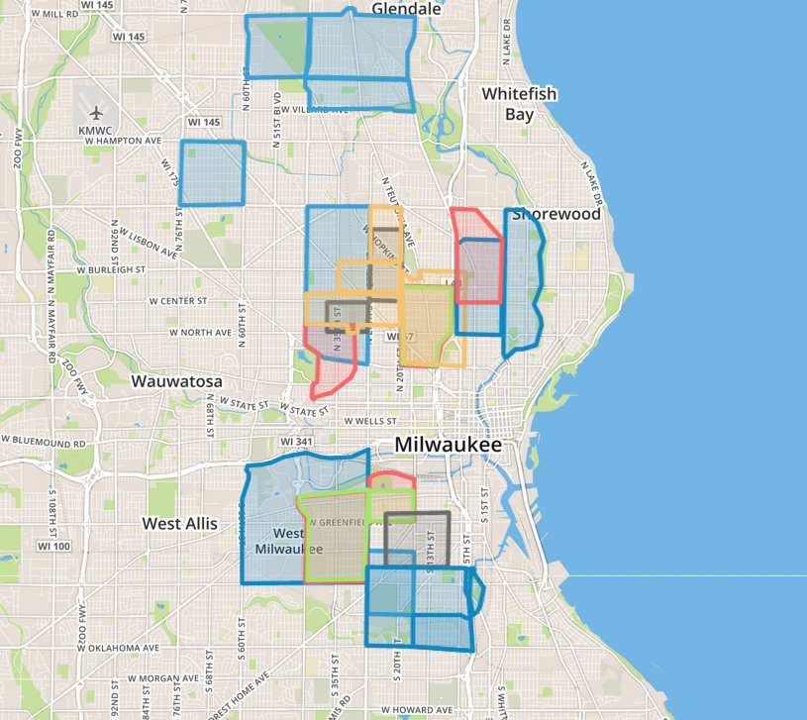
Explosion of Place-Based Funding Initiatives
Notes:
Following the federal lead, several local funders have identified and adopted neighborhoods to invest in. some based on data. Some overlapping, some based on history. This combined with the increased focus on data in applicatons has lead to a paradox where neigh borhood groups need to
have data to get resources, have to have resources to get data.
And the fear that some of the most needy neighborhoods will be left behind.

Slide 12
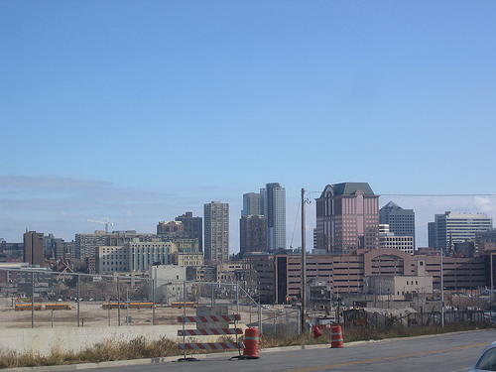
UNDER CONSTRUCTION
Notes:
So as we strive to integrate some of our traditional people data with the more usual place data, Like the city and its neighborhoods, some of our work is under construction– we are working on rebuilding and preserving the data sets from the data center
Building health data at the neighborhood level
Integrating 211 with data share
.

Slide 13
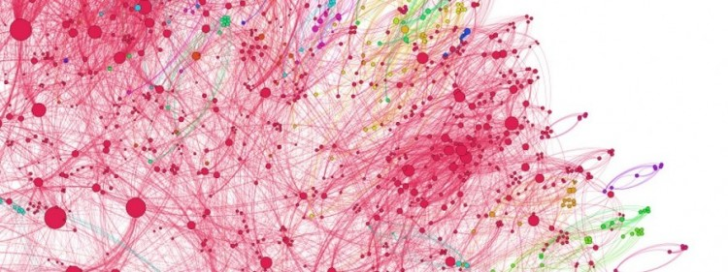
DREAM BIG!!!
Notes:
Road Ahead
Transfer of data from Nonprofit center
Health data at the neighborhood level
On our wish list would be to
make a contribution in the use of health data at the neighborhood level
Engage with NNIP members in some Cross site work with 2-1-1 data to further integrate people and place
Continue to integrate and use data from Data Share and someday
Host an NNIP meeting in Milwaukee

Slide 14
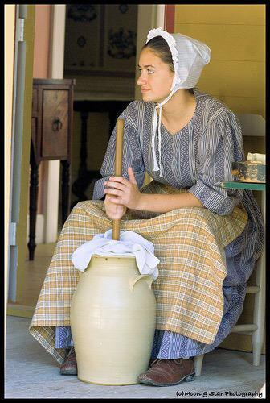
You have to start
somewhere…
Notes:
Starting next week with our first ever Data Day
Kathy Petit coming to help celebrate
Erica from Data driven Detroit will be joining us
Funders have sponsored neighborhoods to attend
Will be connecting geeks with neighborhoods and
Neighborhood residents will team with neighborhood organizations to add their story to the data

Slide 15









Notes:
And ultimately, we are hoping to contribute to and learn from NNIP

