Slide 1
Integrating Data to Advance Equity
Thank you for joining us!
We will get started shortly!
*For the best webinar experience:
Listen by dialing in via Landline Phone
Watch webinar on computer screen

Slide 2
Citi Foundation Welcome

Slide 3
Featured Panelists + Agenda
Somala Diby, Research Assistant, Urban Institute
11th Street Bridge Park
Seema D. Iyer, PhD, Associate Director, Jacob France Institute
Baltimore Neighborhood Indicators Alliance (BNIA)
Q+A

Slide 4
Integrating Data to Advance Equity in DC
April 27, 2017
11th Street Bridge Park
Community Progress Makers Data Series Webinar Somala Diby Research Assistant, Urban Institute

Slide 5
Image courtesy of OMA + OLIN

Slide 6
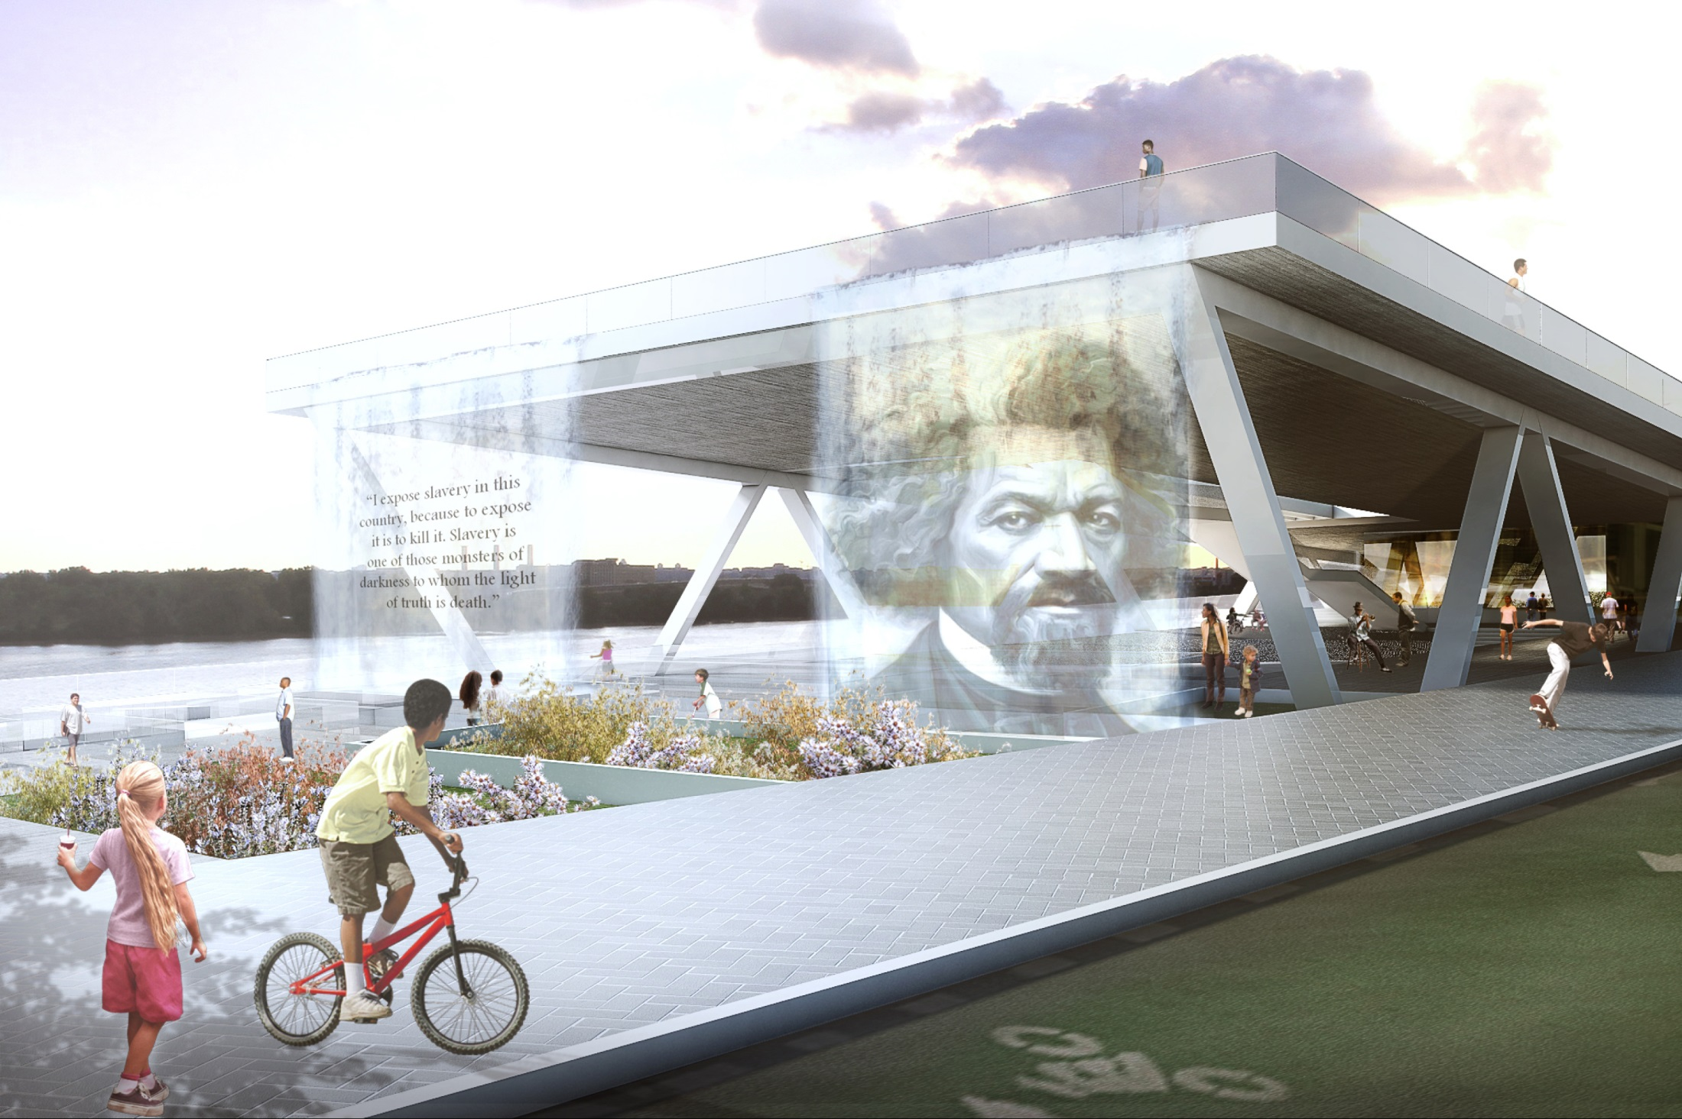
Image courtesy of OMA + OLIN

Slide 7
Bridge Park Impact Area
Image courtesy of 11th Street Bridge Park

Slide 8
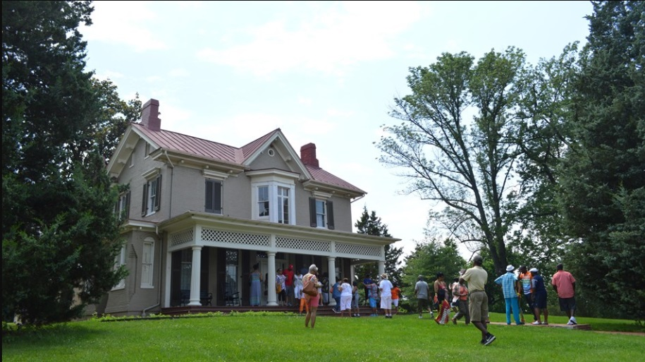
Anacostia is a symbol of black self-empowerment
Attractive destination for southern African American families
Influential black community
Descendants of pre-Civil War free blacks, including Frederick Douglass
Photos of Frederick Douglass’ Anacostia home
Sources: Top: Greater Greater Washington; Left: National Park Service

Slide 9
But is also the victim historical community disinvestment
White flight
Controversial freeway
Multiple massive public housing sites
Exclusion from prosperity on west side of the Anacostia River
Source: Washington City Paper

Slide 10
Employment and Poverty in Impact Area
SHARE OF ADULTS PARTICIPATING IN LABOR FORCE
City | West BP Impact Area | East BP Impact Area
68% | 76% | 58%
UNEMPLOYMENT RATE
City | West BP Impact Area | East BP Impact Area
10% | 5% | 16%
PEOPLE BELOW THE FEDERAL POVERTY LEVEL THRESHOLD
City | West BP Impact Area | East BP Impact Area
18% | 10% | 36%
Source: American Communities Survey, 2011-2015 5-year estimate

Slide 11
Population by Educational Attainment
Source: American Communities Survey, 2011-2015 5-year estimate

Slide 12
Median Sale Price, in 2016 dollars
Source: DC Real Property Tax Database, for all single family and condominiums sales

Slide 15
Planning for Equitable Development

Slide 17
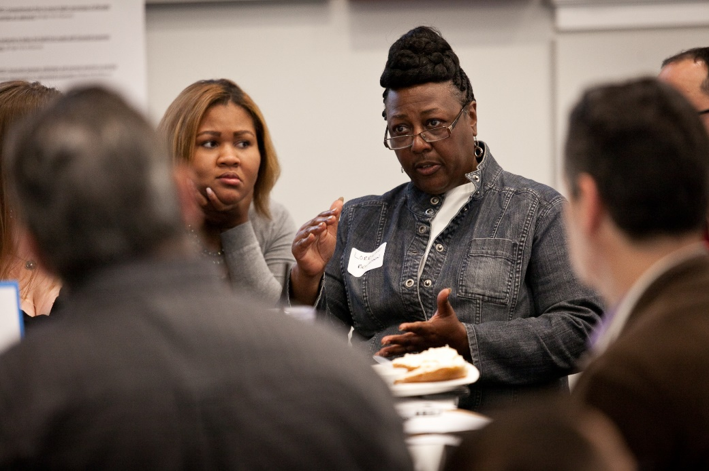
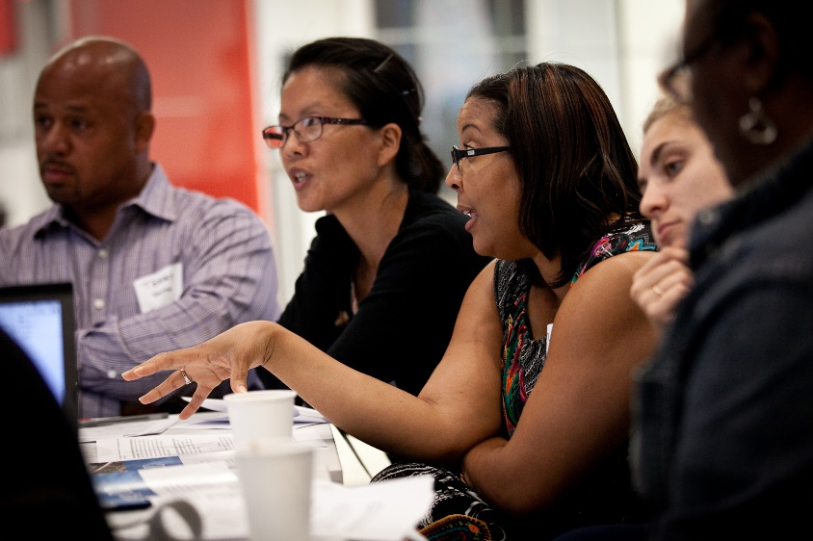
Equitable development stakeholder meetings
Images courtesy of 11th Street Bridge Park

Slide 18
Equitable Development Plan Timeline
February 2015
First stakeholder meeting
June – November 2015
Finalizing recommendations
April 2015
Second stakeholder meeting
November 2015
Begin plan implementation
Fall 2013
First EDTF Meeting
2014
2015
2016
Sep
Oct
Nov
Dec
Jan
Feb
Mar
Apr
May
Jun
Jul
Aug
Sep
Oct
Nov
Dec
Jan
June 2015
Public feedback meetings
November 5, 2015
Plan presentation at Community Development Finance Summit

Slide 20
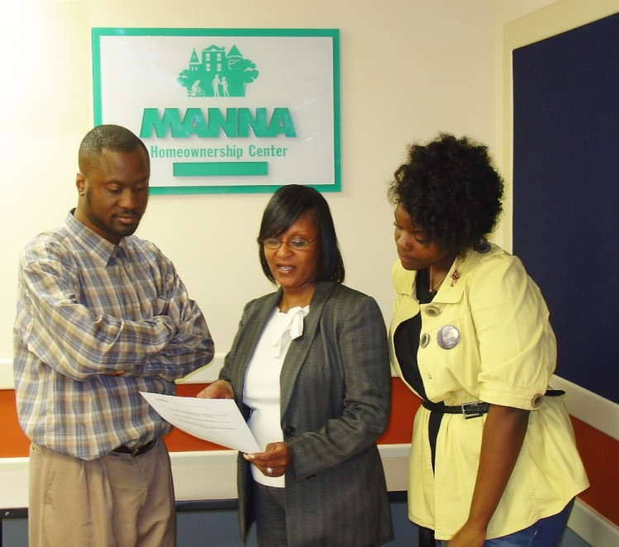
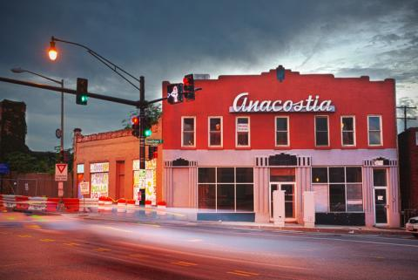
Early progress
Elevating Equity initiative: $50 million commitment by LISC DC to invest in Bridge Park Impact Area
JPMorgan Chase contributed $250,000 to Bridge Park CLT in March.
82 Anacostia residents to attended informative workshops on tenants’ rights and homeownership opportunities.
The Bridge Park has contributed $30,000 in downpayment assistance for affordable housing.
Five Home Buyers Club members have purchased homes.
38 households are either in pending negotiations or at a minimum mortgage ready.

Slide 21
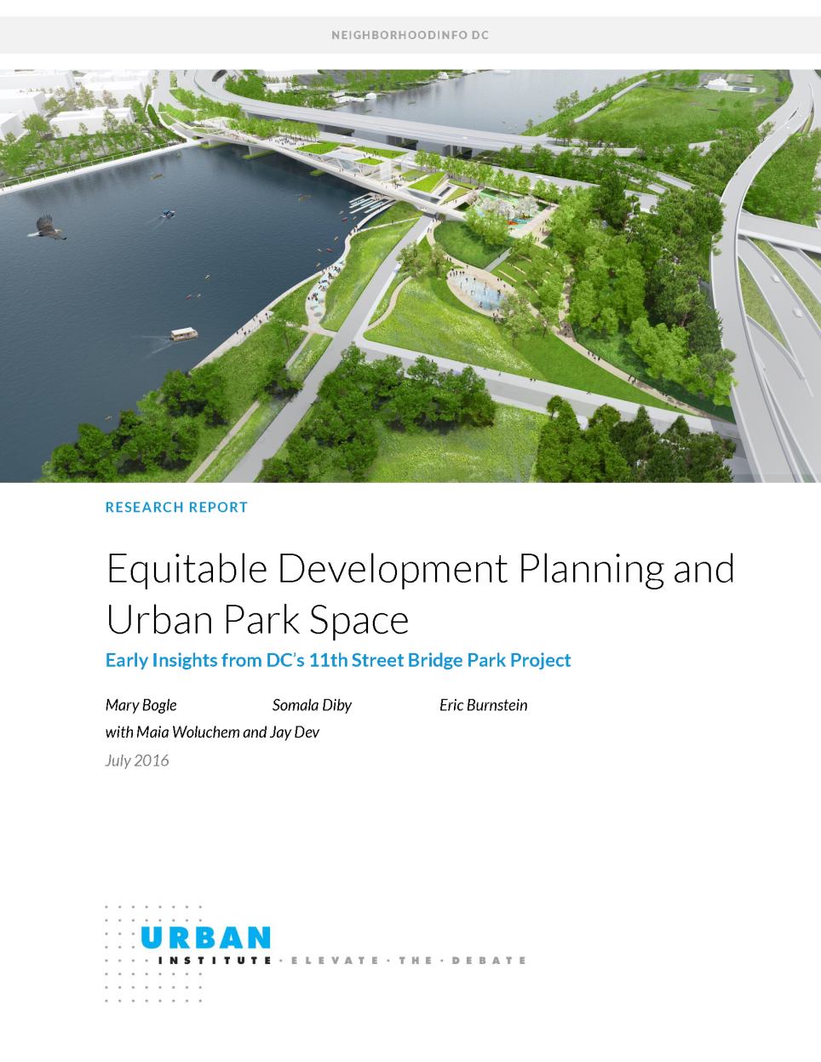
Lessons learned
Start early
Learn from the field
Data informed decisions
Be intentional
Engage the community
Build early wins
What gets measured gets done
Take a multi-sector approach
Add cultural equity platform

Slide 22
Monitoring Implementation

Slide 23
Equitable Development Plan Advisory Committee
Monitor implementation of the Equitable Development Plan
Identify potential programming partners
Meet regularly to evaluate implementation of recommendations
Drive opportunities for regular stakeholder feedback
Shape additional action items as needed

Slide 24
Urban Institute
Bridge Park
LISC DC
Data
Monitoring
Continuous Improvement
Institutional Support
Equitable Development Plan Advisory Committee
(EDPAC)

Slide 25
Storing Bridge Park Data
NeighborhoodInfo DC cleans and stores data from various sources, including national data sources as well as administrative data from city agencies
NeighborhoodInfo DC is currently supporting the Bridge Park Equitable Development Task Force by creating a specialized ‘data room’ within its data warehouse
Currently, the data room holds summarized results from numerous existing data sets for the 11th Street Bridge Park target areas
We plan on expanding the inventory of the Bridge Park ‘data room’ as primary data from the Bridge Park’s programs are collected and data from secondary and administrative sources are updated

Slide 26
 | Goals | Inputs | Outputs | Intermediate outcomes | Long-term outcomes
Workforce development | Ensure neighboring residents in Wards 6, 7, and 8, and harder-to-employ District residents are prioritized in the application process and hired for construction jobs on the Bridge Park | Create a community workforce agreement Establish hiring plan | Local hiring goals Living wages for all jobs on the Bridge Park Labor monitoring and reporting systems hold employers accountable for community workforce agreement Nearby residents are recruited and skills training is employed | Neighborhood residents are hired for jobs on the Bridge Park, construction or otherwise Incomes for families in the Bridge Park area increase Employers on the Bridge Park will comply with Ban the Box and other local regulations | Unemployment for surrounding residents of the Bridge Park decreases Families in the Bridge Park area have greater access to economic mobility Employees are better trained to obtain jobs outside the Bridge Park
Small business development | Support and nurture a thriving network of small businesses that operate on the Bridge Park Leverage the Bridge Park to build and sustain small businesses in the surrounding community Connect the Bridge Park to business corridors on both sides of the Anacostia River | Establish kiosk-based food service Identify businesses for contracting opportunities Connect businesses to community nonprofits and financial institutions Advocate for small businesses in vacant properties Connect business incubators Streetscape improvements on both sides of the park | Additional food vendors and retail spaces in Bridge Park impact area Mentorships form between businesses in the Bridge Park impact area Self-sustaining community of small businesses forms Walkability improves on both sides of the park and to nearby neighborhoods | Residents have more food choices within the Bridge Park impact area Businesses have increased access to workforce training strategies City-owned property is redeveloped for local businesses Capital Bikeshare stations are added, and public transportation becomes more easily accessible | Businesses access a wider customer base Minority and women-owned businesses get more activity Business partnerships can advocate together for future neighborhood change More small businesses attain property east of the Bridge Park Vacant property is filled by businesses
Affordable housing | Collect, organize, and disseminate resources regarding housing opportunities Work with city agencies and nonprofits to preserve existing affordable housing, and leverage additional resources to build new affordable housing Engage and participate in partnerships with housing community to advocate for preservation of existing affordable housing | Educate residents about DC legislation and tenant rights Promote participation in a five-year consolidated plan update Partner with homeownership initiatives within the Bridge Park impact area Secure funding for down payment assistance program and Manna’s Home Buyers Club Community Land Trust Partner with DC Housing Authority to bring Build First to nearby properties Door-to-door canvassing | Partnerships with local agencies involved in tenant rights Language in a five-year consolidated plan update includes vacant and blighted properties in Bridge Park impact area Vacant and blighted properties will be converted to additional affordable units Down payment assistance will be made available in Bridge Park impact area | Tenants can access financing to purchase property Residents can access financial and homeownership services Homeownership campaign is active within Bridge Park impact area More nonprofits and philanthropic funders are involved in securing affordable housing in the Bridge Park impact area | Homeownership in the Bridge Park impact area increases Residents in the Bridge Park impact area have more access to wealth Residents are empowered to advocate for affordable housing in the neighborhood More affordable housing options are available near the Bridge Park Establishment of a sustainable Community Land Trust

Slide 27
Category | Baseline Data (population level for Bridge Park area) | Source
Workforce | % persons 16-64 years in labor force % persons in labor force who are employed (employment rate) % persons below federal poverty level % persons by race/ethnicity % persons 25+ years with a HS diploma or equivalent % persons 25+ years with some postsecondary education # persons receiving TANF benefits # persons receiving SNAP benefits | American Community Survey; DC Department of Human Services
Small Business | # of businesses in main business corridor # of unused spaces in business corridor # of small businesses owned by residents of Bridge Park area # of violent crimes reported # of property crimes reported | Dunn and Bradstreet; MPD
Notes:
Baseline indicators that can be used for starting measurement

Slide 28
Category | Baseline Data (population level for Bridge Park area) | Source
Affordable Housing | # of building permits issued for residential construction/rehab # of affordable units from Preservation Catalog # of renter households # of homeowner households % homeowner households (homeownership rate) % renters with severe housing cost burden % homeowners with severe housing cost burden # of home sales median sales price of SF homes/condominiums % of residential property owned by area residents # of mortgage-financed home purchases by race/ethnicity of buyer # of mortgage-financed home purchases by income of buyer | DCRA; DC Preservation Catalog; Real property data; HMDA

Slide 29
Progress as of March 2017
Socioeconomic demographics and employment trends are available from the Decennial Census and American Communities Survey
Information on housing subsidies and affordable units from the DC Preservation Catalog
Historic inventory of residential units, property sales, and ownership from the DC Real Property Tax Database

Slide 30
Sources we still need
Upcoming
Statistics on crime from the Metropolitan Police Department
Program data on SNAP and TANF participation
Prevalence of mortgage-financed home purchases from the Home Mortgage Disclosure Act
Summary of building permits issued for residential construction and rehabilitation from DCRA
To be collected/ purchased
Small business data from vendor Dunn and Bradstreet
Updated vital statistics from the DC Department of Health
Primary data from the Bridge Park and its affiliates

Slide 31
Considerations for EDPAC
Analyze and set baselines for additional housing, small business, and employment variables
Identify potential government agencies to establish data sharing agreements
Public-facing data products

Slide 32
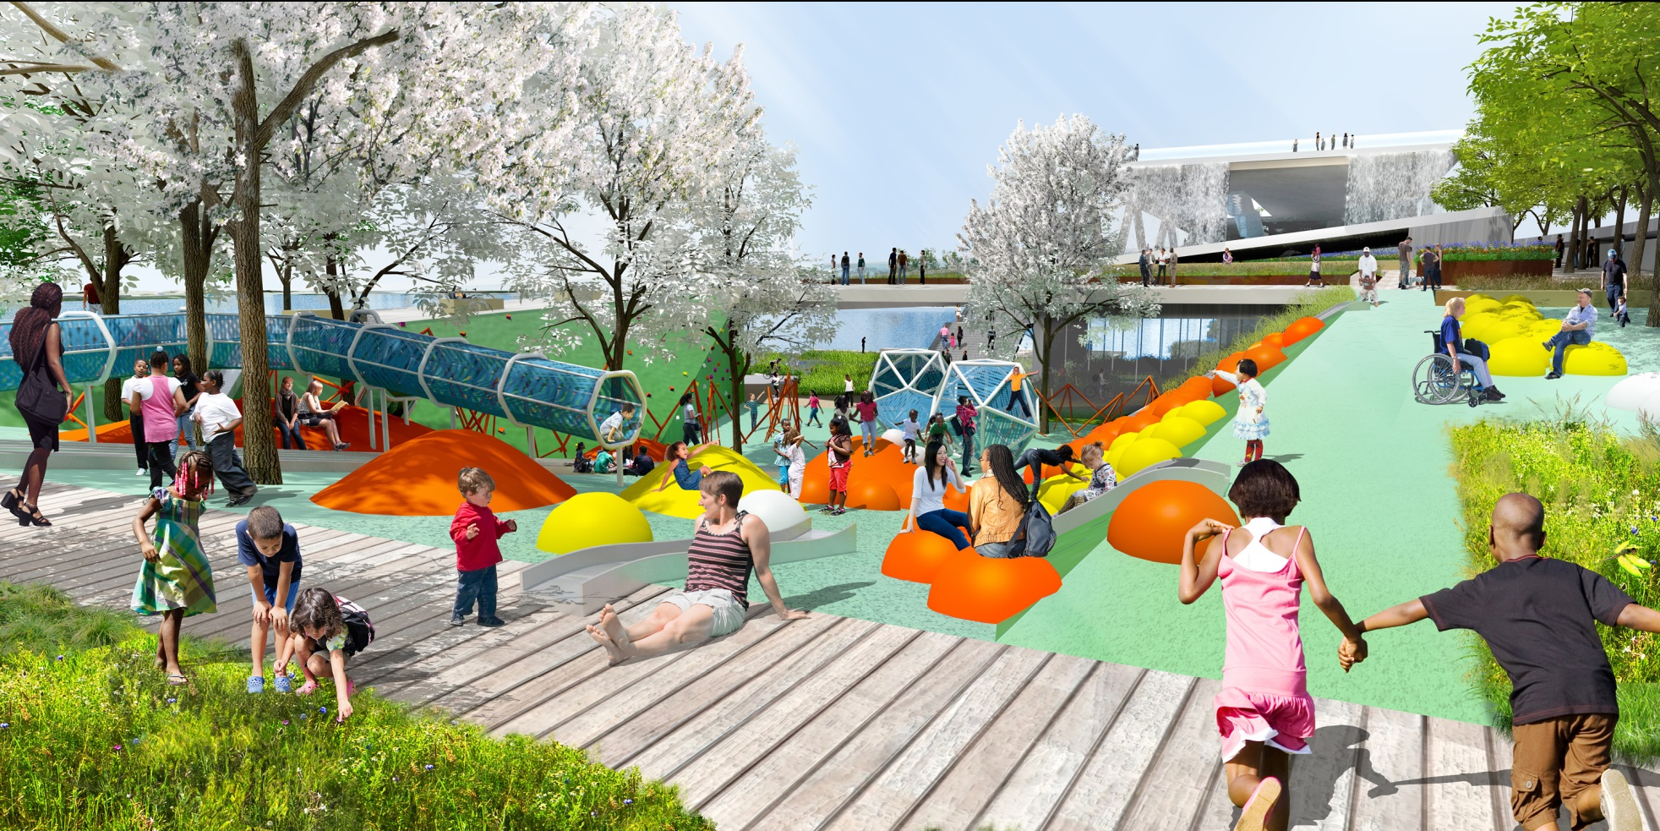
Contact + Information
Somala Diby
Research Assistant, Urban Institute
sdiby@urban.org
202-261-5341
@NborhoodInfoDC
neighborhoodinfodc.org
bridgepark.org

Slide 33
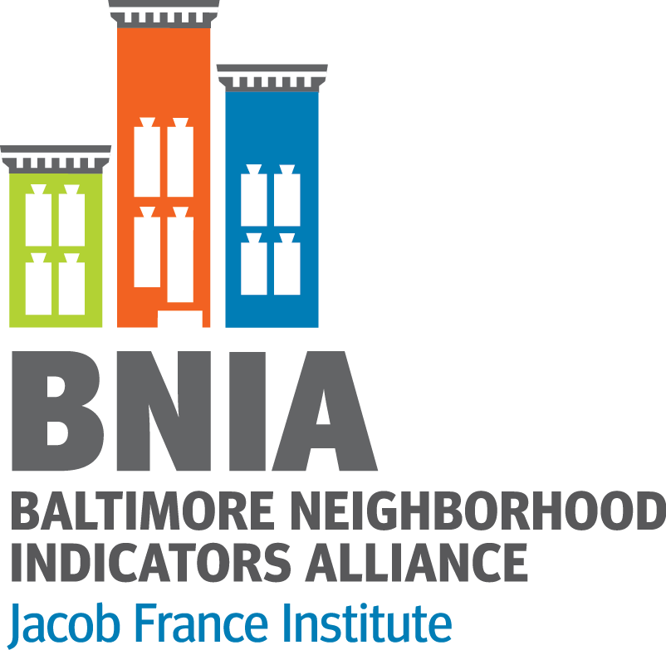
Integrating Data to Advance Equity in Baltimore
Community Progress Makers Data Series Webinar
Seema D. Iyer, PhD
Associate Director, Jacob France Institute
#VitalSigns15
@bniajfi
www.bniajfi.org

Slide 34
What is Neighborhood?
Baltimore is a City of Neighborhoods
Durable properties of places based on people, history, geography
Robert Sampson, Great American City 2012
Home
Neighbors
Community
Services
Schools
Political Representation
Well Being
Health
Identity
Markets
Housing
Retail

Slide 35
Community Based Indicators
Neighborhood context influences how activities and policies take hold
Bits of information that, when combined, generate a picture of what is happening in a local system
They provide insight into and ongoing monitoring of the overall direction of a community
Rhonda Phillips, Community Indicators 2003
Economic
Social
Environmental
Cultural

Slide 36
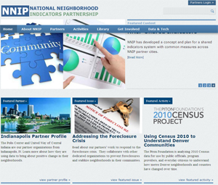
History of BNIA-JFI
Advanced information systems with integrated and recurrently updated information on neighborhood conditions in their cities
“Democratization of Data” Overcome the resistance of local public agencies to sharing data
Baltimore one of the first cities
Now 36 partners
Moved to the Jacob France Institute
in 2007

Slide 37
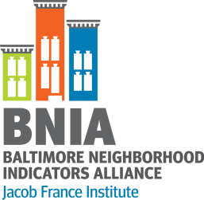
postgreSQL
postGIS Geodatabase
CitiStat
Library
Schools
Vital Statistics
Police
Arts
37

Slide 38
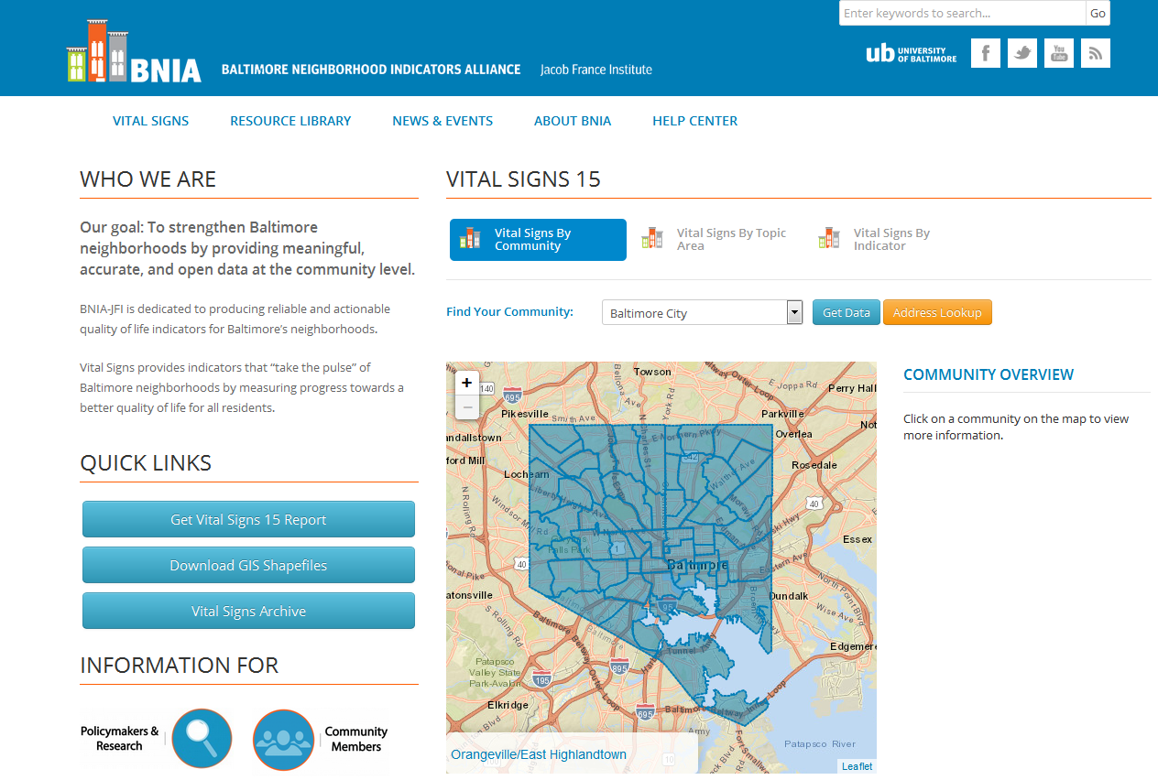
Project funded by the Annie E. Casey Foundation
Available at the CSA data FREE on BNIA-JFI website

Slide 39
After Freddie Gray (April 2015)

Slide 40
Impact of Population Decline on Neighborhoods
Notes:
Vacant housing—ownership, speculation, demolition, liens (not yet)
Transit—45 minute commute time
Scatterplots of both (vacant housing and growth, 45 minute and growth)

Slide 41
Population Decline
Baltimore City lost 330,000 between 1950 and 2010.
Most people/media attribute the loss to crime and poor education
Community Statistical Area (CSA) | Pop 2000 | Pop 2010 | Pop Change | % Pop Change
Baltimore City | 651,154 | 620,961 | -30,193 | -4.6
Greenmount East | 11,561 | 8,184 | -3,377 | -29.2
Allendale/Irvington/S. Hilton | 19,129 | 16,217 | -2,912 | -15.2
Clifton-Berea | 12,496 | 9,874 | -2,622 | -21.0
Greater Rosemont | 21,877 | 19,259 | -2,618 | -12.0
Sandtown-Winchester/Harlem Park | 17,495 | 14,896 | -2,599 | -14.9
Canton | 7,010 | 8,100 | 1,090 | 15.5
Cross-Country/Cheswolde | 11,796 | 13,034 | 1,238 | 10.5
Downtown/Seton Hill | 4,767 | 6,446 | 1,679 | 35.2
Harbor East/Little Italy | 3,523 | 5,407 | 1,884 | 53.5

Slide 42
Vacant Housing

Slide 43
Population Change & Vacant Housing
Sandtown-Winchester/ Harlem Park

Slide 44
What’s New in

Slide 45
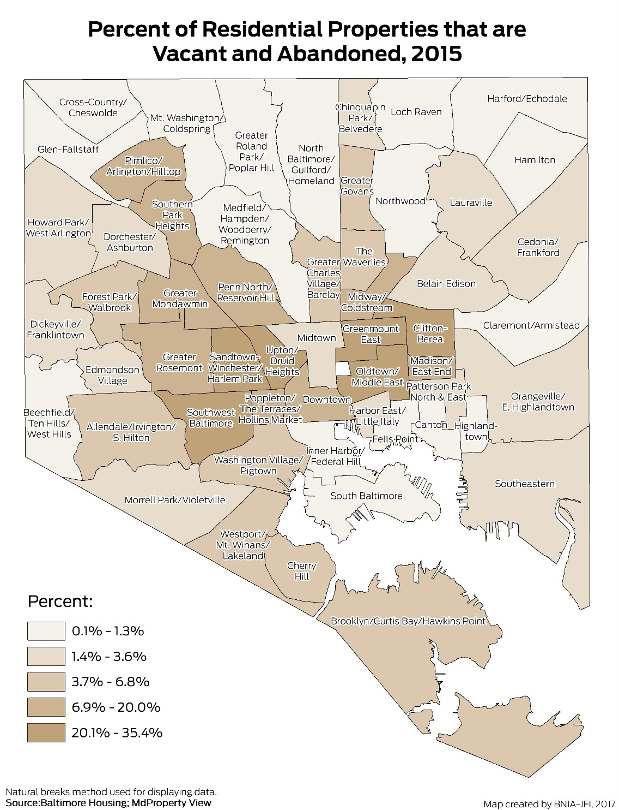
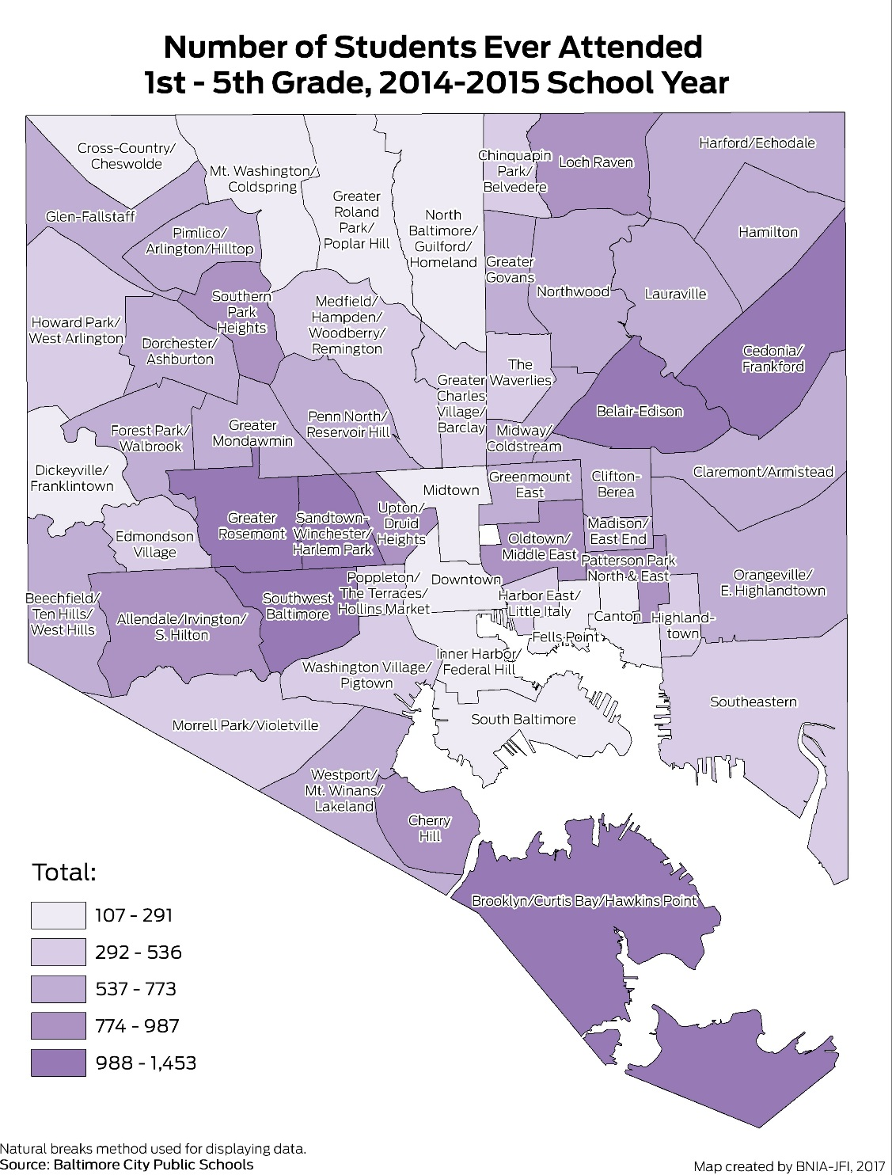

Slide 46
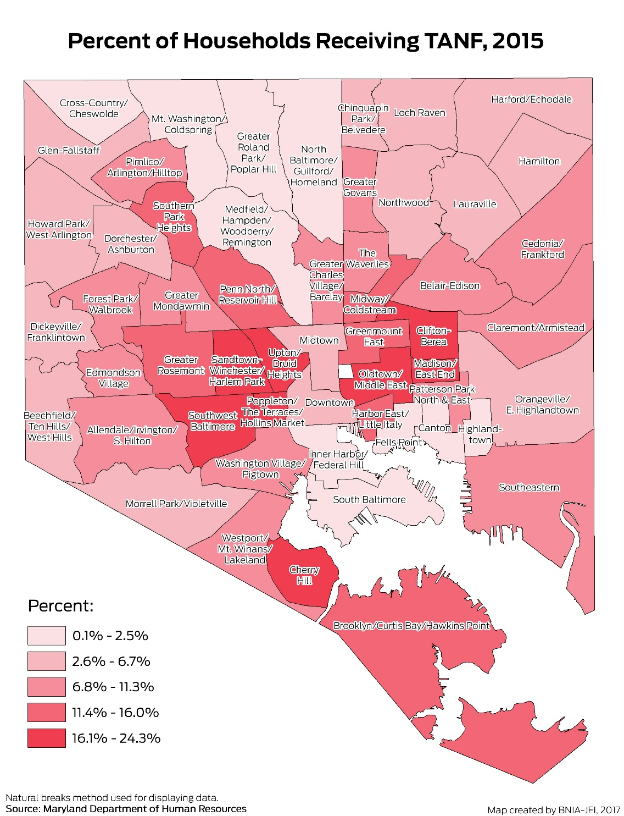

Slide 47
Key Recommendations
Need a plan for high vacancy neighborhoods
Ensure middle vacancy neighborhoods do not cross over to high vacancy neighborhoods

Slide 48
Transportation

Slide 49
Percent Commuting 45+ Minutes, 2011-2015
What’s New in
Community | 2006-2010 | 2011-2015 | Change
Downtown/Seton Hill | 11.4 | 10.7 | -0.7
Sandtown-Winchester/Harlem Park | 30.1 | 34.4 | 4.3
Baltimore City | 19.0 | 20.4 | 1.4

Slide 50
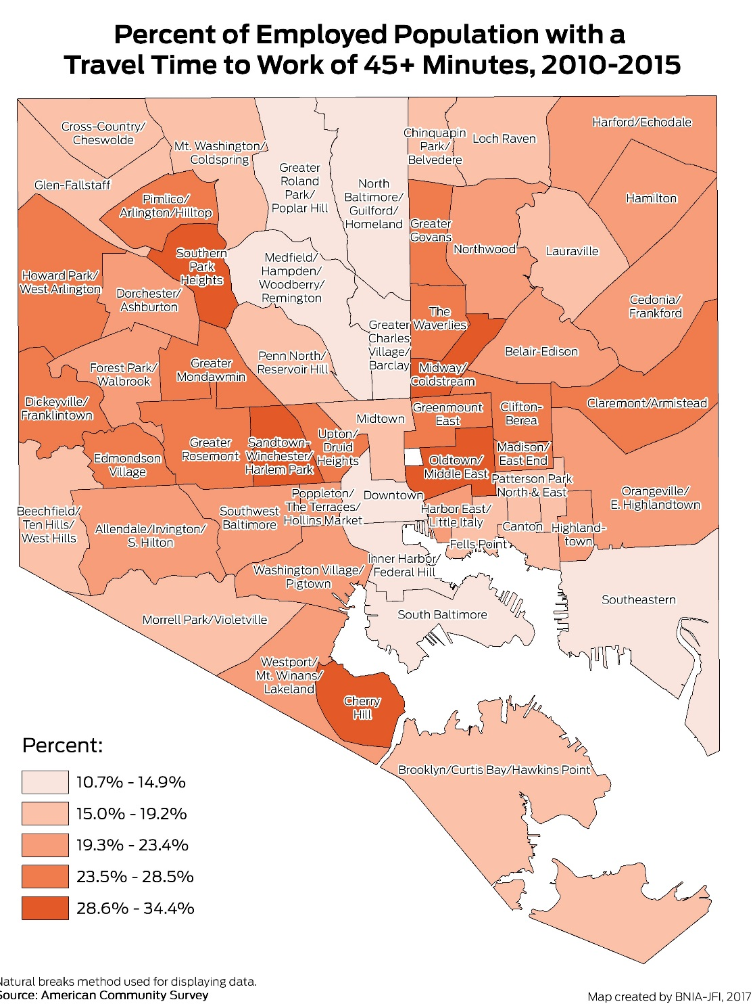
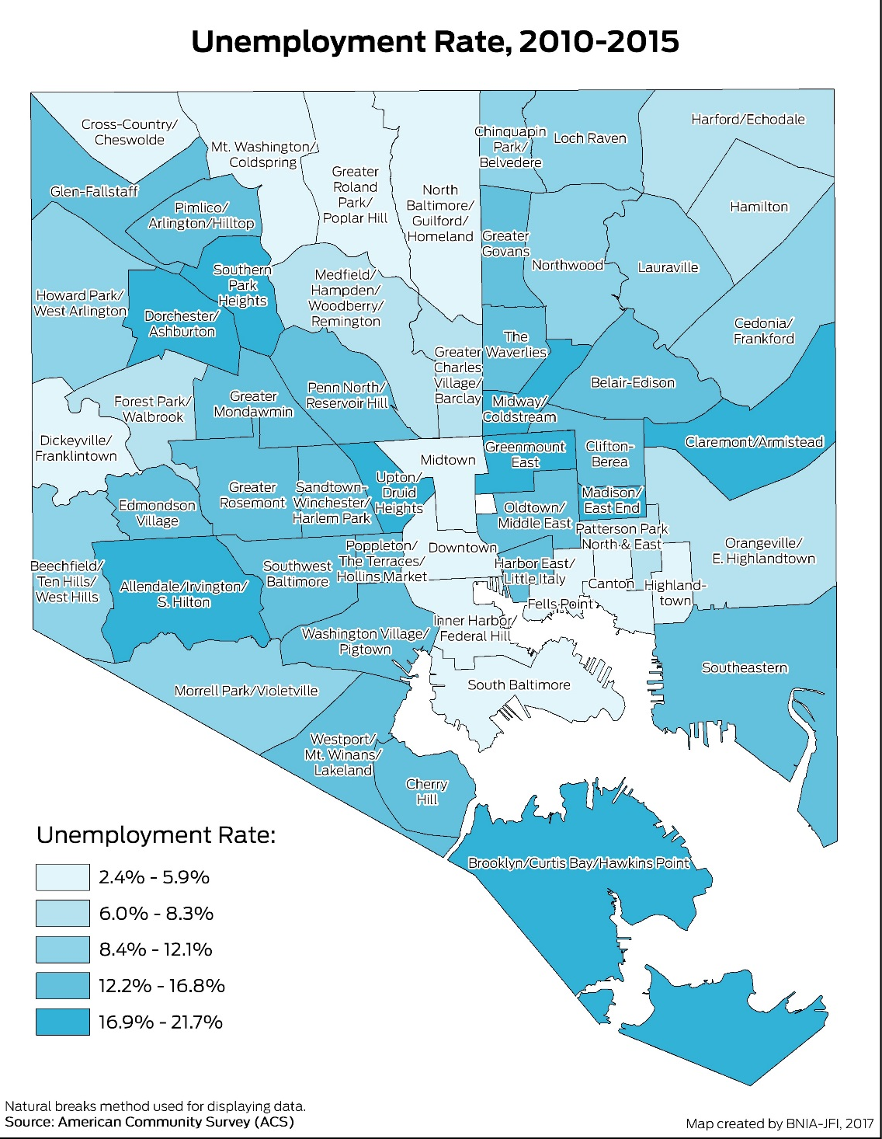

Slide 51
Key Recommendations
Workforce training programs should focus on connecting people to proximate jobs
More jobs in the neighborhood/closer to the high commute neighborhoods
Better transit

Slide 52
Neighborhood Context
Vacant and abandoned housing is an Environmental Justice issue that disproportionately impacts vulnerable populations
Long commute times are a major barrier to truly achieve Regional Equity for everyone in every neighborhood
Data becomes more valuable over time
Need data to truly strengthen civil society and improve democracy
Access to information by itself doesn’t change people’s minds; need to present the data in a compelling way

Slide 53
Questions?
#VitalSigns15
@bniajfi
www.bniajfi.org

Slide 54
Q & A

Slide 55
Thank you!

