Slide 1
Diane Gavarkavich
UNC Charlotte Urban Institute
11/17/16

Slide 2
Knight Cities Challenge
What’s your best idea to make cities more successful?
Notes:
Introduction – similar info as given in the Evaluation Report
a. Knight Cities Challenge
b. Take10CLT’s proposal and purpose
c. Brief timeline of project
i. Team recruitment and formation
ii. Kickoff Training
iii. Data Collection
iv. Evaluation

Slide 3
Take10CLT Project: Increase engagement
9 Months
156 City “Ambassadors”
110-minute Conversation Per Week

Slide 4
Take10CLT Project: PaRtnership
Submitted by City of Charlotte Employee
Urban Institute supported data collection, analysis, and evaluation

Slide 5
Timeline
Recruitment
Aug.-Sept. 2015
Team Leaders
Kick-off Training
Sept. 2015
Logistics
Data Collection
Oct. 2015 – June 2016
Conversations
Evaluation
Ongoing
Team Formation
Interview Best Practices
Monthly Reports
Pre-Post Surveys
Citizen Survey
Focus Groups
Entries

Slide 6
Stats
Almost 2,500 conversations
Over 400 hours spent with community members
42 Ambassadors met or exceeded goal

Slide 7
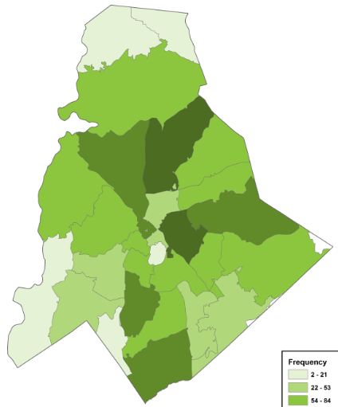
Citizen Participation
N= 2318

Slide 8
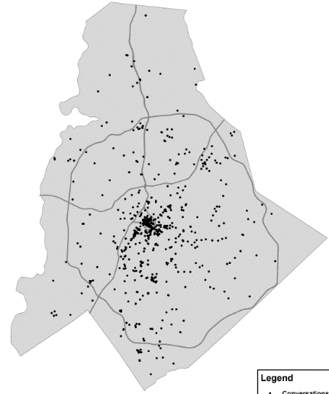
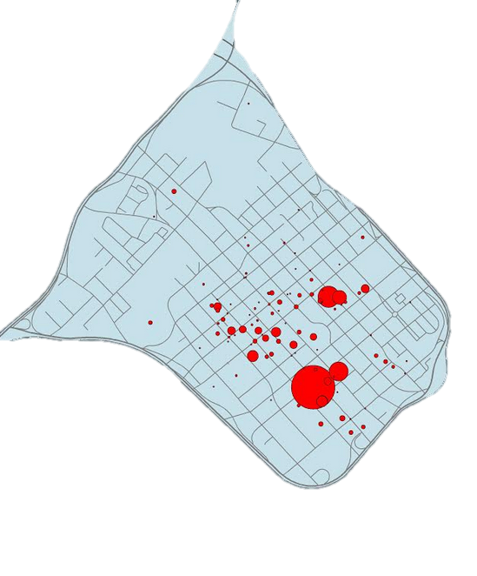
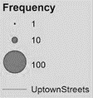
Location of Conversations
Uptown Zoom In
N= 1,991

Slide 9
Length of Citizenship in Charlotte

Slide 10
Take10CLT Project: Increase engagement
What do you like about living here?
Can you tell me about your ideas to improve Charlotte today?
Thinking ahead, tell me what do you want Charlotte to be like in five years?

Slide 11
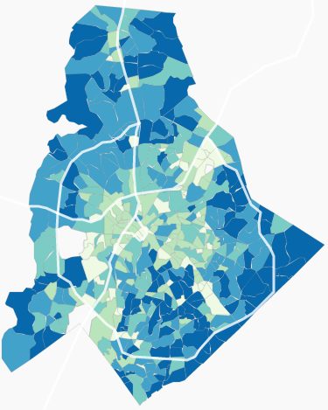
Framework: Quality of Life
Neighborhood Data to Explore and Inspire
Partners: City of Charlotte, Mecklenburg County, and UNC Charlotte Urban Institute with the towns of Cornelius, Davidson, Huntersville, Matthews, Mint Hill, and Pineville

Slide 12
Quality of Life dimensions
Transportation
Economy
Engagement
Housing
Education
Character
Environment
Safety
Health
9 dimensions, 80+ indicators

Slide 13
summary
Notes:
Figure 1. Number of Citizens who "Liked" Aspects of Each Quality of Life Dimension

Slide 14
summary
Notes:
Figure 2. Number of Ideas for Improvement Related to Each Quality of Life dimension

Slide 15
Example: Transportation

Slide 16
Example: Transportation
Theme (Frequency) | Examples
Public transit (631) | “Make it easier to get Uptown, such as an express light rail line.” “Build a 5-spoke train system. Get trains to airport, UNC Charlotte, Davidson/Cornelius.” “Need light rail to the airport. We are the only major international airport that doesn’t have rail linkage.”
Traffic (419) | “Find ways to improve traffic. Maybe encourage more non-traditional working hours to help with commuting time.” “Construction on major arteries into and out of the city should only be allowed at night or during non-rush hour times.”
Roads (380) | “The traffic and planning needs improvement. A good example of planning gone bad was East Blvd…There should have been bus pull-out areas like Raleigh has. Traffic in the one and only lane should not be impeded by a bus.” “We need a law that every new road will have bike lanes and signage, like Portland.”

Slide 17
Lessons Learned
Overall Project
Questions 2 and 3 were very similar in conversation
Opportunities needed to go out in groups or at events
Length of project
Flexibility – timing, materials, and participants
Need motivated ambassadors

Slide 18
Lessons Learned
Leadership Team
More work than anticipated
Need more help with communication/motivation
Need champion higher up and managerial support

Slide 19
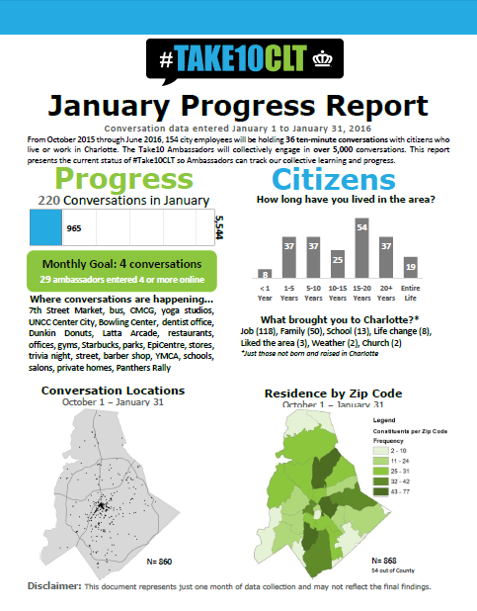
Finalization
Deliverables
9 Monthly Reports
Summary Data Findings Report
Evaluation Report
How-to Guide/Lessons Learned
Summary Presentation

Slide 20
Finalization
Next Steps
Findings to Knight Foundation
Presentation to City Council and Employees
Celebration with Ambassadors

