Slide 1
Designing a Sustainability Planning Process
A story from Pittsburgh’s NNIP partner
February 21, 2018
Presented by Bob Gradeck
Unless otherwise listed, content in this presentation is licensed under a Creative Commons Attribution 4.0 International license.

Slide 2
About the Regional Data Center
Image source: University of Pittsburgh UCSUR Licensed as CC-BY 4.0

Slide 3
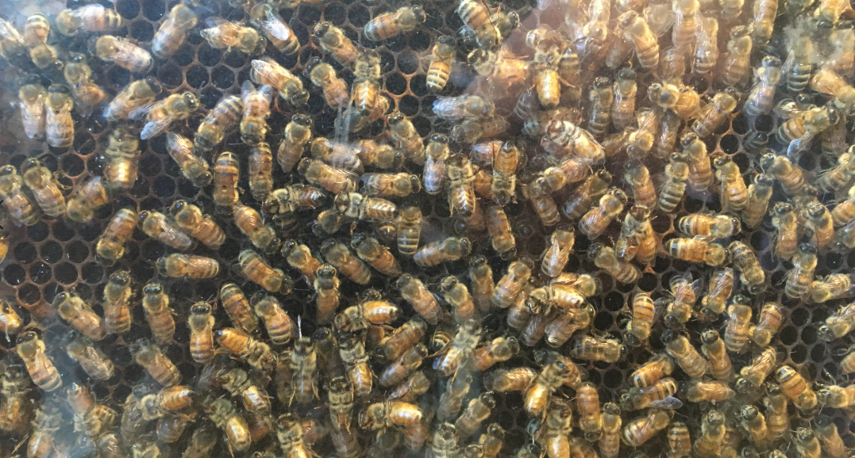
Context
Driven by the questions -
What do we do when the startup foundation $ runs out?
How do we get people to pay for infrastructure?
It took us two years to figure out what we were supposed to do, and how to do it, or we would have gotten started sooner.
I have little experience fundraising beyond our startup grant and small projects.
Image source: Bob Gradeck Licensed as CC-BY 4.0

Slide 4
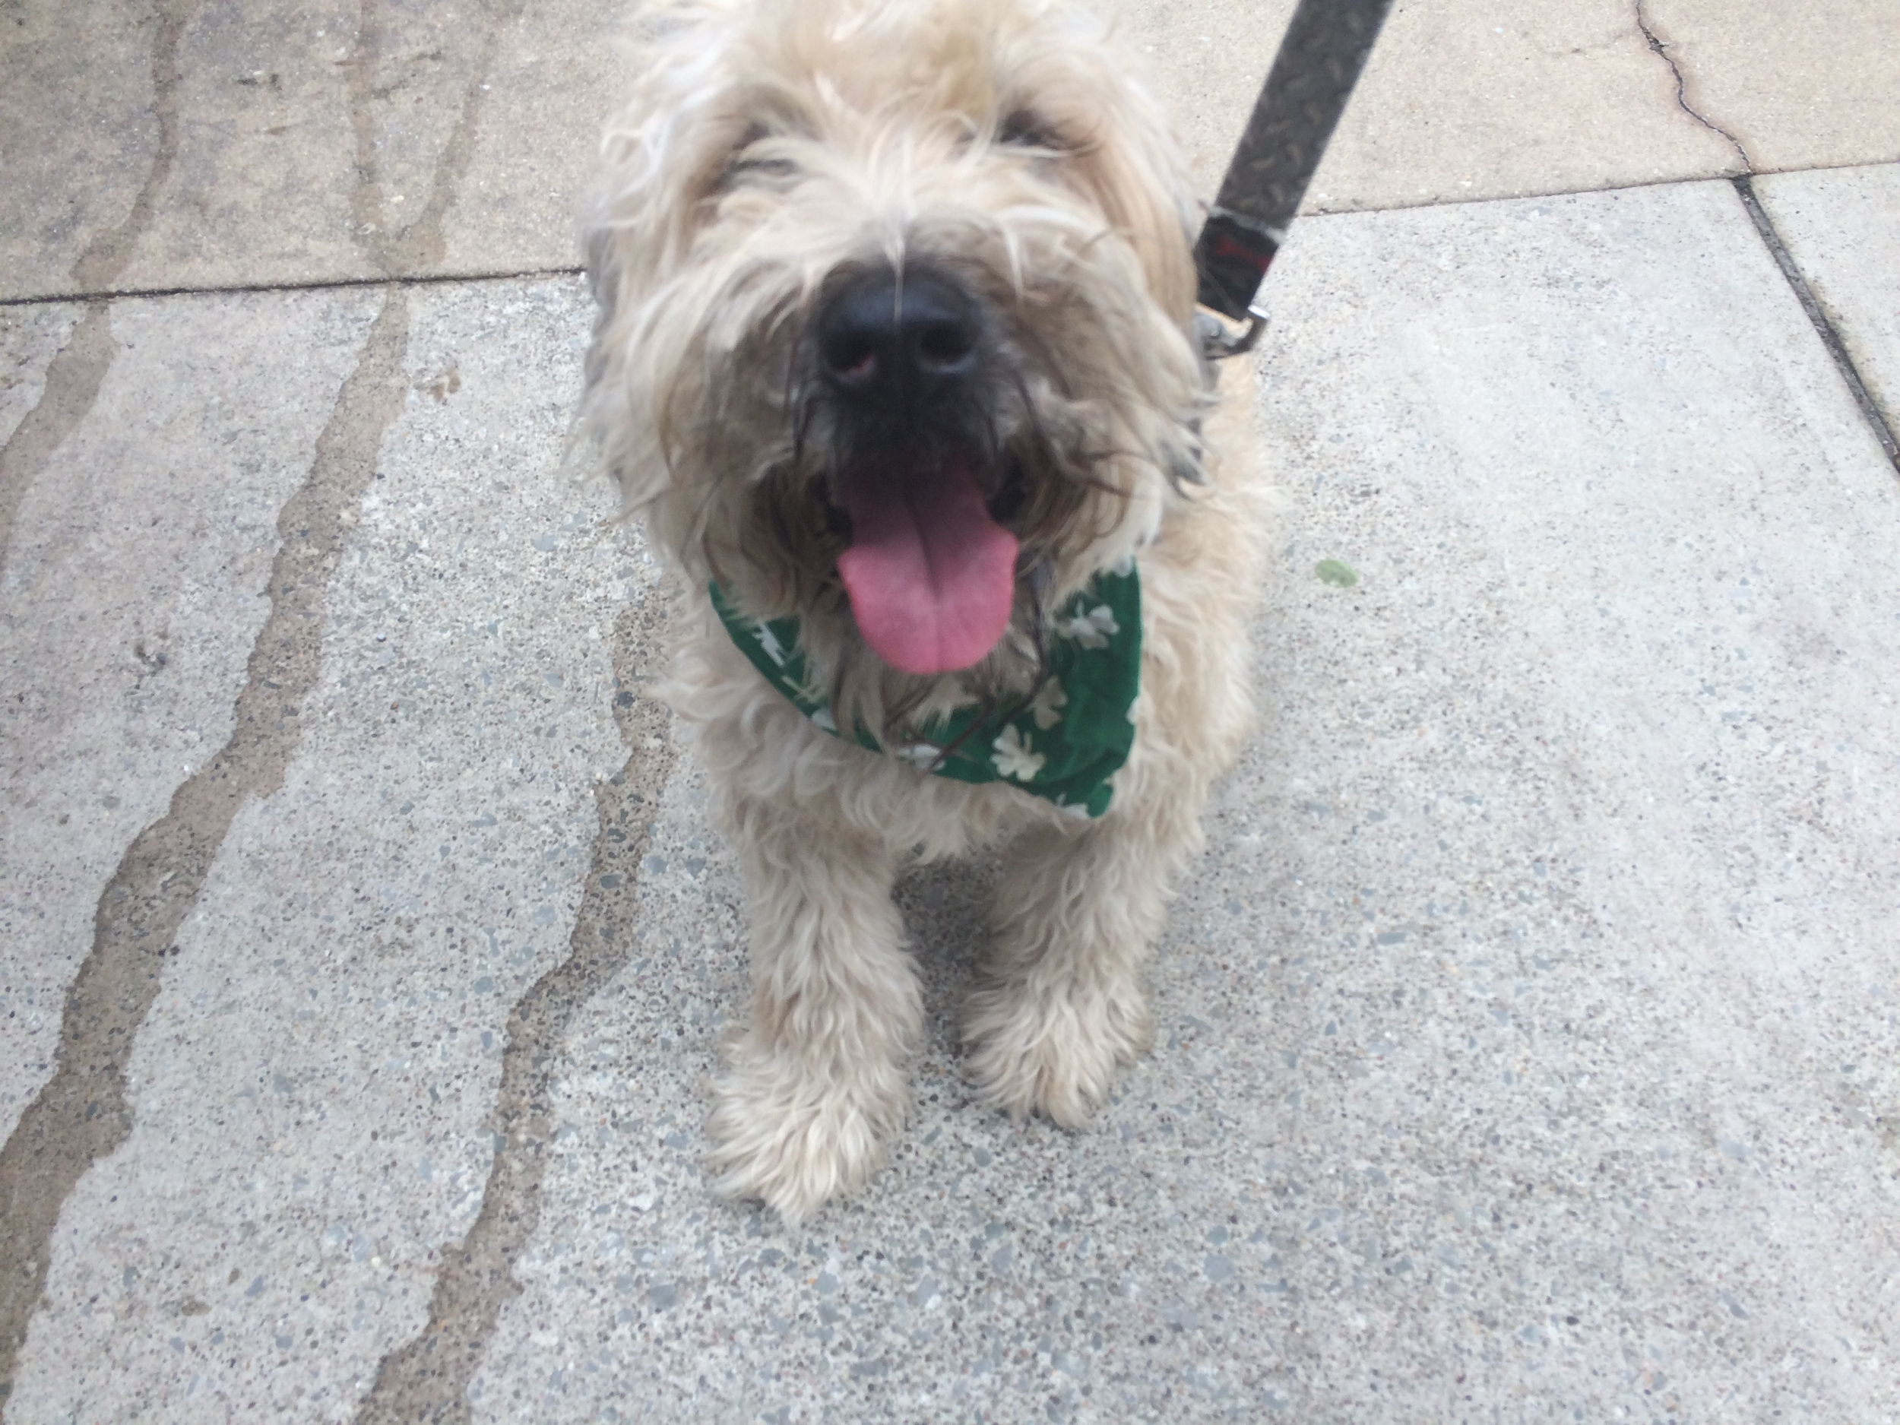
Our Initial Plan
Hire 2-3 fellows to help develop the plan - people with experience running nonprofits would make for good fellows
$40,000 grant secured from a local foundation to support stipends for fellows
Image source: Bob Gradeck Licensed as CC-BY 4.0

Slide 5
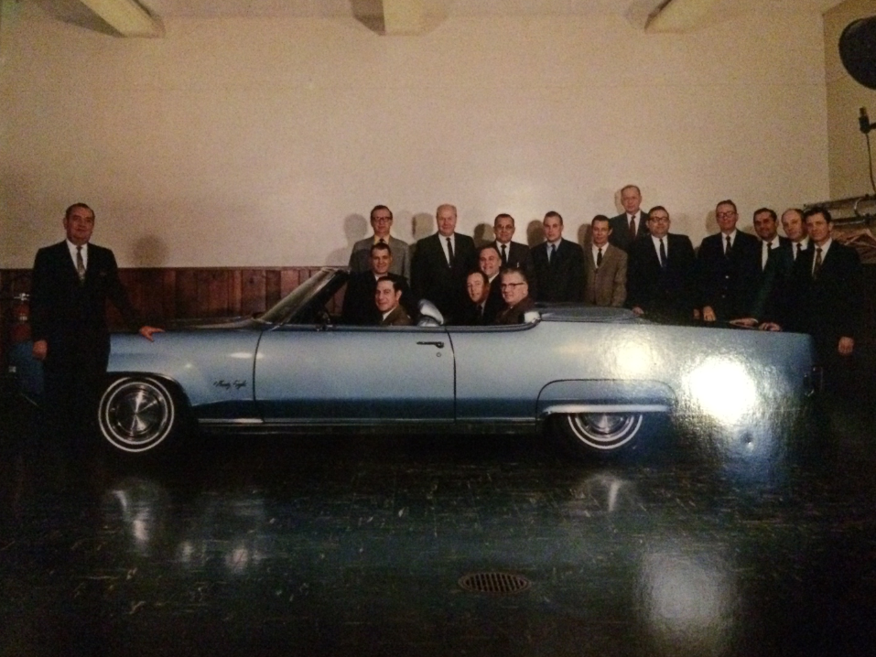
As I got started, I started to ask people I trust from NNIP and my local networks how they’d approach this.
I wasn’t sure I was sold on the fellows model...
Image source: Bob Gradeck Licensed as CC-BY 4.0

Slide 6
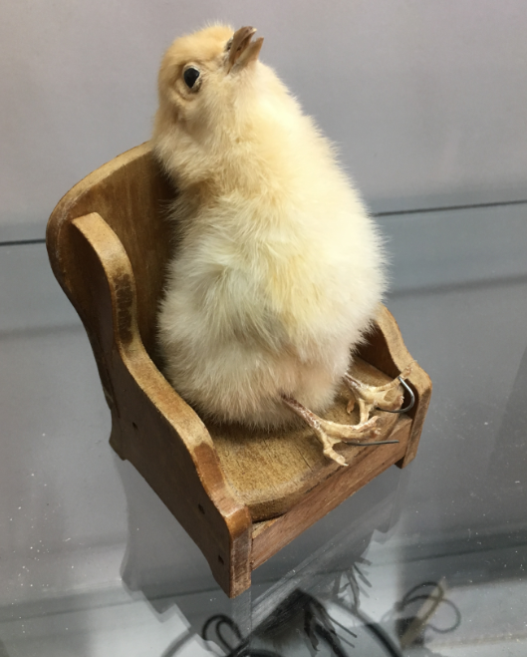
A NNIP alumnus told us…
Don’t outsource the entire project. Going through the process is a great learning opportunity, and nobody knows this space and the project better than you.
Image source: Bob Gradeck Licensed as CC-BY 4.0

Slide 7
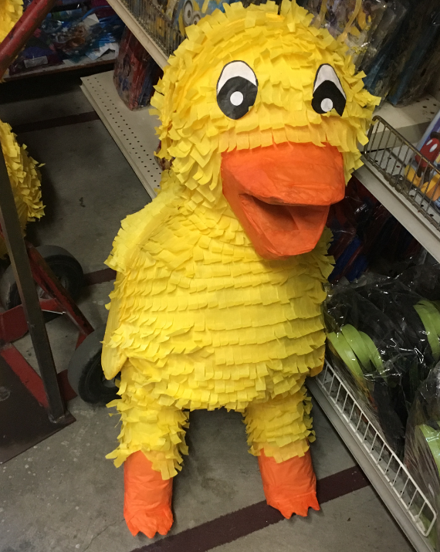
A local funder suggested….
Find someone that can serve as a thought partner that can guide you through this learning and discovery process. You’ll need their help to figure out the money part.
Image source: Bob Gradeck Licensed as CC-BY 4.0

Slide 8
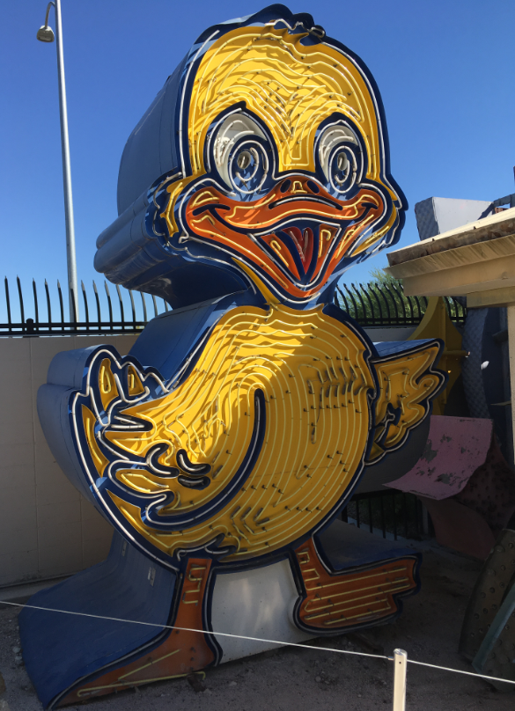
A NNIP partner recommended...
Learn about your work before you start - track your time, measure performance, and talk to people in your community.
Image source: Bob Gradeck Licensed as CC-BY 4.0

Slide 9
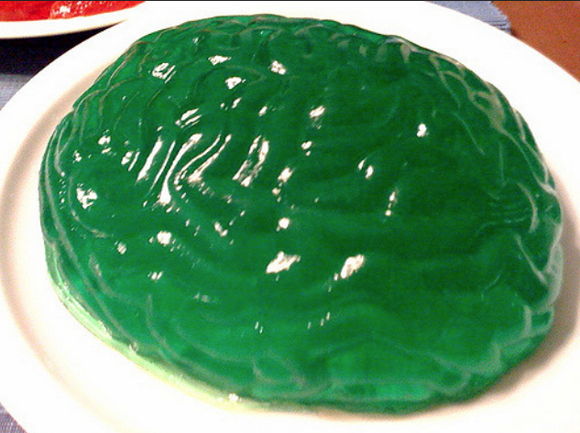
How we found our thought partner
Issued a Request for Information, Solicited proposals and conducted interviews
Hiring criteria:
Good listener
Unafraid to challenge our assumptions
Experienced
Comfort level
Image Source: https://www.flickr.com/photos/skippy/3322258871 Licensed as (CC BY-SA 2.0)
Notes:
https://www.flickr.com/photos/skippy/3322258871

Slide 10
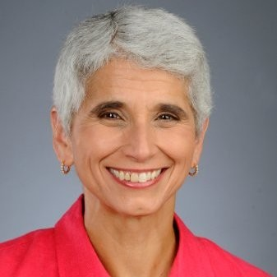
We hired Susie Chase from Open Minds as our thought partner.
I checked all of the boxes!
Image Source: LinkedIn https://www.linkedin.com/in/susan-chase-960595b/ No License Provided

Slide 11
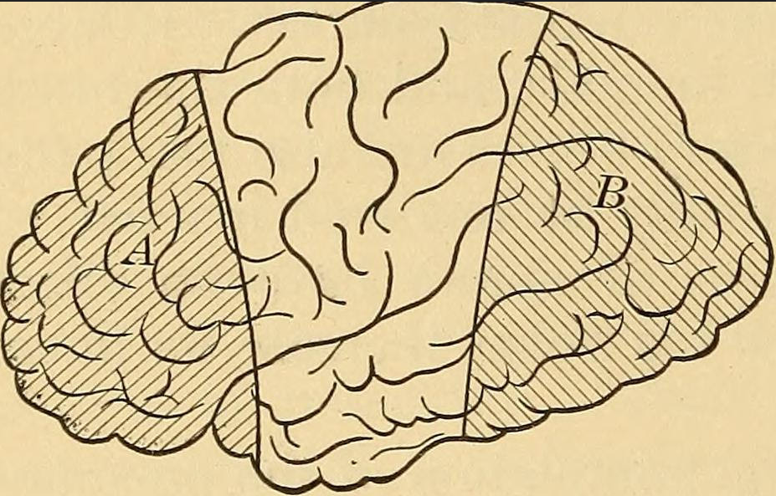
Thought partner role -
Interviews with NNIP partners to learn about their business model and revenue sources.
Interviews and planning sessions with staff and advisors.
Review of competitive projects.
Collection and analysis of financial information.
Interviews with potential clients and funders.
Shared ideas and challenge our assumptions.
Image source: https://www.flickr.com/photos/internetarchivebookimages/14770290611 Posted w/ No Known Copyright Restrictions
Notes:
https://www.flickr.com/photos/internetarchivebookimages/14770290611
Mindset change, finances

Slide 12
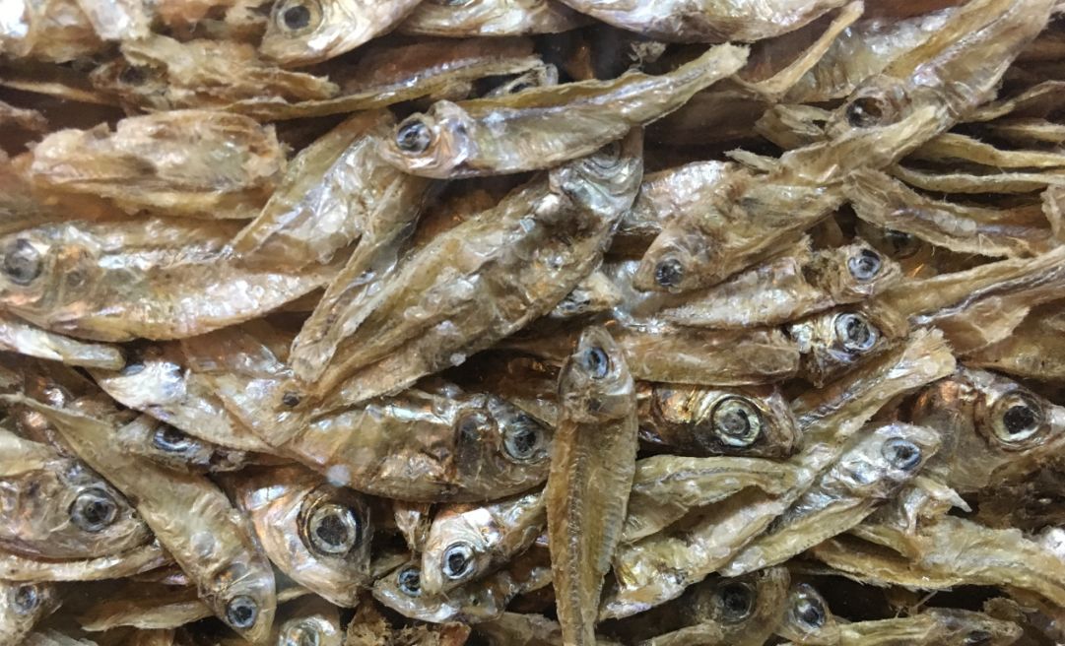
Our Role
Discover models for organizing our products and services through conferences and site visits
Implement a time tracking system
Provide feedback and ideas to the thought partner
Identify non-financial threats
Write the final draft of the plan
Image source: Bob Gradeck Licensed as CC-BY 4.0

Slide 13
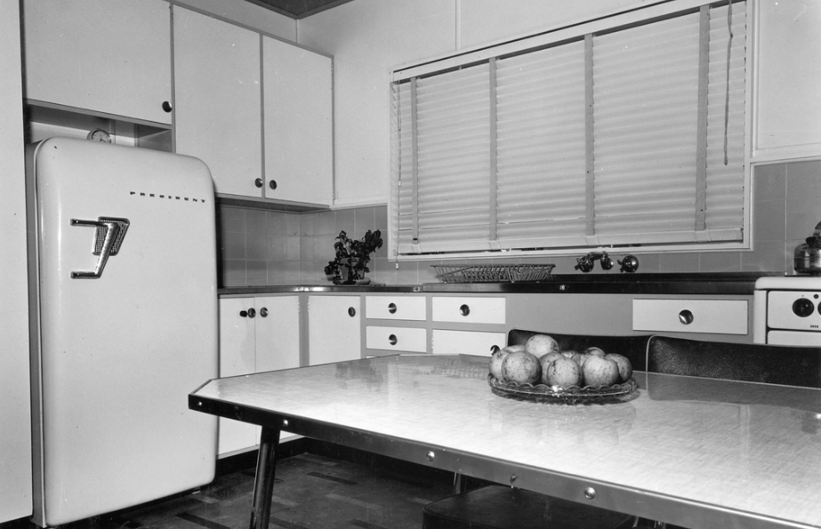
Kitchen Cabinet
Small group of 3-4 trusted advisors to serve as a sounding board
Helped with communication to advisory board
Provided feedback on the plan
Image Source: https://www.flickr.com/photos/queenslandstatearchives/39055718505/ Shared in the Public Domain
Notes:
https://www.flickr.com/photos/queenslandstatearchives/39055718505/

Slide 14
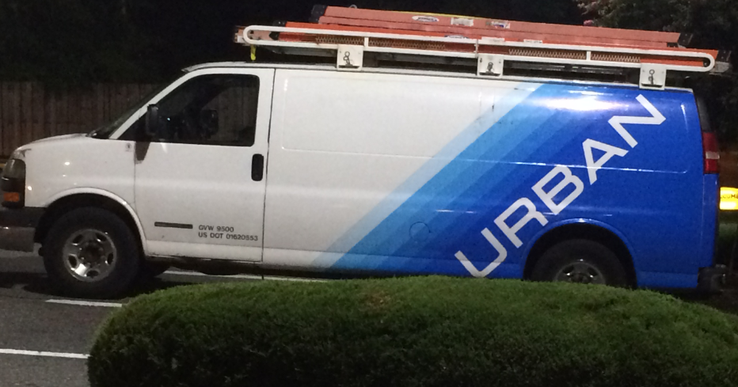
What’s in the Plan?
Image source: Bob Gradeck Licensed as CC-BY 4.0

Slide 15
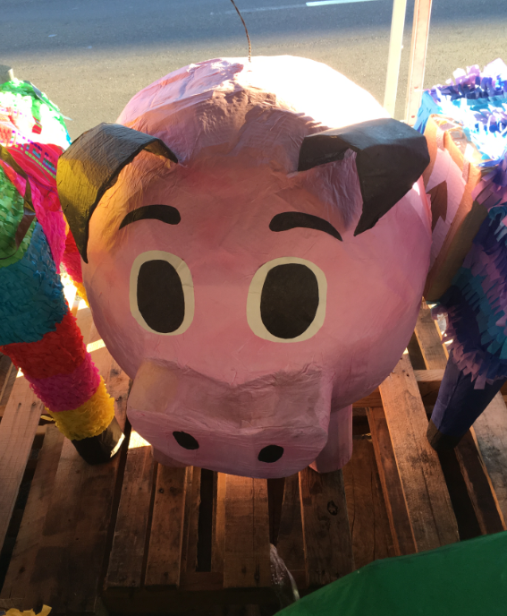
Lines of Service
Data Infrastructure
Data Acquisition & Transformation Services
Development of Tools and Dashboards
Project-Based Assistance and Special Projects
Support for Community Initiatives
Technical Assistance
Training
Image source: Bob Gradeck Licensed as CC-BY 4.0

Slide 16
Pricing Model
Salary & benefits
Unbillable time (+25%)
Data infrastructure (+16%)
Tool maintenance (10% of development cost/year)
Promotion and marketing (3.5%)
Professional development (6%)
Overhead to the University (up to 20% non-federal)
Image Source: https://www.flickr.com/photos/cbpphotos/33053664308/ U.S. Government Work, No Copyright Restriction
Notes:
https://www.flickr.com/photos/cbpphotos/33053664308/

Slide 17
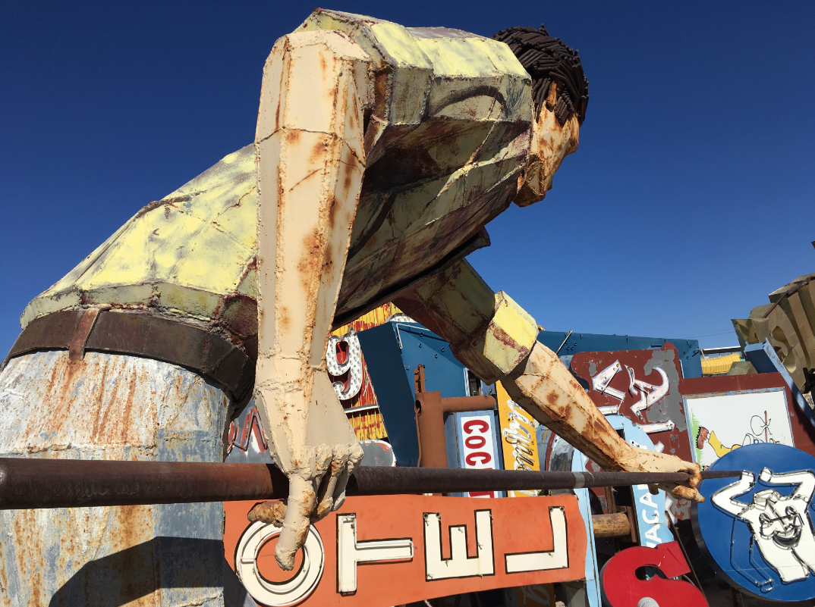
Revenue Sources
Local Government
State Government
University of Pittsburgh
Other Universities
Local Philanthropy
Collaborative Projects
Corporate
National Funder
Image source: Bob Gradeck Licensed as CC-BY 4.0

Slide 18
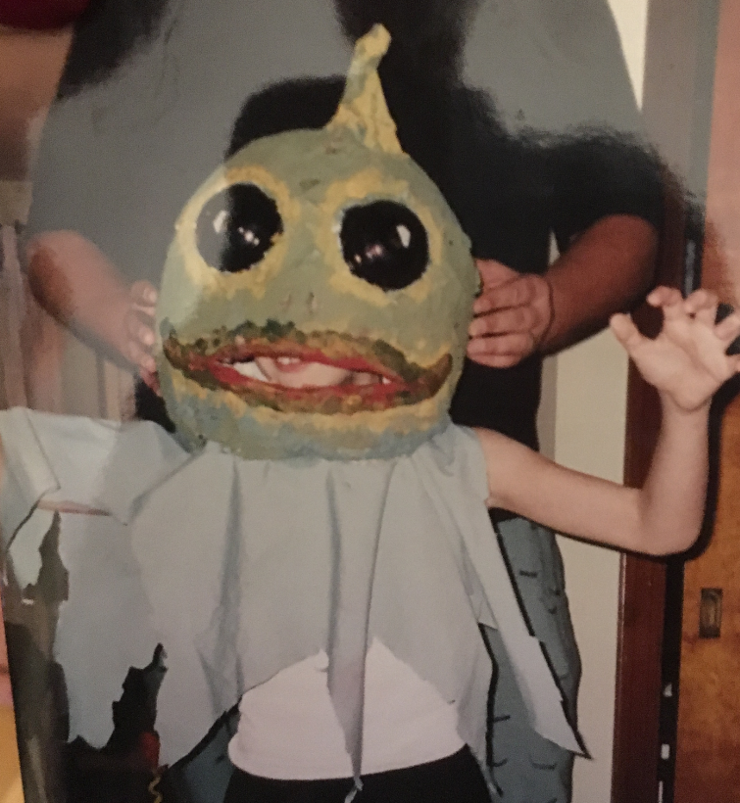
Other Threats
Staff transitions
Career opportunities
Little diversity
Poor documentation
Reputation
Technical debt
Image source: Bob Gradeck Licensed as CC-BY 4.0

Slide 19
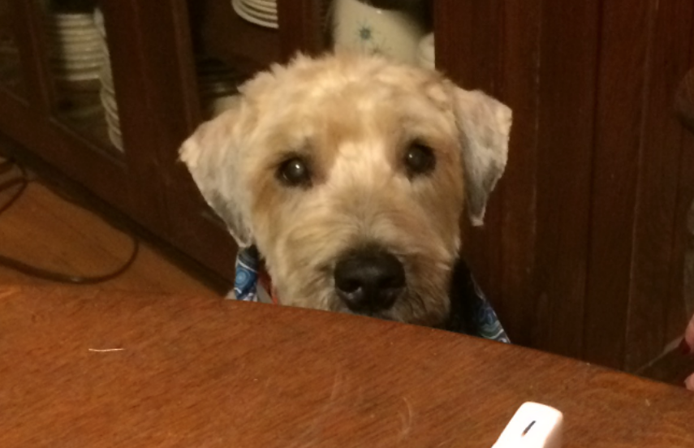
Advice
Engage your whole team in the process
It’s a great learning opportunity to do this
Find a thought partner to guide the work
Sustainability is more than financial
Doing it yourself takes longer than you think
Image source: Bob Gradeck Licensed as CC-BY 4.0

