Slide 1
Creative Applications of Data:
Early Childhood Care & Education
NNIP Idea Showcase: July 20, 2017

Slide 2
FRAMING
1.
Why ECE Matters
2.
Alternative Use of Data
3.
Making the Case for Better Data
4.
Considerations

Slide 3
Why Early Childhood Care & Education Matters
The economic case
Children Are Prepared to Enter Kindergarten “Ready to Learn”
They have been exposed to experiences that develop their sensory, language and cognitive skills.
Children who attend preschool are more likely to enter kindergarten “ready to learn”
Children who enter kindergarten ready to learn are more likely to read proficiently by the end of third grade, a leading indicator of future educational and economic success.
Predicting Future Educational Success: A View of Colorado
49%
73%
Preschool Enrollment
3rd Grade Reading Proficiency

Slide 4
Core Questions
To inform better allocation of resources
Where are supply/demand mismatches?
Where is the highest potential for capital investment?
How should operators plan for contraction/expansion?
Where are various funding streams attributed to centers?
How does access to quality early childcare change over time?

Slide 5
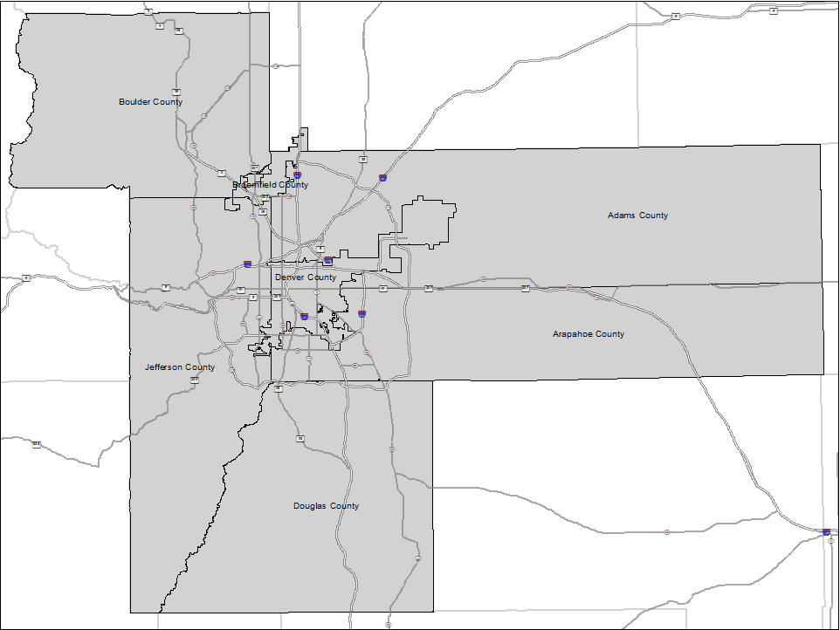
Framing Scope
Nuances across communities
Geographic Extent:
7-County Denver Region
Unit of Analysis:
Neighborhood or Smaller

Slide 6
Behavioral Economics
Triangulating with alternative sources
Question:
What influences households to choose care closer to home vs. closer to work?
Criteria:
1. All low-income block groups
(median income < 200% fpl*)
2. Sample of high-income block
groups
(median income > region AMI*)
*Based on a family of four
200% fpl = $47,100
Region AMI = $77,800

Slide 7
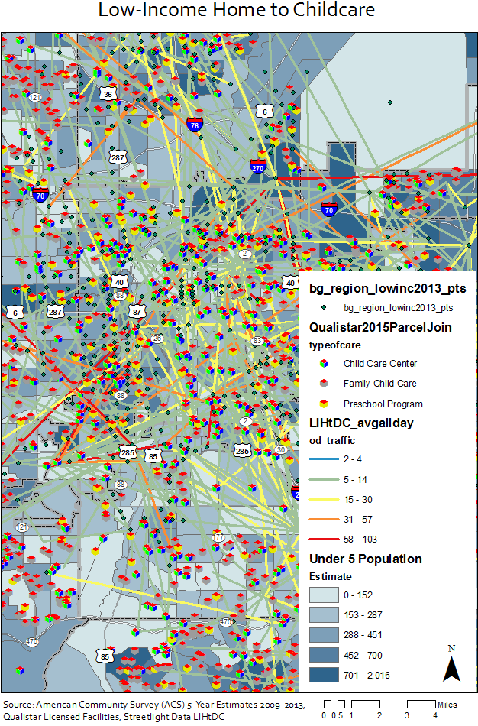
Streetlight Deliverable
Travel origin | destination files
Raw Data Outputs
Low-income home to childcare
Childcare to low-income work
Low-income home to work
High-income to childcare

Slide 8
Homeshed Results
The reasonable commute distance from home tract
(miles) | All Tracts |  | Low-Income |  | Medium Income |  | High Income
 | 50th | 80th | 50th | 80th | 50th | 80th | 50th | 80th
All Tracts | 3.51 | 8.44 | 4.24 | 10.32 | 3.63 | 8.74 | 2.78 | 6.52
Urban | 3.38 | 7.74 | 3.53 | 8.30 | 3.38 | 7.55 | 3.16 | 6.50
Suburban | 3.56 | 8.61 | 4.44 | 11.57 | 3.69 | 9.40 | 2.64 | 6.37
Rural | 4.45 | 14.15
1
1
Because there were relatively few rural tracts, low-income and non-low income tracts were combined into a single category

Slide 9
Accessibility Index
Determining shortage or surplus: scenario #1
Supply
$${C(ADJ)}_{PT}= \frac{H_{PTR}∗D_{T} }{\sum_{T=1}^{N}{{(H}_{PTR}∗D_{T})}}$$
Tract Accessibility
$$A_{TR} =\sum_{P=1}^{N}{\frac{{C_{P}∗C(ADJ)}_{PT}}{D_{T}}}$$
Demand
$$D_{T} = \sum_{Age=0}^{5}{{Part}_{AGE} ∗ {Pop}_{AGE}}$$

Slide 10
Early Care & Education Map
www.Ecemap.org

Slide 11
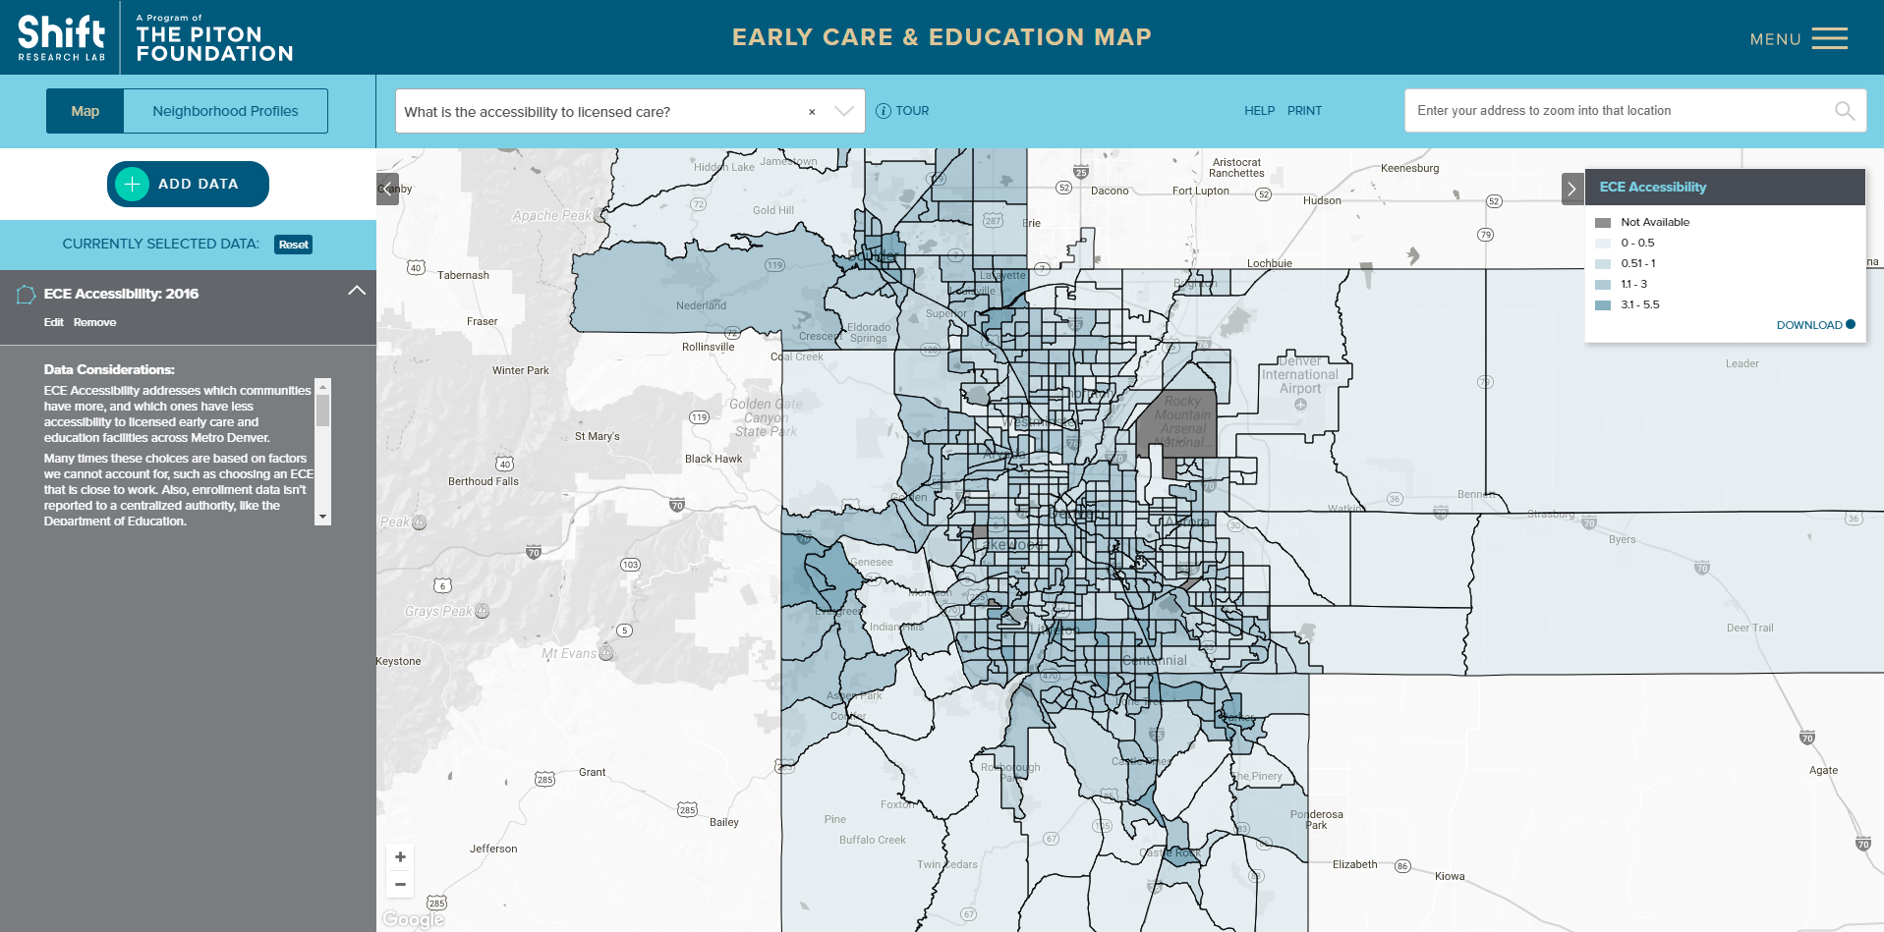
Early Care & Education Map
www.Ecemap.org

Slide 12
Looking Forward
The case for better data
Where are supply/demand mismatches?
Get to actual enrollment counts
Disaggregate by year (infants, toddlers, preschool)
Disaggregate by quality of facility
Where are various funding streams attributed to centers?
Head Start, Early Head Start, Colorado Preschool Program, Denver Preschool Program, etc.
How does access to quality early childcare change over time?

Slide 13
CONSIDERATIONS
1.
Ability to serve the market’s ideal choice
2.
Ultimate influence on experience of all children in K-12
3.
How Data Plays a Role

Slide 14
stay in touch
Jennifer Newcomer
jnewcomer@garycommunity.org
303-454-3776
join our mailing list
Stay up to date on the latest from Shift Research Lab
follow us
for more information visit
SHIFTRESEARCHLAB.ORG

Slide 15
Thank You

