Slide 1

Data as a tool to preserve unsubsidized affordable housing:
Using property records to identify small-medium sized multifamily properties as a source of affordable housing in metro Denver
NNIP Webinar | November 16, 2023

Slide 2





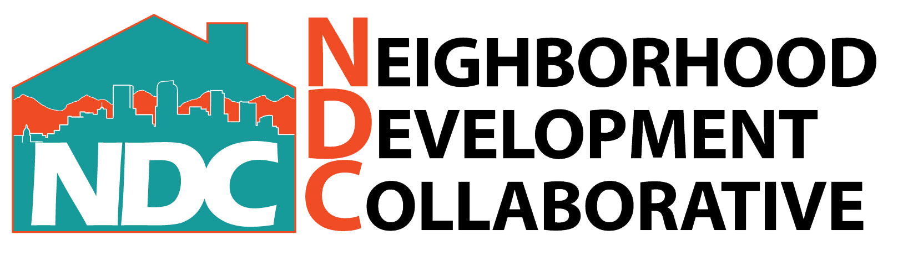
Context Timeline
REA Decommissioned and Reimagined
With support from SPARCC, MHC began conversations on a new interactive tool designed for and with community organizers, nonprofit housing developers.
Housing Preservation Network
Established
Focus on SMMF
Integration with Housing Preservation Network
CHFA agrees to develop front-end tool for housing preservation workgroup. Database updated.
Regional Equity Atlas 1.0
Developed to ensure public investment in rail & bus provided greater access to opportunity; indicators included population, access to housing, jobs, health care. Static maps and data.
Preservation Fund and Reassessment Update
Updates and expansion to database to operationalize with NOAH preservation fund. Preservation Next Academy launched.
Regional Equity Atlas 2.0
Online interactive tool that created maps and summaries of statistics for areas of interest in the region. Funded via the Sustainable Communities Initiative.
Community Alert Database
CFC creates CAD - Focus on communities at risk of displacement using diverse data sets to tell the narrative – who controls properties?
2011
2014
2019
2020
2021
2023
City of Denver
Source: CFC

Slide 3



Data Development
Data Sources
County Assessors (17)
Local governments
RS Means
ETL Process
Cleaning
Text analysis
Spatial analysis
Derivative variables
Front-End
Query criteria
Visualization
Source: CFC

Slide 4
Database Variables (examples)
Property Attributes
Parcel No.
Class code/ type of property
Ownership
Owner
Address
Economics
Valuation
Purchase price
Square feet
Units
Year built
Corporate/ Investor type
Portfolio property/ unit count
Tenure
Zoning
Cost-of-replacement ratio
Density
Date purchased
Derivative variables
Source: CFC

Slide 5
Project analysis slide 3
Identifying NOAH Properties – Scenario Assumptions
“Seller motivations”
LOW BASIS OWNER
GEOGRAPHIC OUTLIER
OUT-OF-STATE SMALL OWNER
REGULATORY INFRACTIONS
OTHER?
Current owner purchased property at a price per unit consistent with affordable purchase at 50% AMI. Intersect this inventory with the ‘CRR’ and cost-to-value spread. Phase 3 could look into recent permit activity to determine addt’l investment.
Owner’s portfolio is largely concentrated outside of the corridor.
Split across multifamily and single-family properties.
Property is a “one off” (with respect to the metro Denver region) for the out-of-state owner.
Property has history of public health complaints filed against it.
Description of other scenario criteria to query records for properties that could be prospective candidates to approach owner.
General consideration of debt service – potential gap in rate

Slide 6
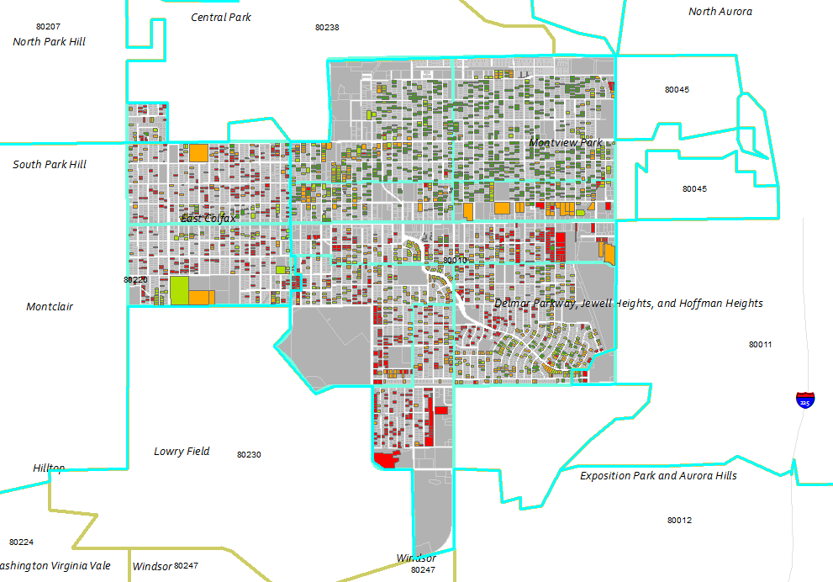
Project analysis slide 5
Potential Properties
This map filtered out properties with an average cost/unit less than $210,000.
LOW BASIS OWNER
GEOGRAPHIC OUTLIER
OUT-OF-STATE SMALL OWNER
3,762 units/944 properties
731 owners
442 units/56 properties
49 owners
422 units/62 properties
54 owners
Average cost/unit below $210K (affordable to $50K HH Inc ~ 50% AMI) and crossed w/CRR values <.75
Corridor property count <5 and region property count >7 and crossed w/CRR values <.75 and low basis.
Property count <5 and crossed w/CRR values <.5 and low basis.

Slide 7

Questions | Contact
Jennifer Newcomer, Doctoral Student
Research Director, Colorado Futures Center
jennifer@coloradofuturescsu.org
www.coloradofuturescsu.org/
The Colorado Futures Center is a 501c3 organization dedicated to informing about economic, fiscal and public policy issues impacting community economic health and quality of life.
@colofutures

Slide 8
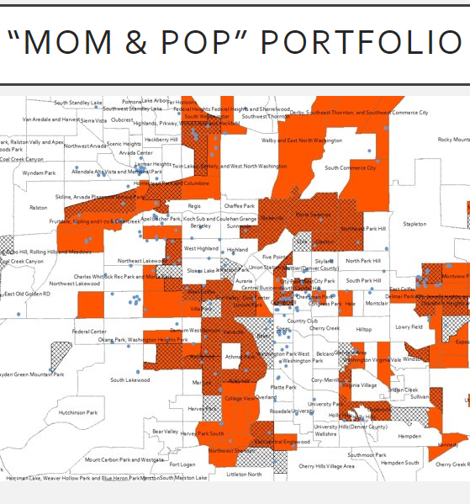
Creating the Ecosystem to Support SMMF Preservation
Enterprise / preservation network levers
Create easy to use dataset to identify properties, target geographies and portfolios for acquisition and preservation
Ensure financing tools are available that work for purchase of unrestricted smaller rental properties – and that financing is quick and easy to access
Provide training to nonprofit providers and mission minded for-profits focused on best practice for SMMF acquisition and preservation
Create tools that can be used to analyze properties, identify financial resources and model proformas
Fund/provide direct technical assistance to find, analyze, underwrite and finance acquisitions
Create policies that incent and increase feasibility of preservation
Ensure that preservation is a stated priority at state and local housing agencies

