Slide 1
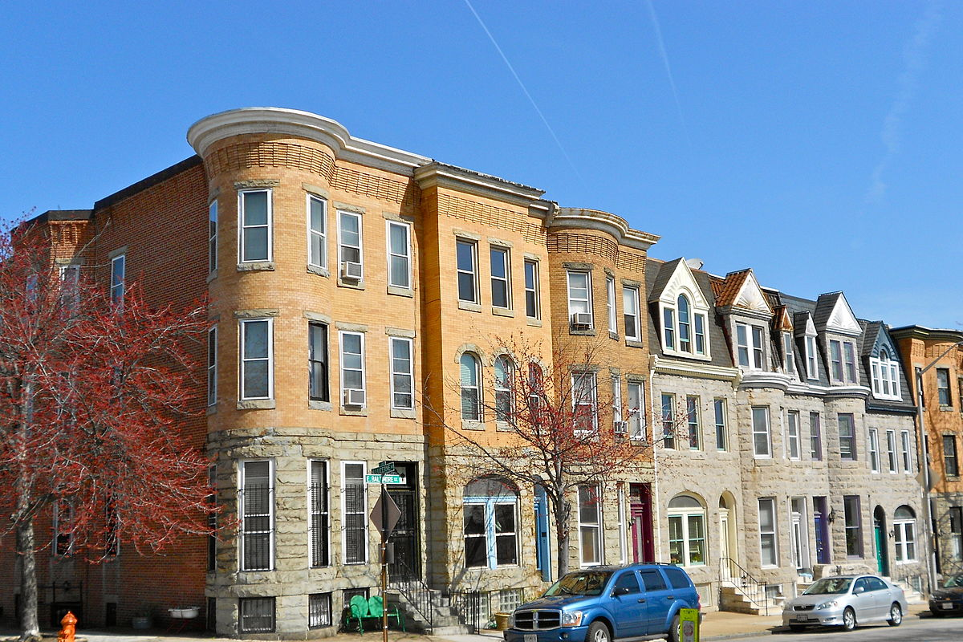


Utilizing Data-driven Technology Tools For Community-led Solutions to Vacant Properties and Urban Blight
Amanda M. Davis, Ph.D.
Kristine J. Dunkerton, Esq.
Seema D. Iyer, Ph.D.
Shana Roth-Gormley, Ph.D

Slide 2



Project Background: The problem
Vacant and Abandoned Properties
Tax lien Sales & Tax foreclosure
Nuisance properties, Code violations, abandonment, Vacancy

Slide 3

Project background: Tax Certificate Sale
11,411 properties included in 2018 tax certificate sale (BidBaltimore)
6,179 were purchased by a single investor
~3,000 tax lien foreclosures in Baltimore City Court each year
Community Law Center founded the Tax Sale Workgroup
  Evolved from the Public Nuisance Project
  Year-long data gathering process
This Photo by Unknown Author is licensed under CC BY-SA

Slide 4
Data gathering challenges
Data Provision
Collect & Clean Data
Data Integration
Data Filtering
User Defined Data
Data Analysis
Report Writing/Policy
Data Gathering
Property Events
- Ownership/Sales
-Tax Cert. Sales
-Foreclosures
-Vacancies
-Citations
-Violations
-Permits
-Tax Credits
-Receiverships
*Parcel data
*Boundaries
EXAMPLES OF DATA SOURCES:
SDAT
SDAT BUSINESS ENTITY
LAND RECORDS
MARYLAND CASE SEARCH
BID BALTIMORE
DEPT OF HOUSING
OPEN BALTIMORE- DATA PORTAL
DEPARTMENT OF PUBLIC WORKS
CITY PROPERTY TAX RECORDS

Slide 5

Data gathering & Integration challenges
Integration of datasets
Data scraping
Lacking a primary or common field
Address files not standardized
Misspelled addresses
Sensitive Data*
Unavailable Data or no relationship with data provider*
This Photo by Unknown Author is licensed under CC BY

Slide 6
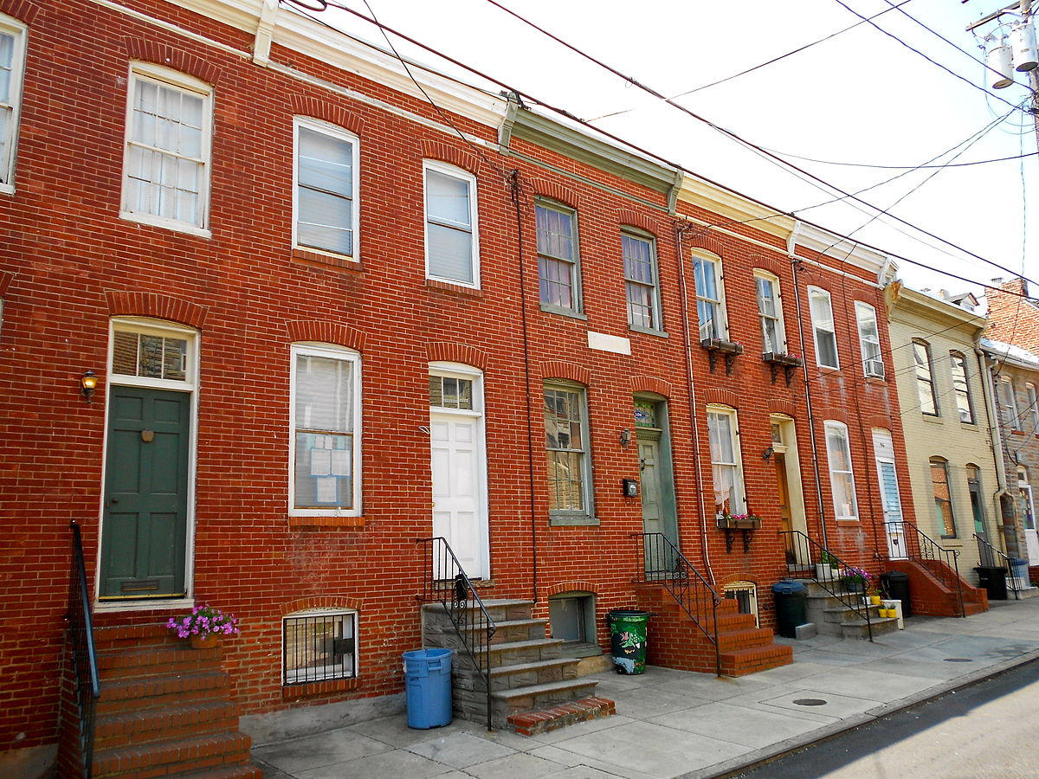


Lessons learned
Topic 01
Topic 02
Automate as much as possible- downloading and cleaning process
Automate updating process
Work in close collaboration with community partners
Discuss the work broadly to gain support around the issues
This Photo by Unknown Author is licensed under CC BY-SA

Slide 7
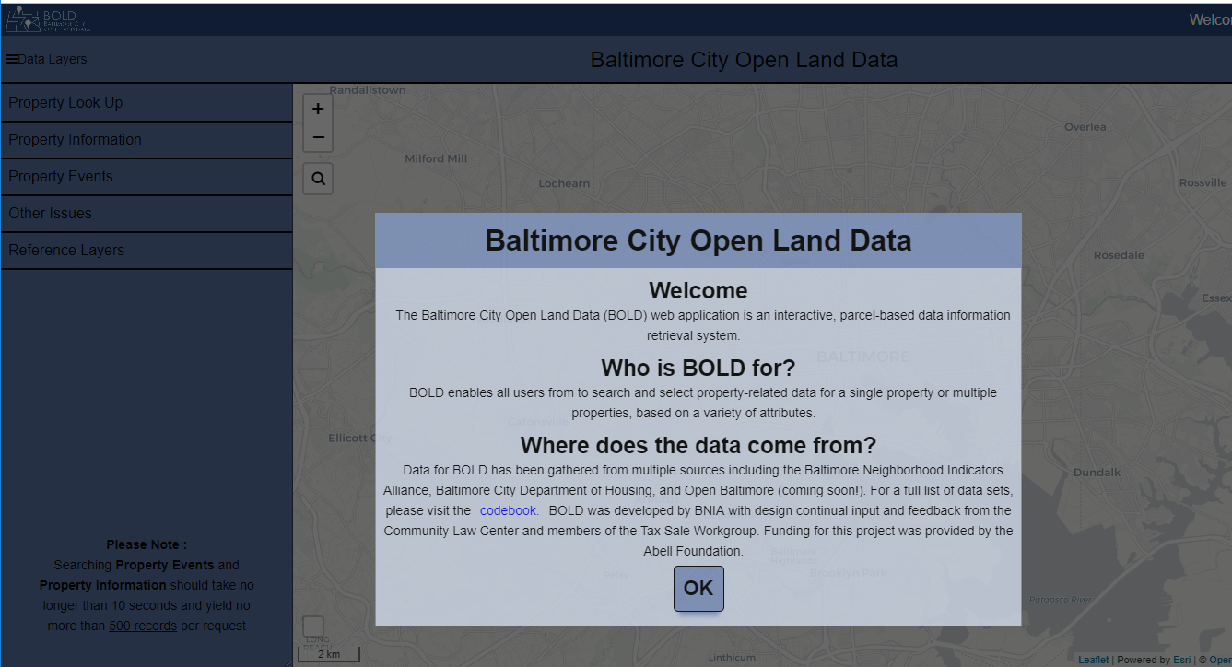
Baltimore City Open Land Data (BOLD): https://bniajfi.org/bold/

Slide 8
Three ways to search property information
Ways to use BOLD:
Property Look-up: detailed information on a single property
Property Search: search specific information that might be common to multiple properties such as owner name, owner address, last sold date
Property Events: Search for all properties with citations, violations, VBNs, Permits, Tax Sales, Foreclosures, Tax Credits or Vacants 2 Values properties (returns 500 results)

Slide 9
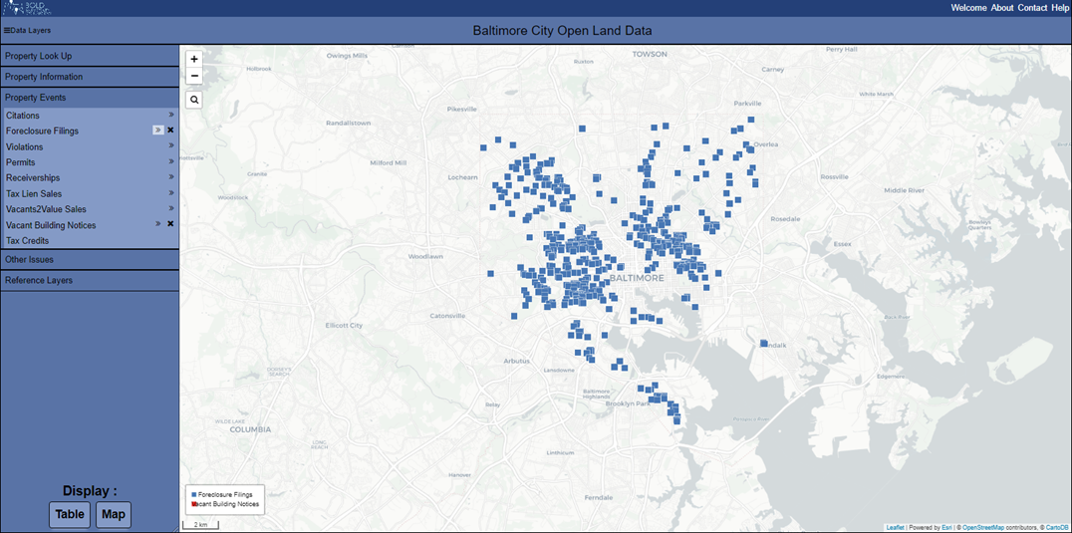
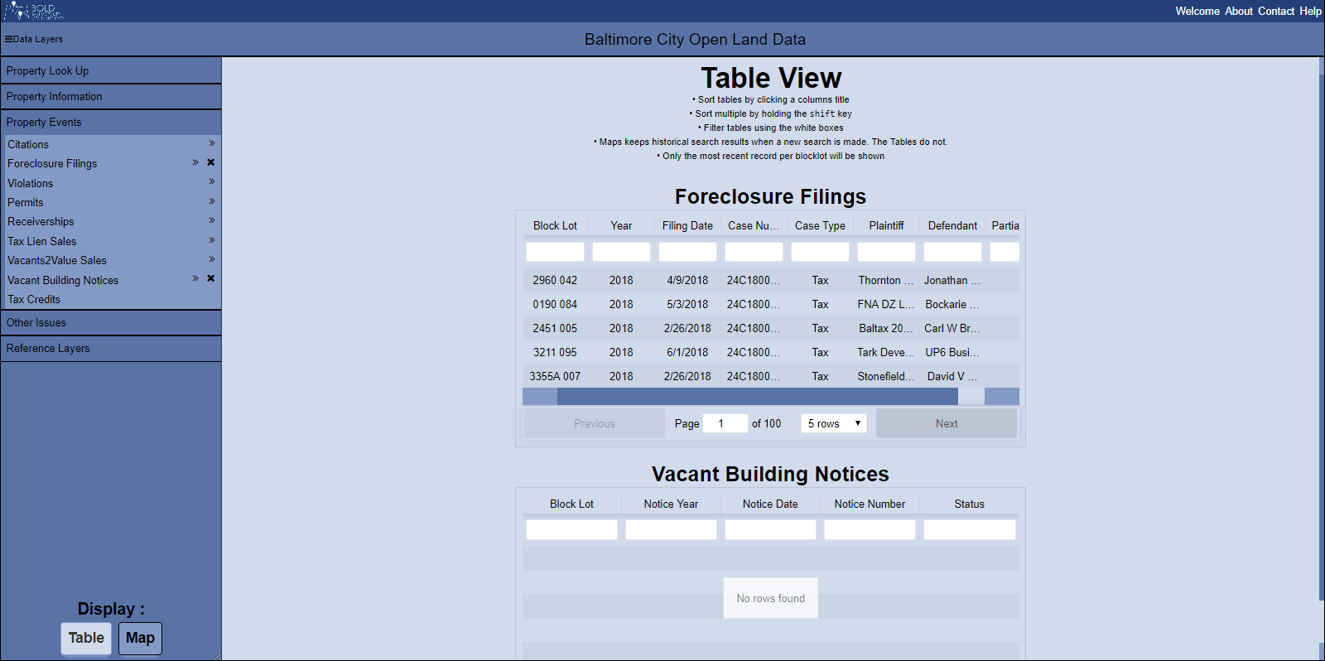
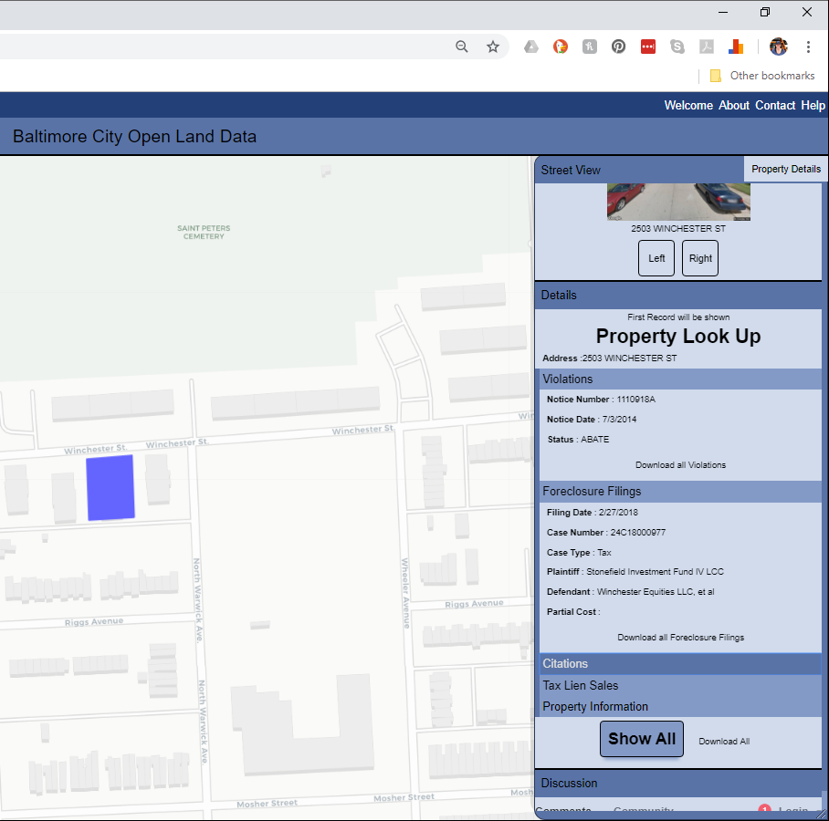

Slide 10
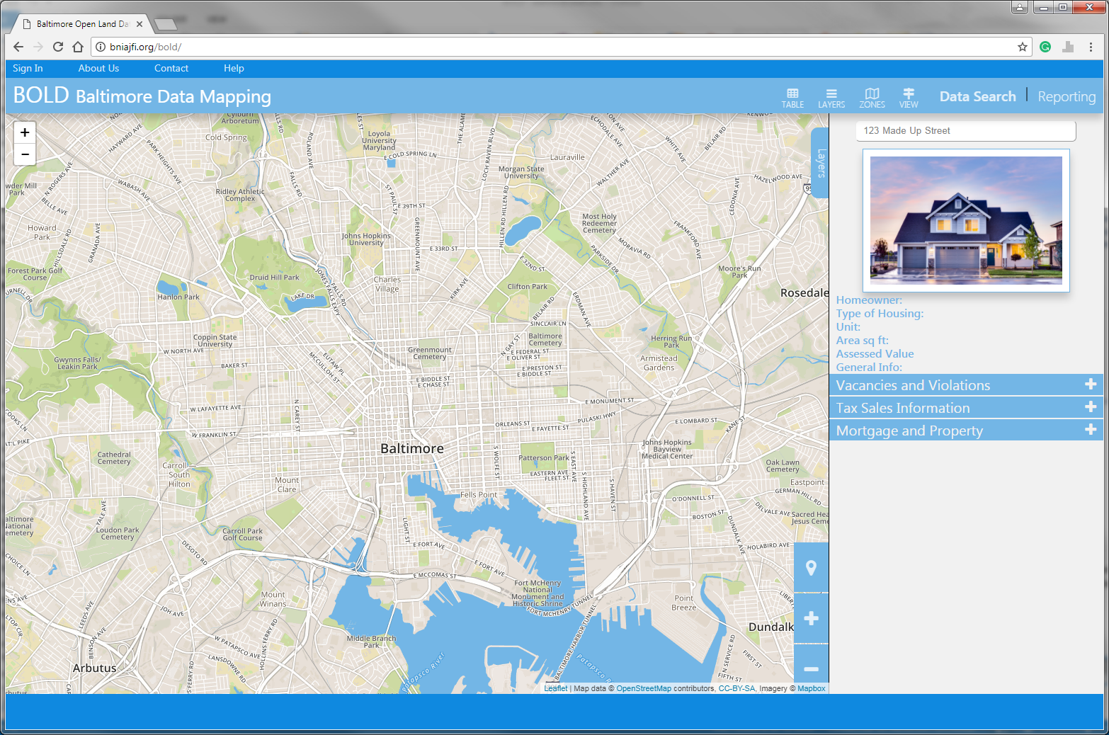
Thank you
adavis@enterprisecommunity.org
http://www.BNIAJFI.org

