Slide 1

Change at the Speed of Trust: Using Data in Rebuilding a Vibrant EastPoint
Moderator: Lloyd Potter
Panelists: Richard Milk, Henrietta Muñoz, Clarissa Ozuna
April 2016

Slide 2
Moderator:
Lloyd Potter
Texas State Demographer
Director, Institute for Demographic and Socioeconomic Research, UT San Antonio
Panelists:
Richard Milk (Wheatley Choice Neighborhood)
Director of Policy and Planning, San Antonio Housing Authority
Henrietta Muñoz (Eastside Promise Neighborhood, Annie E. Casey Dual-Gen)
Vice President of Grant Research and Evaluation, United Way of San Antonio & Bexar Co.
Clarissa Ozuna
Program Manager for Research, CI:Now

Slide 3
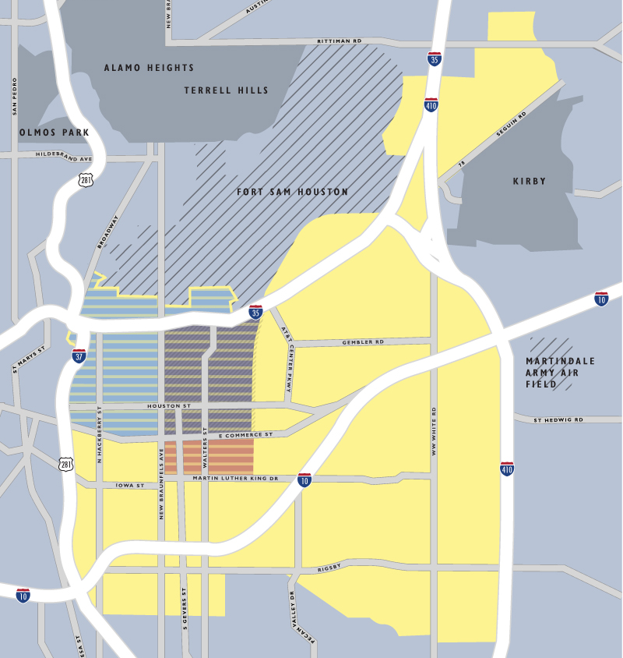
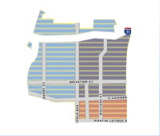
EastPoint: ~4 sq. mi.
Promise, Choice, Dual-Gen, and others
Estimated pop: 22,137
70% Hispanic, 22% African-American
41% in poverty
38% adults w less than HS diploma/GED
Promise Zone: ~22 sq. mi.
Estimated pop: 149,832
64% Hispanic, 18% African-American
28% in poverty
26% adults w less than HS diploma/GED
Sources: American Community Survey 5-year Estimates 2010-2014 and City of San Antonio

Slide 4
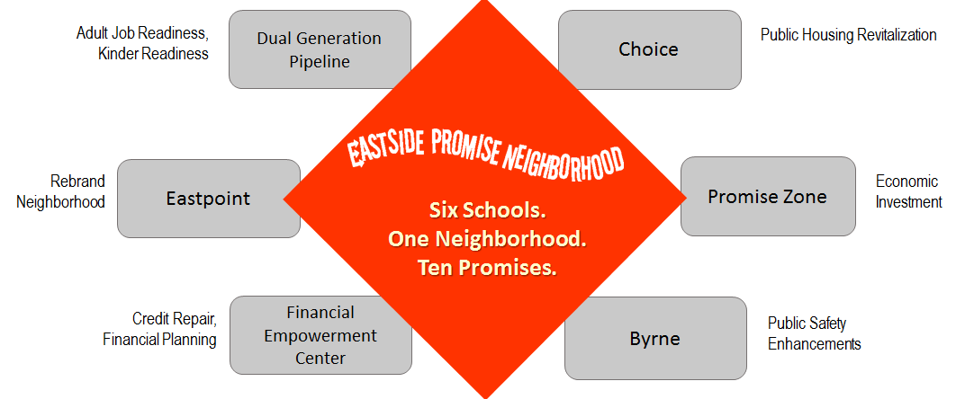
Building on the Promise

