Slide 1
Dallas in Context

Slide 2
You Are Here…

Slide 3
Differences Within the Region

Slide 4
Regional Population Change, 2000-2014
Notes:
MSA is up 68%; County up 14%; City down 32%

Slide 5
Regional Poverty Rates, 2000-2014
Notes:
MSA is up 68%; County up 14%; City down 32%

Slide 6
Dallas in the National Context

Slide 7
Differences Within the City

Slide 8
2000 Per Capita Income

Slide 9
2013 Per Capita Income

Slide 10
Change In Concentrated Poverty: 2000-2013

Slide 11
Raising Awareness Calling Attention
Research as a Tool for Community Change

Slide 12
The Wholeness Index
Notes:
Graph on the left shows change in “Wholeness” from 2006 to 2007 – Overall.

Slide 13
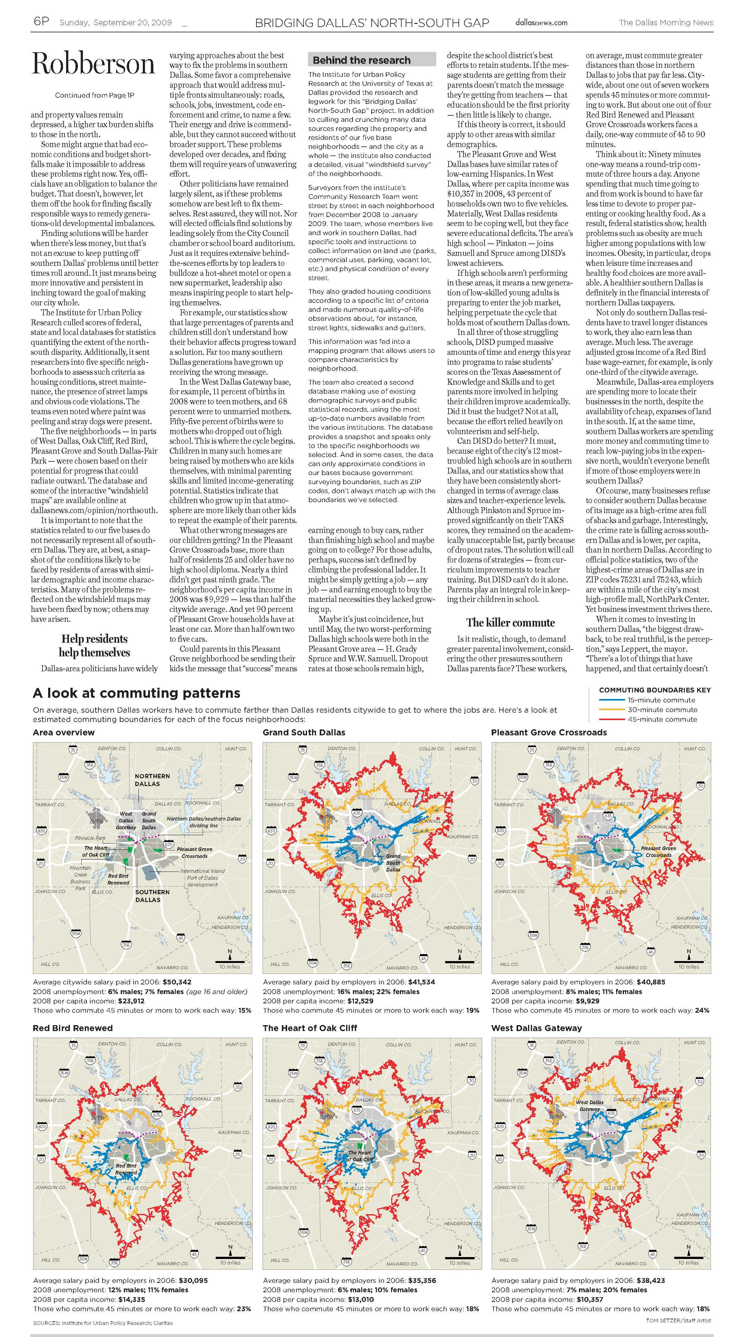
Exploring the North-South Gap

Slide 14
Responding to the Call Taking Action

Slide 15
Mayor Tom Leppert

Slide 16
Mayor Mike Rawlings

Slide 17
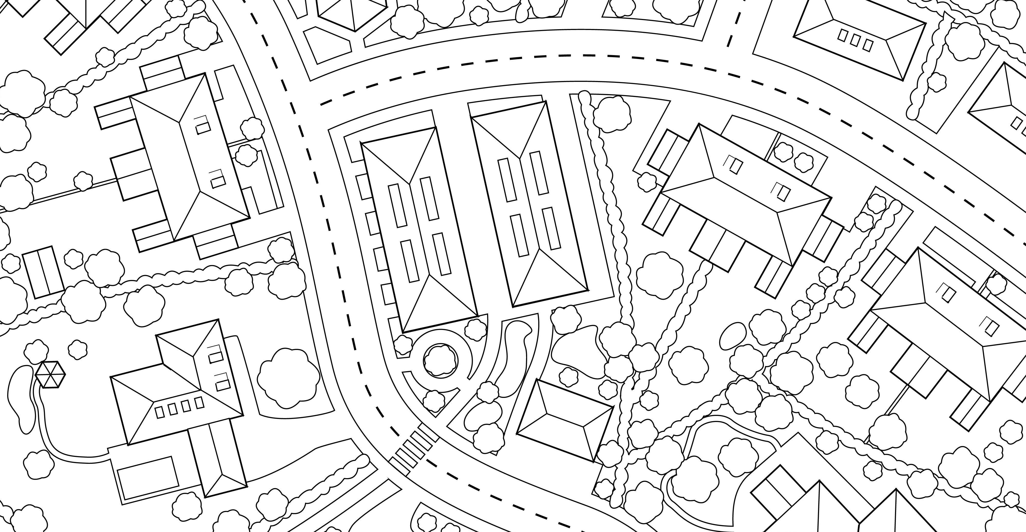
The Rise of the Neighborhood

Slide 18
Grow South – Neighborhoods, Not Sectors

Slide 19
Neighborhood Plus

Slide 20
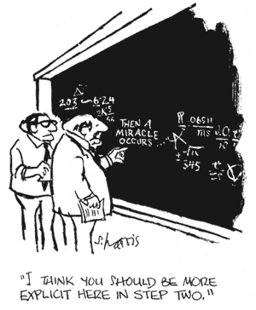
Deliberate Interventions…

Slide 21
Can the River That Divides Us Unite Us?
Notes:
The dots represent per capita block group income from 2015. One dot represents $15,000 in per capita income.

Slide 22
The Mayor’s Task Force on Poverty

Slide 23
Bishop Arts Village

Slide 24
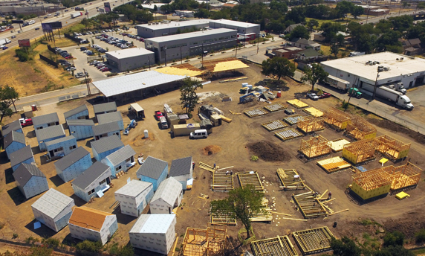
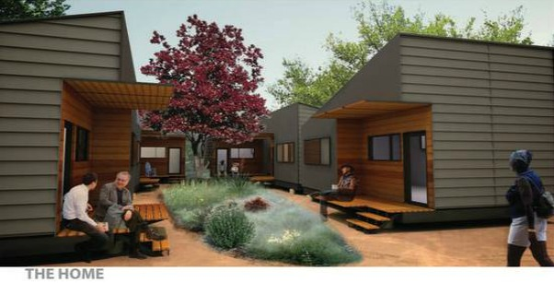
The Cottages at Hickory Crossing

