Slide 1
Charlotte: Reflections and Opportunities
January 28, 2016
Dr. Owen J. Furuseth

Slide 2










Charlotte is a great place to live and work
Notes:
http://charlotte.global/clientuploads/Economic_pdfs/Charlotte_Accolades.pdf

Slide 3

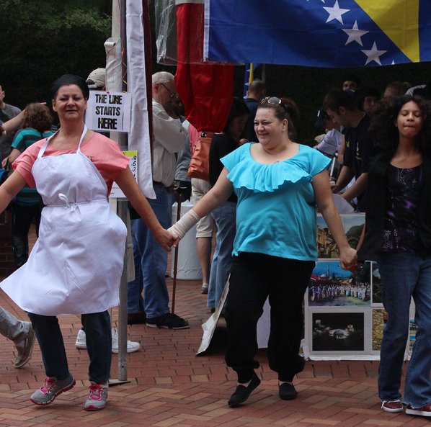
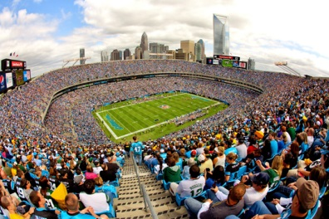
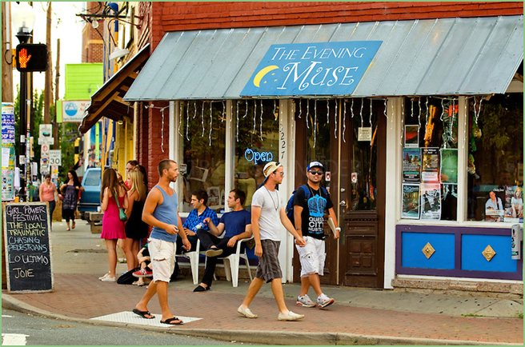
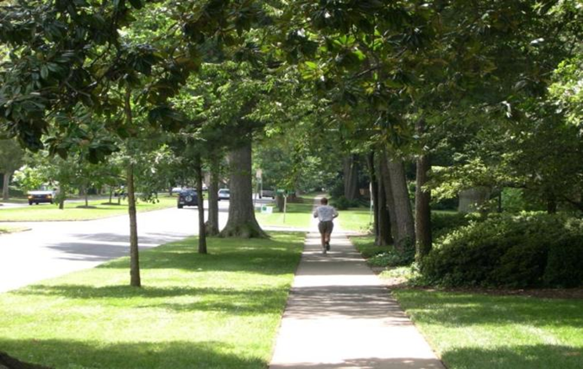
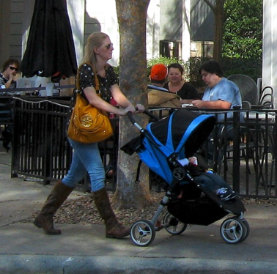
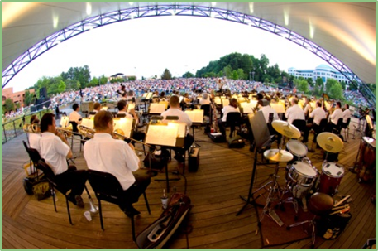
With good quality of life

Slide 4
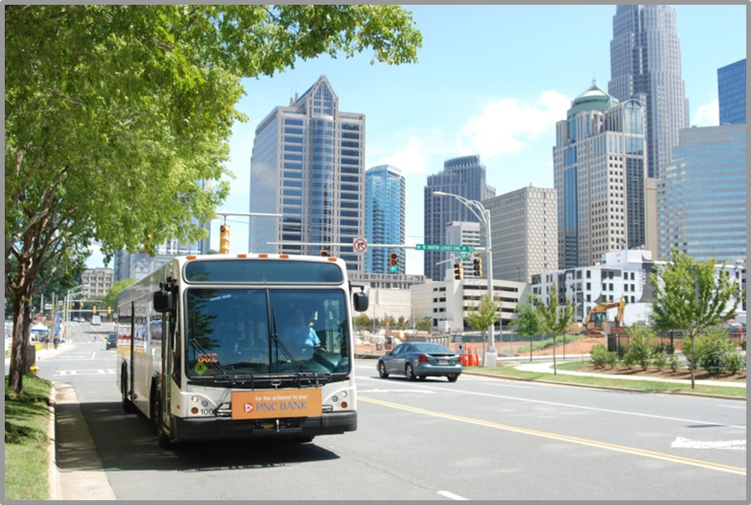
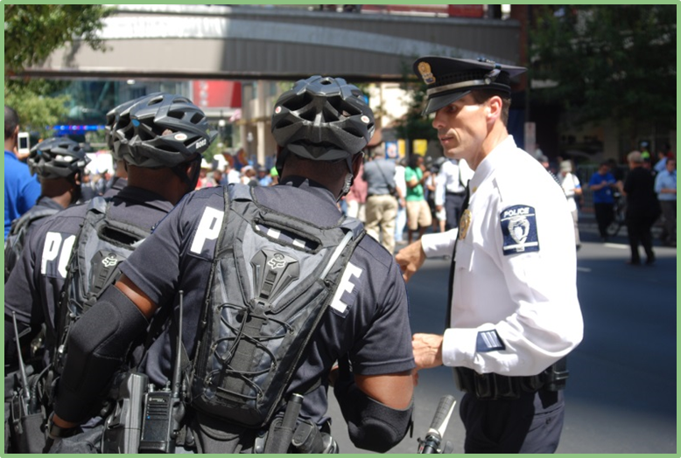
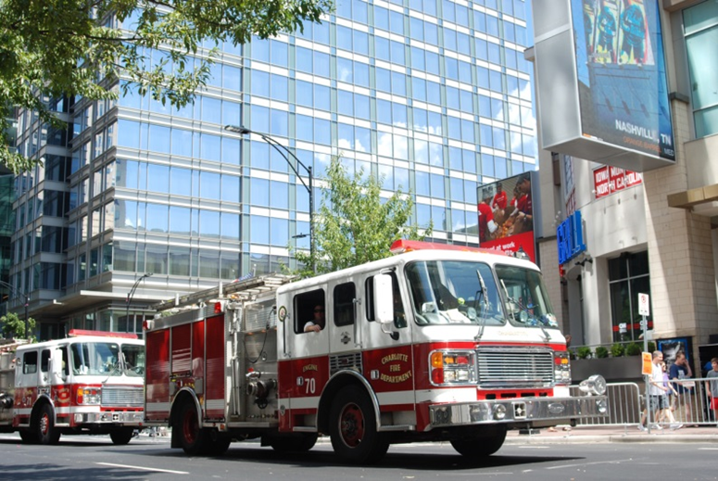

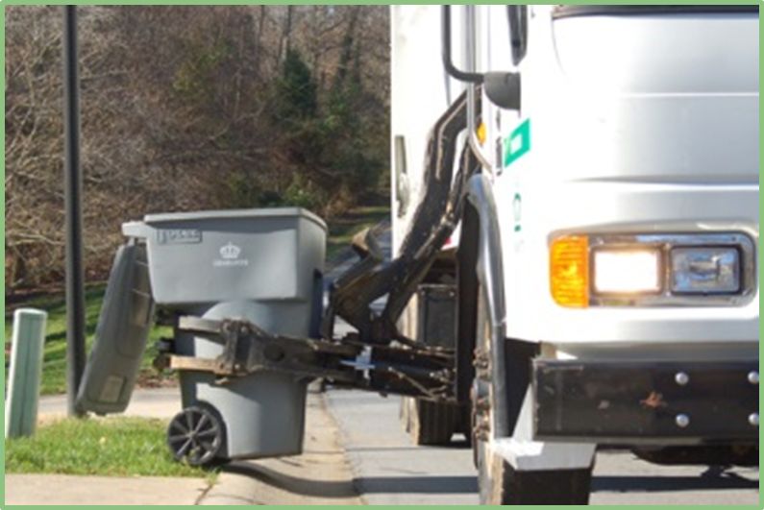
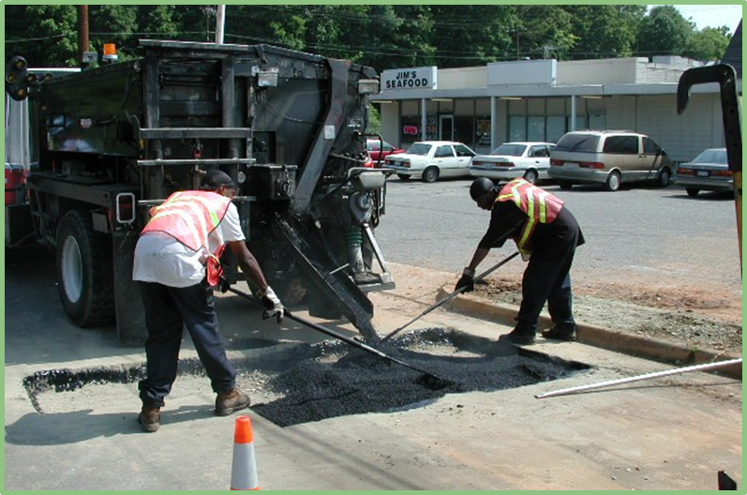
And excellent city services

Slide 5
Population is growing…and growth is expected to continue
Mecklenburg
Charlotte
Sources: Charlotte-Mecklenburg Planning DepartmentCharlotte Regional Transportation Planning Organization; US Census
Notes:
Need to work on formatting of graph
Currently at 810,000 – expected to add 400,000 people by 2040 – that’s the whole population of Raleigh
North Carolina ranked 13th in population growth 2010-2014 (4.3%)
Nearly half of that growth occurred in Mecklenburg and Wake counties
At the same time, almost half of the state’s counties lost population
Charlotte MSA is the 5th largest destination for domestic migration
Mecklenburg County grew faster than any county in the region 2010-2014
Add un projection note

Slide 6
Newcomers to Charlotte are younger and highly educated
Source: Census Bureau American Community Survey 1-year estimates 2014

Slide 7
Our senior population is projected to nearly double by 2030
Source: Office of State Management & Budget, Population Estimates and Projections, accessed January 13, 2016.

Slide 8
Immigrant Charlotteans are diverse and growing
Foreign-born population 128,879 (13.6% of population)
32.3% are U.S. citizens
Source: U.S. Census Bureau, American Community Survey, 3-year estimates (2010-2012).

Slide 9
Job growth has returned
Source: Bureau of Labor Statistics (QCEW) - Data from Q2 of each year
Notes:
talk about what kinds of jobs

Slide 10





Innovative investments
722 firms invested $712 million in Charlotte-Mecklenburg through three quarters in 2015, adding 6,406 jobs
Source: Charlotte Chamber of Commerce
Notes:
Need to work on picture arrangement

Slide 11
Residential development trends: urban, mixed-use and multi-family
FY 11 – FY 15
CY 2015
Single-family demolition permits
Rezonings
Residential renovation permits
(single and multi-family)
New single-family units permitted
(single-family detached)
New multi-family units permitted
(2+ units)
1,456
529
14,008
5,269
12,484
2,697
21,502
4,164
536
125
Sources: Charlotte-Mecklenburg Planning Department; Charlotte Department of Transportation; Mecklenburg County.
Notes:
Calendar

Slide 12
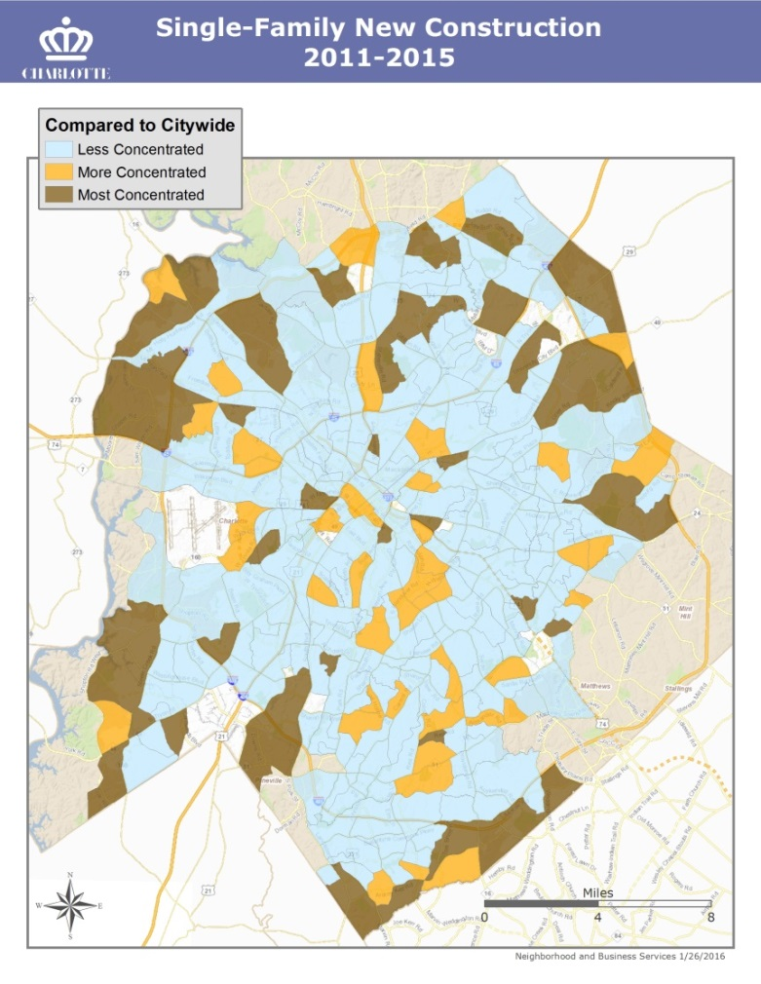
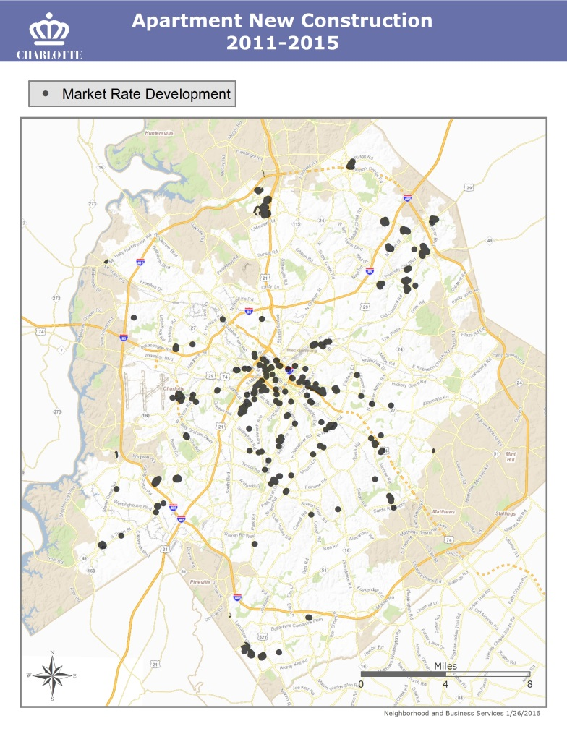
Concentrations of residential activity
FY11 to FY15
Developments 1-4 Units
Developments 5+ Units
Sources: Mecklenburg County; Real Data.

Slide 13






Overall, Charlotte is booming again
FY11 to FY15
+ 34,000
Residential Building Permits
+ 52,000
Vehicles
+ 8 million SF
Commercial
Space
+ 100 Retail Establishments
+ 9,100 Employees
+ 1,160
Hotel Rooms
Sources: Charlotte Department of Transportation; Charlotte Regional Visitor’s Authority; Mecklenburg County; NC Department of Transportation; Quarterly Census of Employment & Wages.

Slide 14
Charlotte is IN THE MIDST OF transformative change

Slide 15

“A revolution is stirring in America. Like all great revolutions, this one starts with a simple but profound truth: Cities and metropolitan areas are the engines of economic prosperity and social transformation in the United States.”
-Katz and Bradley, The Metropolitan Revolution
Notes:
http://www.brookings.edu/~/media/Press/Books/2013/themetropolitanrevolution/themetropolitanrevolutionb.jpg?la=en

Slide 16
Metropolitan Revolutionaries:
Cities and urban regions that are reshaping economies and altering form and function for 21st century prosperity
Diverse and talented
Collaborative
Invest in transformational infrastructure
Adopt policies and practices for community-wide wealth creating
Foster ecosystems that connect business, universities, labor, and government to achieve globally oriented development
Create innovation districts
Identify local uniqueness and advantages and build upon them

Slide 17
OPPORTUNITY
TASK FORCE
Dee O’Dell

Slide 18
opportunitycharmeck.org

Slide 19
Agenda
Where We Are
What We’re Doing
What We Have Learned
    Experts
    Community
How You Can Help
Notes:
START
Good morning (afternoon) (evening)
My name is __________ and it is my pleasure to serve on the Charlotte-Mecklenburg Opportunity Task Force.
On behalf of all of the the 21 members of the Opportunity Task Force, thank you for including this important topic in today’s event.

Slide 20
Where We
Are and Why
Notes:
So…it doesn’t take much to understand now that our community has an issue that we must deal with.
And as we do, we are joining together to respond.

Slide 21
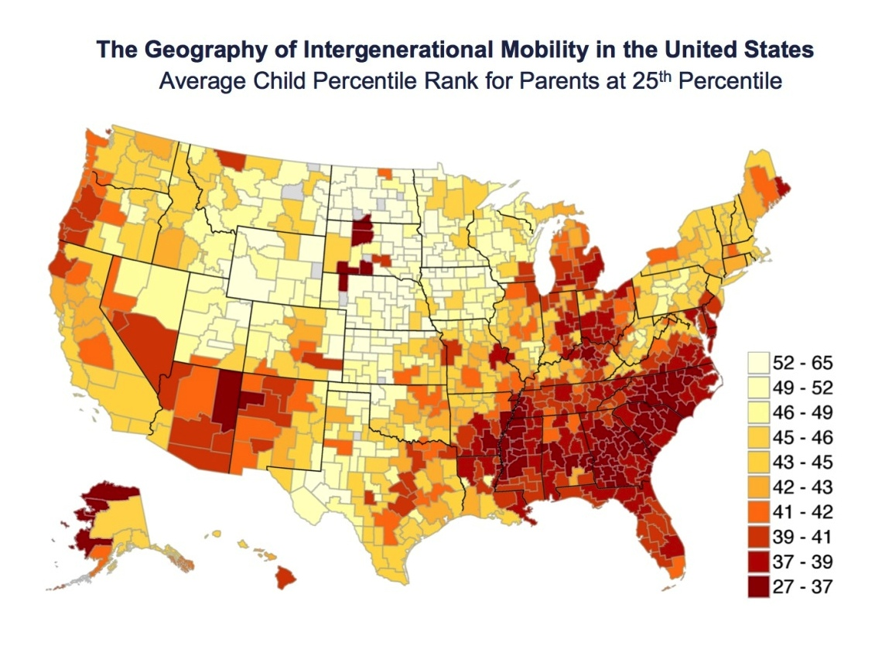
Charlotte 50th of 50 Cities
Top 5 Cities
San Jose (10.8%)
San Francisco
Washington DC
Seattle
Salt Lake City
Bottom 5 Cities
Indianapolis
Dayton
Atlanta
Milwaukee
Charlotte (4.4%)
Notes:
In 2013, Harvard University and the University of California Berkeley released a study of opportunity in 50 large US cities.
The Chetty study, as it is now known:
Looked at children born between 1980-1982.
Child and parent pairs were coded by 714 commuting zones.
The study compared adult children’s positions on the national income distribution with their parents’.
Fro this analysis, the Chetty study contains news for Charlotte-Mecklenburg that is surprising for some of us and perhaps not surprising at all for others.
A recent Harvard/UC Berkeley study shows we are last among 50 communities ranked by economic mobility.

Slide 22



FUTURE ?
What lifts me up?
What holds me down?
Notes:
The rankings mean that a child born into a low income family in Charlotte-Mecklenburg will struggle to move up economically.
Too many economic bricks hold them down and too few economic balloons lift them up.

Slide 23
What We
Are Doing
Notes:
So…it doesn’t take much to understand now that our community has an issue that we must deal with.
And as we do, we are joining together to respond.

Slide 24


A Community Task Force
Notes:
The OTF was created to do help close the gap between our vision and reality. Our purpose is to explore these issues and make recommendations by the end of next year on how our community can address challenges that are core to economic mobility and opportunity.
Our Opportunity Task Force members have taken on this challenge and are a dynamic and diverse group of 20 people from across Charlotte-Mecklenburg.

Slide 25


Partners
+
the community
Notes:
We are pleased to have great partners on this journey who are providing financial support and guidance.
They include:
Mecklenburg County
City of Charlotte
Foundation For The Carolinas, who is supporting the OTF with management and resources.
Knight Foundation
John Belk Endowment
Z. Smith Reynolds Foundation
Plus, the very important voice of the community and that is why we are here tonight.
I’m going to turn things back over to Ophelia.

Slide 26
Process & Milestones
?
2015
2016
May | Jun | July | Aug | Sep | Oct | Nov | Dec | Jan | Feb | Mar | Apr | May | Jun | July | Aug | Sep | Oct
Discovery Phase
Learning Understanding Root Causes Framing
Plan Development Phase
Visioning Narrowing Strategizing Testing Refining
Factor 1
Milestone #1
Discovery Report
What we have learned
Milestone #2
Opportunity Dashboard
What we want to change and measure
Milestone #3
Final Report
Actionable recommendations
Content Experts and Data
Current state
Historical context
New trends
Early ideas
Leverage points
Big
Goal
Setting
Factor 2
Factor 3
Factor 4
Factor 5
Community/Stakeholder Engagement and Input
opportunitycharmeck.org

Slide 27
What We
Have Learned
Notes:
The task force has heard from experts and is also hearing from the community.
I want to share with you what we know so far.

Slide 28








5 Opportunity Indicators
Notes:
The Chetty study discovered that there are five factors correlative to economic mobility and opportunity that correspond closely to a community’s opportunity ranking.
These factors are:
Segregation
Income inequality
School quality
Social capital
Family structure
There are other factors that we believe affect opportunity, too, such as health and housing.
Each one of these factors can help or hold back overall economic mobility in a community – our community seems to hold more balloons than bricks for some of us.
Let’s take a quick look at the factors here in Charlotte-Mecklenburg.

Slide 29

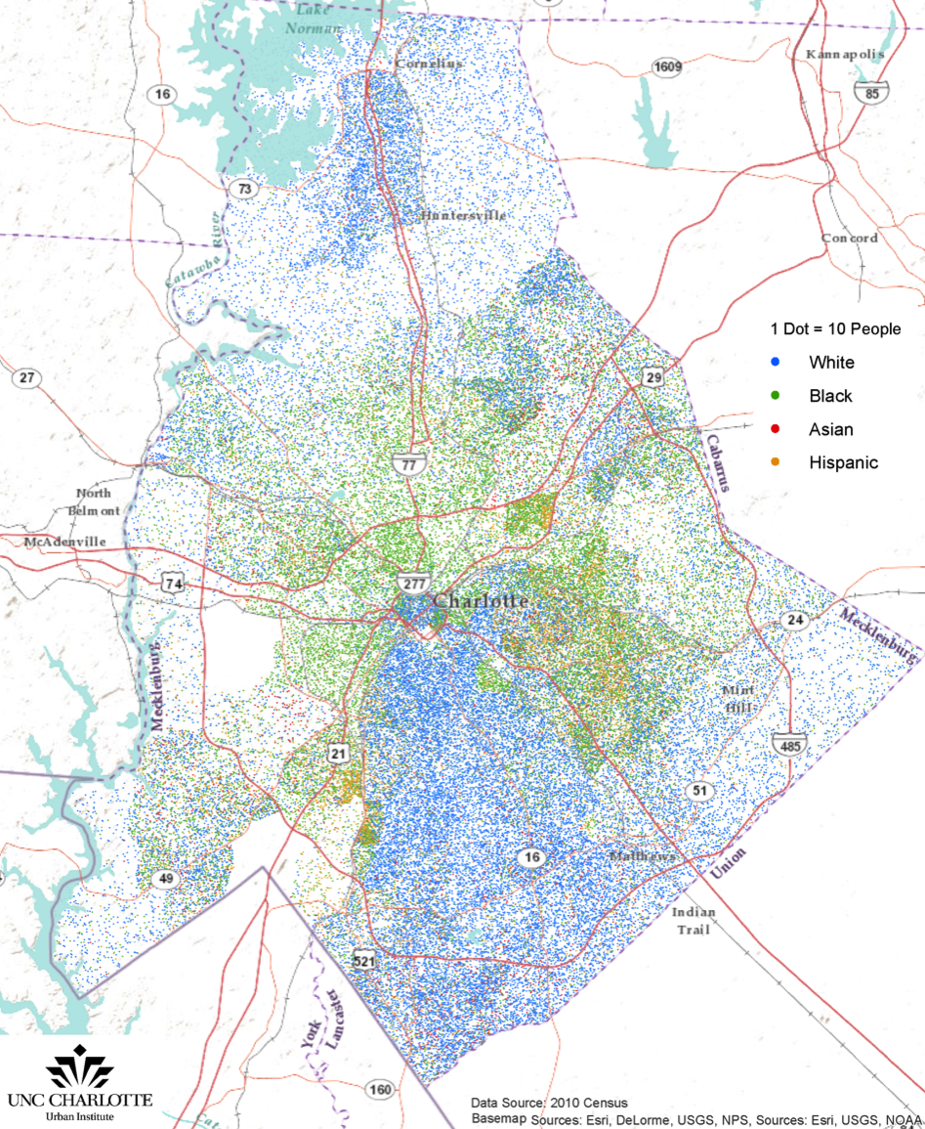
We Are Segregated
by race and ethnicity
North and south predominantly white; east and west predominantly people of color
Notes:
This map shows the distribution of our population by race and ethnicity in the community.
It’s not hard to see that the blue dots representing WHITE populations are heavily concentrated in the North and South quadrants of our County.
Black, Asian and Hispanic populations are heavily concentrated in the West and East quadrants.
We are a racially and ethnically segregated community – this is one of the primary correlations to low economic mobility.
NOW – pay attention to the shape that you see made by mostly the GREEN dots, which represent Black households. The “arc” or “horseshoe” shape you see will show up again and again and again, across the other correlative factors for low economic mobility.

Slide 30

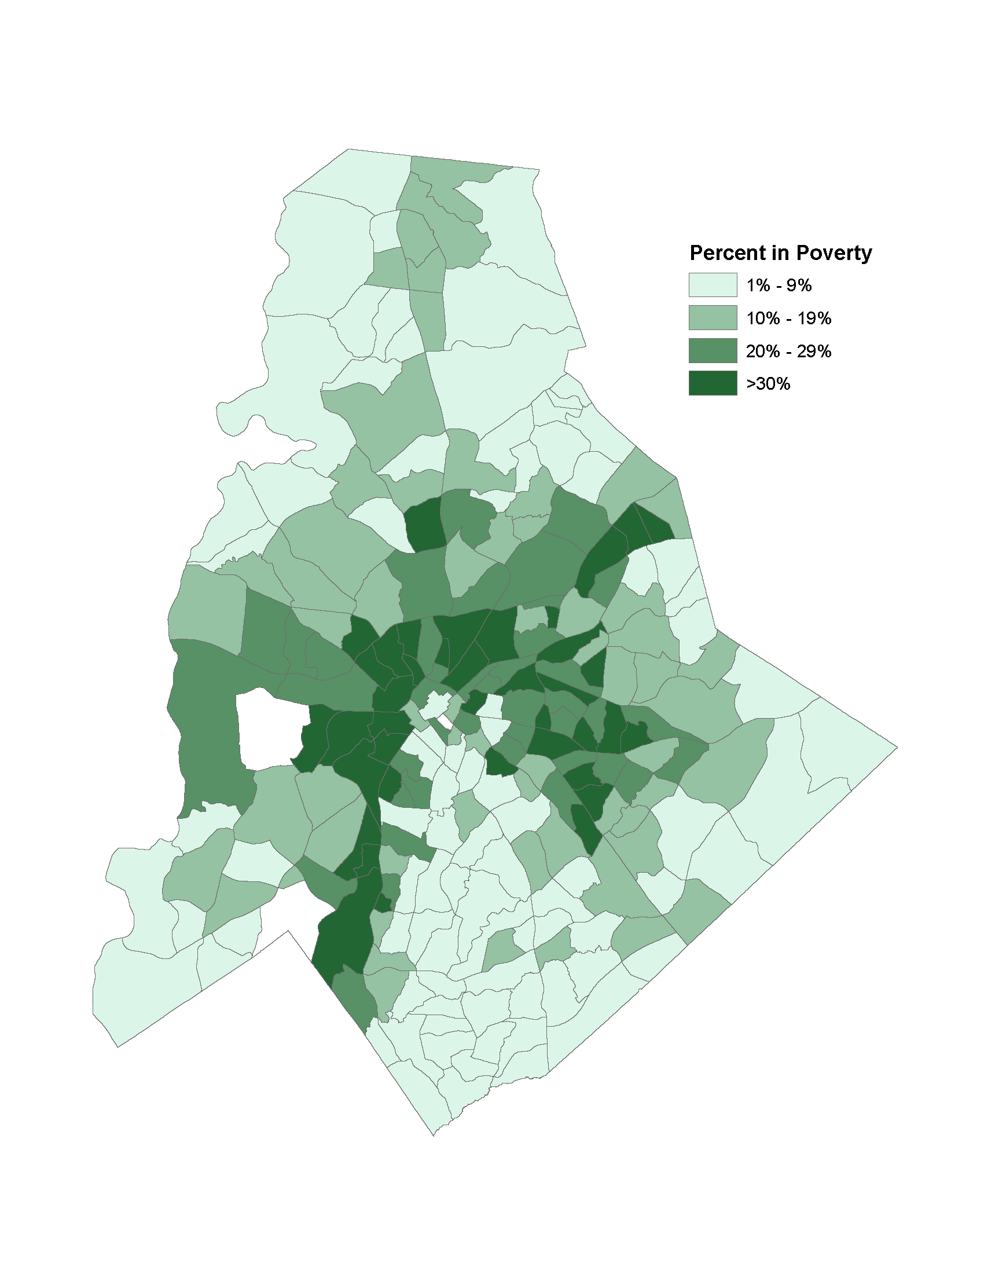
We Are Segregated
by income
We are 9th in segregation of wealthy, college-educated, and working class
Data source: U.S. Census Bureau, 2013 American Community Survey
Notes:
Again, you see the “arc’ shape.
If you had this map in front of you, you could see the breakdown of specific income categories and concentrations of poverty.
To make it easy
On the left hand map, the lighter the color green, the lower the income level. The darkest areas are where 15% or more of households earn in excess of $200,000 annually. The lightest areas show where from 0-3% of households earn in excess of $200,000, which is…just about none.
One the right hand map, the darker the color green, the HIGHER the concentrations of poverty. In the darkest green areas, 30% or more of households live in poverty. In the lightest areas, from 1-9% of households live in poverty.

Slide 31

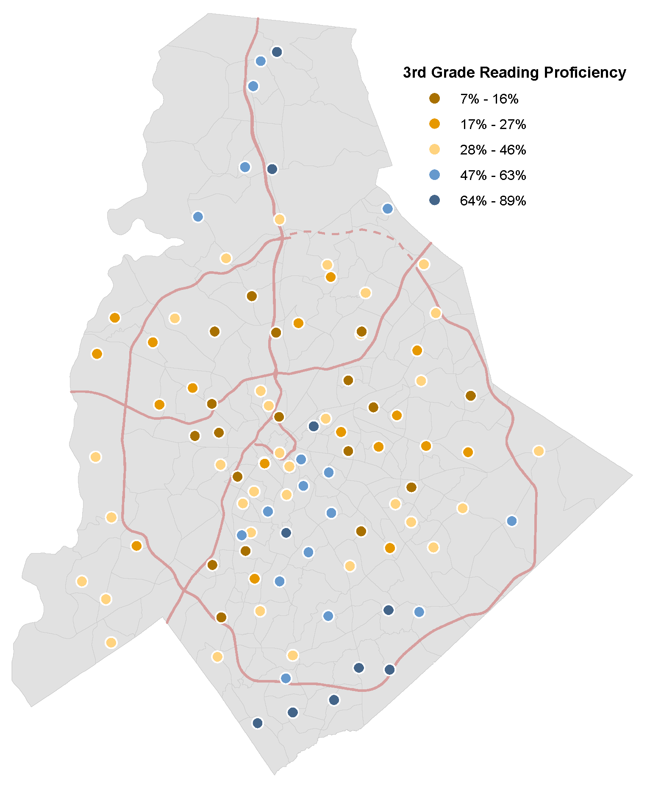
We Are Segregated
by educational achievement
47% of CMS 3rd graders reading attainment levels split by poverty and race
Data source: North Carolina Department of Instruction, 2012-13
Notes:
3rd grade reading proficiency is a key indicator of future academic success by educational experts. In other words, if you’re not proficient in reading by 3rd grade, you are much more challenged to succeed academically in all other areas.
Looking at this map, you can see that the blue dots in the South and North of our County reflect the highest levels of 3rd grade reading proficiency.
The yellow, orange and brown dots represent median to lowest levels of 3rd grade proficiency.
Again, we see the “arc” of opportunity bent in our community.

Slide 32

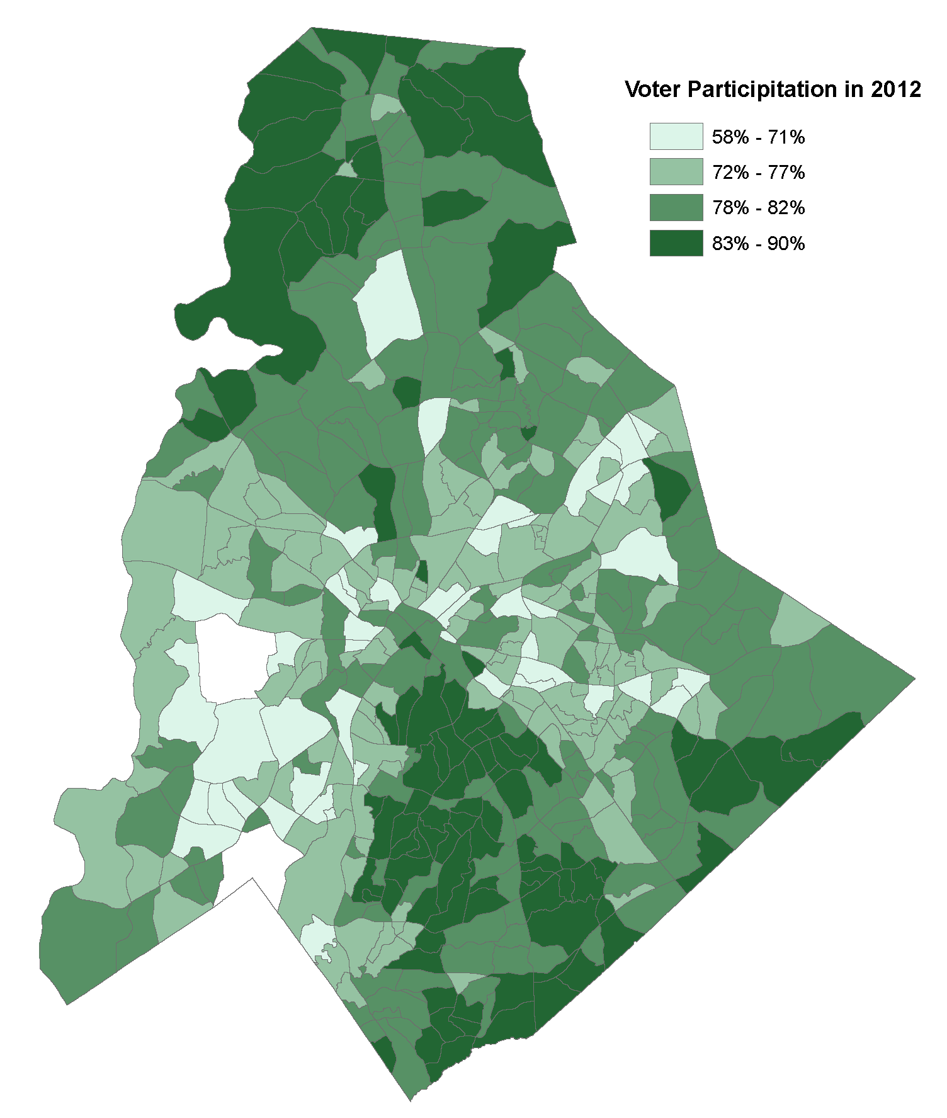
We Are Segregated
by levels of social capital
Voter turnout lower in east and west, higher in north and south
Data source: North Carolina Board of Elections
Notes:
Voter turnout is a key indicator of the level of social capital in a community.
This map of voter participation from 2012, a presidential year and thus unusually high compared to other election cycles, shows that the “arc” of opportunity again conforms to the shape we’ve seen in our other maps of correlative factors to economic mobility.
The lighter areas are areas of lower turnout in the West and East; the darker areas in the North and South reflect higher turnout.

Slide 33

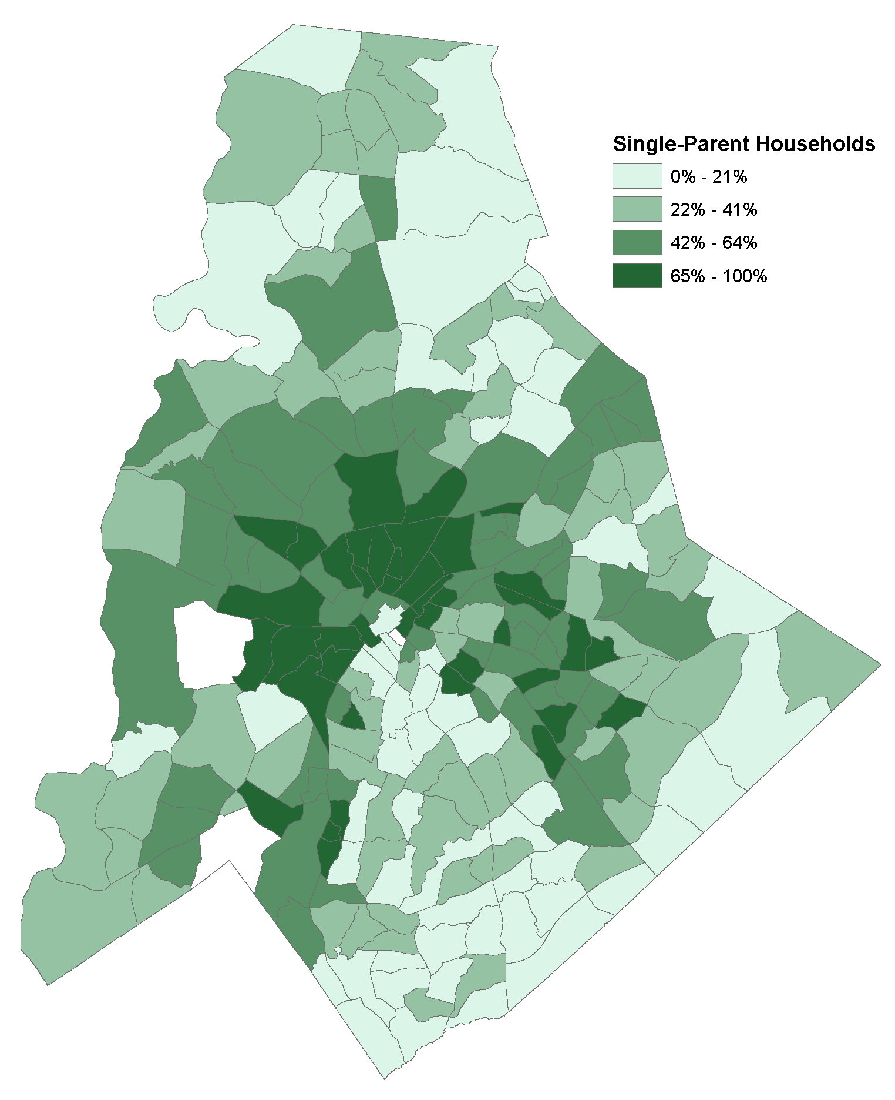
We Are Segregated
by family structure
47,000 single-parent households in Mecklenburg are concentrated in east and west.
Data source: U.S. Census Bureau, 2013 American Community Survey
Notes:
Of all of the correlative factors identified in the Chetty study, family structure is perhaps the most telling.
The higher the number of single parents households as a percentage of the total population a community has, the lower the prospects for economic mobility across generations.
In this map you see again the familiar shape of a segregated community, this time by family structure.
We are learning that really no matter what factor we study, this shape of opportunity made more difficult shows up again and again.
There is much more data on the website and distributed daily through our social media.

Slide 34
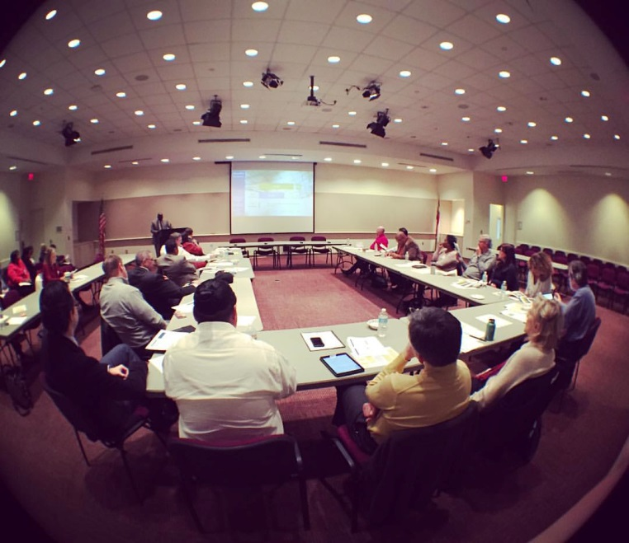
Top Lessons from
EXPERTS (so far)
Commit to the long haul
Think systems, not programs
No magic solution
Human, social, financial resources
Support single parents
Critical factors
    Early childhood development
    Quality childcare
    3rd grade reading
    Family stability
    Positive role models
    Strong social connections
Notes:
As I said, we have talked to experts both nationally and locally.
Nationally: Brookings Institute. Pew Charitable Trusts. Harvard
Locally: leaders and thinkers on education, literacy, child care, early childhood development and public health. We will hear from more as we keep moving forward.
You can find everything they have shared with us at opportunitycharmeck.org.
Keep in mind…we are still in the Discovery Phase of our work, but we do have some early guidance.
Commit to the long haul
No magic solution
Human, social, financial resources
Support single parents
Critical factors
Early childhood development
Quality childcare
3rd grade reading
Family stability
Positive role models
Strong social connections

Slide 35
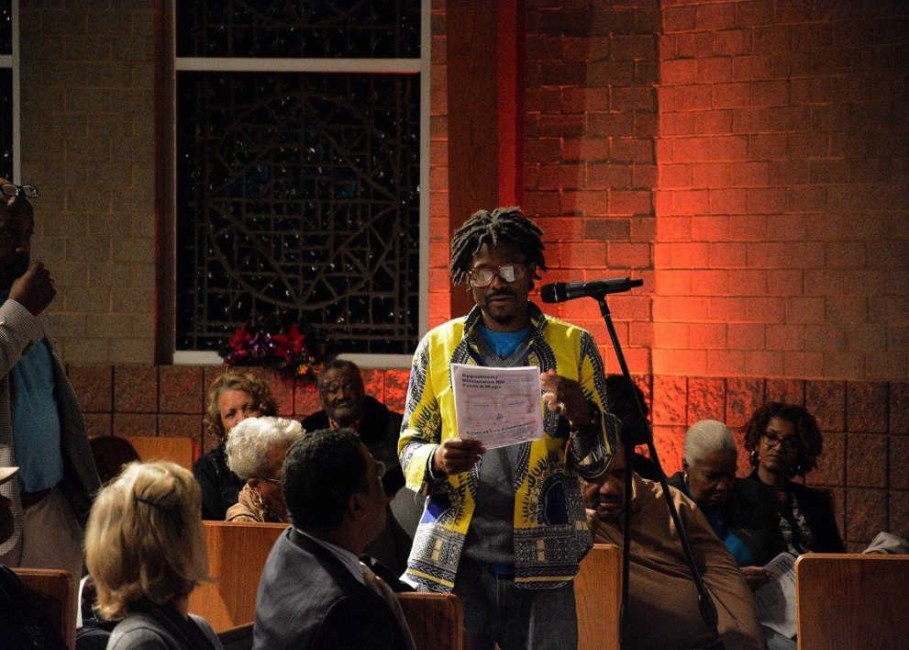
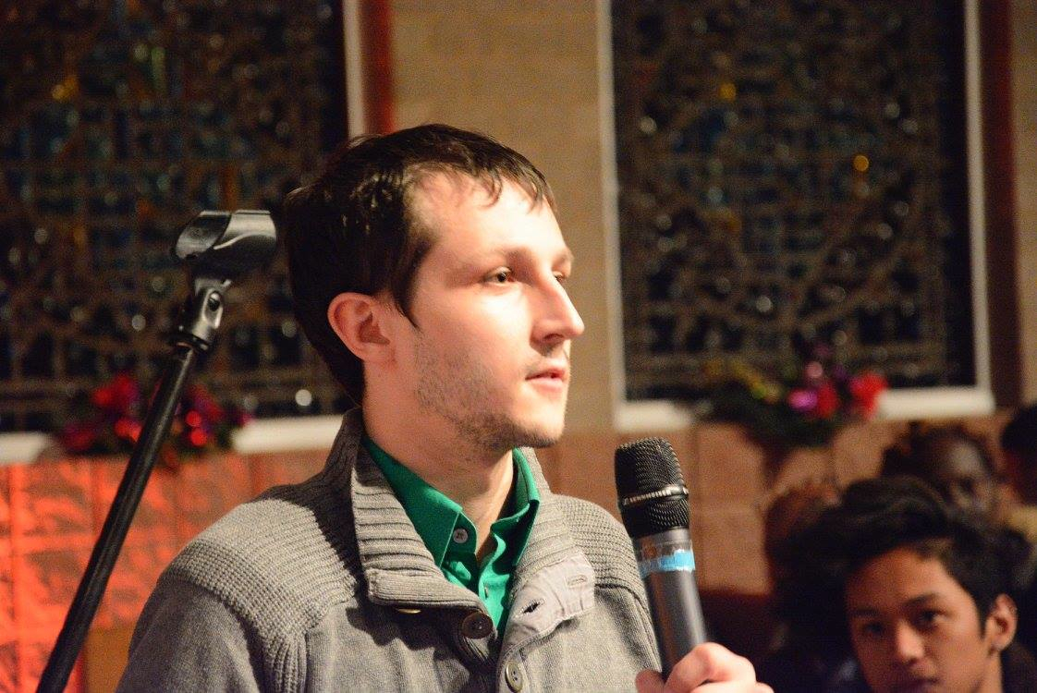
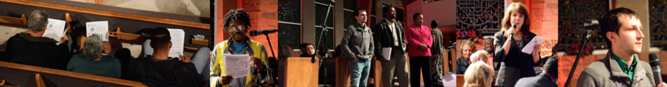
Top Priorities from
THE COMMUNITY (so far)
275 surveys, social media, the Opportunity website and community discussions
Quality K-12 education
Affordable childcare/after school
Affordable housing
Access to good jobs and living wages
Transportation
Connecting people across differences
Mentors and positive role models
Notes:
We’re also reaching out to the community with a series of listening tour town halls across the community, an on-line survey and a discussion kit that you can host on your own.
What we’re hearing so far is probably not surprising to most of you.
Quality K-12 education
Affordable childcare/after school programs
Affordable housing
Access to good jobs and living wages
Transportation
Connecting people across differences
Mentors and positive role models

Slide 36
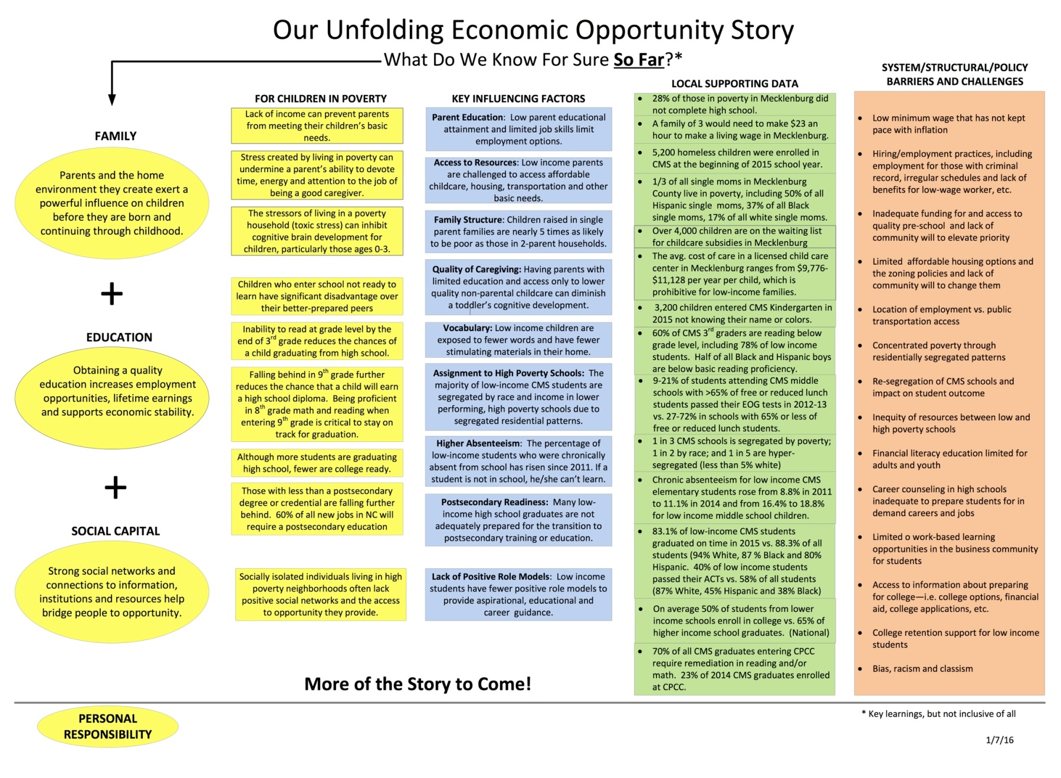
More details available…
Notes:
For those of you that want more detail, go to opportunitycharmeck.org

Slide 37
System/structural/policy barriers (so far)
SCHOOLS | COMMUNITY
Inadequate funding for and access to quality pre-school and lack of community will to elevate priority Re-segregation of CMS schools and impact on student outcome Inequity of resources between low and high poverty schools Career counseling in high schools inadequate to prepare students for in demand careers and jobs Limited/unequal access to information about preparing for college College retention support for low-income students | Low minimum wage that has not kept pace with inflation Hiring/employment practices, including employment for those with criminal record, irregular schedules, lack of benefits, etc. Limited affordable housing options and the zoning policies and lack of community will to change them Location of employment vs. public transportation access Concentrated poverty through segregated residential patterns Financial literacy education limited for adults and youth Limited work-based learning opportunities in the business community for students Bias, racism and classism

Slide 38
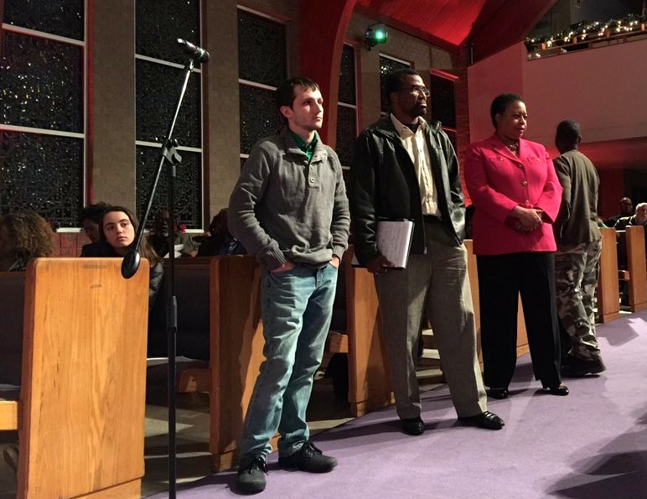
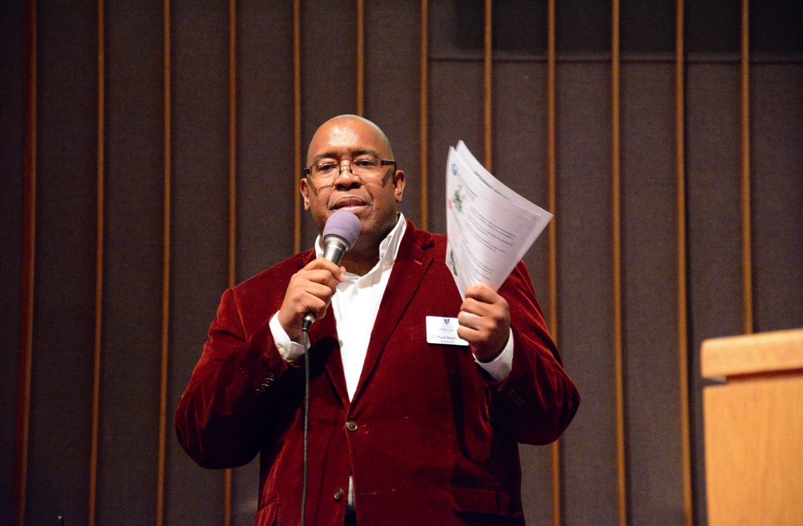
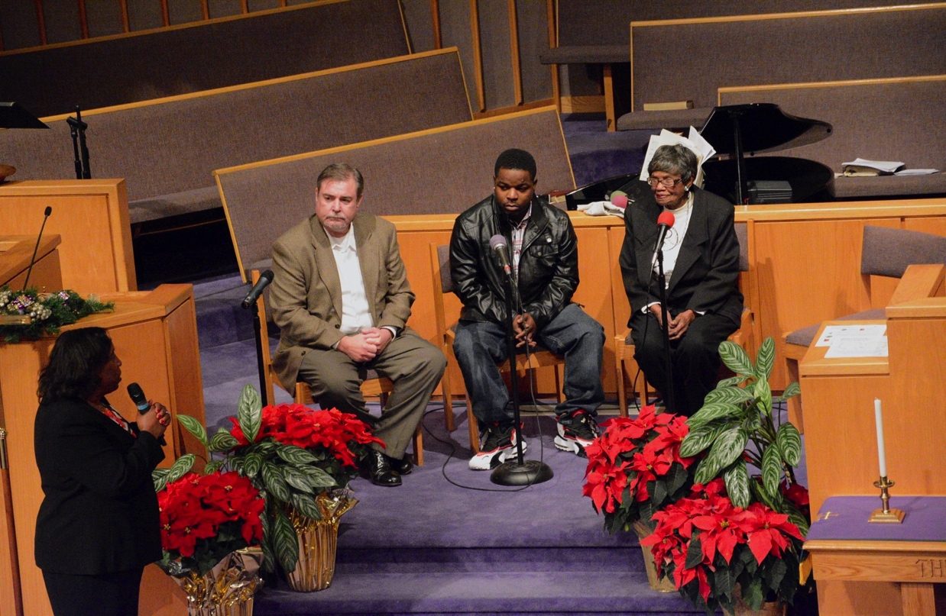
5 Ways to Help
1 Survey
opportunitycharmeck.org
2 Follow
facebook and twitter
3 Host
small group
4 Attend
listening tour
5 Share
what you have learned
Notes:
There are five ways to help.
1. Sign up at opportunitycharmeck.org
2. Follow the Task Force on social media
3. Host a small group discussion with a discussion kit available on the website
4. Join one of the listening tour town halls
5. Share what you learn with everyone around you.

Slide 39
opportunitycharmeck.org

Slide 40
Charlotte: An engine of prosperity and social transformation
Guiding principles of metropolitan revolution are a road map for sustained community-wide growth
Feedback from Opportunity Task Force identifies challenges that are barriers to reaching our economic potential
City of Charlotte is well-positioned to support actions that capitalize on growth and create an inclusive opportunity economy

Slide 41
Policy implications
Balancing growth and opportunity

Slide 42
Creating sustainable growth and economic opportunity
Themes from Opportunity Task Force:
Affordable housing
Access to good jobs and living wages
Transportation and land use
Engagement and youth programs
+
Community safety

Slide 43
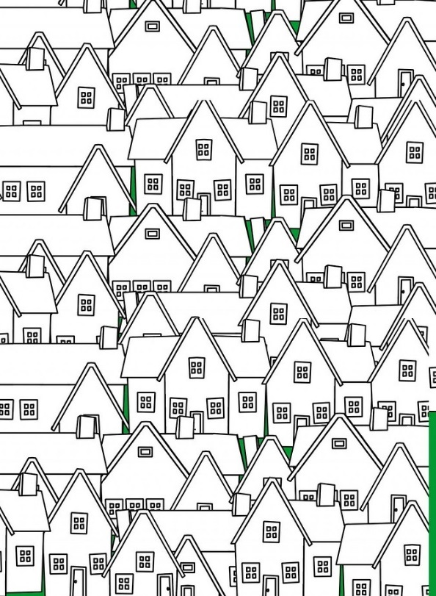

Affordable housing

Slide 44
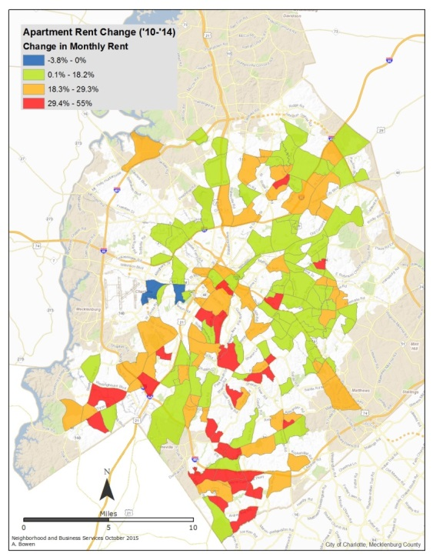
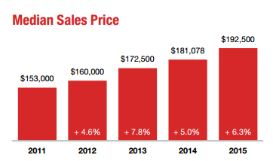
Housing costs rising as incomes stagnate
Sources: American Community Survey, 1-year estimates 2007-2014; Charlotte Regional Realtor Association 2015; Real Data Inc. 2015
Notes:
Rental housing costs increasing and expected to continue to rise, while wages and household income stagnate
From 2010 to 2014, average apartment rent per square foot increased approximately 18%, though appreciation ranged as high as 55% in some areas. Twenty-four neighborhood areas experienced an average increase of 30% or more. The average monthly apartment rent reached $1,000 for the first time in 2015, and this rent growth is not projected to slow down, despite the large number of apartments currently planned and under construction

Slide 45
Charlotte losing market-rate affordable units as share of total
Affordable refers to housing where market-rate rents do not exceed 30% of a household’s income. In 2014, 58% of housing units in Charlotte were affordable to a household earning less than $38,520 (60% AMI).
Sources: American Community Survey, 1-year estimates 2007-2014; US Department of Housing and Urban Development Income Limits Documentation
Notes:
This trend line will continue down
Greater Charlotte Apt Association Multi-Family Forecast – approx. 32,000 new units coming online within next two years, few if any affordable
Can note: Over 100,000 households in 2014 at <60% AMI
Understates need because HUD bases 30% on gross income, and nobody lives on gross income, plus large portion of <80% households rent down
HUD estimates the need in Charlotte at 34,000 units

Slide 46
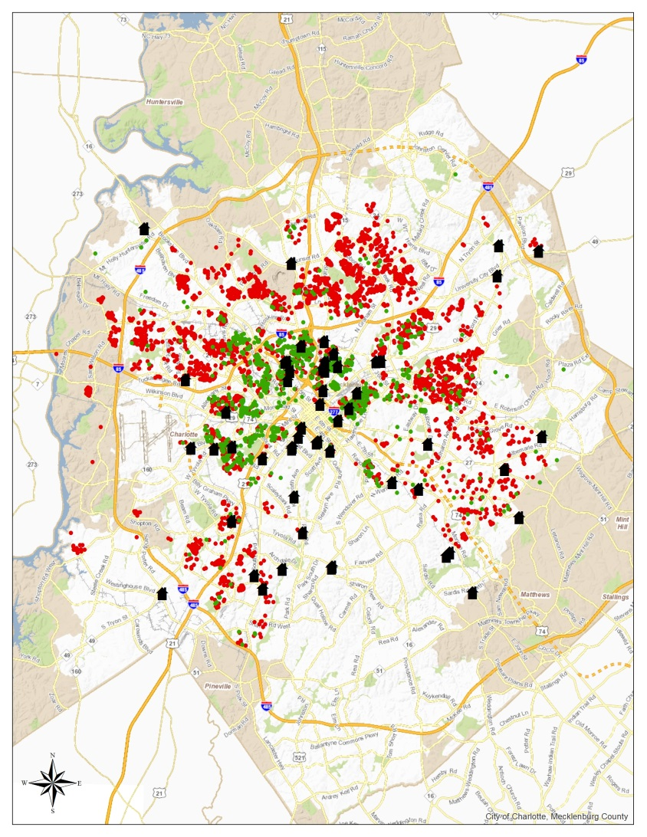
City programs provide quality affordable housing…
4,211
4,211
Invested in
units over last 5 years:
1,467 Housing Trust Fund
1,207 House Charlotte Loans
1,537 Rehabilitated Units
Source: City of Charlotte

Slide 47
…but there’s more to do
1 in 3 households in Charlotte now pay more than 30% of income on housing costs
34,000 affordable housing units needed in Charlotte, per recent HUD estimates
Senior population will grow rapidly, about half expected to be <60% AMI and need affordable housing
Source: US Department of Housing and Urban Development, Comprehensive Housing Affordability Strategy (CHAS)
Notes:
Of note:
Over 100,000 cost-burdened households
44% of renters are cost-burdened
Cost burden rises to 3 out of 4 households for those earning less than 50% AMI

Slide 48

Access to good jobs and living wages

Slide 49
Jobs are growing, but some will grow more than others
Customer service
$15
Health aides
$10
Retail sales
$10
Food prep
$8
Nurses
$28
Laborers
$11
Median wages for forecasted high-growth occupations in Charlotte, 2010-2020.
Source: NC Department of Commerce, prepared for the Charlotte-Mecklenburg Workforce Board.

Slide 50
City of Charlotte is leading the way as an employer
Near-site health clinics for City employees and dependents
FY16 budget included funds to bring all City employees’ wages up to 60% of Area Median Income for a family of one (approximately $27,000 annually or $12.98/hour)

Slide 51
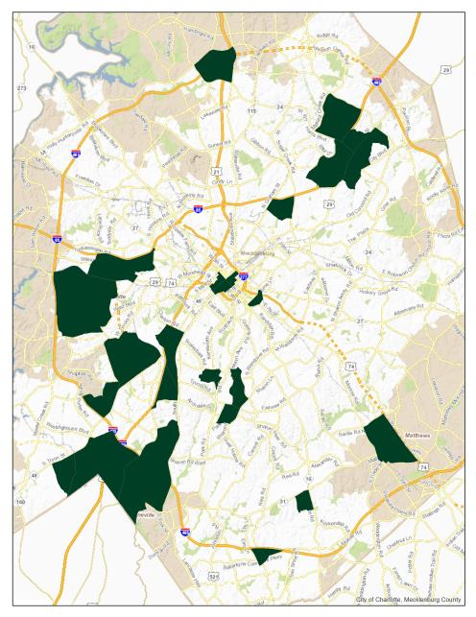
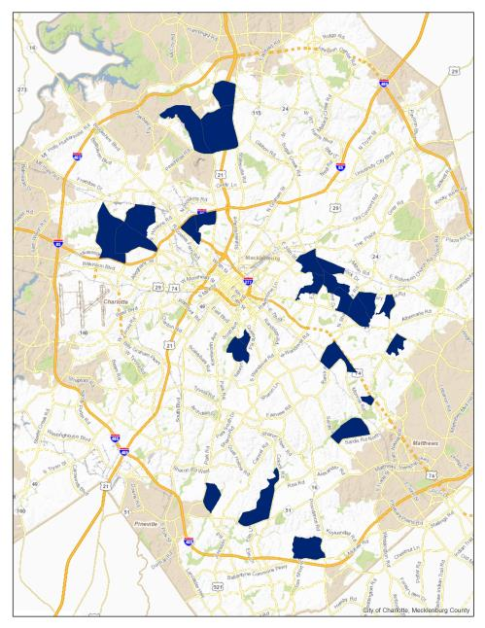
Access to jobs is also critically important
Top Areas Where Low-Wage Workers
Work
Live
Work
Live
Source: US Census Longitudinal Employer-Household Dynamics
Notes:
Dispersion and supply of affordable housing
Transportation and land use
Transit options

Slide 52
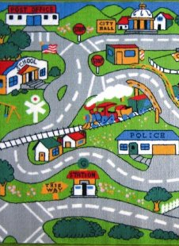
Transportation and land use

Slide 53
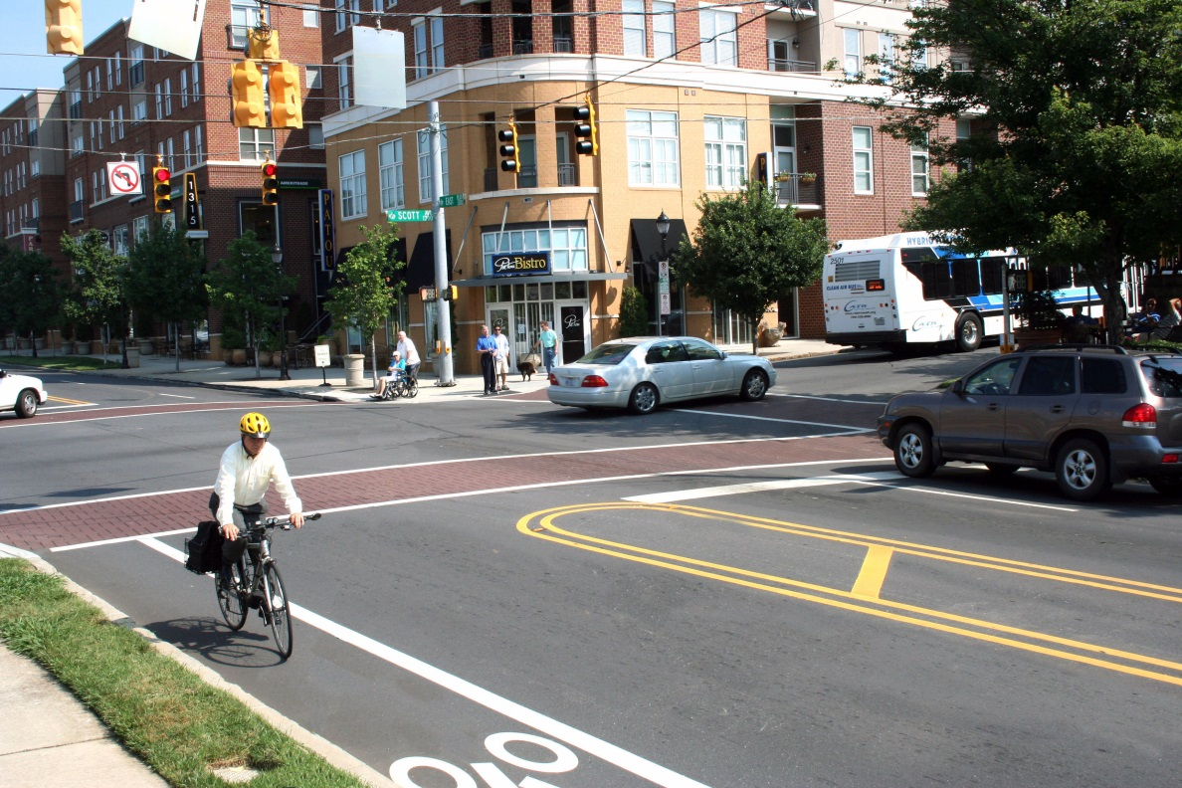
Connectivity, mobility options, mixed-use support opportunity for all

Slide 54
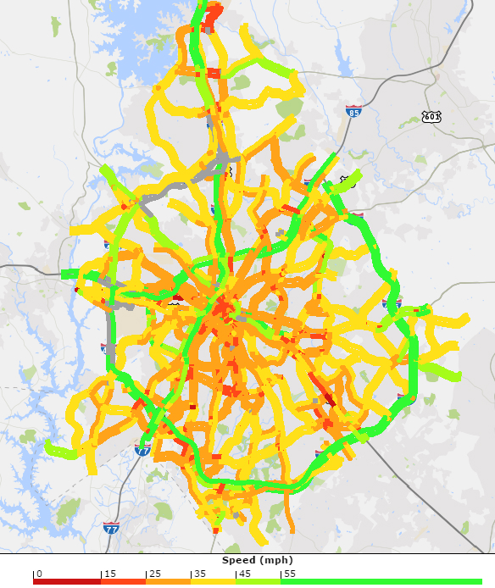
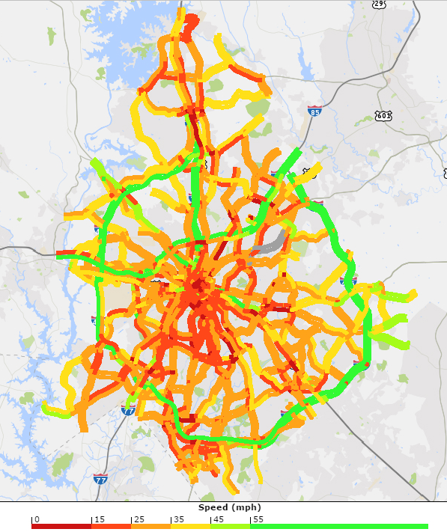
Travel demand increasing rapidly as region grows and economy rebounds
2011
2015
*INRIX data for every Tues, Wed, Thurs in April
Notes:
170,000+ in-commuters

Slide 55
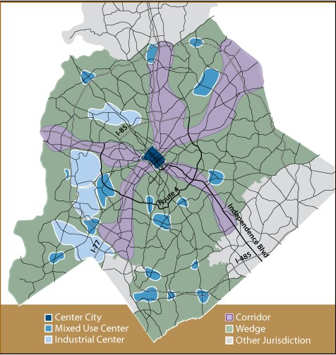

How will Charlotte accommodate growth and promote opportunity?
Capacity
Smart Land-Use
Transit
Other Travel Choices
Smart City Innovations

Slide 56

Engagement and youth programs

Slide 57
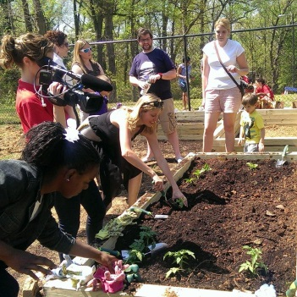


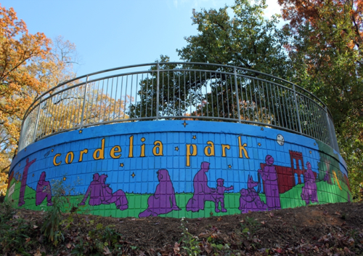


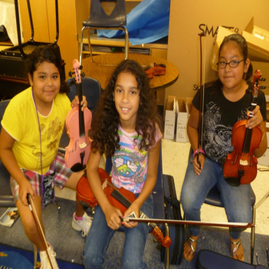
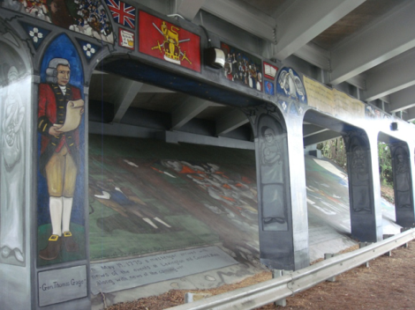

Engagement programs connect and empower neighborhoods
Neighborhood Board Retreats
Technical Training (“How-To”)
Neighborhood Matching Grants
Keep Charlotte Beautiful
Neighborhood-School Partnerships
Neighborhood
Leadership Academy
Neighborhood Advocates
Need A Speaker?

Slide 58

Youth employment and engagement support economic opportunity
34% of youth aged 16-19 are unemployed
3,471 youth aged 16-17 are living in poverty
In 2014, City of Charlotte youth programs supported:
313 students in Mayor’s Youth Employment Program
1,172 students employed with Carowinds
119 students participating on Youth Council
Sources: City of Charlotte; US Census American Community Survey 1-Year Estimates 2014
Notes:
3,471 out of 16,265 (21%)

Slide 59
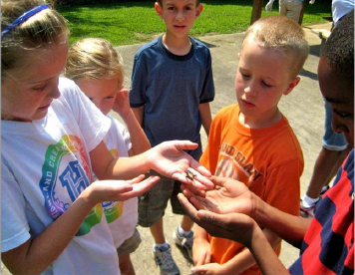
Out-of-school time programs support youth and working parents
30,900 school-age children in Mecklenburg County living in poverty
As of 2011 system scan:
Estimated 11,000 program slots for 4-5 days/week
Approximately 1,500 children were on the waiting list for school-age child care subsidy
Another 2,300 on waiting lists for other free and subsidized programs
In 2014, City of Charlotte funding sponsored 1,183 students in Out-of-School Time programs
Sources: City of Charlotte; The State of Out-of-School Time in Mecklenburg County 2011; US Census American Community Survey 1-Year Estimates 2014
Notes:
30,901 out of 160,943 (19%)
School-age for these purposes is 5-17 (those are the age categories we can get from ACS)

Slide 60

Community safety

Slide 61
Long-term decline in crime rates but increase in 2015
Source: Charlotte-Mecklenburg Police Department 2015; FBI Uniform Crime Reporting 2004-2014
* 2014 population used to forecast 2015 rate, likely slightly inflated

Slide 62
Crime numbers in 2015 exceeded 3-year average
CMPD ended 2015 7.8% above the 3-year average (2012-14) in Index Offenses
  Property crime exceed 3-yr average by 6.3%
  Violent crime exceeded 3-yr average by 16.6%
Largest percentage increases seen in:
  Homicide (60, +22.4%)
  Aggravated assaults (3,735, +19.5%)
  Vehicle thefts (2,230, +17.4%)
Residential burglaries down (4,973, -2.9%)

Slide 63
Some up, some down: A look at national trends
City | 2014 | 2015 Projected
Houston, TX | 5,601 | 6,099
Philadelphia, PA | 4,051 | 3,933
Phoenix, AZ | 4,211 | 4,016
San Antonio, TX | 5,848 | 6,347
San Diego, CA | 2,492 | 2,885
Dallas, TX | 4,164 | 4,091
San Jose, CA | 2,709 | 2,910
Austin, TX | 4,432 | 4,132
Fort Worth, TX | 4,731 | 4,546
Charlotte, NC | 4,369 | 4,652
Seattle, WA | 6,627 | 5,862
Denver, CO | 3,695 | 3,869
Baltimore, MD | 5,962 | 6,181
Oklahoma City, OK | 5,094 | 4,592
Portland, OR | 5,227 | 3,941
Sources: Brennan Center 2014; FBI Uniform Crime Reporting 2014
Notes:
Based on analysis of the 30 largest cities (population served, not city size) – these 15 had data available for comparison
Not a peer city analysis
Not a ranking – used to illustrate variability in national trends – some up and some down year-over-year
Should not rank locales because there are many factors that cause the nature and type of crime to vary from place to place

Slide 64
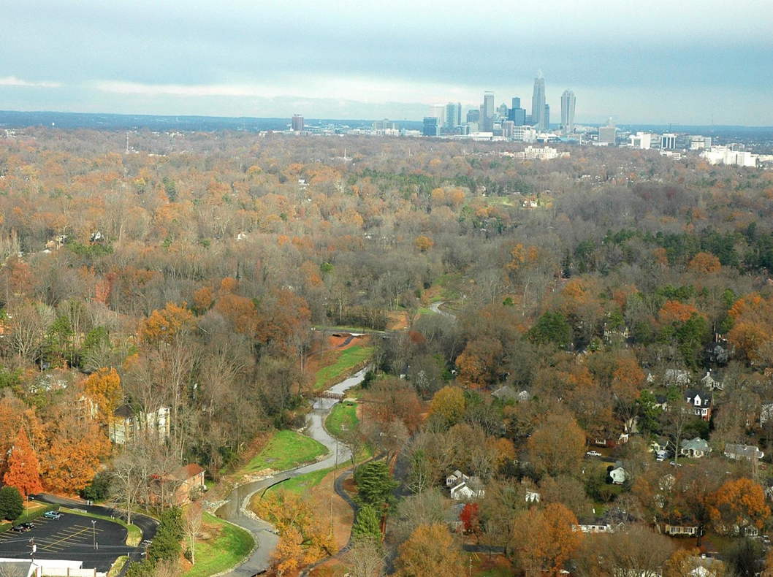
How will we harness these opportunities?
Charlotte is experiencing transformative change.

