Slide 1
Boston Youth Jobs App

Slide 2
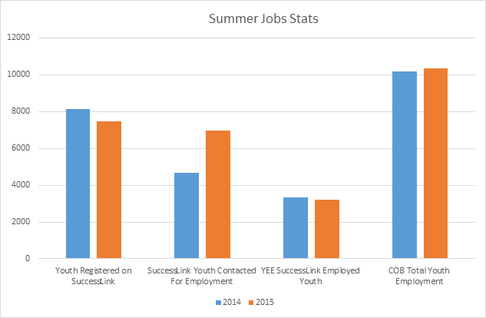
The Challenge
Hard to get a job as a young person, often competing with adults and thousands of youth
Antiquated application process creates barriers for many youth
Youth Employment and career development go hand in hand. When employees are prepared, they are seen as assets

Slide 3
The Quest for Summer Employment!
March:
Wait
May:
More Docs
July:
Work Begins
February:
Apply
September:
Back to School
April:
Submit Docs
June:
Pick a Program
August:
Work Ends
“Does it really take all of this for a CHANCE at a summer job?”
- Yves , Age 15.

Slide 4
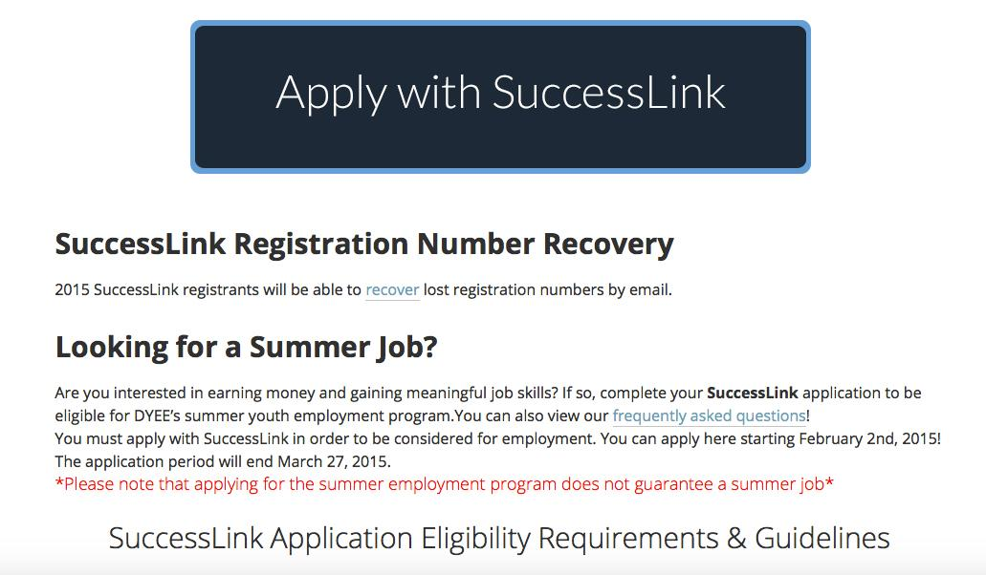
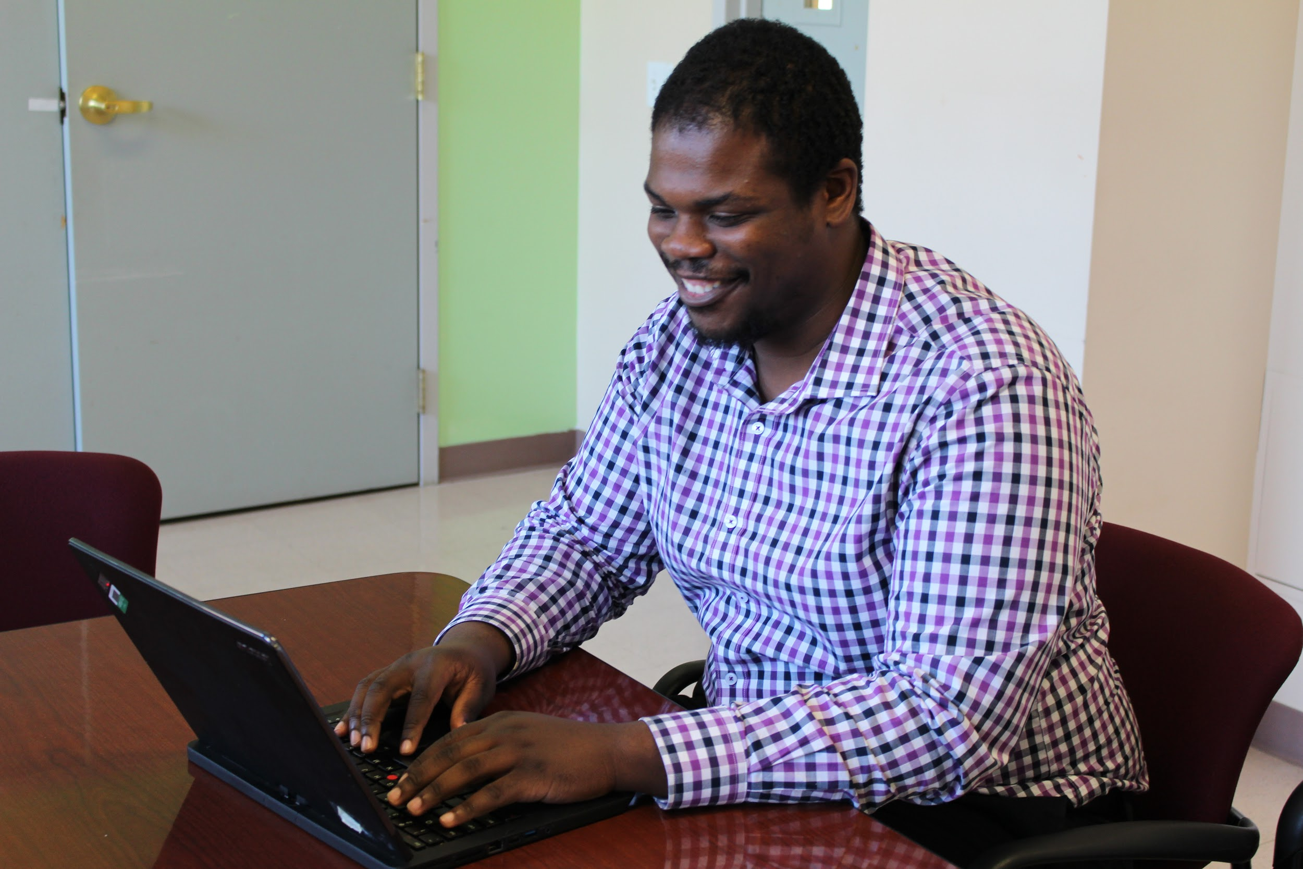
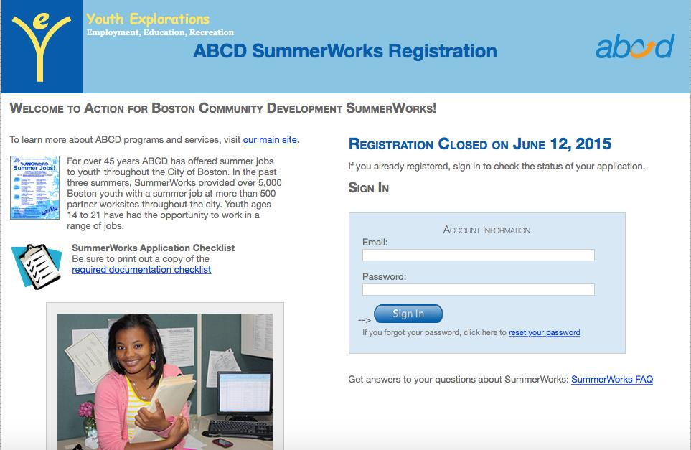
February:
The Registrations Open
Notes:
Yves, a 15 year old BPS student from Mattapan, is now eligible to apply with the City of Boston SuccessLink program.
He had applied with ABCD last year when he was 14 and was able to work at a local community center. He applies with them and now with SuccessLink (YEE)
February 1st, he grabs his phone and heads over to youth.boston.gov to apply! However when he does that, the application doesn’t fit on his phone screen!
He now has to go find a computer at his school because he doesn’t have one at home. He needs his SSN to apply as well, so he has to bring his card with him because he doesn’t have it memorized.
Completes application and receives registration number (notices he enters very similar information as to what he did with ABCD this year and the year before). He is now one of 7,398 young people between 15 and 18 looking for a summer job through the SuccessLink program.

Slide 5
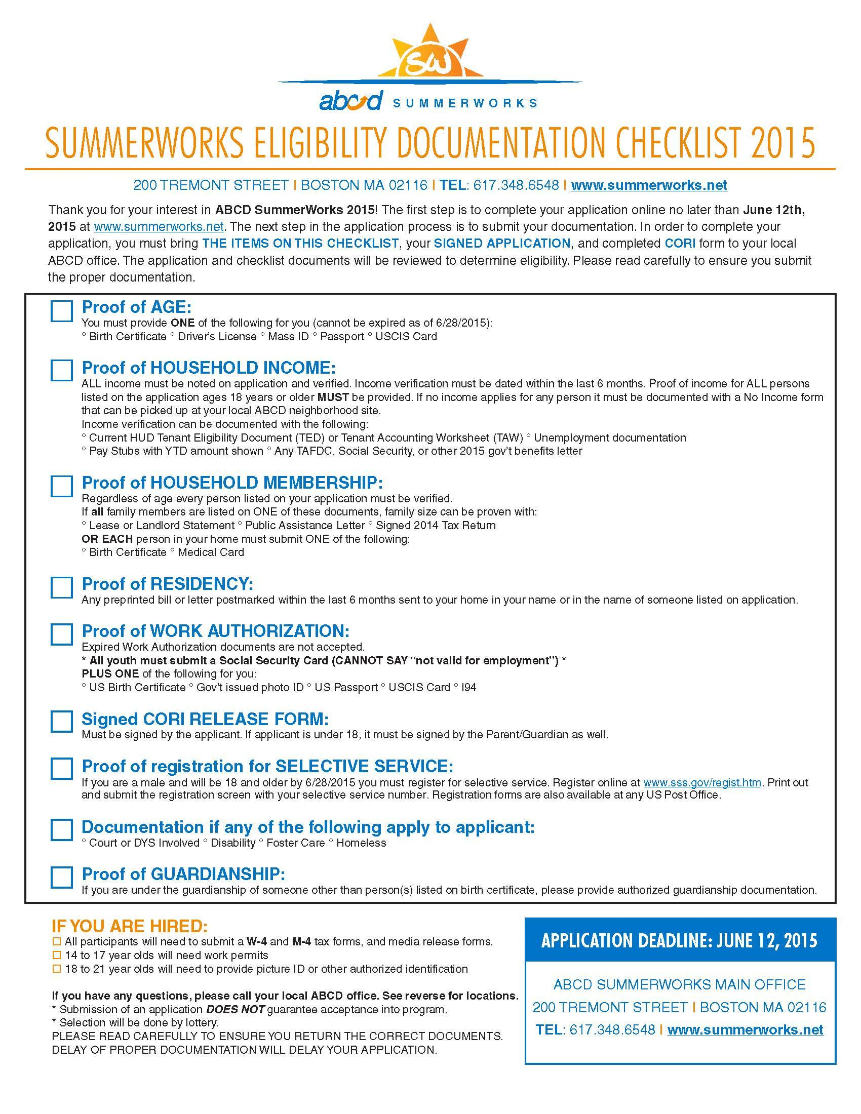
Notes:
Youth Applications to three sites - divided constituent targeting

Slide 6
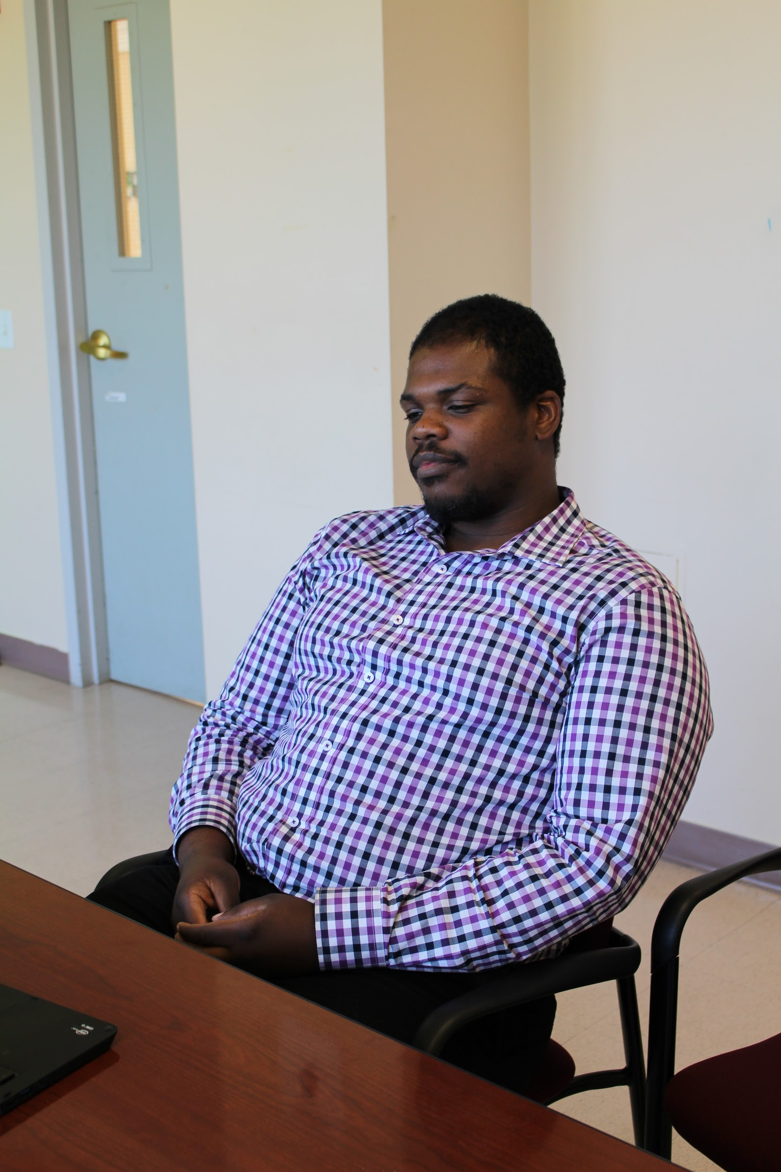
March: The Waiting Game
I should hear back soon!
It won’t be much longer!
It can’t be much longer…
Maybe I won’t get picked this year.
Notes:
Yves has completed the application and looks at the listing. He sees the community center that he worked at last year on the list, as well as some new places.
He talks to his supervisor from the summer prior about how to work there again, but doesn’t get a direct answer, and leaves without a clear understanding of how to be picked.
He waits to hear back from that one program he is previously connected to, but doesn’t take the opportunity to try and connect to a new organization. If he does, he could potentially secure employment somewhere new!
His only options at this point are to wait to hear from his community center, or get assigned randomly within the next several weeks (along with thousands of young people that applied with SuccessLink).

Slide 7
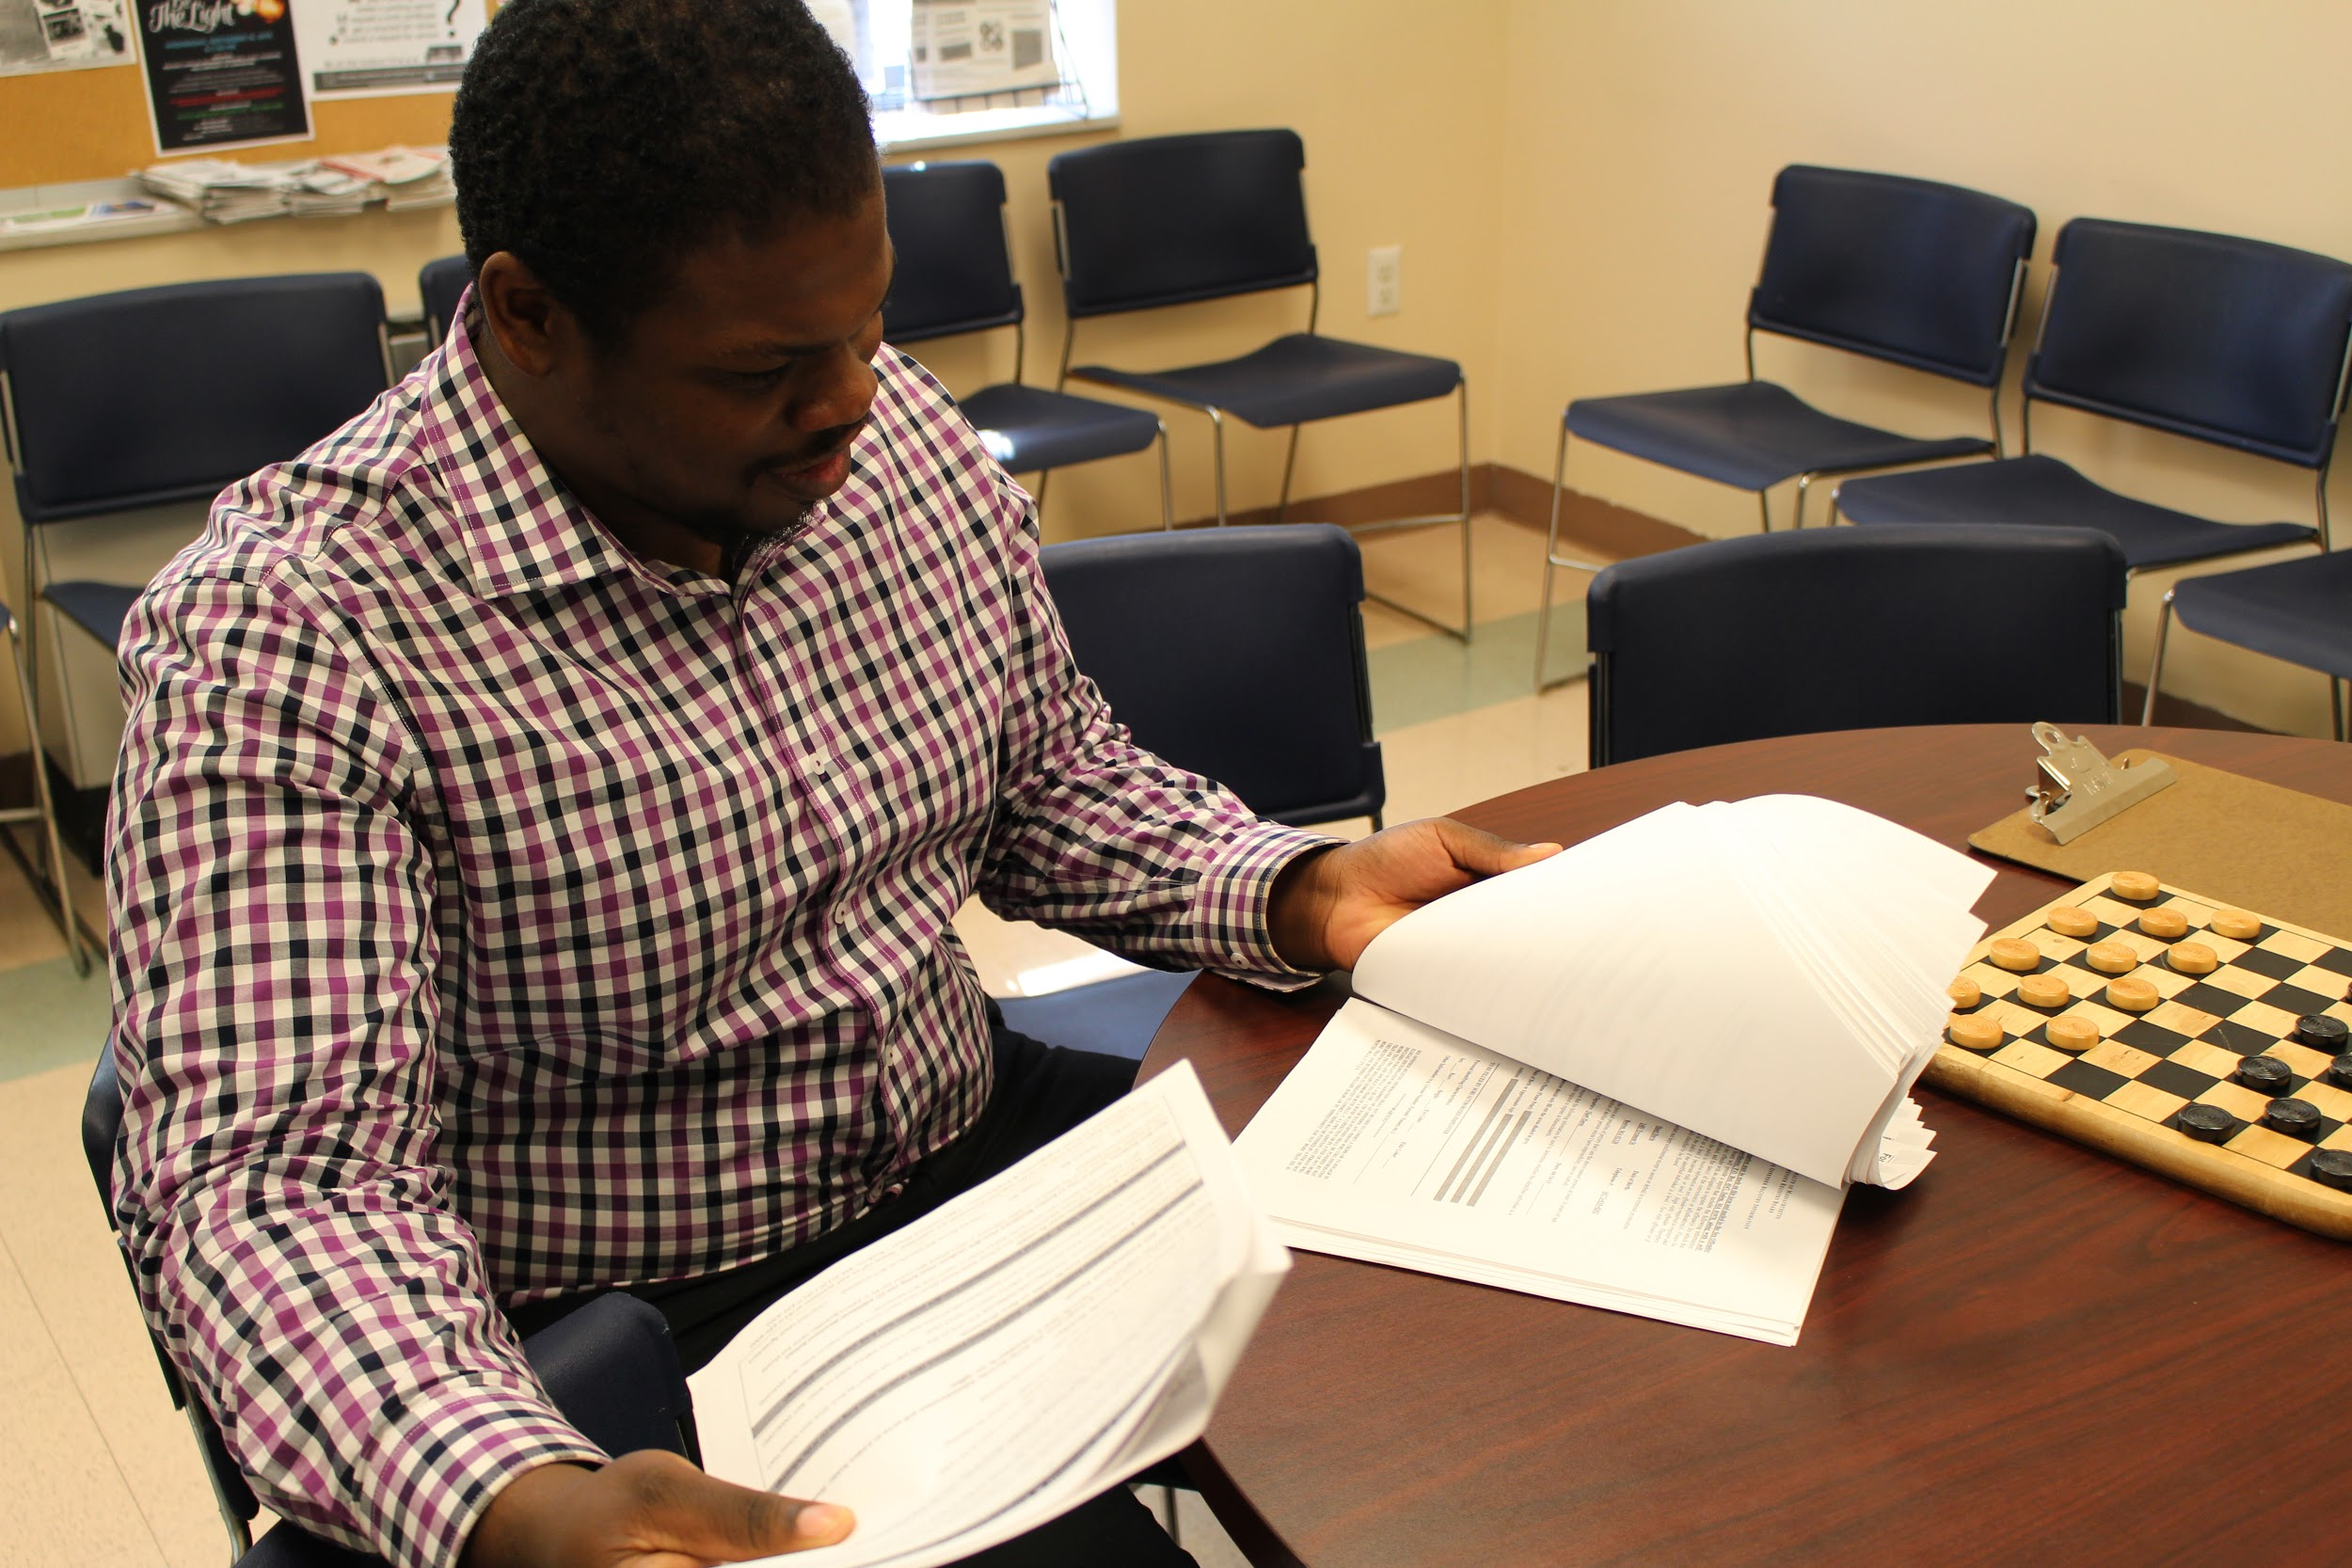
April: Almost there...
Notes:
Yves gets a call from the community center. He’s in luck! They have a space for him and want to bring him back as a camp counselor to help build on the soft skills he learned the year before. They tell him to come and pick up the hiring paperwork for the YEE program. He is excited and ready to get back!
He lets his parent/guardian know he’s working again for the summer and shows them the paperwork.
They look through the checklist and realize this is all information they submitted for ABCD the year before. “Why do we have to do ALL over this again?”
Parent calls YEE and is told that ABCD and YEE are separate programs and the information doesn’t get shared. They must submit and fill out all new documentation.

Slide 8
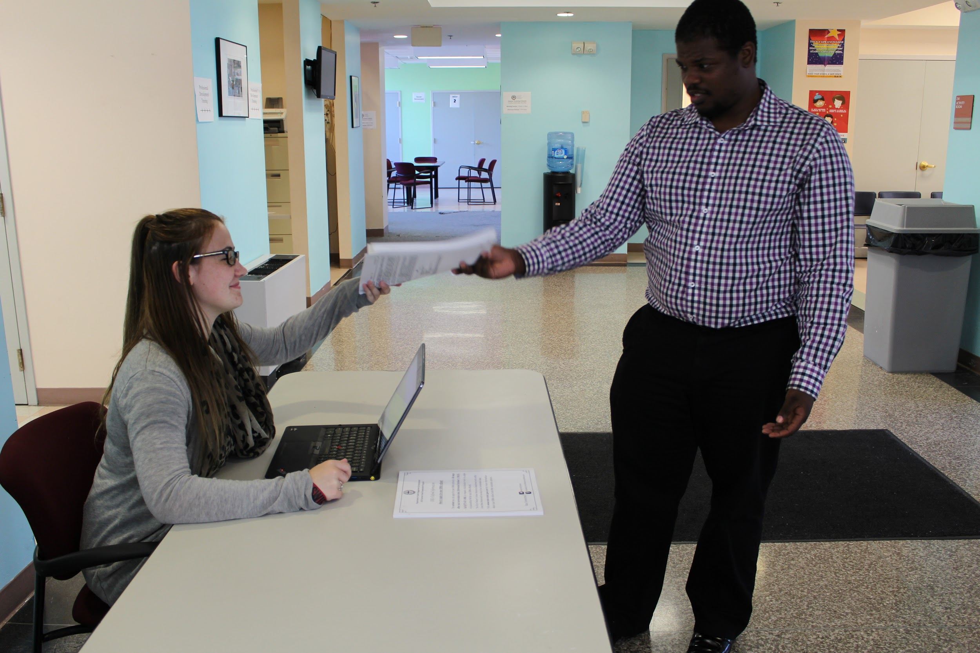
May: Around the World
“Sorry, you don’t have the right documents today. We need you to come back when you have everything!”
PHOTO HERE
Notes:
Yves and his parent/guardian travel to YEE in Mission Hill, a long trip over from their home in Mattapan.
When they go to check in, they realize that he never brought home his SS card from when he applied back in February. They also forgot proof of residency! He can not complete paperwork without it and is turned away.
Parent asks about using a copy, or contacting his school or previous employer to verify this same information..
Yves and his parent/guardian must now go request a new card and wait for it to arrive and retrieve a utility for proof of residence, rather than getting that previous verified information from a reputable source (ABCD, BPS)

Slide 9
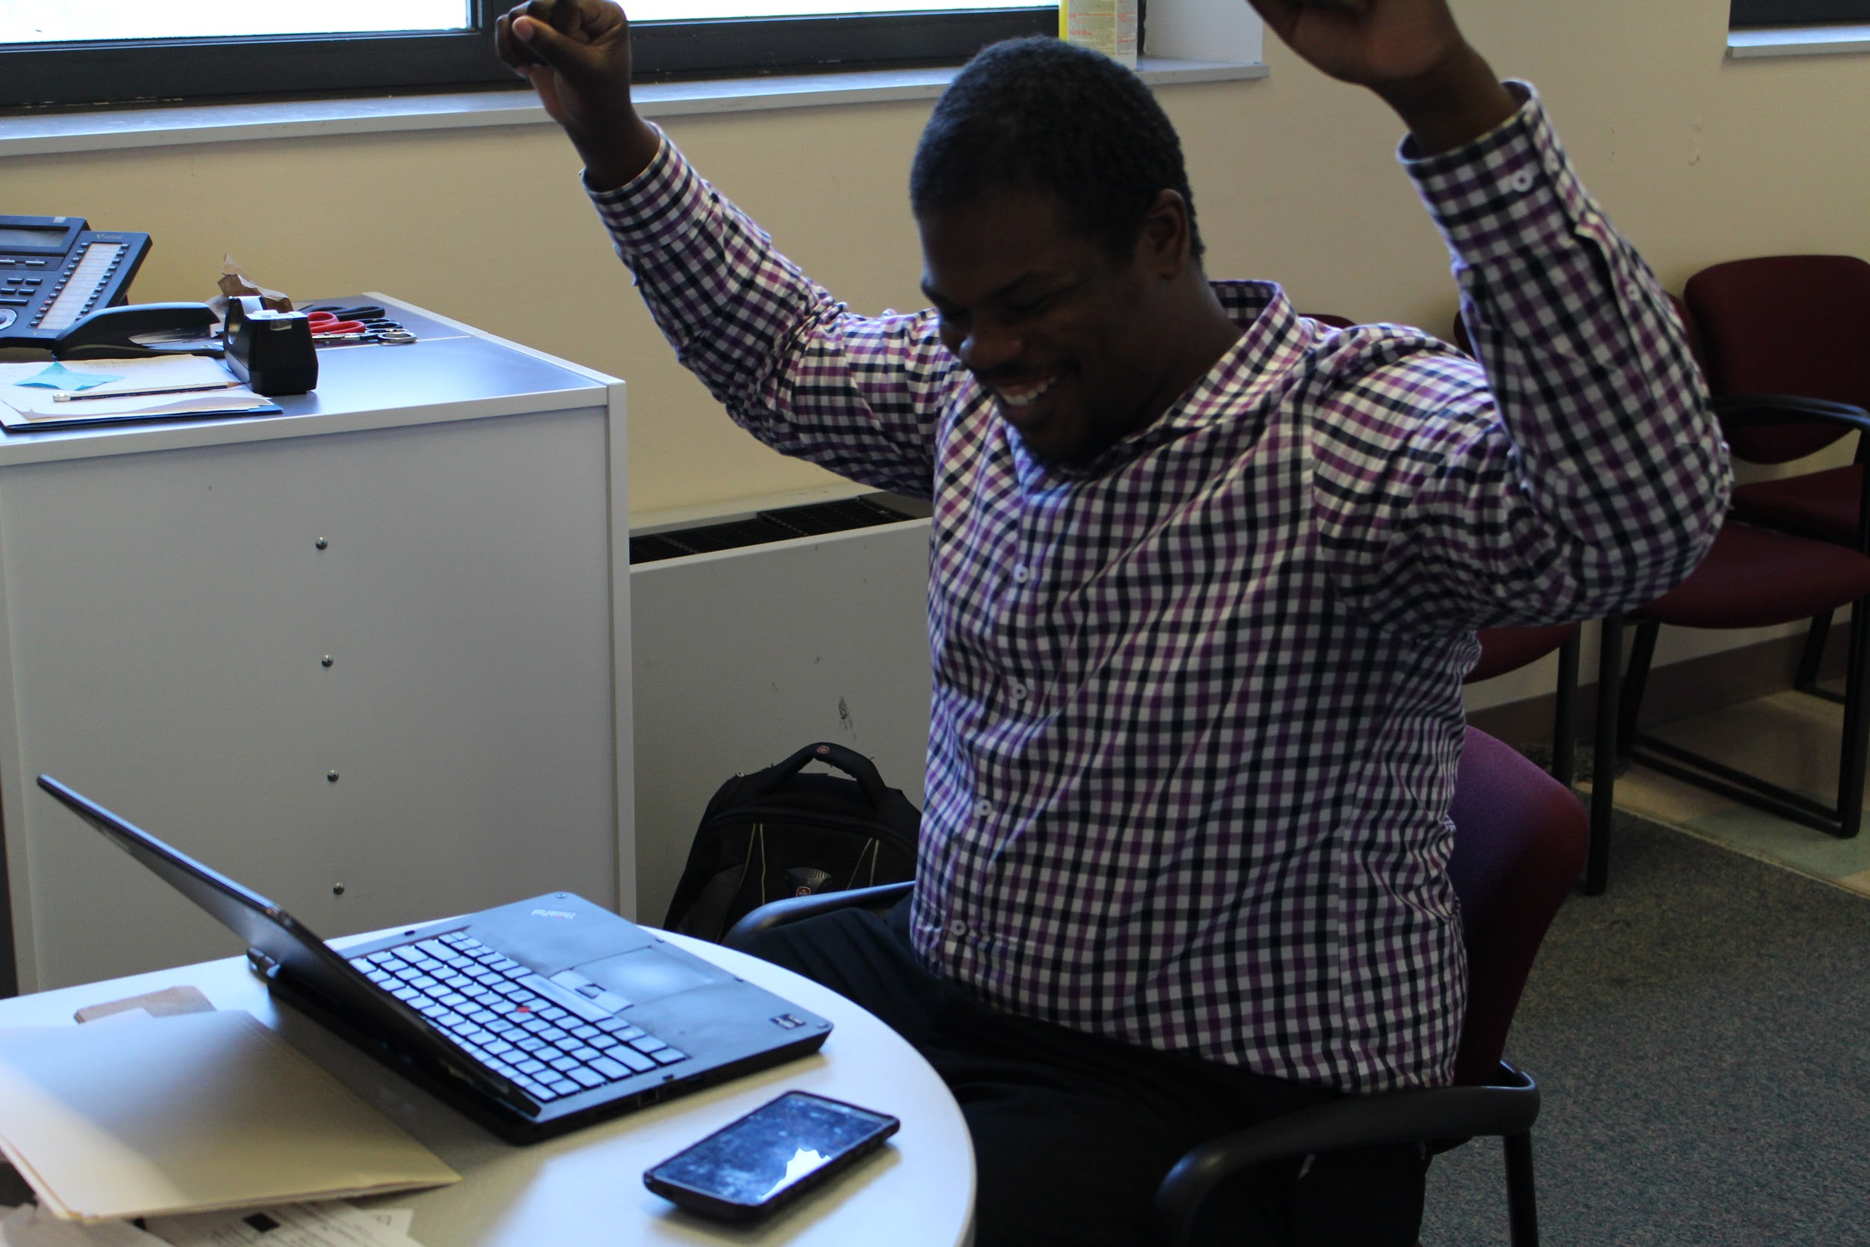
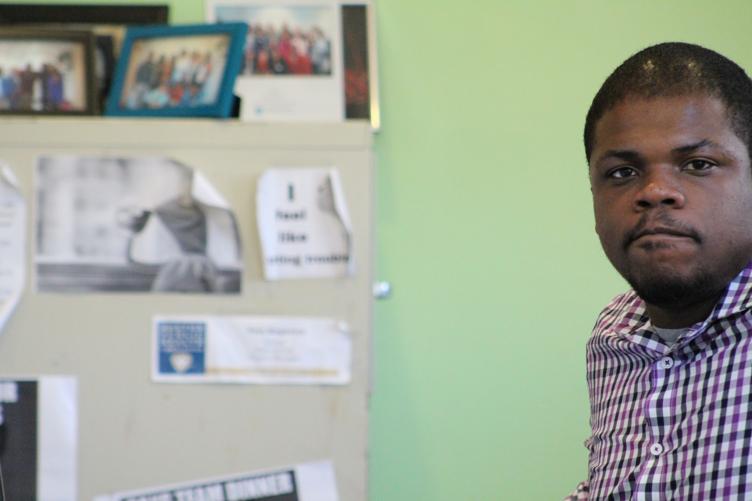
ABCD picks me too…
…but I can’t have both jobs.
Notes:
Just as Yves and his family gather all of the necessary documents to submit to YEE, he gets contacted by ABCD! Through all of the craziness, he forgot that he applied to both programs.
Now that he’s been picked by ABCD at a new location, he thinks that he will be able to work two jobs this summer! (ABCD does not know he was hired by YEE, and vice versa)
He completed all of the paperwork for both programs and is taking up two positions.
YEE finds that he was hired by ABCD as well, and notifies him that he can not work both positions because it’s called “double-dipping”. He doesn’t understand that ABCD and YEE are both city related programs.
He then makes the decision to work with YEE and withdraw his name from ABCD. He is ready to go work with his old program, this time with YEE!

Slide 10
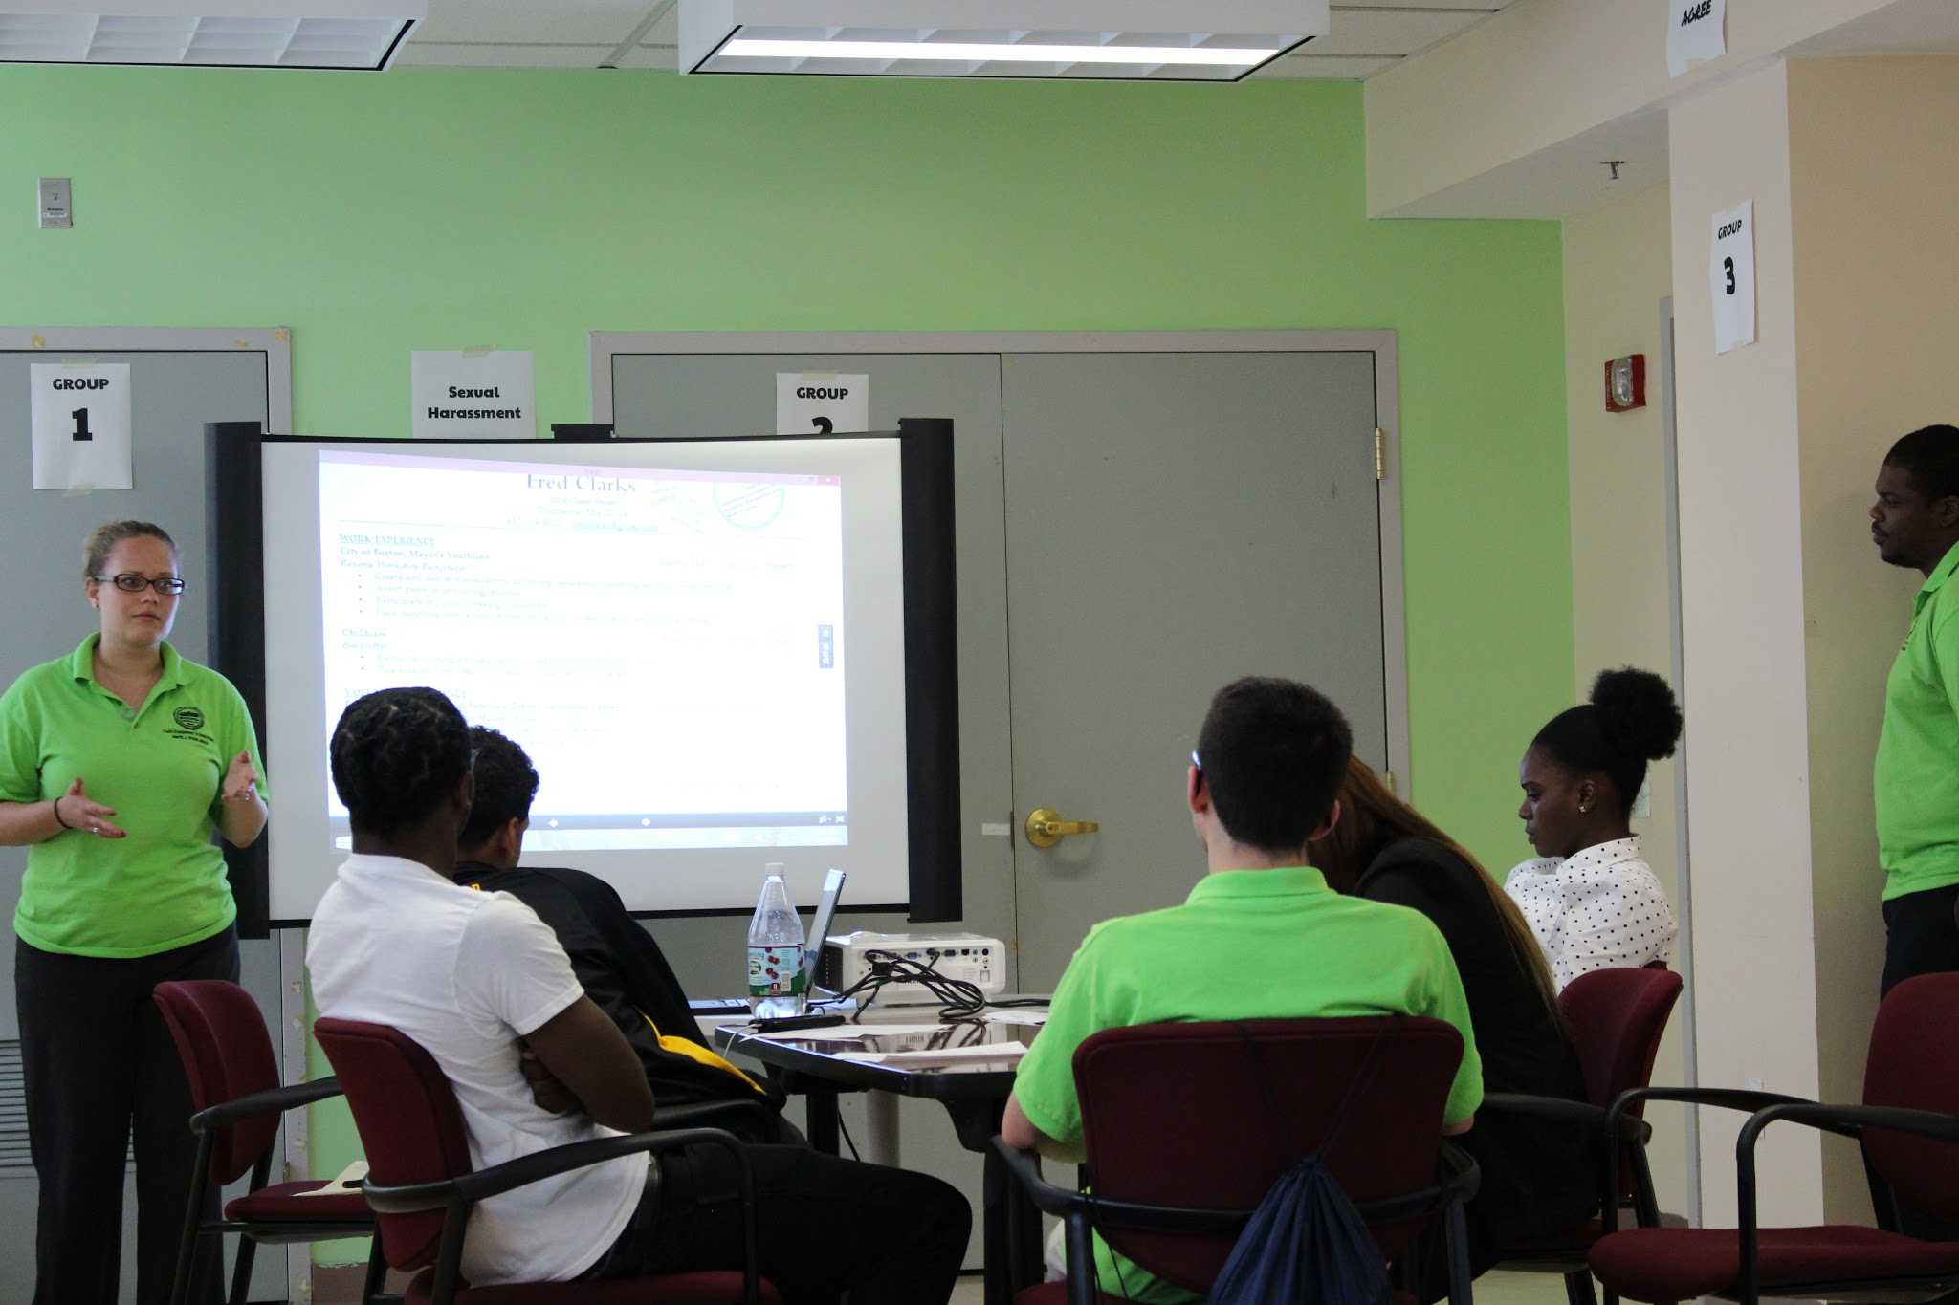
July - August: WORK!
Yves is back now for his second summer and helping lead workshops on career development for other young people just like him!
Notes:
Now with all paperwork issues resolved and his job preference chose, he arrives at the community center for his first day! He is one of 3,208 young people hired by SuccessLink and one of 10,360 hired city-wide!
He is able to work for the summer without interruption. He is able to now earn some money to buy school supplies and help out at home!

Slide 11
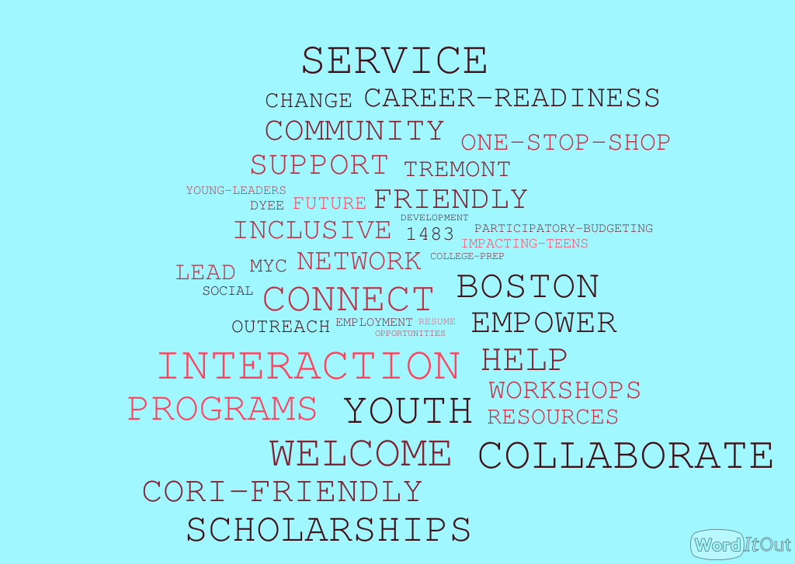
Youth vision for cohesive system

Slide 12
DESIGN WITH
mentorship
Youth learn research & design skills
practice
Youth apply learned skills
co-design
Youth design the service they use

Slide 13
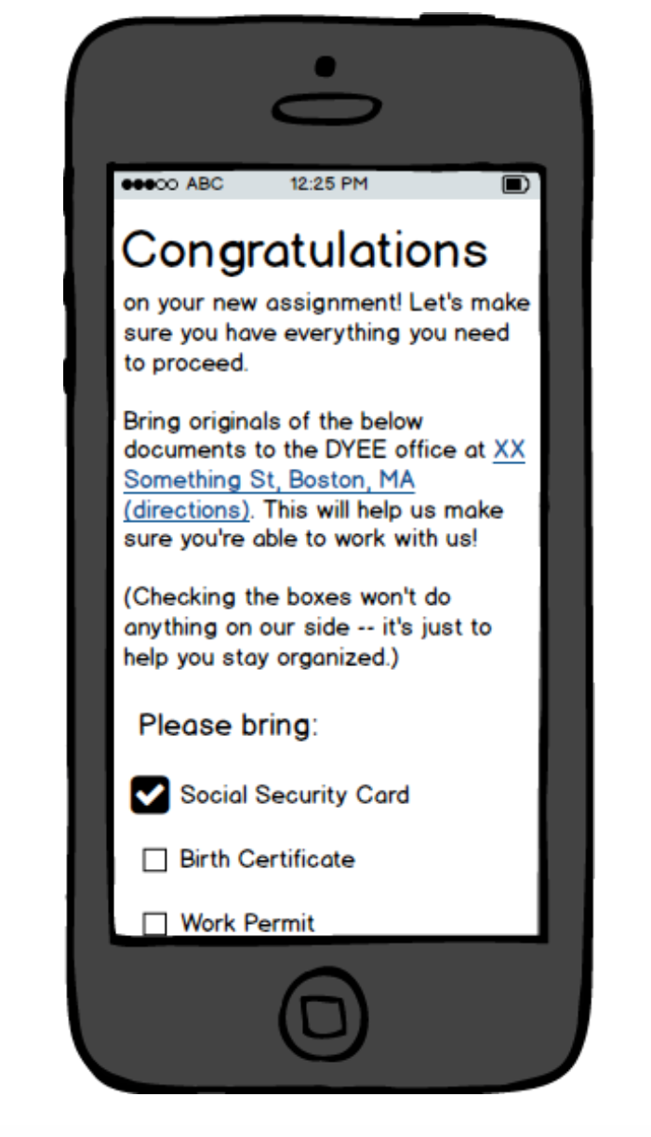
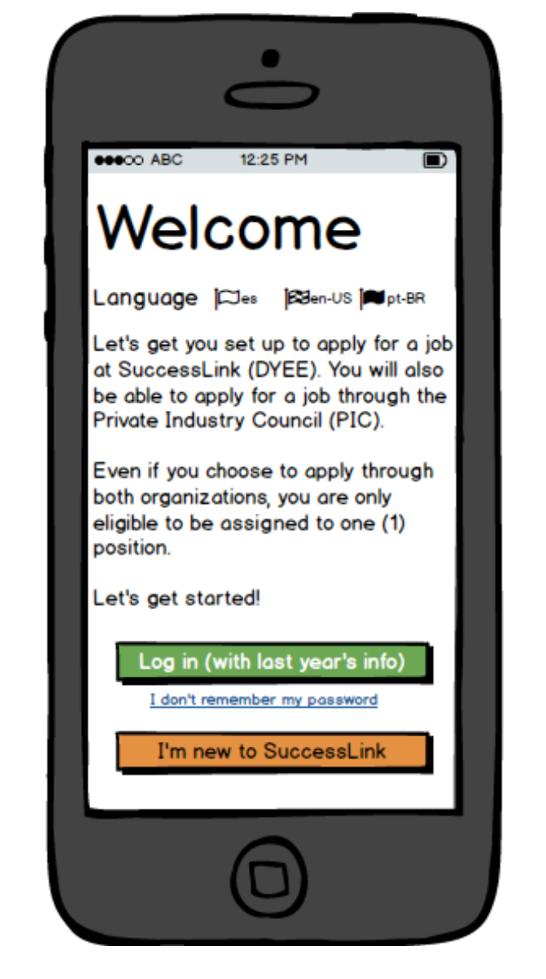
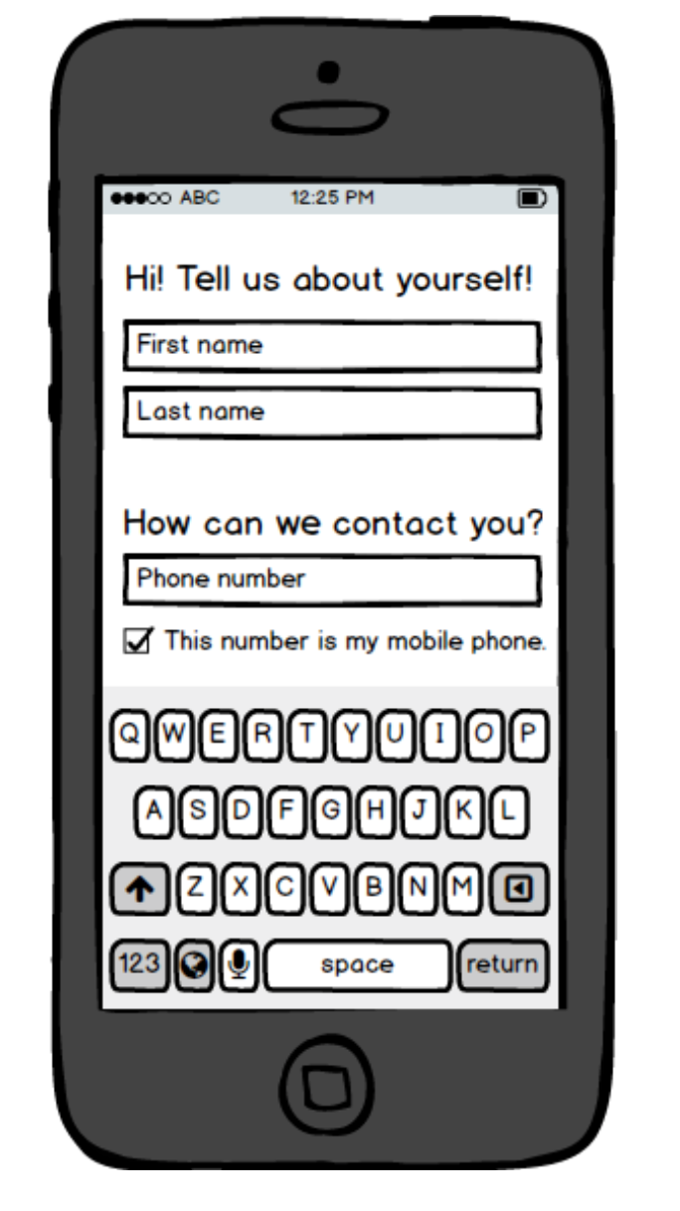
EARLY CONCEPT
Notes:
Our values:
Design with youth and not for the youth
Do the public work in the public

Slide 14
Notes:
Interest in working with CFB and strengthen links and support through the fellow we will be hiring.

Slide 15
Notes:
Look at data to check how representative the participants are of the city and the populations the program seeks to target. Also looking at over time if we can see summer jobs participants have improved student performance.

