Slide 1
Charlotte City Walks
Mary Newsom, UNC Charlotte Urban Institute
July 20, 2017
Notes:
Recently completed our sixth year of City Walks and wanted to share our experience as a model that could be adopted in other cities

Slide 2
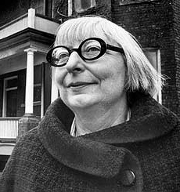
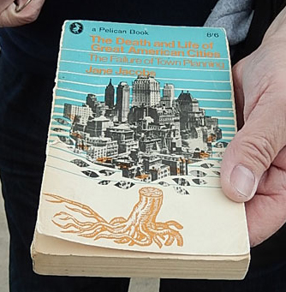
City Walks (a.k.a. Jane’s Walks) are free, public walking tours that bring people together to explore neighborhoods.
Led by local volunteers
In May (usually) to commemorate Jane Jacobs’ May 4 birthday
More than 1,000 Jane’s Walks in 212 cities around the world in 2016
Notes:
Jane Jacobs was a writer and community activist whose book, Death and Life of Great American Cities, was first scorned by professional planners but over time it – and her later books -- changed the way we think about cities and about planning. She believed that planners of her era were forgetting to notice what was happening on sidewalks, streets and at ground level where the people live.

Slide 3
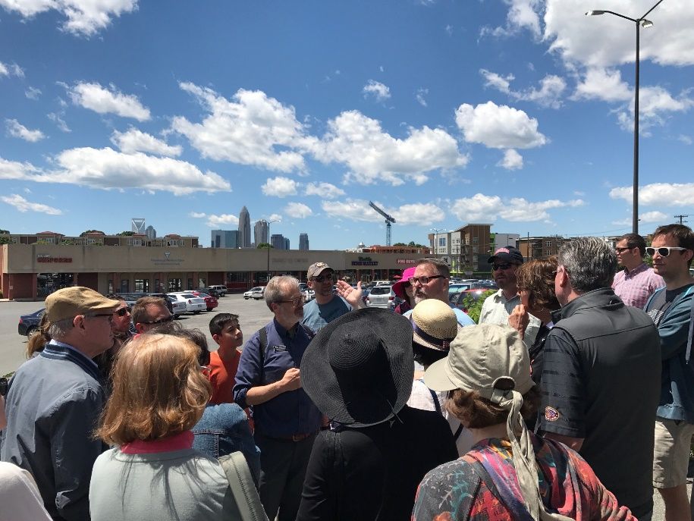
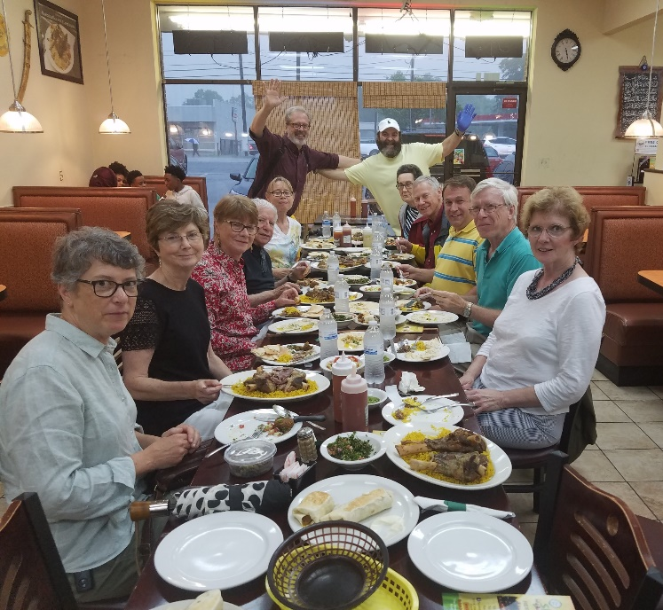
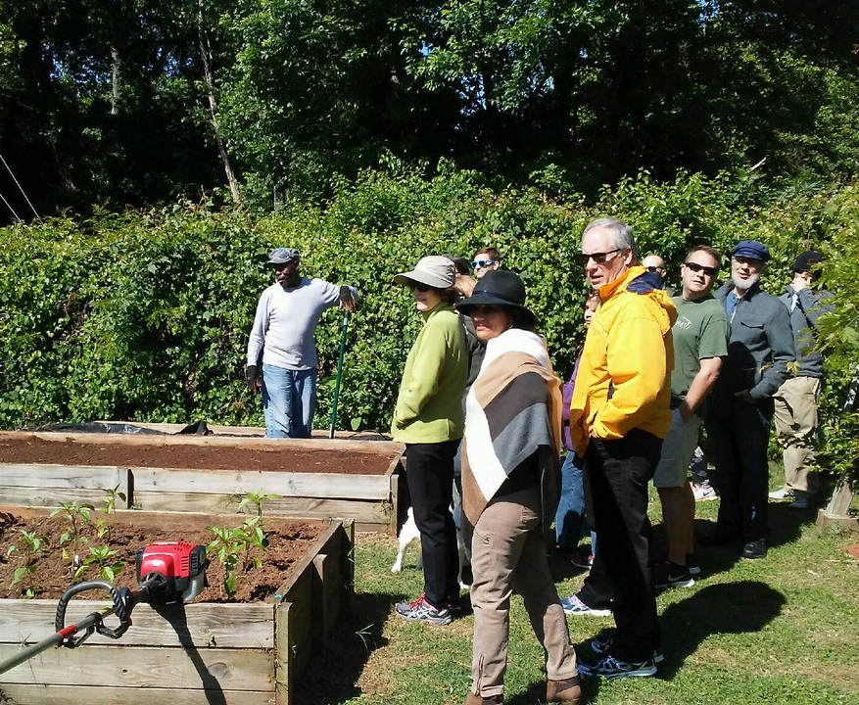
Jane’s Walks ( in Charlotte we call them City Walks) aim to build social capital and a sense of community.
Notes:
In other cities they are called Janes Walks, but people in Charlotte aren’t New Yorkers or planners and the name was confusing to many. So we call them City Walks. They are intended to inspire people to get better acquainted with their neighbors and neighborhoods or to learn about parts of the city they don’t know well. Charlotte is flooded with newcomers – the city grows by an average 44 people a day. So while they learn about neighborhood history and meet people and explore new parts of the city, the walk participants are meeting across barriers of geography, ethnicity, age and length of residence in Charlotte.

Slide 4
Charlotte City Walks began with one walk in 2012 and has grown to 23 walks in 2017.
2017
1 walk
20 people
2 walks
30 people
6 walks
120 people
10 walks
210 people
21 walks
474 people
23 walks
456 people
2016
2015
2014
2013
2012
Notes:
The project began in 2012 with one walk that drew 20 participants. The following year, 30 participants attended two walks. You can see the growth. We work with other groups – history museums, neighborhood associations, the university’s urban design professors, the center city booster organization, etc. In 2017, City Walks held a record number of 23 walks with 456 attendees. Some participants went on more than one walk, but we had 306 separate participants (not counting walk leaders).
In 2017, two-thirds of survey respondents indicated that they had not attended a City Walk in Charlotte until this year.

Slide 5
Institute staff help plan, organize, and publicize the walks.
Recruit walk leaders with the help of a planning committee
Help walk leaders plan their walks
Manage online walk registration through PlanCharlotte.org
Communicate with participants
Publicize walks through our websites, newsletters, and social media
Institute staff time funded by the Knight Foundation
In 2017 Knight Foundation paid for a local marketing/publicity consultant

Slide 6
One example from 2017
This photo is from a walk through a rapidly gentrifying neighborhood, formerly home to workers at several now-closed textile mills.
The walk was in partnership with the Charlotte Museum of History, and was led by a the head of the neighborhood association.
The area is seeing large increases in housing costs. But the neighborhood opposed a proposed affordable housing development.

Slide 7
Over the years we’ve learned…
Lots of planning is required, starting six or seven months in advance.
Planning committee works well for brainstorming and recruiting walk leaders.
Publicity is vital, and community partners and a publicity consultant are great resources.
Community members are hesitant to lead walks. The most willing are neighborhood activists who see the value in the walks and are dedicated to making them happen.

Slide 8
Survey responses indicate the walks’ influence on participants.
50%
Attended a walk in a part of Charlotte they had never visited
78%
Believe their attitudes have changed toward the neighborhood where they walked
93%
Said they were inspired to explore other neighborhoods
1/3
Have since returned to the neighborhood they walked
1/4
Had a follow-up meeting or conversation with someone they met on the walk

Slide 9
City Walks build social capital and sense of community.
"Having thoroughly enjoyed five of the City Walks around Charlotte neighborhoods, we came to a conclusion: City Walks are a vital exercise in building social capital.
Meeting people from other neighborhoods, comparing experiences and discovering shared values created for us a broader and deeper sense of this Charlotte we share.
Deliberately getting outside our bubble is an action more and more of us need to choose if Charlotte is to build new bridges and create a better social climate.
For us some of the positive relationships made during the City Walks are continuing, and isn't that a step toward increasing social capital?"
-- Chris Emerson & Barbara Yacek (2017 walk participants)
Notes:
I learned about this testimonial at a community event where people were sitting at tables talking through ways to increase social capital. Afterward I greeted Chris and Barbara, whom I had met on several walks, and they said they had told their table what a great social-capital-building events City Walks is. I asked them to write up what they had said to their table.

Slide 10
Interested in hosting walks in your city? Check out these national resources.
janeswalk.org
Janejacobswalk.org
Notes:
we would be happy to assist other cities where walk organizers would like to learn more. There are two groups that help you organize. Janeswalk is based in Toronto and has had Knight Foundation funding.
Janejacobswalk is part of the Center for the Living City, founded by some of Jane Jacobs’ closest friends. Both sites let you register your walk and offer plenty of research and tools and tips.

