Slide 1
Notes:
Introduce the project team. Newest member is the DC Dept of Housing and Community Development, represented by Danilo Pelletierre, Housing Development and Policy Advisor in Office of the Director.
Also Scott Bruton, Housing Policy Director for CNHED.

Slide 2
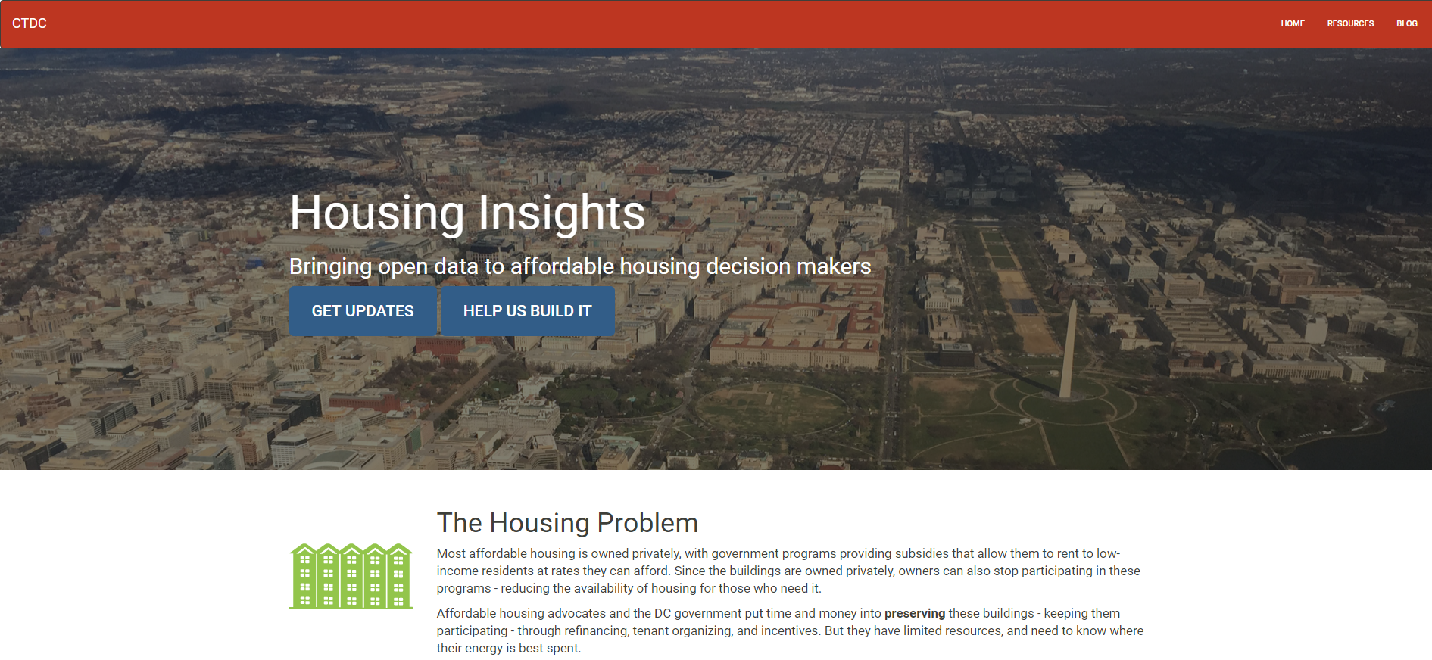
Our Project
Notes:
PETER: Focus is on affordable housing preservation in Washington, DC.
Had previously decided to do something on affordable housing: priority issue for city as well as CTDC partners.
During planning process, we spoke with key stakeholders, including housing agency heads, Mayor’s office, nonprofit developers and affordable housing advocates.
Consensus emerged that a tool to apply data to support decision making around affordable housing preservation would be most useful course to pursue.
Builds on work that the DC Preservation Network (preservation strategy) and city (Strike Force) have been doing.

Slide 3
Introducing Our New Project Manager!
Organization skills
Experience with tech projects
Experience with civic tech or volunteer coding
Enthusiasm for project
Neal Humphrey
Notes:
PETER: We want to introduce our new project manager, Neal Humphrey.
Started only a few weeks ago.
We were very lucky that Neal was available and interested in our project.
Things we were looking for:
Someone organized who can help keep us on track

Slide 4
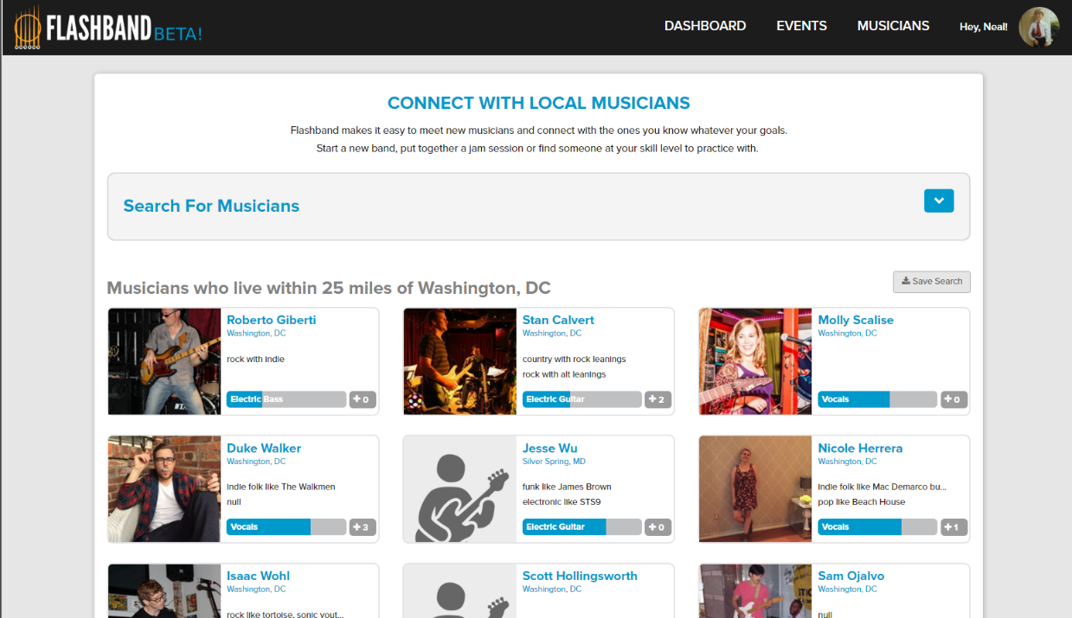
Notes:
PETER:
Someone who knows how to do a tech project
Neal has an engineering background and had his own tech startup, Flashband
Connects musicians with each other

Slide 5
Introducing Our New Project Manager!
Organization skills
Experience with tech projects
Experience with civic tech or volunteer coding
Enthusiasm for project
Neal Humphrey
Notes:
PETER:
Civic tech or volunteer coding
Neal was already involved with a Code for DC Brigade project
Enthusiasm
Neal saw the potential impact of what we were trying to do
Important for convincing others to get involved
Will turn over to Neal for the rest of the presentation

Slide 6
The Problem
Affordable Housing
Data
Most is privately owned; government provides incentives
Owners can choose to stop receiving incentives (under certain circumstances)
Advocates and government agencies can often intervene – spending time and money to preserve these buildings
Need to know how to prioritize preservation efforts.
Dozens of overlapping programs (Section 8, tax credit, DC gov, etc.), data isn’t centralized
Neighborhood info is relevant – demographics, transit locations, nearby economic development, other affordable options in the neighborhood.
City-wide analysis can reveal tradeoffs not apparent at building level.

Slide 7
Why tech is part of the solution
Do it once – use often. Barrier to use is lowered.
Less reactive – earlier warnings and planning of potential issues
Add transparency to prioritization process
Data driven decision making

Slide 8
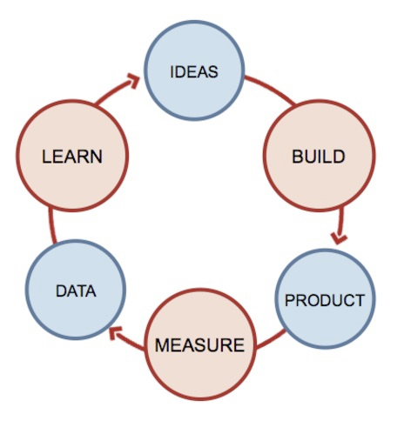
What do we need to know from potential users?
Our riskiest assumption:
People will use the tool to prioritize their efforts and investment.
Interviews:
Is the problem compelling?
Do our priorities align?
Can it integrate to their existing workflow?
The Lean Startup Approach

Slide 9
Key Project Phases
Data Modeling
Can we get the data we want?
What are its limitations?
User Feedback: Is this priority of data sources in the right order?
Prototype
Example ‘one-off’ analysis
Useful mockups – e.g. manually creating a single building report
Core website back-end functionality (e.g. connect to catalog)
Feedback: Is this kind of thing useful?

Slide 10
Alpha
Most important mockups and one-offs brought into tool
Proposed final format / method
Feedback: Usability testing. Do our mockups translate to a tool?
Beta
Correct usability issues
Change prioritization of components as appropriate
Feedback: Registered users, repeat use

Slide 11
Discussion / Questions

Slide 12
Proposed Priorities – Preservation Working Group
First Tier
federally funded with rent or operating subsidy
serves very low-income residents
meets the needs of a vulnerable population
needed to maintain economic diversity
near DC funded economic development projects
near transit
Second Tier:
current low rent levels
a high probability of being lost
low cost per unit to preserve

