Slide 1
Ecosystem Mapping:
Visualizing Connections in Local Communities to Strengthen Collaboration
Thank you for joining us!
We will get started shortly!
*For the best webinar experience:
Listen by dialing in via landline phone
Watch webinar on computer screen

Slide 2
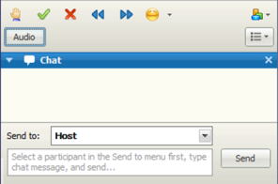
A Few Housekeeping Notes
To keep background noise at a minimum, please self-mute when not contributing a question/comment.
Type your questions into the chat box.
Webinar Q&A is being recorded and will be available in the Resource Library.

Slide 3
Citi Foundation
Welcome

Slide 4
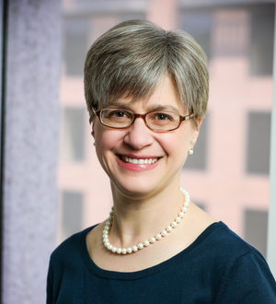
Introduction
Kathryn Pettit
Principal Research Associate,
Metropolitan Housing and Communities Policy Center
Olivia Arena
Research Assistant
Metropolitan Housing and Communities Policy Center
Crystal Li
Senior Associate,
Living Cities
Bob Gradeck
Manager, Western Pennsylvania Regional Data Center at the University of Pittsburgh

Slide 5
Session Goal
Understand the potential of incorporating civic tech and data into your work and partnerships
Examine ecosystem mapping as a process that allows people to visualize their network and understand how each organization can contribute to common goals
Learn from a local group about the potential value of ecosystem mapping to your community

Slide 6
Agenda
1
Civic Tech and Data Collaborative
2
Process and tools for ecosystem mapping
3
Lessons from Pittsburgh

Slide 7
Building the Civic Tech and Data Ecosystem
Notes:
We wanted to share a bit about the broader project that the Ecosystem guide was a part of so you can understand the context, but also put in a plug for thinking about data and tech organizations as you do your own ecosystem mapping at home.

Slide 8
National Partners
Notes:
The Civic Tech and Data Collaborative or CTDC - was supported by the MacArthur Foundation.
I think most of you know about the National Neighborhood Indicators Partnership from previous webinars. Wee joined forces with two other organizations with local networks.
Living Cities, which Crystal is representing today – a consortium of 18 foundations and financial institutions that works for dramatically better results for low-income people, faster.
Code for America – an organization which promotes the principles and practices of the digital age to improve how government serves the public.

Slide 9
Civic Tech & Data Collaborative
“
“How can we harness the power of ​
data and technology to increase ​
the efficiency, equity, and effectiveness ​
of policies and programs that will ​
benefit low-income urban residents?​”
Notes:
Our three networks have extensive experience in local communities around the county, and we all perceived that we were not taking full advantage of the exciting potential of data and technology to advance our common mission of improving opportunities for people with limited economic resources.
In fact, we were concerned that the increasing use of data/tech by cities could exacerbate inequities and reinforce power imbalances.
We believed that we had the connections and experience to create some proof points about how this could be done.

Slide 10
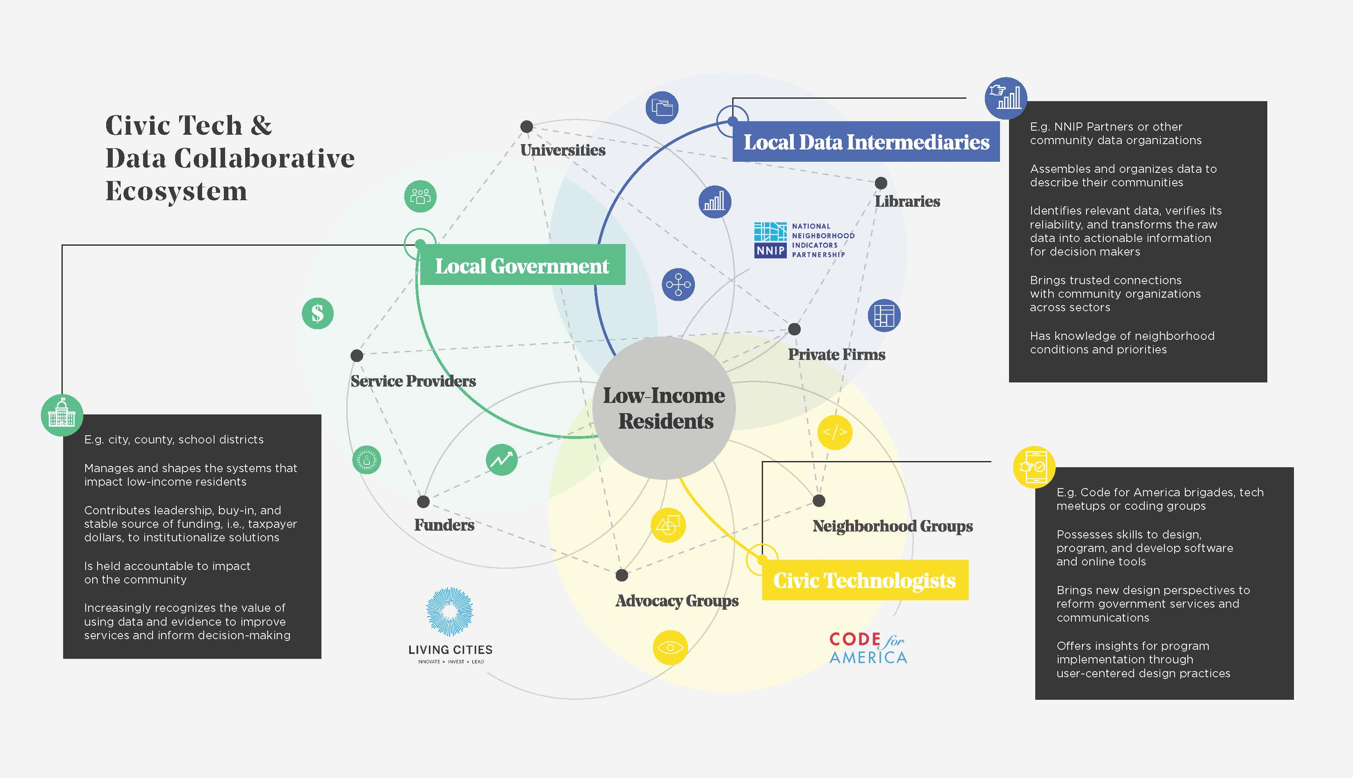
Local Partners
Notes:
We also knew that any one sector couldn’t do it alone.
For our project, we each brought the members of our networks – 1) NNIP partners – local data intermediaries 2) civic technologists like the volunteer Code for America brigades and 3) local government agencies.
We selected seven communities to experiment with us to see what we could accomplish with intentional collaboration among these groups to solve civic problems. You’ll hear from Bob from Pittsburgh in the third part of this presentation.
Each of the local collaboratives included a myriad of other critical players – private sector, universities and funders, service nonprofits, and advocates.

Slide 11
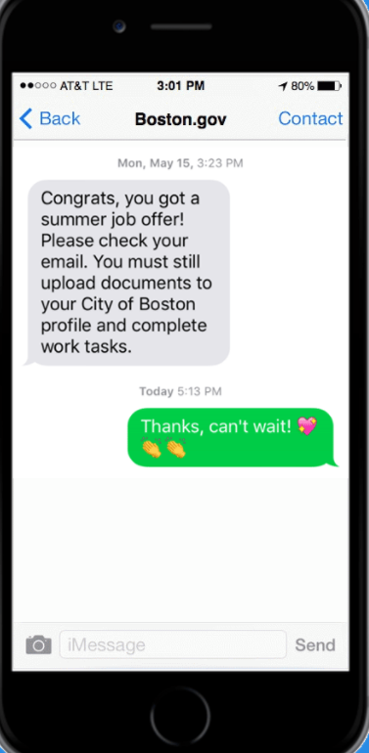
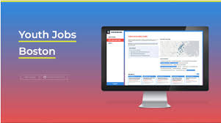
Local Products: Boston, MA
Notes:
For three of the cities - here in DC, Boston, and St. Louis, we asked them to propose a specific project that would leverage new relationships across groups and could benefit from a fresh infusion of data and technology. Each went about forming their teams and accessing new data/technology talent in a different way.
We have detailed case studies on each of these. We’re sharing these not so much for the specific tools, but to illustrate the players and give a sense of what local allies accomplished together.
In Boston, our NNIP partner the Metropolitan Area Planning Council (MAPC) and the city’s Division of Youth Engagement and Employment came together to redesign key program elements of the city’s youth employment program.
The team convened a dozen youth as part to first re-think how youth are assigned to jobs. They worked with MIT experts to adapt an algorithm that better optimized the matches of youth to positions. They youth gave input on which factors to include and prioritize – for example, they wanted heavier weight on that versus distance to work. Youth also helped design the application interface and the language with the agency communicates with applicants. (see image)
By automating the matching and contacting youth through text messaging, they increased placements by 20 percent in one year.. The project also freed up 19 work weeks of time so staff could focus on recruitment of students and employers.
Code for Boston helped the collaborative plan out the project, MAPC brought the digital expertise, and MIT contributed their knowledge of algorithms. The city’s youth department needed to partner with external groups in their ecosystem to be able experiment with new ways of doing things.
The agency has now taken the process in-house to fully integrate it into their own systems.

Slide 12
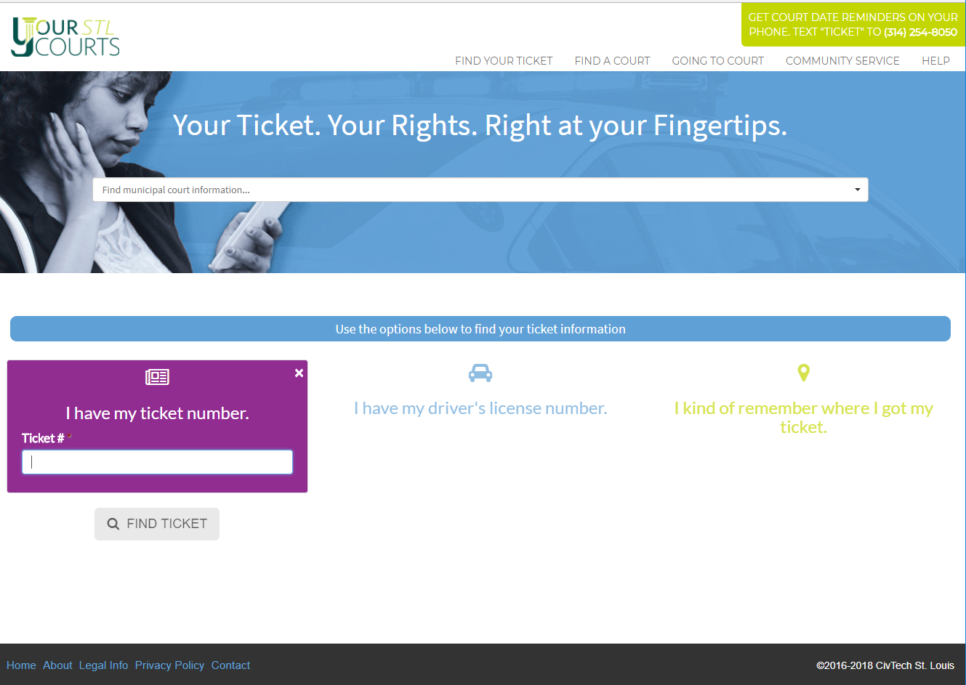
Local Products: St. Louis, MO
Notes:
The St. Louis team wanted to use data and tech to solve the information gap that sends people to jail for nonviolent, mostly traffic, offenses.
St. Louis County has are more than 80 different courts – many from tiny towns with offices only open 1 day a week. Residents had no way of locating information about their tickets or court dates across the area’s numerous courts. Without these basic details, the impacts of a minor traffic ticket could lead to a spiral of negative consequences for residents – fines, warrants, and even jail time. Particularly devastating for low-income residents.
They created YourSTLCourts, an open-source website that pulls real-time data on tickets from all those courts into a single interface. Search by citation number, driver’s license number, or location where they received their ticket. Plus a built-in tool for residents to receive text messages with court updates.
CivTech St. Louis began as a partnership between Rise (the NNIP Partner) and the St. Louis County Economic Development department. They had to strengthen build connections or build new relationships in their ecosystems to access tech talent to get the website built.
To identify a prototype, a local nonprofit GlobalHack raised prize money of about $80K from the private sector for a hackathon.
To make sure they were asking users what they need, students in the local school of social work interviewed people outside the courts about why they didn’t pay their tickets and how they got information.
Developers from the small private firm who won the contest donated consulting time to transform their initial idea into a public product.
LaunchCode, a local coding training company, helped them to recruit a paid developer to do the detailed coding
HandsUpUnited, a local Black Lives Matter group, guided youth of color enrolled in its summer Tech Institute to design the user interface and draft the guidance on attending court and community service options.
They also had a similar varied set of partners for the communications work – local printers for promotional materials, the radio station, and local libraries.
The process was so successful that they have now spun off CivTech STL as an independent nonprofit with many of these groups represented on their new board of directors

Slide 13
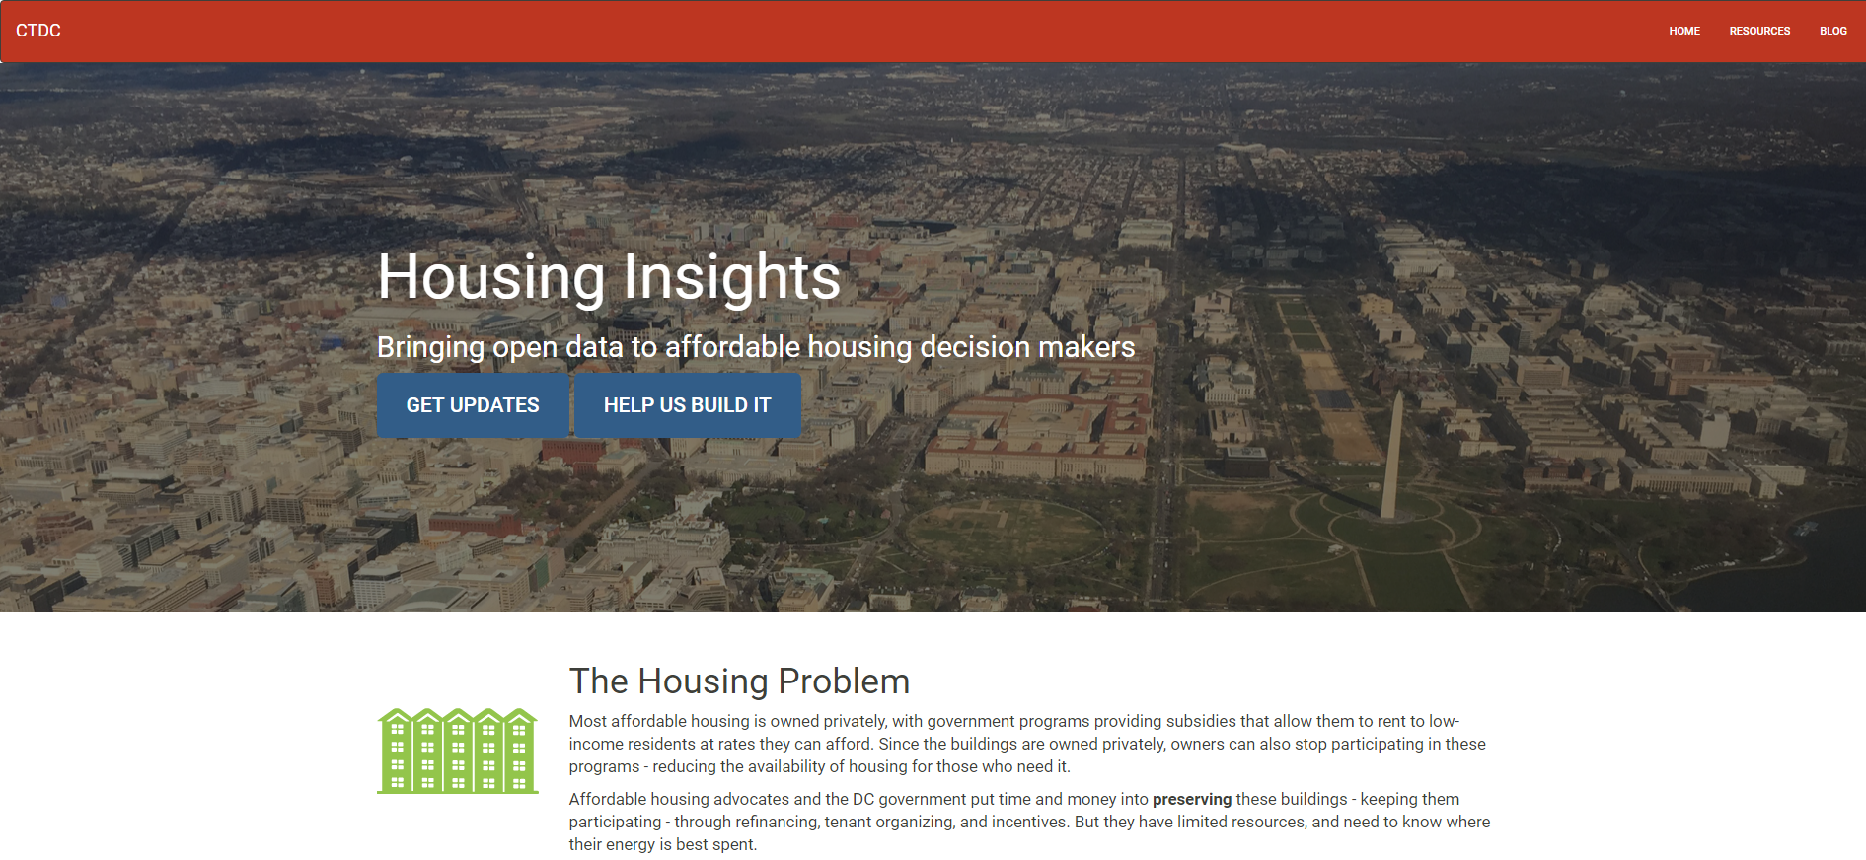
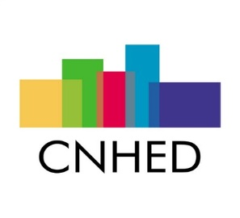
Local Products – Washington, DC
Notes:
In DC, as in many of your cities,, affordable housing is a major crisis – with housing costs squeezing out other essentials in the family budget and preventing families from accessing opportunity in quality neighborhoods.
Our project in DC was Housing Insights, an open-source tool that uses data and technology to help government and community development staff make better investments in affordable housing. The tool compiles key data sources to help stakeholders identify properties that are at risk or difficult to replace, understand neighborhood demographic trends, and access information on individual properties needed for action.
We at DC are the local NNIP partner, and have been working with an advocacy group - Coalition for Nonprofit Housing and Economic Development and the DC Department of Housing and Community Development – for more than a decade.
But we needed to create new connections in the ecosystem to tap the volunteer tech sector. We reached out to Code for DC, the local Code for America brigade, to partner with us. The team decided to hired a part-time project manager to guide the work of the local Code for DC volunteers - $84K worth of time. He produced a whole series of blogs advising on how to harness volunteers for civic tech projects.
In addition to the tech help, many volunteers, who are residents and voters in DC, understand the importance of preserving affordable housing.

Slide 14
Lessons from Local Teams
Exposure to new allies, approaches, perspectives
Explore data and technology as a catalyst for relationships and action
Experience in user-centered design
Notes:
So in sum, our hypotheses was confirmed. For all three places, they made new connections with organizations that lived beyond the specific project. With a different set of people at the table, they devised innovative ways to address the problem they chose.
Some of the projects required the creation of more formal structures to enhance the ecosystem – in St. Louis, they formed an advisory group. Others were founded on extending previous relationships like in DC where Urban Institute had collaborated with the advocacy group for a decade, but reached out to the local brigade for the first time.
Tapping tech talent is the most intimidating task for local groups, but our sites demonstrated the many ways this can happen.
The tech and data were vehicles for acting in different ways – whether re-thinking the process for contacting youth; convincing the courts to share the data with an outside group; or using different criteria to decide on affordable housing investment.
And finally, all the projects put the people they were trying to help at the center of their work. This ensured their were solving the right problem in the right way. Some were already trained in user-centered design techniques – others used tools like Chicago’s Civic User Testing guidebook to help

Slide 15
Notes:
https://medium.com/civic-tech-data-collaborative
In addition to case studies about the three sites, we prepared a report synthesizing our lessons across these five areas. All are available on a Medium site we’ll share the link to.
I think the areas will all resonate with your work.
Ingredients for a Civic Tech and Data Collaborative
Engaging Low-Income Residents
Mobilizing for Collective Action
Resourcing Collaboratives
Sustaining the Gain
For each area, we also curated a toolkit for each topic area – listing a few references to dig in deeper.

Slide 16
Questions?

Slide 17
Ecosystem Mapping
Notes:
Facilitator should discuss some of the results of the interactive poll, open the floor for questions, and prompt discussion using the below discussion prompts:

Slide 18
Poll
Notes:
Do you belong to any formal networks? (Check all that apply.)
- Yes, a local network(s) related to our issue area
- Yes, a local network(s) related to a particular geographic area
- Yes, a national network (excluding CPM)
- None

Slide 19
Poll
Notes:
Have you done any analysis of the universe of individuals or organizations related to your work? (Check all that apply.)
- Yes, by assembling a list
- Yes, by assembling a list and documenting different connections
- Yes, by assembling a list and creating visuals to display the information

Slide 20
What is an Ecosystem?
“
Ecosystems are dynamic
networks that emerge through connections
between many actors.
Notes:
Before we get started with the tools and process of ecosystem mapping, let ‘s start from the beginning. What is an ecosystem? They’re dynamic networks that emerge through connections between many actors. Actors are what you decide to map so they can be people, organizations, or even events. Whatever you want to map connections between. It’s key to note that ecosystems are always changing and evolving – actors enter and exit the ecosystem depending on resources, time for a variety of reasons such as funding or a natural end like a grant.

Slide 21
What is an Ecosystem Map?
“
A visualization tool to understand
connections between organizations
and/or people.
Notes:
Now that you know what an ecosystem is, what’s the map? Simply put, it’s a visualization tool that helps you understand connections.
(Depending on poll answer) Some people (or no one) mentioned that they keep contact lists like in an excel file. How many people can look at an excel and immediately spot how people are connected? Probably just a few rare people. By creating a visual, you’ll be able to engage more people if your map is easy to use.
But at the end of the day, a map is just a tool. Like all tools, it’s only helpful if you have a plan on how to use the tool before creating one.

Slide 22
Why map?
Notes:
If you’re thinking of creating an ecosystem map. First ask yourself, why map?
1. Why are you creating this map?
- To describe the organizations and connections in your current network?
- To identify opportunities to bring new groups in and strengthen ties?
To document the progress of your network over time?
Or meeting a funder’s request?
2. Who is the audience? You can get overloaded with data really quickly so make sure you only choose to capture the most important information that’s relevant to your audience.
3. Finally what is your budget and timeline. These are always important questions for community organizations. Make sure that this map is the most efficient use of your budget whether in actual dollars or human capital
Establishing a clear purpose will keep your scope from expanding or drifting and make it easier to decide what your process of collecting and visualizing the data will be.

Slide 23
“
Envisioning the mapping process as the beginning of a journey, rather than a destination, can inspire new ideas for collaboration or help uncover areas in need of growth.
Notes:
One last thing before we go into the process.
I’d like everyone to keep in mind that the completion of the ecosystem map is just the beginning of a journey, it’s not a destination. The map itself can inspire new ideas for collaboration or help uncover areas in need of growth. But so many people create the map at the end and think they’re done, expecting it to all of a sudden give them
Insights and new ideas for collaboration. That’s why the last thing you should think about before creating a map is – how are you going to use it? How will you share this with your audience? What takeaways do you want them to have or questions you want them to ask after looking at the map?
If you’re not going to use it, then I would not suggest spending the time and resources to create one.

Slide 24
Deciding the Details
The two main components of a network ecosystem map are the actors and the connections between actors:
Government
Individuals
Funders
NGO’s
Nonprofits
Corporations
Hackers
Organizers/Activists
Data intermediaries
Libraries
Funding streams
Social connections
Events
Projects
Organizational Partnerships
Locations
Resources
Actors
are generally represented by nodes
Connections are edges or lines
Notes:
Ok – let’s dive in.
As I mentioned, ecosystem mapping helps identify relationships and resources. The two main components are actors (who is a part of the ecosystem) and connections (how are they connected to one another). The example above includes actors and connections that you may find in the civic tech space and actors that we saw were important to our collaborative such as libraries.

Slide 25
Important Mapping Questions
What “actors” do you work with?
Who are the organizations in your ecosystem?
What role do they play?
How do the organizations you identified interact with each other?
Notes:
“Actors” are the organizations or people that work in the ecosystem. They can be active in the project or groups that you have yet to connect with. You can begin by mapping the partners you regularly work with, and then expand to include their partners or funders. Using this method can help you organically map connections starting with your current partnerships. This approach can identify commonalities between organizations and connections to potential partnerships.
How do the organizations you mapped interact with each other? Through formal collaboratives? Specific projects?
What types of events occur?
How is each organization, project or partnership funded ?

Slide 26
Important Mapping Questions
What types of events occur (frequency and structure)?
Are there relevant boards or committees that make decisions in this space?
How is each organization or partnership funded, and what do funding relationships look like (partnerships and projects)?

Slide 27
Determining the Scope and Process
Using an existing contacts database
Conducting an online survey
Crowdsourcing
Interviewing key actors
In-person group mapping
Least Complicated
Most Complicated
Things to consider: desired level of collaboration, goals, project scope, budget, timeline, and staff capacity
Notes:
Next – how will you go about collecting the data?
Your data collection method should fit your project scope, budget, timeline, and staff capacity. Here we show a few examples of what our collaborative did. The least complicated is to use an existing list of actors and their connections. The most complicated but engaging is to do in-person group mapping and bringing all the key players together and ask them to show their connections. Later, Bob from our Pittsburgh team will describe this process.
Of course, you don’t have to pick one or the other and you can change your collection method later on if one isn’t working. For example, our San Antonio team (The Alamo Regional Data Alliance) started with using an existing contacts database that had limited information and later decided they wanted to capture richer information directly from their stakeholders and created a portal for organizations to input information such as organization type, function, location, and willingness to participate in civic tech work.
If the intent is to form new connections, I would suggest taking an interactive approach. Interviewing partner organizations about their networks or hosting a group mapping session can foster conversations and bring together potential partners.

Slide 28
Notes:
We have been talking about the values of ecosystem mapping as a process, but visualizing your ecosystem data can help you analyze your network. For example, visualizing your data can help identify patterns including gaps in resources, clusters of similar organizations, opportunities for partnership, and areas for future investment.
A finalized visual can be a useful tool for communicating to potential partners or funders.
Maps can continue to evolve to show the changes in an ecosystem, or be a point in time look at a field, city, or network. The above example shows a finalized ecosystem map that shows the connections between different tech startups in STL. You’ll notice that the connections are bucketed around funding, facilities, community resources, and acceleration. On this map, the TYPES of connections are highlighted vs. characteristics of the individual organizations.

Slide 29
Selecting a Tool for Mapping
Functionality
How much can you customize?
Does it include analysis metrics?
How do you input data?
Does it include a search function?
What visualization options does it have?
Notes:
Assessed the functionality of four visualization software tools:
Civic Graph
Connect the Dots
Kumu
Gephi
Keeping in mind the goal and scope of your map, there are several factors to weigh in selecting a tool for mapping. Without a focused goal, your mapping process can quickly expand or derail. So think about what you want to get out of the map/use it for as you begin your tool selection. For example, if the map is a collaborative effort between partners, it may make more sense to look at tools that allow for multiple log-ins, ability to change individual nodes, and import information from csvs. When we started to look at tools, these are the questions we asked around functionality.
How much can you customize?
Does it include analysis metrics?
How do you input data?
Does it include a search function?
What visualization options does it have?

Slide 30
Selecting a Tool for Mapping
Does it have a pre-set structure?
Ownership
Can multiple people edit or contribute to the map?
Does it include geo-tagging?
How much does it cost to use?
Features
Notes:
Keeping in mind the goal and scope of your map, there are several factors to weigh in selecting a tool for mapping. Without a focused goal, your mapping process can quickly expand or derail. So think about what you want to get out of the map/use it for as you begin your tool selection. For example, if the map is a collaborative effort between partners, it may make more sense to have a map that allows multiple people to edit. Or, if you are looking at a single city, maybe the geo-tagging features are more important .
Features
What does the completed project look like?
Can it be downloaded?

Slide 31
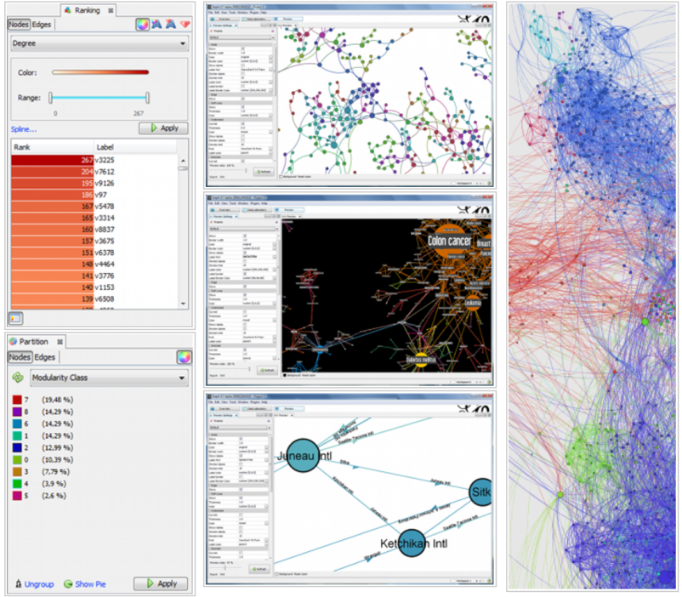
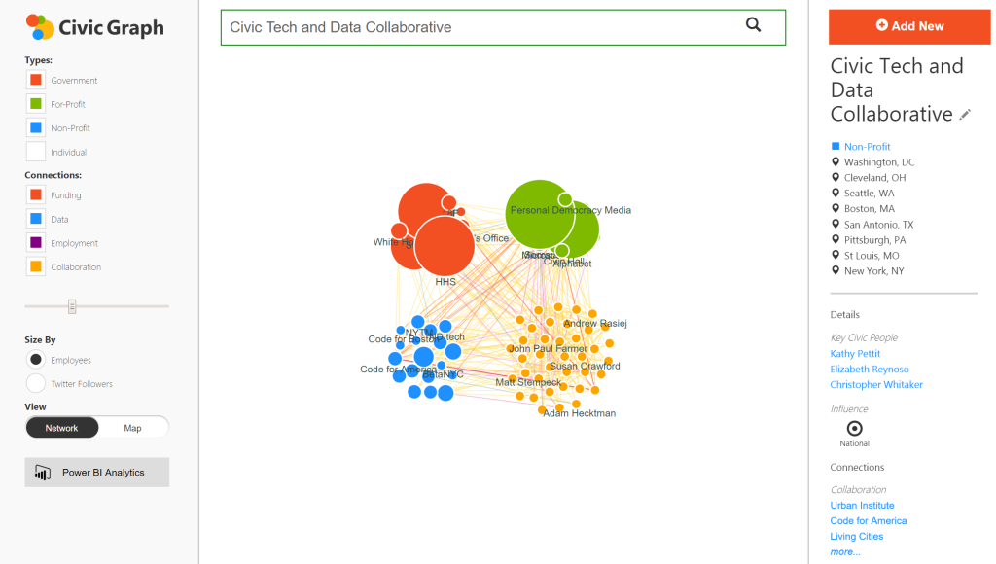
Tools We Analyzed
Least Complicated
Most Complicated
Civic Graph
Connect the Dots
Kumu
Gephi

Slide 32
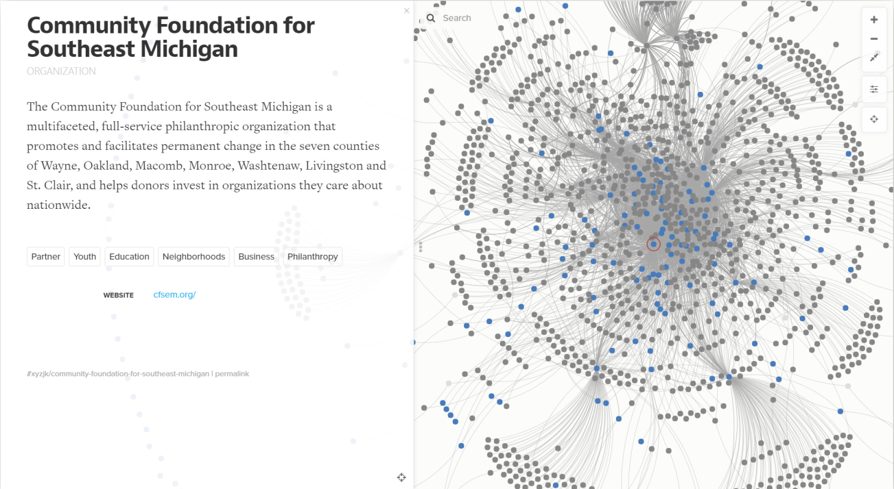
Tools We Analyzed
Least Complicated
Most Complicated
Civic Graph
Connect the Dots
Kumu
Gephi

Slide 33
Benefits of Kumu
Free and supports multiple users for crowdsourcing
Imports and exports from Excel or CSV
Includes a search bar
Easy to Use
Allows users to include information on each actor (including images)
No set structure for the fields
Can color code and cluster based on different characteristics
Ability to Customize
Notes:
After analyzing the different tools, we decided on Kumu. Please note that this analysis was done early last year, and we all know technology changes fast in just a few months. We were really looking for something easy to use with a low learning curve.

Slide 34
Our Kumu Mapping Experience
Partners gathered network data
Collected information in Excel template
Input responses to master spreadsheet
Ecosystem map included color-coded nodes, background information, and images
Notes:
To explore the tool and show our grantees how to use it, we (the national partners Code for America, Living Cities, and NNIP) created an ecosystem map of our Civic Tech and Data Collaborative (CTDC) convening in Kansas City. Our actors were people, organizations, and cities they’re from. The connections were individuals’ project role, role at the convening, organizations’ sector and networks it belonged to. We compiled the information in an excel sheet, then imported it into the Kumu platform.

Slide 35
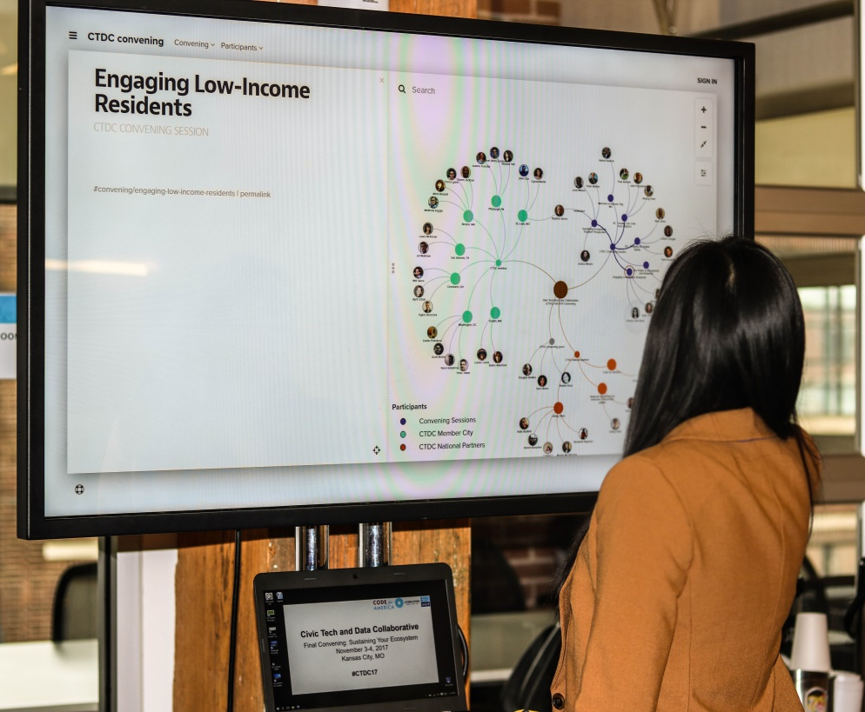
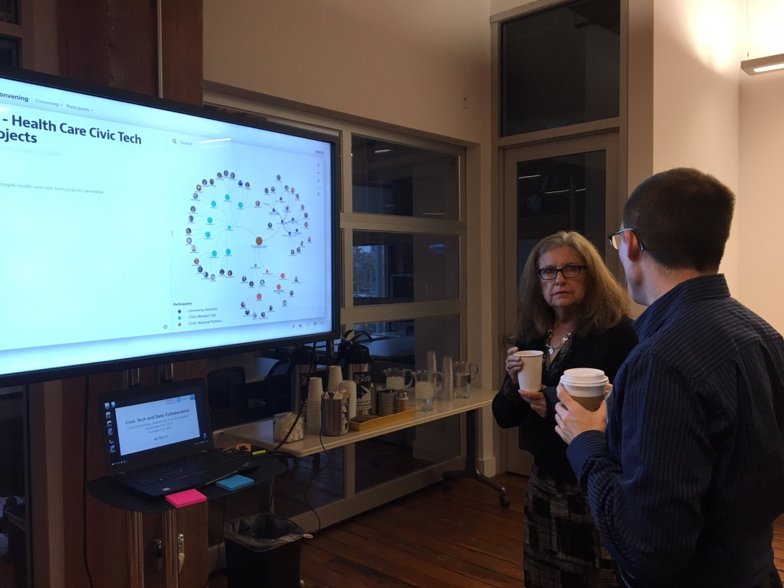
Civic Tech & Data Collaborative Convening
Notes:
Instead of the usual printed participant list, we had an interactive touchscreen where convening participants could see who was at the convening and how they were connected to each other beyond just being at the event. For example, who were from the same city, which organizations were part of the same network, who had similar roles. We also asked them a couple of additional questions to show additional connections between people such as where will they go for your next vacation? and what social issue are they passionate about?
Our project-specific map attributes included: Filters (Elements) • Person • Organization • CTDC member • CTDC national partner • CTDC convening session • Event • Networks • City • Sector Filters (Connections) • City • Sector
KUMU MAP FROM KANSAS CITY
*Notes that were cut from the picture:
Civic Tech and Data Collaborative (CTDC) fall 2017 Convening: With support and partnership from John D. And Catherine T. MacArthur Foundation, three national organizations– Code for America (CFA), Living Cities, and the National Neighborhood Indicators Partnership (NNIP) are working with seven communities around the country to advance the frontier of civic technology and data ecosystem development. Our organization have developed extensive ties with localities across the country over 54 collective years of working with the non-profit and public sectors.

Slide 36
Questions?

Slide 37
Importance of Analysis
Reflecting on your map or process can be an opportunity for growth
Gut check your map – is the picture accurate?
Use your map as a stepping stone
The analysis process looks different for every organization
Notes:
Ok – you created the map. Now what?
As I mentioned at the start, this is just the beginning!
Reflecting on your map or process can be an opportunity to brainstorm new ideas for collaboration or recognize areas in need of growth and investment.
Most importantly, gut check your map before sharing. Have relationships been accurately reflected? Is information missing?
There can be issues of missing data (gaps) or data quality (are there errors in data entry?)
Now that you have your map, use it as a stepping stone, to create an open dialogue between organizations and communities.
Like the mapping process, the analysis process looks different for everyone. Refer back to your purpose and scope.
Once you know your data is accurately mapped. There are some general questions that you should ask
Questions to ask:
Are there any silos? Are any sectors, organizations, people not represented? why?
Are there opportunities for new collaboration?
What additional information about the current actors would be helpful?
What makes some connections weaker than others?
What can make more connections stronger?
For example, our Seattle NNIP partner saw that her network was heavily represented by researchers and lacked technology partners. Part of the issue was that her data source only came from existing partners so she’s looking at how to show this map to her team to highlight that they need to expand who they work with and get new ideas and ways of working.

Slide 38
What will you do differently?
Notes:
Ultimately, after your analysis, what will you do differently?
--How do you make new connections or deepen existing partnerships?
--Maybe more outreach? Different events?

Slide 39
Lessons From Pittsburgh

Slide 40
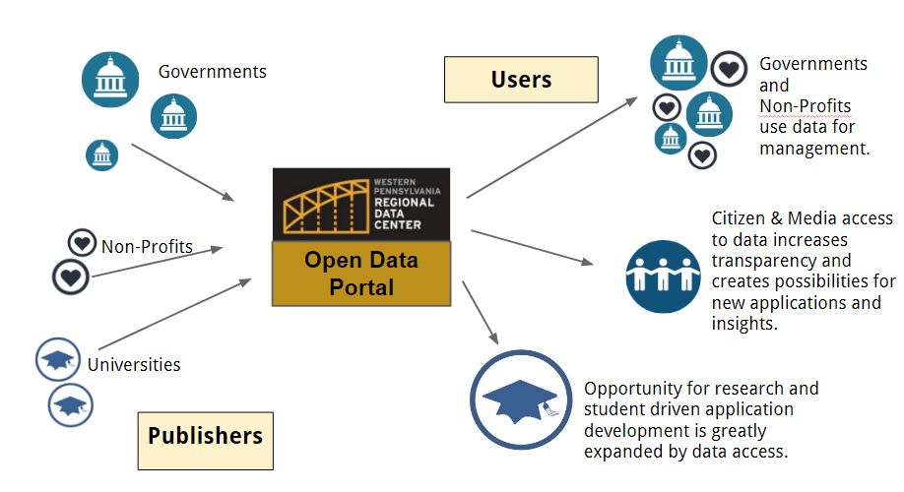
Western Pennsylvania Regional Data Center
Notes:
describe the process you went through and how engaging with their stakeholders to build the list made the map richer.
Decision points about time and tradeoffs
Discuss what you learned from having the map - how it has helped - did it spark anything afterwards? What is the value?
Lessons learned - what would you have done differently.
And then feel free if it makes sense to plug your civic switchboard ecosystem guide and encourage them to think about their academic and public libraries as allies. These aren’t data/tech orgs, but have social missions where libraries could be a resource for their outreach/engagement and services for their residents/communities.

Slide 41
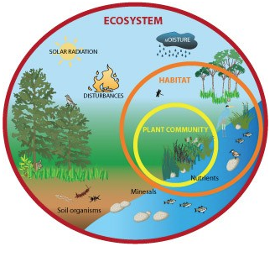
Ecosystem Approach to Engagement
We’re interconnected and no one organization can do it all alone
Thinking about ecosystems makes our work more resilient, more-connected, more agile, and more inclusive
Must be intentional about building an ecosystem
Notes:
http://www.theexpressweeklynews.com/june-calendar-of-events/all-about-ecosystems-easy-science-for-kids-a-diagram-of-an-ecosystem/

Slide 42
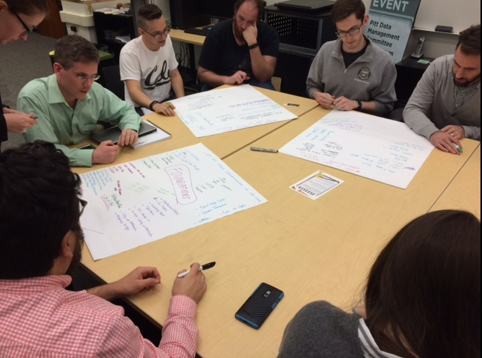
Civic Tech and Data Roundtable
Building long-term relationships
Discussing challenges in a safe space
Mentoring
Pooling funding
Marketing and promotional support
Notes:
Newsletter and strategy for leadership transition came from Roundtable – open invitation to any org leaders

Slide 43
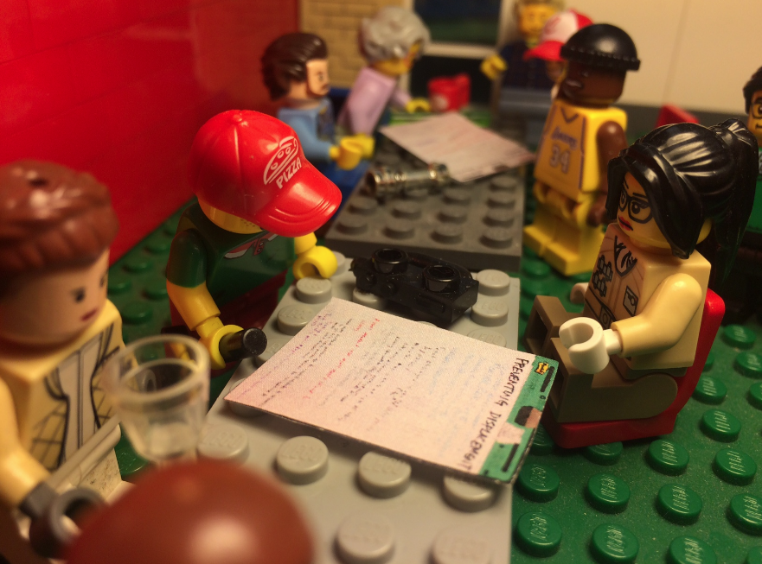
Participatory Mapping Process: Standardizing Vocabularies and Providing Prompts
Organizations
Roles & Functions
Tech. Infrastructure
Capacity
Events
Physical Spaces
Notes:
At first roundtable meeting, defined common vocabulary and elements through pass-around list=building activity

Slide 44
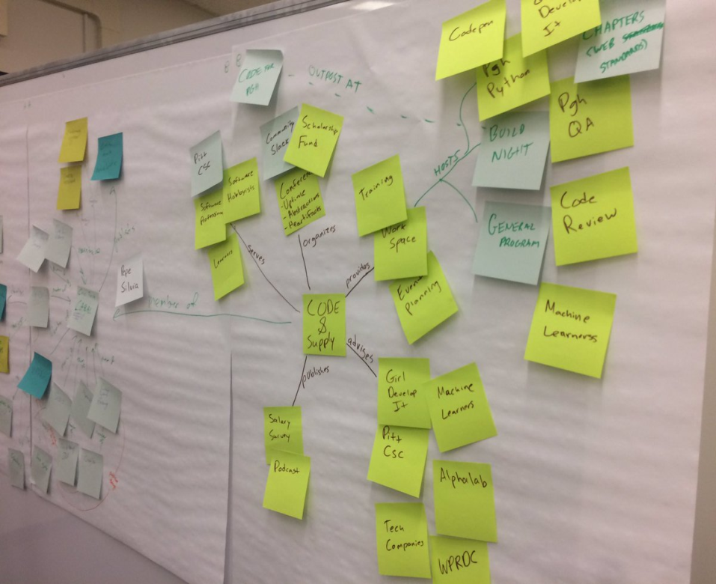
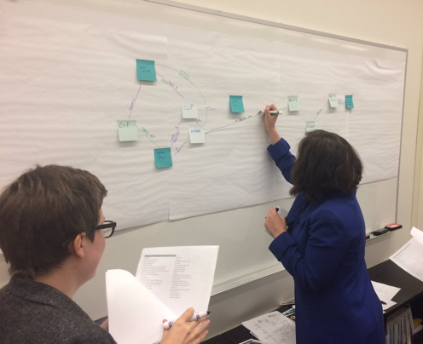
Participatory Mapping Process: Building the Map
Notes:
Second meeting roundtable participants mapped the ecosystem – distributed the lists generated at the first meeting as prompts
Post-its & lines – crazy wall

Slide 45
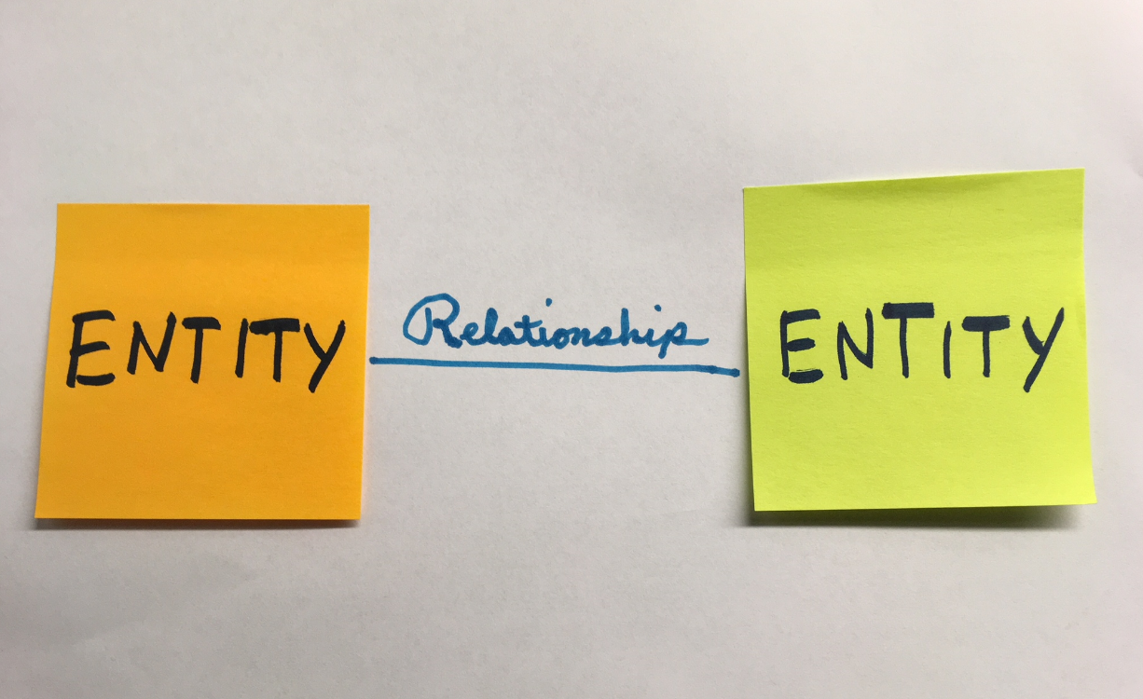
Participatory Mapping Data Model
Notes:
Second meeting roundtable participants mapped the ecosystem – distributed the lists generated at the first meeting as prompts
Post-its & lines – crazy wall

Slide 46
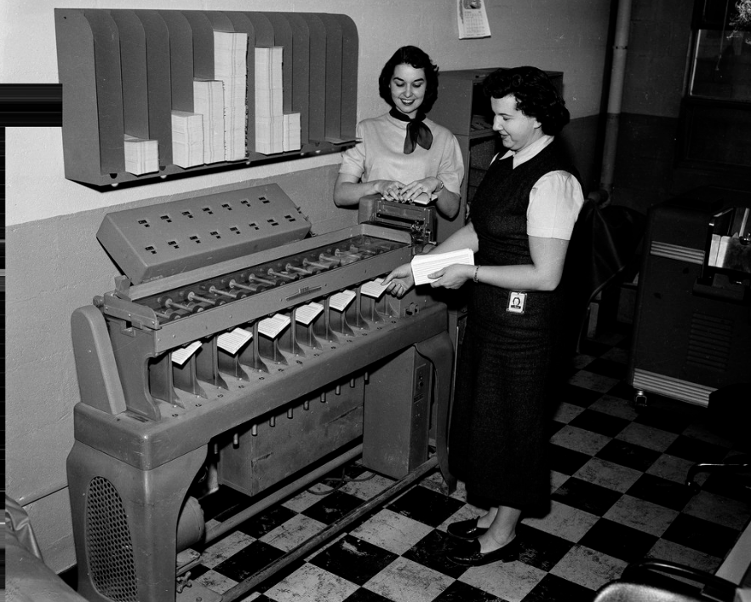
Data Entry
Notes:
U.S. Department of Energy FEMP 31 1408 https://www.flickr.com/photos/departmentofenergy/29242374641/in/photolist-grS6rz-hJxzVt-hQCaJe-21iqGC1-Ly3Pc8-KSKCMt/

Slide 47
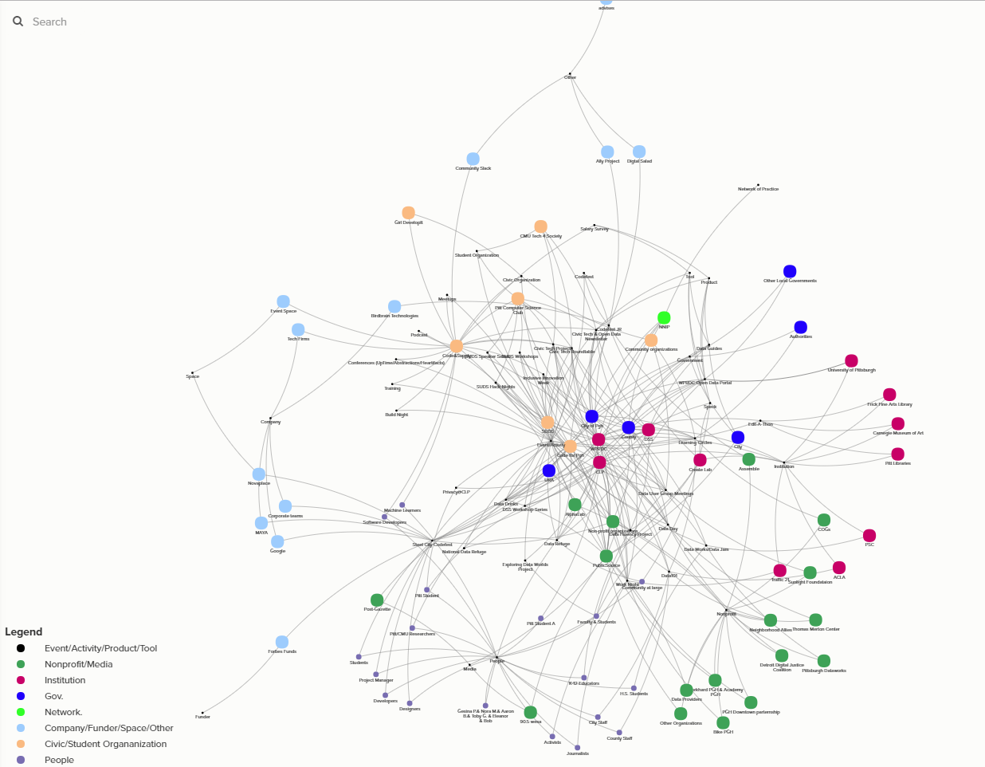
Our Ecosystem Map
Notes:
https://embed.kumu.io/235a7fabc22c44887d98ed963db2f596#pittsburgh-ecosystem

Slide 48
Roundtable members took a look at the ecosystem map
Notes:
SMU Libraries Digital Collection https://www.flickr.com/photos/smu_cul_digitalcollections/6863317608/in/photolist-bsuidd-ouyWVs-8ZjWCz-owkBA7-8ZjWBp-ouVJYk-oeYkT1-rJnBkw-fbMdek-dcqoZg-YwQ6je-owqqvz-cCbQXS-osU9CS-ounYgU-ZUaJNA-otT2w2-oyeQfr-24FgMzM-i6NwHE-ouTFvE-odrBoA-8Zo1cj-ouGtaw-id1VNj-owcVNe-ourky6-hLZdav-oyc65x-XpdyFc-YhuBWc-ouGL5d-od8tM1-oeYeMo-ovbkqV-oeVenj-owrEWJ-owaJbd-odpUym-oweefg-hZzGzL-owhJjf-H4Az6k-cWGmbW-ouUf19-i16i9h-odnQri-idkygR-i97eae-owFnux

Slide 49
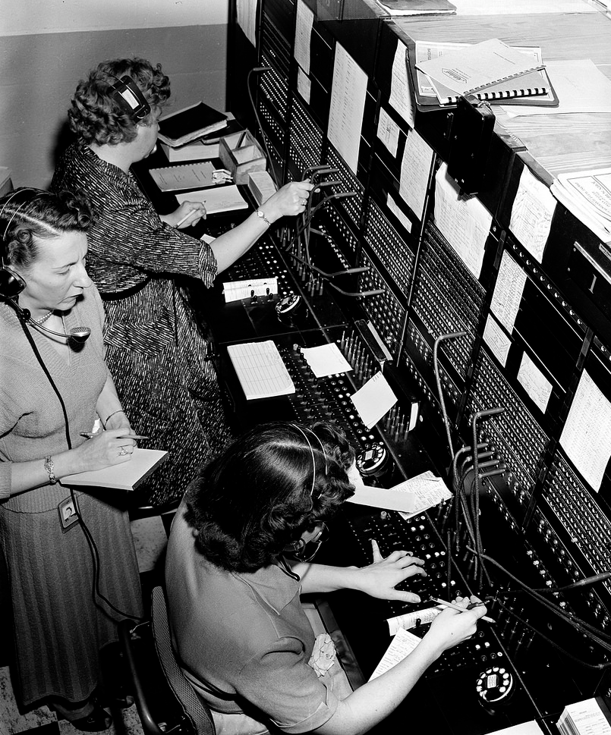
Analysis: Connectivity
Institutions like local governments, libraries, and universities play central roles in our ecosystem
Social events are more important at connecting organizations than we thought
Relationships are important feedback loop
Notes:
U.S. Department of Energy: CHIEF OPERATOR CHARLOTTE STOECKER OBSERVES SWITCHBOARD OPERATIONS https://www.flickr.com/photos/departmentofenergy/30492597021/in/photolist-engZvs-nqFEnJ-NswwKp

Slide 50
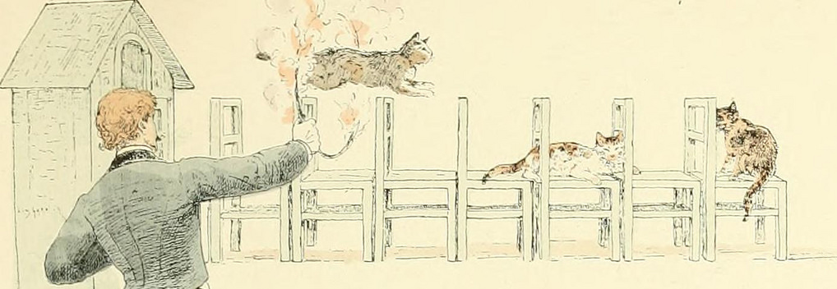
Analysis: Agility
Long-term relationships enable collaboration
Volunteer organizations were hosting many events already
Notes:
Agile: Image from page 94 of "Les jeux du cirque et la vie foraine. Illus. de Jules Garnier" (1889) from Internet Archive Book Images https://www.flickr.com/photos/internetarchivebookimages/14578835120/in/photolist-odhkLd-osKLwd-odhRzj-F3VZQs-odhxBf-odhuk6-odiad5-ouMrFv-osKNMA-ouKCSj-72ETwh-ov2ziB-odhkSL-odi4hN-ouMb9Z-ouzACb-8i5nEK-ouKBGU-FcnwJH-ow78LK-odhqyu-osKddA-7bSrT4-odhS3z-osKp3G-dXZ8B8-73xiei-osKwDd-wNVCHs-osKAjQ-oeQHJF-odgp2v-ownTKY-odhjKW-odhTnD-ouzD4y-21UiPvS-osKMmE-5nRRNf-ouzhzh-odhPUA-odiGfp-oditsk-fh6eSv-odiJm8-GYn8Xo-owxxFR-zXEQqJ-oup9ro-GYnbsU

Slide 51
Analysis: Health and Resiliency
Many of our organizations are led by volunteers
Some organizations only have one relationship linking them to the rest of the ecosystem
Notes:
Internet Archive Book Images: Image from page 431 of "The Bermuda islands. An account of their scenery, climate, productions, physiography, natural history and geology, with sketches of their discovery and early history, and the changes in their flora and fauna due to man" (1902) https://www.flickr.com/photos/internetarchivebookimages/19746609673/in/photolist-w5Wx6t-oegww5-xp7qEq-xrzKbs-xD9jJQ-sM9nCQ-xEByQK-xizUqz-tDWxCD-oesdHr-oeDMgk-ouf2au-wYmo7s-xEzA8D-trePVN-xbBYUJ-oeBURf-w6B9Zg-oxSYzV-xD8zCE-ovUiBw-xbKGjT-wQDCdZ-owehtp-wHmohi-ws12XK-tkNF7g-xJ8B8g-oxNTc8-xma9hd-w9WMXP-owhc97-xbCAyC-tnotFV-vdz1w9-xoCA4b-wvLhzV-wGUNcE-ovUaJ9-owmxbr-wEPdCC-xnj3aQ-xsYvZ4-oddSAL-xt2wYc-xnnb13-tHEJUG-owm8FR-ounwq9-xDt72C

Slide 52
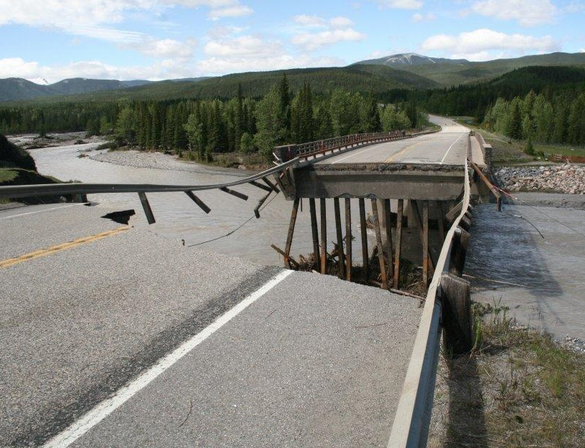
Analysis: Gaps
No relationships with some of the organizations included in the ecosystem map
Organizations missing from the map entirely
Notes:
https://www.flickr.com/photos/governmentofalberta/11466421765/in/photostream/
We didn’t have relationships with some of the organizations included in the ecosystem map.
Organizations whose members often face discrimination, feel excluded, and lack power were missing from the map entirely.

Slide 53
Analysis: Roles
Convener/Organizer
Funder
Network Manager
Cheerleader
Bridge-Builder
Infrastructure Provider
Notes:
Internet Archive Book images – American bee Journal https://www.flickr.com/photos/internetarchivebookimages/18113909875/in/photolist-tAEwjX-ocbncC-odhyhd-od8sVF-djG62M-L7BTDa-24a8v46-rbEDi9-tAur4g-29sbZzu-rbMy4t-rbMR6V-owbmN1-owv3PZ-tAB8wW-kyp8Pa-owvjgF-wP1oiW-owiGpS-sDTQFt-ounhHQ-7ZC7XU-wNYdYW-sDsF3S-rt9MSp-tAfeAS-tAMadk-oeZ5rg-owpmF2-ovCjtp-L7C8Cn-tmKbrQ-sEtzMH-owdYK4-owgr5Y-tALXMp-wPu6cL-L7BSyK-r9VEak-nooQTj-as7zT8-doFJs3-e5ze6h-tApm7E-j82sPs-ovsmAc-9NoZWD-23zaUQt-nJN25W-nL2yb2

Slide 54
How the Process Helped Our Organization
Communicated our value beyond formal programs and activities
Presented us with an opportunity for introspection e.g. our role:
Should we be doing something if others can’t do it?
Who should fill the gaps in the ecosystem?

Slide 55
Civic Switchboard Project - Resources
Civic Switchboard is an Institute of Museum and Library Services supported effort that aims to develop the capacity of academic and public libraries in civic data ecosystems.
Introduction to Civic Data Ecosystems (Blog)
Guide to Mapping Your Ecosystem
Guide to Measuring the Health and Capacity of Your Ecosystem
Call for Proposals - $3,000-$9,000 awards available!
Notes:
We're Using the Ecosystem Framework in the Civic Switchboard Project

Slide 56
Poll
Notes:
What role(s) do you see yourself playing in your ecosystems? (Check all that apply.)
Network Manager
Bridge-Builder
Convener
Organizer
Funder
Infrastructure Provider
Cheerleader

Slide 57
Questions?

Slide 58
Community Progress Makers Technical Assistance
All Technical Assistance requests should be submitted using the new TA request form
Following your request, a scheduler will contact you to gather information and book an appointment
CPMTechnicalAssistance@urban.org
Notes:
The first is that the TA request form is live and you are free to submit any requests for TA through the link.
The second is just a friendly reminder to please complete the indicator survey if you haven’t done so already.
That concludes our webinar for today.
Click slide.

Slide 59
Thank You!

