Slide 1
The 2020 Census
Mobilizing Data-Driven Local Outreach
Thank you for joining us!
We will get started shortly!
*For the best webinar experience:
Listen by dialing in via landline phone
Watch webinar on computer screen

Slide 2
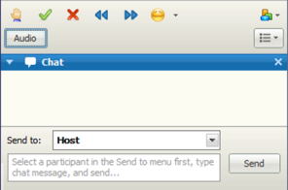
A Few Housekeeping Notes
To keep background noise at a minimum, please self-mute when not contributing a question/comment.
Type your questions into the chat box.
Webinar Q&A is being recorded and will be available in the Resource Library.
Notes:
Note: If there is any audio feedback at any point during the call, remind all participants to self-mute your audio unless they are contributing a question or comment.

Slide 3
Citi Foundation
Welcome

Slide 4
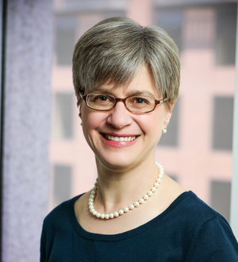
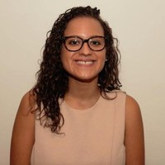
Introduction
Kathryn Pettit
Principal Research Associate, Metropolitan Housing and Communities Policy Center
Claire Ross
National Partnership Specialist, National Partnership Communications Directorate, U.S. Census Bureau

Slide 5
Session Goals
Uncover the background on the status of the Decennial Census
Discuss current resources available for communications
Explore ideas on how local organizations and actors can get involved
Notes:
Bring you up-to-date on the 2020 census, communicate the urgency of getting involved now, and spur some ideas about how your organization can contribute.

Slide 6
Agenda
1
Background on the Decennial Census
2
Ways to Get Involved
3
Census Design Workshop
Notes:
There’s three parts to this session and we’ll stop for questions after each one. I’ll be going through the first two sections and then Claire and I will be covering the last section together.

Slide 7
Poll
Notes:
Was your organization involved in 2010 Census activities?
Yes, formally - we joined the complete count committee or were a Census Partner.
Yes, informally – we promoted the Census through word-of-mouth, newsletters or meetings.
No, we weren’t involved.
I don’t know.

Slide 8
Poll
Notes:
Has your organization engaged in any organizing for 2020 Census promotion in your city?
We’ve attended one or more meetings already.
We’re aware of others organizing, but haven’t gotten involved yet.
We’re not aware of any local organizing, but have begun to discuss how our organization can get involved.
We’re not aware of any local organizing, and we haven’t talked about it yet.

Slide 9
Background

Slide 10
What is the Decennial Census?
The U.S. Census counts every resident in the U.S. every 10 years as mandated by the Constitution
The z
The Bureau cannot share personal responses with any other government agency, outside entity, or court of law for any reason
The oath that Census Bureau employees take not to reveal personal information is enforced for life
Violations are subject to fines up to $250K and up to 5 years in prison
The Census data are confidential
Notes:
We want to start with the basics. The goal of the Census is to count every person, only once, and in the right place.
The data collected are governed by a law titled Title 13, which stipulates that no individual's information can be shared outside the Bureau. If someone breaks this law, they face large fines and a possible prison term.

Slide 11
The Census Affects Your Community
Governments use the counts to:
Apportion the number of representatives in Congress among states
Draw districts for state and local elections
Draw the congressional district boundaries
Statistical agencies use Census data as input for many other data sources including the American Community Survey
State and local governments and businesses also use decennial and decennial-influenced data for investment decisions
Notes:
POLITICAL REPRESENTATION:
The primary purpose is to get a complete count of the people living in the US so that the number of representatives in Congress can be apportioned among states.
The decennial census counts are then used to draw the congressional district boundaries.
States and Local governments also use the counts to draw districts for state and local elections.
A complete count ensures that as all of these political boundaries are drawn that everyone is fairly represented.
COMMUNITY INFORMATION: (in future move this to last)
The decennial census also is the foundation to many other data sets, including the American Community Survey.
- The quality of the decennial data affects the quality of our federal statistics about our communities over the next decade.
INVESTMENT DECISIONS
Cities and counties plan for all kinds of services use the data to decide spending priorities- from where to put a new senior center or a new school.
The business community use census counts or other data derived from the census all the time to make decisions and market products. They might use these data to figure out where to locate an office, or whether a community has enough people to support a grocery store.

Slide 12
The Census Affects Your Community
300 federal programs geographically allocated over $800 billion a year based on Census-derived statistics in FY15
Health: Medicaid, Children’s Health Insurance Program
Food and nutrition: SNAP, school lunch program
Child services: Title IV-E Foster Care and Adoption Assistance, Child Care and Development Fund
Housing: Housing vouchers and project based subsidies, Low-income Home Energy Assistance
Transportation: Highway funds
Education: Head Start, Title I, and special education grants
Notes:
$800 billion of federal funds also are distributed based on data that relies on the decennial census - health and education to housing and transportation.
If we don't get a complete count - people may not have access to important services. And we only get this chance once a decade. If the data are flawed, there will be repercussions for the next ten years.

Slide 13
Who Does the Census Miss?
In 2010, the Census missed counting:
2.1% of blacks and 1.5% of Latinos | 0.7% of children under 5 | 1.1% of people living in rental housing
Notes:
People of color have been undercounted since it was discovered that there was an issue with undercounting people in the 1940 census.
People of color vs. non-Hispanic whites overcounted by 0.8%. This translates to 1.5 million blacks and Latinos not county.
Renters - compared to a net over-count of 0.6 percent for people living in owner-occupied housing units

Slide 14
Why Is There An Undercount?
Missing the housing unit altogether
Housing instability
Language barriers
Complex household arrangements
Mistrust of government

Slide 15
New Challenges for 2020
The fractured media environment makes it harder to reach people
The campaigns for the 2020 election year will complicate the media messages
The Census Bureau will accept responses through the internet for the first time
Funding for Census related communications has decreased and been delayed
Last-minute addition of the citizenship question will mean immigrants may not trust completing the Census
Notes:
Each of these could be an hour conversation, but most won’t be a surprise to you.
Media – the multiplicity of ways people get news and the emergence of “fake news”
Election – fear about it being politicized
Internet – concern about digital divide – how well it will work on mobile, places without widespread broadband, or older browsers.
Funding – Bureau got started later on communications because of budget constraints from past years
Citizenship question – In late March, Sec Ross added a question asking about citizenship to the survey. Currently being fought in the courts, but assuming it goes forward, undocumented immigrants and their families (who might be legal residents) could fear the information will be used against them. (in future pull this out as a separate slide)
***
Most stakeholders agree that the citizenship question should not have been added, particularly at this late date when it is too late to test.
By adding a citizenship question to the census, the Trump administration will:
suppress response rates in immigrant communities,
increase costs to taxpayers in administering the census,
and disproportionately impact the allocation of resources for government services in a way that hurts communities of color, low-income communities, and other vulnerable populations.
Problem with late addition - we don't have a way to estimate what kind of impact it has without testing the instrument.
In Interviews and focus groups that the Census Bureau conducted last year, they heard unprecedented increase of concerns about how the data would be used. Spanish-speakers feared that the responses would be shared with immigration officials. Respondents stated that the media and political climate undermined their trust in the the Census Bureau messages about confidentiality. These were findings before the citizenship question was added, so I believe they would just be intensified now.

Slide 16
Questions?
Notes:
So – I promise the rest of the presentation will be more optimistic, but first are there any questions about the basics of the Census or the particular challenges we are facing this time?

Slide 17
Ways to Get Involved
Notes:
So – now for the fun part….

Slide 18
Poll
Notes:
Does your organization work with? (check all that apply)
Renters
Immigrants
Families with young children
Families with limited income
People of color

Slide 19
We need you!
Your organizations can be trusted messengers that:
Know the neighborhoods and the people you serve
Know how your neighborhoods are changing
Know local priority issues and concerns
Collaborate with key players in public and nonprofit sectors
Notes:
The census won’t be successful without groups like you on the ground serving as TRUSTED MESSENGERS about the importance of the Census to your communities.
Whether you work on economic development or affordable housing or education, there’s a political and economic necessity to get involved to make sure the people you work with are counted.

Slide 20
National Activism
z
Citizenship Question
Federal Register requests feedback on the questionnaire by August 7
Resource: Leadership Conference Fact Sheet and Comment Form
z
Adequate Congressional appropriations for operations and communications is not assured
There is support from Democrats and Republicans, but they need to hear from their constituents
Resource: Census Project
Funding
Notes:
So, what can you do –
First, there’s actions you can take at the national level to ensure the best implementation possible.
The Bureau has issued a federal register notice calling for comments on the 2020 Census data collection procedures and questionnaire. This is an opportunity for individuals or organizations to formally comment on the addition of the citizenship question, in addition to any concerns you have about the other questions and processes. Comments are due by August 7. I’ve linked to Leadership Conference resources – they have a template letter you can adapt for your own organization. Your voices matter and getting a diverse set of stakeholders around the country to comment can make a difference.
The Census needs to be fully funded to ramp up operations over the next year. Congress people listen to their constituents and you can share the impt of the Census. For FY19 – the president and house budget are $3.8 billion – $1 billion short of the Senate number and what stakeholders believe is needed.
Census Project tracks appropriations bills and provides sign-on letters and opportunities to weigh in.
[insert comment about advocacy rules?]

Slide 21
Local Activism: Get Connected
Sign up to be a Census partner organization
Website includes:
Census 101 Fact Sheets
Audience Outreach Toolkit
Mapping Tools
Census Solutions Workshop
Resource: Census Partnership Website
Notes:
The census bureau just released its official website with some basic resources – outreach messages and fact sheets – We’ll be talking more about the mapping tools and workshop in a moment.
I encourage you to sign up so you can get updates as they post more resources.

Slide 22
Local Activism: Get Started
What’s happening locally?
z
Civil rights and other advocacy groups
Complete count committee (city, county, state level)
How can you educate key stakeholders?
z
Funders, local officials, business leaders
Resource: FCCP Funders’ Toolkit
What are ways to start spreading the word day-to-day?
What opportunities exist to link residents to Decennial Census jobs?
Notes:
So what should you do locally? Range of involvement (Knowing you will make decisions on activities based on your mission, interests, and local context).
INFORMATION GATHERING: First is to find out what activities are happening locally. Likely formal and informal activities, but it varies a lot across the country where localities are in getting organized
Local governments and groups outside of government will be forming Complete Count Committees.
I imagine most of you won’t be leading local coalitions, but your groups have really important perspectives from the ground so I think it’s impt that voices like yours are at the table.
**
FUNDERS: You also can help educate your local funders.
The Funders Committee on Civic Participation has prepared a toolkit for Funders (persuasive, but also factsheets, milestone dates)
– participate – share the information among their peers and grantees
- convene – create spaces to exchange information and ideas
- invest – fund organizations – yours or other community organizing groups – to plan and implement outreach or fund a hub to help with information-sharing/coordination
Some local govts have also funded efforts in the past.
DAY-TO-DAY: updates in your newsletters, social media, materials at events
JOBS: The Census Bureau is already recruiting for many field positions. Starting in Spring 2019, they will be hiring 76,000 people for address canvassing and in Fall 2019, they will begin recruiting for 450,000 field staff to support 2020 operations. Current field jobs are listed on the Census Bureau website and you can also sign up for email updates on recruitment efforts. (will provide links in the resources). A dedicated website is scheduled to be live in Sept 2018.
Good for individuals for workforce development, but also better if people from hard-to-count neighborhoods are doing the outreach.

Slide 23
Local Activism: Think Strategically
What are the neighborhoods and groups that should be prioritized?
Resources: Census Low- Response Rate & Engagement Maps Hard-to-Count Map
Notes:
There will not be enough time and resources to do intense outreach to everyone or even all the ngh and groups at risk of being undercounted.
So 1 example of where your insights can make a difference is helping to think about priorities – either for your organization or contributing to broader efforts.
There are 3 mapping tools that cover the nation that can help spur ideas. Each has pros/cons.

Slide 24
INSERT MAPPING SLIDES
Notes:
Response Outreach Area Mapper (ROAM) from the Census Bureau
Shading is based on a modeled score called the Low-response score (taking characteristics that predicted the 2010 mailing response rates and applying them to more recent data). The darker the color, the less likely that the households in that area will self-respond.
Snapshot of Chicago – it’s a little hidden by the tract near the top with the aqua boundary.
Hispanic: 86%
Foreign Born: 25%
Population 5+ Who Speak English Less Than "Very Well" and Speak Spanish: 30%
No One in Household Age 14+ Speaks English "Very Well": 21 %
The information from this and the next 2 mapping tools should just be used as a starting point.
The concern is that they rely on 5 year national data that is already a few years out of date. So – this information needs to be interpreted through the lens of your local knowledge about neighborhood change – maybe a new large mixed use redevelopment has gone up displacing former residents OR maybe gentrification is pushing low-income households to areas farther from downtown OR maybe there’s been an influx of new immigrant families into a neighborhood.

Slide 25
Notes:
Here’s another view from the Census Bureau which has more friendly design.
In this case, the shading is based on the 2010 percent of households who mailed their census form back. You can start from the county level and then zoom in.

Slide 26
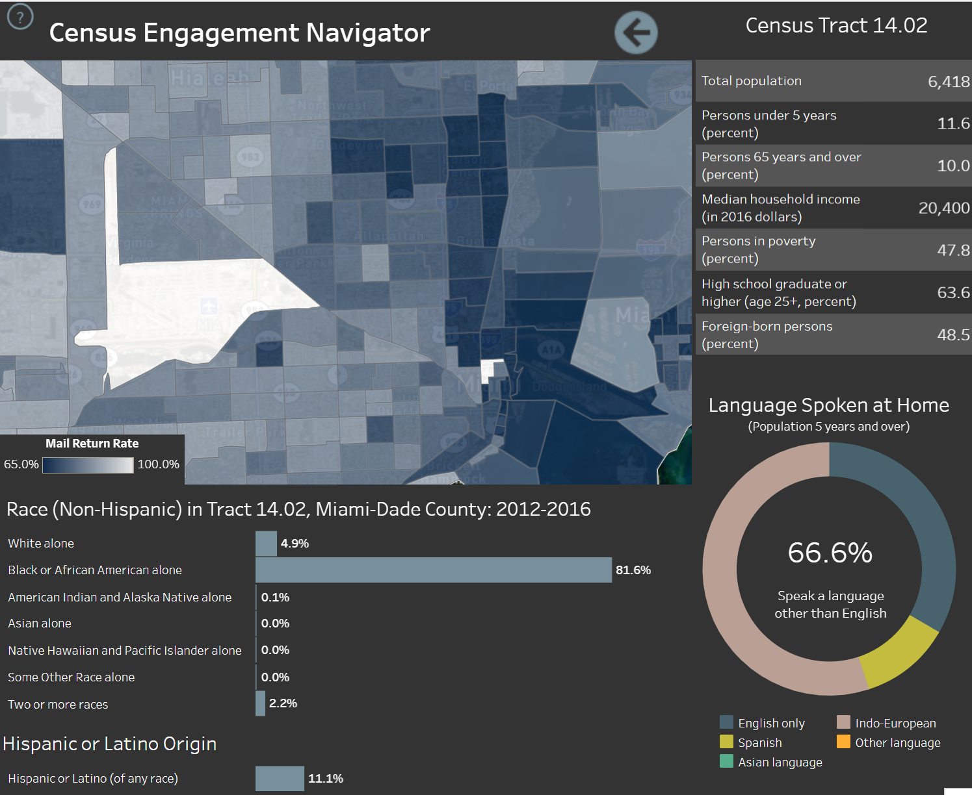
Mapping Resources
Notes:
Here’s a tract level map from the same system of Miami…
In this ngh, ½ are immigrants and 2/3 of the residents do not speak English at home (Haitian community).
The medium income is only $20,000 with 48 percent poverty rate.

Slide 27
Notes:
Source: CUNY Center for Urban Research, funded by a philanthropic collaborative.
This is a screenshot of LA – shaded by the mail return rate like the previous one. It includes stats for the various groups likely to be missed – people of color, renters and those in multifamily units, crowded households, young children.
The advantage of this is that it has good narrative text on the left panel explaining the importance of the different indicators.
It also has statistics in the narrative from the FCC about internet connectivity. In this case more than 60% of the households did not have an adequate upload/download speed (200 kilobits per second. In 2014, intro dsl speeds are 1500 kbps)
Another unique feature of this one is that This has congressional and state legislature districts.

Slide 28
Questions?
Notes:
Facilitator should discuss some of the results of the interactive poll, open the floor for questions, and prompt discussion using the below discussion prompts:

Slide 29
Census Solutions Workshop

Slide 30
Census Solutions Workshop
A creative, collaborative, problem-solving event to bring together diverse thinkers
Structured process to brainstorm, prioritize and propose action steps
Generates new ways of:
Communicating the importance of Census data
Reaching hard to count populations
Encouraging participation in Census Bureau surveys

Slide 31
Census Solutions Workshop
Empathize:
Get to know your users
Define:
Articulate the problem clearly
Ideate:
Generate Solutions
Prototype:
Test an idea with users
Iterate:
Revise based on feedback
Design
Thinking
Approach

Slide 32
Census Solutions Workshop Toolkit
1 | OVERVIEW | Why host a Census Solutions Workshop: What it looks like, why it matters and who benefits from it
2 | LOGISTICS | How to host a Census Solutions Workshop: Roles and responsibilities, planning timeline, checklists, and what to keep in mind
3 | ACTIVITIES | What to do at a Census Solutions Workshop: Sample agendas, step by step guide to the activities suggested
4 | CASE STUDIES | What we’ve learned from hosting Census Solutions Workshops: Lessons from pilot workshops
5 | RESOURCES | Tools and Materials you can use at your Census Solutions Workshop: worksheets, checklists, and printable handouts

Slide 33
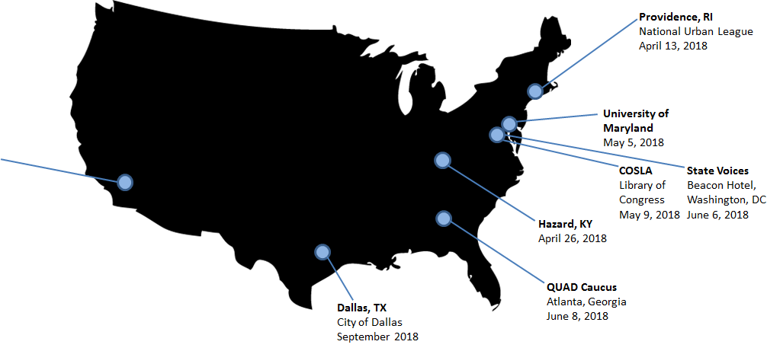
Census Solutions Workshops

Slide 34
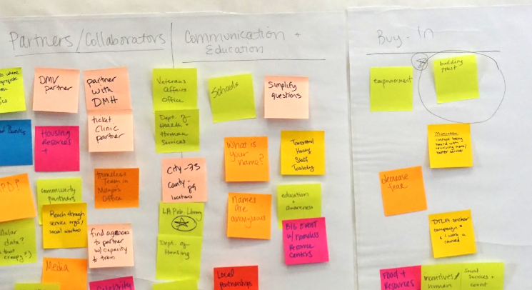
Providence Workshop - Spring 2018
Focused on reducing the undercount of people of color and young children
Sponsored by National Urban League, Annie E. Casey-Kids Count, Children’s Leadership Council, American Library Association and the state/local library networks
Featured high-level speakers– mayor, Secretary of State, National Urban League executive director
Photo credit:
Notes:
Census Bureau team conducted a "design-thinking" session in Providence in April aimed at reducing the undercount of people of color and young children

Slide 35
Questions to Consider
What is the right focus question for the workshop?
Who are the right people to be in the room for a given focus question?
Government, private sector, service providers, advocates, funders, residents?
Who else can you bring in beyond the usual suspects?
Is there a mechanism to hold groups accountable after the workshop?
Is there a mechanism for groups to stay engaged or communicate after the workshop?

Slide 36
Census Timeline
Date | Action
April 2018 | Launch of Census Partnership program
August 7, 2018 | Comments due on questionnaire
Summer/Fall 2018 | Launch of Complete Count Committees
Fall 2018 | Barriers, Attitudes, and Motivators Survey results
Spring/Summer 2019 | Hire ~76,000 people for address canvassing
Spring/Summer 2019 | Finalize electronic/paper versions of questionnaire
Fall 2019 | Open and staff 248 Area Census offices
Fall 2019 | Recruitment starts for ~450,000 staff
January – April 2020 | National advertising campaign
April 1, 2020 | Census Day!
May – July 2020 | Non-response follow-up efforts
December 31, 2020 | Publish state population totals and congressional apportionment

Slide 37
Questions?
Notes:
Facilitator should discuss some of the results of the interactive poll, open the floor for questions, and prompt discussion using the below discussion prompts:

Slide 38
Community Progress Makers Technical Assistance
All Technical Assistance requests should be submitted by email to CPMTechnicalAssistance@urban.org and a scheduler will contact you to gather information and book an appointment.
CPMTechnicalAssistance@urban.org
Notes:
A reminder that all TA requests can be submitted to the CPM Technical Assistance email CPMTechnicalAssistance@urban.org
7/30: Urban will be releasing an online form to streamline the TA request process – grantees should stay tuned for more information this upcoming week

Slide 39
Thank You!

