Slide 1
CI:Now and Growing Local Data Capacity
Laura McKieran, Director, Community Information Now
Leilah Powell, Chief of Policy, Office of Mayor Ivy R. Taylor
April 2016
Notes:
1 min for intros and setup

Slide 2
Laura McKieran, Director
Community Information Now
Local data that’s trustworthy, neutral, and timely
Notes:
30 sec - Leilah start here
LP revise

Slide 3
Late 1990s: A Community Network (SATNET) and the SA Community Information System (SACIS)
Common goal: easy public access to information related to healthcare, education, and social services
Planning meetings: over 30 public, private, and non-profit organizations
AACOG, City of SA, Kronkosky Charitable Fdn, Methodist Healthcare Ministries, SA Area Foundation, UT San Antonio, United Way of San Antonio
2000: SATNET and SACIS merged into Alamo Area Community Information System (AACIS)
2008: Contract with UT School of Public Health, SA Regional Campus
2009-2010: AACIS rebranded as Community Information Now (CI:Now) and accepted into NNIP
2016: Many relevant providers of data and/or analysis, including CI:Now, Texas State Demographic Center, City of SA, Bexar Co., Metro Health, P16 Plus, State of Texas, Trinity Univ., UT Health Sci Ctr
Notes:
2 min

Slide 4
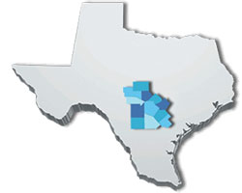
CI:Now in 2016
Annual budget ~$500K
general operating support only 15% of revenue
5 staff, 4.45 FTE
Unincorporated; United Way is fiscal agent and longtime funder
UTSPH SA Regional Campus (SARC) is partner and staff “home”, plus academic resources, data access
Geographic focus: Bexar and 11 counties surrounding
Cover all issue areas, esp. education and health
Active local partner in NNIP
Notes:
2 min
Recognize MV in audience
Recognize MEB and TVB in audience

Slide 5
What We Do
Collection and analysis of secondary/existing data to assist in neighborhood and community planning or change monitoring
Integration/linkage of administrative datasets to link the records of individuals or households across service sectors
Data visualization through maps, charts, scatterplots, and other formats
Dashboards and other online progress reporting
Evaluation of intervention effects on community-wide systems
Assisting many different audiences in understanding and using data
Consultation on the development of outcomes/results and indicators and selection of data sources
Notes:
2 min

Slide 6
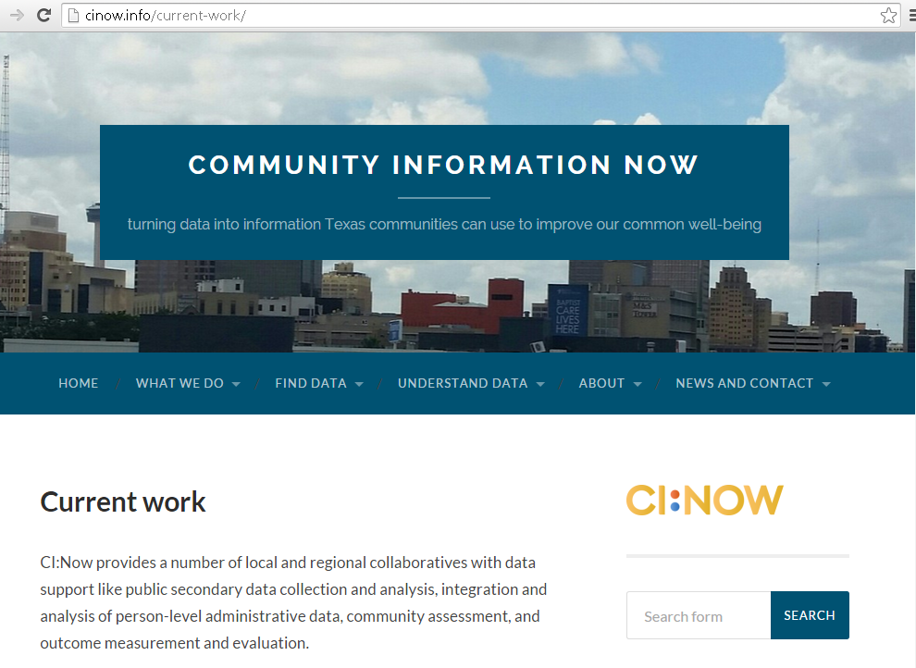
Some of our projects and partnerships
Notes:
15 sec

Slide 7
Data support for PaCT place-based initiatives
PaCT – Promise and Choice Together
Eastside Promise Neighborhood (US DOE education and early childhood; UWSA is lead)
Wheatley Choice Neighborhood (US HUD housing and neighborhood; SAHA is lead)
Dual-gen multi-issue (Annie E. Casey Fdn Family Centered Community Change; UWSA is lead)
Community Safety (US DOJ Byrne; UWSA and SAHA are leads)
Promise Zone (US HUD designation; COSA is lead)
Notes:
30 sec
Ref panel discussion

Slide 8
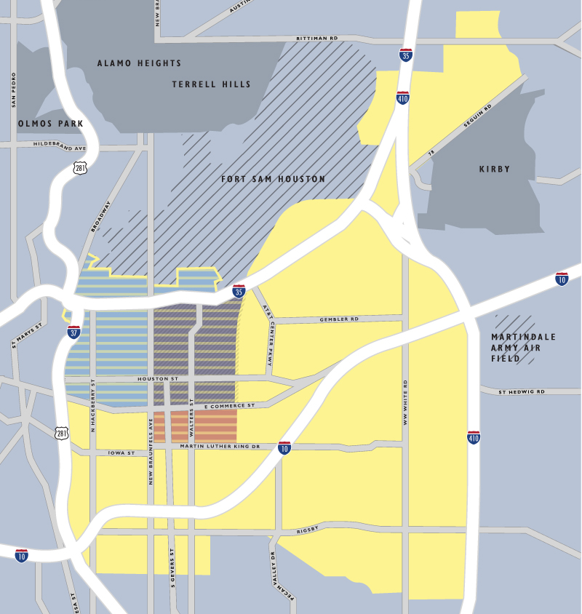
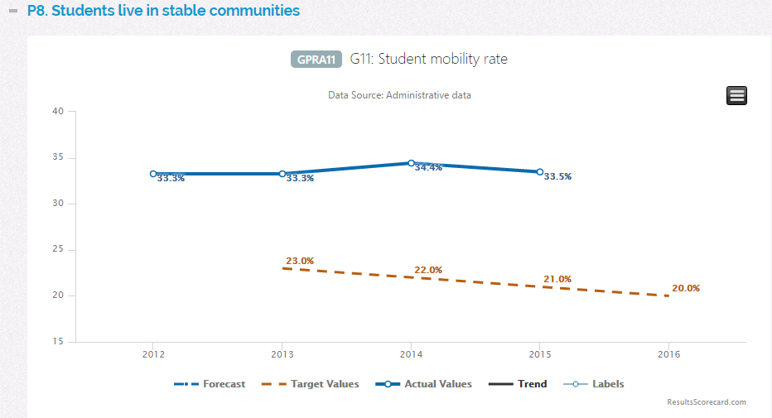
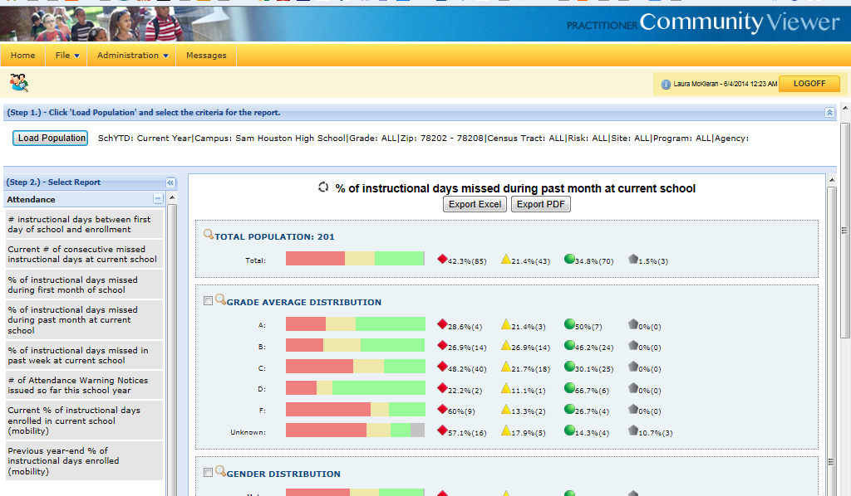
Notes:
30 sec

Slide 9
Assessing and monitoring community conditions
United Way Children’s Issue Council Dashboard
SA2020 Data Dashboard
Promise Zone Dashboard
Community Needs Assessment for Comal and Guadalupe Co.s (2014)
2016 Bexar County Community Health Assessment
Data visualization: trends, demographic & geographic distributions
Direct data download
Notes:
15 sec

Slide 10
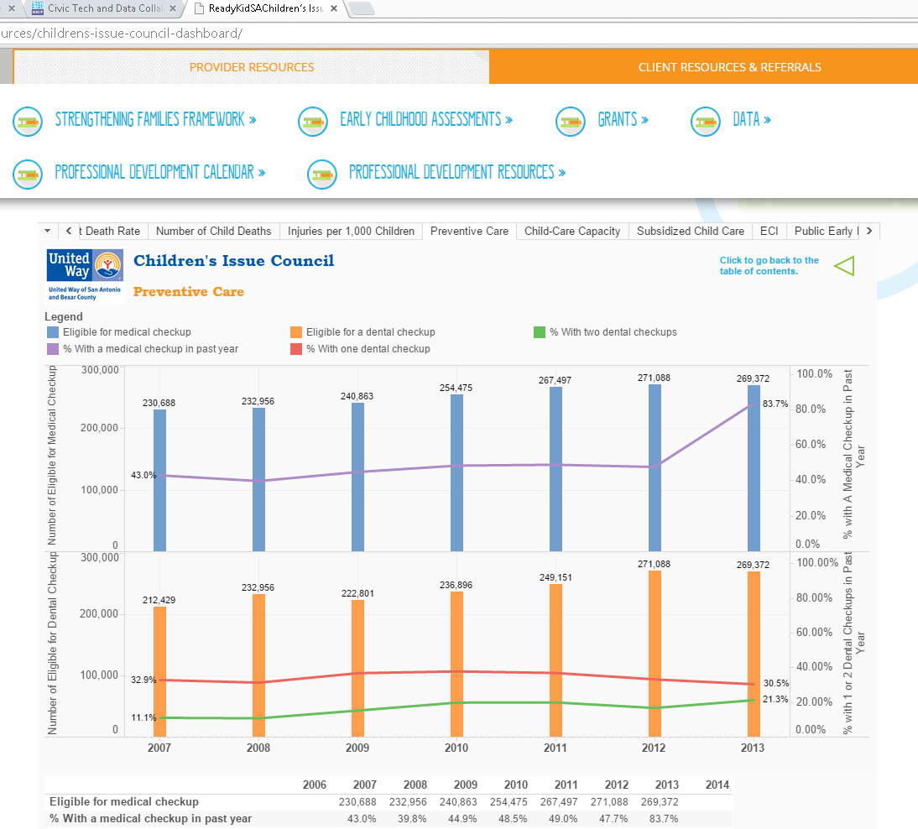
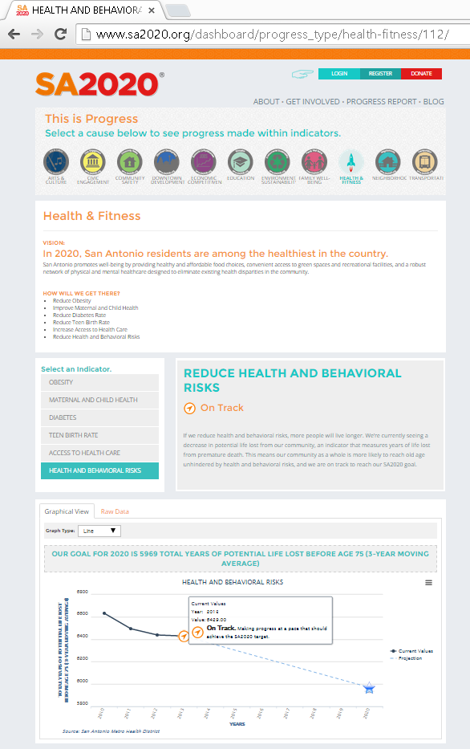
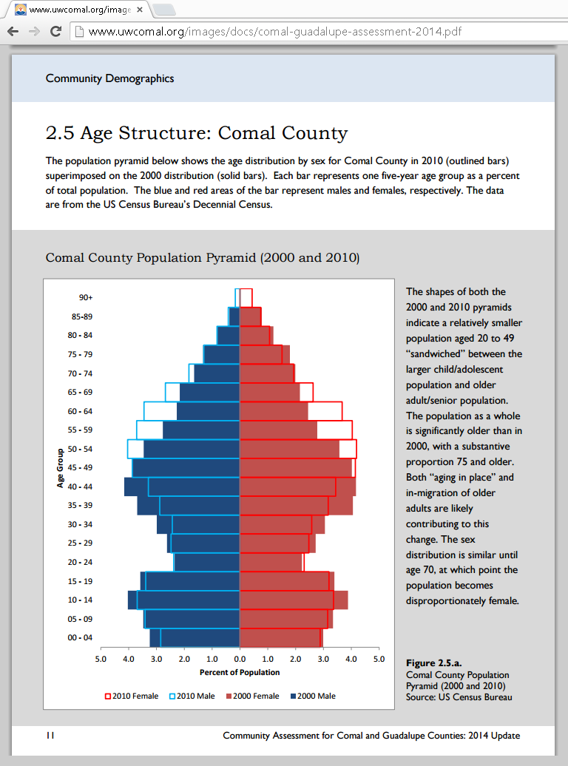
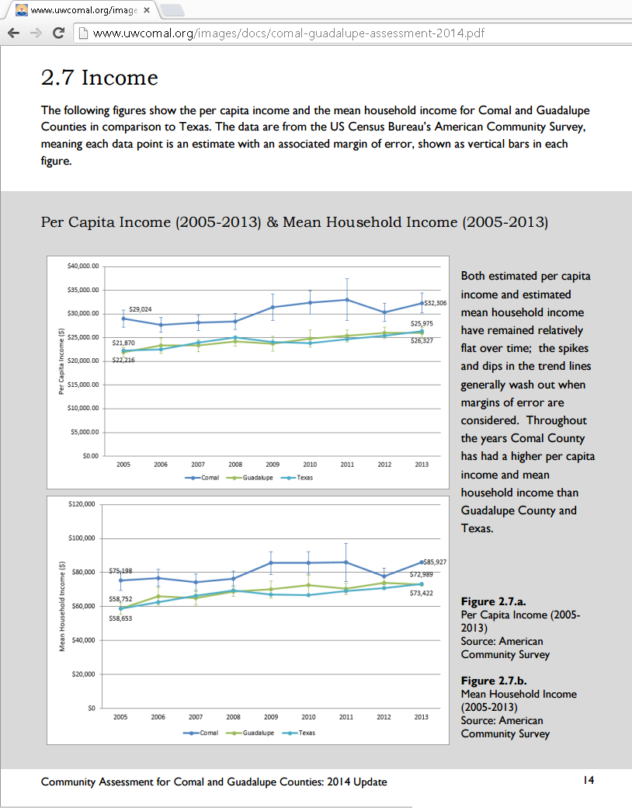
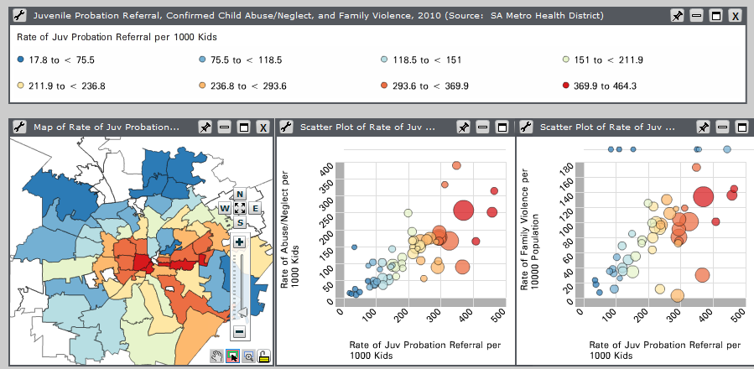
Notes:
2 min

Slide 11
Data Explorer
current selection criteria
nowdata.cinow.info
Curated, searchable repository of online data resources
Built in Django
Live but maintenance not funded
change selection criteria
Notes:
30 sec

Slide 12
Evaluation of collaborative interventions
Center for Health Care Services’ integrated care for “high utilizers”
Process, behavioral health status, physical health status, quality of life, ER visits, general hospital inpatient stays, incarcerations, cost
RWFJ Data Across Sectors for Health (DASH) – CHCS + HASA HIE for community treatment plan
BHFSA-funded CHW/promotora hospital readmission prevention program
30-day readmissions, 180-day readmissions, quality of life, satisfaction, mortality
Out-of-school time programs for academic success
Attendance, course grades, STAAR scores
Common denominator is integration of administrative datasets
Notes:
2 min
Recognize RWJF in audience

Slide 13
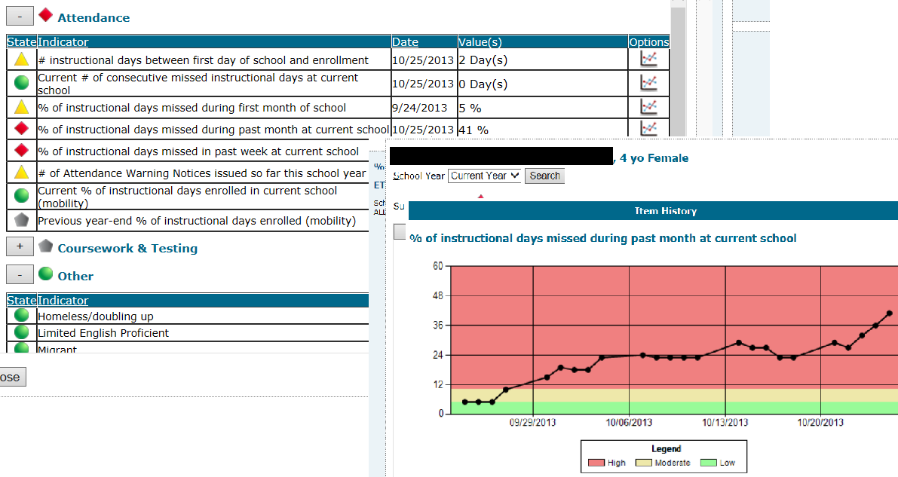
CommunityViewer – integrated admin data
Person-level dashboard
Notes:
1 min

Slide 14
CommunityViewer household & family dashboards
Notes:
30 sec
(Old note:
And with consent we can start to build a family-level dataset that captures things like parent employment and transportation and after school child-care. This is the dashboard we need to support family-centered approaches)

Slide 15
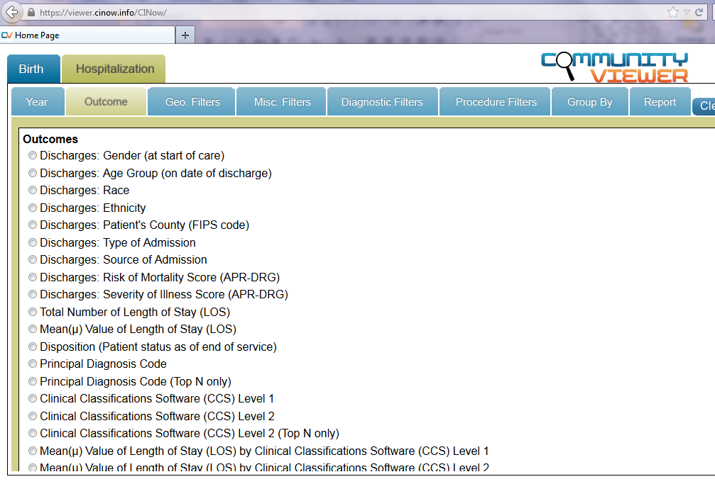
CommunityViewer Public Reports
Notes:
30 sec

Slide 16
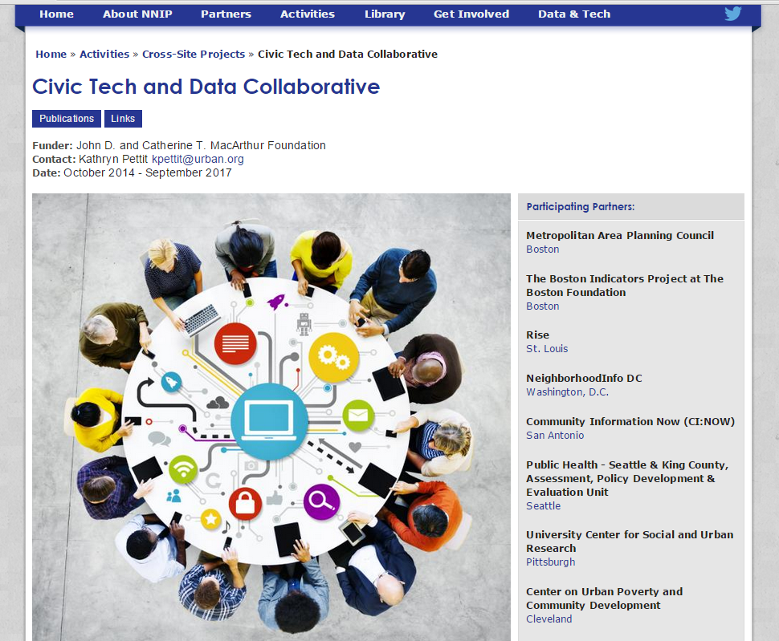
Notes:
30 sec

Slide 17
What We’d Like to Be Doing More Of
Deeper-dive research: effect sizes, variable associations
Need clear research question(s) to meet current local need, data permissions
Open data portal: download of datasets with metadata
Need clarity about audience, data needs, format, permissions
Data literacy training and supports
Curricula and tools available; need clarity about audience and format (“just in time” vs. “Data Day”)
… and funding.
Notes:
2 min

Slide 18
Leilah Powell, Chief of Policy Office of Mayor Ivy R. Taylor
Growing Local Data Capacity:
The Public Policy Perspective
Notes:
Leilah start here

Slide 19
Why Are We Having a Conversation About Data?
Mayor Ivy R. Taylor—elected June, 2015
Background in community development, non-profit, local government
Elected Official’s Perspective:
Better data will support community engagement on urban issues through improved accountability
Focus on outcomes rather than outputs
Must be able to accurately represent community needs and assets in order to work with federal, national funders—and local philanthropic community
Current lack of a specific public policy entity/function
Notes:
2 min
LP revise

Slide 20
How Can We Support a More Developed Data Ecosystem?
Centralized integrated datasets, standards, and metrics
Annual community survey
Data advocacy and innovation
Availability of open source data [ideal condition]
Support for Smart City innovations
Notes:
2 min
LP revise

Slide 21
New Conversations
Feb 2016 convening of organizations that provide and/or use data
Leadership from Mayor’s Office, SA Area Foundation, CI:NOW
Common issues: sharing/access, collecting/mining, quality, integration, analysis
Immediate next steps:
White paper with shared vision, history and current efforts, data success stories
Directory of “data folk” in order to build network
Electronic discussion forum/platform
Comparison/peer cities
Notes:
2 min
LP revise

Slide 22
“What does data nirvana look like?”
“The ability to effectively gather, report and use information to answer meaningful questions without unnecessary constraints.”
“Client-centered connectivity will enable cross-sector coordination around people”
Constraints:
Identifying current needs and a way of identifying emerging needs
Mapping local data assets and gaps, and costs of both
Identifying funds and other resources to build assets and fill gaps
Maintenance
Technical requirements/barriers
Notes:
3 min
LP revise

Slide 23
How Do We Get There: Determining/Negotiating Roles
Build on existing capacity to develop network of complementary data sets/nodes
Centralized vs de-centralized functions/assets
Legal constraints and legislative mandates
Determining audience—policy makers, policy implementers, broader community
Developing community capacity to produce and use data: service providers, funders, media, general public
Funding!
Notes:
2 min
LP revise

Slide 24
You’re doing the hard work of
changing our community for the better.
How can we help you?
Notes:
To close

