Slide 1
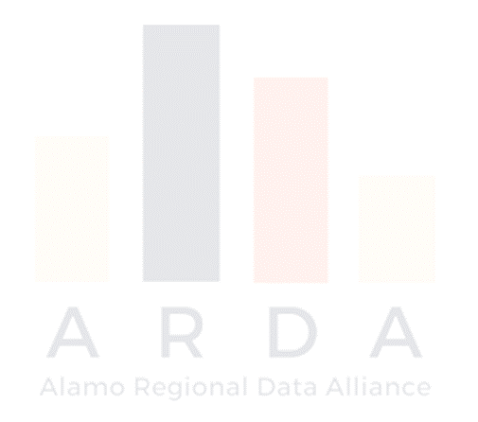
Community Information Now Local data that’s trustworthy, neutral, and timely Laura McKieran, Executive Director
Organizing for a Data-Driven Community
Community Progress Makers
Citi Foundation
July 24, 2017

Slide 2
CI:Now’s data role in the San Antonio region
Nonprofit local data intermediary; annual budget ~$500K
UT School of Public Health in SA is partner and staff “home”
Cover all issue areas, esp. education and health & human services
Five ways we help:
Open up access to timely, relevant, neutral data
Assess and monitor community conditions
Assist in understanding and using data
Consult on the development of outcomes/results and indicators and selection of data sources
Bring others together to build our local capacity to use data to improve quality of life: Alamo Regional Data Alliance

Slide 3
What’s the rationale for not using data?
Things like….
Planning for infrastructure, interventions
Budgeting and resource allocation
Monitoring progress; performance management
Organizing and advocacy
Problem-solving complex issues
Should be driven by….
The personal passions and quirks of the people with the deepest pockets
The good old boy/girl network of sketchy favors and ridiculous feuds
The biggest jerk in the room the day we had that stupid retreat
The very best information we can get

Slide 4
What’s needed for a community to be good at using data?
Widespread…
culture of valuing data
data literacy
processes and structures to support engagement around data
good data management practices
access to data
access to help in using data effectively
collaborative and continual planning and coordinated action to build local capacity to use data

Slide 5
Why bother organizing and coordinating?
No one organization holds all the data
the info you need is in somebody else’s dataset
legitimate privacy issues and red-herring turf issues are both real
No one organization holds all the power
to share or get data
to set public policy, organizational policies and practices
to use data thoughtfully and to good effect
to access funding and human resources
No one organization holds all the good ideas
More brains are so much better than one

Slide 6
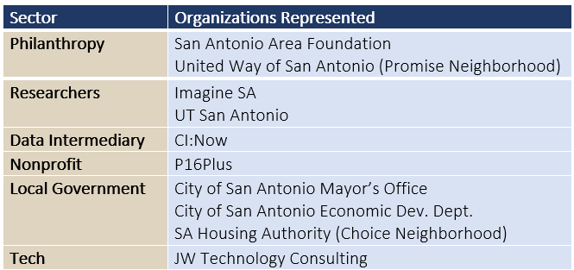
“Data Nirvana” meeting (2/16)
AACIS formed (late 90s)
Rebranded CI:Now (‘08)
Product Vision Board (9/16)
“Small group” formed (8/16)

Slide 7
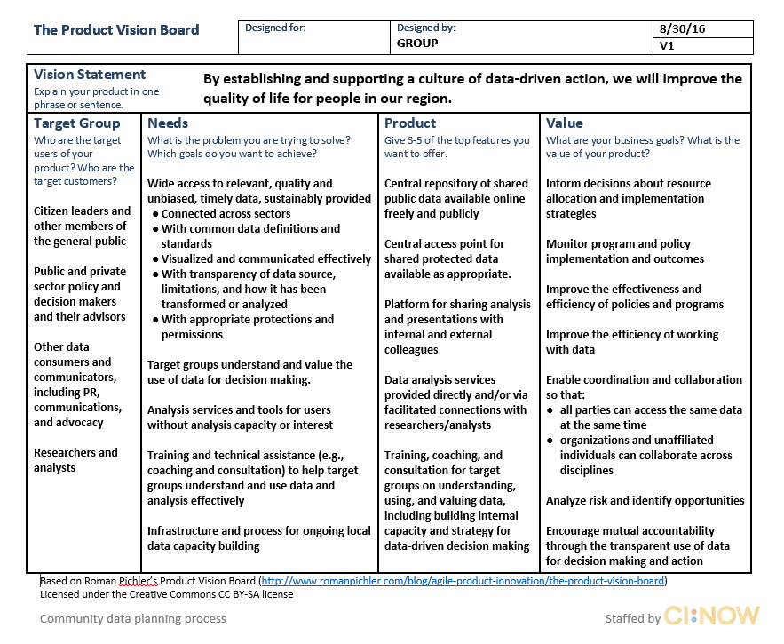

Slide 8
“Data Nirvana” meeting (2/16)
AACIS formed (late 90s)
Alliance convening (3/17)
Alamo Regional Data Alliance (9/16)
Rebranded CI:Now (‘08)
“Small group” formed (8/16)
CI:Now backbone staffing (10/16)
Product Vision Board (9/16)
Interim Steering Cmte (10/16)

Slide 9
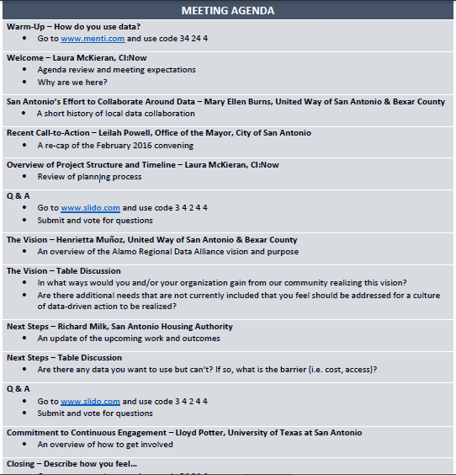
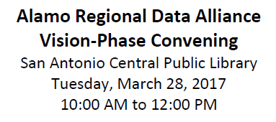
~68 attendees by invitation only
First priority given to Feb ’16 attendees
Broad representation of:
local government, nonprofits, funders, academia, residents
data generators/collectors, intermediaries, analysts, users

Slide 10
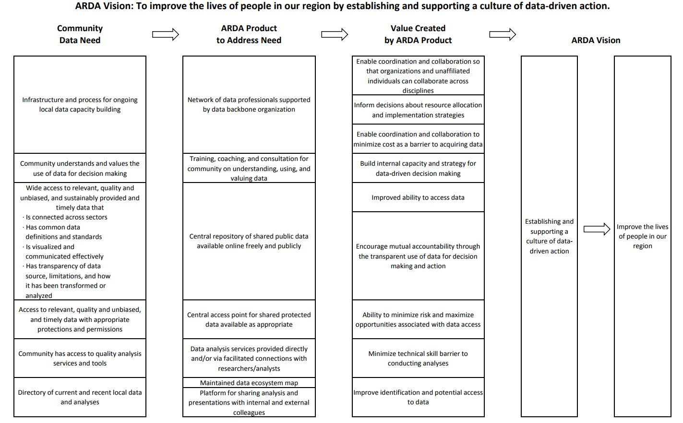
ARDA Community Strategy

Slide 11
Community Data Need ARDA Community Strategy to Address Need
Infrastructure and process for ongoing local data capacity building
Community understands and values the use of data for decision making
Wide access to relevant, quality and unbiased, and sustainably provided and timely data that: Is connected across sectors Has common data definitions and standards Is visualized and communicated effectively Has transparency of data source, limitations, and how it has been transformed or analyzed
Access to relevant, quality and unbiased, and timely data with appropriate protections and permissions
Community has access to quality analysis services and tools
Directory of current and recent local data and analyses
Network of data professionals supported by data backbone organization
Training, coaching, and consultation for community on understanding, using, and valuing data
Central repository of shared public data available online freely and publicly
Central access point for shared protected data available as appropriate
Data analysis services provided directly and/or via facilitated connections with researchers/analysts
Maintained data ecosystem map
Platform for sharing analysis and presentations with internal and external colleagues

Slide 12
Community Data Need ARDA Community Strategy to Address Need
Infrastructure and process for ongoing local data capacity building
Community understands and values the use of data for decision making
Wide access to relevant, quality and unbiased, and sustainably provided and timely data that: Is connected across sectors Has common data definitions and standards Is visualized and communicated effectively Has transparency of data source, limitations, and how it has been transformed or analyzed
Access to relevant, quality and unbiased, and timely data with appropriate protections and permissions
Community has access to quality analysis services and tools
Directory of current and recent local data and analyses
Network of data professionals supported by data backbone organization
Training, coaching, and consultation for community on understanding, using, and valuing data
Central repository of shared public data available online freely and publicly
Central access point for shared protected data available as appropriate
Data analysis services provided directly and/or via facilitated connections with researchers/analysts
Maintained data ecosystem map
Platform for sharing analysis and presentations with internal and external colleagues

Slide 13
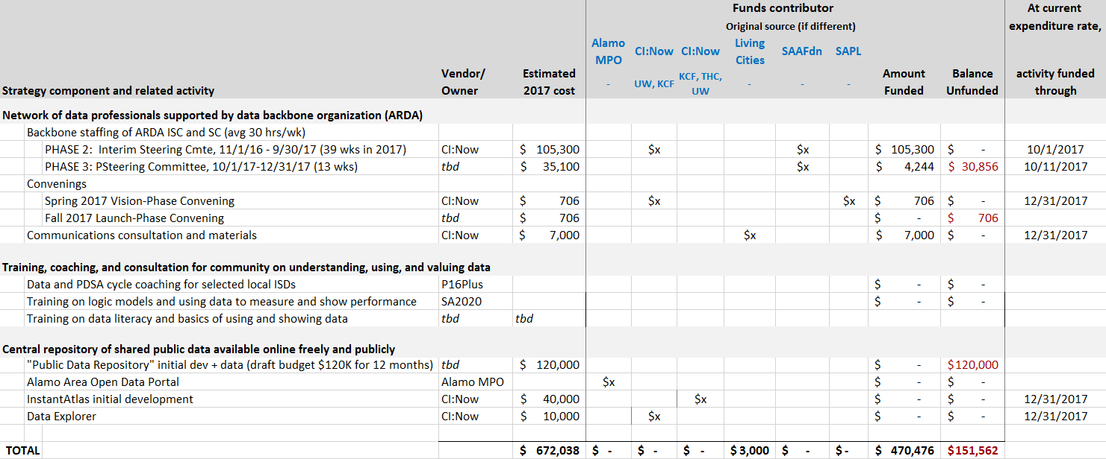
Sample Community Strategy Budget

Slide 14
How your organization can financially support a Community Strategy
Align a portion of your own budget with a part of the Community Strategy, so that you are directly contributing toward shared goals
Donate in-kind costs (staff time, office space, data, software license seats, equipment, supplies)
Routinely build support for part of the Community Strategy into your requests for funding;
Collaborate rather than compete with other organizations for data-related grants;
Identify and help secure new/additional funds from new or existing sources
Serve as administrators for funding for Community Strategy activities

Slide 15
Some early milestones
Shared goals and direction
Vision statement and values finalized
Community Strategy drafted
Shared language developed (Glossary of Key Data Terms)
Leadership development
Plan for elected Steering Committee hammered out
Steering Committee Charter nearly finalized
Outreach and community building
Other coalitions and initiatives discovered (Alamo Area GIS User Group, San Antonio Data Science Meetup); ecosystem map drafted
High level of local energy and interest
Access to data has already increased through new relationships

Slide 16
“Data Nirvana” mtg (2/16)
Alliance convening (3/17)
Steering Cmte launch (10/17)
AACIS formed (late 90s)
Alamo Regional Data Alliance (9/16)
Rebranded CI:Now (‘08)
CI:Now staffing (10/16)
“Small group” formed (8/16)
Product Vision Board (9/16)
Workgroups launch (10-11/17)
Interim Steering Cmte (10/16)
Website launch, membership drive (8/17)
Steering Cmte elections (9/17)

Slide 17
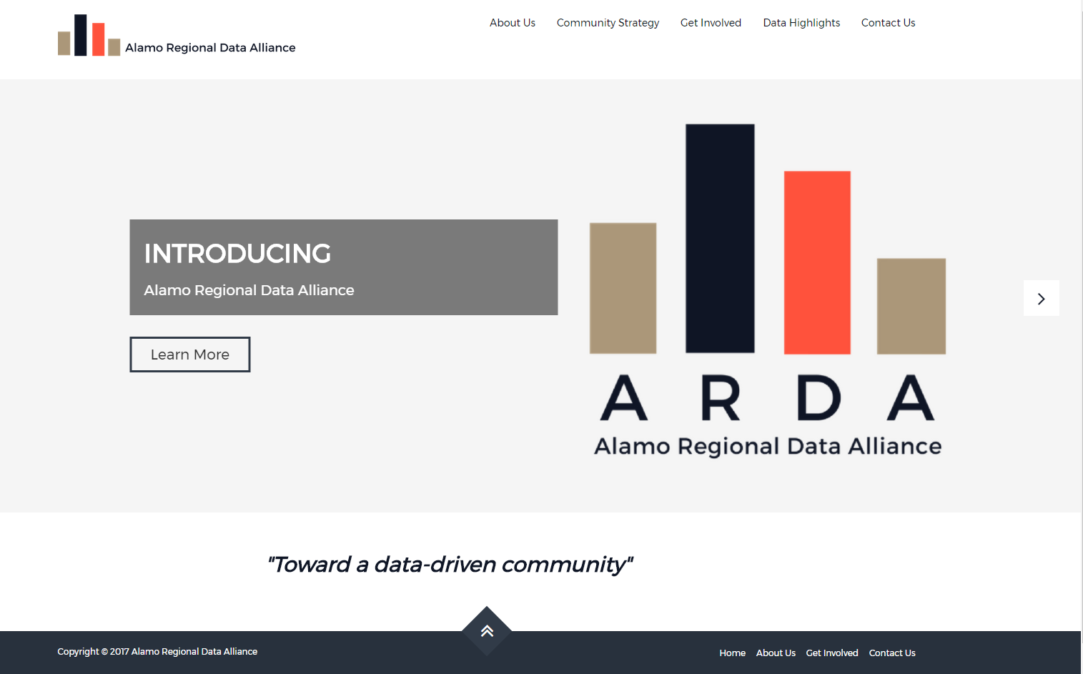
alamodata.org
Steering Cmte Charter
Participation guide
The story so far

Slide 18
Trustworthy. Neutral. Timely.
How can we help you?
Laura.C.McKieran@uth.tmc.edu
CINow.info
210.276.9007
http://cinow.info/newsletter-signup/
Credits:
Clarissa Ozuna, PhD(c)
Norma Garza, DrPH(c)
Courtney Denton, MPH
Jef Waltman

