Slide 1
GETTING STARTED WITH PERFORMANCE MANAGEMENT
JAKE COWAN, SEEMA IYER, BOB GRADEK
SEPTEMBER 27, 2016
COMMUNITY INDICATORS CONSORTIUM IMPACT SUMMIT

Slide 2
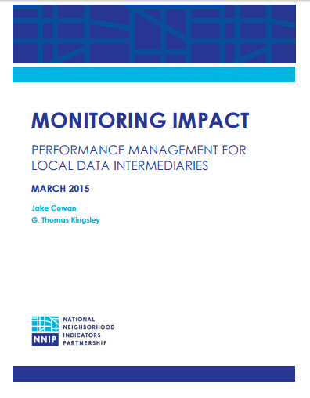
Performance Management and
Monitoring Impact
Guidebook available for download on CIC page for this session and at www.urban.org

Slide 3
Performance Management and
Monitoring Impact
The measure of impact
  How do we know we are making a difference?
  Positive Influence on outcomes (not end stage outcomes directly)
To have impact
  Strategy is the first step
  Variety of approaches

Slide 4
Management Context for
Performance Management
1. Establish desired goals
2. Develop a strategy (and more detailed plans) for achieving those goals
3. Implement the strategy and plans
4. Monitor performance and make in-course corrections to strategies and plans for achieving goals based on lessons learned

Slide 5
The Guidebook
Performance management also key
  Regular & direct measuring of influence
  How well is a program working in the short term? (Not evaluation)
Guidebook
  Framework of approaches/techniques
  How to get started, and why

Slide 6
Why Performance Management?
Internal Benefits
Common language and shared understanding
Program planning and improvement
Development and justification of budget needs
Identification of staff training needs

Slide 7
Why Performance Management?
External Benefits
Improved community impact
Regular data for communication and reporting
Strengthened credibility

Slide 8
What gets measured?
Key Outputs (posting data to your web site; sending out an e-newsletter; making community presentations)
Information reaches intended users (number of press releases and media hits; number of visitors to the website or signups for an e-newsletter)
Users interact with the information (partners discussing data in meetings; neighborhood groups publishing data; or number of technical assistance requests)

Slide 9
What gets measured?
Users adopt a new or changed mind-set (groups changing support for policies or programs; groups having a new understanding of the nature, drivers, or spatial patterns of a community issue)
Users take action (neighborhood plans and priorities informed by data are changed; training participants using data to develop program strategies and tactics; new partners agreeing to work together based on common interests identified through working with data)

Slide 10
Measurement Approaches
4 Stages of Influence
Information reaches intended users
Users interact with the information
Users adopt a new or changed mind-set
Users take action
6 Measurement Approaches
Web Site Analytics
Content Analysis
User Analytics
Surveys
Collecting Data Through Meetings
Case Studies

Slide 11
Getting Started
Commit and set goals for performance management
Start: Incrementally, In the Middle, With Priorities
Involve staff
Identify specific indicators and measurement techniques for activities

Slide 12
Performance Management Process
Collect
Measure
Report
Review
Apply

Slide 13
Review Meetings
What are we doing well? How do we know?
What are we not doing well? How do we know?
What can we do to improve?
How have indicators changed since the last measurement period (increase, decrease, or the same)?
Were these results expected?
Are we using the right measurement techniques?

Slide 14
Creating Local Performance Management Indicators
Bob Gradeck
Research Manager, University of Pittsburgh
Center for Social and Urban Research

Slide 15

Inspired by NNIP report, but how do I create measures for my program?

Slide 16
Activities we wanted to capture in our measures
Host and manage open data portal (with multiple publishers)
Meetings and workshops
Promotional efforts
Training sessions
Encouraging classroom uses
External data requests
Technical assistance
Data user guides
Blog posts
Etc.

Slide 17
Report framework used to develop a series of templates
Basic project information
Types of performance management indicators
Data collection plan
Wanted to collaborate with other cities on this.
Worked closely with the Providence Plan.

Slide 18
Step 1: Including basic project information focuses thoughts and helps other cities understand our process
Geographic area of project:
Geographic Coverage:
Project goals and objectives:
Primary or Targeted Users/Audiences:
Secondary, Other Expected Users/Audiences:
Typical uses and applications for indicators:
Features and activities associated with the project:
Website URL:
Other relevant details:
Date this worksheet was last updated:

Slide 19
Step 2:
Turning activities into measures started with a matrix
Six Techniques for Measuring Impact
Four Stages of Influence

Slide 20
Techniques for Monitoring Impact
 | Web Analytics | Content Analysis | User Analytics | Surveys | Meetings | Case Studies | Other (describe)
Key activities/outputs
Information reaches intended users
Users interact with the information
Users adopt a new or changed mindset
Users take action

Slide 21
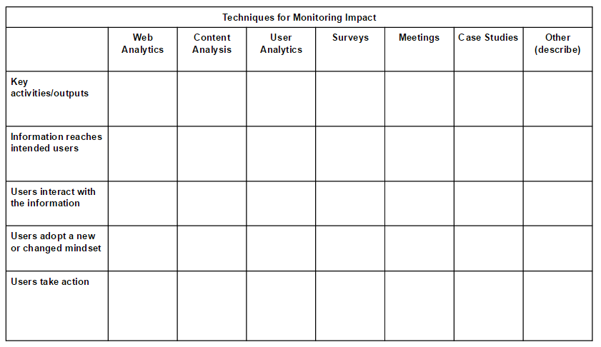
We completed the template
Techniques for Monitoring Impact
 | Web Analytics
Key activities/outputs | open data portal
Information reaches intended users | # datasets # publishers #/% automated publishing % of data licensed % complete metadata # privacy breaches # dead links repaired

Slide 22
Step 3: Data Collection Plan
Connect indicators to your activities
Identify collection frequency
Assign Responsibility
Assess collection burden

Slide 23
Data Collection Plan
Data Collection Activity | Performance Management Indicators | Data Collection Frequency | Data Collection Responsibility | Cost/burden (low, medium, high)

Slide 24
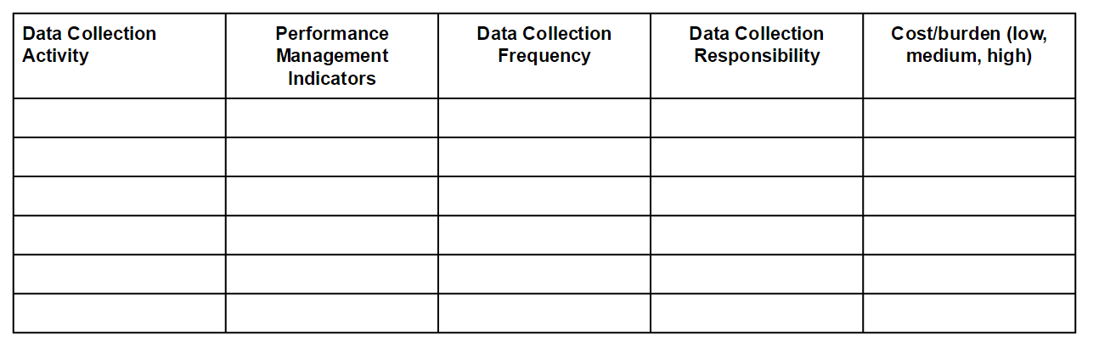
Data Collection Plan
Data Collection Activity | Performance Management Indicators | Data Collection Frequency | Data Collection Responsibility | Cost/burden (low, medium, high)
Google analytics report | Unique visitors, page views, bounce rate, length of time on site, referring sites. | Monthly | Bob | Low
Other Web stats | # of publishers (by type), # of datasets (by publisher and category) # of datasets w/ automated publication, # with on-time publication by organization, # of licensed datasets by type of license, datasets with acceptable or complete metadata, number of data downloads, number of api calls, number of registered users, most popular datasets, privacy breaches, dead links on site repaired/removed. | Monthly | Bob, others | medium

Slide 25
Advice: Always collect data, review monthly, adjust activities accordingly
Constantly collecting data - keep a spreadsheet open all the time.
Implementing quarterly user survey this fall - how are you using data?
With every user interaction, we ask how they’re using data.

Slide 26
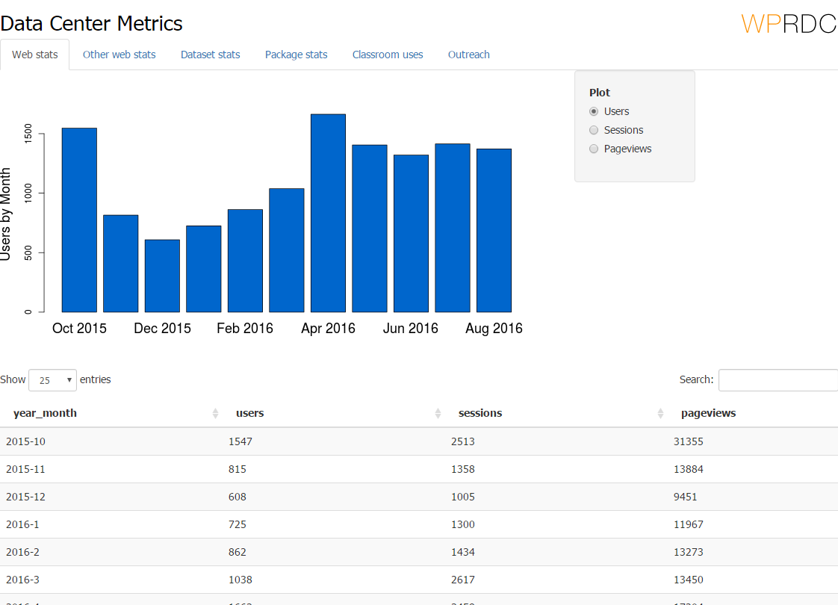
Sharing performance measures openly is how we stay accountable
Share with project partners only for now
Public dashboard being finished
Raw data to be shared as open data
Automate where you can to make it less of a heavy lift - (Google Analytics API)

Slide 27


Performance Monitoring and Management
September 2016
Seema D. Iyer, PhD
Associate Director, Jacob France Institute
    #VitalSigns14
    @bniajfi
    www.bniajfi.org

Slide 28
From the Everyday to the Overarching
Google Alerts
Social Media Engagements
Pro Bono Requests and Responses
Web Analytics
Attendees at Baltimore Data Day
Online Survey Respondents
Public History Project
Funding
BNIA-JFI “does bring a certain discipline and a certain expertise to guide the conversation” regarding data analysis. In terms of “BNIA as a fact repository” Nelson believes that is a function of the past because other groups now have similar data as well. Hager shares these views, stating that there needs to be analysis and policy discussion along with collecting and displaying data
~Sherrill and Nelson, interview 2012

Slide 29




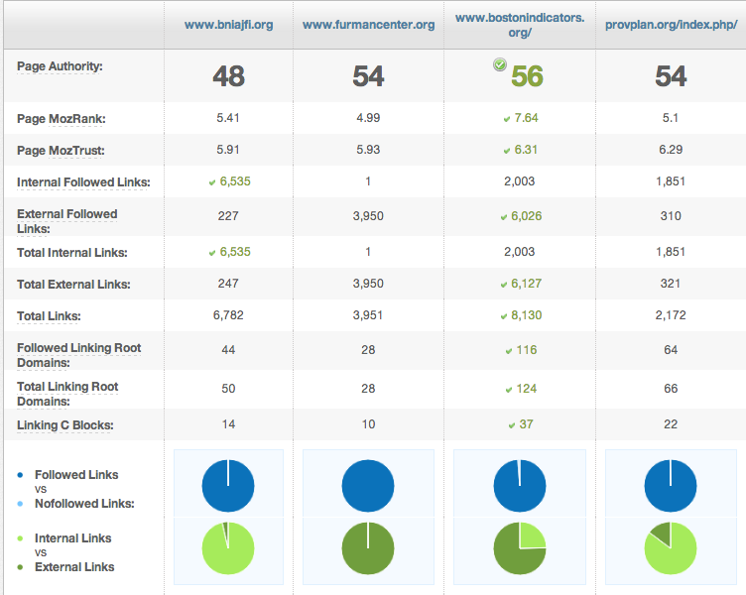
Sites Reviewed in 2014
.
Predicts this page's ranking potential in the search engines based on an algorithmic combination of all link metrics
Number of followable links that come from pages on the same root domain as this URL.
Number of followable links that come from external websites.

Slide 30
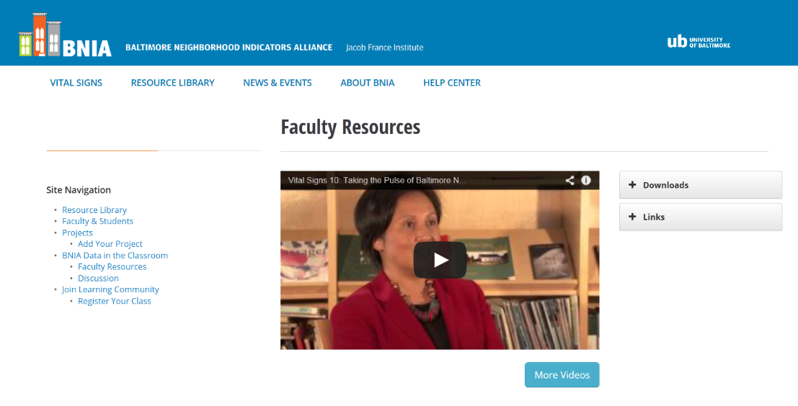
Community Outreach via Social Media, Education and Training
BNIA in the Classroom – Funded by UB Foundation
  Space for Instructors to obtain curriculum modules and analytical tools
  Community forum for students and other users to post and search for research/projects
  Current institutions in the Learning Community: MICA, Towson, University of Maryland College Park and Baltimore, Morgan State, Loyola University and Johns Hopkins
“Divided Baltimore: How Did We Get Here, Where Do We Go?” With sections designed for undergraduate and graduate experiences, the semester-long course—taught by veteran UB faculty members and guest lecturers in both physical and online environments—will focus on a broad-based, multi-disciplinary approach to address the city’s long-standing issues regarding segregation, economic and racial inequalities, and untapped potential. The overarching goal of the course is to explore the city’s problems and prospects from a variety of perspectives, and begin the process of positive change.
~http://blogs.ubalt.edu/dividedbaltimore/

Slide 31
On the Wish List
Mayor Rawlings-Blake would help herself, and the city she represents if she were to make a full court press to bring businesses to the wide belt of poverty.
How can she do this? A start would be to consult closely those statistics I mentioned earlier, the Baltimore Neighborhood Indicators Alliance (BNIA), and, more important, consult the researchers who put them together. …when you look at how detailed and thorough this research on Baltimore's economy, culture, ethnography and quality of life is, you see just how very devoted to the improvement of life in Baltimore the Jacob France Institute is.
This is not meant to be a cheerleading session for the BNIA and the Jacob France Institute. What I mean to do, though, is point out that…leaders of the city… would all show deep love for their city by making their focus the same as the BNIA's mission. It calls for "a common threshold from which to have discussions about what is best for changing conditions…to hold itself and all others …accountable for moving in the right direction.
“Beyond the riots: Is there hope for Baltimore? A reporter’s notebook from that city’s streets” MAY 4, 2015, BY JAMES FORD
Embeddedness?
Number of peer-reviewed journals that cite/use research and data
Number of Politicians who cite BNIA data
Number of boards, task forces

