Slide 1
Community Indicators Consortium, August 4, 2020
Investing in Data Capacity for Community Change
Kathy Pettit Co-Authors: Leah Hendey, Jake Cowan, and Marcus Gaddy
Notes:
Introduce myself – researcher at Urban Institute, and co-director of National Neighborhood Indicators Partnership.
NNIP is a learning network connecting partner organizations in 30 cities that ensure their communities have access to data and the skills to use information to advance equity and well-being across neighborhoods.
I’m here today to share insights from our new brief with this title. I would thank RWJF for funding for this project.

Slide 2
Communities often lack the skills and resources
to use data to achieve big goals such as
reducing poverty and promoting health equity.
Notes:
Increased interest and more data available than ever before.
Despite the widespread hunger in using data, we see from our experience across the country that communities lack the skills and resources to put that data to use to set goals and make their communities better places to live.

Slide 3
Foundations can help remedy the shortage and unequal distribution of local data capacity to advance community priorities.
Notes:
There’s many pieces to solving this problem, but we think foundations have a special role to play to enhance a community’s ability to achieve change with data.
They have the resources, influence, and aligned goals for making progress towards more equitable outcomes.

Slide 4
Today’s presentation
Describe elements of community data capacity.
Recommend ways foundations can enhance community capacity for change.
Share examples of foundations investing in data capacity.

Slide 5
What is community data capacity?
People can access and use data to understand and improve outcomes where they live.
Notes:
This is not an abundance of data from portals or untapped skills, but putting the data to work.
We aspire that that this capacity should be held across institutional sectors, as well as by the people who live in a place to make real progress on hard problems.

Slide 6
Why use an equity lens for data use?
1) People have used (and continue to use) data to harm
people of color and those with low incomes.
2) People creating and analyzing data without input from the people most affected by the issues miss critical insights.
See Urban Institute companion brief: Principles of Equitable Data Use.
Notes:
And it’s essential that we set these concepts within a set of values to prevent harm and maximize the benefits to everyone.
Data have been used against people of color and other marginalized communities, from historical redlining practices to modern biases in hiring algorithms.
Even when data aren’t used to intentionally harm, they are often created and analyzed by data professionals.
People most affected by issues have few opportunities to access data or build skills to use data to advocate for change.

Slide 7
Community data capacity requires. . .
Enabling Resources
Access to Data
Open data platforms
Public websites
Help with Data
Technical Assistance
Training Workshops
Notes:
We heard too often people saying a collaborative or an organization is just not good at using data.
We wanted to pull apart the many elements of community data capacity so places can begin to assess where they are strong and where there are gaps.
The first set is called “enabling resources – includes access to data but also help with data, like our NNIP partners and many indicators groups provide.

Slide 8
Community data capacity requires. . .
Skills and Practices
Individual
Organizational
Collective
Notes:
The second set of elements is a list of about a dozen skills and practices - I won’t go through them all – a full list is in the brief.
But to give you a flavor of them,
Individual
Confidence with data
Ethical conduct
Technical Expertise
Organizational
Culture of curiosity
Data governance
Routine data use
Collective
Learning communities
Data sharing
Collective planning

Slide 9
How can funders contribute?
Promote use of data by grantees.
Champion community data resources and capacity.
Invest directly in building community-wide data capacity.
Notes:
We describe three ways that foundations can help their communities get better at using data.
This can be done through the obvious way of funding, which is certainly needed, but they can also wield their influence, convening power and communications to improve skills and practices.

Slide 10
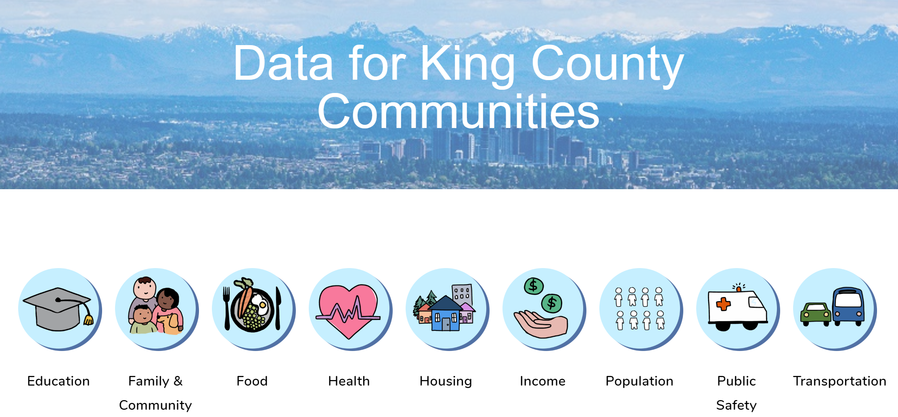
Promote Use of Data by Grantees Using Data to Tell Stories in King County
Notes:
Larger, established nonprofits generally have more experience using data, which gives them an advantage in competitions for funding, perpetuating inequities that harm organizations led by and serving people who have been marginalized.
In Seattle, staff members from Communities Count—a cross-sector collaboration funded by the Seattle Foundation, the United Way of King County, and local governments—wanted to better understand the impacts of this data disparity.
They analyzed the groups that won the grants from a program called Communities of Opportunity and learned all funded proposals had used data effectively, only 41 percent of unfunded proposals had done so.
Some unfunded proposals were seeking support for innovative programs or responses to emerging needs in communities, “they were unable to articulate their need or link the data they provided to the actual project.”
Communities Count staff reached out to groups that had not won the grant and offer trainings on using data to tell their stories to improve their chances the next round. They then started proactively offering the training to prospective grantees. Support for using data in applications to this program started at the bidders’ conference and continued through the application process. In this way they encouraged a more diverse and higher quality set of proposals.

Slide 11
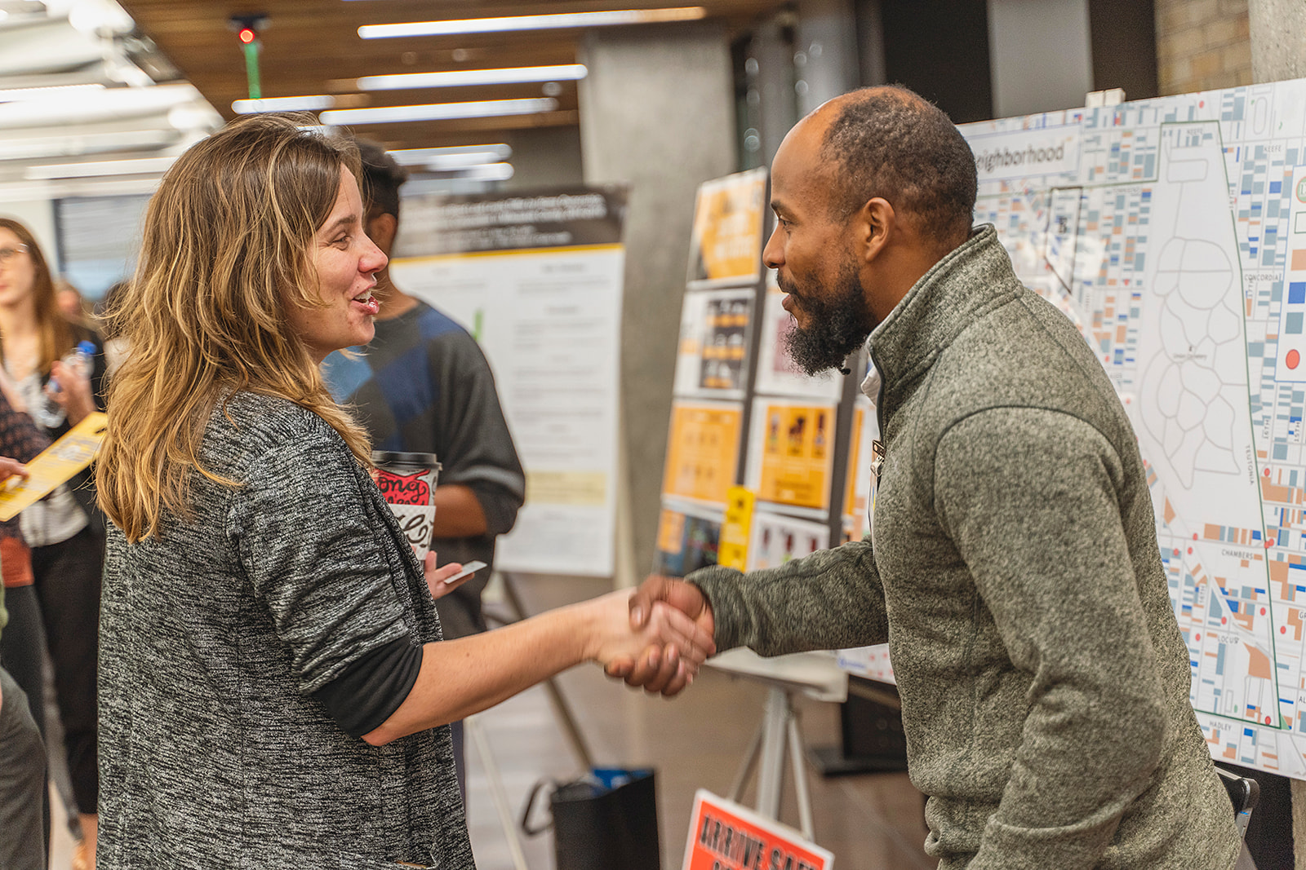
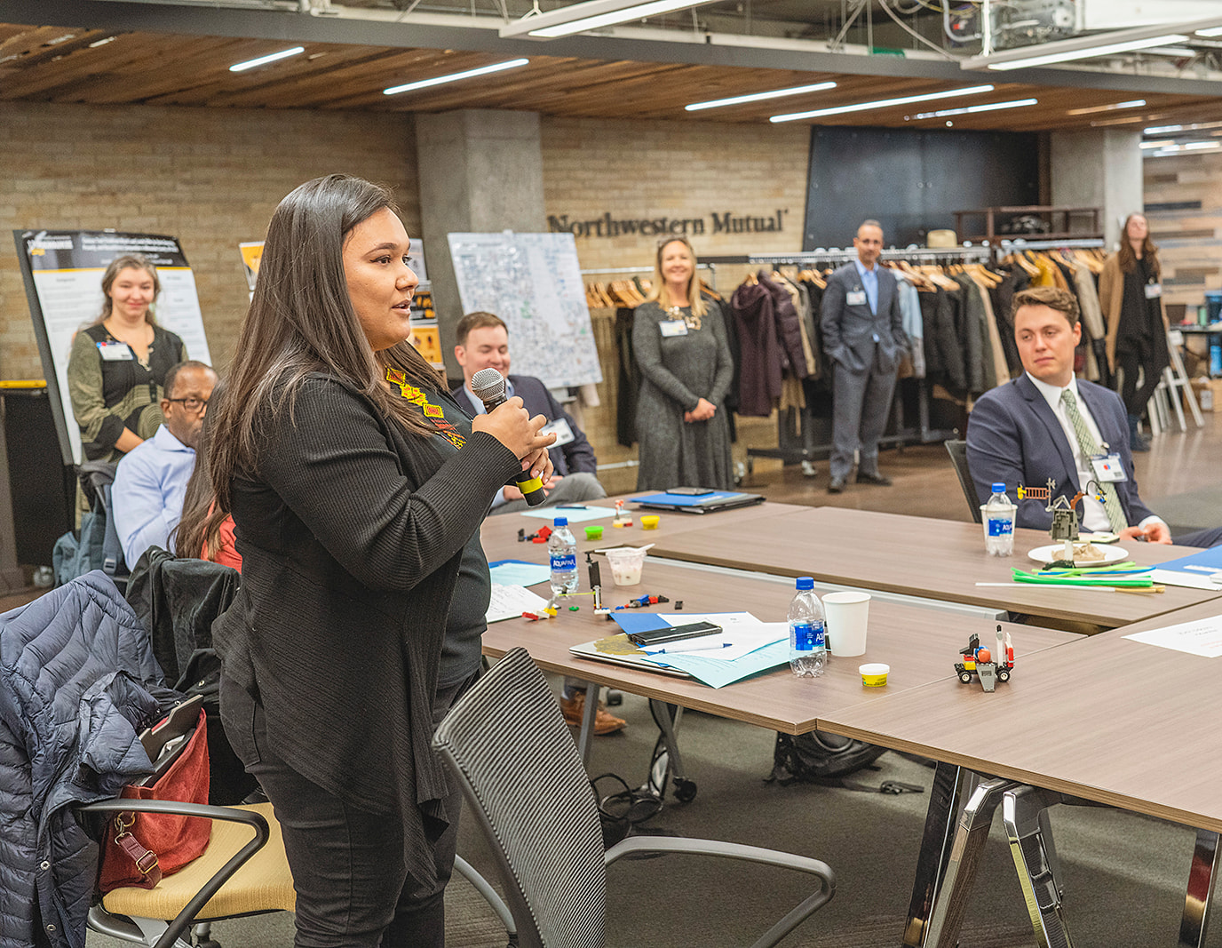
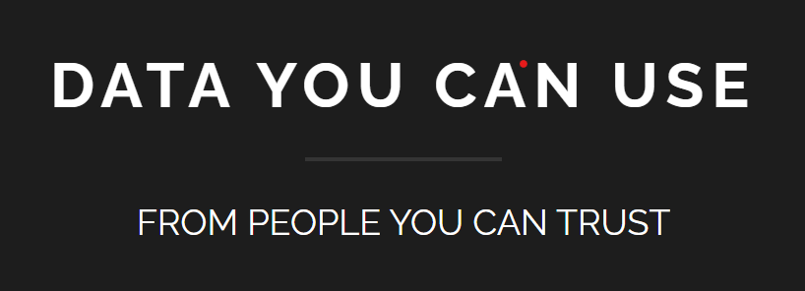
Champion community data resources and capacity Milwaukee Data Days
Notes:
Second example….
Across the country, several cities organize annual gatherings to highlight how data can help improve neighborhoods/.
Since 2015, Milwaukee has hosted Data Days, organized by Data You Can Use, to connect about 100 people from government agencies, academia, data science groups, and neighborhood organizations . Several local foundations have supported past events.
The day includes presentations from community groups and networking.
It also includes the Data Dream competition where Milwaukee-based volunteer neighborhood groups, churches, and nonprofit organizations can win up to $5,000 in support for collecting and analyzing data to meet a neighborhood’s needs.
IF TIME: The 2019 finalists included a children’s health advocacy group, an organization working to end gun violence, and a neighborhood nonprofit organization that focuses on civic engagement, environmental stewardship, and economic enterprise.
**funders including the Greater Milwaukee Foundation, the Northwestern Mutual Foundation, Siebert Lutheran Foundation, and the Zilber Family Foundation,

Slide 12
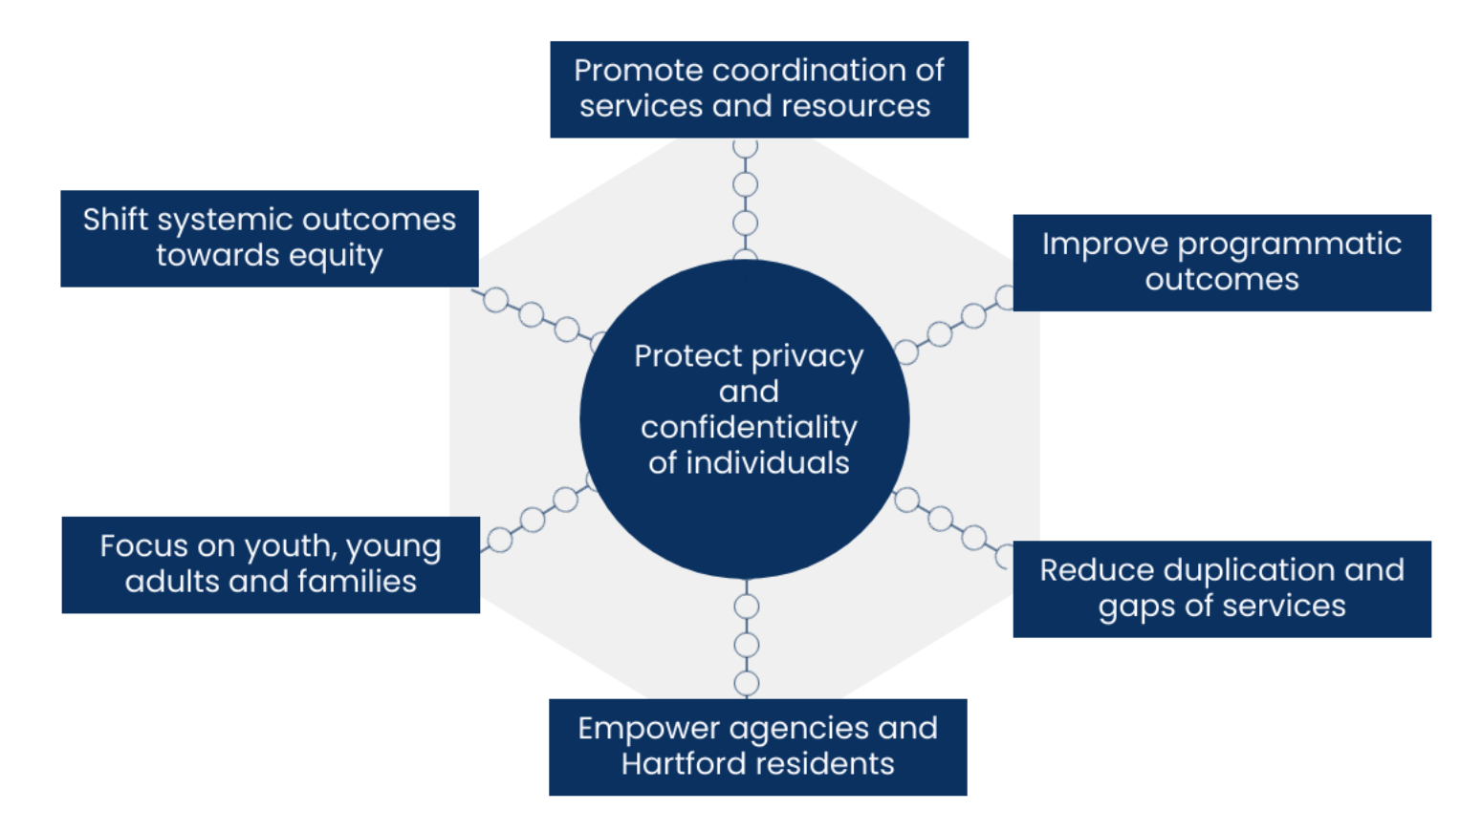
Champion community data resources and capacity Hartford Data Collaborative Principles
Notes:
Final example –
In 2018, Hartford youth-serving organizations expressed interest improving their services by sharing and integrating data to track the education outcomes of the youth in their programs.
In response, the community foundation commissioned an in-depth assessment of the needs and barriers to data sharing and integration across the organizations. The assessment found many challenges to sharing and integrating data, legal, political and technical.
In response to the findings, several local funders supported the development of the Hartford Data Collaborative (HDC), a shared client-level data infrastructure to provide timely, integrated, and accessible data for analysis of services, operations, policies, and outcomes.
Established in 2019, the HDC piloted its first data integration project between Hartford Public Schools and Hartford youth service providers to understand enrollment across multiple agencies and related employment and education outcomes.
IF TIME: In 2020, HDC is integrating data from youth services providers about their enrollment in summer programs. This data matching effort is creating a better understanding of how youth are engaging with services during COVID-19, and is enabling youth service providers to identify and target youth (especially at-risk youth) for program recruitment.

Slide 13
Call to Action
How are you investing in community data capacity?
What more can you do?
Notes:
So we hope program officers will use our brief to advocate for more deliberate and coordinated efforts to increase data capacity in their communities.
And that community organizations and those providing data services can use our brief to make the case to their own funders.
Data can be a powerful tool to understand our communities, set goals, and track progress.
This is more important than ever as the pandemic has caused increased need and reduced resources, so this power to use data must be shared throughout communities to address the current hardships and help guide us to an equitable recovery.

Slide 14
Resources
Elevate Data for Equity website: urban.org/elevate-data-equity
Expanding site on Monday, August 10
Stories of foundations investing in data capacity
Resource lists for promoting data capacity and equitable data practice
National Neighborhood Indicators Partnership
Twitter: @NNIPHQ Email: nnip@urban.org
neighborhoodindicators.org
Notes:
This brief is up on the Urban Institute website right now, but we are also launching…
And here’s the general information for NNIP. We’d love to hear from all of you how it is happening where you live.

