Slide 1
IHS’s Approach to Data Development and Applied Research
November 16, 2017
Presented by the Institute for Housing Studies at Community Indicators Consortium Impact Summit

Slide 2
Institute for Housing Studies
IHS’s mission is to provide reliable, impartial, and timely data and research to inform housing and community development policy decisions and discussions in the Chicago region and nationally
IHS accomplishes this through an applied research model
Data collection and improvement
Research
Technical assistance
Presentation – How IHS uses data to inform policy development
Tracking trends using housing market indicators
Measuring impact of place-based public investment projects and policy interventions
Developing a data lens to inform place-based policy development and implementation

Slide 3
Tracking trends using housing market indicators
Example – IHS Cook County House Price Index
Tracks changes in the values of single family homes for 33 submarkets in Cook County
Changes in house prices can tell stakeholders about:
Long-term price trends
Recovery to previous peak levels or from market bottom
Areas seeing recent, rapid price appreciation
Geographic variation in these metrics
Connection to policy:
Measure of neighborhood health
Wealth creation via home value appreciation
Underwater homeowners
Affordability concerns
Need for investment

Slide 4
Tracking housing market trends – IHS House Price Index
Quarterly price trends for single family homes in Cook County, 1997 to 2017 2Q
Index value 100 = 2000 1Q levels
Source: IHS Cook county house Price index 2017 2q

Slide 5
Tracking housing market trends – IHS House Price Index
Quarterly price trends for single family homes in Cook County, 1997 to 2017 2Q
Index value 100 = 2000 1Q levels
Source: IHS Cook county house Price index 2017 2q

Slide 6
Tracking housing market trends – IHS House Price Index
Quarterly price trends for single family homes in Cook County, 1997 to 2017 2Q
Index value 100 = 2000 1Q levels
Source: IHS Cook county house Price index 2017 2q

Slide 7
Submarket variation in peak to current price change
Source: IHS Cook county house Price index 2017 2q

Slide 8
Using the IHS Price Index to measure impact
Example – The 606 Analysis
Linear park project on Chicago’s NW Side that cut through neighborhoods with very different demographic and housing market characteristics
What role does public investment play in driving neighborhood change?
How did the housing market respond to The 606 park system?
House price changes indicate shifts in demand and affordability
Using a special cut of the index data and model, we found:
Neighborhood characteristics and proximity matter
Policy incentives must be responsive to market changes
The timing of interventions are important to their success

Slide 9
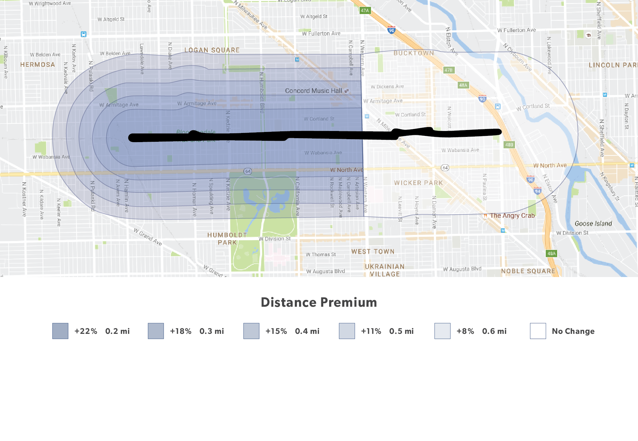
How does the distance premium change in 606 West?
Change in price premium in 606 West by distance (miles) from The 606
Source: IHS calculations of data from IHS Cook county house Price index 2016 2q
Notes:
We know the trail opening had an effect
Effects of the trail decline with distance
After ½ mile it becomes less significant.

Slide 10
What does this mean in actual value?
Distance premium for 1/5 mile applied to median single family home value in 2015
$450,000
Source: IHS calculations of data from IHS Cook county house Price index 2016 2q
Notes:
For the median SF property in 2012 in 606 East:
2015-$815,000
Median SF property 606 West
2015 - $450,000
Can attribute 22% of that price, or over $100,000 to the 606 premium

Slide 11
Using a data lens as framework for place-based strategies
Example – Affordability and displacement risk mapping
Identify areas that are potentially vulnerable to displacement
Affordability shifts
Current sales price: Measure of market affordability
Change in sales price: Indicator of shifting demand
Vulnerability
Demographics
Housing stock
Combine layers to highlight areas with different levels of displacement risk
Vulnerable areas with rising demand for housing
High-cost, rising demand
Moderate-cost, rising demand
Low-cost, rising demand

Slide 12
Mapping current and changing levels of housing affordability
Source: IHS calculations of property sales data from Cook County recorder of deeds, 2016 and 2012

Slide 13
Identifying areas with vulnerable populations and housing types
Source: IHS calculations of 5-year American community survey data, 2011-15

Slide 14
Combining layers to identify areas with displacement risk
Source: IHS calculations of 5-year American community survey data, 2011-15 and property sales data from Cook County recorder of deeds, 2016 and 2012

Slide 15
Application to policy issues
Provide framework for discussing affordable housing and displacement challenges
Support implementation of targeted interventions
Inform proactive strategies around public investment projects
Connect to other place-based community development issues in areas such as infrastructure, economic development, public health

Slide 16
IHS’s Approach to Data Development and Applied Research
November 16, 2017
Contact: gsmith33@depaul.edu

