Slide 1
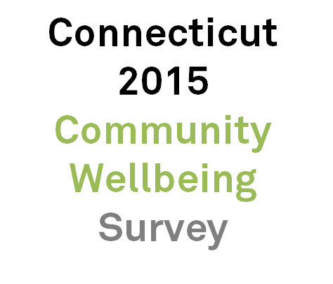
Notes:
- Hi, I’m Mary Buchanan, the project manager at DataHaven.
- Today I’ll talk about our largest ongoing project, the 2015 Connecticut Community Wellbeing Survey
- We’d love your thoughts on how to use the information in the survey to enable community and neighborhood-level action.

Slide 2
Summer 2012:
2012 Community Wellbeing Survey interviews
2014-Spring 2015:
Sponsors & partners recruited,
Survey Design
Spring 2013:
2013 Community
Index published
Spring-Summer 2015:
2015 CWS Interviews
Fall 2015:
Survey data released
Winter 2016:
Partner projects released
2016-2017:
Preparation for
2018 CWS
Spring 2016:
Community Index
reports published
Notes:
- I’ll give you a brief history of this project
- Our first major community well-being survey was conducted in 2012 in the New Haven region and published in the 2013 Community Index
- Many partners were interested in the results and how they were used to support various efforts.
And we found that about a dozen other cities and regions throughout Connecticut had conducted community surveys over the past decade,
- There was a great deal of overlap across the surveys
- Throughout 2014, we found funding sponsors and recruited partners who helped to design the survey
- This year’s survey was conducted from May through October of 2015
- Results will be released starting in November
- Over the coming year, DataHaven and our partners will use data for their own research, both at a local and a statewide level
- And then we’ll start prepping for the 2018 survey

Slide 3
Motivation Behind 2015 Survey
Valuable – 2012 Community Wellbeing Survey data highly useful to partners
Longitudinal – Overlap with 2012 survey
Comparable – Expanded geography of study covers entire state
Sustainable – Hospitals’ CHNA requires assessment every 3 years
Notes:
- The 2012 survey and the several reports that came out of it have been highly useful to our New Haven partners
- The scope of the now-expanded 2015 survey covers all cities, regions, and towns in Connecticut, creating comparable data across the state
- Besides community interest, there is ongoing, foreseeable need for data. For example, the Affordable Care Act requires hospitals to complete a local needs assessment every three years

Slide 4
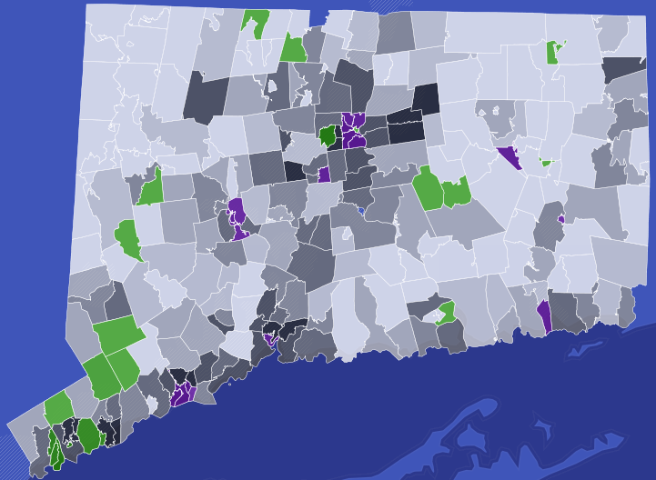
Survey Area & Findings
17,000 interviews from May-Oct. 2015
All 169 towns in Connecticut
Data shown here from 2015 CWS are preliminary and for illustration only – please do not cite
Analysis based on “The Five Connecticuts,” CT State Data Center
Notes:
- Our survey reached nearly 17,000 adults in every town in Connecticut
- So now I’ll present preliminary analyses that are subject to change -these analyses use only preliminary weighting ,and only a portion of the full dataset
- Considering how individual income and neighborhood-level income impact indicators
- Green will be our highest-income zip codes and purple will be our lowest-income zip codes

Slide 5
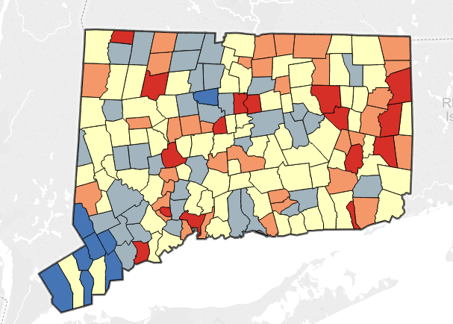
Today’s Analysis: The Five Connecticuts
Wealthy
Suburban
Rural
Urban Periphery
Urban Core
About the Five Connecticuts methodology from the CT State Data Center: http://web2.uconn.edu/ctsdc/ctsdc_reports/five_connecticuts_preview/
Data shown here from 2015 CWS are preliminary and for illustration only – please do not cite
Analysis based on “The Five Connecticuts,” CT State Data Center
Notes:
- Our survey reached nearly 17,000 adults in every town in Connecticut
- So now I’ll present preliminary analyses that are subject to change -these analyses use only preliminary weighting ,and only a portion of the full dataset
- Considering how individual income and neighborhood-level income impact indicators
- Green will be our highest-income zip codes and purple will be our lowest-income zip codes

Slide 6
Access to Transportation
Data shown here from 2015 CWS are preliminary and for illustration only – please do not cite
Analysis based on “The Five Connecticuts,” CT State Data Center
Notes:
- Looking at perceptions of government:
- Government responsiveness to residents’ needs as excellent or good.
- Household income: from less than $15,000 to over $200,000 a year – confidence in government increases linearly with income.
- Neighborhood Income – poorest zip codes and richest zip codes in the state.
- One’s neighborhood has a larger impact on responses than household income.

Slide 7
Perception of Government
Data shown here from 2015 CWS are preliminary and for illustration only – please do not cite
Analysis based on “The Five Connecticuts,” CT State Data Center
Notes:
- Looking at perceptions of government:
- Government responsiveness to residents’ needs as excellent or good.
- Household income: from less than $15,000 to over $200,000 a year – confidence in government increases linearly with income.
- Neighborhood Income – poorest zip codes and richest zip codes in the state.
- One’s neighborhood has a larger impact on responses than household income.

Slide 8
Environment for Children
Data shown here from 2015 CWS are preliminary and for illustration only – please do not cite
Analysis based on “The Five Connecticuts,” CT State Data Center
Notes:
- Looking at perceptions of government:
- Government responsiveness to residents’ needs as excellent or good.
- Household income: from less than $15,000 to over $200,000 a year – confidence in government increases linearly with income.
- Neighborhood Income – poorest zip codes and richest zip codes in the state.
- One’s neighborhood has a larger impact on responses than household income.

Slide 9
Quality of Life
Data shown here from 2015 CWS are preliminary and for illustration only – please do not cite
Analysis based on “The Five Connecticuts,” CT State Data Center
Notes:
- Looking at perceptions of government:
- Government responsiveness to residents’ needs as excellent or good.
- Household income: from less than $15,000 to over $200,000 a year – confidence in government increases linearly with income.
- Neighborhood Income – poorest zip codes and richest zip codes in the state.
- One’s neighborhood has a larger impact on responses than household income.

Slide 10
Wellbeing Differentials Wealthy – Urban Core
Data shown here from 2015 CWS are preliminary and for illustration only – please do not cite
Analysis based on “The Five Connecticuts,” CT State Data Center
Notes:
- Looking at perceptions of government:
- Government responsiveness to residents’ needs as excellent or good.
- Household income: from less than $15,000 to over $200,000 a year – confidence in government increases linearly with income.
- Neighborhood Income – poorest zip codes and richest zip codes in the state.
- One’s neighborhood has a larger impact on responses than household income.

Slide 11
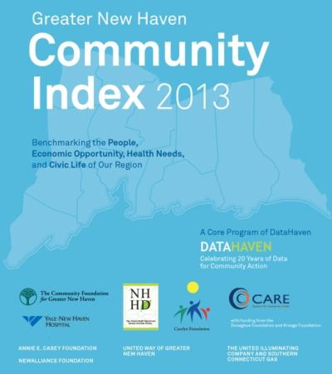
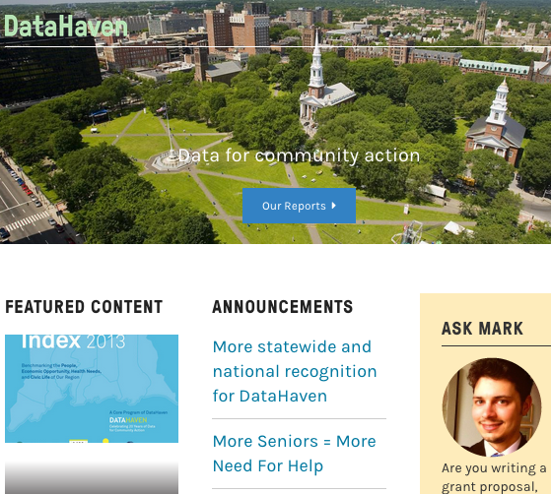
Up next from DataHaven…
Notes:
- We are excited to launch a new website by the end of 2015
- Three 2016 Community Index projects, involving many local partner organizations and covering more than half of the population of Connecticut, are underway.
- These will incorporate survey data, as well as other indicators.
- They will be released by June 2016 and will cover cities throughout Fairfield and New Haven counties
- We’ll start planning for 2018 survey!

