Slide 1
Mobility (or Displacement) and Voting Data
Using voter data to track intra-county mobility and proactively identify areas in need of equity interventions
Andrew Bowen
Data analytics manager
Innovation & Technology

Slide 2
Presentation Overview
What we’re tackling
How we’re tackling these issues programmatically
Add in voting data to tracking movement of residents
How to tie this all together to improve programs and inform interventions
Charlotte and Mecklenburg County
Residents who do not identify as White alone

Slide 3
What Charlotte is Tackling
Rapid development, infill, continued in-migration
Displacement risk, elevated in communities of color
Neighborhood Change, heavily impacting communities of color
Affordable housing preservation and new construction
Equity and Mobility

Slide 4
Programs in Place
Housing Trust Fund
data: Neighborhood Change
2040 Comprehensive Plan
data: Displacement Risk
Aging in Place
data: Registered Voters + parcel data
Notes:
2019-2020 Program to offer grants to allow seniors to stay in home
~150 participants (elderly, up-to-date on taxes)

Slide 5
Neighborhood Change
Used to assess locations of city-funded Housing Trust Fund support of affordable housing
Neighborhood characteristics
compared to neighborhoods
Heavily reliant on:
Building permit activity
Home sales activity and prices
Local administrative data + Census ACS
Notes:
Year-over year activity changes with circuit breakers included

Slide 6
Displacement Risk
Used in part for Charlotte’s 2040 Comprehensive Plan to identify neighborhoods at risk
People characteristics
(by neighborhood)
compared to the city
Even weighting of:
Poverty
Education (HS Diploma)
Age (Population 65+)
People of color (1- White Alone)
Home Ownership
All Census ACS data / weighted equally
Notes:
Looking at 5 risk factors (above or below the city value) risk is 4 or more.

Slide 7
Areas at Highest Risk
Indicator | Value | County Comparison
% College graduates | 15% | 1/3
Household Income | $29,264 | 1/2
% People of Color | 83% | 2x
Residential Demolitions | 5 per 1000 | 2x
Residential Construction | 9 per 1000 | 3x
Notes:
These are the areas of interest. No surprise there is extreme housing activity, low income, low education, and high percent people of color
Let’s track what happened from a personal level

Slide 8
Voting Data
2016 registration file + 2020 registration file
Created time series
Watched mobility of voters into and out of the areas of interest
Who is moving into areas at risk ?
Where are people out of these areas moving to?
Using individual data to tie neighborhood conditions to people and inform the next equity interventions

Slide 9
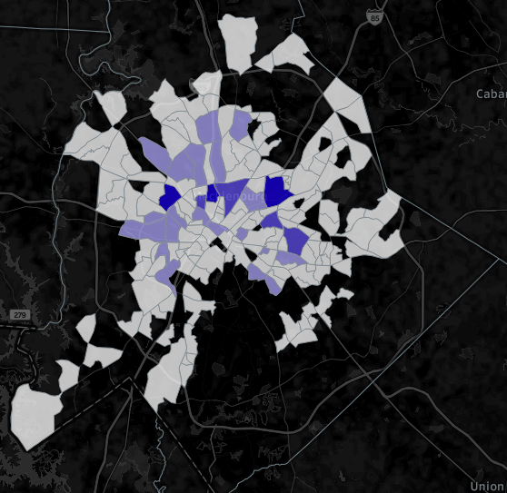
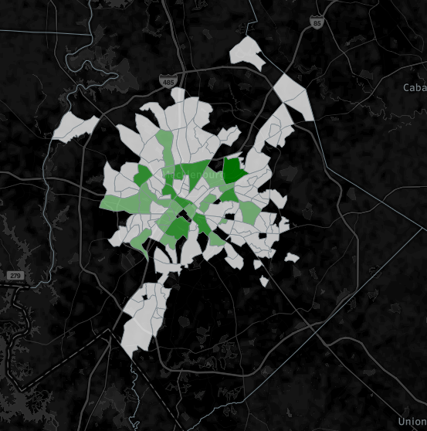
Mobility from 2016-2020
2016 dwellers moved out to these areas
2020 dwellers moved in from these areas
Notes:
Using Voter data from 2016 and 2020, we tracked individuals moving out of and in to these areas of interest
Map of neighborhoods where n>30 +30 covers half the moves
But what are the demographics of the ins and outs?
apartment/younger areas
Moved to
- Farther out, more suburban areas

Slide 10
Who left / where did they move to?
Age | Person of Color | White | Not Listed | Grand Total
18-24 | 317 | 19 | 30 | 366
25-34 | 1,528 | 664 | 110 | 2,302
35-44 | 1,222 | 439 | 62 | 1,723
45-54 | 1,020 | 177 | 46 | 1,243
55-64 | 968 | 117 | 36 | 1,121
65+ | 612 | 100 | 12 | 724
Grand Total | 5,667 | 1,516 | 296 | 7,479
Notes:
More detail by age and race, many of these moves are more outward to less urbanized areas
30+

Slide 11
Who moved in, where from?
Age | Person of Color | White | Not Listed | Grand Total
18-24 | 228 | 83 | 58 | 369
25-34 | 1,314 | 1,085 | 147 | 2,546
35-44 | 982 | 505 | 67 | 1,554
45-54 | 798 | 185 | 30 | 1,013
55-64 | 890 | 109 | 25 | 1,024
65+ | 457 | 74 | 14 | 545
Grand Total | 4,669 | 2,041 | 341 | 7,051
Notes:
More details by race and age, many are moving in from areas filled with young apartment dwellers

Slide 12
Net Change
Age | Person of Color | White | Not Listed | Grand Total
18-24 | (89) | 64 | 28 | 3
25-34 | (215) | 420 | 38 | 243
35-44 | (239) | 66 | 5 | (168)
45-54 | (220) | 8 | (16) | (228)
55-64 | (78) | (8) | (11) | (97)
65+ | (155) | (26) | 2 | (179)
Grand Total | (996) | 524 | 46 | (426)
Notes:
Net change: focus on persons of color, elderly, younger.
Older and people of color are moving. Are they being displaced – is this equitable ?
1,500 moved from one of these areas to another high risk

Slide 13
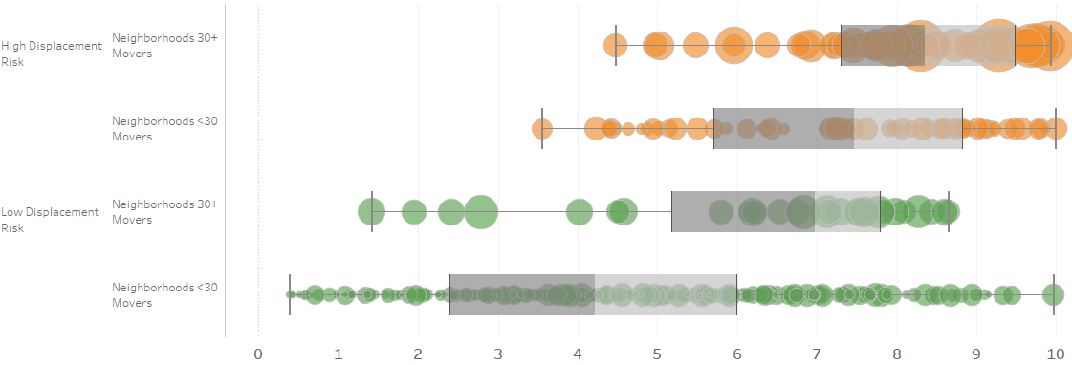
People Move Out, to the Same Neighborhood?
Many individuals moved from High Risk Neighborhoods to neighborhoods with high change & displacement risk to another
Change Score
Notes:
Box and whisker of neighborhoods that account for half of the population moves by high displacement risk / high neighborhood change
People are moving from the areas of extremely concentrated displacement risk and neighborhood change to areas with still high levels of both

Slide 14
What’s Next? This is About People
Track movement to the “next” neighborhoods
Combine improved individuals’ location data with other sources:
Food & Nutrition Services
Tax / ownership history
Building & housing information
Monitor the change across neighborhoods and its impact on residents
Building activity and home sales
Identify high-risk and high-movement areas using voter/other data

Slide 15
Conclusion
Intervene by building and informing programs around understanding:
Mobility of residents (by choice)
Displacement pressures on residents and the reasons for moving, staying, etc (social, work, family networks)
Use annual (or quadrennial) voting data to:
Stay (relatively) up-to-date on movement within the city
Identify who is impacted at most by rapid development and find ways to mitigate, equitably

