Slide 1
NNIP Idea Showcase
December 3rd, 2020
Tracking Evictions in the Atlanta Metro Region
Presented by
Erik Woodworth
Research & Data Visualization Coordinator
Data Scientist, Neighborhood Nexus
Atlanta Regional Commission (ARC)
Sarah Stein
Research Adviser,
Community & Economic Development
Federal Reserve Bank of Atlanta

Slide 2

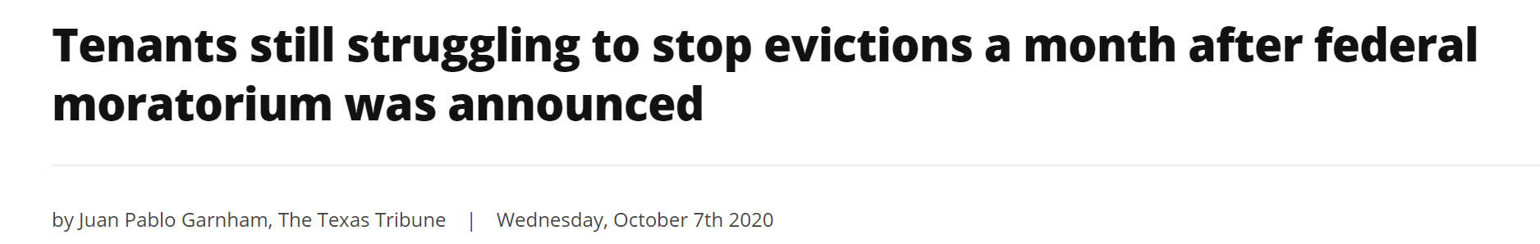

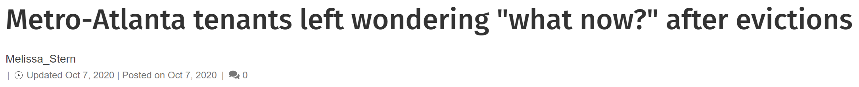


Using Data to Promote Smart Housing Policy and Strategic Interventions
Eviction Activity During a Pandemic

Slide 3



Tracking Evictions in the Atlanta Metro Region
Our Team…
Erik Woodworth (Project Lead)
Research & Data Visualization Coordinator
Atlanta Regional Commission
Data Scientist
Neighborhood Nexus
John Sasser
Assistant Web Developer
Neighborhood Nexus
Alan Grosse
Assistant Web Developer
Neighborhood Nexus
Sarah Stein (Project Lead)
Research Adviser
Community and Economic Development
Pearse Haley
Research Analyst
Center for Workforce Engagement and Opportunity
Nisha Sutaria
Research Analyst
Community and Economic Development
Elora Raymond, PhD (Project Lead)
Assistant Professor
School of City and Regional Planning
Georgia Institute of Technology
Subhro Guhathakurta, PhD
Chair, School of City and Regional Planning
Director, Center for Spatial Planning Analytics and Visualization
Rama Sivakumar, MS
Senior Research Engineer,
Center for Spatial Planning Analytics and Visualization
Gordon Zhang, PhD
Research Scientist,
Center for Spatial Planning Analytics and Visualization

Slide 4
Tracking Evictions in the Atlanta Metro Region
What we’ve been doing…
  Formed a collaborative partnership between the Atlanta Regional Commission, Federal Reserve Bank of Atlanta, and Georgia Institute of Technology to better understand patterns in eviction filings and judgments amidst the COVID-19 pandemic and associated economic downturn and after
  Currently gathering eviction filing case details weekly from the region’s 5 core counties and geocoding and aggregating the filings by location and filing data to be displayed on a public-facing dashboard
  Working with regional leaders and legal aid organizations to provide strategic interventions like rental assistance and legal support for those at risk of losing housing as a result of the COVID-19 pandemic and associated economic downturn

Slide 5
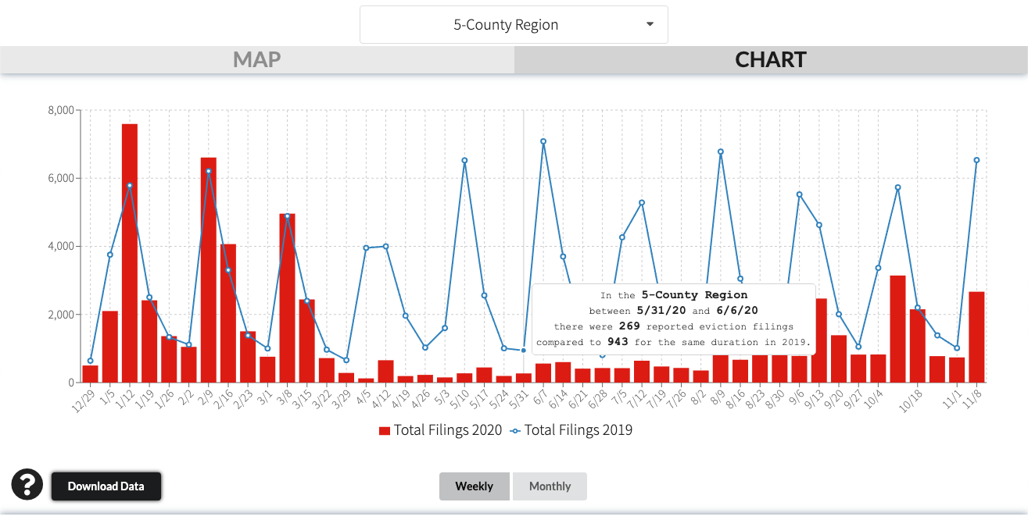
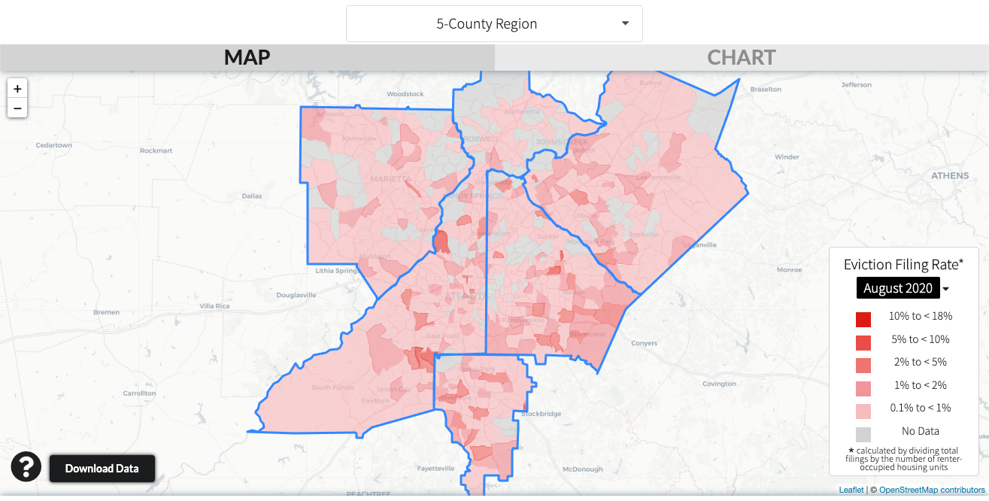
Tracking Evictions in the Atlanta Metro Region
Atlanta Region Eviction Tracker metroatlhousing.org/eviction-tracker/

Slide 6
Tracking Evictions in the Atlanta Metro Region
What we know…
While eviction filings are not the same as evictions themselves, they do portend potential displacement and housing instability for those against which the filings are initiated.
The lapse in the federal eviction moratorium and $600 unemployment add-on in August was evidenced by a 96% higher number of filings across the 5-county region for first week of September compared to the same week in 2019.
While filings were relatively low during the initial stages of the lockdown, our tracking has revealed that, despite the CDC eviction moratorium, filings have been steadily rising since the lapse of the CARES Act eviction moratorium and supplemental UI assistance.
While the CDC-issued ban on evictions goes a long way to protect renters from being ejected from their homes for the remainder of the year, it does not address the accrued missed rent payments, setting up the conditions for an even bigger wave of evictions at the beginning of next year.

Slide 7
Tracking Evictions in the Atlanta Metro Region
Supporting Legal Services and Outreach
 | Cobb | DeKalb | Fulton | Gwinnett
Initial Filings* | 1400 | 2690 | 3640 | 1530
Answers | 240 | 460 | 1060 | 250
Answer Rate | 17% | 17% | 29% | 16%
Answer
No Answer
www.wabe.org/tenants-must-respond-to-eviction-notices-to-get-hearings-but-many-may-have-missed-the-deadline/
* in August 2020

Slide 8
Tracking Evictions in the Atlanta Metro Region
Identifying Hotspots
County | Building Address | Eviction Filings in August 2020
Fulton | 3200 Lakeview Place, College Park GA 30337 | 38
Gwinnett | 1100 Indian Trail Lilburn Road, Norcross GA 30093 | 35
Dekalb | 1401 N. Hairston Road, Stone Mountain GA 30083 | 27
Fulton | 250 Piedmont Ave NE, Atlanta GA 30308 | 26
Fulton | 4001 Lakemont Drive, College Park GA 30337 | 25
Clayton | 8050 Taylor Road, Riverdale, GA 30274 | 24
Dekalb | 3515 Pleasantdale Road, Doraville GA 30340 | 19
Clayton | 8050 Tara Blvd, Jonesboro, GA 30236 | 18
Dekalb | 100 Camellia Lane, Lithonia GA 30058 | 17
Clayton | 5758 Hwy 85, Riverdale, GA 30274 | 17
Gwinnett | 1500 Willow Trail Drive, Norcross GA 30093 | 15

Slide 9
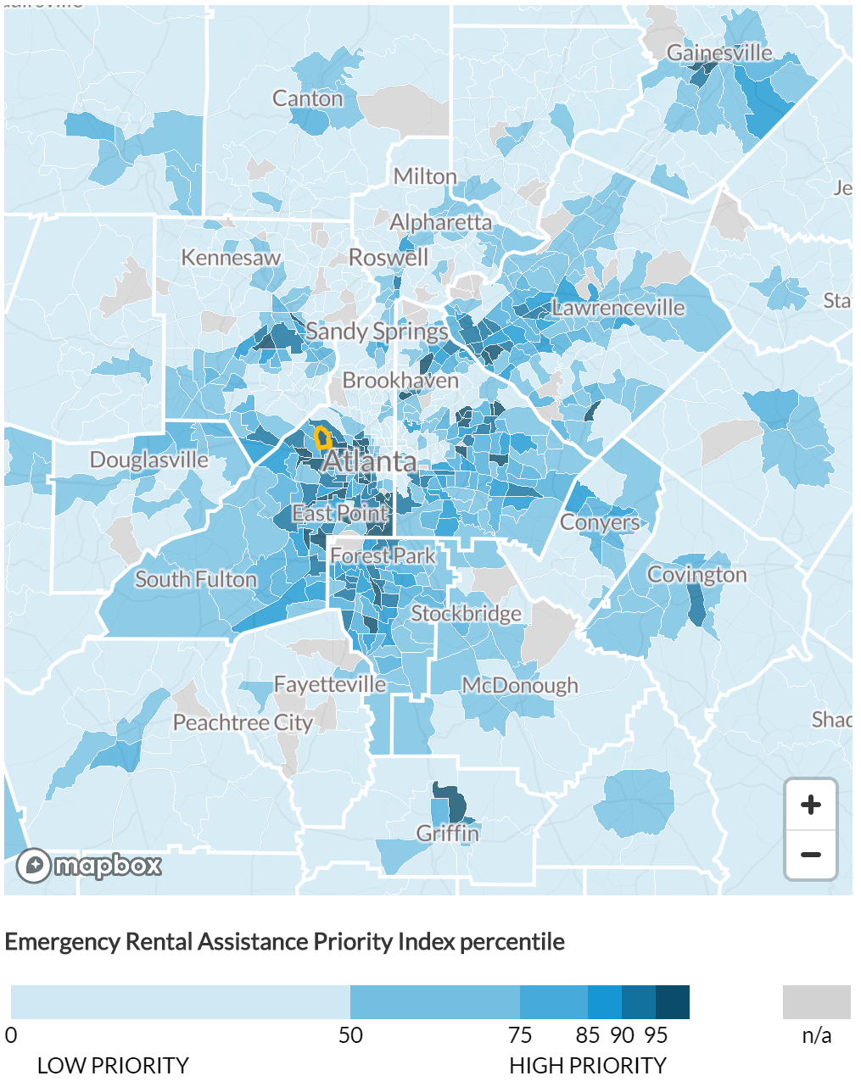
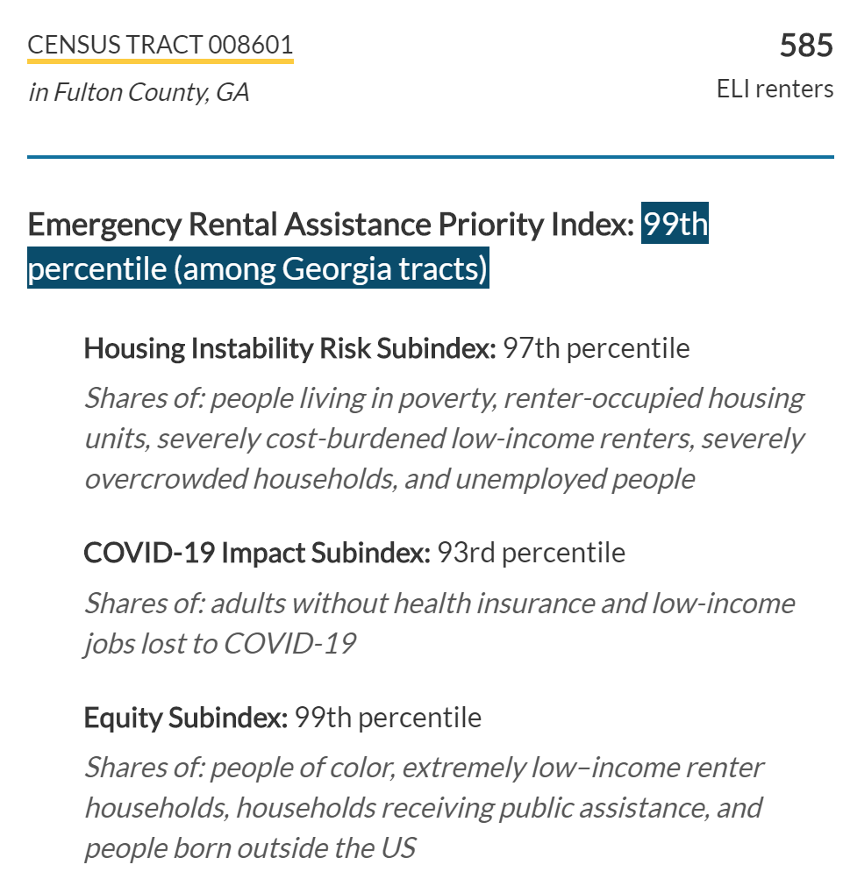
Urban Institute’s
Emergency Rental Assistance Priority Index
urban.org/features/where-prioritize-emergency-rental-assistance-keep-renters-their-homes

Slide 10
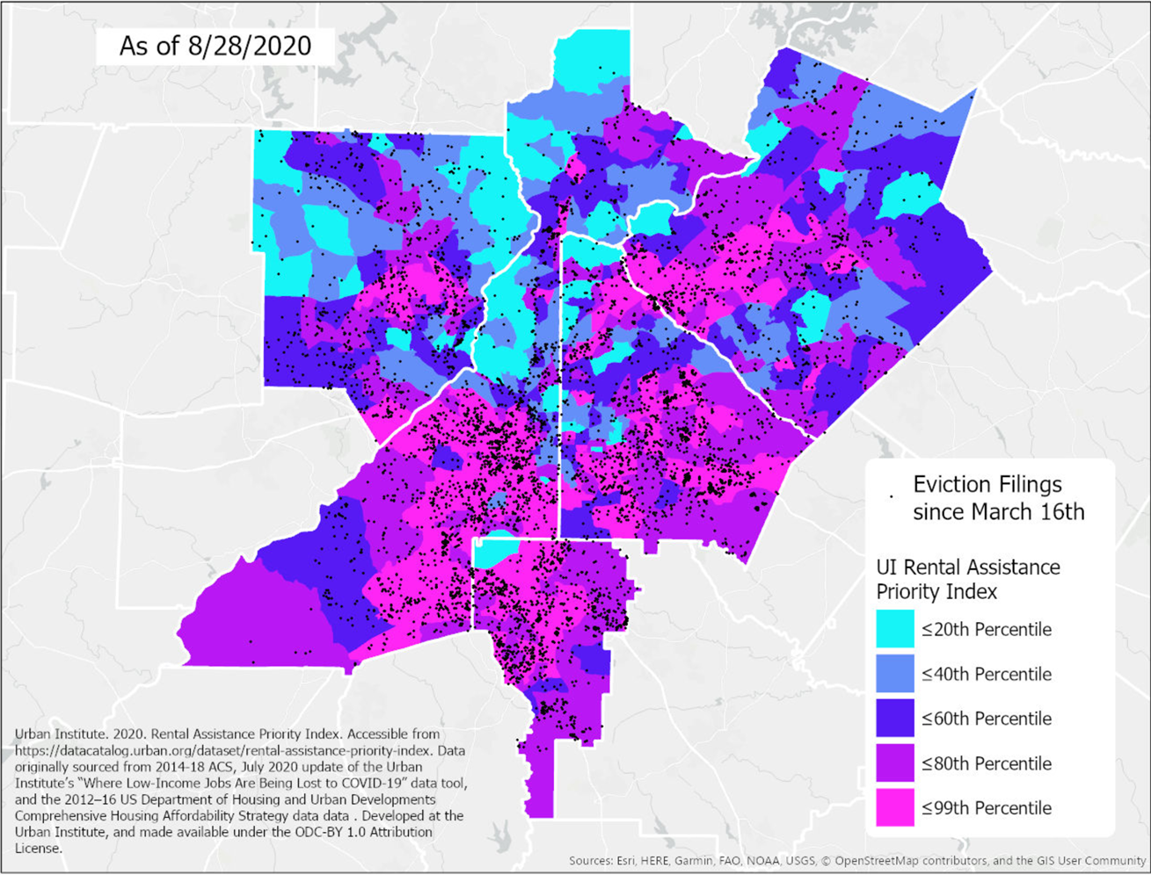
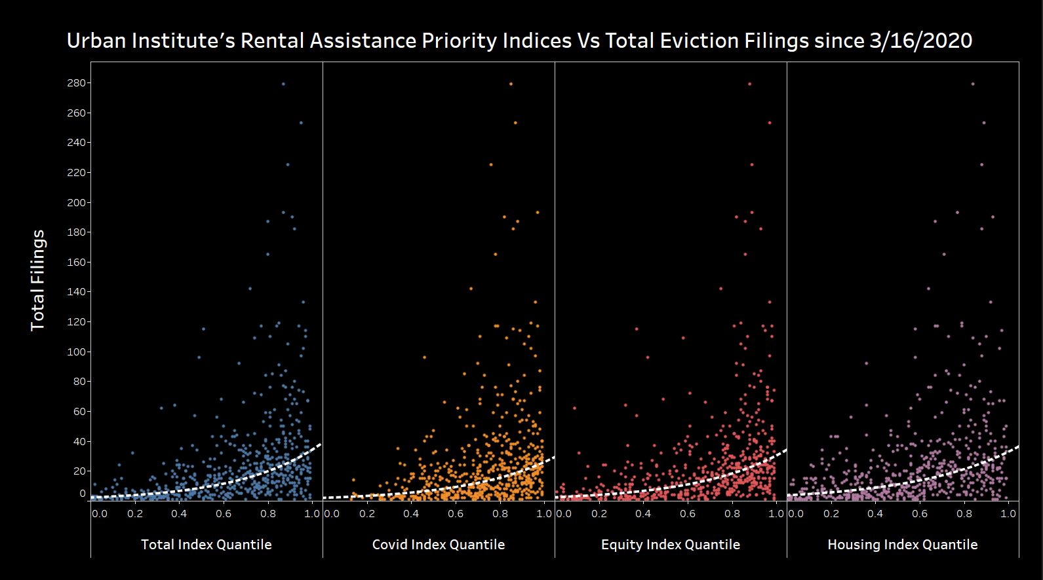
Tracking Evictions in the Atlanta Metro Region
Estimating Need and Targeting Rental Assistance
Saving Our Atlanta Region Residents (SOARR), an initiative bringing together a number regional leaders, is working to raise funds and have a system of disbursement ready on January 1st , 2021, the day after the CDC Moratorium expires at which point, if no other protection is implemented, rents will come due along with accrued missed payments. We estimate roughly 80K households will need assistance making rent and settling arrears at this point.

Slide 11
Questions?
Notes:
Can you go into more detail about how you gathered the eviction filing data?
Why aren’t you tracking actual evictions?
Can you share the code for accessing the eviction case records?
What plans do you have for the near future for the housing strategy/eviction tracker?

