Slide 1
The Institute for Urban Policy Research
Celebrating 10 Years

Slide 2
Born in 2005
The J. McDonald Williams Institute was founded as part of the Foundation for Community Empowerment.

Slide 3
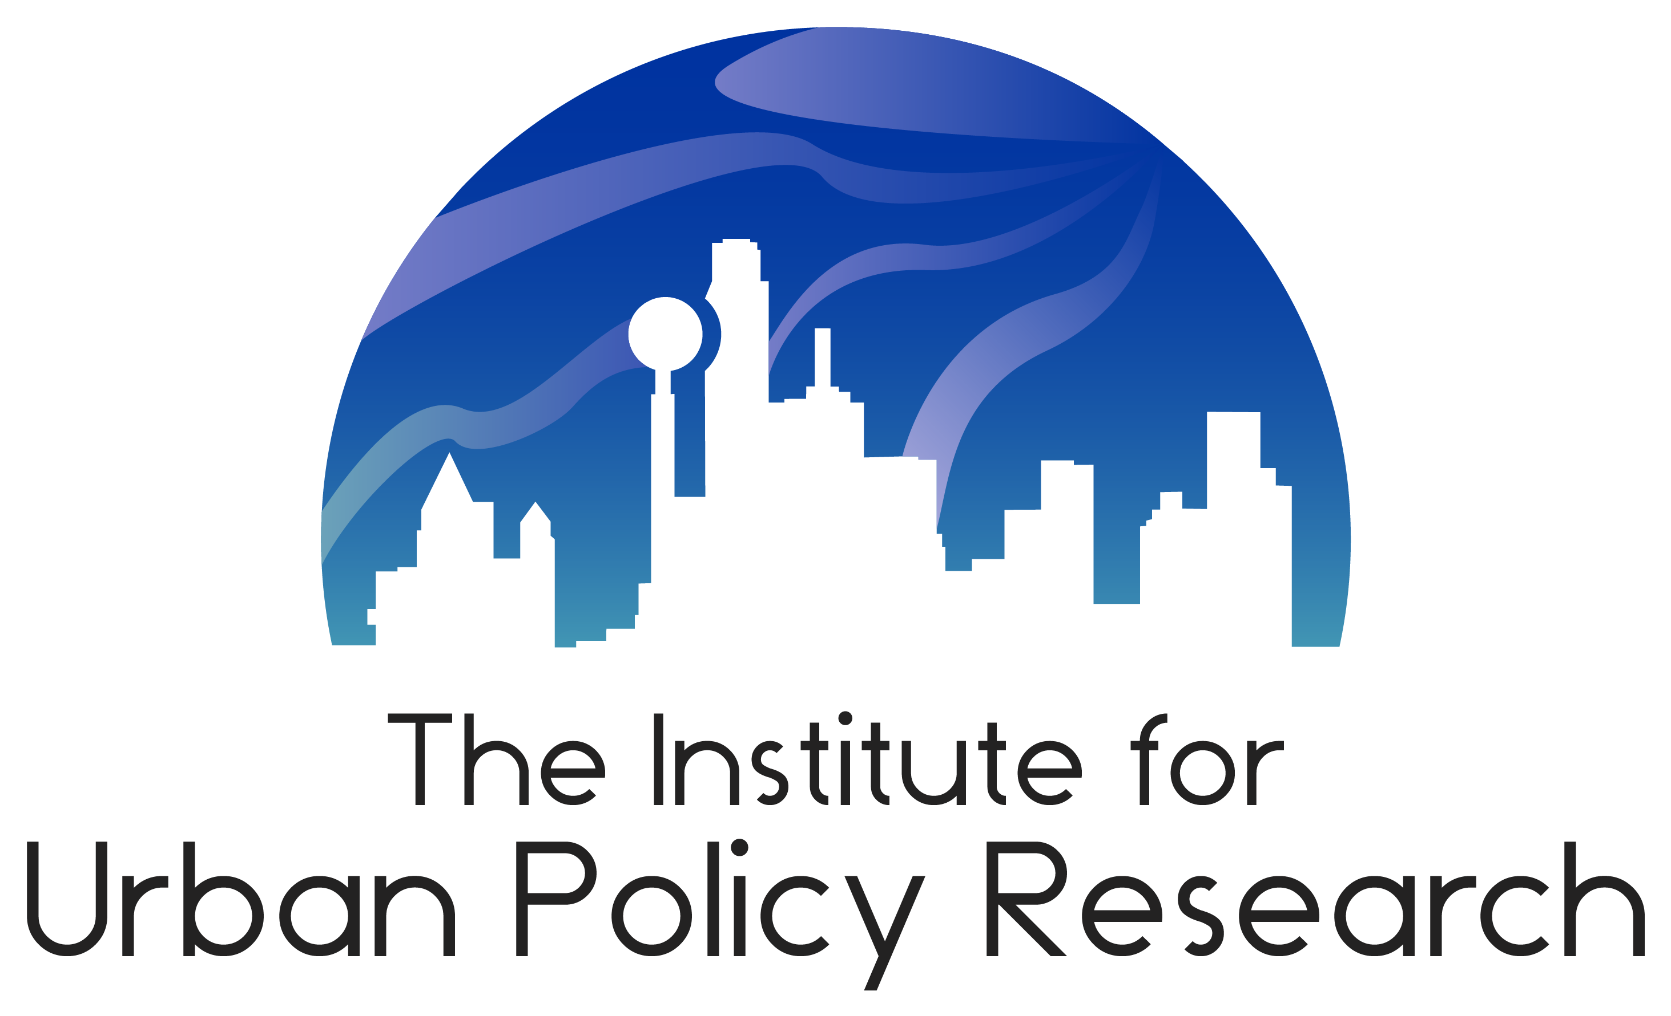
Reborn in 2008
Baptized by state government, the Williams Institute joined the University of Texas at Dallas and took a new name:
  The Institute for Urban Policy Research.

Slide 4

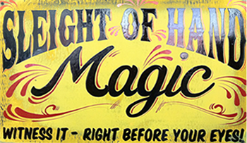
Funding and Support
University Support
  Overhead and Office Space
  Research Infrastructure
  Access to Resources
External Funding
  Contracts and Grants (Restricted)
    Project-related Equipment
    Project-related Staff
  Gifts and Cost Recovery (Unrestricted)
    Administrative Costs
    New Business Generation

Slide 5
Annual Revenue and Staff Growth

Slide 6
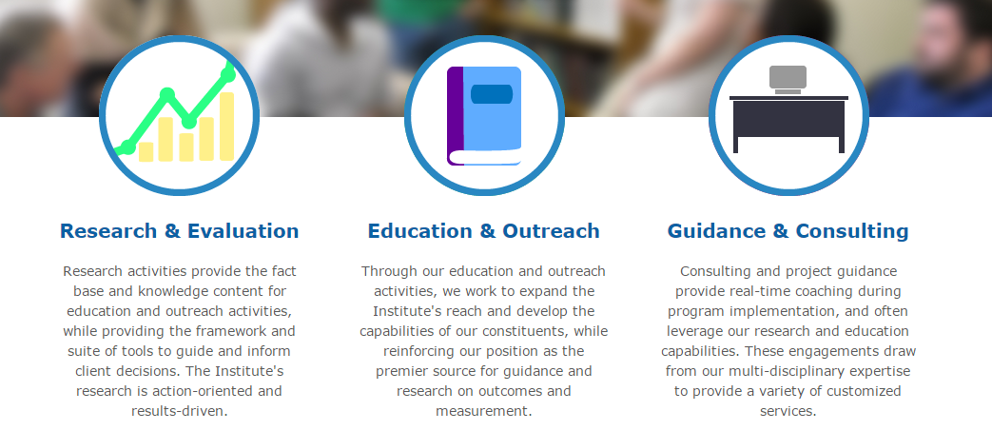
Our Scope of Work

Slide 7





Our Partners

Slide 8
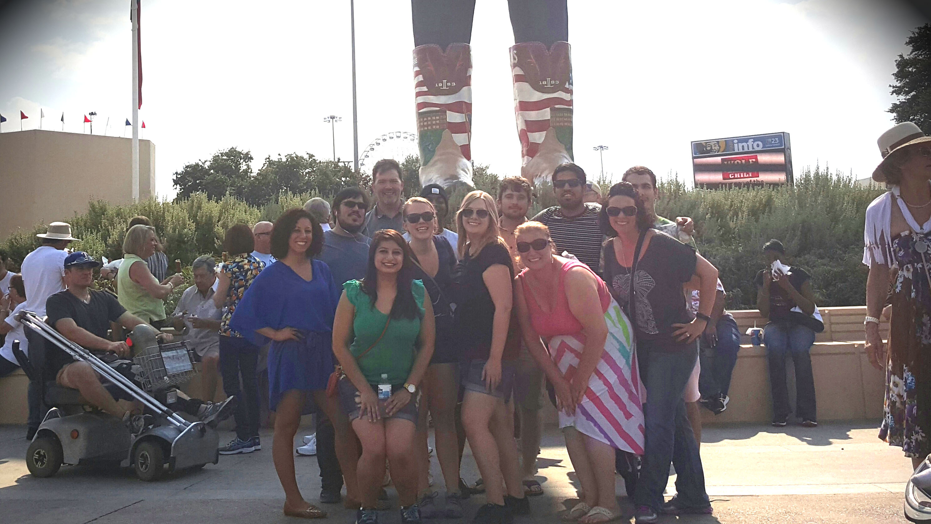
Our Team

