Slide 1
Atlanta Regional Commission
Housing Market
Subarea Analysis
Presented by
Erik Woodworth
Senior Planner, Research & Analytics Group
Data Scientist, Neighborhood Nexus
NNIP 2019 | Milwaukee, WI
Notes:
At the ARC, we recently completed the housing market subarea analysis portion of our regional housing strategy, for which I was lead researcher. In the this brief presentation I will quickly share our…
Research Objectives
Methodology
Techniques
Results
Next steps…

Slide 2
Atlanta Region Housing Market Subarea Analysis
Research Objectives
Identify housing market subareas for the Atlanta region which are:
  Granular enough to be helpful in identifying and prioritizing housing affordability policies and strategies at the local and municipal level
  General enough to be applied regionally
  Easily understandable to a range of stakeholders, community members, government staff, and elected officials
Notes:
We had three principle objectives in the pursuit to identify subareas for our region…

Slide 3
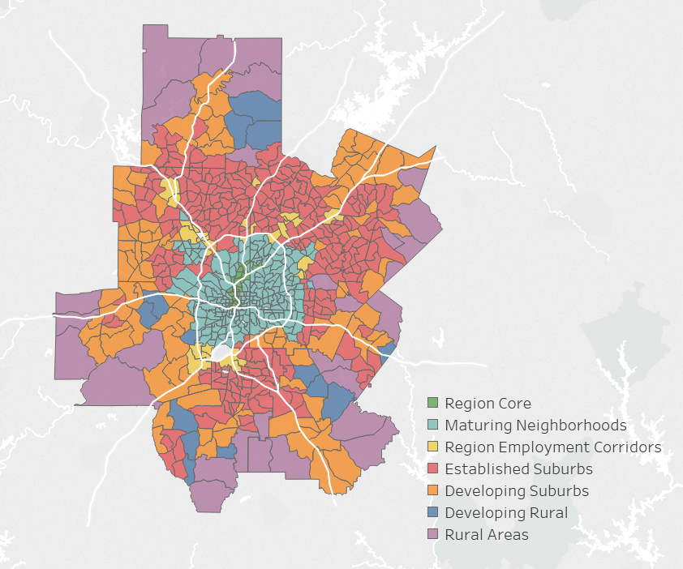
The most vetted representation of local land use characteristics and future development in the Atlanta region
Unified Growth
Policy
Map
Assigned to Census Tracts
Notes:
We started with the most coarse, albeit most vetted, categorizing framework we have in the Atlanta region, the UGPM.

Slide 4
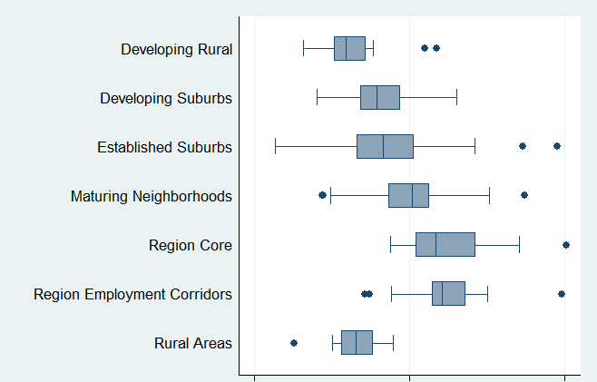
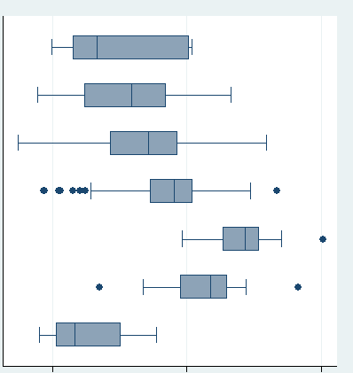
Atlanta Region Housing Market Subarea Analysis
Validation and Condensing of UGPM Categories
based on general housing characteristics
Owner
Renter
SF
MF
Notes:
We then validated this framework as useful differentiator of general housing characteristics, namely housing tenure and building type and then condensed them in three general catrgories
Analysis of Variance (ANOVA) and Pairwise Comparison of Means tests were performed on both Renter-to-Owner and MF-to-SF Ratios for the seven UGPM categories.
Both measures exhibited statistically significant and strong differences between the UGPM category.

Slide 5
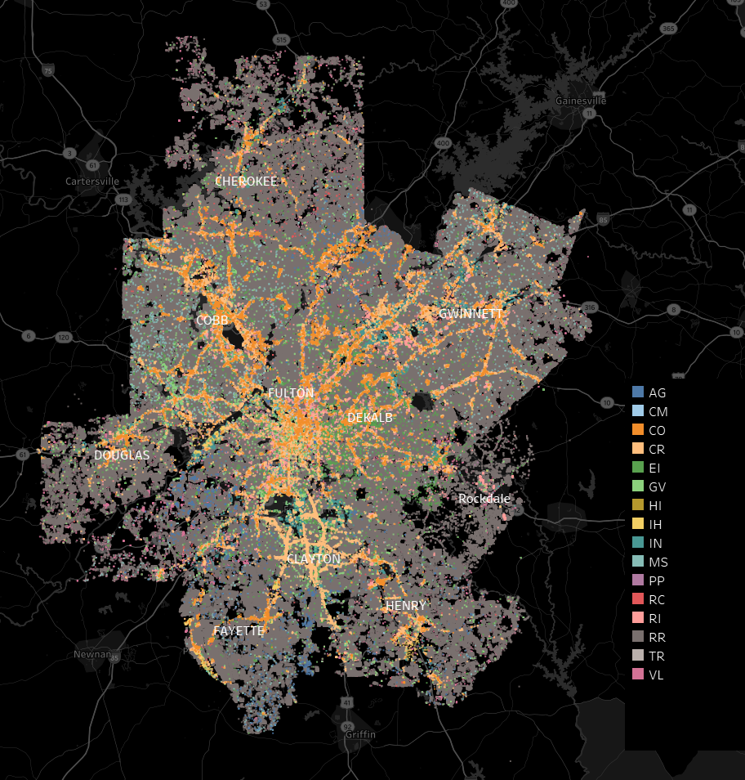
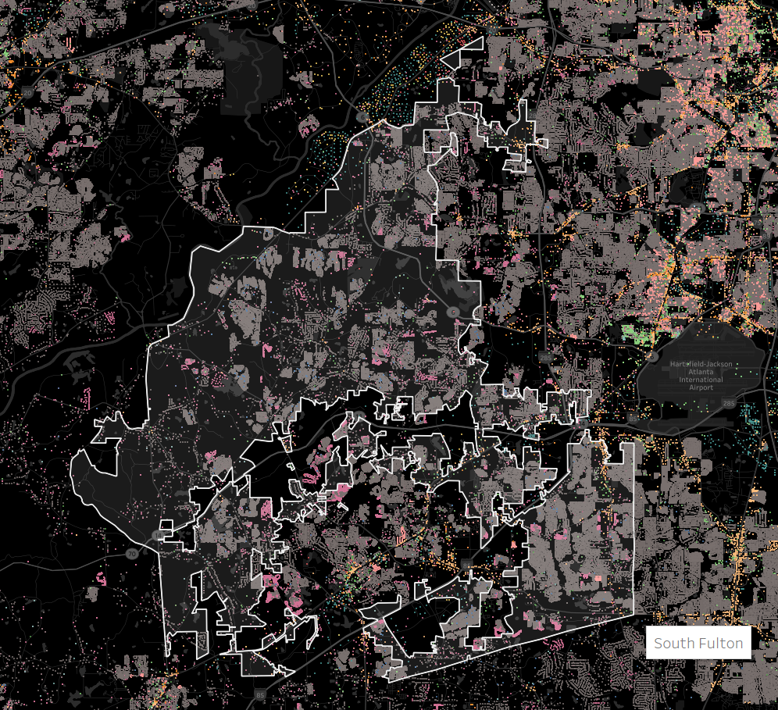

Zillow ZTRAX Data
Assessment Records
Land Use
Notes:
Next, we dug into the wealth of information provided by Zillow in the form of their ZTRX records, a confidential dataset shared with research, nonprofits, and government agencies working in the housing arena.
It includes both transaction and assessment data for most of the US.
In just Georgia,…
A lot of records
4.6 million plus assessment records statewide
Each record with a lot data
Some tables containing 100 plus attributes (many null)

Slide 6
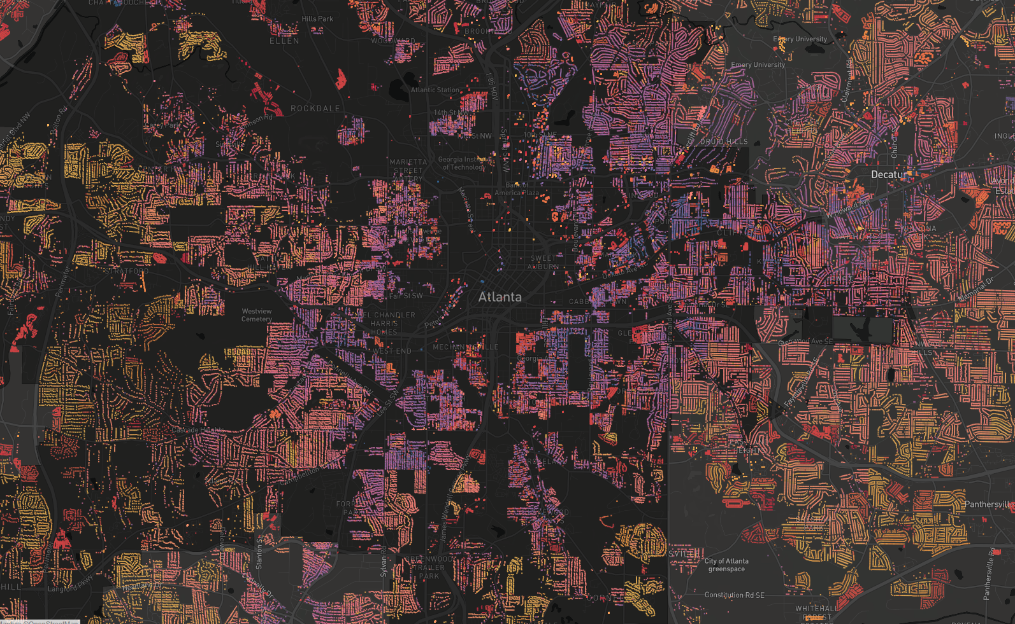
Zillow ZTRAX Data
Assessment Records
Year Built
1900
2018
Notes:
Useful for analysis as well as creating telling visualizations like this…

Slide 7
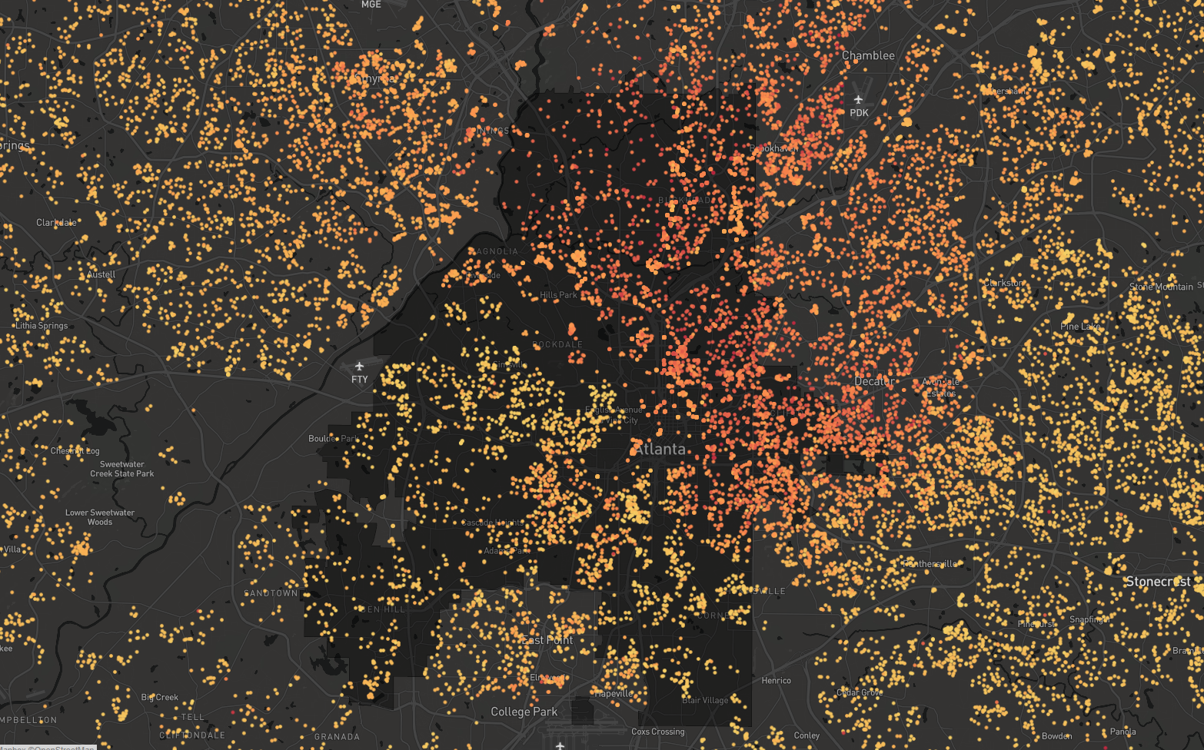
Zillow ZTRAX Data
Transaction Records
Home Sale Price Per Sq. Ft
$20
$600
Notes:
15 million home sale transactions statewide going back to the year 2000 and prior

Slide 8


Atlanta Region Housing Market Subarea Analysis
Extracting and Querying ZTRAX Data
Extraction to MongoDB
Transaction and assessment records provided by Zillow in multiple 5GB+ pipe-delimited text files
Created NodeJS application to parse text files and insert into to a MongoDB
Query MongoDB to CSV
Created NodeJS application to query from MongoDB and write CSV
Queried to limit records using filter parameters like county, year, property land use code, etc.
Output CSV in comma-delimited format for further filtering using Excel’s Power Query, analysis using STATA, and visualization using Tableau
Notes:
To work with this data, we wrote two javascript scripts (which we ran using NodeJs)
To extract data as provided by Zillow to a queryable DB
To query to csv for analysis and visualization

Slide 9
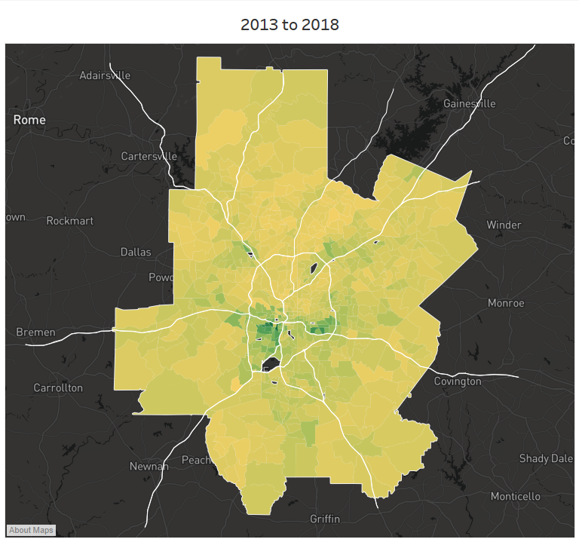
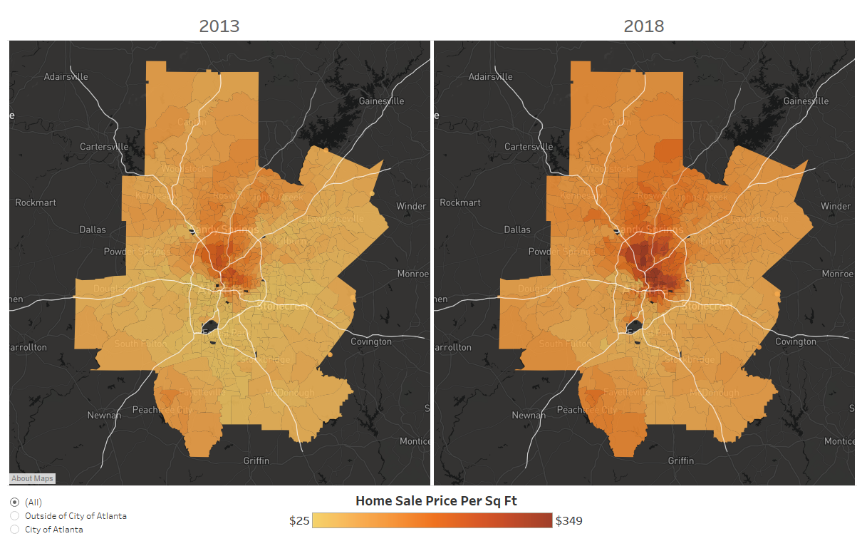
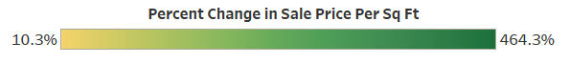
Atlanta Region Housing Market Subarea Analysis
Home Sale Price Analysis
using Zillow’s ZTRAX Transaction Data
Notes:
The ZTRAX transaction and assessment data was cleaned through a filtering process to include only sale price and building area data reflecting single-family consumer-to-consumer home sales.
To accomplish this, the following filters were applied to the transactions data:
Include only sale prices between $15K and $5M
Include only property land use codes AG, CD, RR, & SR
Exclude all duplicate transaction IDs and import parcel IDs
Include selected building area standard code for each county
ascertained by comparing sampling of records from each county to Zillow reported area and county assessors’ records
Include only sale price per ft² between -2 and 2 standard deviations of the mean within each census tract

Slide 10
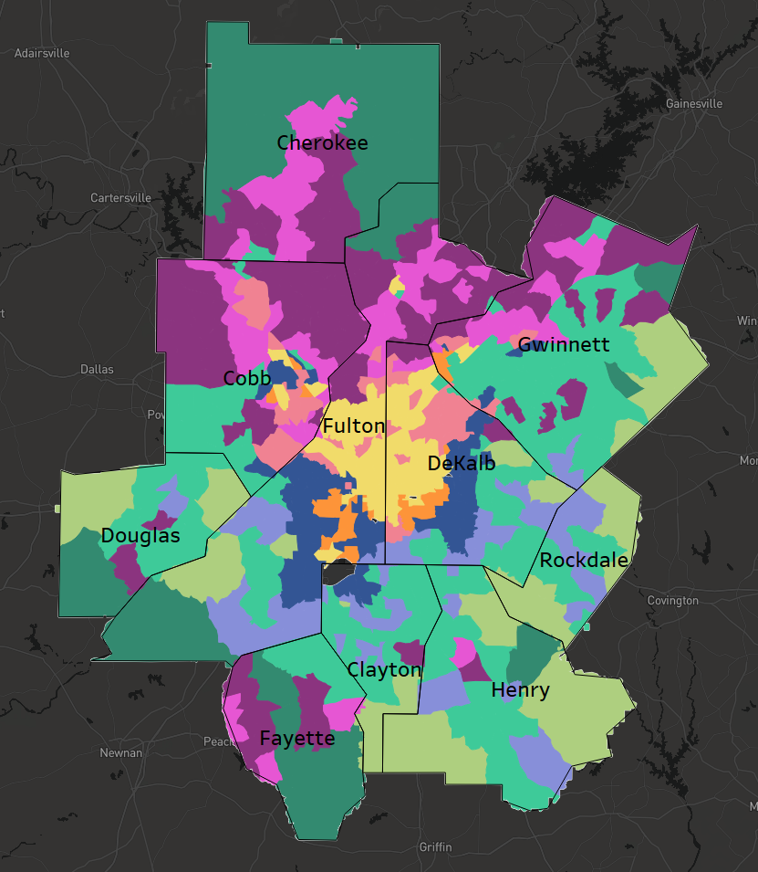
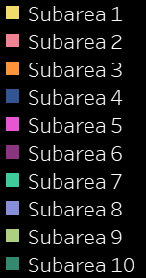
Atlanta Regional
Housing Market Subareas
Notes:
Combining the UGPM categories with the home price analysis and then using some inductive reasoning…these are the resulting subareas. I am happy to go into how exactly we arrived at these 10 in the Q&A but the short of it is that this came about through a data-driven iterative stakeholder engagement process with housing policy relevance being a central criterion. I will now very quickly go through each of the subareas.

Slide 11
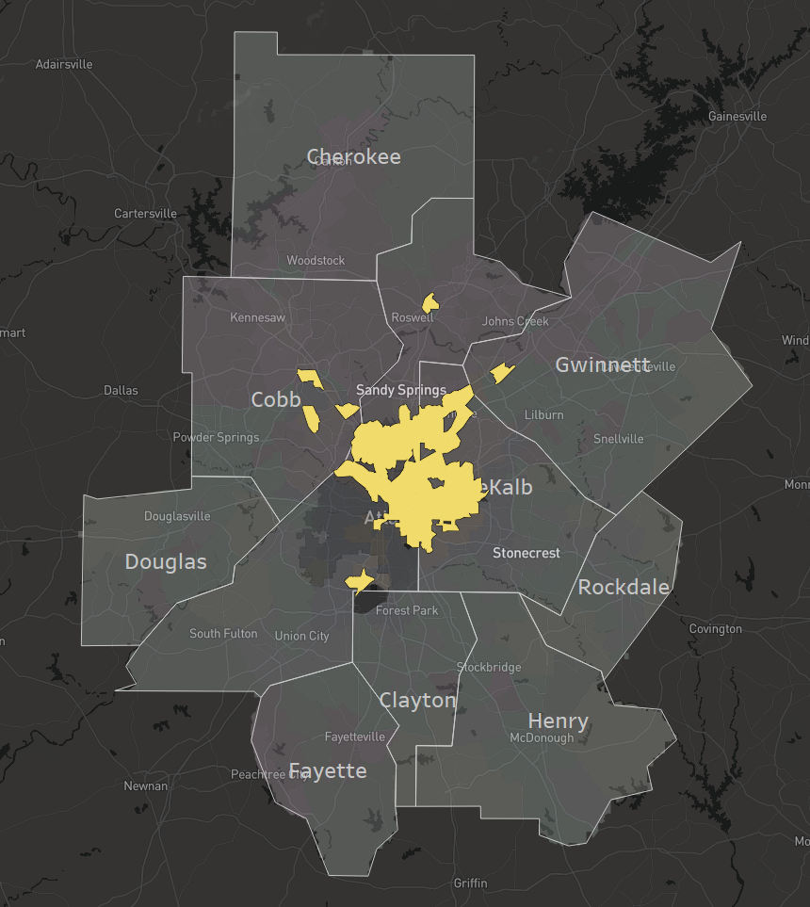
Subarea 1
Core neighborhoods with mostly older, higher-priced homes and high than average rents. Of the higher-priced urban areas in the region, the home sale prices in this subarea are increasing at the quickest rate.
Median Year Built 1966 | Median Building Area 1,516 sq. ft
Average Home Sale Price (2018) $252.83 per sq. ft +50% since 2013
…$505,660 for a 2,000 sq. ft home
Data Source: Zillow, ZTRAX (2018)
Notes:
Highest-priced homes in the region’s core
Includes much of the regions preserved and renovated historic housing stock
Highest proportion multifamily
Home prices change was somewhat higher than the regional average between 2013 and 2018

Slide 12
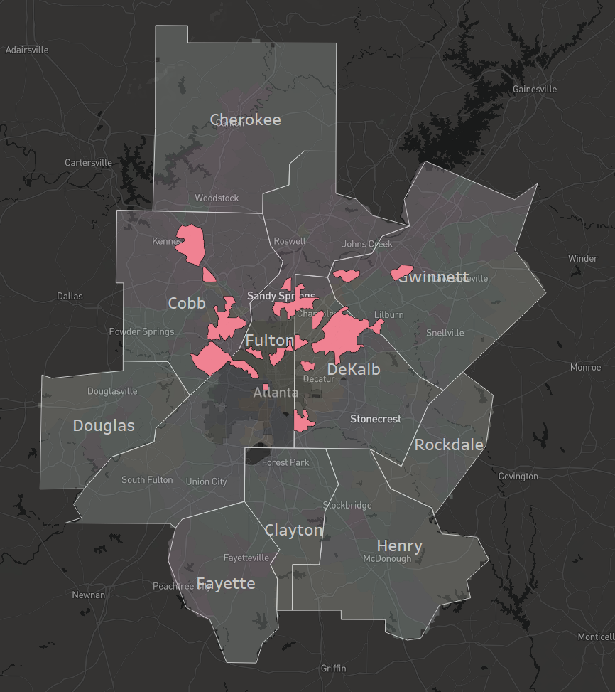
Subarea 2
Near core and employment corridor neighborhoods with a mix of newer and older, higher-priced homes and higher rents. The neighborhoods in this subarea are exhibiting home sales price increases at a rate similar to that of the region as a whole.
Median Year Built: 1984 | Median Building Area: 1,606 sq. ft
Average Home Sale Price (2018): $164.72 per sq. ft +36.2% since 2013
…$329,440 for a 2,000 sq. ft home
Data Source: Zillow, ZTRAX (2018)
Notes:
Higher-priced homes near core and along employment corridors
Mix of older and newer homes
Home prices change is similar to the regional average
Second highest increase in the proportion of non-white residents since 2010

Slide 13
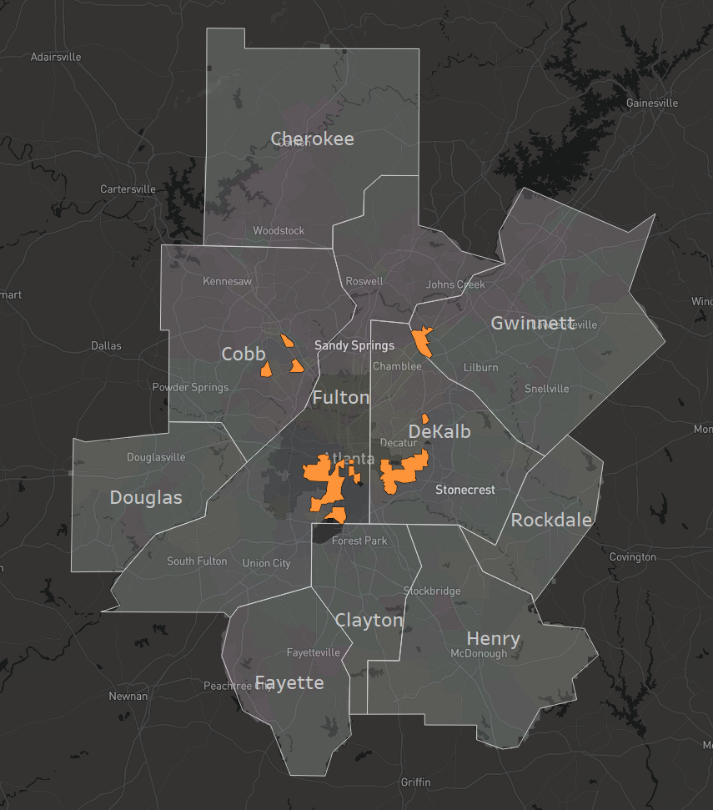
Subarea 3
Rapidly changing urban neighborhoods with relatively smaller and older homes. The neighborhoods in this subarea have experienced, by far, the quickest increases in home prices while at the same time losing the greatest proportion of non-white households.
Median Year Built: 1955 | Median Building Area: 1,279 sq. ft
Average Home Sale Price (2018): $130.36 per sq. ft +183.7% since 2013
…$260,720 for a 2,000 sq. ft home
Data Source: Zillow, ZTRAX (2018)
Notes:
Our region’s gentrifying and recently gentrified neighborhoods
Oldest and smallest homes
Greatest decline in the proportion of non-white residents
184% increase in home sale price between 2013 and 2018

Slide 14
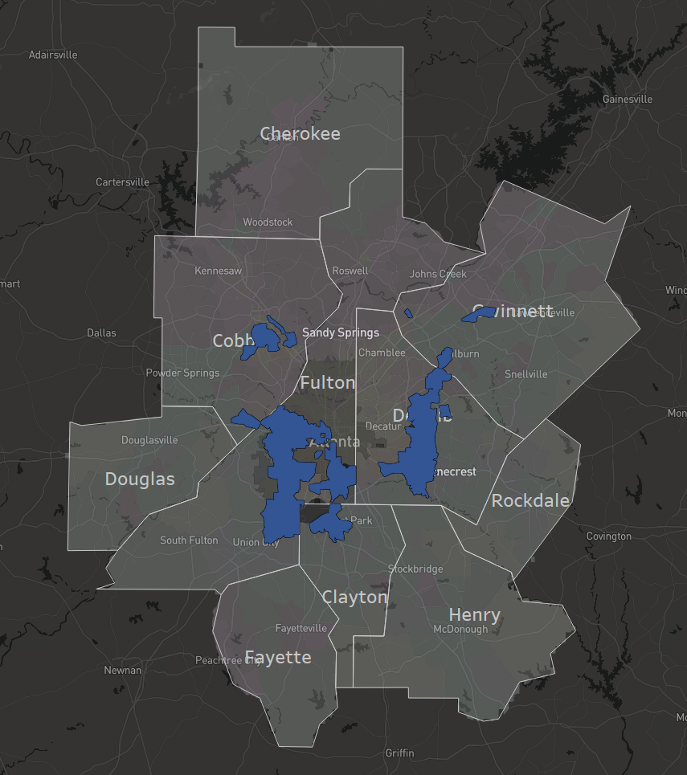
Subarea 4
Lower-priced urban areas with older, moderately-sized single-family homes, which are a mix of owner- and renter-occupied. Whereas the actual increase in the average home sale price per square foot is on par with that of the region, the rate of increase has been significantly quicker than the regional average.
Median Year Built: 1969 | Median Building Area: 1,470 sq. ft
Average Home Sale Price (2018): $79.07 per sq. ft +94.4% since 2013
…$158,140 for a 2,000 sq. ft home
Data Source: Zillow, ZTRAX (2018)
Notes:
Similar housing stock to subarea 3, although slightly larger and newer in some places
Lower-income areas at risk of gentrification
The nominal increase is similar to regional average
The rate of increase in significantly higher than the regional average
Largest proportion on non-white residents

Slide 15
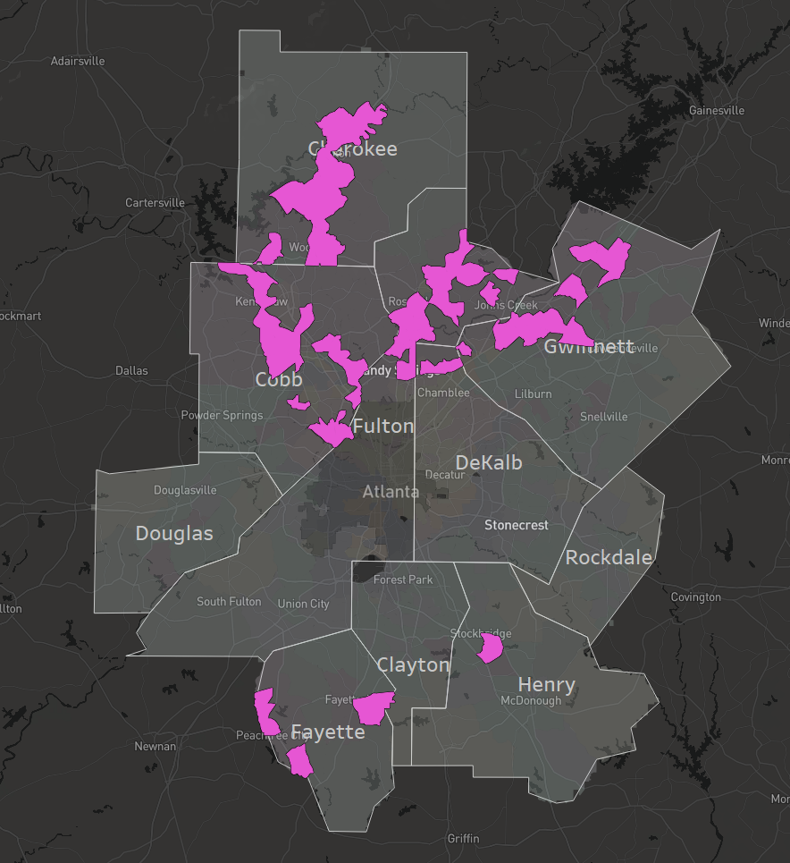
Subarea 5
Moderately- and higher-priced neighborhoods with a mix of renters and owners and both single-family and multifamily units. The neighborhoods in this subarea are exhibiting home sale price increases similar to that of the region as whole.
Median Year Built: 1995 | Median Building Area: 1,777 sq. ft
Average Home Sale Price (2018): $138.25 per sq. ft +40% since 2013
…$276,500 for a 2,000 sq. ft home
Data Source: Zillow, ZTRAX (2018)
Notes:
Moderate to higher-priced suburban homes
Mix of single and multifamly suburban neighborhoods
Along major arterials and near job centers
High proportion of renters

Slide 16
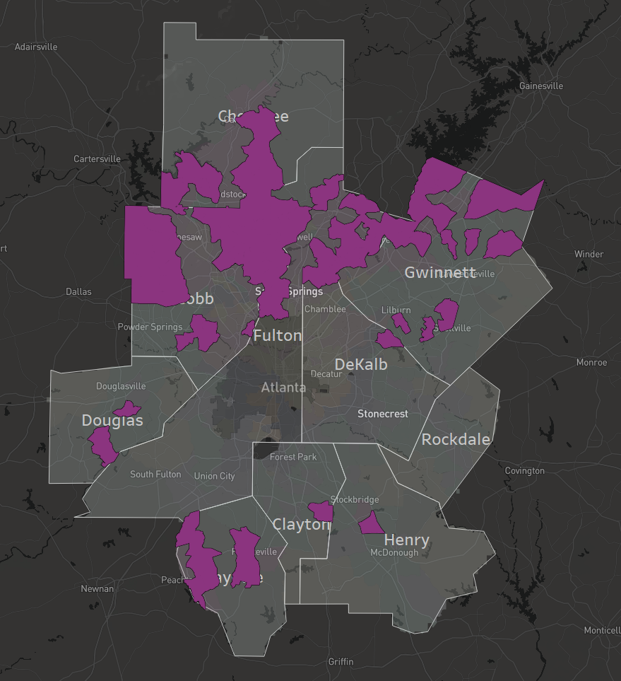
Subarea 6
Moderately- and higher-priced neighborhoods with comprised primarily of single-family owner households. This neighborhoods in this subarea are exhibiting home sale price increases slightly below to that of the region as whole.
Median Year Built: 1993 | Median Building Area: 2,148 sq. ft
Average Home Sale Price (2018): $137.90 per sq. ft +35.4% since 2013
…$275,800 for a 2,000 sq. ft home
Data Source: Zillow, ZTRAX (2018)
Notes:
Moderate to higher-priced single family homes
Very few MF
Home sale prices are increasing slightly more slowly than the region as a whole

Slide 17
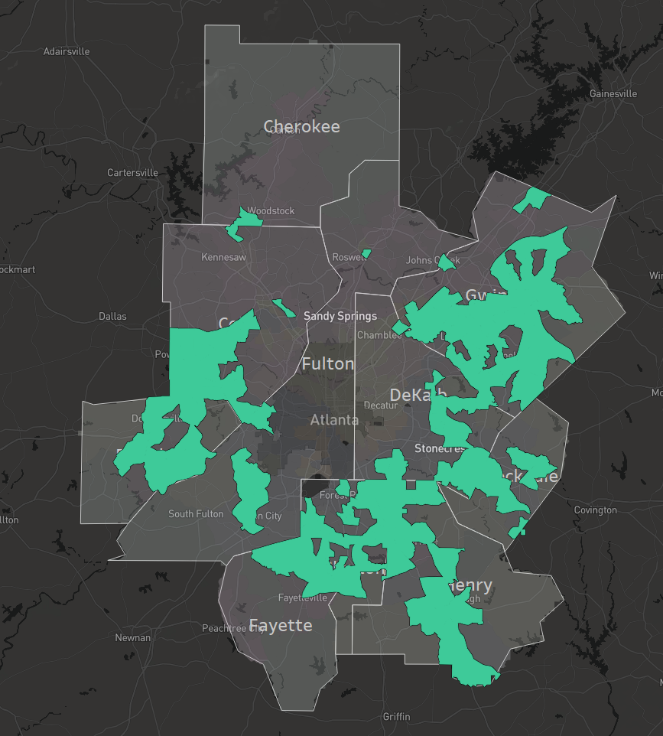
Subarea 7
Lower-priced single family suburban neighborhoods, which while at the moment are mostly owner-occupied, are exhibiting a significant increase in the proportion of renters. The home sale price increases in this subarea area are slightly below the regional average.
Median Year Built: 1992 | Median Building Area: 1,847 sq. ft
Average Home Sale Price (2018): $88.19 per sq. ft +61.1% since 2013
…$176,380 for a 2,000 sq. ft home
Data Source: Zillow, ZTRAX (2018)
Notes:
Lower-to-moderate priced suburban neighborhoods
20% MF
More than a third renter with largest increase in the proportion of renter since 2010
Mostly non-white
Increasing proportion of residents in poverty

Slide 18
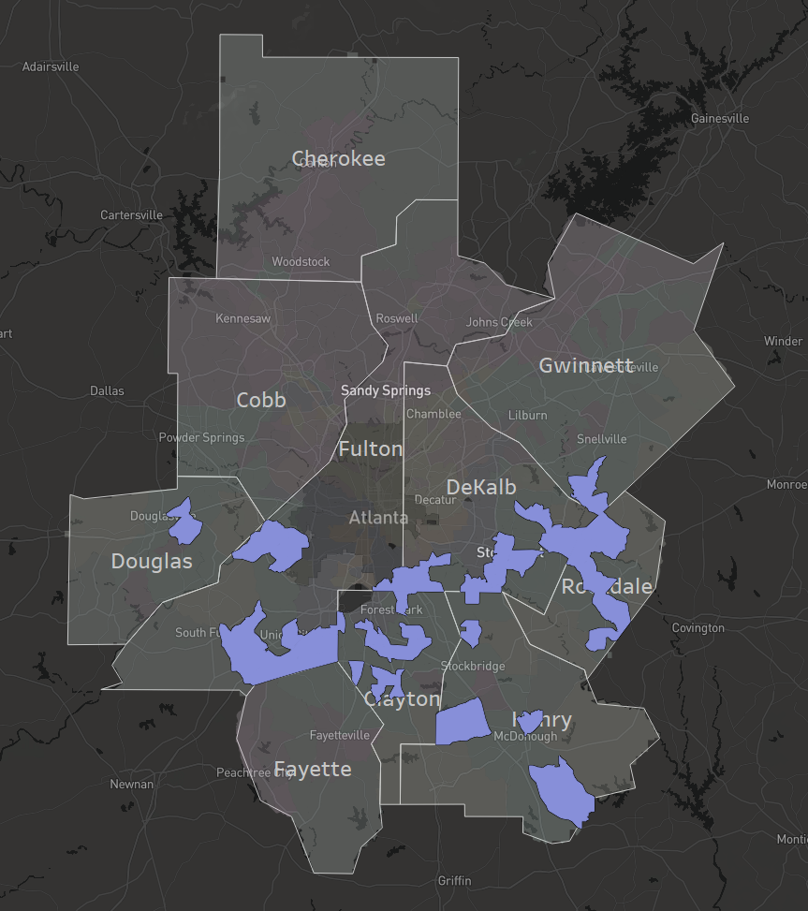
Subarea 8
Lower-priced moderately-sized suburban homes in neighborhoods mostly consisting of home-owners, albeit with an increasing proportion of renters. The home sales prices per square foot are the lowest and have increased the slowest among the subareas.
Median Year Built: 1996 | Median Building Area: 1,896 sq. ft
Average Home Sale Price (2018): $75.35 per sq. ft +48.5% since 2013
…$150,700 for a 2,000 sq. ft home
Data Source: Zillow, ZTRAX (2018)
Notes:
Lowest priced subarea with slowest price increase
Nearly a quarter MF
Largest increase in the poverty rate since 2010

Slide 19
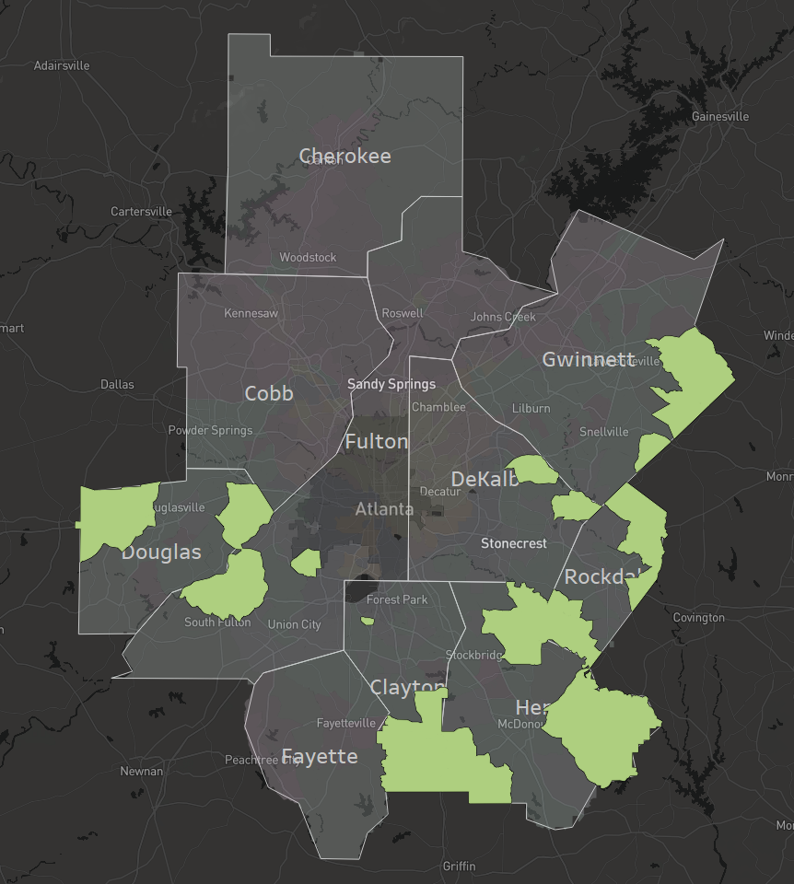
Subarea 9
Lower-priced rural areas with large lots and mostly single-family housing stock, although significantly higher proportions of multifamily units and renters compared to their higher-priced rural counterparts. The home sale prices in this subarea are increasing more slowly than the region as a whole
Median Year Built: 2000 | Median Building Area: 2,316 sq. ft
Average Home Sale Price (2018): $87.28 per sq. ft +55.7% since 2013
…$174,560 for a 2,000 sq. ft home
Data Source: Zillow, ZTRAX (2018)
Notes:
Lower-priced rural
Larger, newer homes
Largest increase in proportion non-white
10% MF
Poverty rate increasing as well

Slide 20
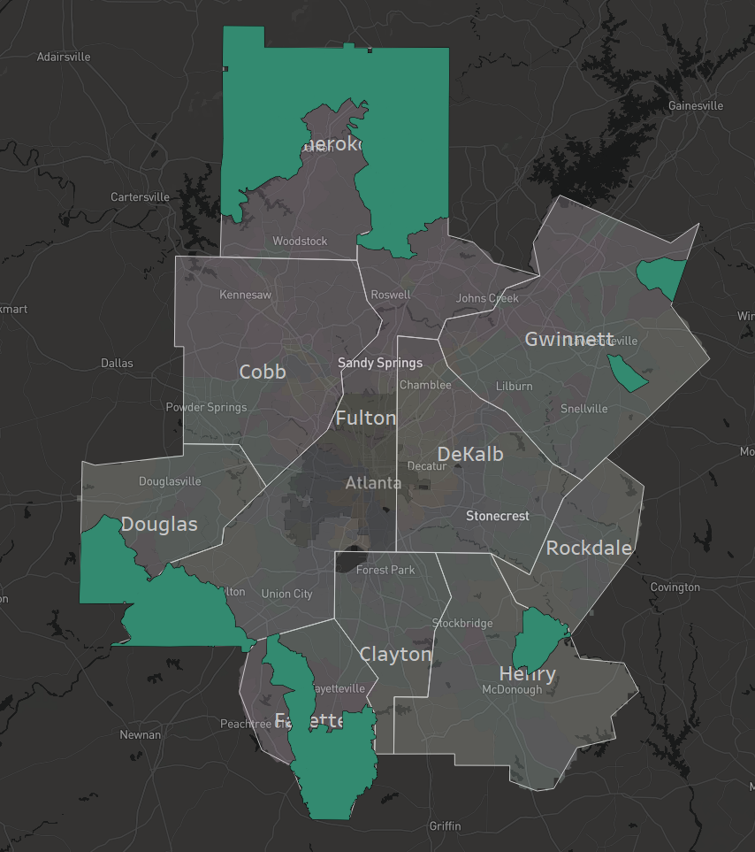
Subarea 10
Rural areas with generally newer, higher-priced, large owner-occupied single-family homes on large lots. The home sale prices in this subarea are increasing somewhat slower than the regional average.
Median Year Built: 1999 | Median Building Area: 2,460 sq. ft
Average Home Sale Price (2018): $130.88 per sq. ft +35.8% since 2013
…$261,760 for a 2,000 sq. ft home
Data Source: Zillow, ZTRAX (2018)
Notes:
High priced rural
Newer, larger homes
Smallest proportion non-white
Smallest proportion MF
Home sale prices are increasing slightly slower than the regional average

Slide 21


Atlanta Region Housing Market Subarea Analysis
Meetings and Charettes with…
Metro Atlanta Mayors Association (MAMA)
Land Use Coordinating Committee (LUCC)
Regional Housing Action Committee (RHAC)
Regional Housing Task Force
Local Developers Roundtable
Other Local Data Experts
Notes:
As I mentioned before, the 10 subareas at which we arrive resulted from a combination of our research and feedback from a variety of interested parties including mayors (we have 70+ in the Atlanta metro region), planning staff, civic leaders, some developers, and our always helpful local data experts.

Slide 22
Next Steps…
Connect strategies to subareas under the following buckets
Promote Housing Stability
Rent to Own
Renter rights programs
Develop Leadership
Capacity building resources for non-profit and community- based developers
Landlord recruitment and retention
?
?
Increase Supply
Flexible Zoning
Streamline Building permits
Preserve Affordable Supply
Low cost Rehab assistance
Code Enforcement
?
?
Reduce Housing and Transportation Costs
Permit mixed use in commercial corridors
Joint development
Expand Capital Resources
TAD’s throughout Region, LCIs and Town Centers
Employer-assisted housing programs
?
?
Notes:
Going forward in furtherance of our broader housing strategy, the housing market subareas will be connected to housing strategies and policies as a means to help our various county and municipal partners strategize and plan to best provide housing that is affordable, accessible to jobs, and which meets the current and future demands of our growing region.

Slide 23
Thank You!
Erik Woodworth
Senior Planner, Research & Analytics Group
Data Scientist, Neighborhood Nexus ewoodworth@atlantaregional.org

