Slide 1
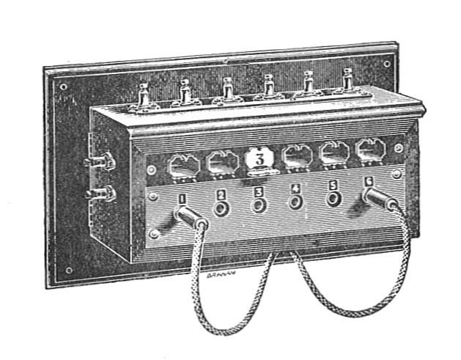
Initial Outreach to Local Libraries
(a primer)
https://civic-switchboard.github.io/updates/post_2

Slide 2
Why Libraries?
As a civic data intermediary, your role includes helping people find and use data.
Libraries have a long tradition of providing similar support for all kinds of information, but many are just beginning to make connections to data intermediaries like you in the civic data space.

Slide 3
outreach to PUBLIC LIBRARIES

Slide 4
Who to talk to at PUBLIC LIBRARIES?
Departments interested in potential long term strategies
Digital Strategy/Digital Initiatives
Technology Services/ Emerging Technology
Departments with interested audiences
Adult programming/Program coordinators
Information Services/Reference Services
Nonprofit resources/Foundation Centers
Outreach/Community Engagement

Slide 5
Areas for collaboration with PUBLIC LIBRARIES
Advancing inclusive civic data efforts
Resource awareness
Public programming
Data publishing and transparency

Slide 6
Some benefits to PUBLIC LIBRARY
Public libraries want to connect people with the best information and learning opportunities possible. Civic data is an increasingly important resource. Trainings on basic civic data concepts can help libraries better serve their communities.
Civic data can help libraries plan effective programs and services and evaluate their impact in the community.
Improving lines of communication between civic data intermediaries and library staff may open up opportunities for libraries to access additional data and/or find volunteers to assist in analysis and visualization.

Slide 7
Examples of PUBLIC LIBRARY Partnerships
Through the Open Data to Open Knowledge project - the city of Boston is partnering with the public library to create a digital civic data catalog and then will provide classes on how to use the too.
The Chapel Hill Public Library is home to the open data portal and holds public events to explore open data.
Open Chattanooga is a collaborative between the City of Chattanooga, the Chattanooga Public Library and the Open Chattanooga Brigade. The data portal is hosted by the Public Library and is part of their website.

Slide 8
outreach to ACADEMIC LIBRARIES

Slide 9
Who to talk to at ACADEMIC LIBRARIES?
Potential positions to connect with:
Data Services Librarian
Digital Scholarship Librarian
Government Documents Librarian
Liaison librarian / Subject Specialists for urban studies, public health, public policy, or social work
Assistant or Associate University Librarian for Research

Slide 10
Areas for collaboration with ACADEMIC LIBRARIES
Metadata
Repository selection and management
Digital preservation and archiving
Assistance to data publishers
User needs
Events and Education

Slide 11
Some benefits to ACADEMIC LIBRARIES
Many academic institutions focus on public engagement as a core part of their missions, for example building centers that support collaborative partnerships between universities and community organizations. Libraries, which are service-minded organizations, want to demonstrate alignment with their institutional missions.
Readily-available civic data supports research and community-based learning in universities. Instructors may use civic open data in courses, students may create projects that draw on civic information, and faculty may analyze civic data for a study of regional relevance.

Slide 12
Examples of ACADEMIC LIBRARY Partnerships
At the University of Pittsburgh, the University Library System worked with Western Pennsylvania Regional Data Center. The library participated in the selection of a repository platform for the open data portal, consulted on metadata and privacy issues, and has hosted events on regional data and the data center.
Temple University Libraries partnered with Open Data Philly to investigate how libraries can assist with preservation and long-term access to open civic data.
Indiana University Northwest Academic library houses the Indiana University Northwest Center for Data and Analysis which serves as a data intermediary for both the campus and community.

Slide 13
(Just a little about)
The Civic Switchboard Project
connecting libraries and community information networks
Project Website + Blog + Community of Practice
https://civic-switchboard.github.io/
Civic Switchboard Guide and Toolkit
https://civic-switchboard.gitbooks.io/guide/
2018 Workshops: Before NNIP and DLF
2019 Sub awards
Notes:
Our Pittsburgh experience: libraries and librarians should be key actors in civic open data ecosystems and act as core data intermediaries
Conviction 1: Cultivating a healthy local civic data ecosystem depends upon the coordinated efforts of a variety of data intermediaries. In other words, no single entity can effectively cover all of the necessary roles alone. Library involvement can include both academic and public libraries
Conviction 2: no single model can be made to fit every city or region.Because each community’s civic data ecosystem is unique, the structure of local data intermediaries have evolved to take different shapes. Modelling at the national level must be done by capturing a wide variety of successful local practices.

