Slide 1
Sequencing a Property’s Path Towards Vacancy
October 23, 2014
Presented by the Institute for Housing Studies at NNIP Partnership Meeting
@HOUSINGSTUDIES

Slide 2
Need for Better Data to Understand Vacancy in Chicago
Post-crisis, addressing the vacant property issue requires quality data and analysis for policy development and implementation.
Significant gaps in the availability of data that gets at property status and housing market conditions
  Data exist to help identify broad market trends for policy development (USPS/HUD)
  Limited property-level data necessary for policy implementation (???)
@HOUSINGSTUDIES

Slide 3
Sequencing Data to Learn More About Vacant Properties
Presentation focuses on development of a data set that utilizes parcel-level administrative data to better understand the circumstances and last-known entity that may be accountable for a significantly blighted vacant property.
@HOUSINGSTUDIES

Slide 4
Data Sources
Data Sources from the IHS Data Clearinghouse
      Cook County Assessor – Data on all parcels in the County
      Cook County Recorder of Deeds – Sales, mortgages, foreclosure auctions
      Cook County Clerk of the Court – Foreclosure filing activity
Additional Administrative Data Used
      Complaints of open or abandoned properties in the City of Chicago (311 Data)
@HOUSINGSTUDIES

Slide 5
Defining a Blighted Vacant Property
Selection Criteria for Analysis
  More than one 311 complaint within two years
  Most recent 311 complaint was in the preceding last year
  No subsequent activity after the 311 complaint
@HOUSINGSTUDIES

Slide 6
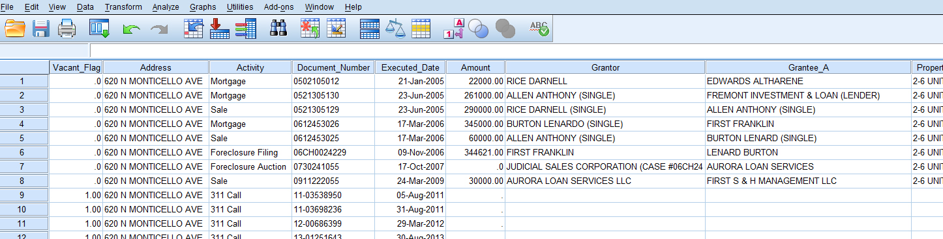
Sequencing Method
Determining Chain of Activity on a Parcel Later Identified as Blighted and Repeatedly Vacant
@HOUSINGSTUDIES

Slide 7
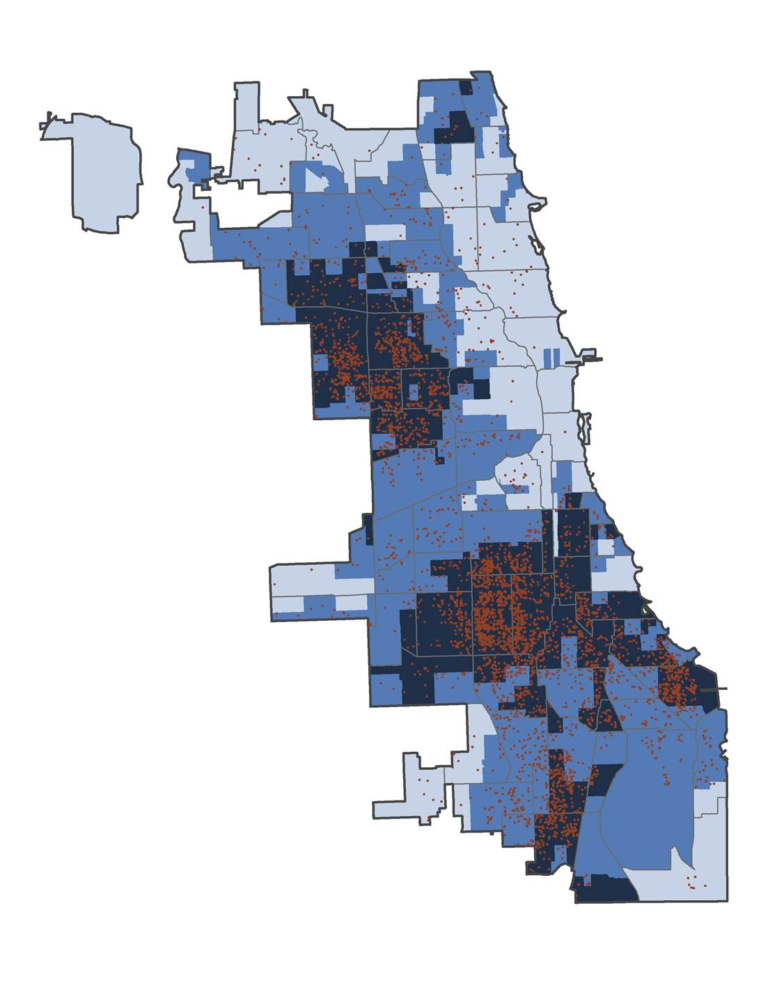
Blighted vacant properties follow patterns of concentrated foreclosure activity
@housingstudies

Slide 8
Understanding A Property’s Path to Blight
Distribution of Last Known Activity by Neighborhood Foreclosure Distress Level
@housingstudies

Slide 9
Understanding A Property’s Path to Blight
Distribution of Last Known Activity by Neighborhood Foreclosure Distress Level
@housingstudies

Slide 10
Understanding A Property’s Path to Blight
Average Number of Years Since Last Known Activity by Neighborhood Foreclosure Distress Level
 | All Activity | Mortgage | Foreclosure | Foreclosure Auction | Sale
Low Foreclosure | 1.8 | 1.9 | 2.7 | 0.7 | 1.4
Moderate Foreclosure | 2.4 | 5.2 | 2.7 | 0.9 | 1.4
High Foreclosure | 3 | 5.2 | 3.0 | 2.4 | 2.6
@housingstudies

Slide 11
Understanding A Property’s Path to Blight
Average Number of Years Since Last Known Activity by Neighborhood Foreclosure Distress Level
 | All Activity | Mortgage | Foreclosure | Foreclosure Auction | Sale
Low Foreclosure | 1.8 | 1.9 | 2.7 | 0.7 | 1.4
Moderate Foreclosure | 2.4 | 5.2 | 2.7 | 0.9 | 1.4
High Foreclosure | 3 | 5.2 | 3.0 | 2.4 | 2.6
@housingstudies

Slide 12
Understanding A Property’s Path to Blight
Average Number of Years Since Last Known Activity by Neighborhood Foreclosure Distress Level
 | All Activity | Mortgage | Foreclosure | Foreclosure Auction | Sale
Low Foreclosure | 1.8 | 1.9 | 2.7 | 0.7 | 1.4
Moderate Foreclosure | 2.4 | 5.2 | 2.7 | 0.9 | 1.4
High Foreclosure | 3 | 5.2 | 3.0 | 2.4 | 2.6
@housingstudies

Slide 13
Key Findings of the Analysis
Blighted vacant properties are concentrated in distressed neighborhoods.
Regardless of market conditions, a foreclosure filing is most often the last-known activity for blighted vacant properties.
However, longer lag times between the non-foreclosure activity and the 311 call in distressed neighborhoods raise concerns about oversight and abandonment.
@HOUSINGSTUDIES

Slide 14
How to Apply this Analysis
Where a foreclosure filing or a mortgage is the last known activity, analysis can help identify post-foreclosure or pre-foreclosure walkaways.
Where the last known activity was a sale, data can help identify accountable entity and ownership status.
@HOUSINGSTUDIES

Slide 15
What’s Next?
Further analysis to determine the characteristics of property sales and ownership associated with blighted vacant properties.
Utilizing additional data like building violations or liens to better understand a property’s current status and help identify potential policy levers.
Codifying analysis in the IHS Data Clearinghouse to allow for quarterly updates of data set.
@HOUSINGSTUDIES

