Slide 1
From Fact Books to MapBox: The Evolution and Impact of Woodstock Institute’s Data Services
October 22, 2014
Katie Buitrago | Senior Policy and Communications Associate
Woodstock Institute | Chicago, Illinois
P 312.368.0310 | F 312.368.0316
kbuitrago@woodstockinst.org
@woodstockinst
WoodstockInstitute

Slide 2
What is Woodstock Institute?
Create a just financial system in which lower-wealth persons and communities and people and communities of color can achieve economic security and community prosperity.
Fair Lending
Wealth Creation
Financial Systems Reform

Slide 3
Woodstock’s model for change
Economic Security
Community Prosperity
Advocacy
Research TA
Coalition Building

Slide 4
How data drive the movement
Research IDs problem
Policy solutions
Build support
Social change
Advocacy campaign
Develop supporting data
Persuade policy- makers
Social change
Technical Assistance
Allies get more resources
Stronger movement
Social change
Allies conduct targeted work

Slide 5
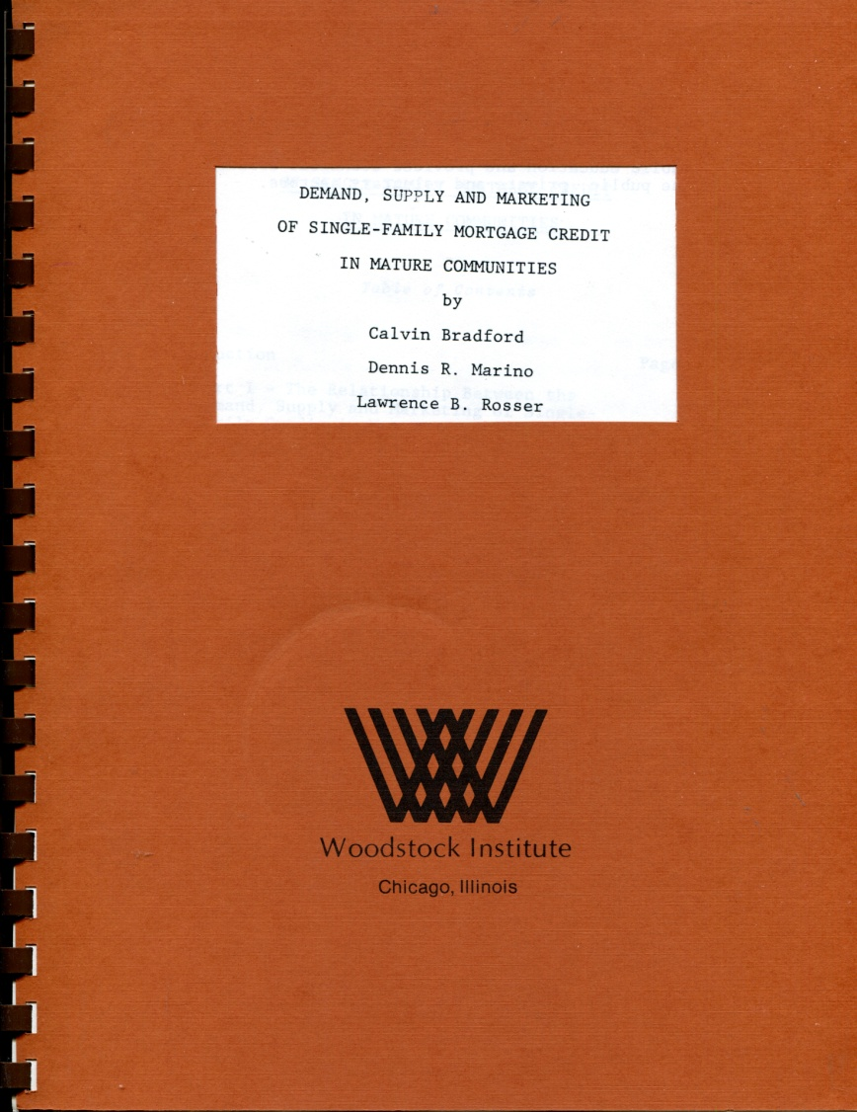
Where we began

Slide 6
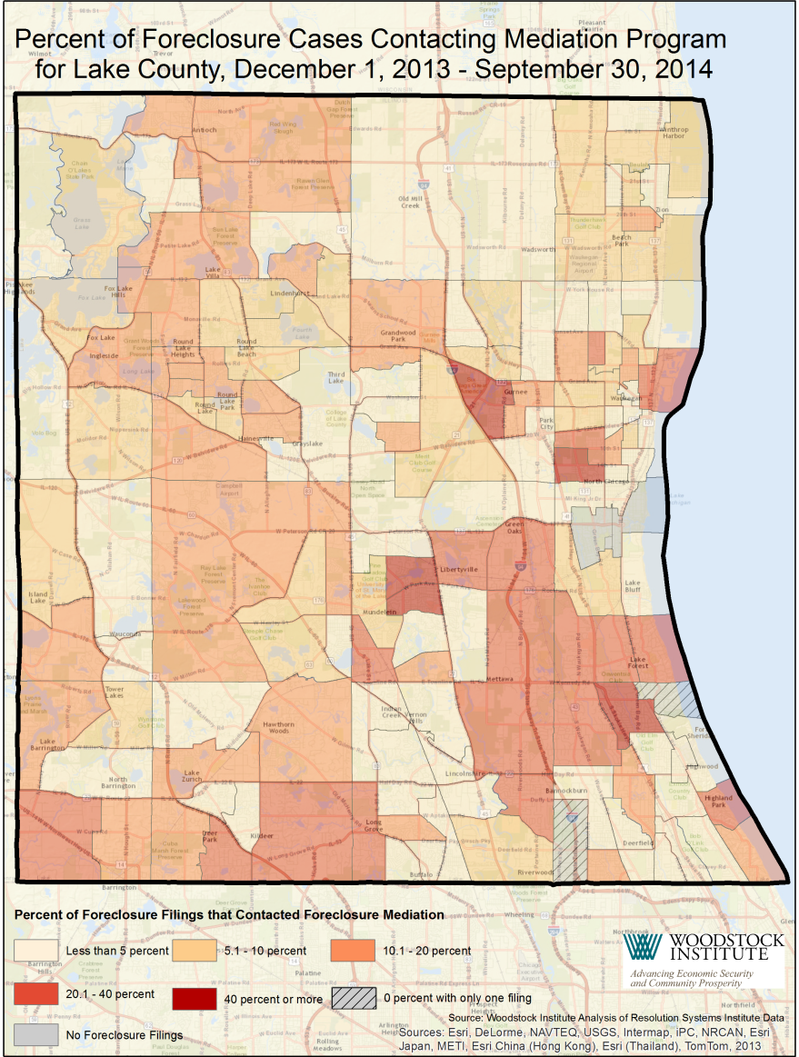
Technical assistance

Slide 7
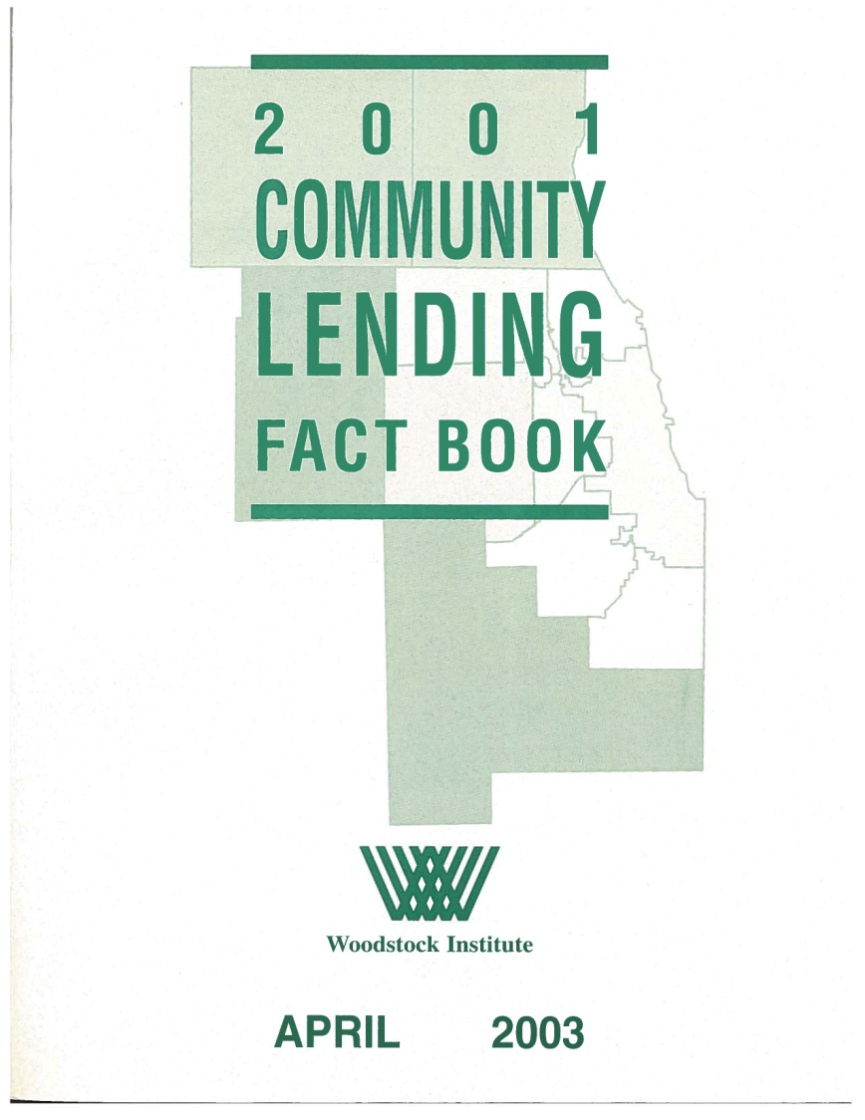
Community Lending Fact Book
Notes:
Community Lending Fact Book

Slide 8
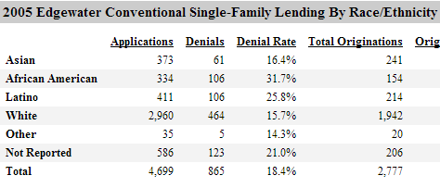
Online Community Lending Fact Book

Slide 9
Online Data Portal

Slide 10
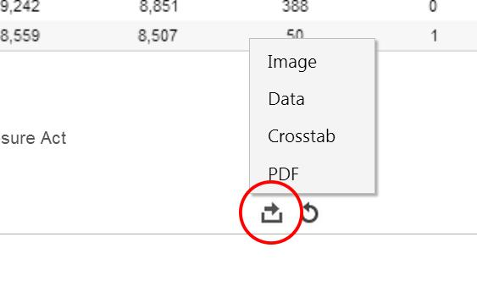
Online Data Portal

Slide 11
Online Mapping Tool

Slide 12
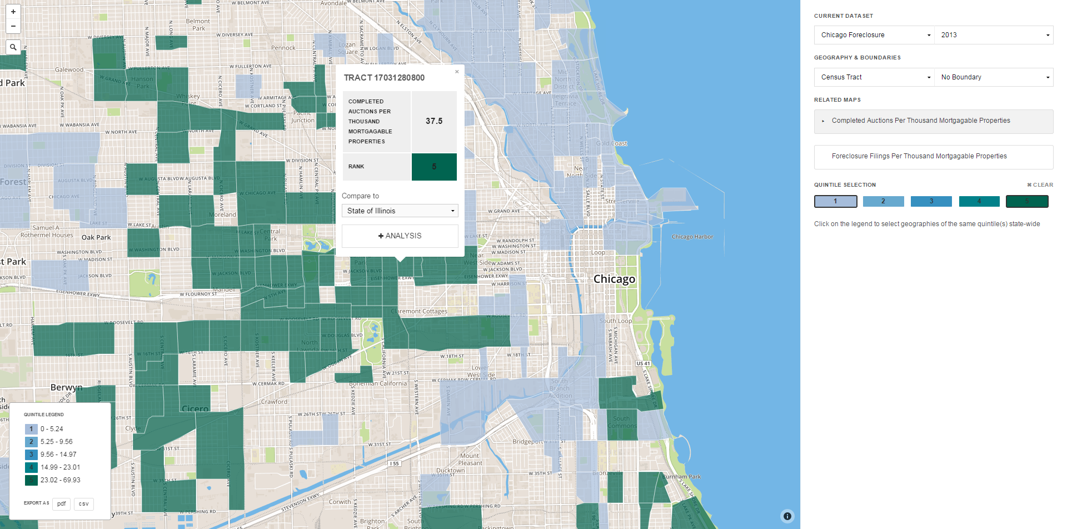
Online Mapping Tool

Slide 13
Data Compendium

Slide 14
Audiences we serve
More data savvy
Less data savvy
Compendium
Data Portal
Technical Assistance
Online mapping

Slide 15
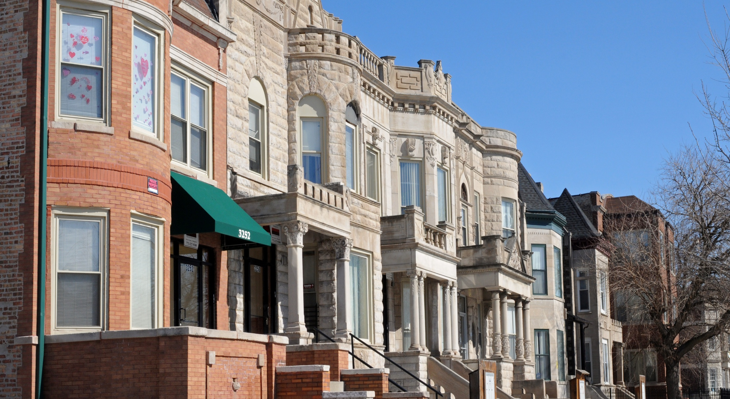
More accessible data = Stronger economic justice movement

Slide 16
From Fact Books to MapBox: The Evolution and Impact of Woodstock Institute’s Data Services
October 22, 2014
Katie Buitrago | Senior Policy and Communications Associate
Woodstock Institute | Chicago, Illinois
P 312.368.0310 | F 312.368.0316
kbuitrago@woodstockinst.org
@woodstockinst
WoodstockInstitute

