Slide 1
PDF Data extraction made simple
(and Open Source)

Slide 2
Textricator
https://textricator.mfj.io
https://github.com/measuresforjustice/textricator
https://github.com/measuresforjustice/textricator-web
100% Kotlin (Java-interoperable)
AGPLv3
Expression Parser
https://github.com/measuresforjustice/expr
Apache 2.0

Slide 3
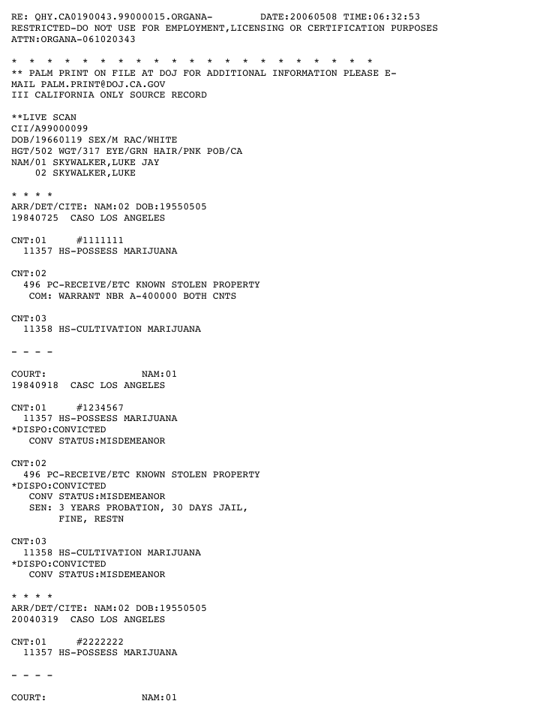
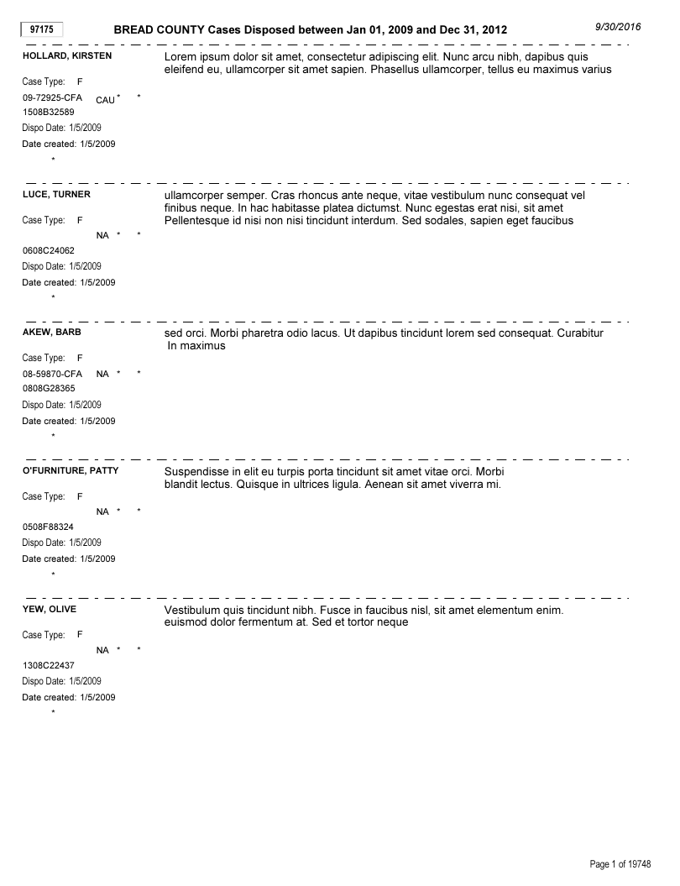
Examples of documents Textricator can parse

Slide 4
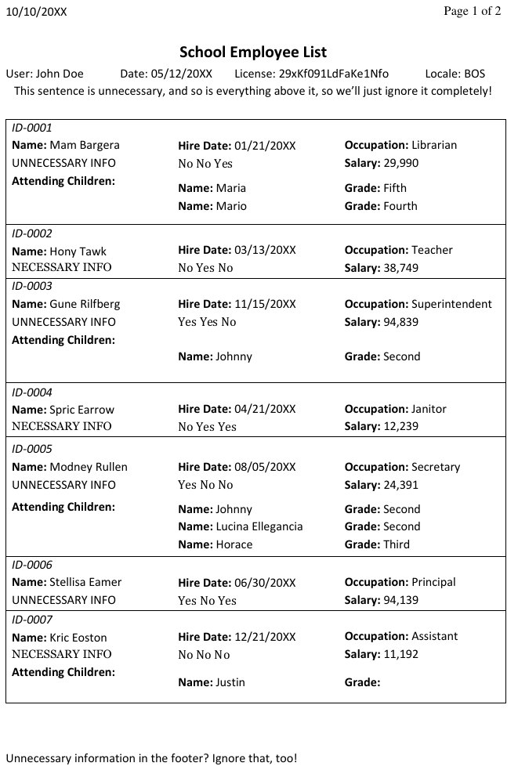
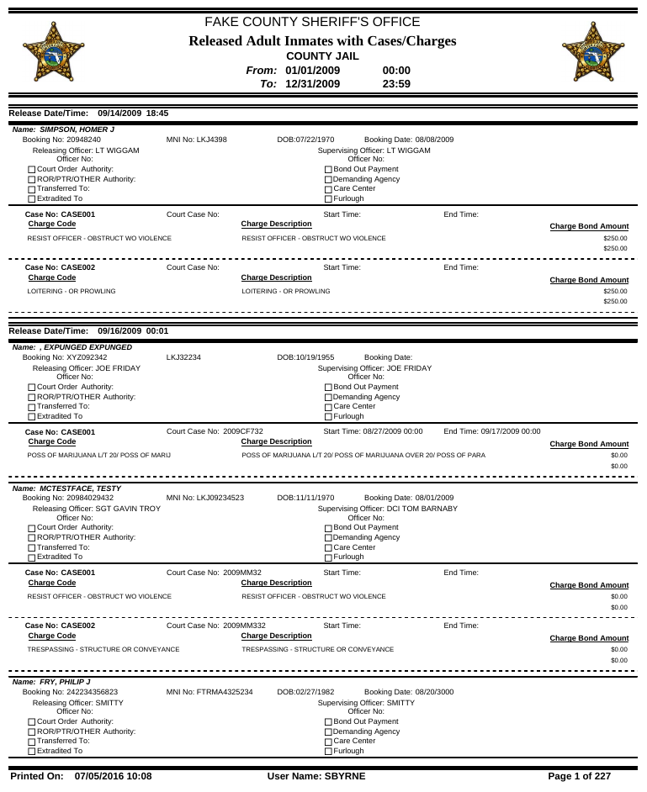

Slide 5
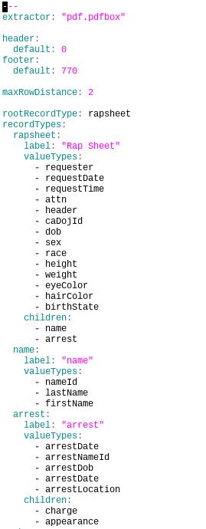
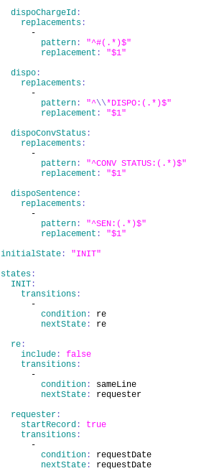
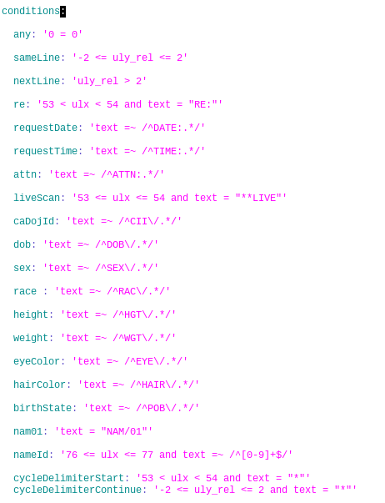
Parser configuration
YaML
Contains
extractor config
record definitions
type definitions
FSM state definitions
FSM transition conditions

Slide 6
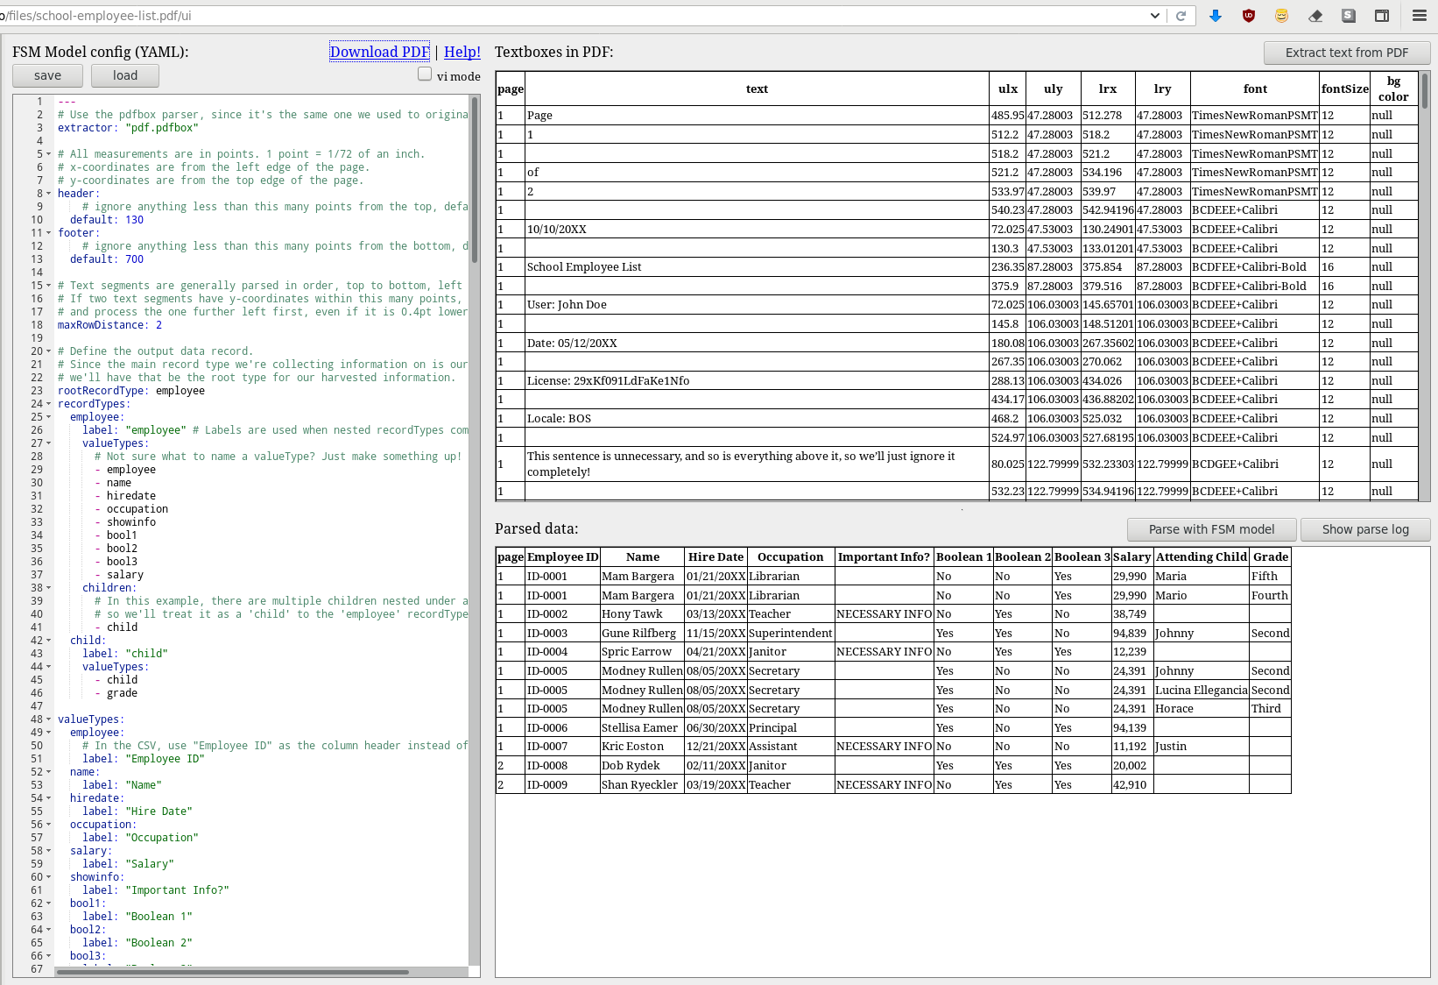
Web GUI https://textricator-demo.mfj.io

Slide 7
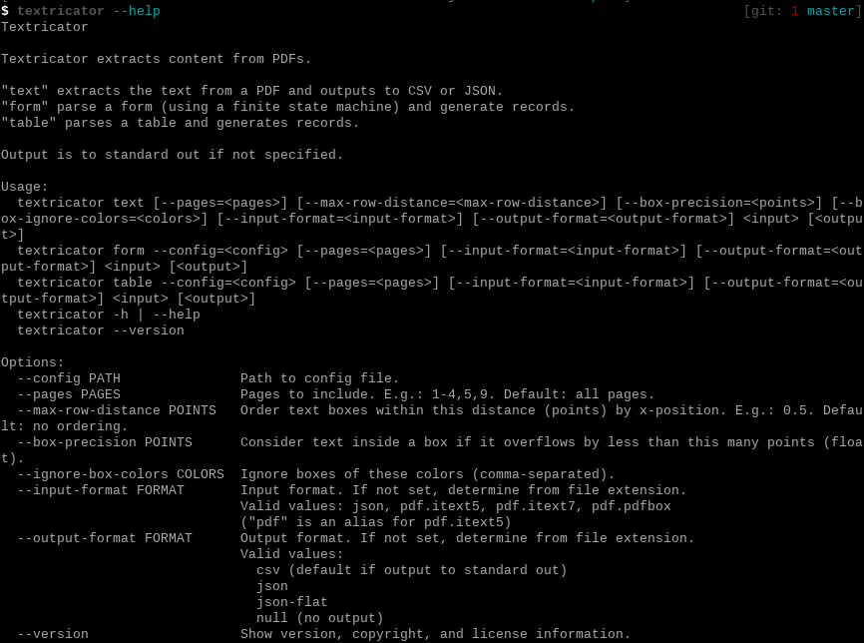
Command Line Interface

Slide 8
Command Line Interface

Slide 9
Advanced Features
Match on color/background color
Regex matching
Page number matching
First and last page are often different
Output data match/replace
Variables
Complex data types
JSON output

Slide 10
Possible Future Features
GUI to build the parser configuration
doc / docx parsing
We have received Word file reports. We converted them to PDF and then parsed them with Textricator.
spreadsheet parsing
We have received Excel file reports (for which we wrote report-specific parsers) that could probably be easily parsed by the Textricator FSM if column/row were mapped to ulx/uly.

