Slide 1
Introduction to Git & GitHub
April 11, 2024
Rob Pitingolo & Erika Tyagi (Urban Institute)
A Practical Introduction to Version Control for NNIP Partners

Slide 2
Objectives for Today
Understand the benefits of Git & GitHub
Introduce key terms and simple workflows to use these tools
Learn best practices and additional features
Come away with next steps to start adopting these tools

Slide 3
What are Git & GitHub?
Tools to enable version control and collaboration.
Manage and track changes to files over time.
Share, discuss, edit, and review code more easily.
Know who made what changes, why, and when.
Revert changes to previous versions.
Git is a software like Word’s “tracked changes.”
GitHub is a collaboration tool like Dropbox or Google Drive.

Slide 4
Why are Git & GitHub useful?
Internal management
Code is safely stored in one central location
All staff have access to the same version of code
External collaboration
Share code developed for your city for use in others
Work together on cross-city projects
Reproducibility over time
Efficiently produce results on a schedule

Slide 5
Why are Git & GitHub useful?
Git & GitHub help avoid this →

Slide 6
How do NNIP partners use Git & GitHub?
CI:Now (San Antonio)
Share code and toolkits from data projects
Reprioritize tasks as developer requests and needs of project evolve over time
MAPC (Boston)
Support decision-making transparency
Develop web applications
BNIA (Baltimore)
Democratize data by sharing resources with other civic technologists

Slide 7
Key Terms & Concepts
Git lets you take a snapshot (or commit) of files in a folder (or repository or repo).
You decide when to take a snapshot and which files to include.
GitHub lets you back up your work in a remote place.
To get work on your local computer for the first time, you would clone a repo.
To send updates to GitHub, you would push changes.
To download updates from GitHub, you would pull changes.

Slide 8
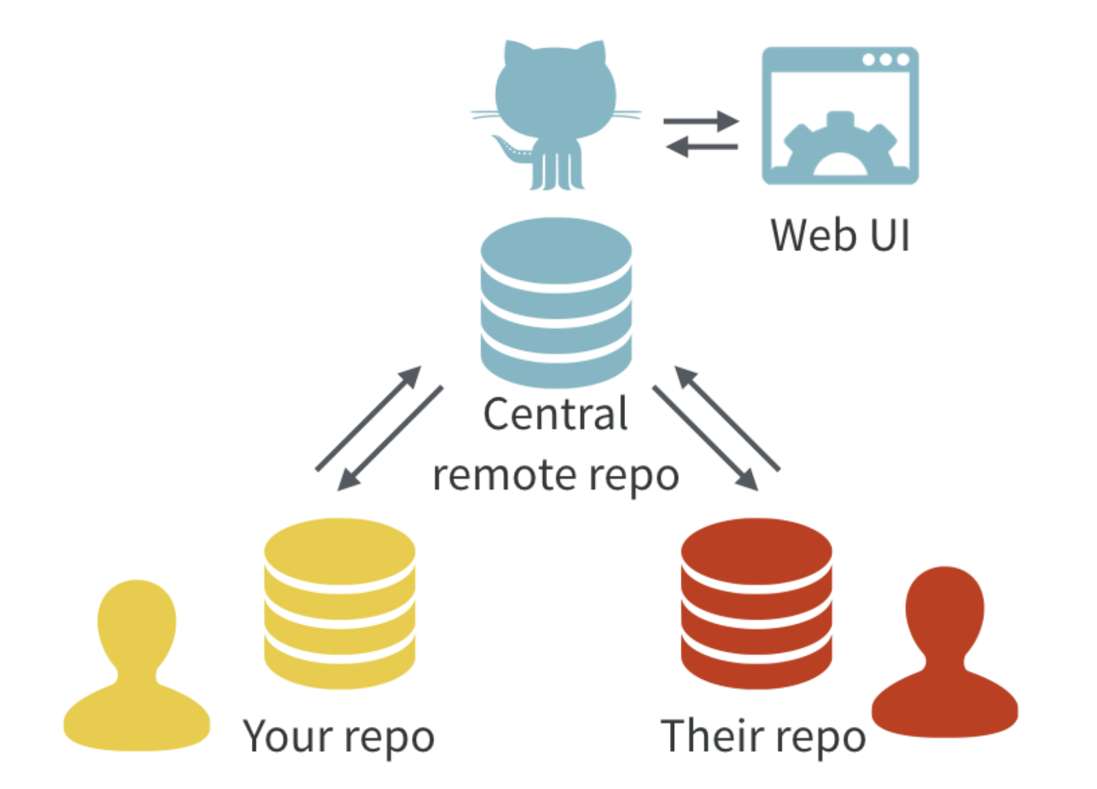
Key Terms & Concepts
All contributors have a local copy of the Git repository. These stay in sync through a central remote repository hosted on GitHub.
Image Credit: Excuse me, do you have a moment to talk about version control? (Jenny Bryan)

Slide 9
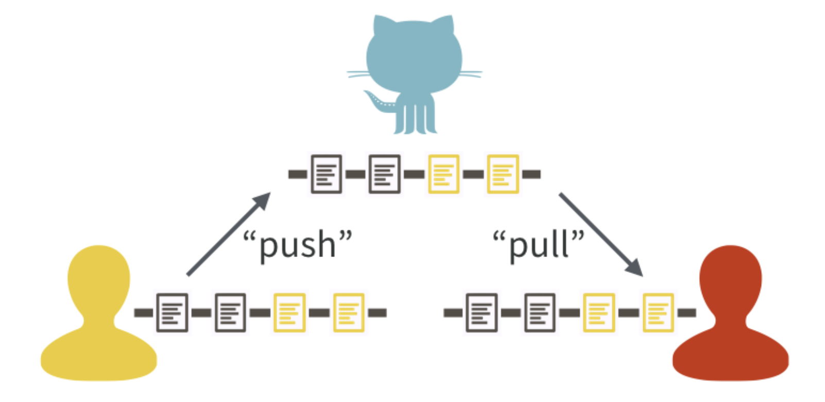
Key Terms & Concepts
One contributor makes commits and pushes their updates to the central version on GitHub. The other contributor pulls from GitHub to stay up-to-date.
Image Credit: Excuse me, do you have a moment to talk about version control? (Jenny Bryan)

Slide 10
Initial Setup
Create a GitHub account.
Install Git and GitHub Desktop on your computer.
Configure Git and GitHub.
Configure your GitHub username and email address.
Set up a personal access token (PAT).
See GitHub’s Getting Started guide for detailed instructions.

Slide 11
Basic Workflow
Initialize a repository (create or clone), edit files, tell Git which files to track (add), take a snapshot of those files (commit), send those snapshots to GitHub (push), and repeat.

Slide 12
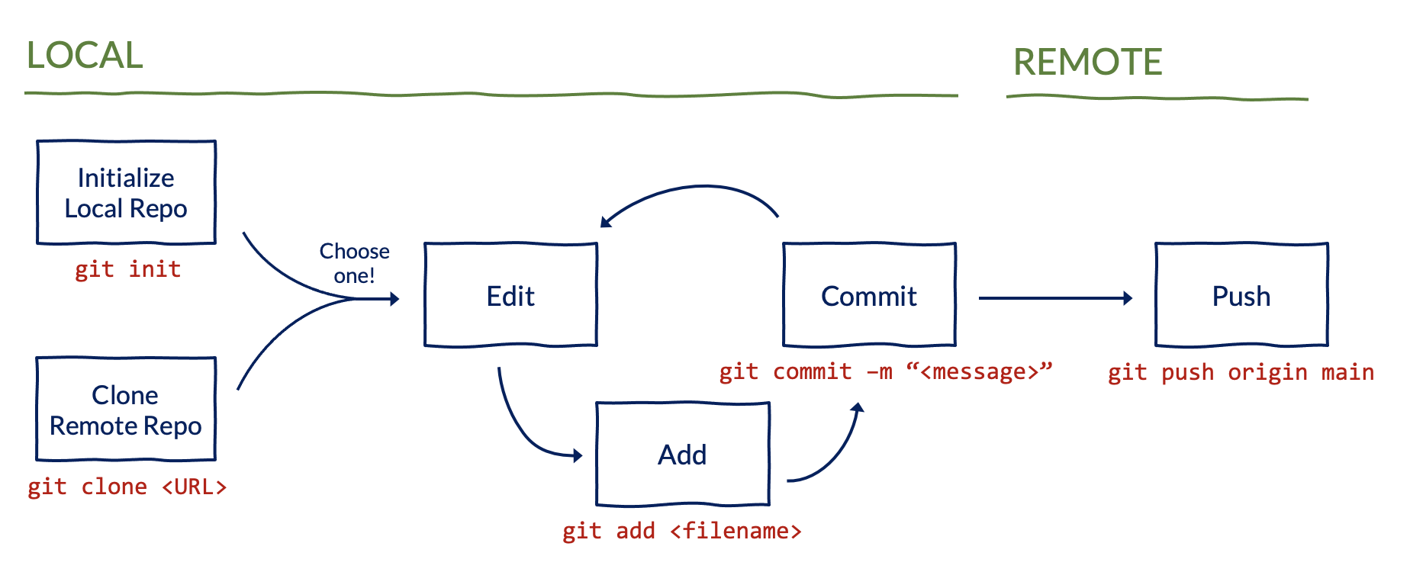
Basic Workflow
If starting from scratch, you will need to create a new repository. If not, you can clone an existing repository.

Slide 13
Demo: Part 1
Create a new repository
Clone an existing repository
Edit a file on your local computer
Add and commit the changes
Push the updates to GitHub

Slide 14
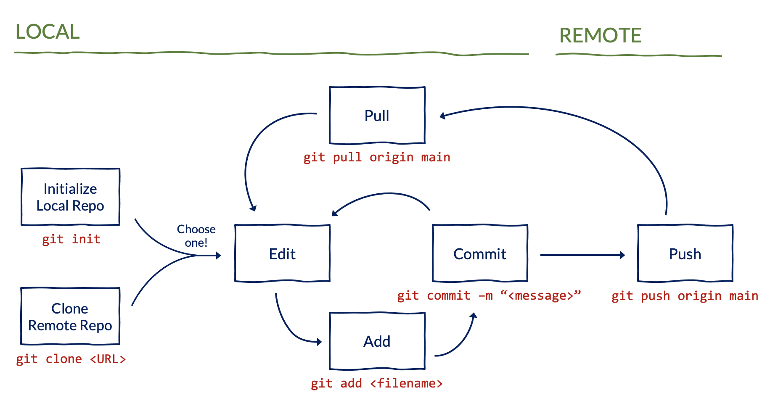
Collaborative Workflow
A collaborative workflow includes an extra step to pull updates from GitHub.

Slide 15
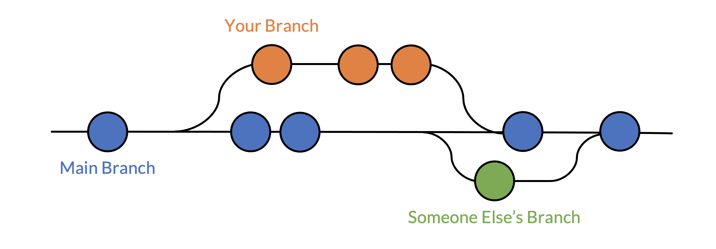
More Terms & Concepts
Branches let you and your collaborators update existing code or add new code without fear of overwriting each others’ files.
All commits live on a branch. The default branch in a repository is called the main branch.
Pull requests let you merge changes from one branch into another.
GitHub provides a helpful interface to review pull requests.

Slide 16
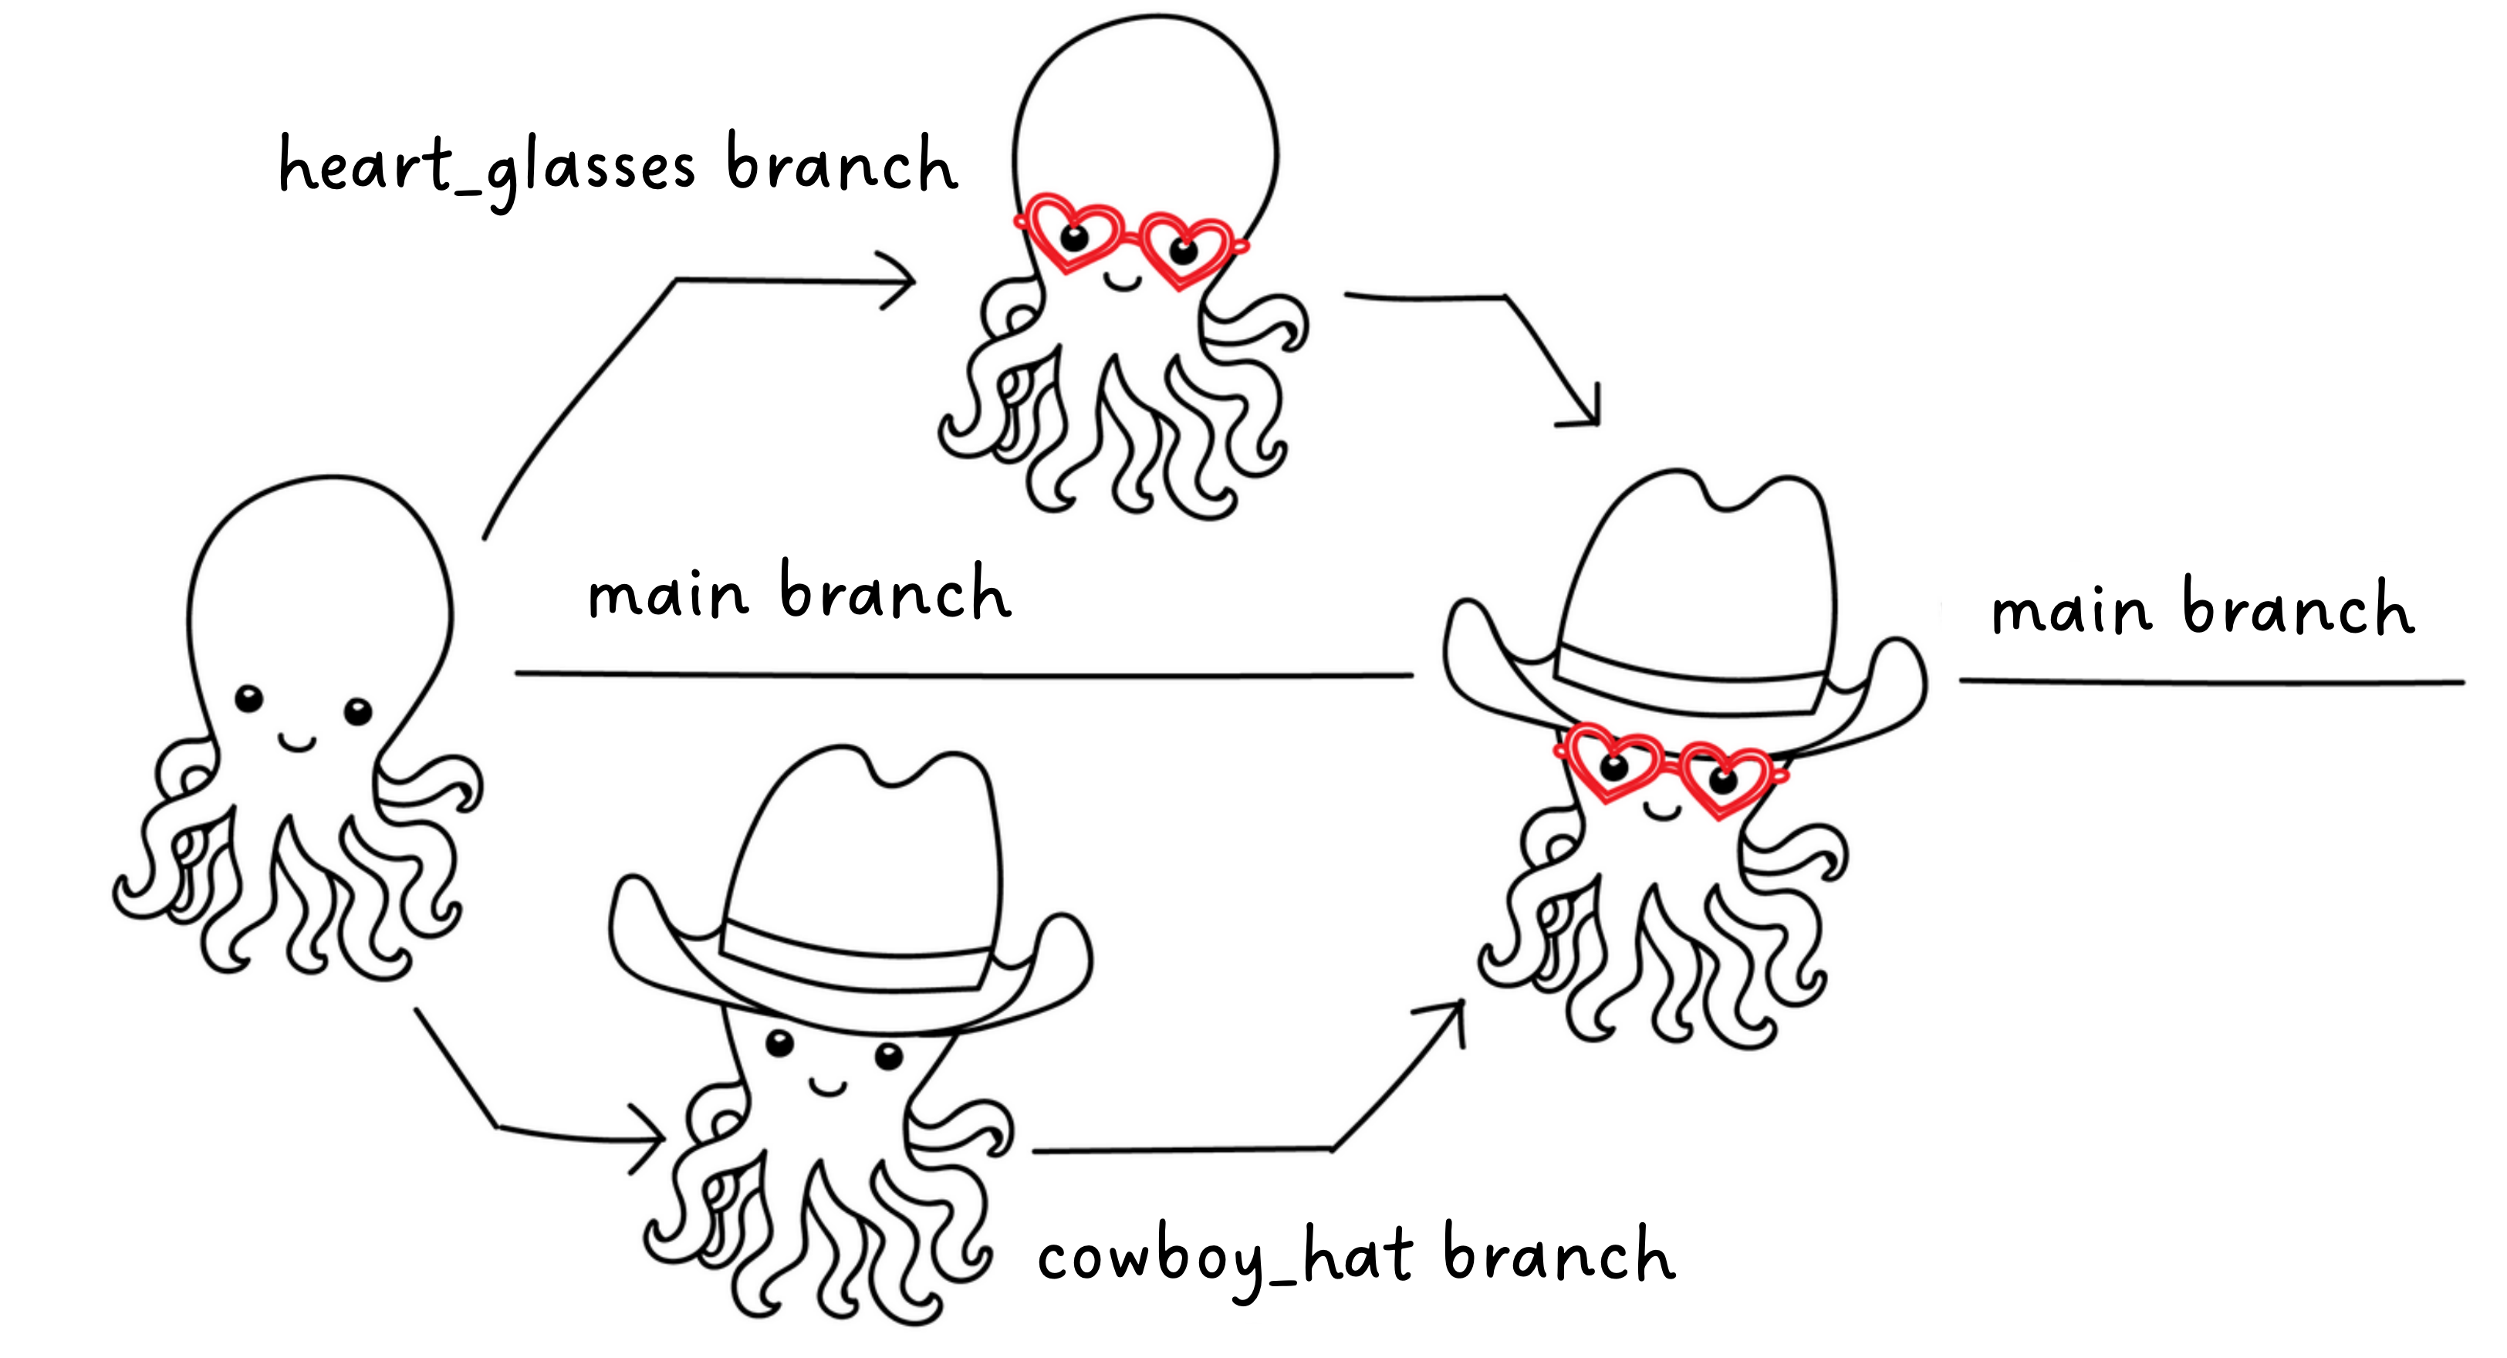
More Terms & Concepts
Branches let multiple collaborators make updates at the same time to later merge into the main branch.
Image Credit: An Introduction to Git, GitHub, and Atom (Steven J. Clipman)

Slide 17
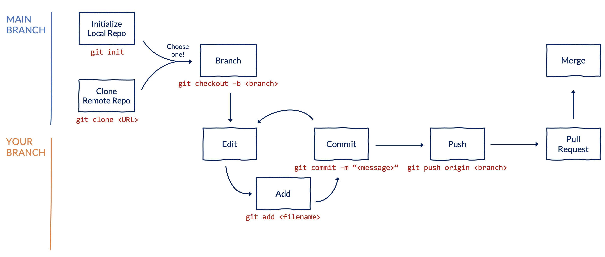
Collaborative Workflow
A more robust collaborative workflow involves using branches and pull requests.

Slide 18
Demo: Part 2
Pull updates from GitHub to your local computer
Create a new branch
Edit a file on your local computer
Add, commit, and push the updates to GitHub
Open a pull request
Merge the pull request into the main branch

Slide 19
Key Commands
git clone <url>: “Copy this remote project to my local computer.”
git add <filename>: “Look at this file.”
git commit -m <message>: “Take a snapshot of the files I’ve added.”
git status: “Tell me what you’re looking at.”
git push: “Send my snapshots to GitHub so others can see them.”
git pull: “Replace my local version of this project with the remote version.”
git checkout –b <new_branch>: “Create a new branch and switch to it.”
git checkout <existing_branch>: “Switch to a different branch.”

Slide 20
Best Practices & Tips
Always follow your organization’s policies and avoid pushing potentially confidential information to GitHub.
In general, you should only track code on GitHub.
Consider whether a repository should be private or public.
Use README files to document your repositories.
Write descriptive commit messages to help your collaborators and future self.
Work with your collaborators to develop workflows to meet your needs.
Learn about other useful features from GitHub (e.g., manage projects, host websites, automate tasks, and much more).

Slide 21
Next Steps
These are some of our favorite resources to learn more:
GitHub’s Getting Started Guide
Happy Git and GitHub for the UseR
Getting Git Right
This is a great interactive exercise to practice what you learned today:
GitHub Skills – Introduction to GitHub
Erika and Rob will be around to answer questions until 2:30pm ET!

