Slide 1
Civic Technology

Slide 2
Civic Technology…?

Slide 3

Notes:
access and deliver public data and services

Slide 4

Notes:
engage with decision-makers and mobilize around issues we care about

Slide 5

Notes:
connect with one another to share ideas

Slide 6


Notes:
visualize the present and imagine the future

Slide 7
?
Notes:
visualize the present and imagine the future

Slide 8
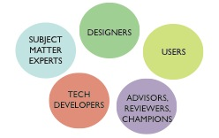
Notes:
visualize the present and imagine the future

Slide 9
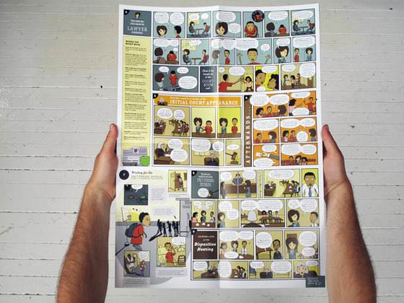
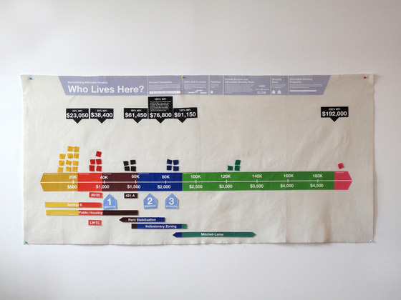
Center for Urban Pedagogy
Notes:
visualize the present and imagine the future

Slide 10
who benefits?
Notes:
visualize the present and imagine the future

Slide 11
a civic tech incubator!
Launch!
Phase 1:
prototypes
Phase 2:
betas
HCD Workshop
Demo Day!
January
May
October

Slide 12
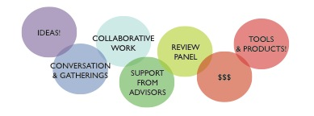
a civic tech incubator!
Notes:
So we wanted to invite you all to lunch to talk about civic tech, share some examples and to start ideas percolating, and also because we’d love your feedback and input. So first, just your gut level reactions, are we crazy?
(end by 12:15/12:20)

Slide 13
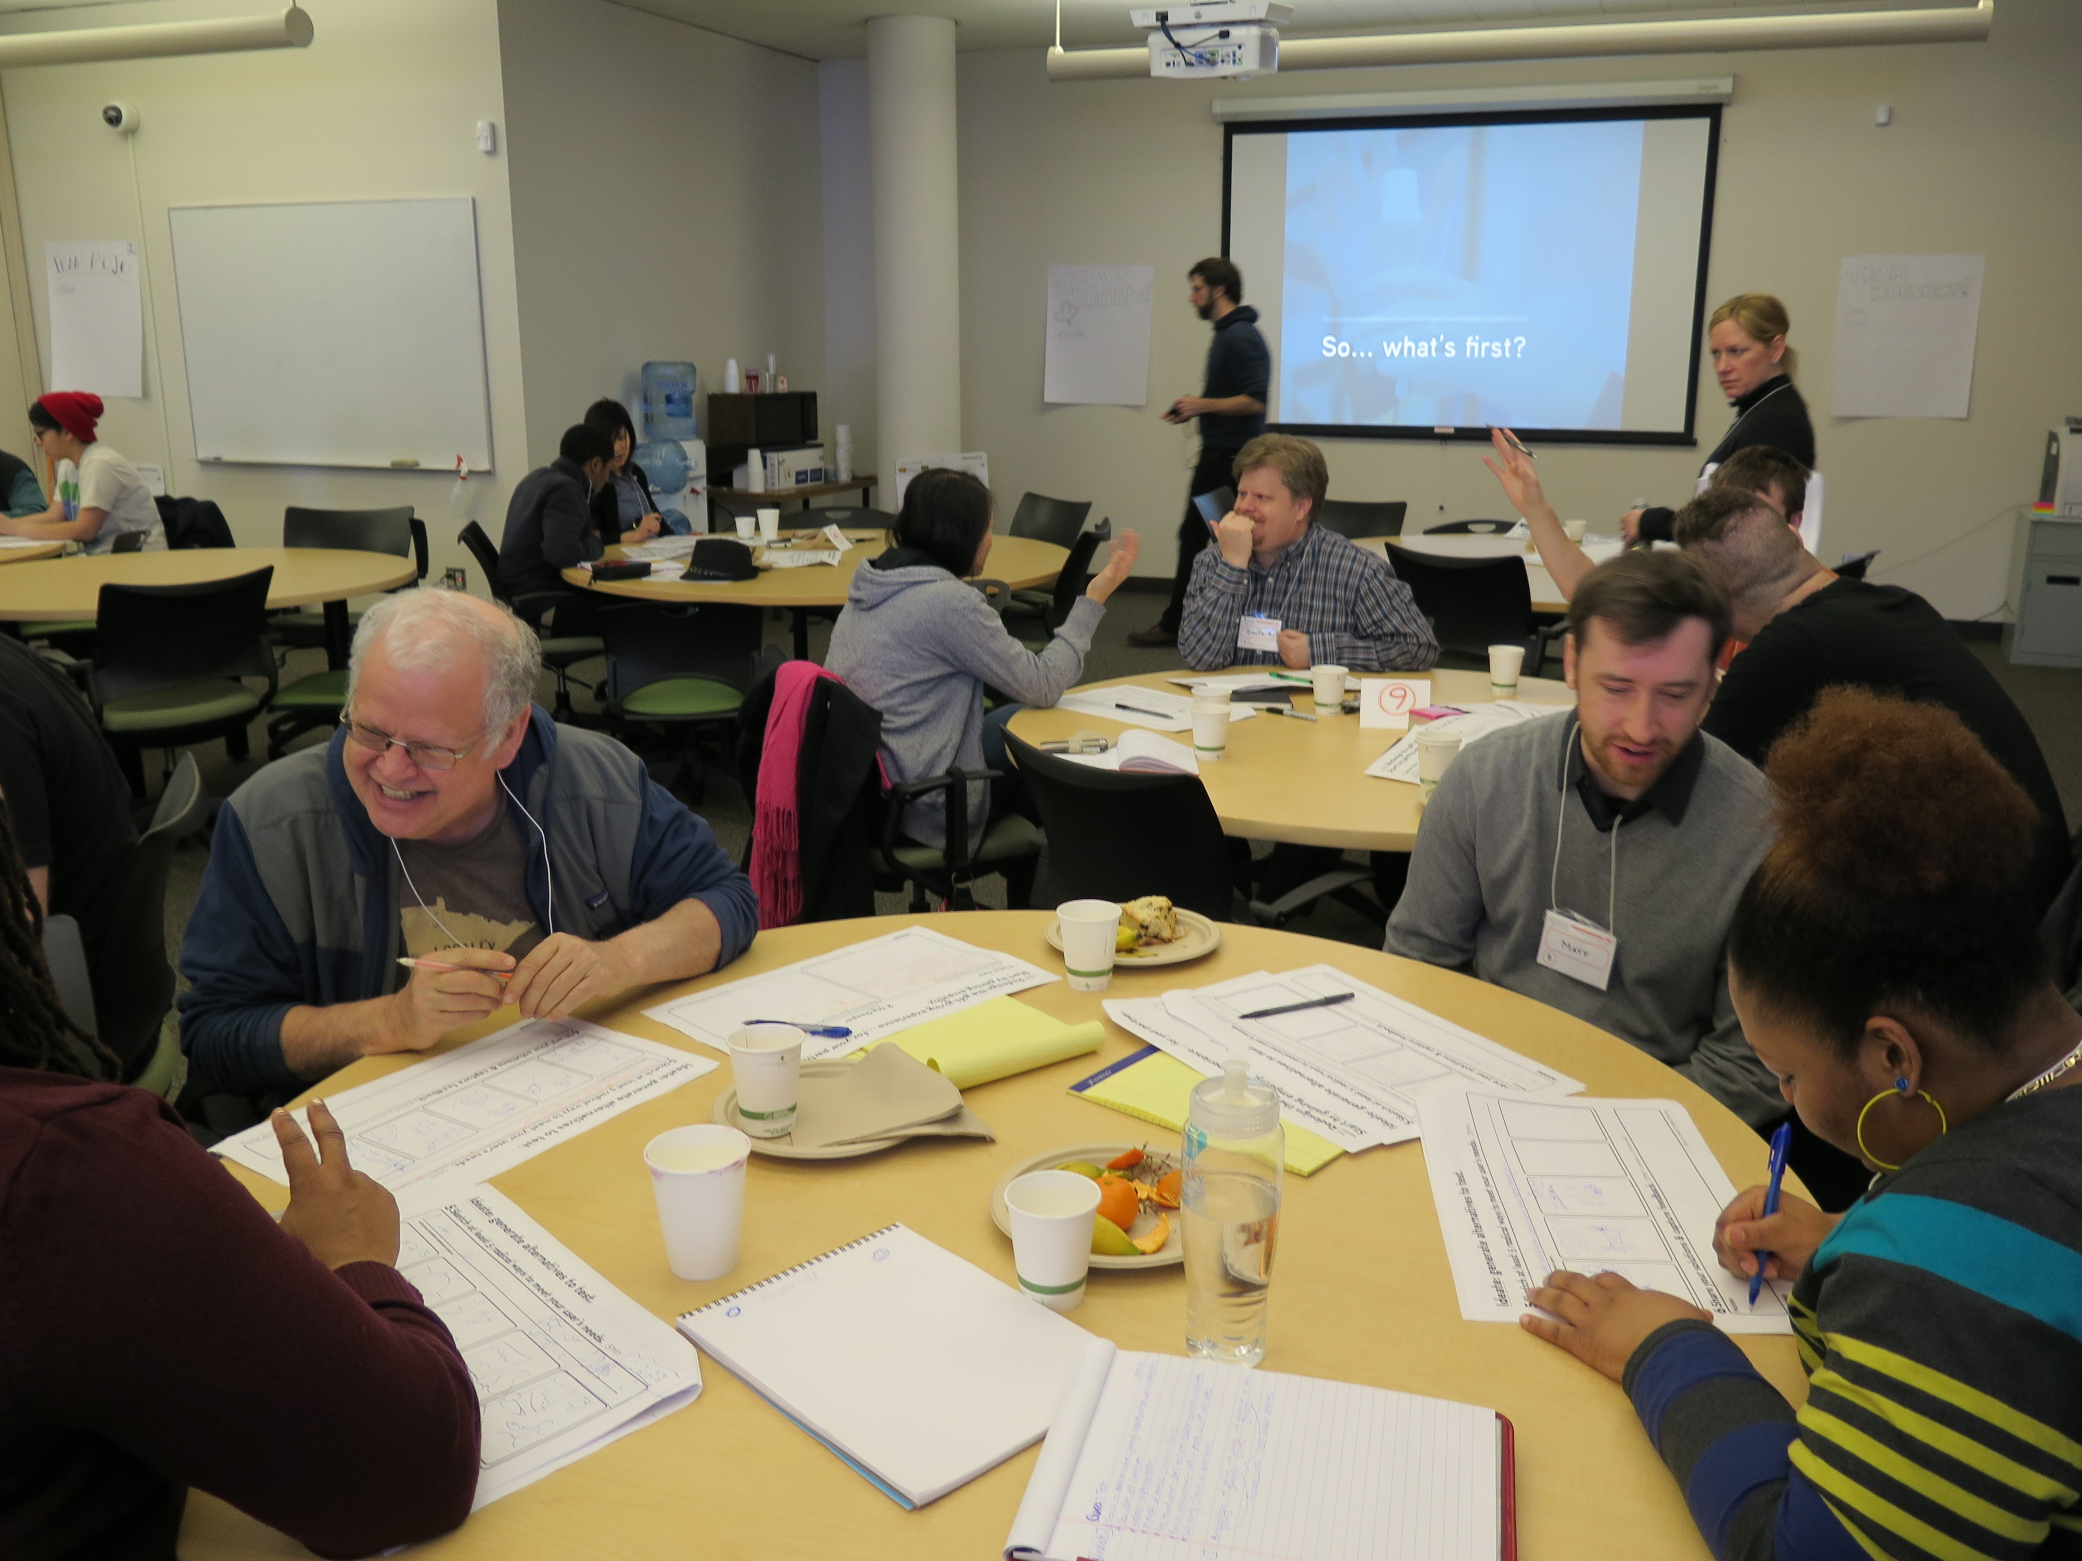

Slide 14
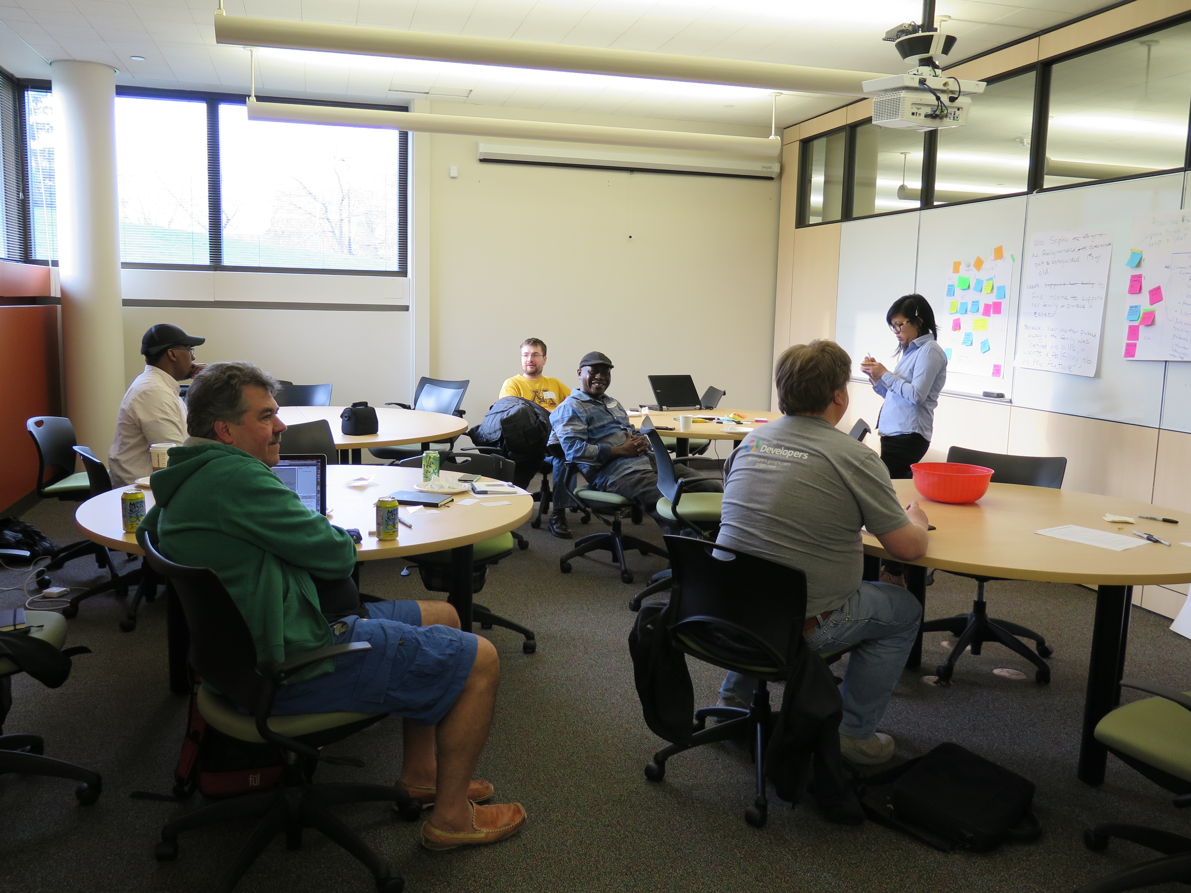
Notes:
Digital literacy and access efforts, Digital Empowerment Academy and CTEP.
So… does civic technology offer an opportunity to create a more equitable future for our cities and our region?
Too soon to tell, but potential. Several examples

Slide 15
Center for Earth, Energy and Democracy
Notes:
Unique – also layer in demographic info about vulnerable pops
Important to look at the way CEED is developing this tool.
Tool for advocacy; gvmt also interested

Slide 16
Tuloko
Notes:
New social enterprises

Slide 17
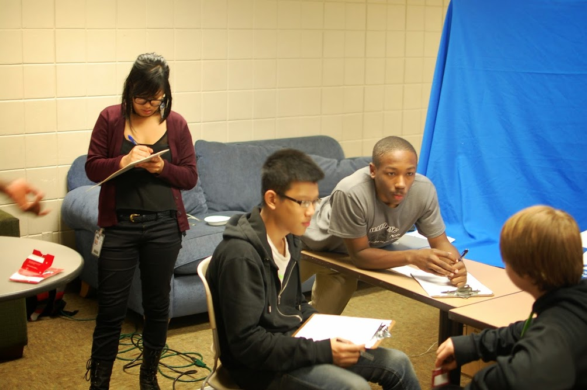
Teen Tech Crew
Notes:
TTC interviewed lots of peers… gap in info and how it’s getting to young people

Slide 18
Data Innovation & Advancement Lab
Notes:
Another project by David Kang and collabs at the Data Innov & Adv Lab
Improve Asian Americans with LEP’s access to public health information.
Lack of parity in design and delivery… collabs with CBO and PH agencies

Slide 19
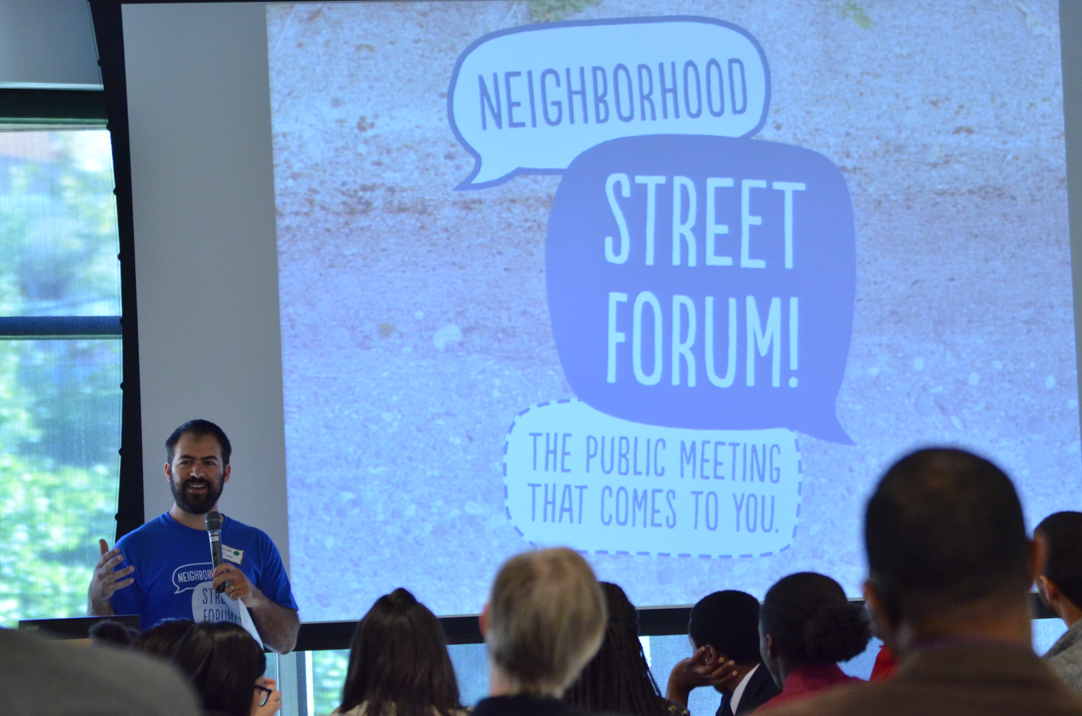

Slide 20

www.cura-tech.org

