Slide 1
Tactical Absurdity for Data Intermediaries
Bob Gradeck
July, 2018

Slide 2
What is tactical absurdity?
Intentionally incorporating dumb and/or ridiculous things in your professional toolkit to help you manage meetings, encourage participation, and make presentations and other products more-engaging.

Slide 3
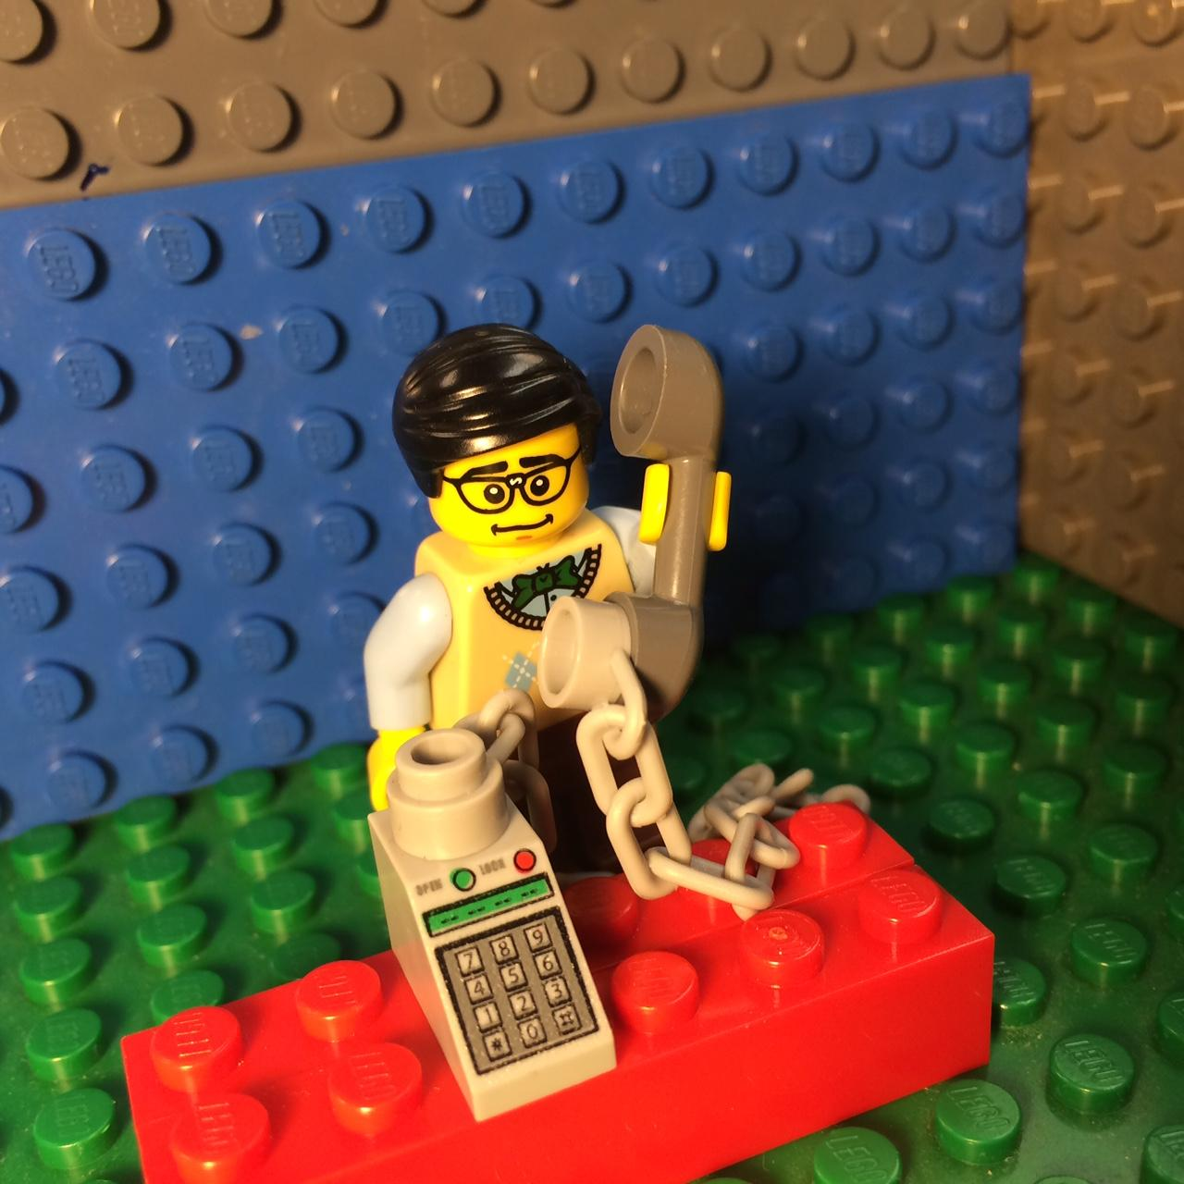
A note about privilege
I can get away with things that not everyone can.
If you are in a position to encourage someone to try something absurd, do so.
Support them if and when they fail.

Slide 4
Tactical Absurdity in Meetings and Events

Slide 5
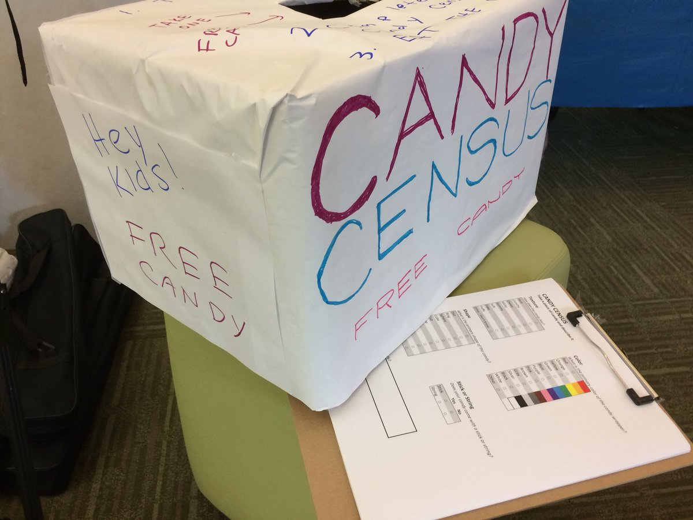
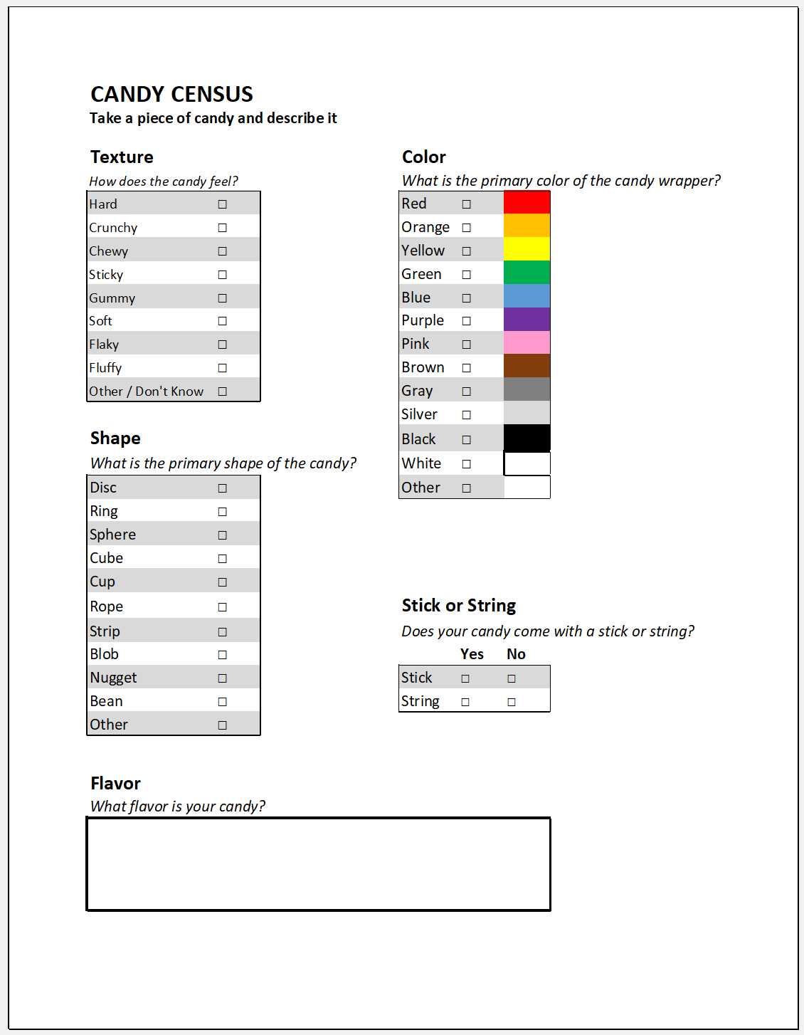
Absurd activities encourage participation in events

Slide 6
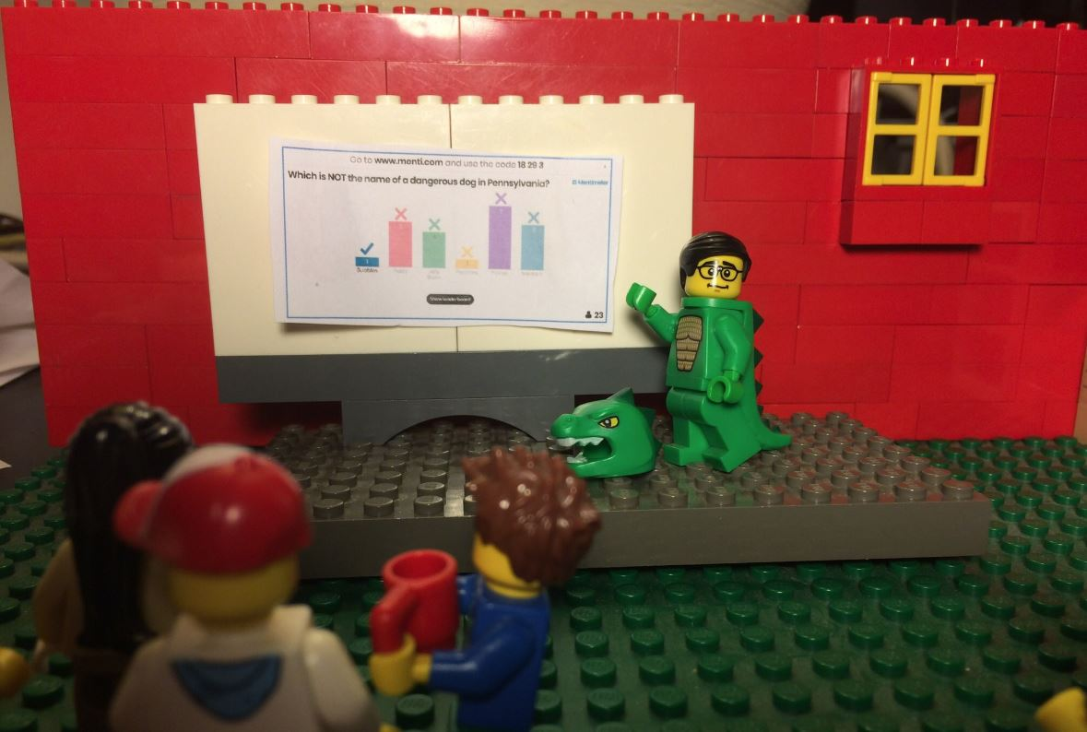
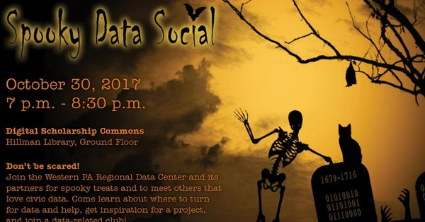
Absurd events are great ways to engage students

Slide 7
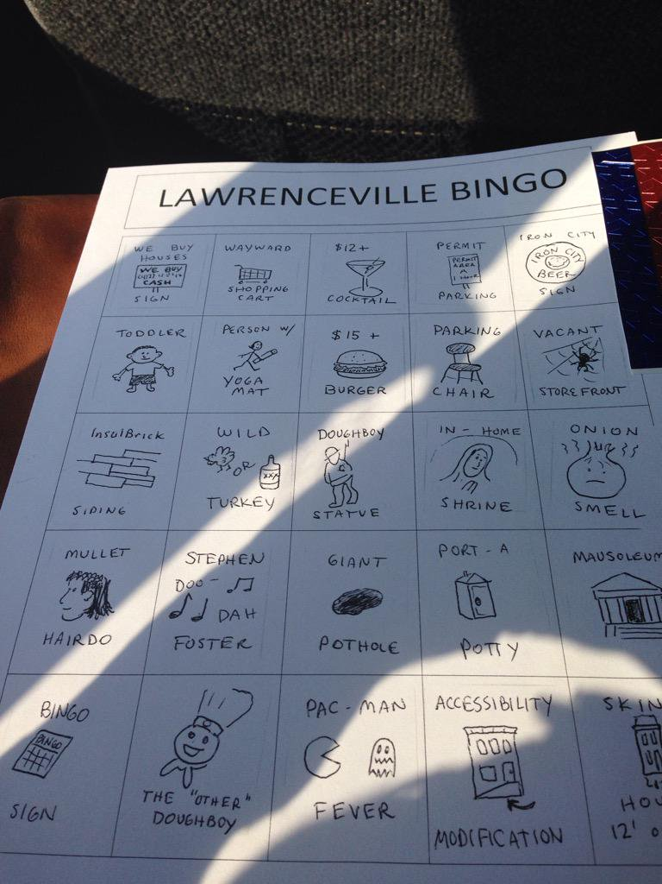
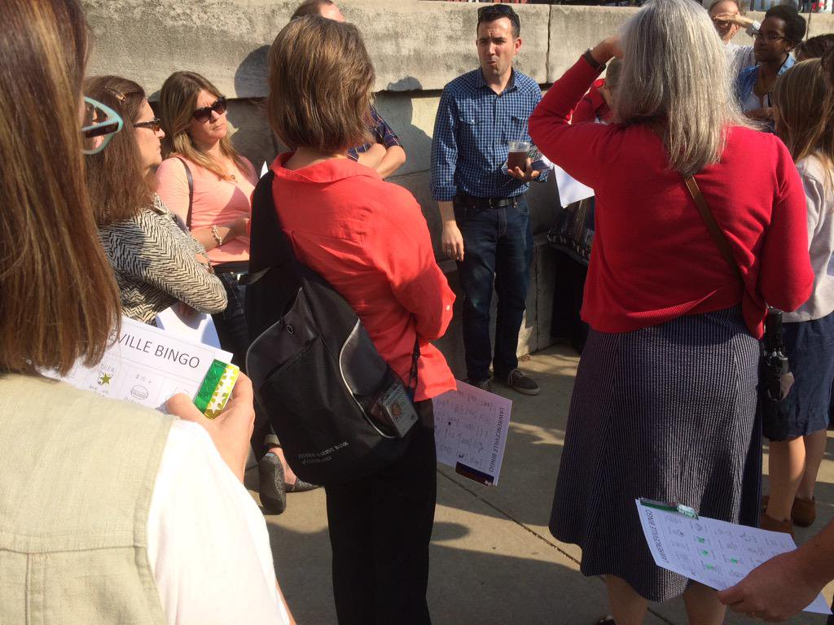
Incorporate games into your events to make them even more fun!

Slide 8
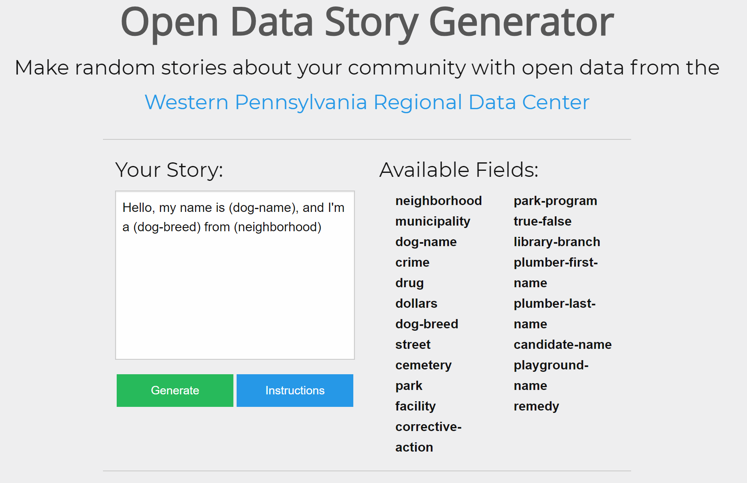
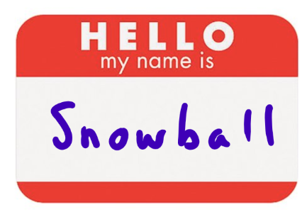
Make name tags absurd to break-down barriers
Notes:
We used a tool we built to generate people’s name tags at an event. The tool automatically assigned people names from the County’s dog license database - Some people can be shy and a back-story on the name can be a conversation starter.

Slide 9
Trivial icebreaker questions are better than serious ones...
Ask this...
What superpower would you like to have, and why?
What was your weirdest job?
Who is your favorite mascot?
If you could be an animal, which would it be, and why?
Not this
What is your passion in life?
What do you do for a living?
What is your favorite vacation spot?
What’s your favorite neighborhood indicator?

Slide 10
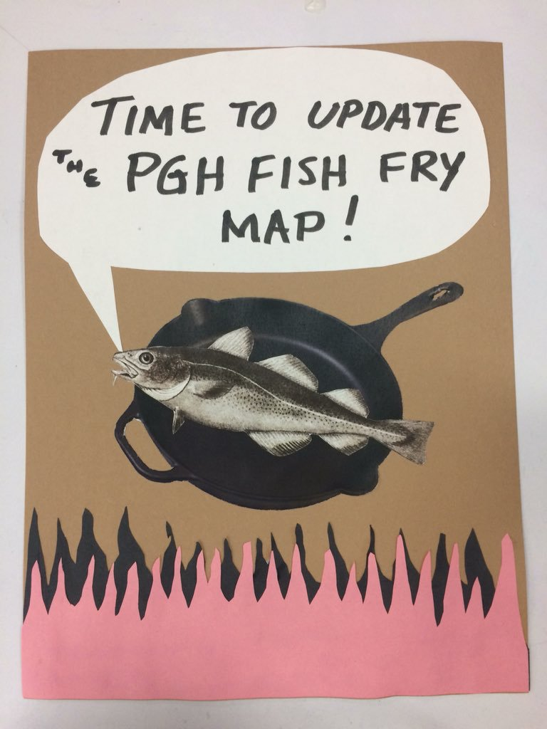
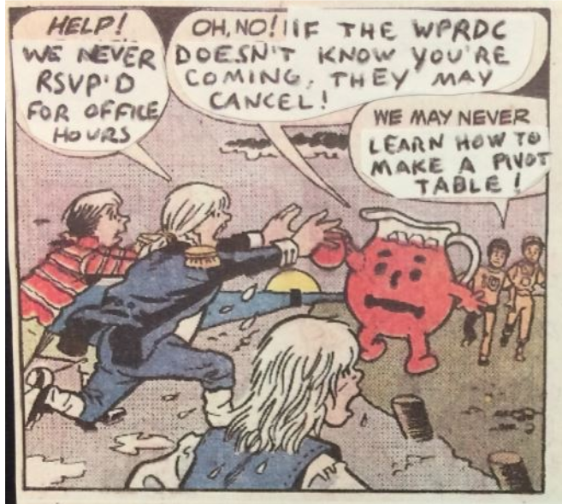
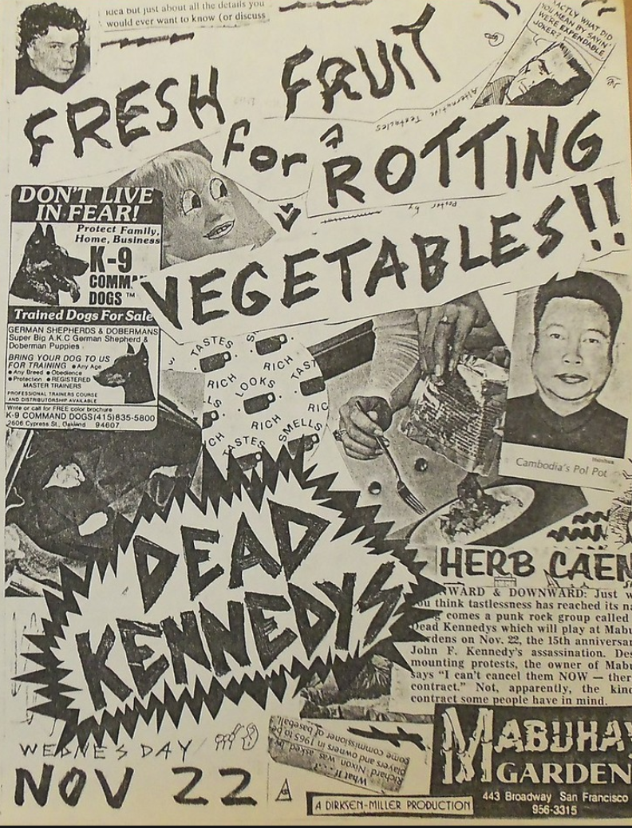
Hand-made flyers are great ways to promote events

Slide 11
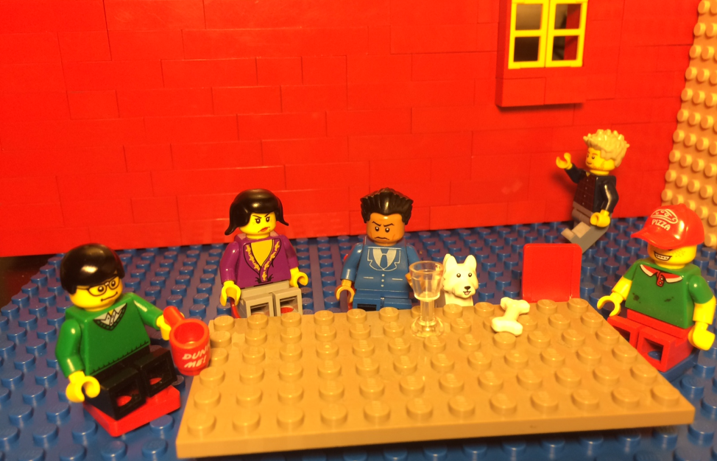
Introduce absurdity in meetings to refocus conversations

Slide 12
We need a dashboard to track gentrification in our neighborhoods.

Slide 13
So far,
So good...

Slide 14
We could update housing cost and demographic data each day!

Slide 15
Let’s use a speedometer to show how the community is changing. Like on a car dashboard!

Slide 16
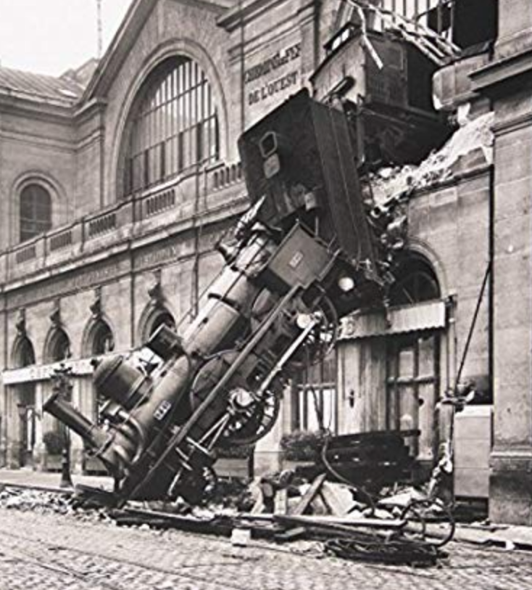

Slide 18
Once I hit a button on my car dashboard and all of a sudden, a Lionel Richie song started to play on the radio.

Slide 19
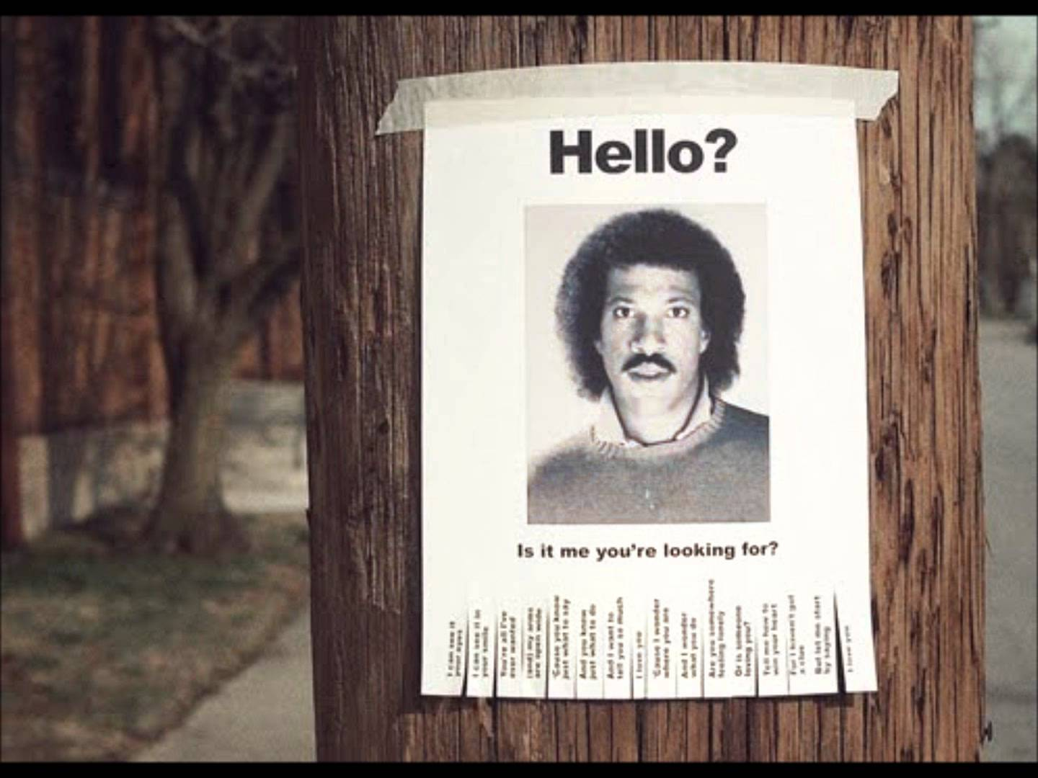
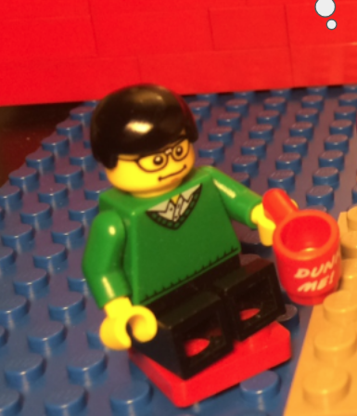
The next week at my bus stop, I saw a flyer with his picture on it that said “Hello, is it me you’re looking for?”
There were little tear-off tabs at the bottom with a phone number on them. I wish I had called the number.

Slide 20
...
...
...

Slide 21
How might we use data about housing market conditions to inform anti-displacement initiatives?

Slide 22
Tactical Absurdity in Promotion and Communication

Slide 23
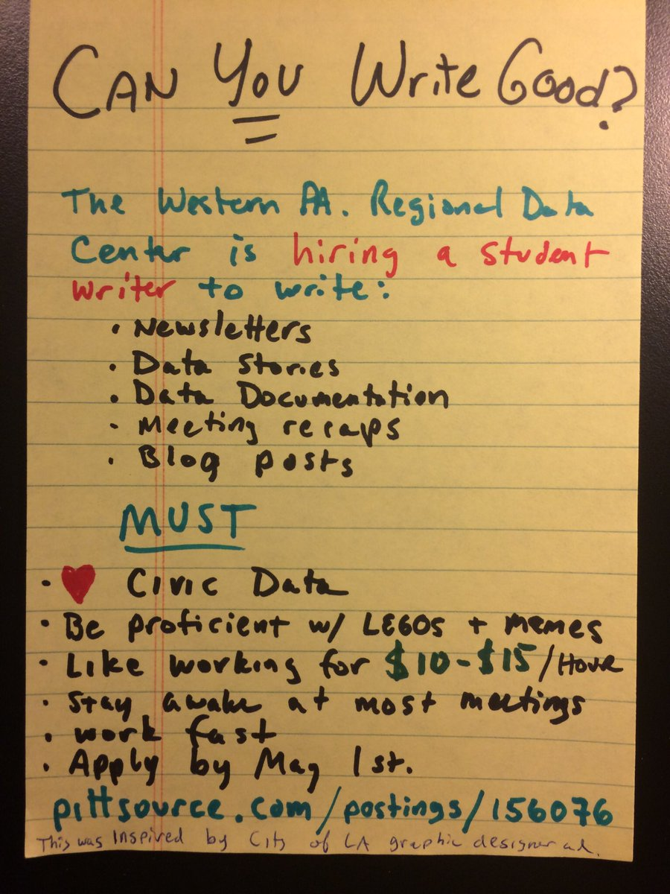
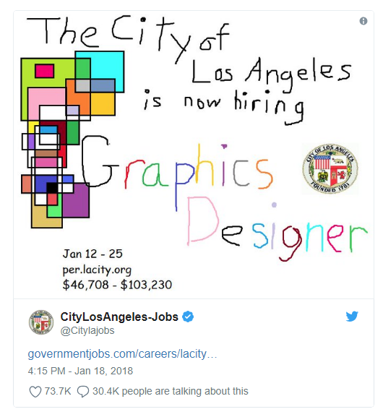
Use tactically bad design to attract good job candidates

Slide 24
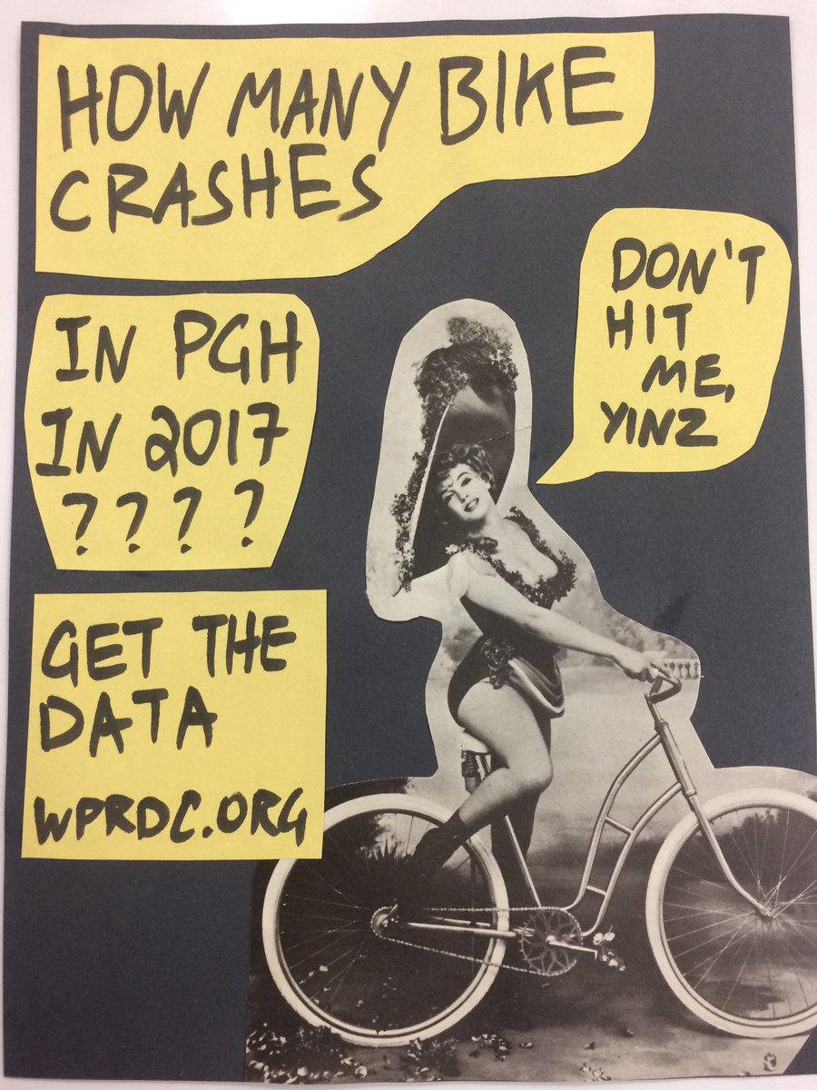
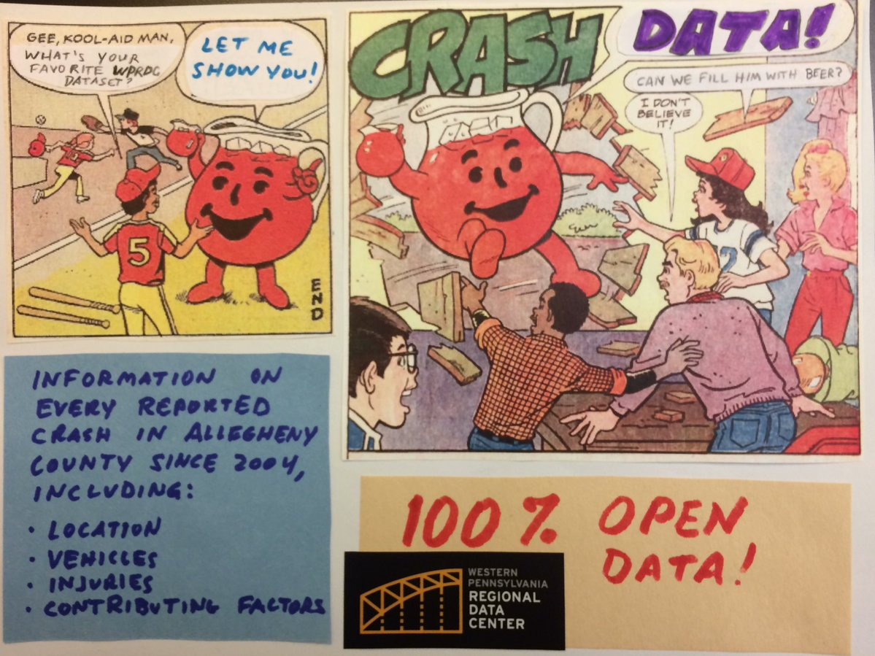
Use flyers to promote data and tools

Slide 25
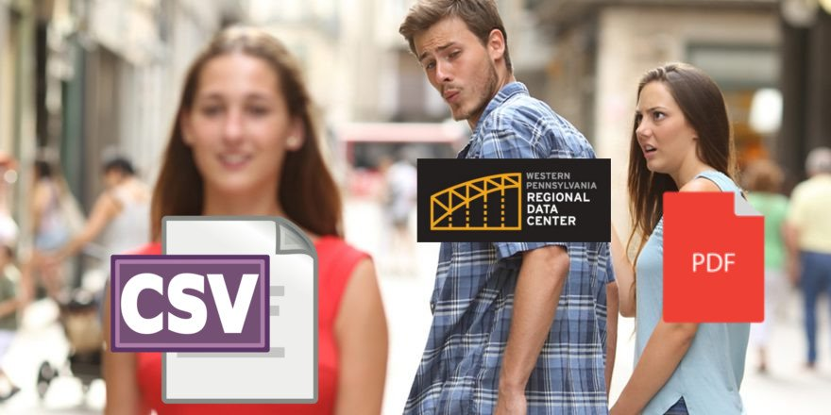
Experiment with memes!

Slide 26
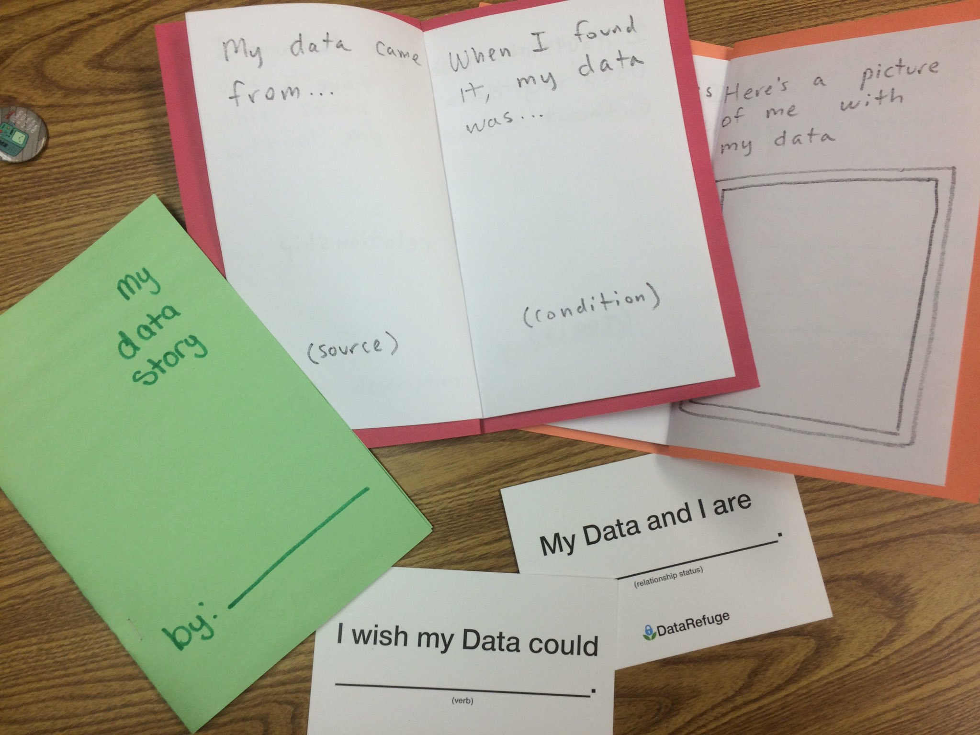
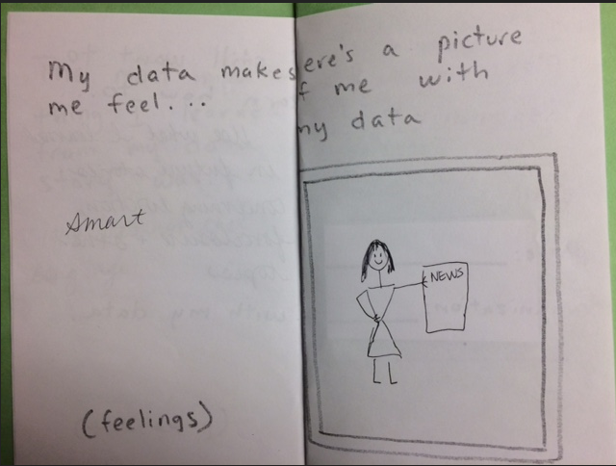
We’re also capturing users’ data stories through our storybook. The more absurd, the better!

Slide 27
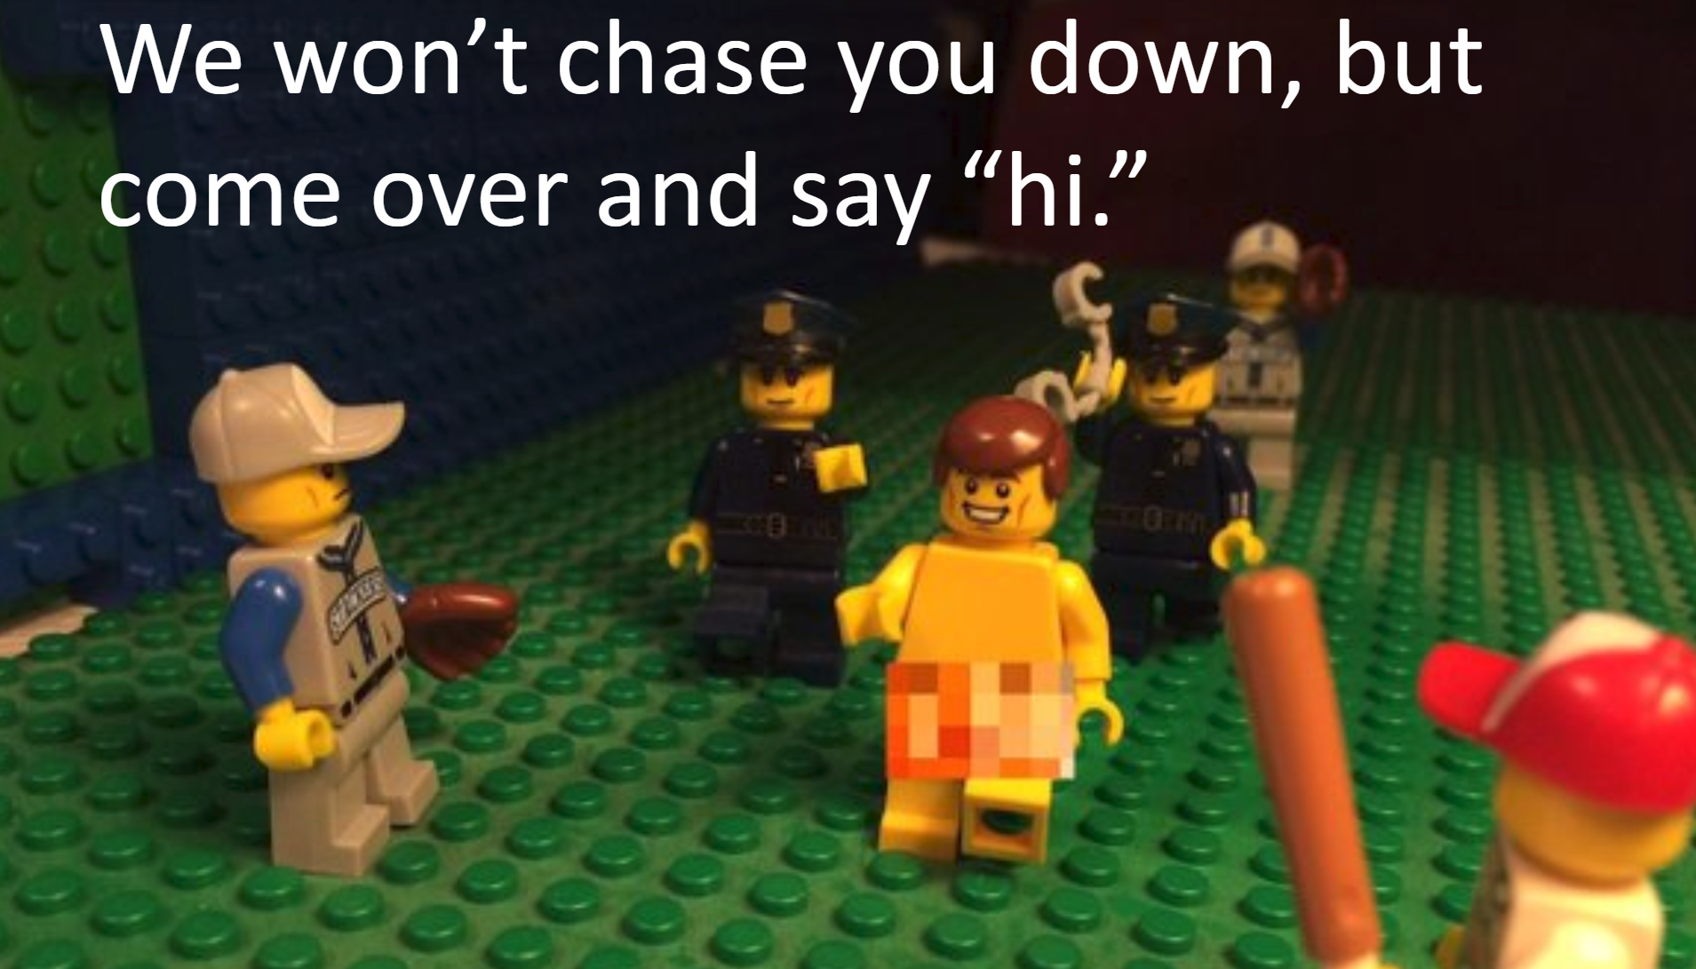
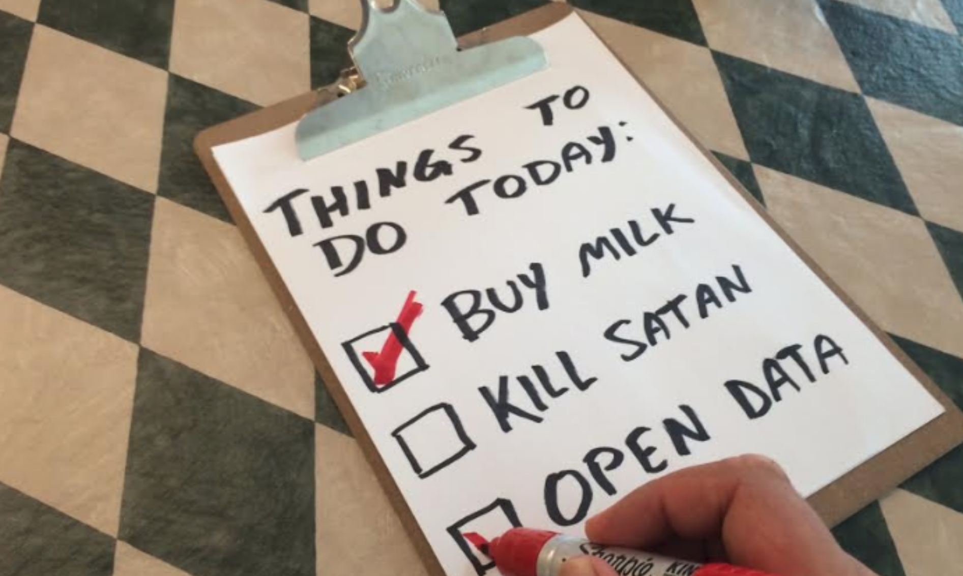
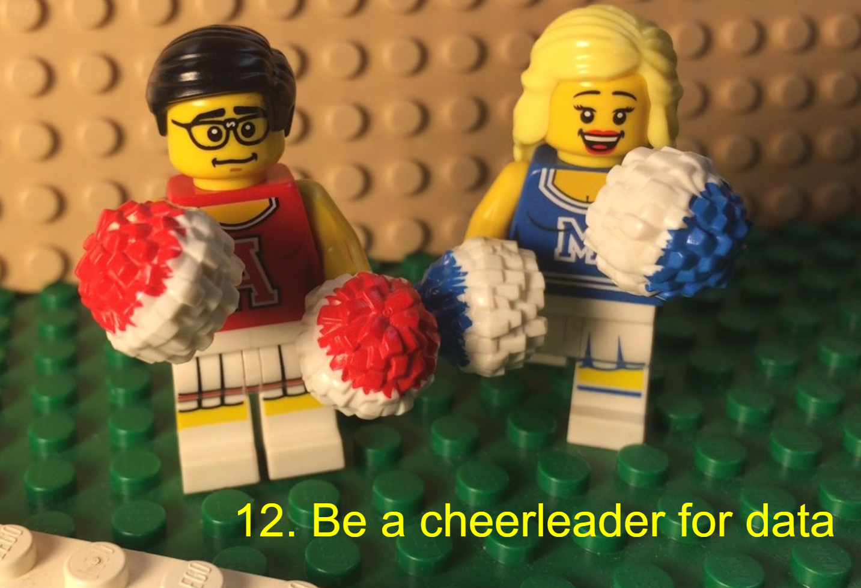
People pay way more attention to absurd slides
Pictures tell a story better than words
2:1 or 3:1 ratio of normal to absurd slides is ideal - don’t over-do it!

Slide 28
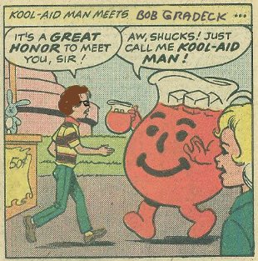
My advice
Find your own style
Rely on trusted editors
Test the waters with something small
Handmade is ALWAYS better than computers

