Slide 1
Lessons Learned from the RI DataHUB Data Story Process The Good, the Bad, and the Ugly
Rebecca Lee October 2014
@ ProvPlan

Slide 2
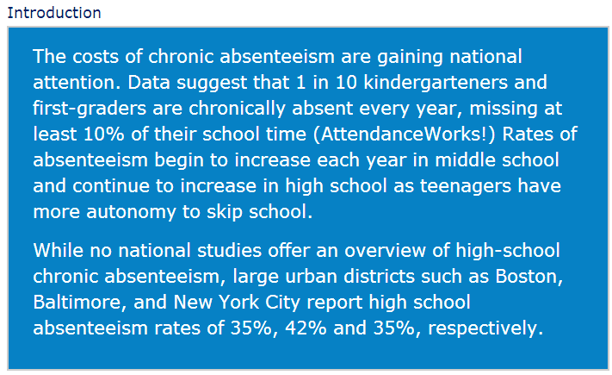
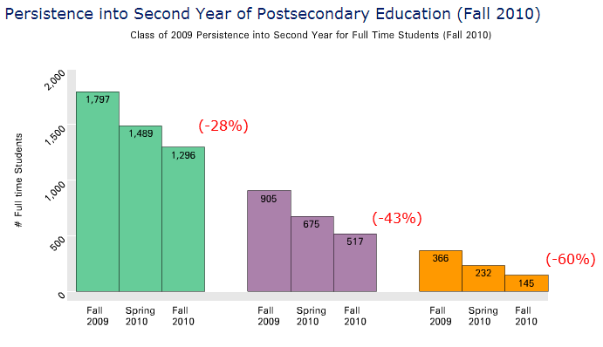
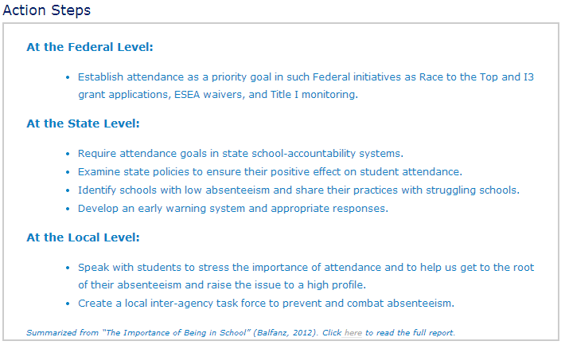
What is a RI DataHUB “Data Story”?
A PRODUCT….CREATED FROM A TEAM PROCESS

Slide 3
Data Story Team
Team Leader
Facilitator
Data Analysts
Copywriter
Graphic Designer
Key Stakeholders:
Reps from Data Partners
Content Experts
Program Directors
Community Partners
Etc.
TEAM CAN BE LARGE OR SMALL, DEPENDING ON GOALS.
TIMING OF ENGAGEMENT MAY VARY.

Slide 4
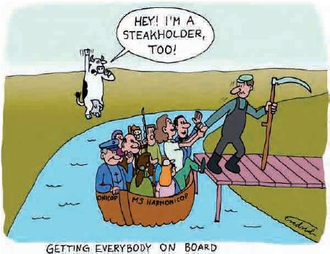
Why Stakeholders?
Gain expertise and context
Increase data literacy
Create shared understanding
Cultivate ambassadors for story
Built-in user testing
Make new friends!

Slide 5
Typical Large Team Process
FIRST, A FUNDER/CONVENER IDENTIFIES A TOPIC.
Unhealthy Housing
Juvenile Justice
Out-of-School Time
Workforce Development
Postsecondary Access
Educational Transitions
Chronic Absenteeism
Civic Engagement
Adult Education

Slide 6
Convene a Cross-Sector Team
K-12
Higher
Ed.
Work-force
Community Partners
Group Diversity Considerations:
Content expertise
Comfort with data
Prior experience
Logistics
Politics

Slide 7
The Team Picks an “Essential Question”
BE CLEAR THIS IS A DRAFT!
MANAGE EXPECTATIONS.
OK TO START BROAD, NARROW LATER.

Slide 8
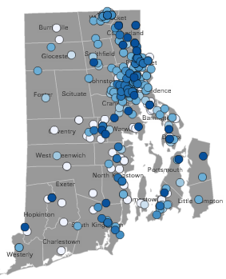
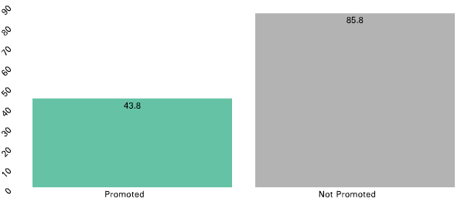
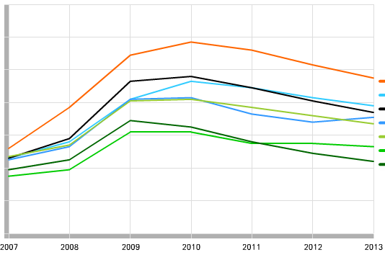
Explore Data Together, Write Story
Explore data.
Refine essential question.
Write story.
This is ITERATIVE and will take TIME.

Slide 9
Vet Story. Expand Stakeholders.
Timing depends on what you’re willing to change.

Slide 10
Publish and Disseminate.
Plan for rollout while the team is still captive.

Slide 11
Some Lessons Learned.
Facilitators are really helpful.
Data exploration with novices is hard.
Consistent participation is key.
Adjust use of collaboration tools according to team skills.

Slide 12
The Good.
“I Learned a lot about education policy and how administration works”
“What data we have/don’t have is surprising!”
“Not everyone sees things the same way. Dropouts to K-12 are new entrants to workforce to DLT.”
This process made clear the need to understand each other across agencies – more of this! ‘Kids are all of ours’”
“I was surprised how hard it can be to represent data in graphics.”
“I learned about the data and the process around it; learned to trust”

Slide 13
The Bad and the Ugly.
Expensive!
Too long to be “timely”.
Not all questions are fit for stories.
Building data literacy is hard.

Slide 14
Summary
Creating “Data Stories” with a large cross-sector team can be a really effective way to build relationships, break down barriers, increase capacity, and produce a better product. However, they cost lots of time and money, so being clear about the goals for the story is essential.

Slide 15
Thank You!
http://www.ridatahub.org

