Slide 1
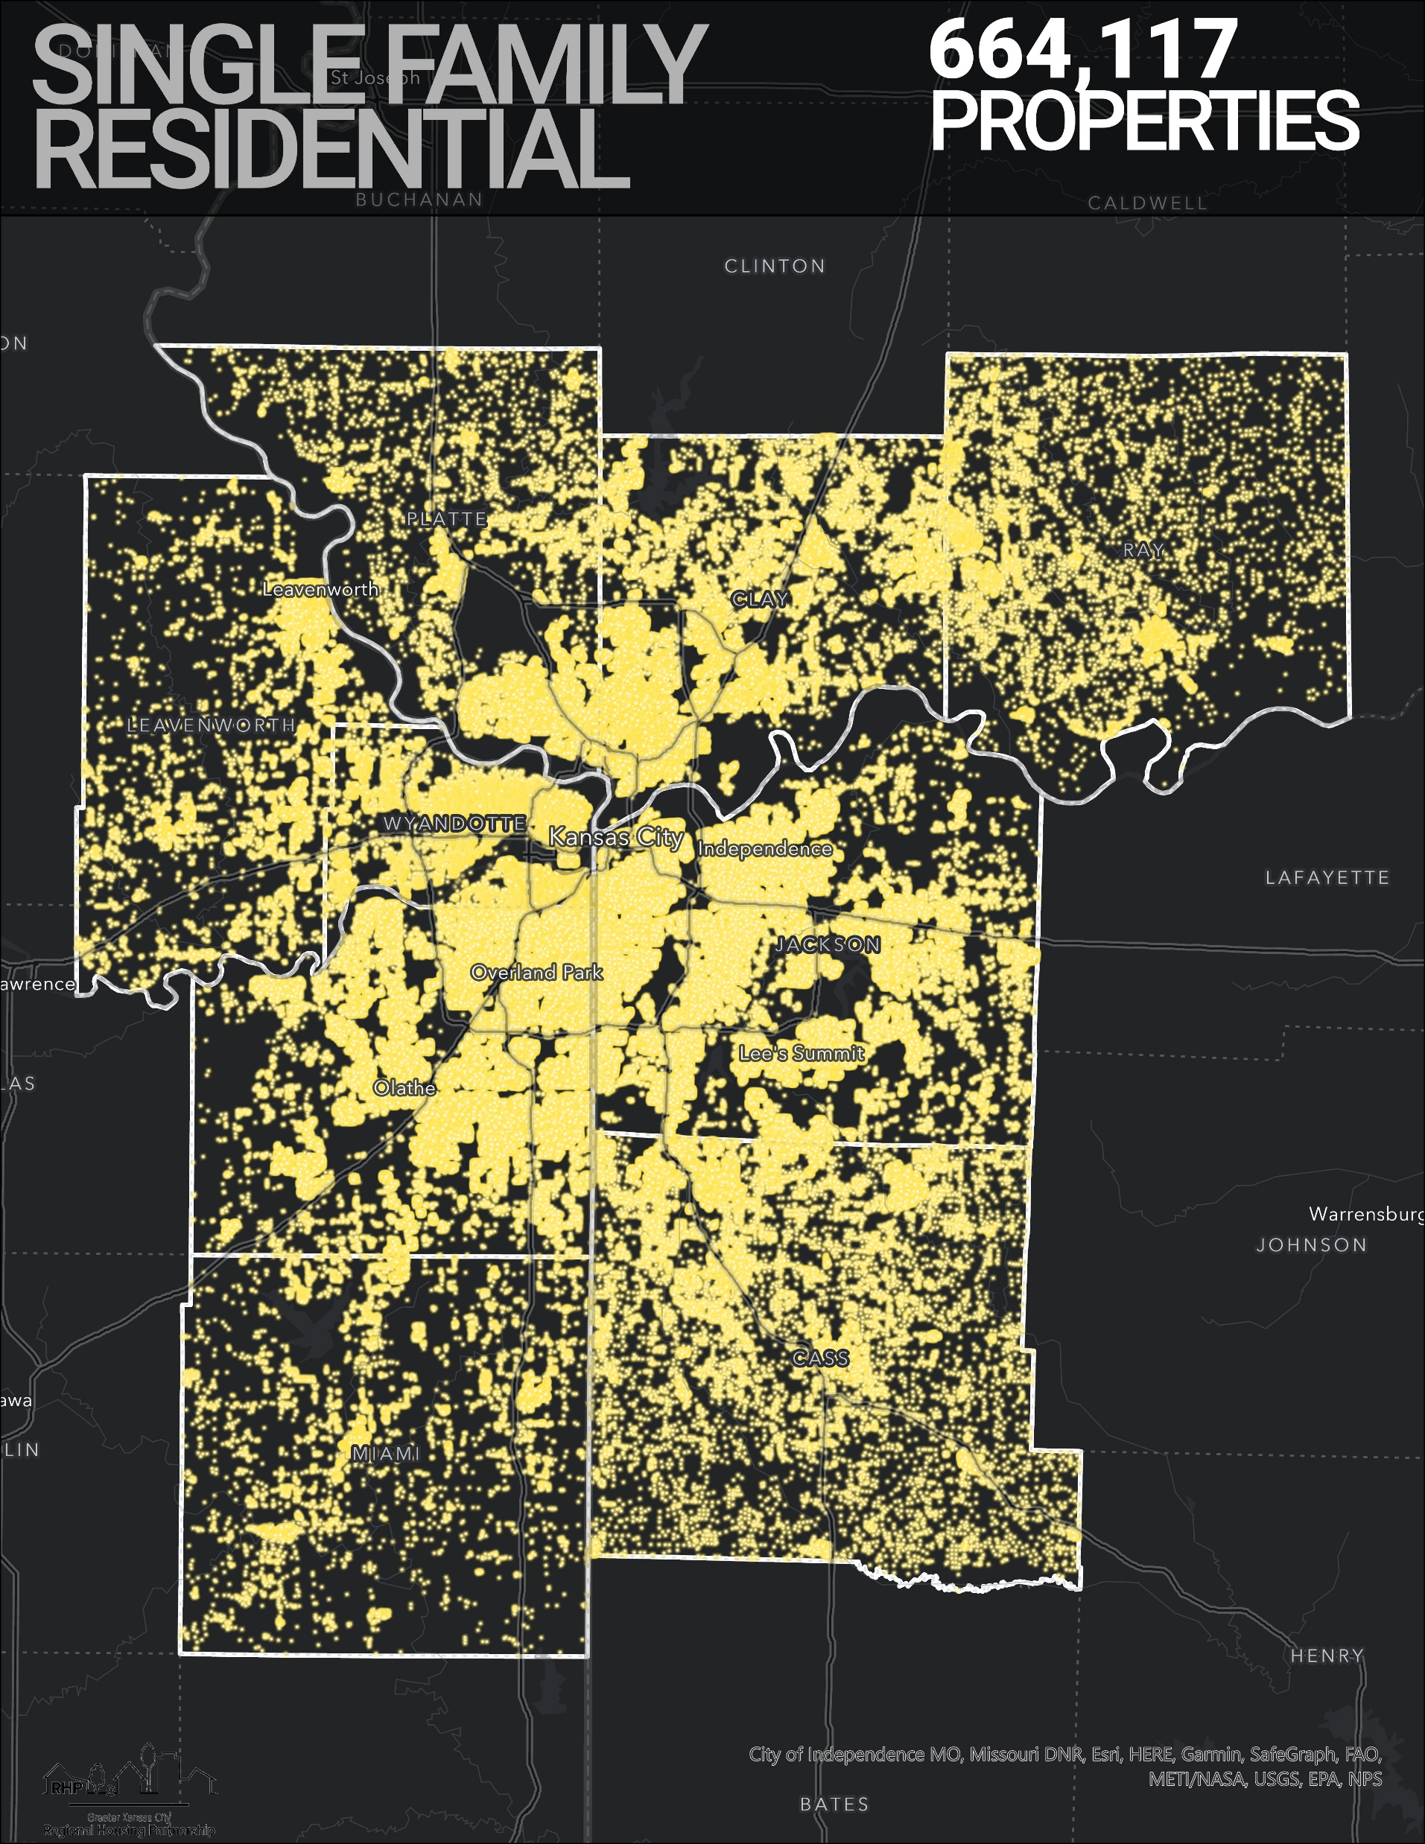
SFR Investor Ownership in the KC Metro Region
NNIP
03/06/24
Presented by Josh Akers

Slide 2
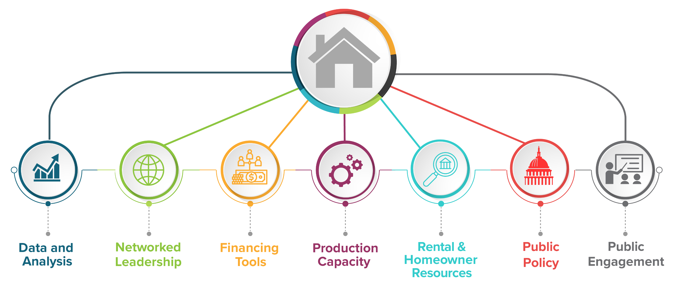
Regional Housing Partnership
Partnership between MARC and LISC Greater Kansas City
Emerged from work by the First Suburbs Coalition

Slide 3
Regional Housing Partnership
Focused on increasing supply and preserving affordable housing across the region
Currently in research, analysis, and education phase

Slide 4
Insights on Investor-Ownership
High Volume Investor Ownership impacts local renters and buyers
Concentrated ownership results in pricing power = higher rents
Targeted houses are often in the price range of lower to moderate income families limiting supply of properties for sale
Research documents undesirable impacts on cities and neighborhoods
Higher evictions
Limited upkeep

Slide 5
There are 664,117 Single Family Residential (SFR) properties throughout the region.

Slide 6
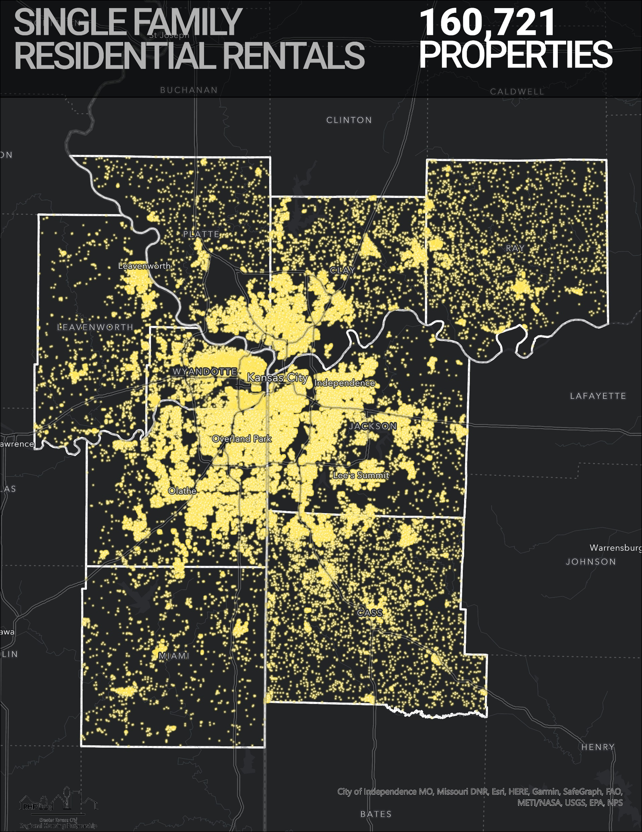
160,721 or nearly 25% of these are rental properties, or owned by someone who does not live at the address.

Slide 7
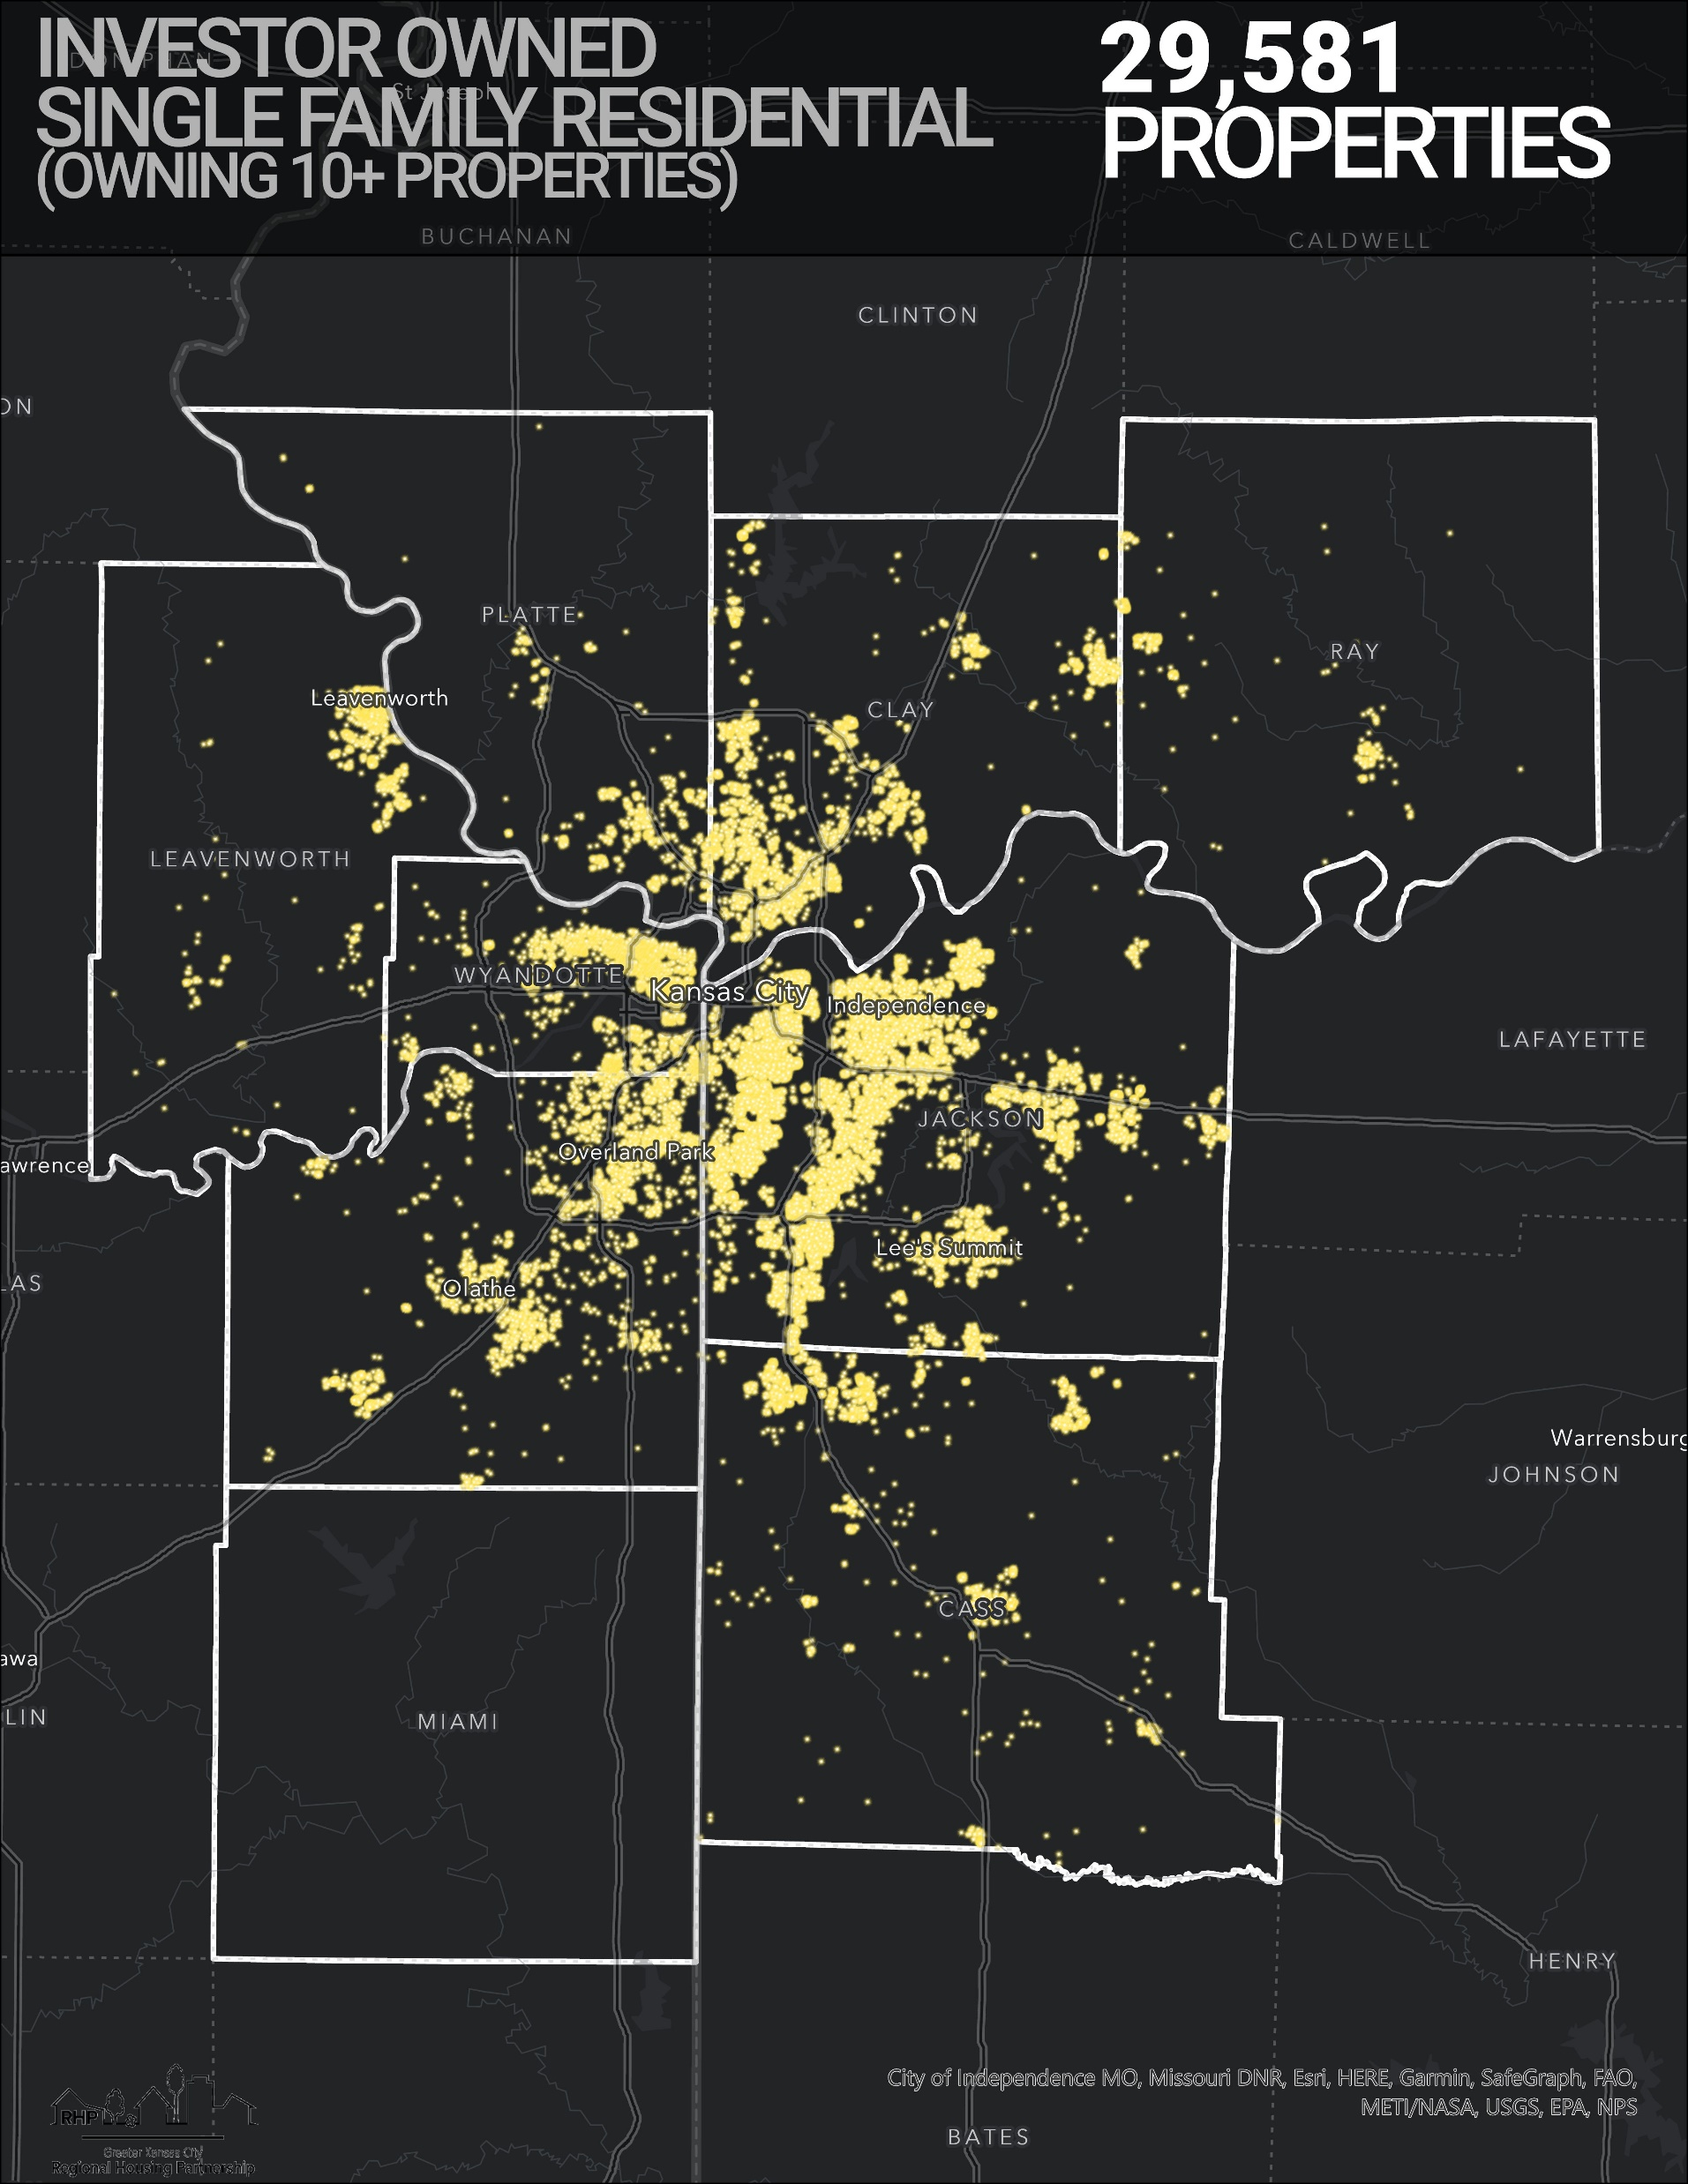
Nearly 30,000 of those single-family rentals are owned by large investors (those who own 10+ properties).

Slide 8
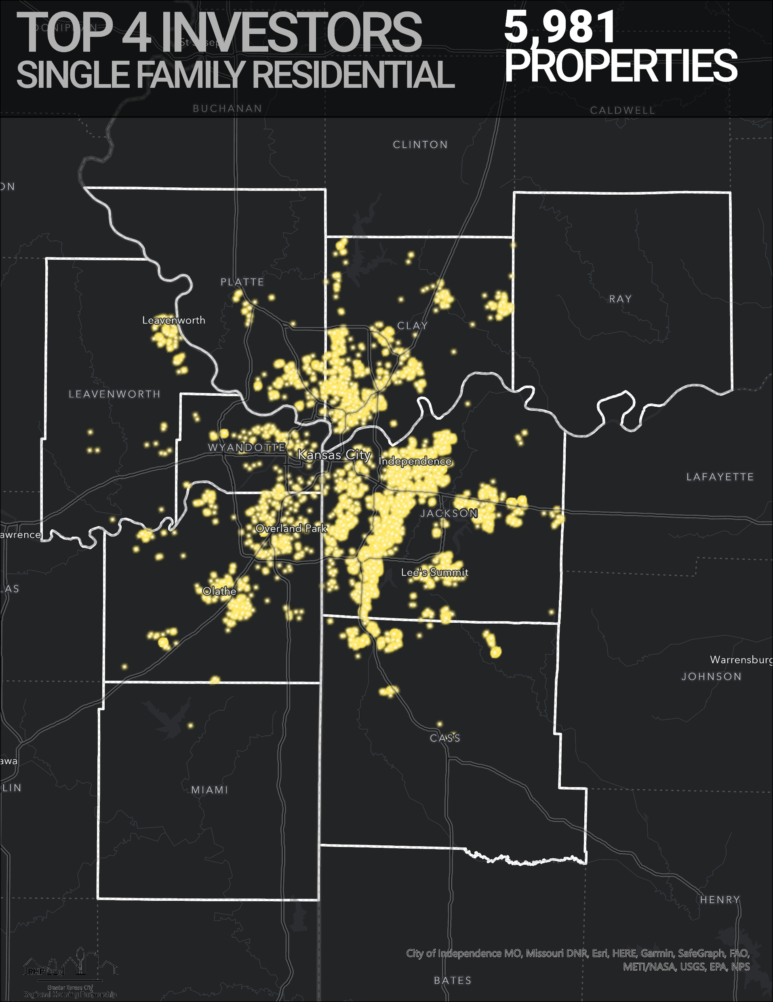
Nearly 6,000 SFRs are owned by the four largest investor-owners.

Slide 9
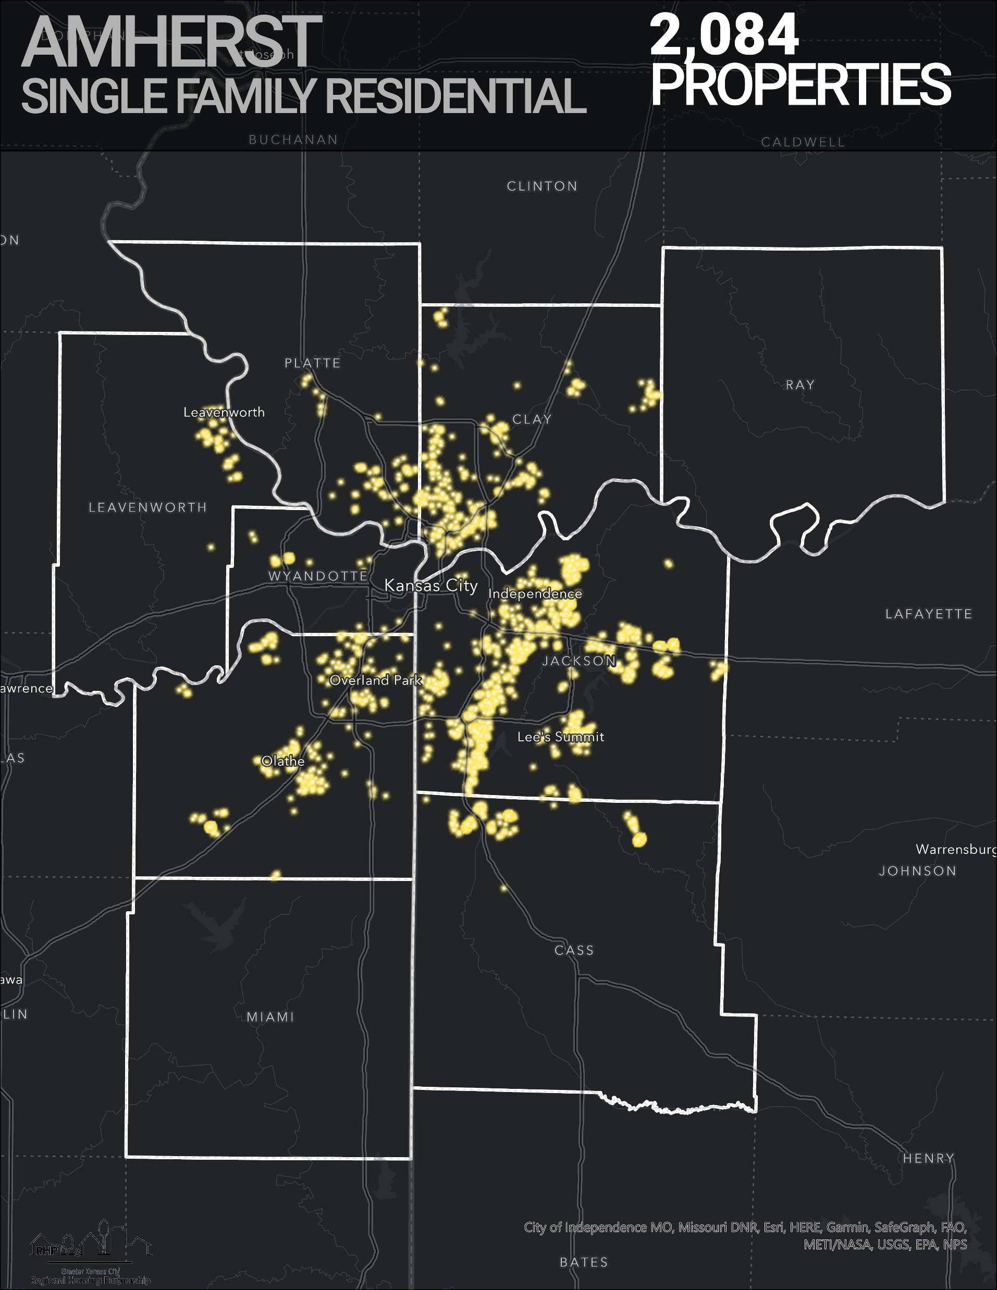
Amherst owns more than 2,000 SFR in the region.

Slide 10
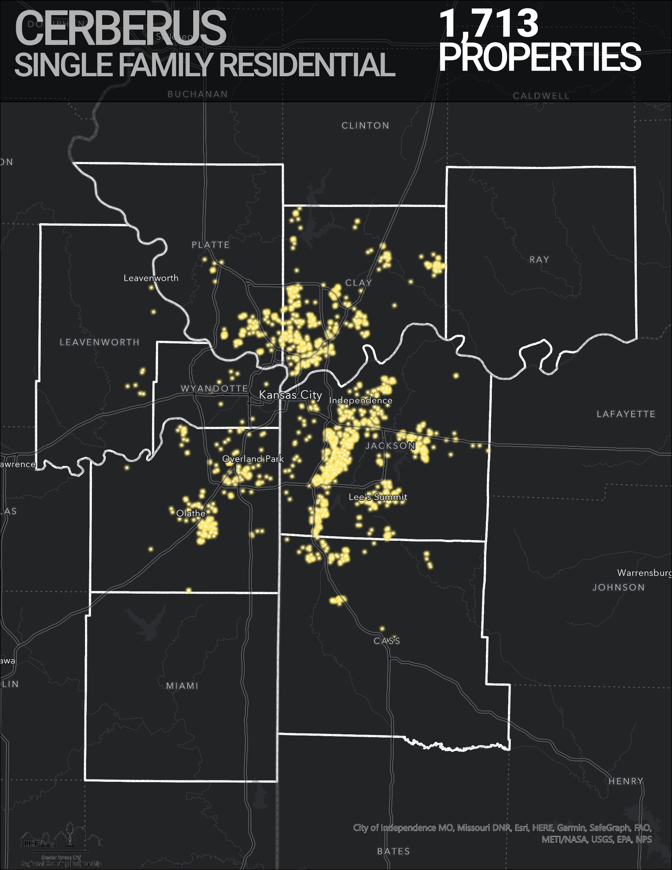
Cerberus owns more than 1,700 SFR in the region.

Slide 11
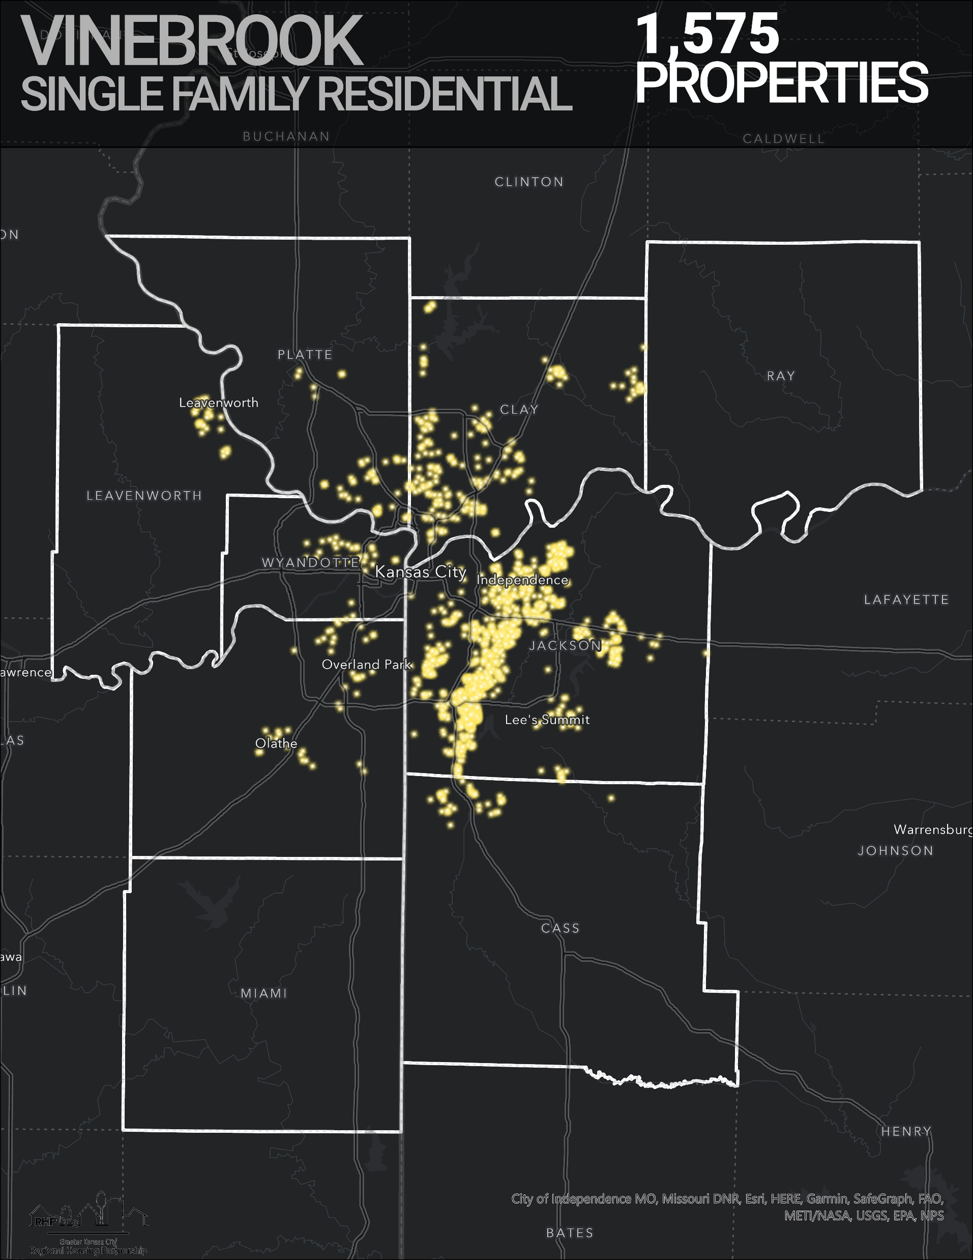
VineBrook owns more than 1,500 SFR in the region.

Slide 12
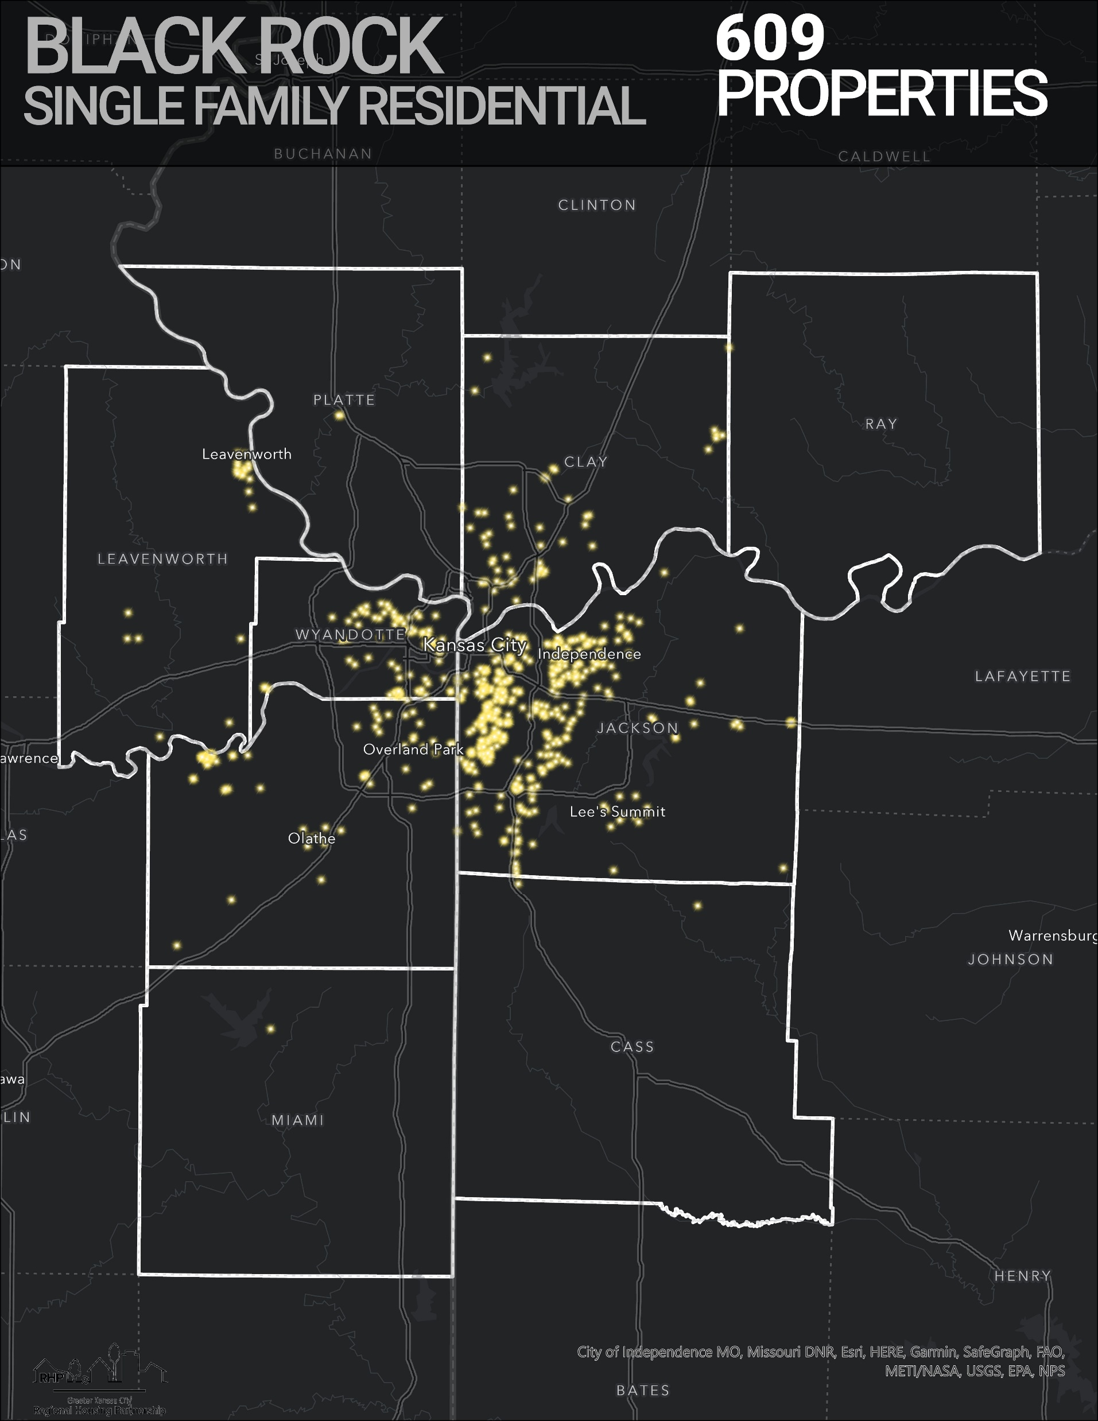
Homevestors
Homevestors
owns more than 600
SFR in the region.

Slide 13
Large investor-owners own more than 30% of the rental properties in a number of Kansas City communities.

Slide 14
Questions?

