Slide 1

A Study of Student Absenteeism in Pinellas County

Slide 2
Current Situation in Pinellas County
Florida Department of Education Statistics
% Absent 21 Days or More: All Students (K-12)
School Year 2013-2014:
Florida 9.5%
Pinellas County: 12.8% (15,545 students)
Pinellas County higher rate than Florida for at least the last five years (since 2009-2010 School Year).
Chronically absent students:
  Perform worse on standardized tests of reading and math
More likely to drop out of school
Less likely to graduate on time

Slide 3

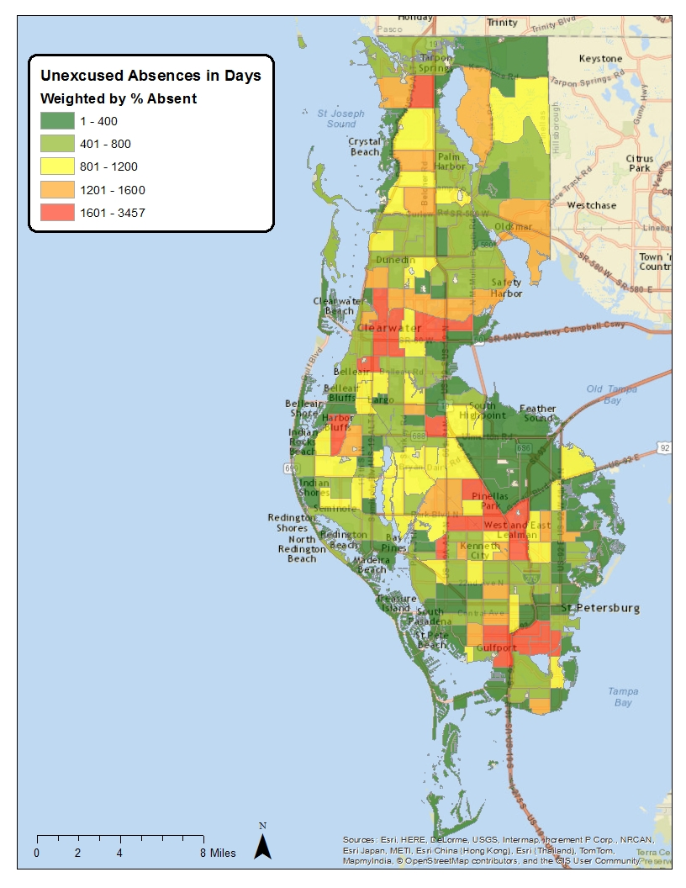
Using an Integrated Data System to Examine
Multiple Influences on Absenteeism
Neighborhood
School
Parent
Student

Slide 5
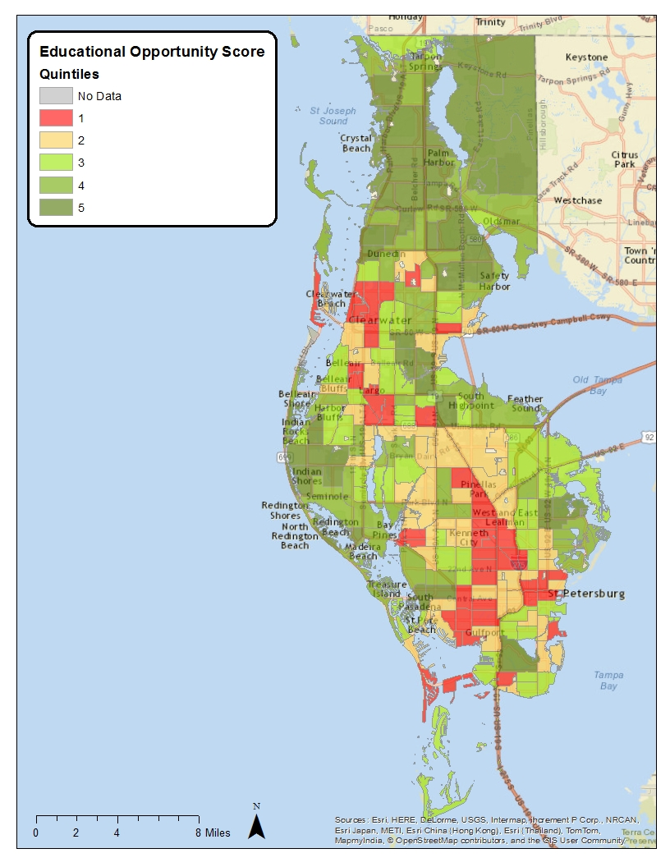
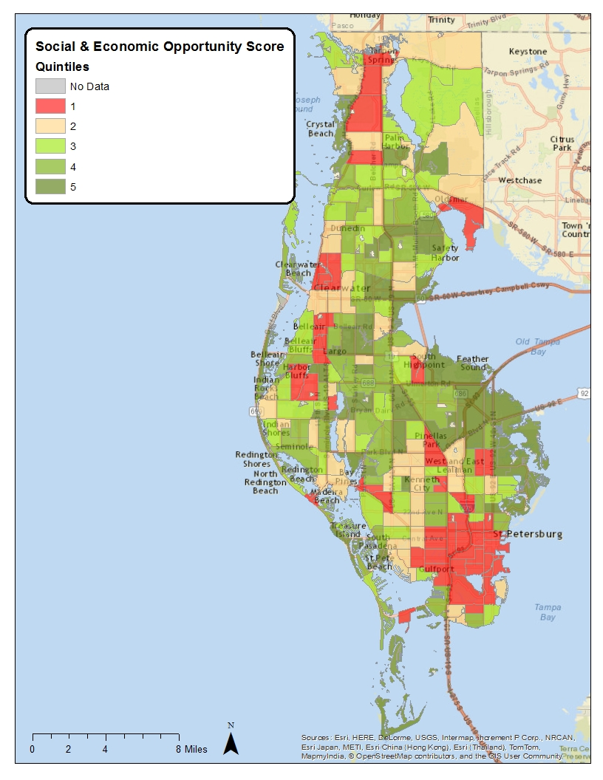

Slide 6
Opportunities Impact
On Absenteeism

Slide 7

Policy Development
Linking to Current Initiatives
Working with the School District
Tapping Local Expertise
Communication Plan
Engaging Others to Carry on the Work

Slide 8

Pinellas Campaign
for Grade Level Reading
Goal: Increase % students who are reading proficiently by third grade
Focus: Increase the percentage of students who are…
entering kindergarten ready to learn
attending school regularly
are engaged in learning over the summer months

Slide 9
Kindergarten Counts

Slide 10
Kindergarten Counts

Slide 11






Thank You!

