Slide 1

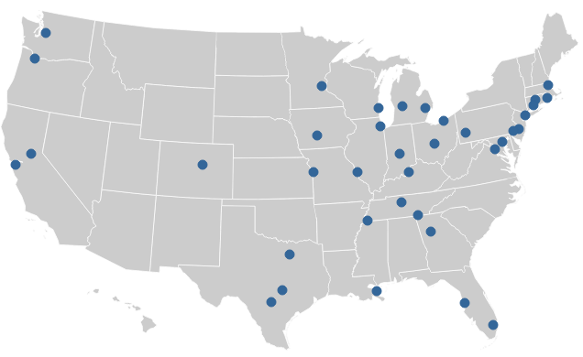
Data Inventory Analysis
Rob Pitingolo, The Urban Institute
NNIP Partnership Meeting, October 2014

Slide 2



Neighborhood Data is More than Just Municipal Data
NNIP Data should be…
Small Geography
Tract, Block Grp, Address, Parcel
Up-to-Date &
Historic Trends
2

Slide 3
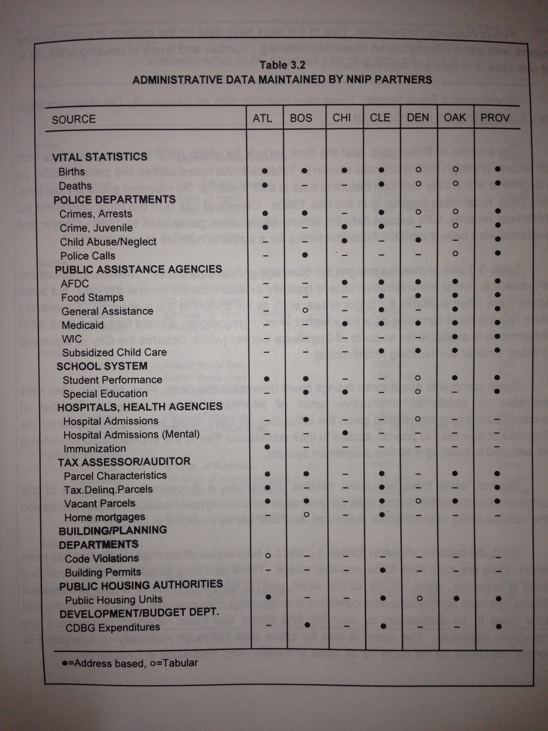
What is the Data Inventory?
First published1996 →
Became machine readable in 2007
Mix of datasets and indicators
Includes:
  Years of data
  Geographic & coverage level

Slide 4

Value of the Data Inventory
Documenting “state of the network”
Identify cross-site opportunities
Self-assessment
Network improvement
Crime
Vital Stats
Housing
Education
Health

Slide 5
How NNIP Partners Stack Up
Max Score = 26
Average Score = 10.9

Slide 6

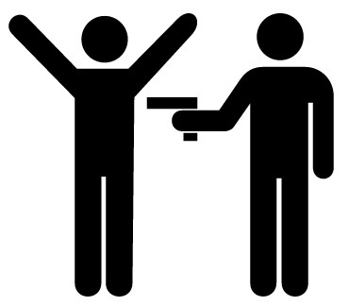








Introducing the SNIP Score
Small-geography Neighborhood Indicator Performance (SNIP) Components:
Births
Pt1 Crime
Foreclosures
Child Health
School Enrollment
Adult Health
Property Data
Prisoner Reentry
Home Sales
Public Assistance

Slide 7
Methodology
Neighborhood Data Must Be…
Held in-house
Small geography
  Parcel, Address, Block Grp, Tract
Recurring & recent as of at least the year →
Point awarded when all conditions are met

Slide 8
How NNIP Partners Score
Max Score = 10

Slide 9

Let’s Dig Down Into the Stats
Range: 0-10
Mean: 4.7
Median: 5.0
Mode: 6.0
N: 37

Slide 10
NNIP Partner Tenure has Little Correlation to SNIP Score

Slide 11
How to Improve Your Score:
Go Deeper on Existing Datasets

Slide 12
How to Improve Your Score:
Bringing Data Up-to-Date

Slide 13
How to Improve Your Score:
Expand Your Holdings

Slide 14

Proposed Network Goals
for NNIP Pittsburgh (Spring 2015)
Increase average SNIP score 1+ points
More partners with SNIP score of 8+
No partners with zero SNIP score

Slide 15

Congratulations!
OAKLAND!
PERFECT SCORE 10/10

