Slide 1


NVU
Furman Center
BY THE NUMBERS:
Exploring Neighborhood Inequality
@FurmanCenterNVU
#Stateof NYC

Slide 2
Income inequality in New York City has become more pronounced since 1990
Distribution of Income (2013$) Across Households, New York City
2012
30%
20%
21%
20%
20%
19%
15%
10%
3%
5%
0%
$0-$20,000
$20,001 -
$40,000
$40,001 -
$60,000
$60,001 -
$100,000
$100,001 -
$250,000
> $250,000

Slide 3
Income inequality in New York City has become more pronounced since 1990
Distribution of Income (2013$) Across Households, New York City
1990 2012
30%
20%
23%
23%
21%
20%
20%
19%
19%
16%
16%
15%
10%
3%
5%
0%
$0-$20,000
$20,001 -
$40,000
$40,001 -
$60,000
$60,001 -
$100,000
$100,001 -
$250,000
> $250,000

Slide 4
Income inequality in New York City has become more pronounced since 1990
Distribution of Income (2013$) Across Households, New York City
1990 2012
30%
20%
23%
23%
21%
20%
20%
19%
19%
16%
16%
15%
10%
3%
5%
0%
$0-$20,000
$20,001 -
$40,000
$40,001 -
$60,000
$60,001 -
$100,000
$100,001 -
$250,000
> $250,000

Slide 5
Income inequality in New York City has become more pronounced since 1990
Distribution of Income (2013$) Across Households, New York City
1990 2012
30%
20%
23%
23%
21%
20%
20%
19%
19%
16%
16%
15%
10%
3%
5%
0%
$0-$20,000
$20,001 -
$40,000
$40,001 -
$60,000
$60,001 -
$100,000
$100,001 -
$250,000
> $250,000

Slide 6
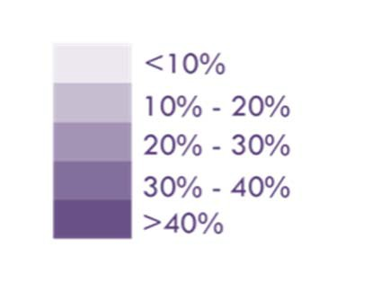
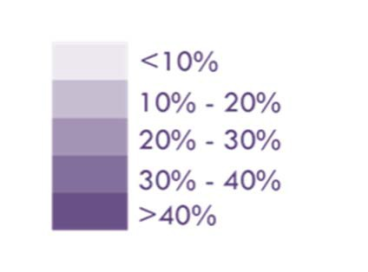
The highest- and lowest-income households are spatially isolated in New York City
Share of Households in the Top Income Decile
Share of Households in the Bottom Income Decile

Slide 7
Violent crime rates improved in every neighborhood, but significant gaps remain
Average Neighborhood Violent Crime Rate by Income (2013$) of Household
2000 2013
10
8
7.6
-2.6
6
6.6
5.0
4
2
0
NYC
$0-$20,000
$20,001 -
$40,000
$40,001 -
$60,000
$60,001 -
$100,000
$100,001 -
$250,000
> $250,000

Slide 8
Violent crime rates improved in every neighborhood, but significant gaps remain
Average Neighborhood Violent Crime Rate by Income (2013$) of Household
2000 2013
10
8
8.9
7.6
-3.1
7.9
7.7
7.3
6
6.6
6.4
5.8
-2.6
5.0
5.2
5.0
4
4.6
4.2
3.8
2
0
NYC
$0-$20,000
$20,001 -
$40,000
$40,001 -
$60,000
$60,001 -
$100,000
$100,001 -
$250,000
> $250,000

Slide 9
Violent crime rates improved in every neighborhood, but significant gaps remain
Average Neighborhood Violent Crime Rate by Income (2013$) of Household
2000 2013
10
8
6
5.8
5.0
5.2
5.0
4
4.6
4.2
3.8
2
0
NYC
$0-$20,000
$20,001 -
$40,000
$40,001 -
$60,000
$60,001 -
$100,000
$100,001 -
$250,000
> $250,000

Slide 10
Student performance has improved, but disparities persist
Share of Students Performing at Grade Level in Math
2000 2012
80%
60%
46%
37%
39%
41%
34%
37%
20%
0%
$20,001 -
$40,000
$40,001 -
$60,000
$60,001 -
$100,000
> $250,000

Slide 11
Student performance has improved, but disparities persist
Share of Students Performing at Grade Level in Math
2000 2012
80%
70%
60%
62%
64%
65%
59%
61%
46%
37%
39%
41%
34%
37%
20%
0%
$20,001 -
$40,000
$40,001 -
$60,000
$60,001 -
$100,000
> $250,000

Slide 12
Student performance has improved, but disparities persist
Share of Students Performing at Grade Level in Math
Math (2000) Math (2012)
80%
70%
60%
62%
64%
65%
24%
59%
61%
25%
46%
40%
41%
37%
37%
39%
34%
20%
0%
$20,001 -
$40,000
$40,001 -
$60,000
$60,001 -
$100,000
> $250,000

Slide 13
Student performance has improved, but disparities persist
Share of Students Performing at Grade Level in Math
2000 2012
80%
 |  |  |  |  |  |  |  |  |  |  | 70%
 |  |  |  |  |  |  |  |  | 65%
 |  |  |  |  |  |  | 64%
 |  |  | 61% |  | 62%
 | 59%
60%
40%
20%
0%
$20,001 -
$40,000
$40,001 -
$60,000
$60,001 -
$100,000
> $250,000

Slide 14
Increasing income inequality is not unique to New York City
Distribution of Income (2013$) Across Households, New York City
1990 2012
30%
20%
23%
23%
21%
20%
20%
19%
19%
16%
16%
15%
10%
3%
5%
0%
$20,001 -
$40,000
$40,001 -
$60,000
$60,001 -
$100,000
> $250,000

Slide 15
Income inequality has increased in
Los Angeles
Distribution of Income (2013$) Across Households, Los Angeles
1990 2012
30%
24%
24%
20%
21%
20%
20%
19%
17%
16%
10%
12%
4%
5%
0%
$20,001 -
$40,000
$40,001 -
$60,000
$60,001 -
$100,000
> $250,000

Slide 16
Income inequality has increased in
Chicago
Distribution of Income (2013$) Across Households, Chicago
1990 2012
30%
26%
20%
22%
21%
19%
20%
19%
18%
18%
18%
16%
10%
1%
3%
0%
$20,001 -
$40,000
$40,001 -
$60,000
$60,001 -
$100,000
> $250,000

Slide 17
Income inequality has increased in
Houston
Distribution of Income (2013$) Across Households, Houston
1990 2012
30%
25%
20%
23%
20%
20%
21%
20%
18%
15%
17%
15%
10%
4%
2%
$20,001 -
$40,000
$40,001 -
$60,000
$60,001 -
$100,000
> $250,000

Slide 18
Income inequality has increased in
Philadelphia
Distribution of Income (2013$) Across Households, Philadelphia
1990 2012
30%
29%
27%
23%
20%
18%
19%
18%
18%
17%
17%
12%
1%
2%
0%
$20,001 -
$40,000
$40,001 -
$60,000
$60,001 -
$100,000
> $250,000

Slide 19
Income inequality has increased throughout the United States
Distribution of Income (2013$) Across Households, United States
1990 2012
30%
26%
20%
21%
22%
19%
18%
19% 19%
16%
17%
17%
10%
3%
2%
0%
$20,001 -
$40,000
$40,001 -
$60,000
$60,001 -
$100,000
> $250,000

Slide 20
Income inequality has increased in New York City The highest and lowest earners are spatially isolated
Neighborhood conditions have improved at all income levels, but significant gaps persist
Rising income inequality is not unique to New York City

