Slide 1
Census Solutions Workshop Feedback
Megan Swindal, PhD
Senior Research Associate
Notes:
We were not present at NNIPCamp in Baltimore in May 2017 but one of the sessions was a Census Open Innovation-design thinking workshop which some of you attended. A similar format was presented in Providence in April which I attended, and for which Kathy has asked me to provide feedback.

Slide 2
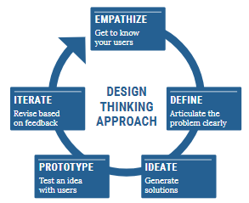
Overview
Census Bureau team conducted a "design-thinking" session in Providence in April aimed at reducing the undercount of people of color and young children
Structured process to brainstorm, prioritize and propose action steps
Sponsored by National Urban League, Annie E. Casey- Kids Count, Children's Leadership Council, American Library Association and the state/local library networks

Slide 3
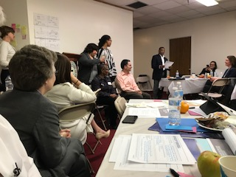
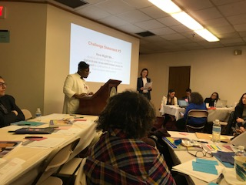
Featured Speakers
Ron Jarmin, Acting Director, US Census Bureau
Nellie Gorbea, RI Secretary of State
Jorge Elorza, Mayor of Providence
Elizabeth Burke Bryant, KIDS COUNT RI Executive Director
Don Cravins, Jr., Executive Director, National Urban League Washington Bureau

Slide 4
Goals of Workshop
How might we amplify collaborative partnerships and resources to ensure young children between the ages of 0-5 are accurately counted in the 2020 Census?
How might we improve the undercount of HTC populations overall, particularly among young African American men (ages 16-24)?
How might we develop outreach strategies to address the digital divide (low-connectivity areas) in communities of color and other HTC communities?
How might libraries serve as community hubs for census education, awareness and participation, especially among HTC communities?
Notes:
DataSpark felt it was important to participate because we have been a source of curated or mapped Census data for the community. The focus on the role of libraries was relevant to us too, since we’re now housed at the University Library at URI.

Slide 5
Workshop Toolkit
“A solutions workshop is a creative, collaborative, problem-solving event that brings together diverse thinkers”
“The workshop consists of a specific series of activities based on a design thinking methodology that help participants get to know each other, set ambitious goals, think outside the box, brainstorm with others, and quickly develop proposals for new solutions to engage communities in the Census”

Slide 6
Generating Ideas
Participant groups are each given a “user scenario” who represents a specific type of population that may be hard to count for a variety of reasons
For example: Do-Yun, a 75-year old retiree living with spouse, adult daughter, and granddaughter who speaks limited English and gets most news from TV
Notes:
A Census Solutions Workshop begins with a welcome presentation for all participants and an icebreaker exercise, setting the tone for a creative and collaborative session
Workshop facilitator should articulate the goals for the session and provide a brief Census 101 presentation
Icebreaker exercises are designed to get people comfortable with each other and cultivate a future-oriented mindset
Compare sticky notes about your vision for success for the day
With the specific user in mind, participants generate as many ideas as possible and begin to cluster them
around themes. Our group brainstormed ways to reach Do-Yun about the importance of responding to the Census: through his granddaughter’s school or through his church, and barriers like transportation that would have to be solved for him to complete the Census questionnaire someplace where translation services might be available, like the library.
The sticky notes are low-tech but they make the process more tactile which gets people a little more energized and creative. The feeling was of being in high school school and working on a team project– a little silly, not too mentally taxing, and a place where barriers that otherwise exist—in this case, barriers due to our fields or professions—would be less relevant.

Slide 7
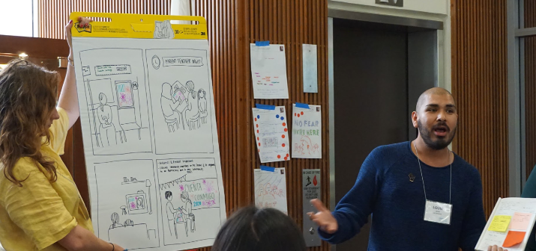
Turning an Idea into a Strategy
Participants decide on an idea to flesh out. Using a Storyboarding exercise, the group pitches their idea visually
Notes:
Some groups drew an actual storyboard; some acted out a scenario in which the user type would be educated about the Census and overcome their apathy or uncertainty about it.
This part of the day was really fun and goofy—most groups presented a storyboard with the drawing skills you’d expect of adults who type on computers all day. A couple acted out their scenarios, which were creative and silly and just made people smile. The energy level was high.
Using commitment worksheets, participants are asked to think about what they have learned today and what they or the organizations they work for can do to follow push towards the visions they articulated.

Slide 8
Our Take
Was it worthwhile? Were people engaged? Would you recommend it be a diverse group (across sectors, etc.) or a more homogenous one (like early childcare service providers)?
Notes:
Kathy asked for our feedback on the Census with a couple of targeted questions. In general from someone who knows very little about design thinking, I was REALLY impressed with the format. The participants were pretty diverse in terms of profession and sector but the prompts were set up to draw on common knowledge, not specialized knowledge, so it worked. There was a lot of energy and high spirits because participants were asked to be creative. I was so impressed that I already implemented some pieces of the workshop format with a data training session for our United Way partners :) Also, the mayor attended the Census workshop to give a quick keynote which added to the sense of importance and focus.
I suppose the only down side to the Census workshop was that I didn't get to see if any of those creative approaches to problem-solving was actually implemented (although most were quite doable). Delivering it to a more specialized group (who would be likely to come together again in different contexts) might keep them accountable/push them to follow through on concrete next steps.

