Slide 1
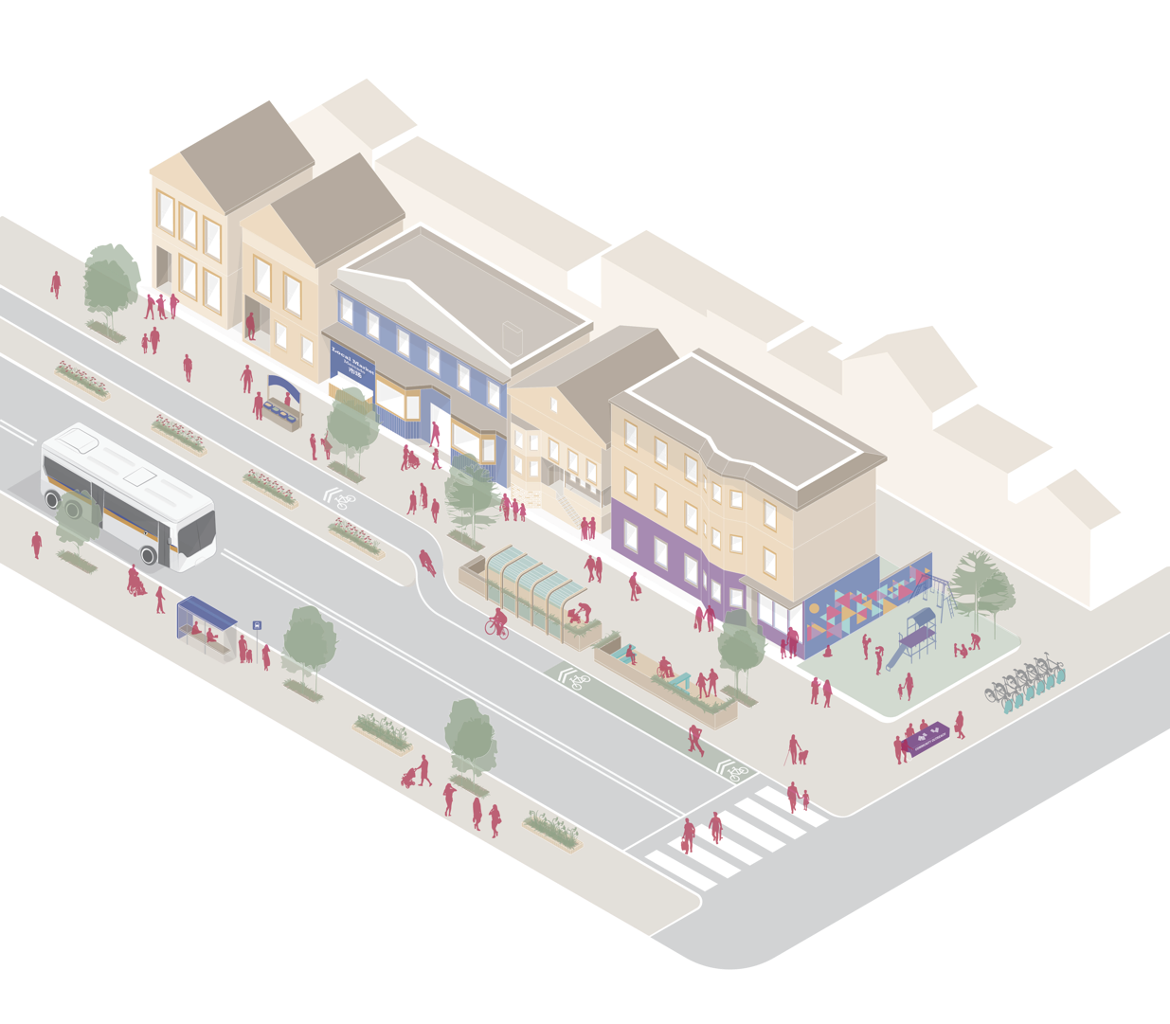
Redesigned streetscapes that include space for walking, biking and gathering

Slide 2
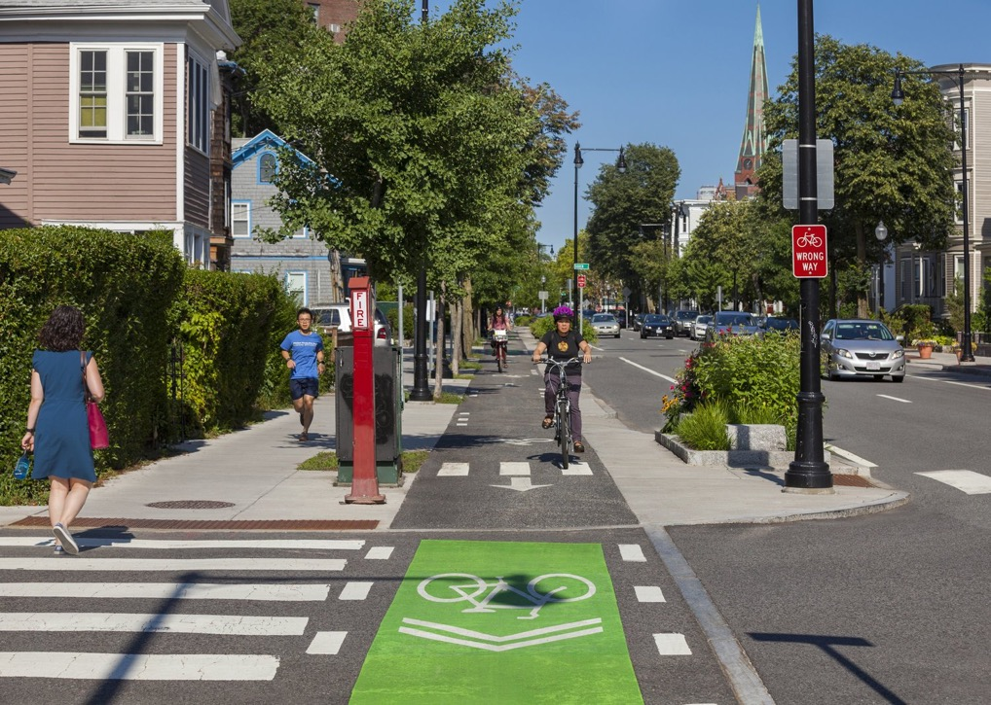
Notes:
Source: City of Cambridge

Slide 3
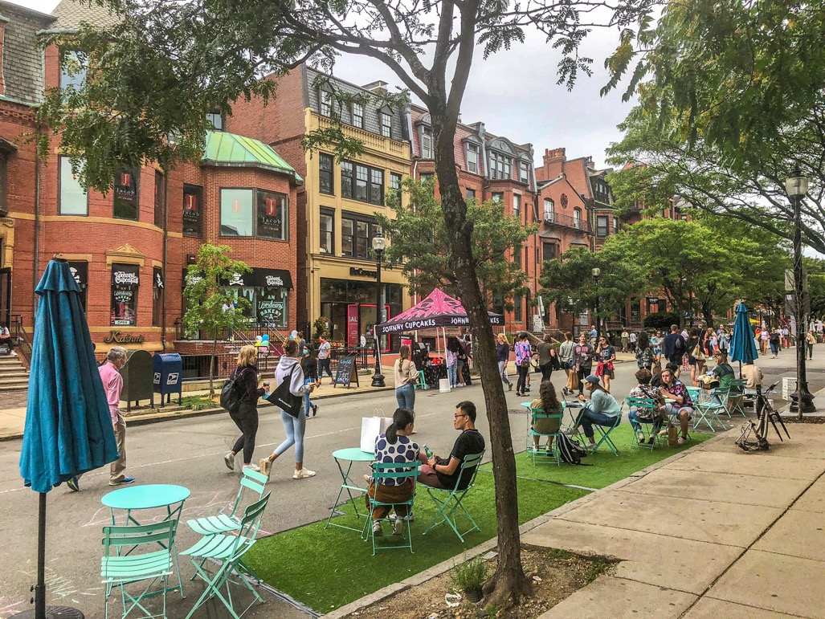
Notes:
Image:
https://www.boston.gov/departments/transportation/boston-green-links
https://www.bloomberg.com/news/features/2021-01-05/a-tiny-twist-on-street-design-the-one-minute-city

Slide 4
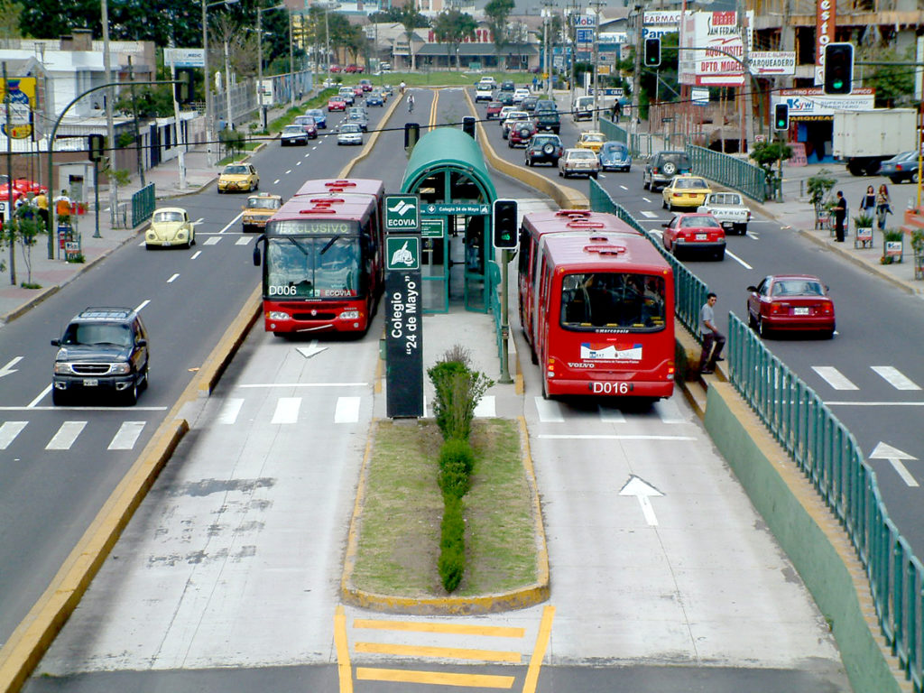
Notes:
Source: ITDP

Slide 5
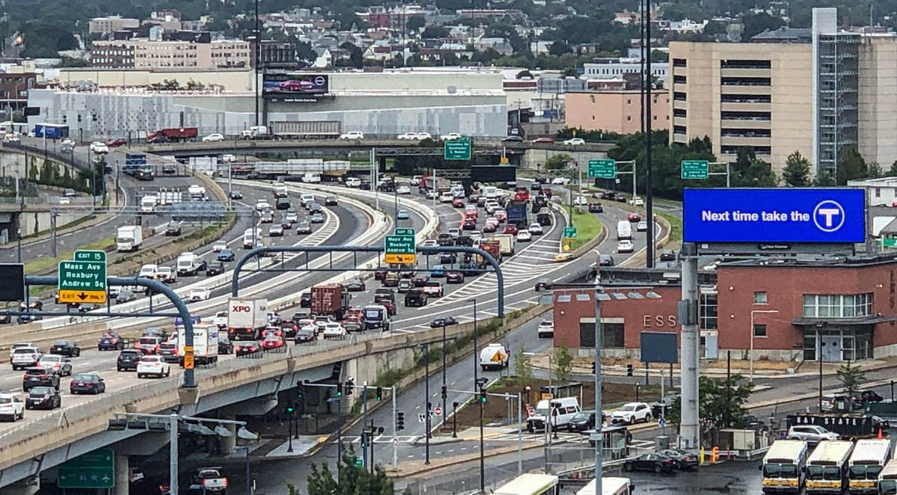
COMPLETE, LIVABLE STREETS: Where are we falling short?
Notes:
Image:
https://www.boston.gov/departments/transportation/boston-green-links

Slide 6
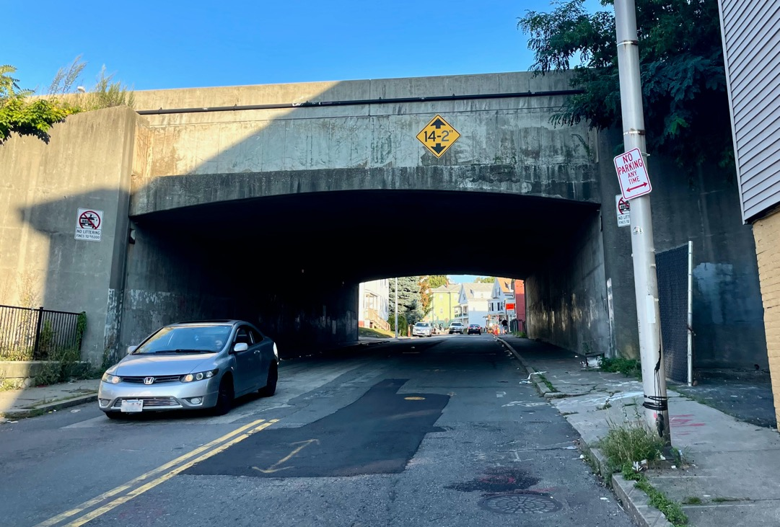
Notes:
Image:
https://www.boston.gov/departments/transportation/boston-green-links

Slide 7
Accessible commercial spaces
Redesigned streetscapes that include space for walking, biking and gathering

Slide 8
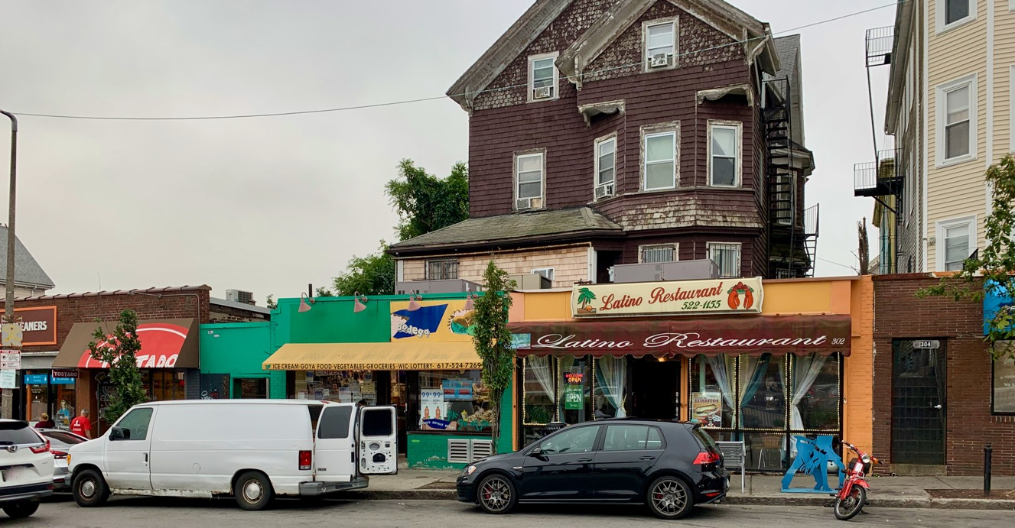

Slide 9
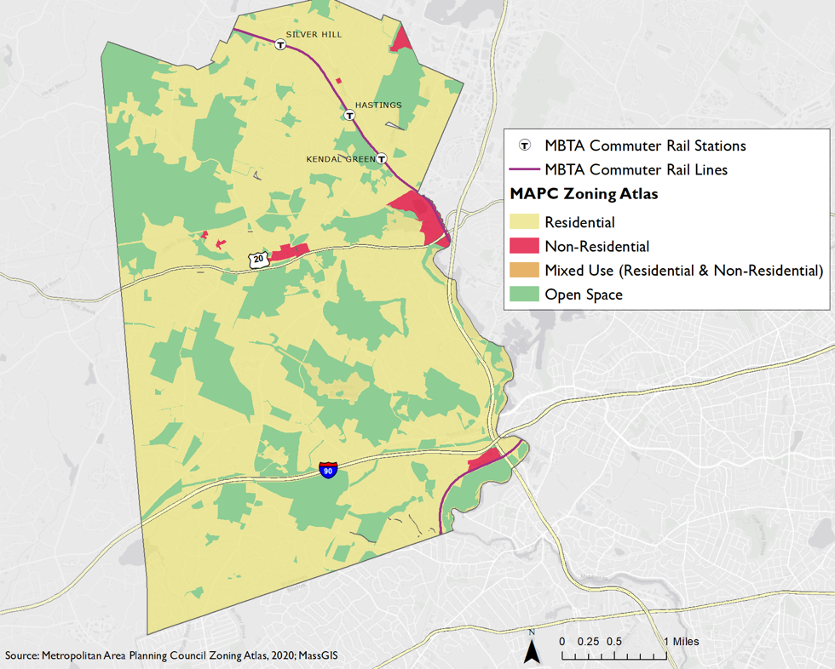

Slide 10
Diverse housing options
Accessible commercial spaces
Redesigned streetscapes that include space for walking, biking and gathering

Slide 11
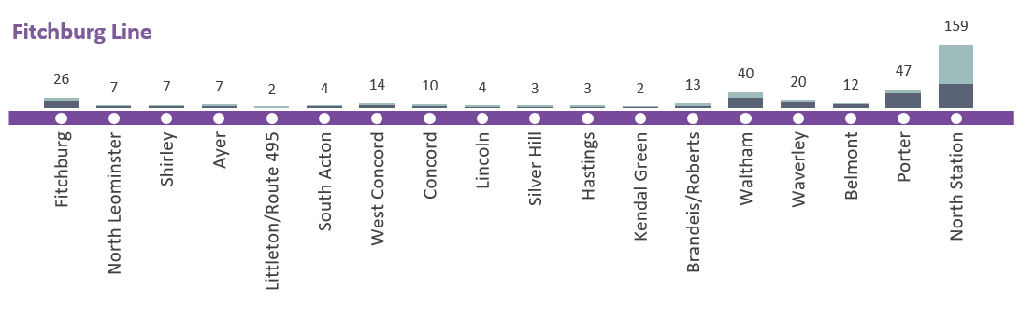


Slide 12
Diverse housing options
Accessible commercial spaces
Redesigned streetscapes that include space for walking, biking and gathering
Strong social infrastructure

Slide 13
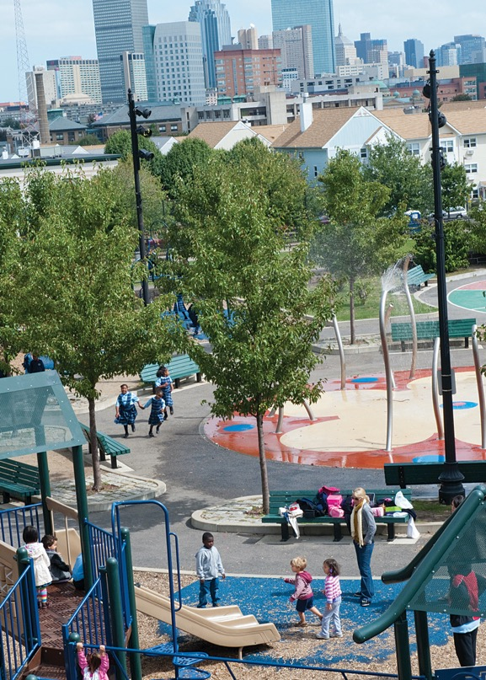

Slide 14
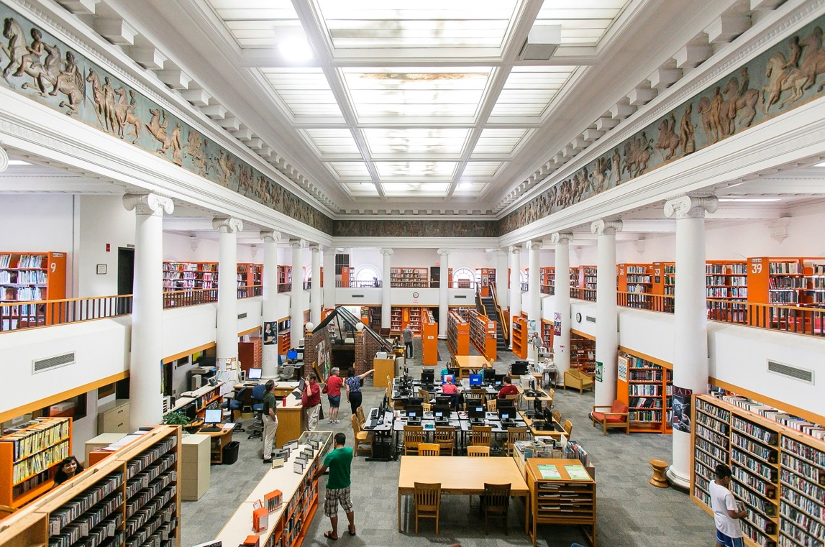
Notes:
Picture Source: Somerville Public Library
https://www.somervillepubliclibrary.org/how-do-i

Slide 15
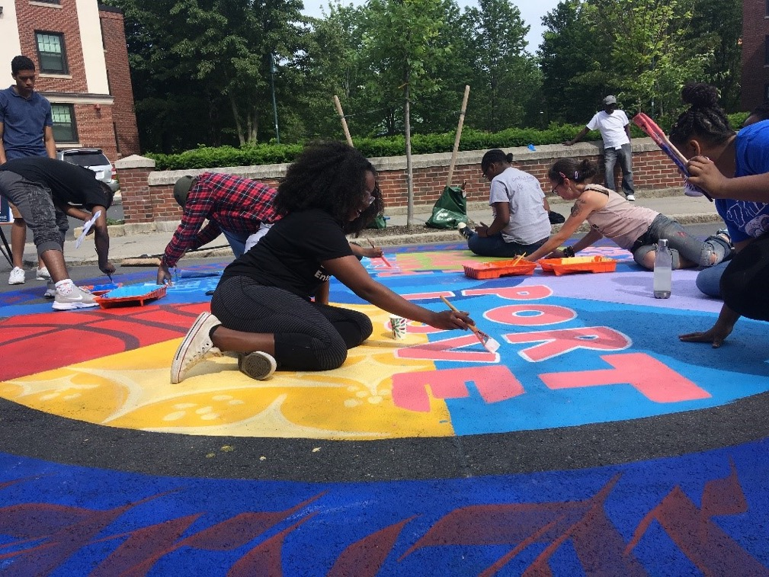

Slide 16
Diverse housing options
Accessible commercial spaces
Diverse and empowered resident population
Redesigned streetscapes that include space for walking, biking and gathering
Strong social infrastructure

Slide 17
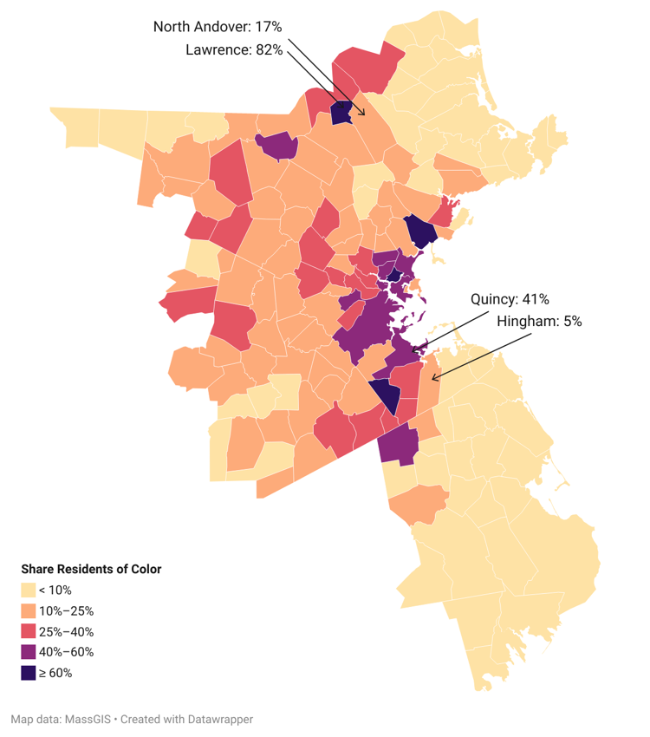
DIVERSE & EMPOWERED RESIDENTS: Where are we falling short?
Source: Census 2020

Slide 18
Diverse housing options
Accessible commercial spaces
Diverse and empowered resident population
Redesigned streetscapes that include space for walking, biking and gathering
Strong social infrastructure

Slide 19
STATE & LOCAL POLICY LEVERS
FOR BUILDING A REGIONAL NETWORK OF EQUITABLE 15-MINUTE NEIGHBORHOODS

Slide 20


STATE ACTION
STATE ACTION
Zone for Inclusivity
Plan Mobility Holistically
Build Broader Economic Prosperity

Slide 21
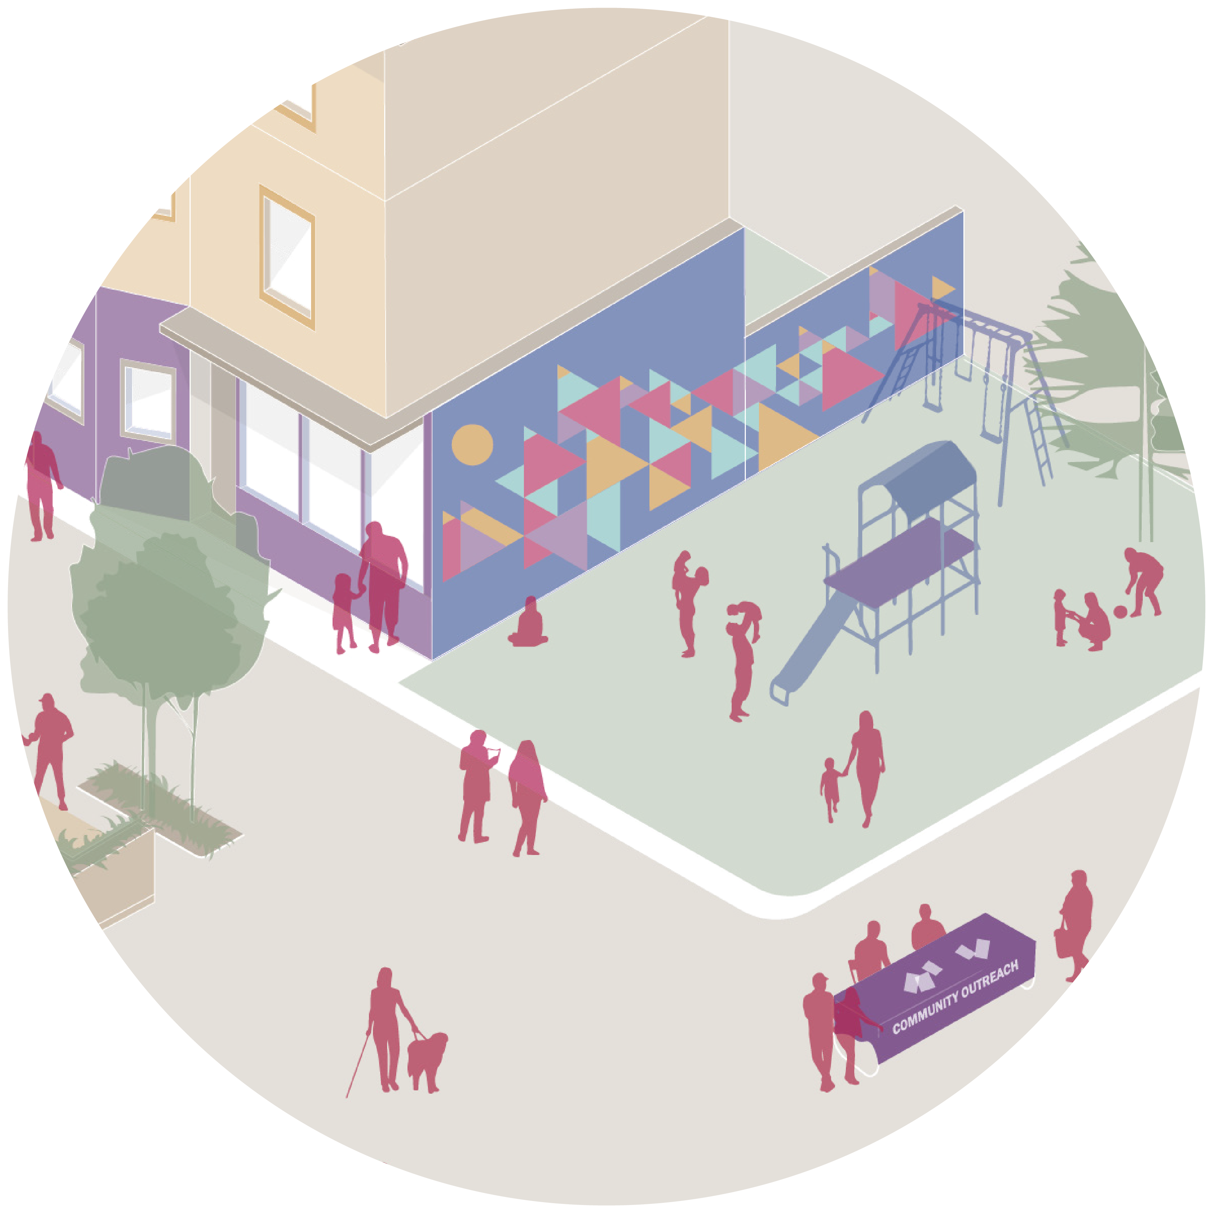
LOCAL ACTION
LOCAL ACTION
Plan with communities, instead of for communities.
  Plan at the “speed of trust.”
  Provide childcare.
  Provide adequate translation services.
  Ensure that professional planning staff are representative of the community.

Slide 22
WWW.BOSTONINDICATORS.ORG/15MIN

