Slide 1
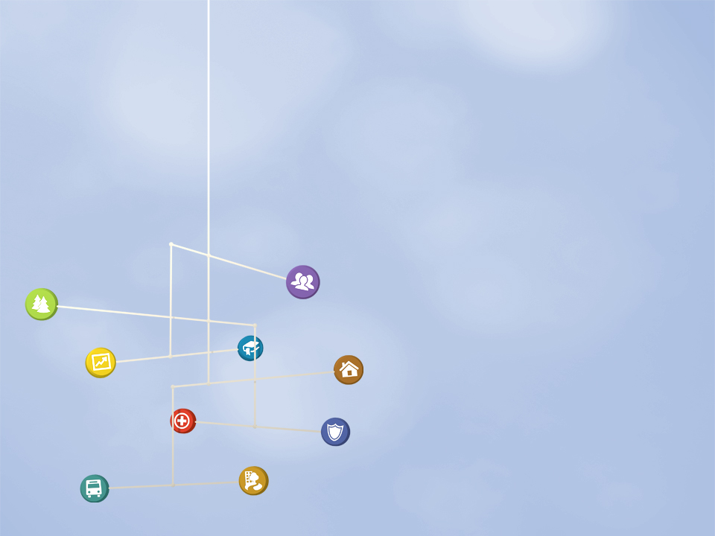
The State of Equity in Metro Boston
PolicyLink Equity Summit
November 10, 2011

Slide 2

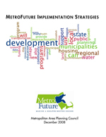
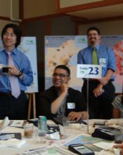
What is MetroFuture?
A vision for the region we want, building on the region’s strengths and investing in our residents
65 goals, supported by hundreds of objectives, for Greater Boston in the year 2030
13 implementation strategies, with hundreds of specific recommendations, designed to help the region achieve its goals
A constituency of 5,000 “plan builders” who will work to accomplish the MetroFuture goals

Slide 3
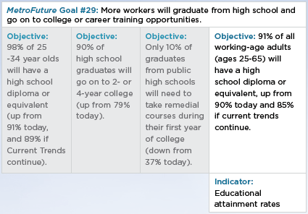
Measuring Progress to MetroFuture
Goals describe the MetroFuture vision in general terms.
Objectives support each of the goals. They are more specific and largely numeric.
Indicators are tied to as many of the objectives as possible. They are regularly collected data points.

Slide 4
Regional Indicators Reports
Indicators reports will monitor the region’s progress towards achieving the MetroFuture goals.
First come “baseline reports” that establish the numbers against which progress will be measured. Future reports will tell us whether we are trending towards our goals - or away from them.
We highlighted equity-related goals first, because meeting them is crucial to achieving the vibrant region envisioned in MetroFuture.

Slide 5
What is “Equity”?
"’Equity means all people have full and equal access to opportunities that enable them to attain their full potential.”
- King County, Washington developed this definition
Notes:
When people are coming from different starting points, the opportunities they need to attain their full potential may vary
This is fair treatment so that everyone has a fair shot at growing up healthy, getting a good education, having a job that pays a living wage, enjoying the region’s recreational resources, retiring comfortably in the community of their choice, etc.
In some places this may mean removing barriers, in others it may mean different levels of investment, or even affirmative policies (we hope to hear from you about what changes will lead us to our vision of an equitable region)
The flip side of equity is inequity, and this is what we strive to document in our report.
When we talk about inequities we mean differences between groups that harm people- that are unfair, systematic, preventable, and grounded in social, political, economic, and/or historic factors.
There is no biological or natural reason that your race should predict how much money you earn, or how likely you are to be hospitalized for a serious chronic disease – but it does. There is no reason renters should have to pay more of their income for their housing than owners, but they do. And the structure of your family – who lives in your household – shouldn’t be related to whether or not you live in poverty.
When we see harmful differences where none should exist, this is inequity.
Benign and unchangeable differences - the average man is taller than the average woman; different schools offering different but equally enriching after school activities – these are differences that may actually contribute to our diversity and vibrancy as a region.

Slide 6
Selected MetroFuture Equity Goals
#15: There will be less regional segregation as all municipalities increasingly reflect Metro Boston’s growing diversity.
#16: Low-income households will be able to find affordable, adequate, conveniently located housing.
#24: Residents in all communities and of all incomes will have access to affordable, healthy food.
#38: More minority and immigrant workers will have opportunities to advance on the career ladder, acquire assets, and build wealth.
All the MetroFuture goals are at www.metrofuture.org

Slide 7

Selecting Indicators
Assemble “universe” of potential indicators
Assess indicators for credibility
Assess indicators for availability
Determine final list of indicators to track
Notes:
Assemble “universe” of potential indicators
Look at indicators associated with the 20 MetroFuture equity goals
Select other key indicators not currently included in MetroFuture
Assess indicators for credibility
Compare with list of commonly used indicators around the country
Compare with Boston Indicators list
3. Assess indicators for availability
Determine whether the necessary data set has been collected and is collected on a regular basis
Determine level of MAPC analysis required
Determine final list of indicators to track
Report covers 30 indicators
Many more live on the website

Slide 8
The State of Equity in Metro Boston:
Key Findings
For complete findings, visit www.regionalindicators.org/equity

Slide 9
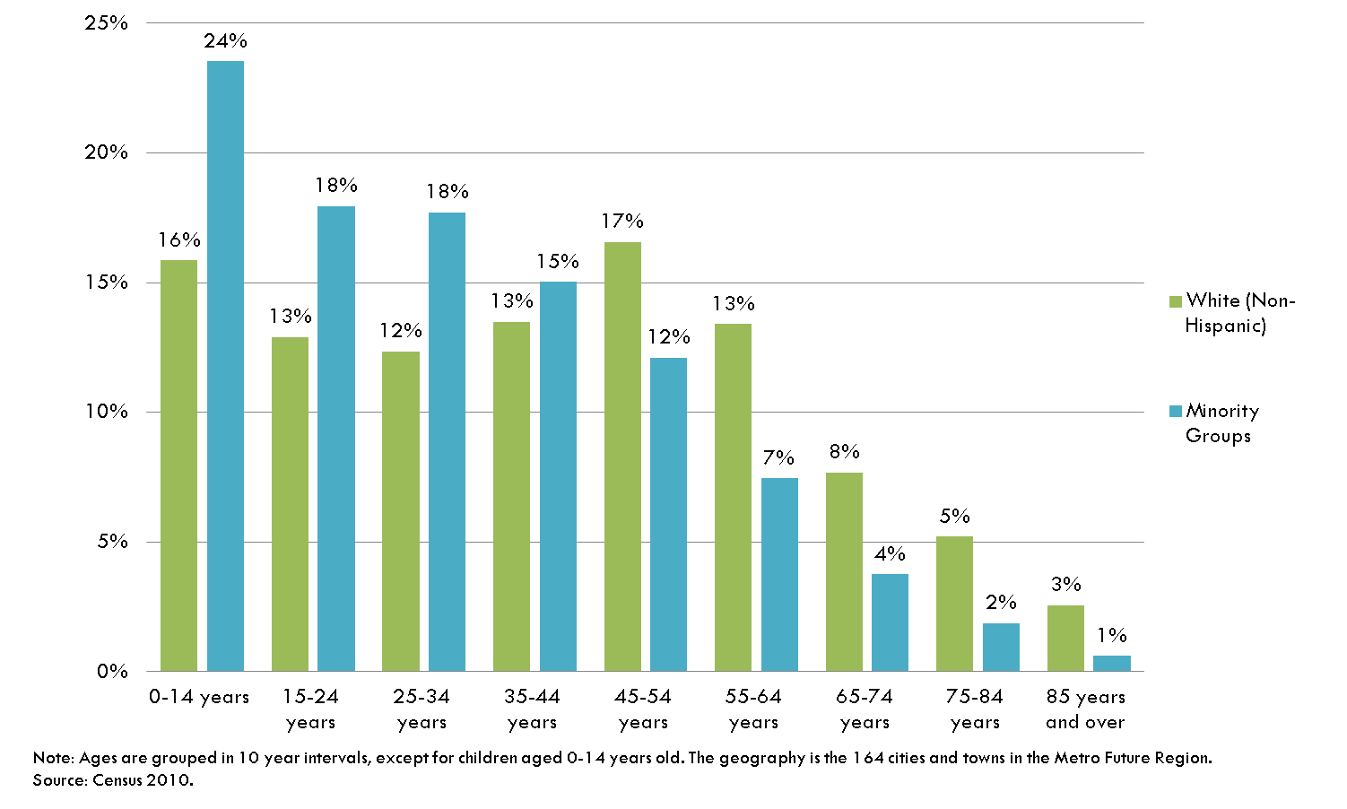
Demography is Destiny
Notes:
This chart shows the age distribution in our region. The population is divided into two groups: non-Hispanic whites, in green, and of members of racial/ethnic minority groups in blue.
The length of each bar corresponds to what proportion of a given group falls into a given age category.
You’ll notice that these two groups, non-Hispanic whites and people of color, have significantly different age structures.
About 25% of all people of color in our region are 14 years old or younger., whereas only 16% of non-Hispanic whites fall into this age group.
Looking at the oldest age groups, we see the opposite trends: about 8% of non-Hispanic whites are 75 or older, but only 2% of residents of color are 75 or older.
Since non-Hispanic whites account for the majority of our region’s population, there are still more white than non-white people at every age group, but if demographic trends continue, the diversity we see in our children will move up the population pyramid increasing diversity in our older age groups as well.

Slide 10
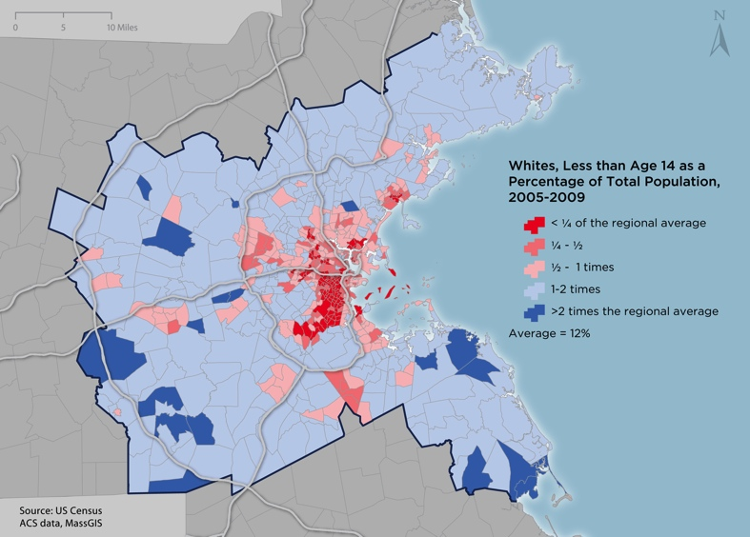
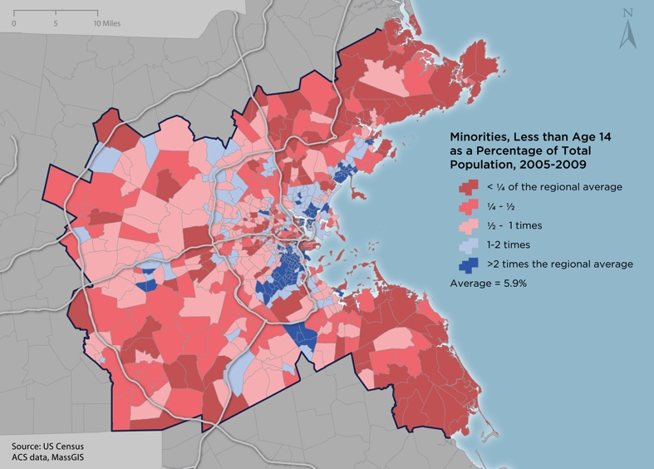
Inequity Across the Region
Notes:
If people were randomly distributed throughout our region, without regard to age or race/ethnicity, about 12% of the people in every neighborhood would be white children (under 14) and 6% would be children of color. These are the “regional averages.” However, looking at maps of where our children actually live, we see very few places that actually have such concentrations.
The map on the left shows where white children live in our region compared to the regional average, the one of the right shows where children of color live.
Red colors mean there are fewer kids than we’d expect if everyone were randomly distributed. Blue colors mean there are more kids than we’d expect. The darkest red means that the actual concentration of children is less than a quarter of the regional average; dark blue shows places where the concentration is twice what we’d expect.
These maps are nearly perfect mirror images of each other, but one not the inverse of the other by definition. It’s not just that there are high concentrations of minority kids in some areas, it’s that there are particularly low concentrations of white kids in the same places.

Slide 11
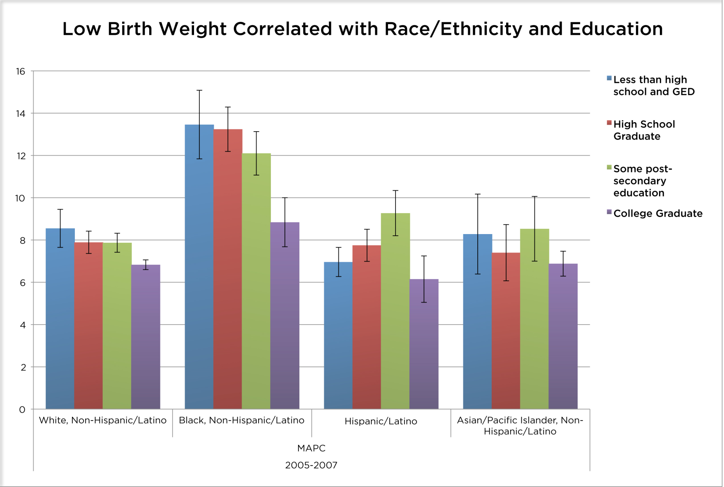
Inequity Impacts Children
Percent
Notes:
This chart shows the proportion of babies that were born too light (<2500 grams, about 5.5 lbs) between 2005-2007 in MAPC’s municipalities. The data exclude twins and triplets, who are usually born lighter than average.
These data are dived two ways: the bars are grouped by race/ethnicity, with whites on the left, Black/African Americans next, Hispanic/Latinos in the third group, Asians/Pacific Islanders fourth, and members of all other racial groups in the last cluster.
Low birth weight increases the risks of infant health problems and infant mortality. It contributes to educational and developmental delays, as well as from adult health problems ranging from asthma to high blood pressure, heart disease, and Type 2 diabetes.
Colors show different levels of educational attainment. Blue, for example, shows those without a high school education while purple indicates college graduates. Because these data come from a sample of births, the black bars show the range within which the true percentage actually falls.
This chart shows that there are both racial/ethnic and educational disparities in birth weight. The racial disparities are so strong that an African American woman with a college degree has worse birth outcomes on average than a white woman without a high school degree.

Slide 12
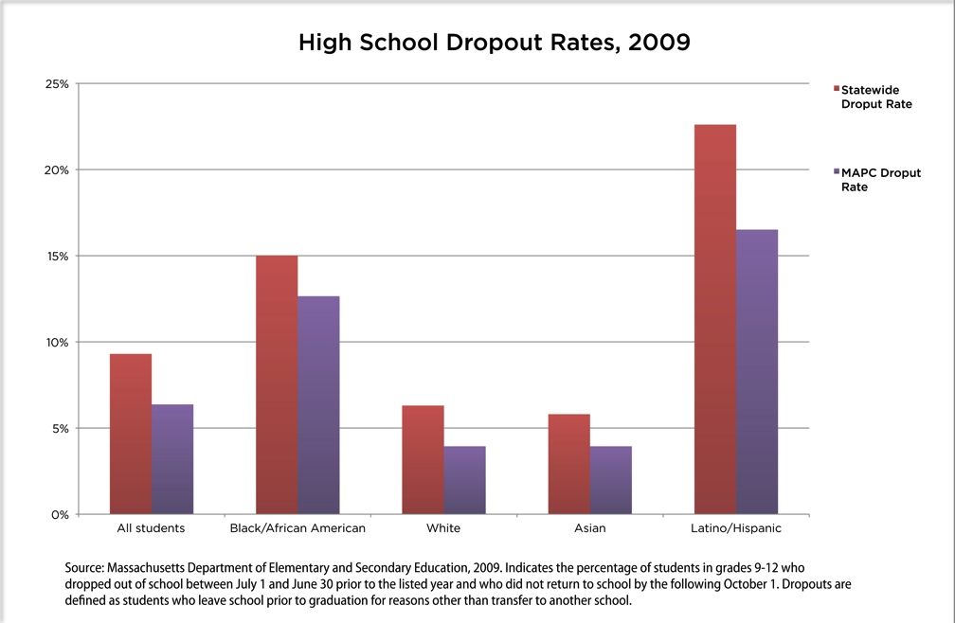
Inequity Impacts Teens
Notes:
This chart shows high school dropout rates by race/ethnicity for our region in purple and the state overall in red.
We are doing better than the state in every racial/ethnic group, but there are still huge disparities among these groups.
The dropout rate for Latino students is over three times that of white and Asian students

Slide 13
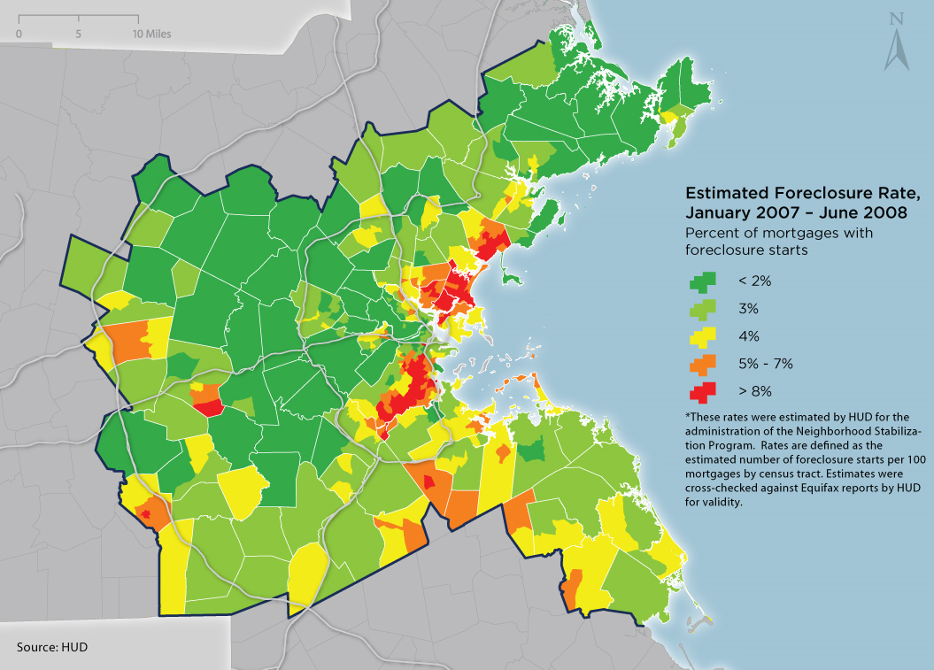
Inequity Impacts Adults
Notes:
This map shows HUD-estimated foreclosure rates across MAPC between January 2007 and June 2008. These rates were calculated in order to decide where to spend Neighborhood Stabilization Program funds. They reflect the number of “foreclosure starts” per 100 mortgages in each Census tract. Any property receiving a foreclosure filing such as a Notice of Default or Lis Pendens counts in the “foreclosure starts” total, even if the loan was eventually made current and the home was never repossessed.
The darkest shade of green shows areas where fewer than 2 of every 100 mortgages were subject for foreclosure filings. Dark red shows places where more than 8 of 100 mortgages were embroiled in the foreclosure crisis.
Within the most distressed category (dark red), we know that foreclosure rates exceeded 10% in parts of Roxbury and the South End between January 2007 and June 2008. Framingham, Randolph, Revere, Lynn, Chelsea, Everett, and Milford also grappled with distressed neighborhoods where the foreclosure rate exceeded 8% during this period. By contrast, less than an estimated 2% of mortgages were subject to foreclosure filings in many of the North Shore communities. Wealthy suburbs to the north and west of Boston also enjoyed some of the region’s lowest rates.
Foreclosures hurt individuals and families who lose their homes, but also impact entire communities through “spillover effects.” There is strong evidence that nearby foreclosures can lower surrounding property values and increase crime rates.
There are some changes over time, but this pattern is maintained, for the most part. You can see town by town yearly data here: http://www.bostonfed.org/economic/dynamicdata/module1/bmap.html# to see if you agree.
I think we can say that the crisis has gotten worse since 2009 (a 32% increase in 2010 compared to 2009) and is supposed to worsen through 2012.

Slide 14
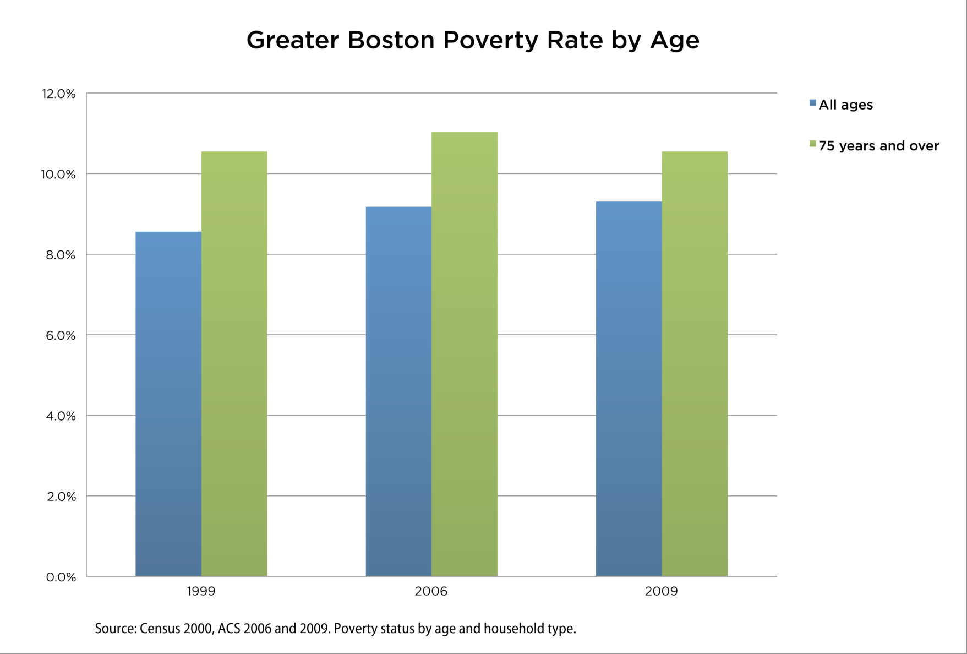
Inequity Impacts Seniors
Notes:
This chart shows the poverty rates for seniors vs. the population overall
The poverty rate is federally set, based on the percentage of the population living below the Office of Management and Budget's national poverty threshold. The poverty threshold is intended to reflect the lowest income needed to meet an individual’s or family’s basic needs, and therefore varies depending on family size and composition.
In 2009, the overall poverty rate was about 9%, although 11% of seniors 75 and older lived in poverty. This disparity between seniors and the general public has persisted for the past decade
Elders earn lower incomes, on average, than younger individuals. Whether these incomes are from Social Security, pensions, earnings from work, or asset income, they are generally not as high as the incomes of those who are participating in the labor force, and that means that seniors are particularly vulnerable to living in poverty.

Slide 15
“State of Equity” Moving Forward
State of Equity part 2 will consist of policy recommendations to “bend the trends” towards a more equitable region.
MAPC is undertaking an internal review of agency priorities, practices, and culture.
Equity is increasingly informing agency work in other areas, particularly our implementation of MetroFuture.

Slide 16
Equity and Sustainable Communities
The Consortium requested proposals for place-based projects to undertake through Sustainable Communities.
Of the seven project selection criteria, 4 deal with equity in whole or in part:
MetroFuture and Program Objectives
Key MetroFuture Goals: Equity
Process – Inclusive Participation
Process – Mitigation of Adverse Impacts
These criteria are worth 8 of a total of 30 points.

Slide 17
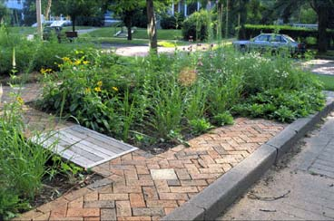
Place-Based Projects 2012
Urban Green Infrastructure in the Mystic River Watershed
Will help to reduce water pollution and improve environmental quality in one neighborhood in Chelsea, an environmental justice community just north of Boston.
Project emphasizes engaging a variety of stakeholders including the neighborhood’s resident
community, municipal agencies, local
institutions, and businesses.

Slide 18
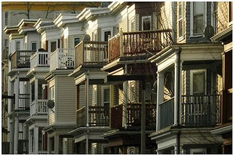
Place-Based Projects 2012
Transit-Oriented Development in Fields Corner
Led by Viet-AID, a community based organization serving the Boston neighborhood, particularly its large Vietnamese population.
Will help mobilize the community around a shared vision of growth without displacement, as well
as supporting green affordable housing
and local entrepreneur assistance.

Slide 19
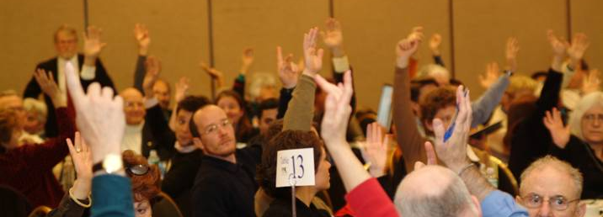
Marc D. Draisen
Executive Director
Metropolitan Area Planning Council mdraisen@mapc.org
617-451-2770 x 5005
Questions? Comments?

