Slide 1

Mapping for Advocacy and Community Change
November10, 2011
Junious Williams, CEO
Urban Strategies Council
Oakland, CA www.urbanstrategies.org www.infoalamedacounty.org
Equity Summit 2011: Healthy Communities, Strong Regions, A Prosperous America

Slide 2
Presentation Outline
About Urban Strategies and our Research and Technology Program
About Open Data
Data and Information for Action and Change
About Data Intermediaries
Case Study: Oakland Foreclosure Crisis
Our New Tool: www.InfoAlamedaCounty.org
Changing Face of the Digital Divide: New Tools and New Opportunities
Final Comments

Slide 3
About Urban Strategies Council
Community building, support, and advocacy organization
Our mission is to eliminate persistent poverty by working with partners to transform low-income neighborhoods into vibrant, healthy communities
Economic Opportunity
Research, Evaluation & Technology
Education Excellence
Community Safety & Justice
Community Capacity Building

Slide 4
About Research & Technology Program
GOALS
Increase capacities of low-income residents and community-based organizations (CBOs) to collect, analyze, and use data and information technologies to support their change efforts
Support and facilitate data-driven decision making for nonprofit organizations and local government
METHODS
“Democratize” Data by making public data available to the public and developing tools for accessing the data
Advocate for open data

Slide 5
Open Data
Concept
Open data is data that can be freely used, reused and redistributed by anyone - subject only, at most, to the requirement to attribute and share alike.
“Open Data is rocket fuel for innovation.”
-Aneesh Chopra, US Chief Technology Officer

Slide 6
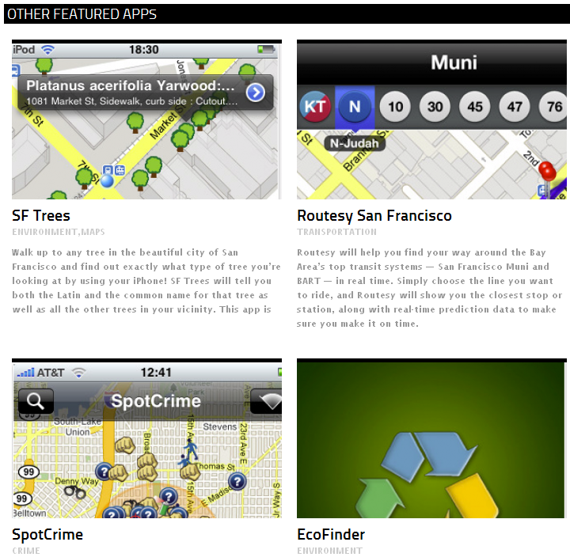
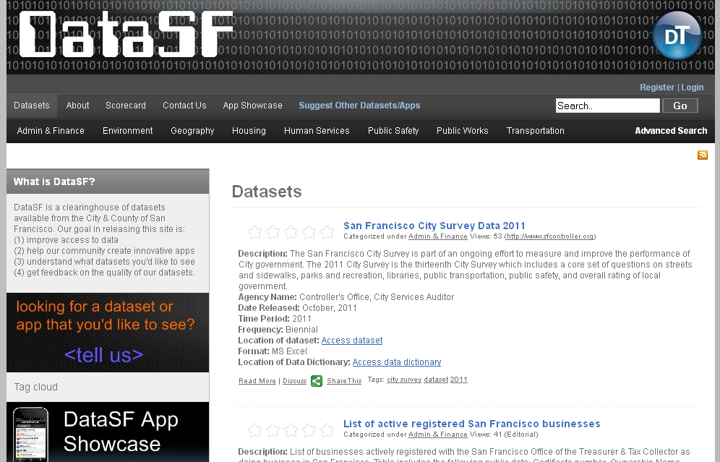
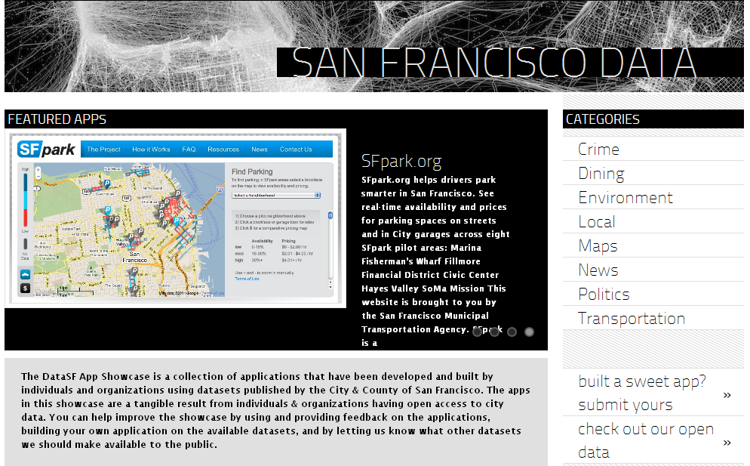
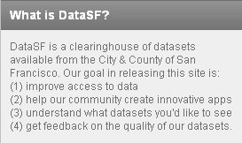
Open Data
Policy: San Francisco, Philadelphia, New York City

Slide 7

INFORMATION
FOR
ACTION AND CHANGE
WORKSHOP

Slide 8
SAMPLE AGENDA
Introduction and Overview of Data for Action and Change
A few words about data and information
Introduction to Case study
Community change cycle
Talking Points and Messages
Case study planning and role play
Debriefing

Slide 9
Data Intermediaries
The National Neighborhood Indicators Partnership
http://www.neighborhoodindicators.org/
NNIP is a collaboration of the Urban Institute and local partners in 35 cities to further the development and use of neighborhood-level information systems.
In recent years all NNIP partners have built advanced information systems with integrated and recurrently updated information on neighborhood conditions in their cities.
Partners democratize data by facilitating the direct practical use of data by city and community leaders. And all have adopted as a primary purpose using information to build the capacities of institutions and residents in distressed urban neighborhoods.

Slide 10
Data Intermediaries
Atlanta
Baltimore
Boston
Camden
Chattanooga
Chicago
Cleveland
Columbus
Dallas
Denver
Des Moines
Detroit
Grand Rapids
Hartford
Indianapolis
Kansas City
Louisville
Memphis
Miami
Milwaukee
Minneapolis-St. Paul
Nashville
New Haven
New Orleans
New York
Oakland
Philadelphia
Pittsburgh
Portland
Providence
Sacramento
San Antonio
Seattle
St. Louis
Washington, D.C.

Slide 11
Data Intermediaries
DON’T HAVE AN NNIP PARTNER?
Local College or University
Local For-Profit and Non-Profit Research Firms
Community Foundations and United Ways
Local Technology Firms
Regional Government Planning Associations

Slide 12
Foreclosure Crisis
Oakland Case Study

Slide 13
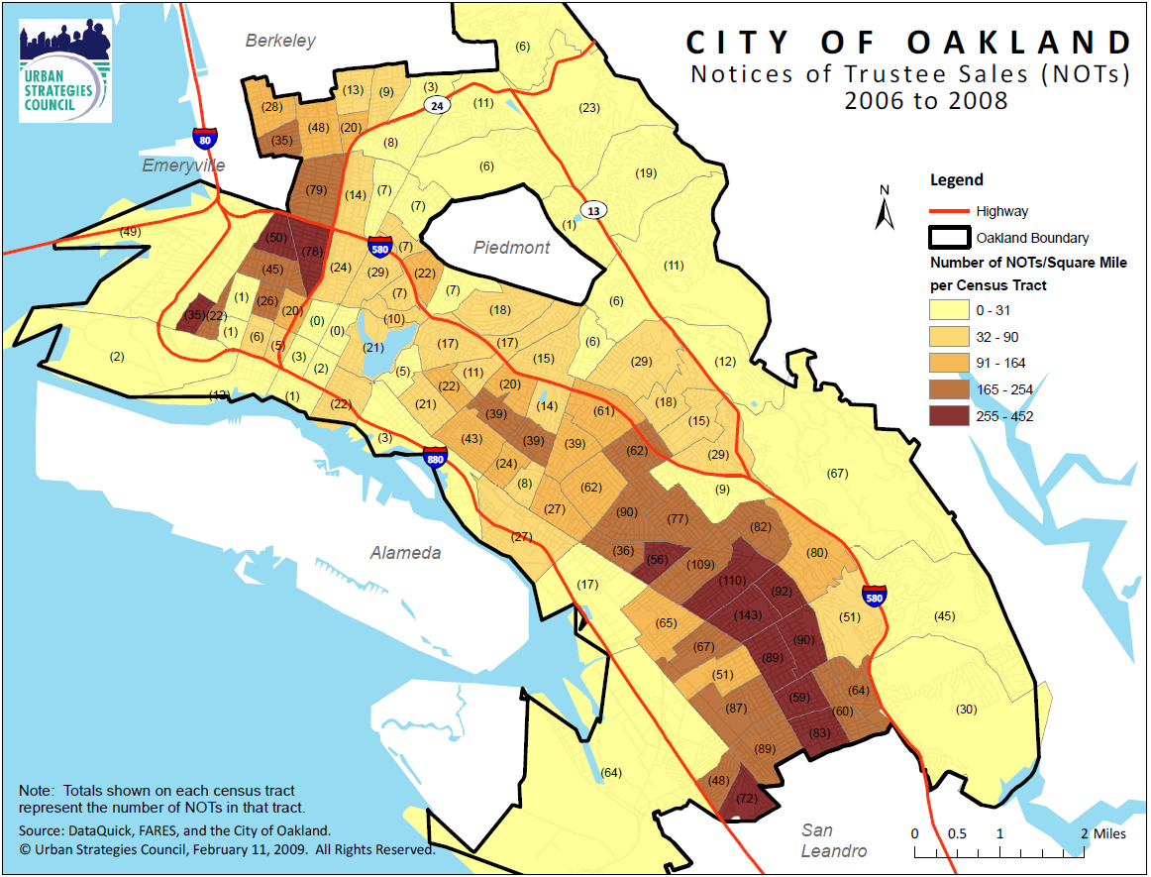
#1 - Identify the Problem

Slide 14
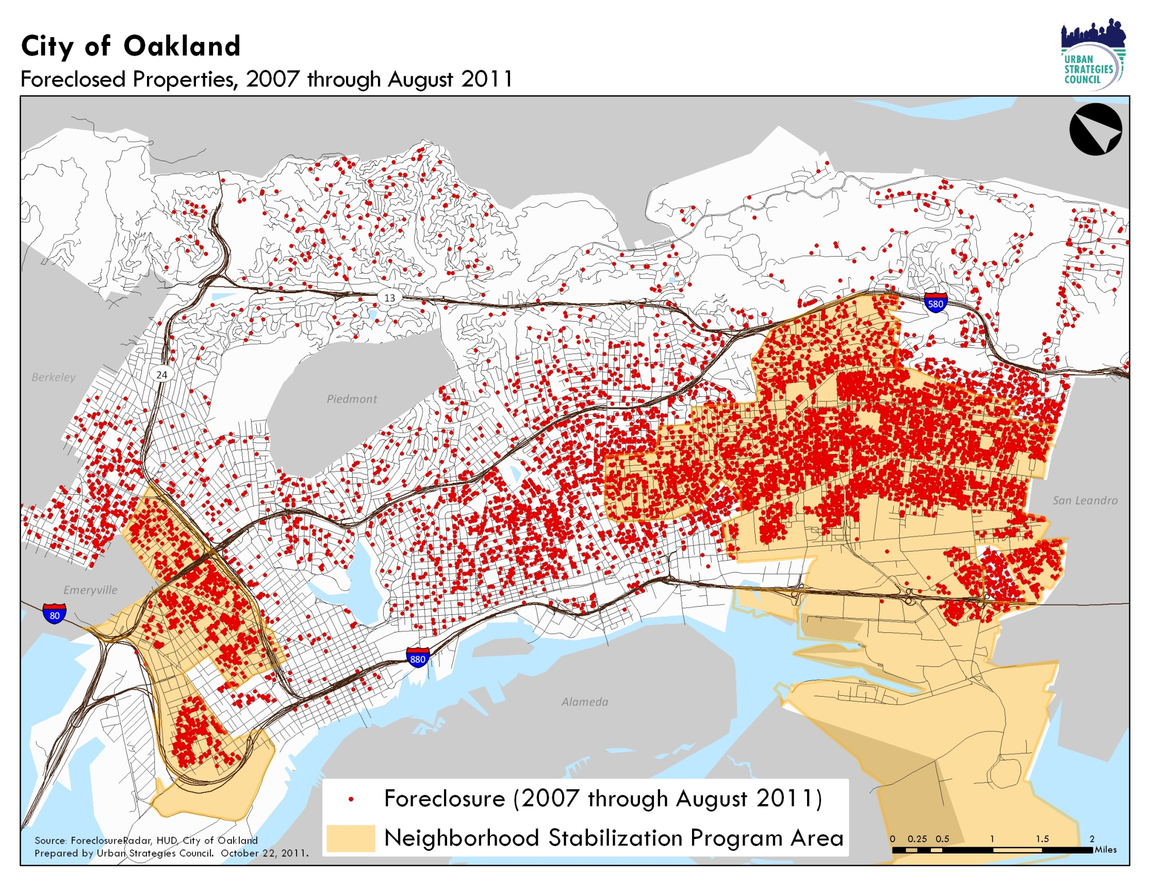

Slide 15
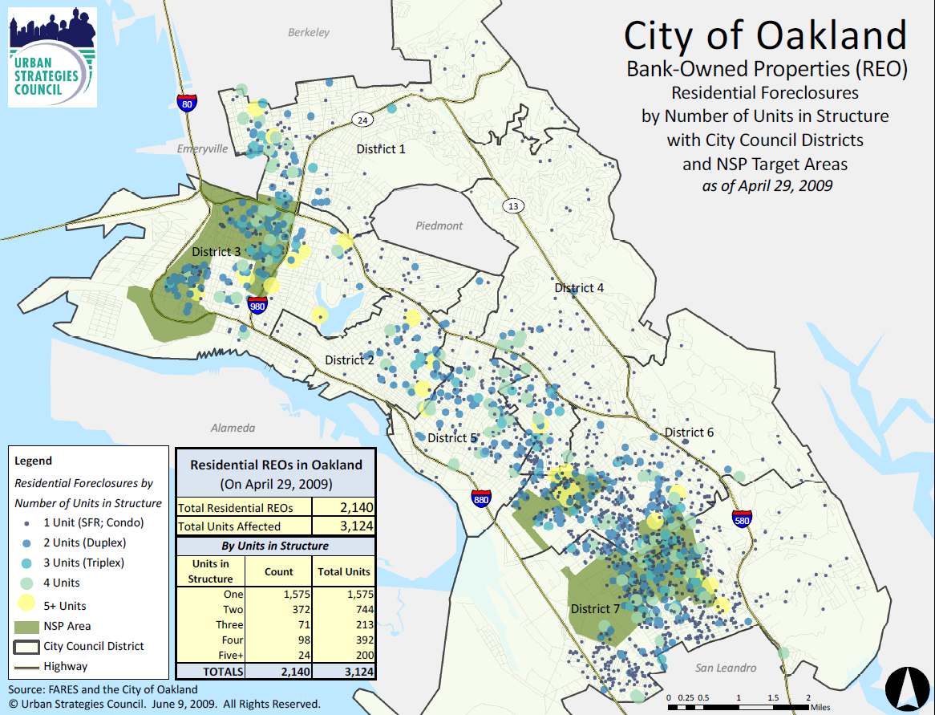
#2 - Understanding the Problem

Slide 16
Tracking Foreclosure Activity…

Slide 17
…and Trends in the Housing Market

Slide 18
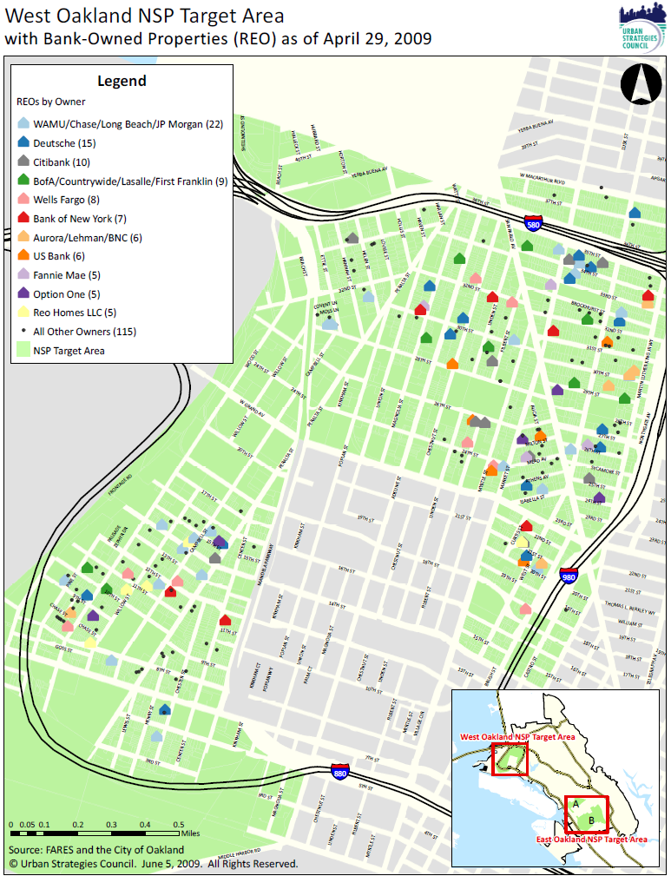
#3 – Digging further into the data

Slide 19
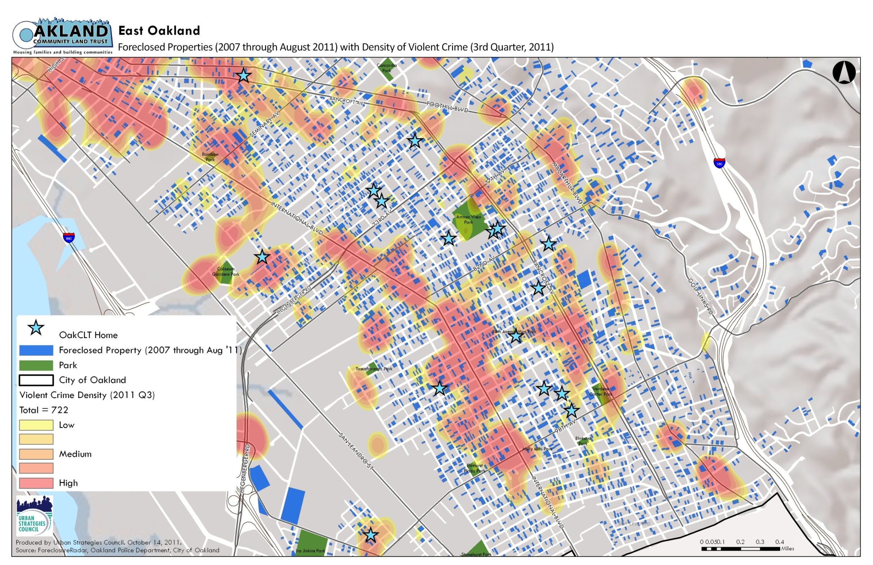
#4 – Layering with Other Relevant Data

Slide 20
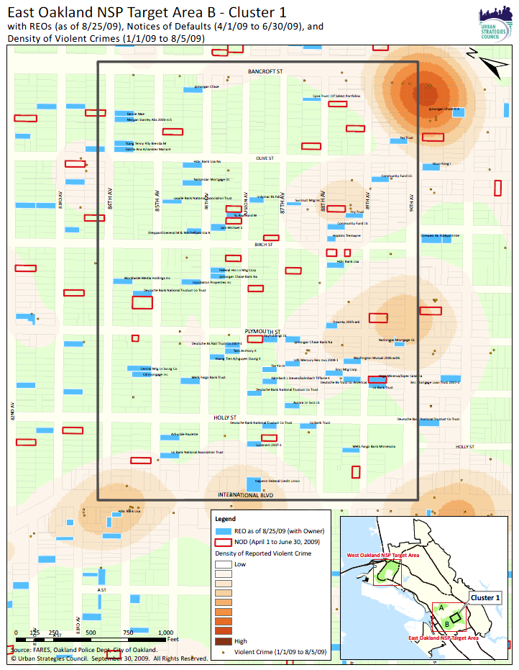
#5 Using data to provide more context
Better planning & decision making

Slide 21
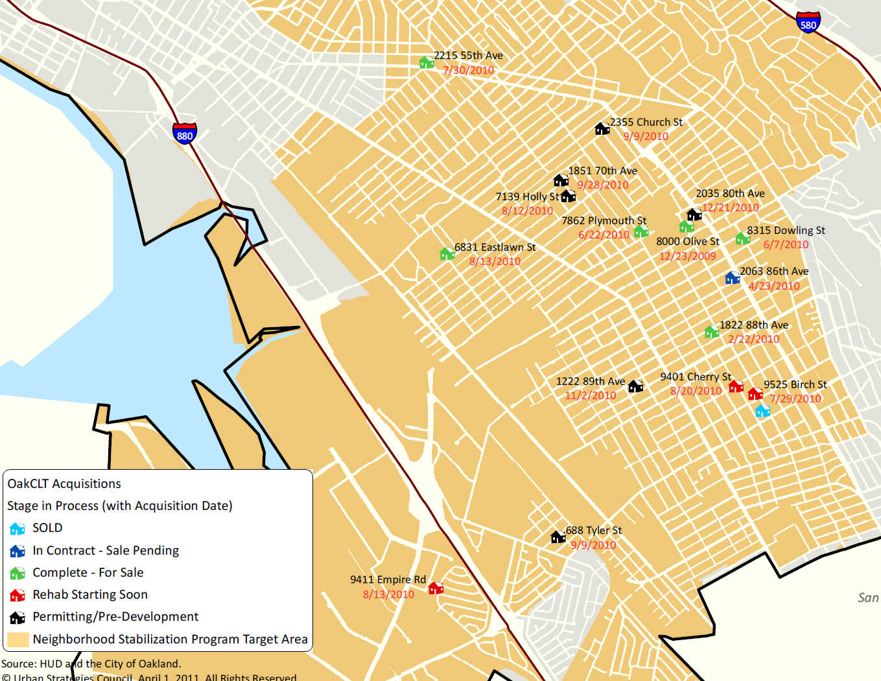
#6 – Tracking Implementation

Slide 22
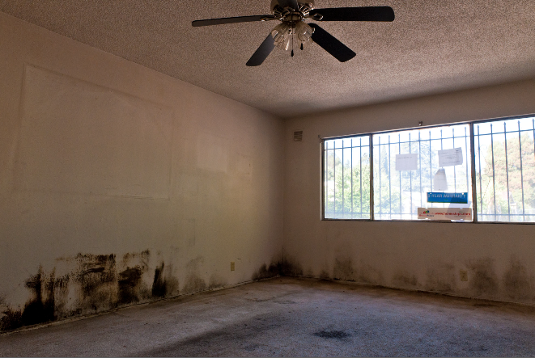
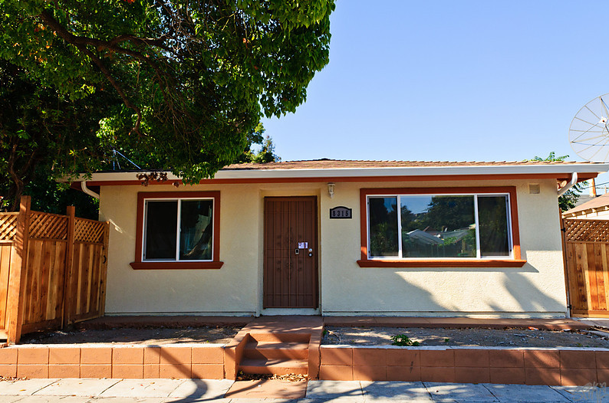
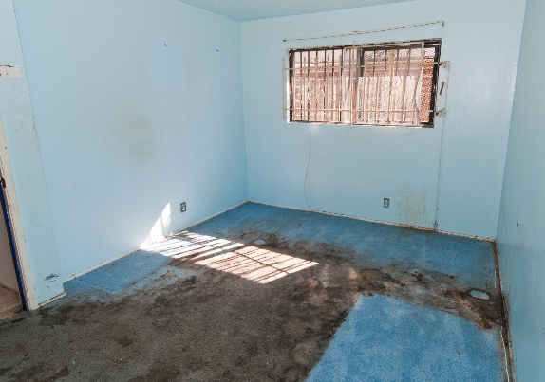
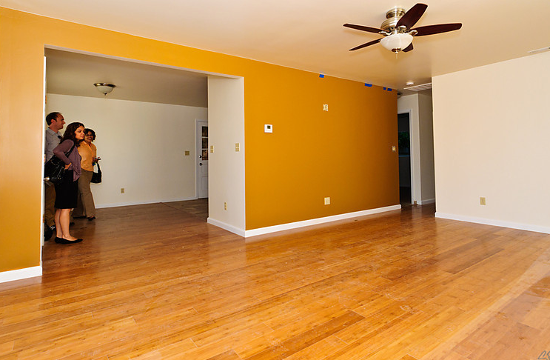
#7 – Management and Evaluation
Before…
…After

Slide 23

InfoAlamedaCounty.org
3 Main Components:
Content Management System (Blog)
Open Data Warehouse
Web-Mapping/Data Visualization site

Slide 24
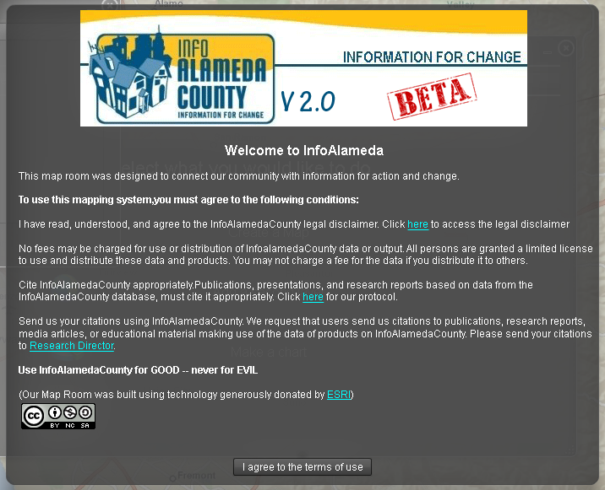
InfoAlamedaCounty
Our third generation data warehouse and mapping platform is built on an application that utilizes open data

Slide 25
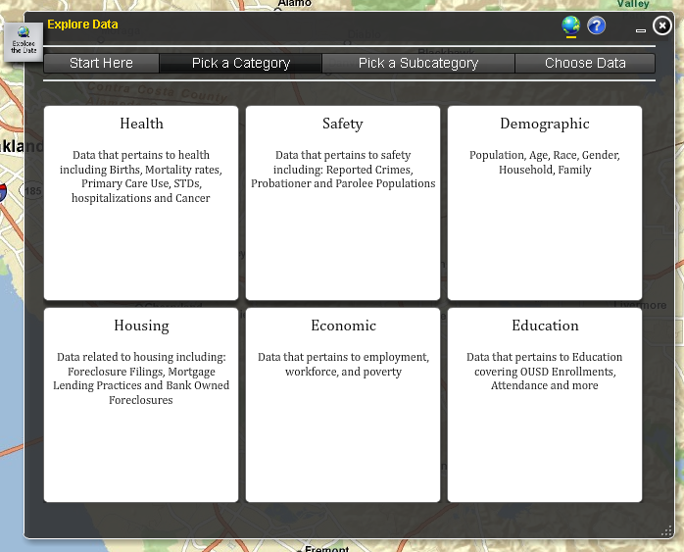
InfoAlamedaCounty
How to find information?
We all do not understand data in the same way.

Slide 26
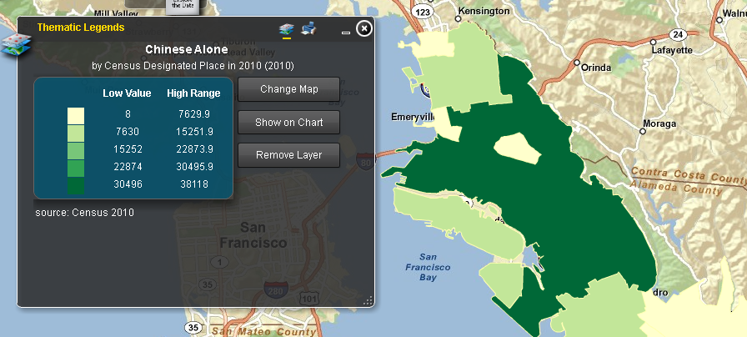
Mapping Data

Slide 27
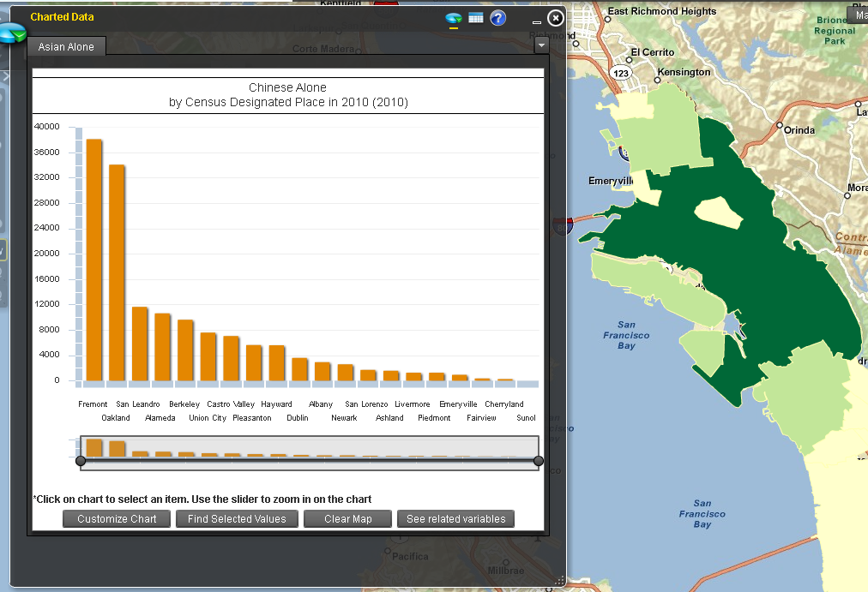
Charting Data

Slide 28
Digital Divide
Traditionally measured in terms of computer hardware and Internet access
With new information technologies, especially cell phone and tablet, focus is shifting
Improvements in technologies are decreasing the divide in some areas

Slide 29
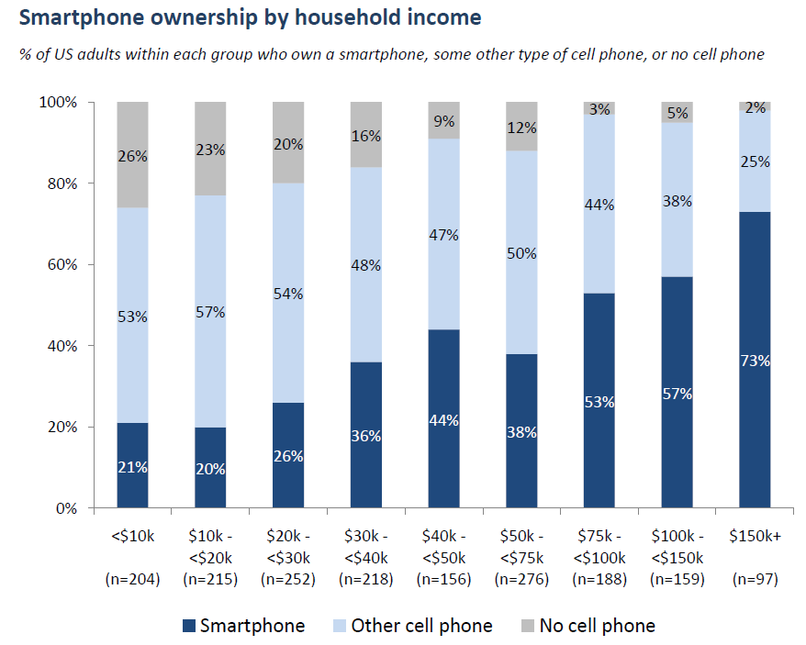
Smartphone Ownership by Income
Source: The Pew Center’s Internet and American Life Project, 2011.

Slide 30
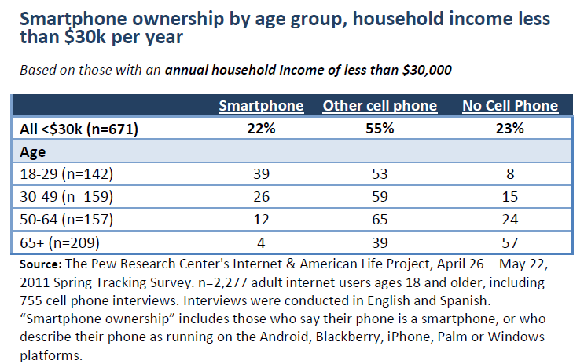
Smartphone Ownership by Age/Income (<$30K)
Source: The Pew Center’s Internet and American Life Project, 2011.

Slide 31
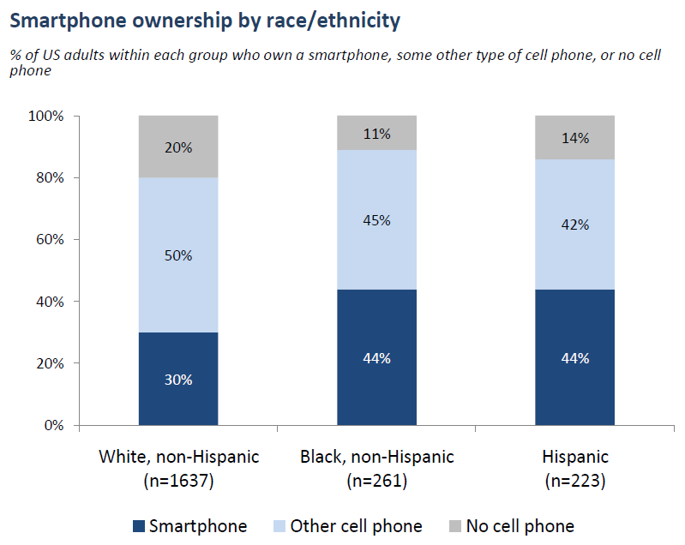
Smartphone Ownership by Race/Ethnicity
Source: The Pew Center’s Internet and American Life Project, 2011.

Slide 32
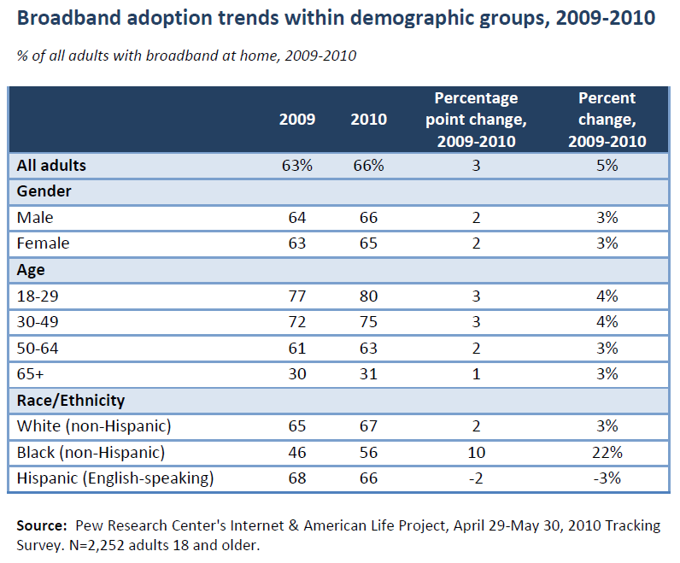
Internet Usage: Broadband at Home
Source: The Pew Center’s Internet and American Life Project, 2010.

Slide 33
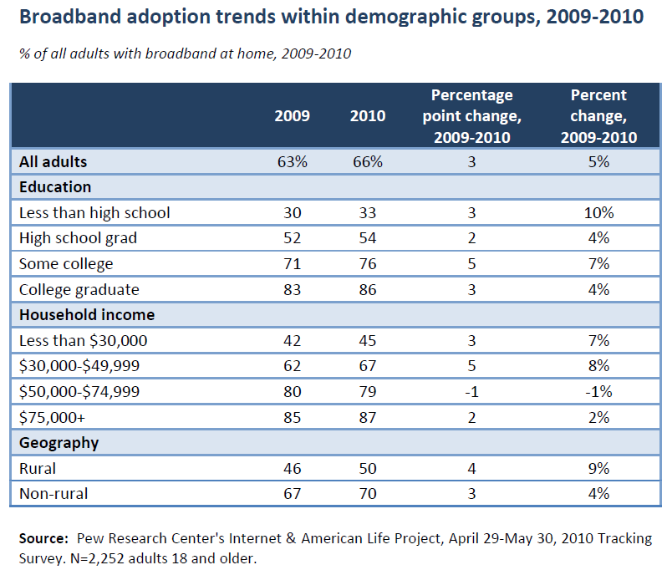
Internet Usage: Broadband at Home
Source: The Pew Center’s Internet and American Life Project, 2010.

Slide 34
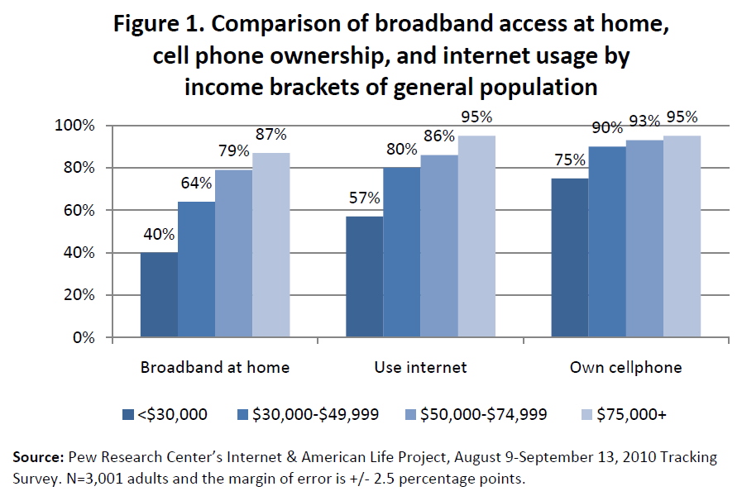
Internet and Cellphone Usage by Income
Source: The Pew Center’s Internet and American Life Project, 2010.

Slide 35
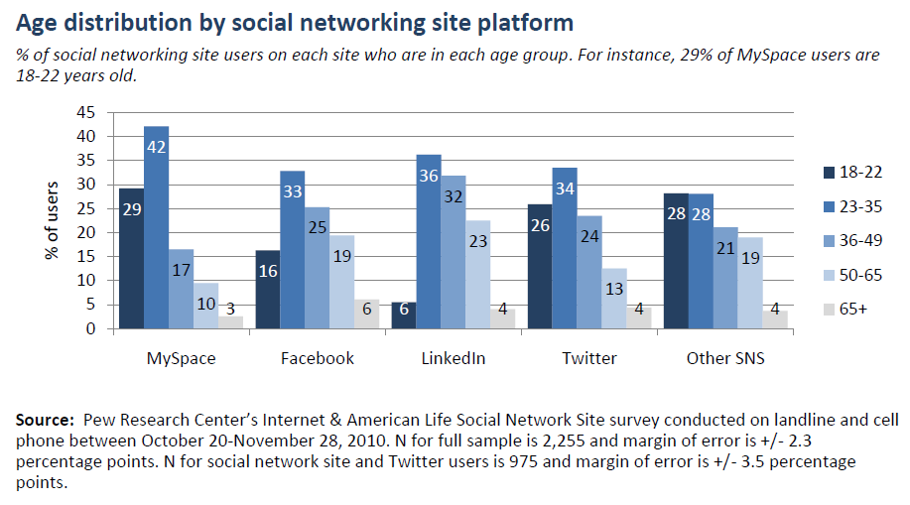
Social Networking by Age
Source: The Pew Center’s Internet and American Life Project Social Network Site Survey, 2010.

Slide 36
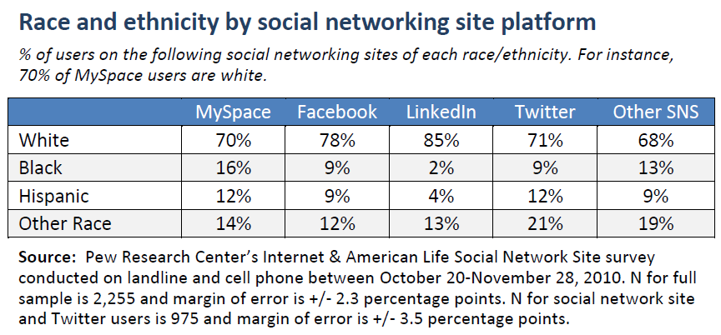
Social Networking by Race
Source: The Pew Center’s Internet and American Life Project Social Network Site Survey, 2010.

Slide 37
Creating Community Data
REO Investor Survey Case Study

Slide 38
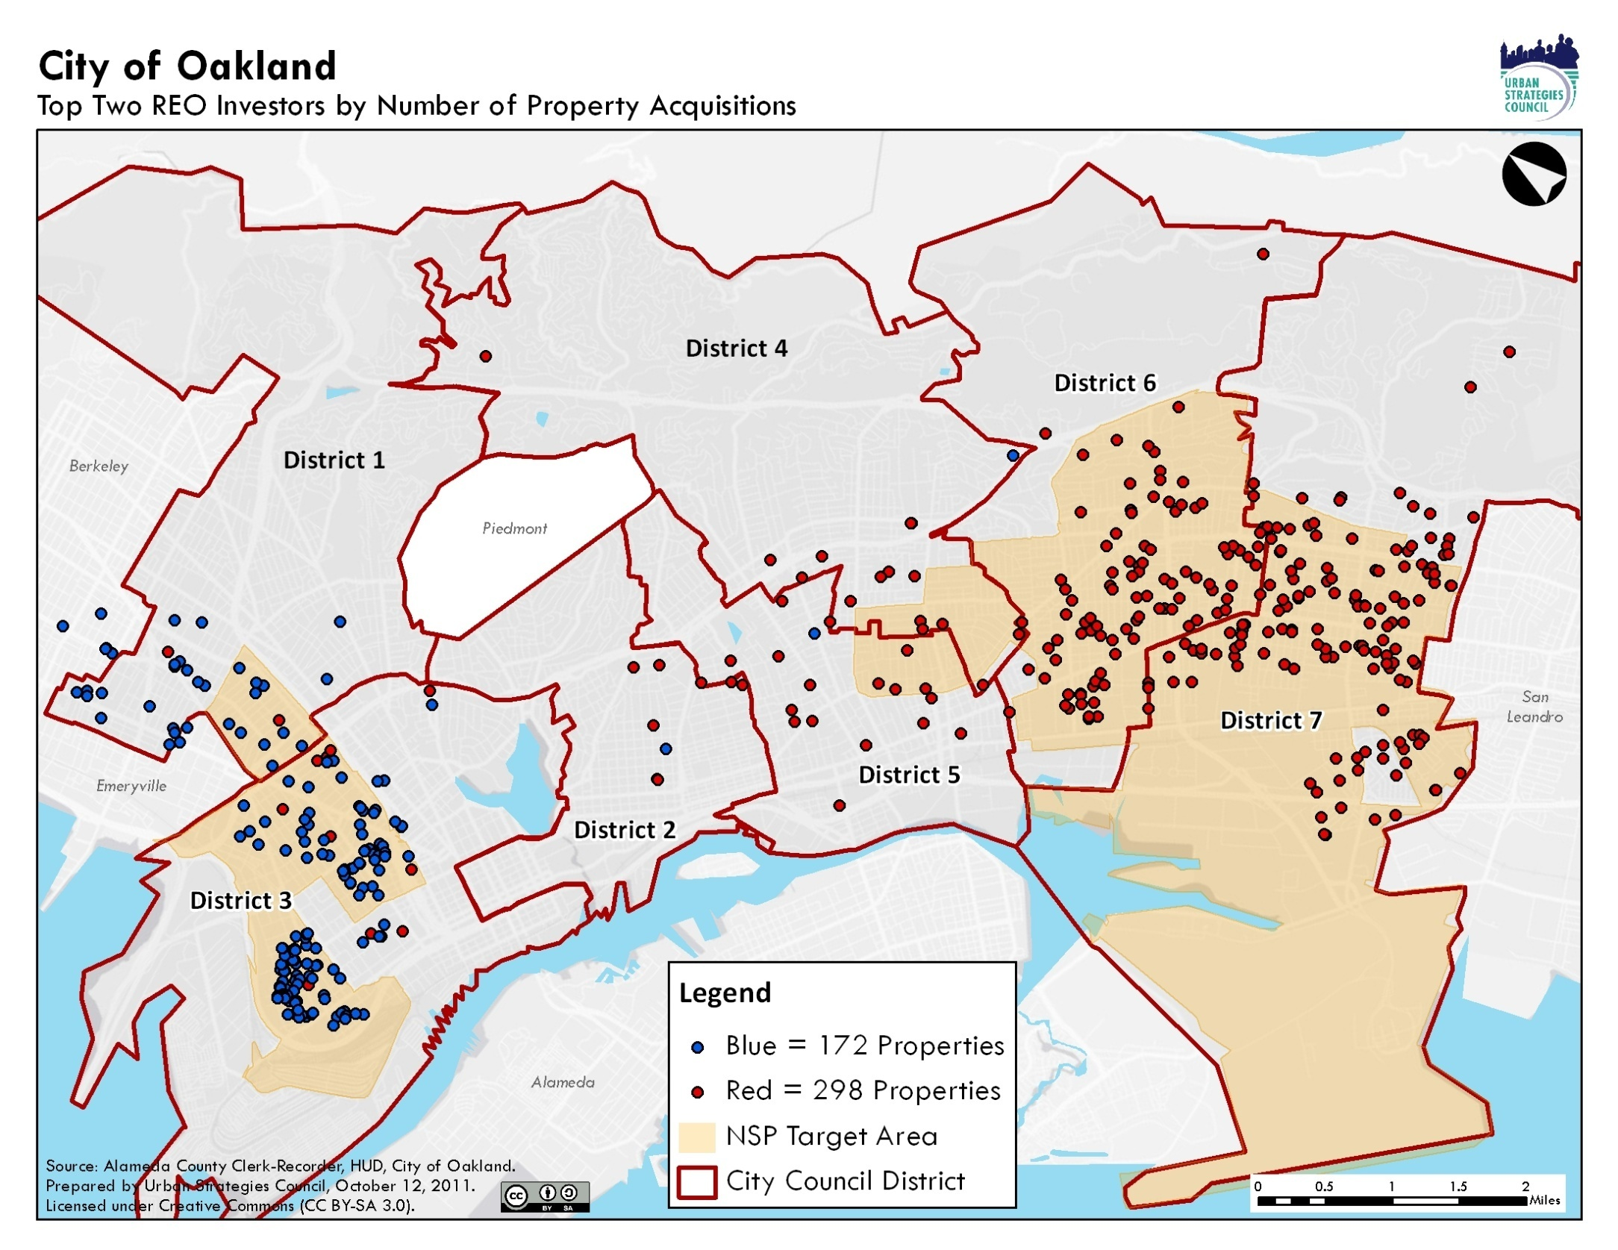

Slide 39
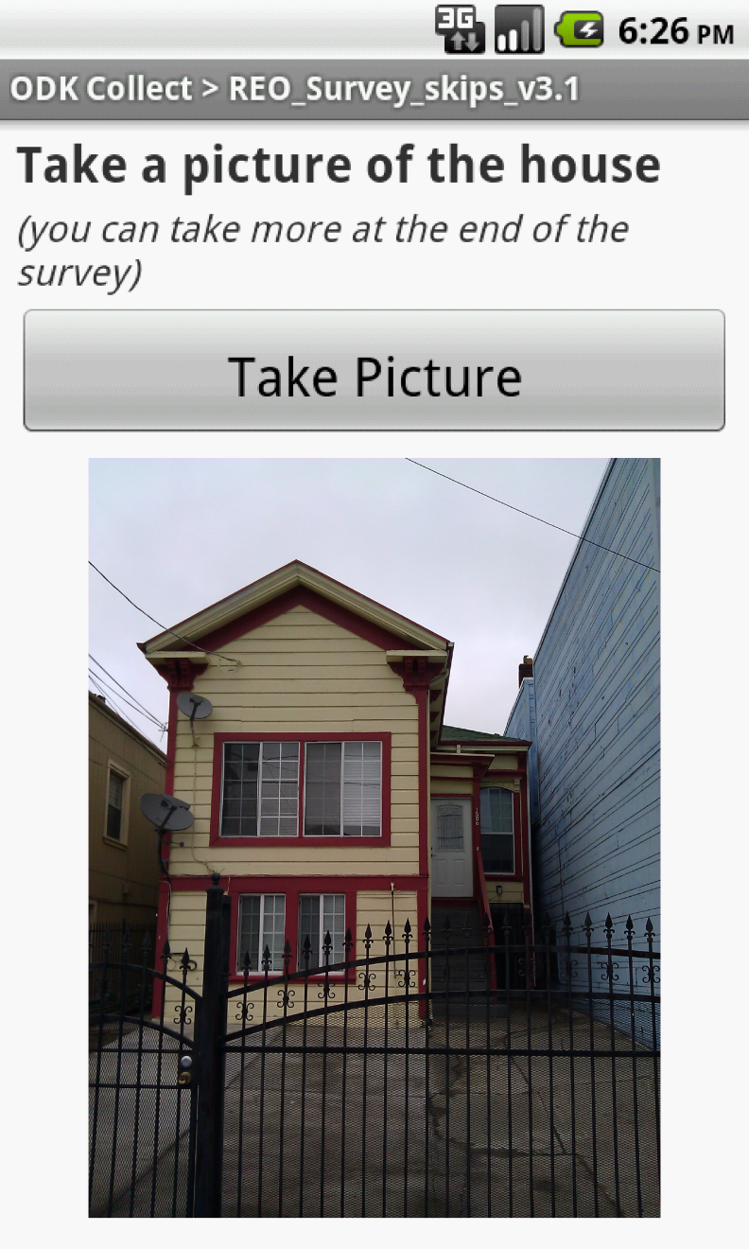
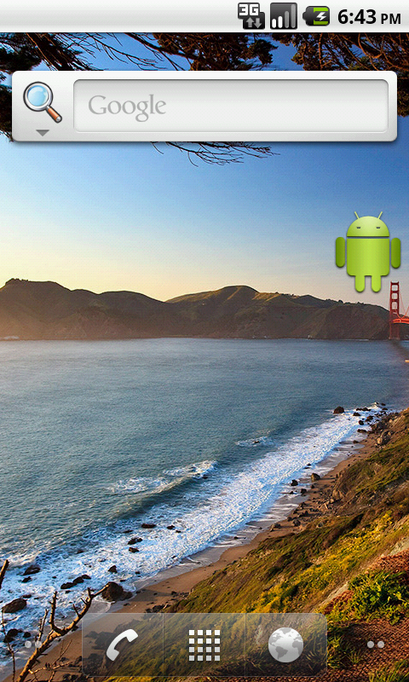
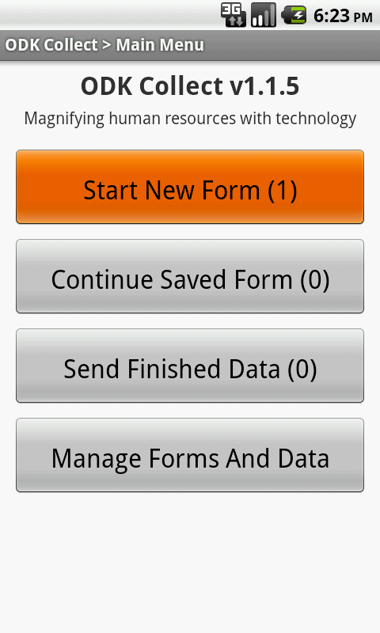
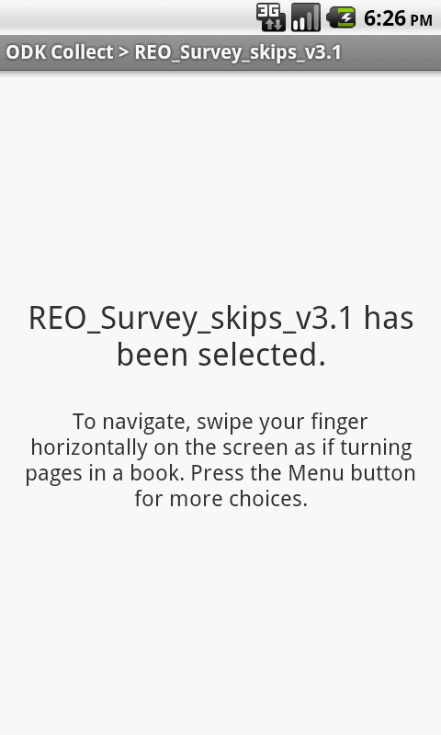
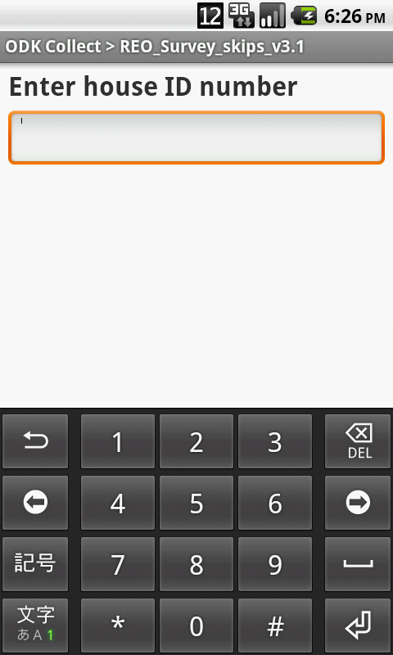
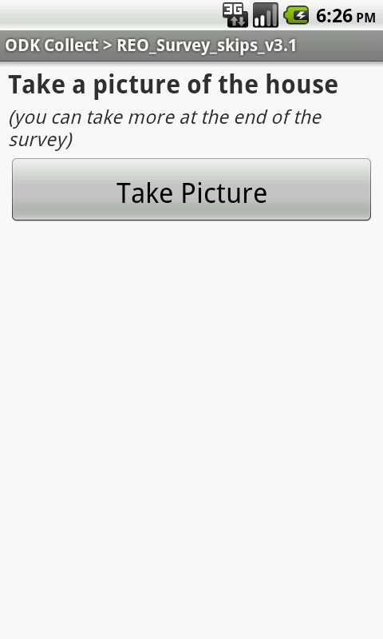
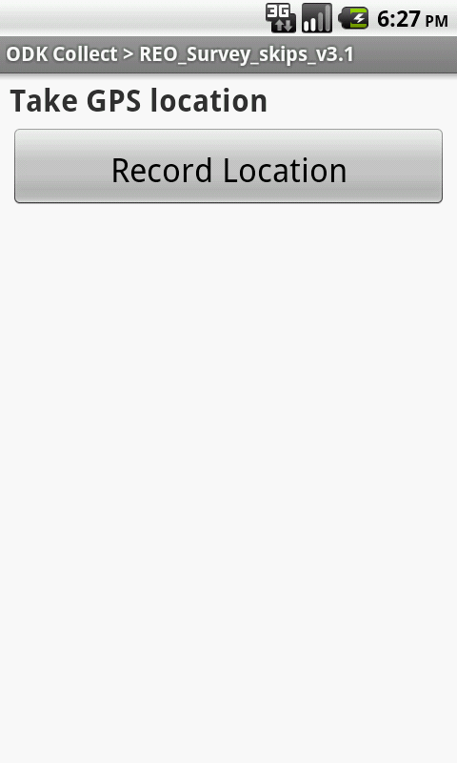
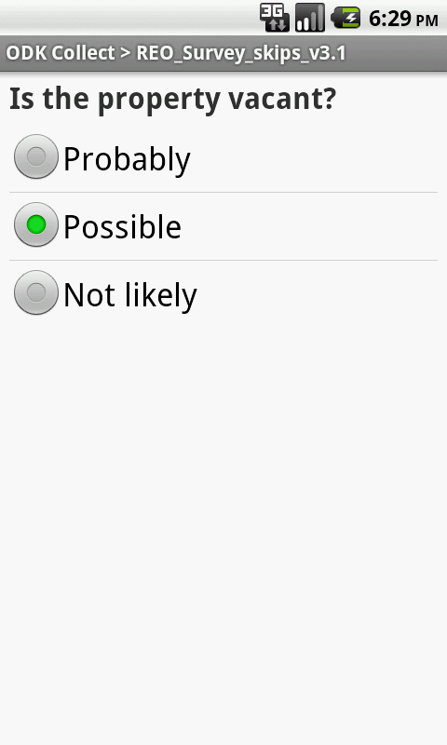
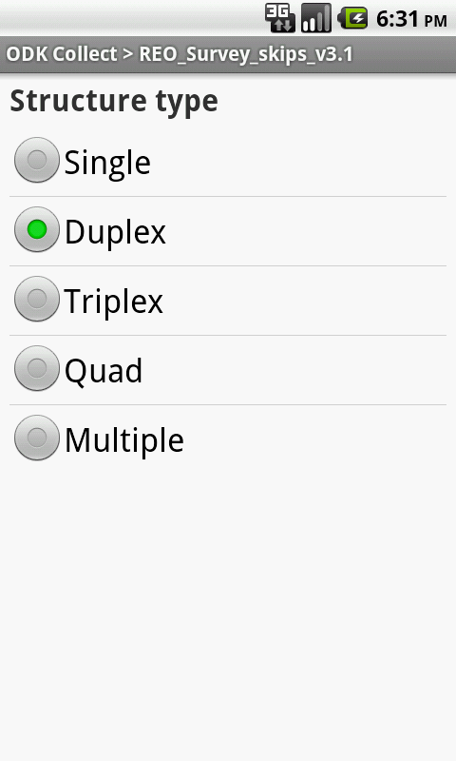
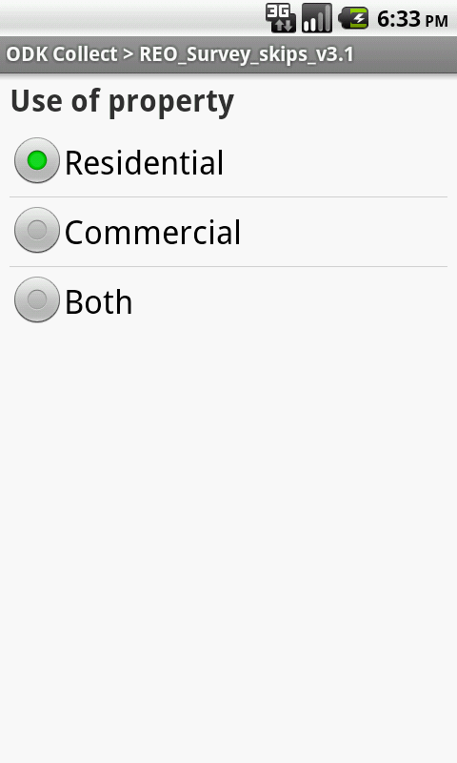
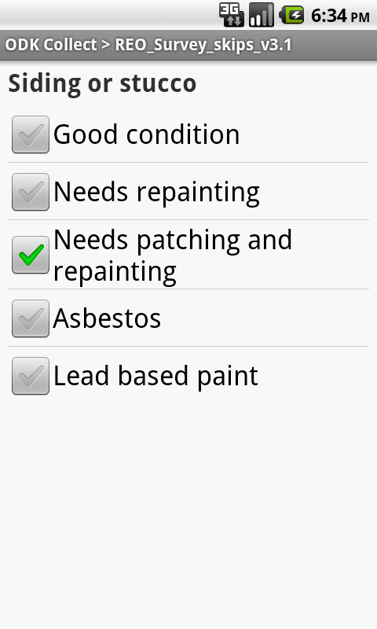
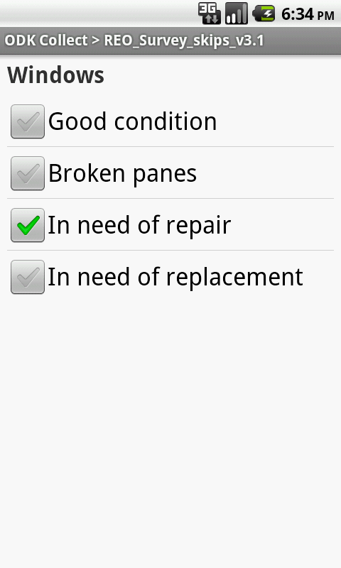
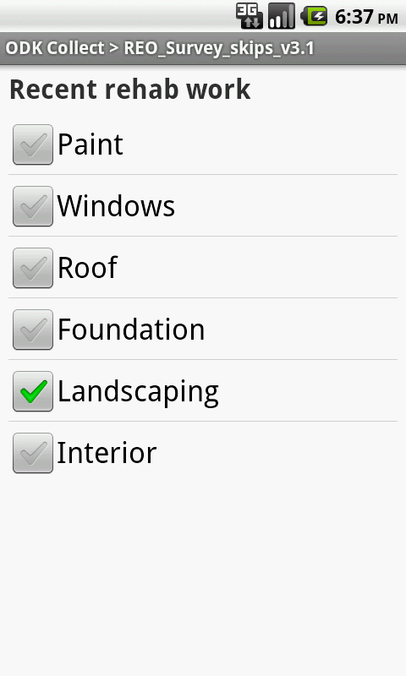
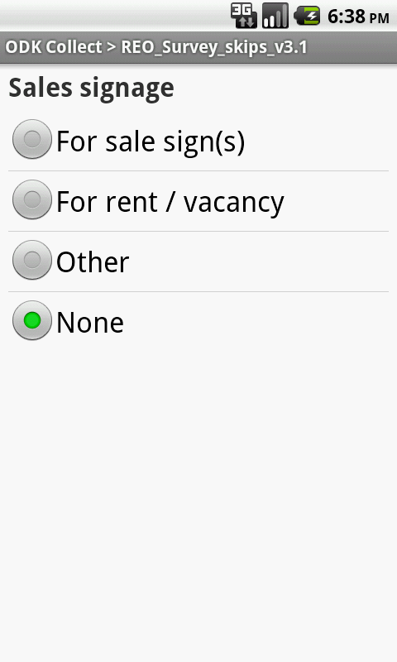
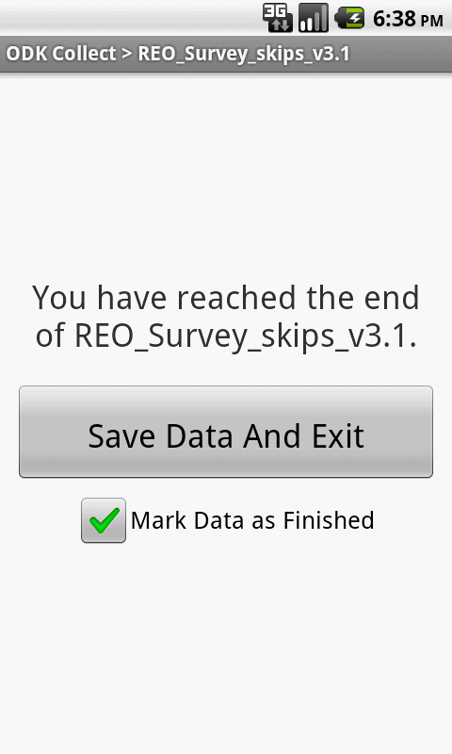
Mobile Survey Apps:
1. Open Data Kit
2. EpiCollect

Slide 40
Final Comments
Access and use of administrative data is an increasingly important component of equity and social change work
There and increasing number of websites and low-cost tools to provide access to administrative and other data
New technologies and software provide opportunities for residents and CBOs to access public data and, more importantly, create their own data to support their work and to communicate it among members, policy makers and the community at large

