Slide 1
Informed Minds, Improved Lives, Whole Communities
Timothy M. Bray

Slide 2
Some Organizing Thoughts
“Rationally, let it be said in a whisper, experience is worth more than theory.”
- Amerigo Vespuci
“We cannot solve the problems of today with the same thinking we used when we created them.”
- Albert Einstein
Is Mapping Dead?
Is Analysis Uncool?
Is Advocacy Useless?

Slide 3
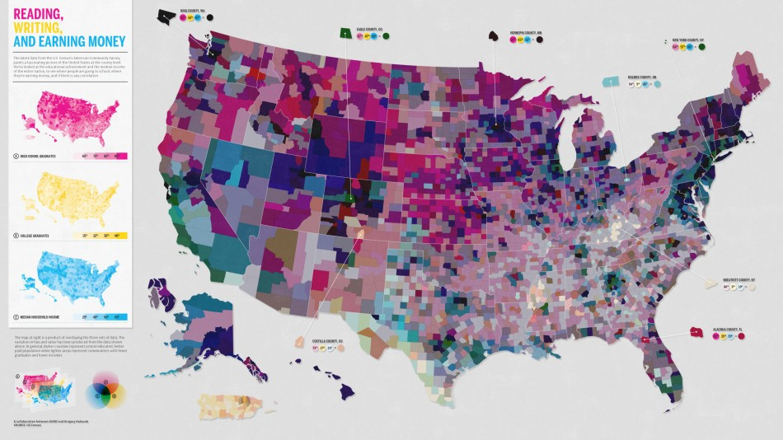
(Just) Mapping Is Dead.
Image: Good, Gregory Hubacek

Slide 4
(Ungrounded) Analysis Is Uncool.
“Height in Adolescence Predicts Polydrug Use in Adolescence and Young Adulthood.”
“Bachelor Pads are 15 Times Dirtier than Bachelorette Pads.”
“Reputation, Price, and Death: An Empirical Analysis of Art Price Formation.”

Slide 5
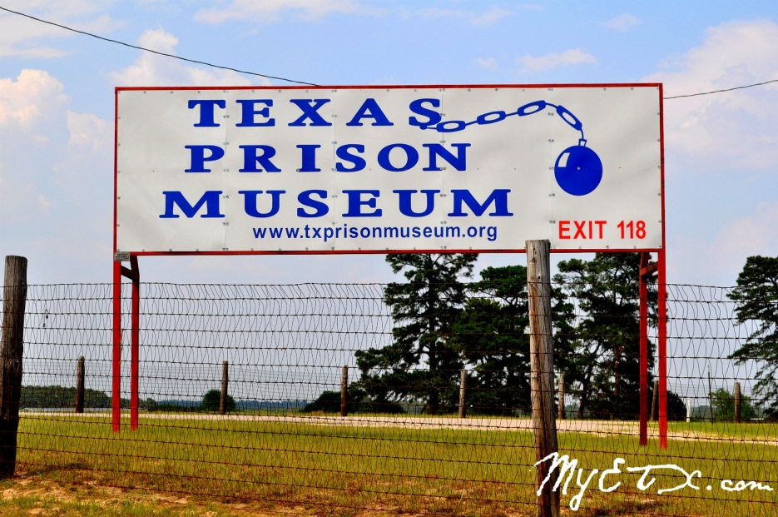
(Uninformed) Advocacy Is Useless.
“An idea not coupled with action will never become any bigger than the brain cell it occupied.”
-Arnold Glasow
“For every talent that poverty has stimulated, it has blighted a hundred.”
-John W. Gardner
Image: My East Texas

Slide 6
Mapping for Advocacy and Community Change
We must break the cycle of linear thinking.
We must root our work in the we of community.
We must move beyond Democratization of Data.
We must address the generation gap.
We must move beyond the web.

Slide 7
We Must Move the Dialogue
We Must Move From… | To…
From Mapping | To Visualization
From Analysis | To Problem Solving
From Democratizing Data | To Democratizing Change
From “On the Web” | To “Beyond the Web”
From Open Data | To Open Solutions

Slide 8
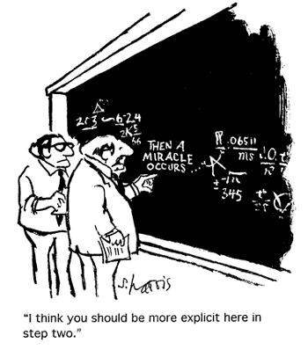
Some Things to Think About
– & →
Image: S. Harris Science Cartoons

Slide 9
For More Information
Timothy M. Bray
The Institute for Urban Policy Research
The University of Texas at Dallas
Iupr.utdallas.edu
timothy.bray@iupr.utdallas.edu
(972)883-5432

